Slide 1
Midterm Project Report DIGITAL LOCKER WITH uC 8051 FAMILY
13/05/2023
Mentor: PhD. Tri Nhut Do
Member 1: Nguyen Dao Trong Nhan Student ID: 21522403
Member 2: Nguyen Nhat Minh Student ID: 18521107
Notes:
Em chào thầy và các bạn.
Em đại diện cho nhóm báo cáo cuối kỳ về "Bục giảng tích hợp điểm danh tự động và điều khiển không dây"

Slide 2
Report Contents
Introduction
Problem Summary
Aim and Objective of Project
Limitations
System theory
Circuit design and software algorithm
System evalution
Conclution

Slide 3
Introduction
Problem Summary: At these times, all human beings have a place of their own in which they keep their property with the help of locks to limit the penetration of their personal property or privacy but there are many defects in these locks, such as easy penetration poor security, people can loss the key easily, sometimes they also forget to close the door. At that point a digital door lock can help we improve the security for our house.
Aim and objective of project:
Design a digital code locker using 4x3 keypad and 16x2 LCD controlled by uC 8051 family.
Functions:
Passcode door lock, can alarm and shutdown automatically.
Change passcode for the lock.
Prevent forgetting to close the door.
Limitations:
Simulate the system with software.

Slide 4
Report Contents
Introduction
System theory
Simulation software
Hardware overview
Circuit design and software algorithm
System evaluation
Conclution

Slide 5
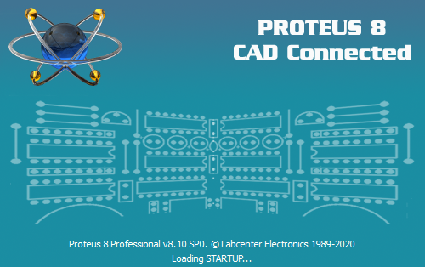
System theory
Simulation sofware:
Proteus:
Provide all pre-built components and easy to design a circuit (PCB).
Have simulate function to test and debug the system.

Slide 6

System theory
Simulation sofware:
Keil C:
IDE support C compiler beside Assembly.
Easy to compile, debug an application for a variety uC.
User-friendly interface.

Slide 7
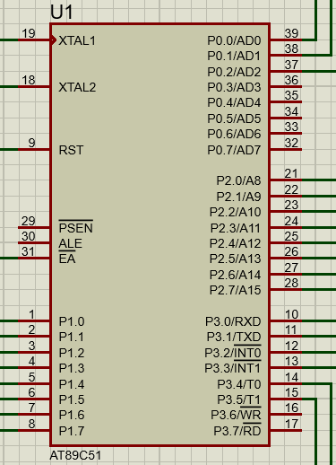
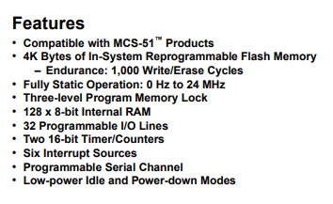
System theory
Hardware overview:
AT89C51:
The AT89C51 is a low-power, high-performance CMOS 8-bit microcomputer with 4K bytes of Flash programmable and erasable read only memory (PEROM)Easy to compile, debug an application for a variety uC.

Slide 8
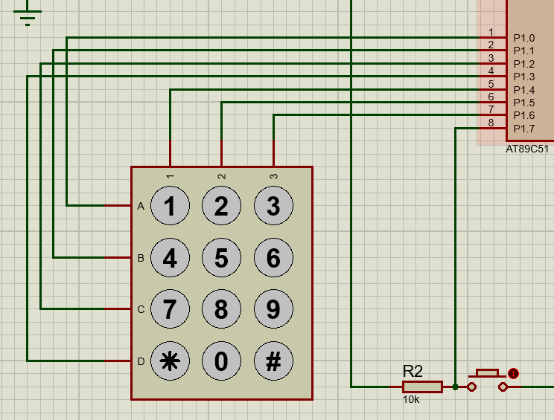
System theory
Hardware overview:
4x3 keypad (phone keypad):
Divide into 4 rows and 3 columns with default signal are 0 connect to AT89C53.
Focus on column signal to know what button clicked.
EX: R0=R1=R2=R3=1, R1 = 0 if C0 signal is 0, the system will know button “4” is clicked. Do the same with all the buttons.

Slide 9
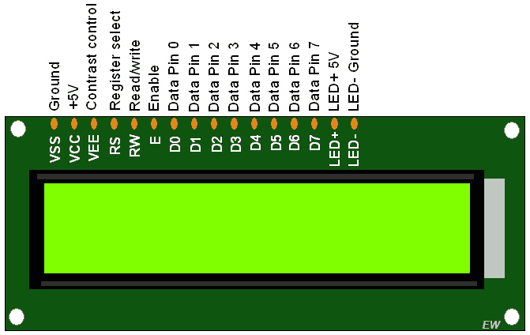
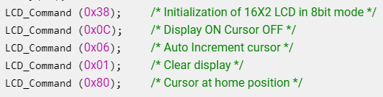
System theory
Hardware overview:
LCD 16x2 (8-bit mode):
Initialize | Command write function | Data write function
1/ Power on LCD. 2/ Wait for 15ms. 3/ Send 0x38 command (2 line, 5x8 matrix, 8-bit mode). 4/ Send any Display ON command (0x0E, 0x0C). 5/Send 0x06 command (increment cursor). | 1/ Send command to the data port 2/ Make RS pin low, RS=0 (command reg.) 3/ Make RW pin low, RW=0 (write operation) 4/ Give High to Low pulse at Enable (E) minimum of 450ns. | 1/ Send command to the data port 2/ Make RS pin low, RS=1 (data reg.) 3/ Make RW pin low, RW=0 (write operation) 4/ Give High to Low pulse at Enable (E) minimum of 450 ns

Slide 10
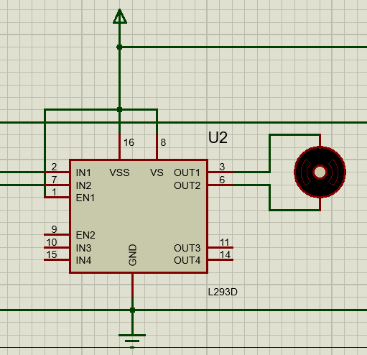
System theory
Hardware overview:
DC motor & driver:
IN1 | IN2 | Motor status
0 | 0 | Stop
0 | 1 | Anti-clockwise
1 | 0 | Clockwise
1 | 1 | Invalid state

Slide 11
Report Contents
Introduction
System theory
Circuit design and software algorithm
Circuit design
Software algorithm
System evaluation
Conclution

Slide 12
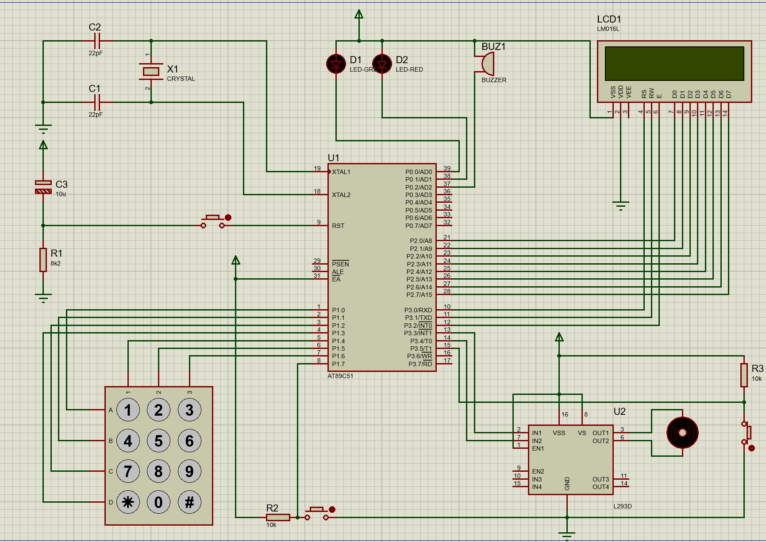
Circuit design and software algorithm
Circuit design:

Slide 13
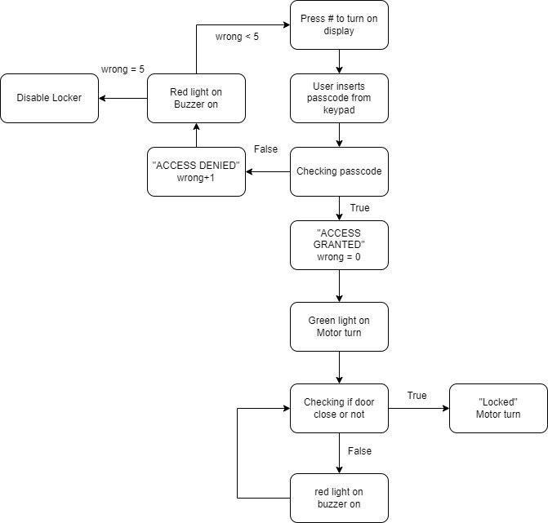
Circuit design and software algorithm
Software algorithm:
Main system
- The system will be run automatically when the power turn on, or if the user wants to re-run or clear all the passcode on the screen they can use the “#” button with the interface solution above. - When user inserts the code, it will show on the LCD within 0,5 second before turn into “*” with the 0x10 LCD command. - After user inserted passcode, the continues with the “*” button, system will check the passcode user inserted with the system passcode using the strcmp function if the result is 0, system will send the signal to turn on the green led, turn the motor to open the door. If the result of strcmp doesn’t equal 0, the system will send signal to turn on the red led, it also alarms

Slide 14
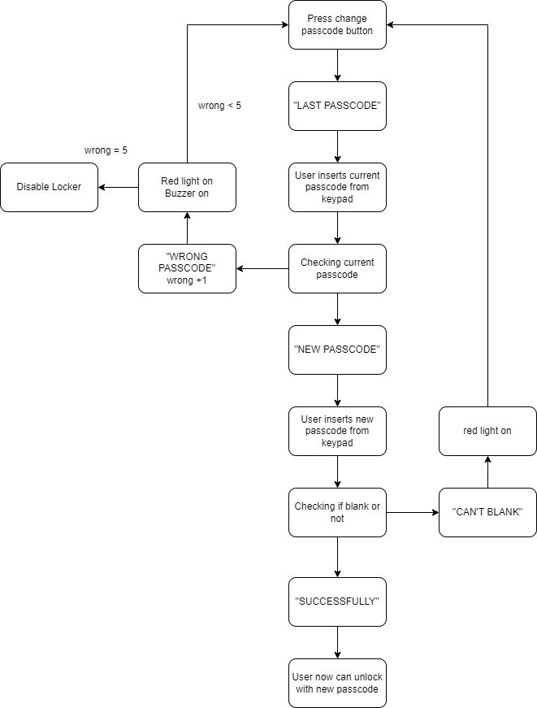
Circuit design and software algorithm
Software algorithm:
Passcode change function
Similar to the main system, passcode change function will do the same jobs but without open the door. The difference between the main system and the passcode change function is follow the block diagram when the change passcode is valid, user now can open the door with the new code.

Slide 15
Report Contents
Introduction
System theory
Circuit design and software algorithm
System evaluation
Experimental Scenario
Result
Conclution

Slide 16
System evaluation
Experimental senario:
Regular situation:
- User inputs the wrong code first to see what happens.
- Inputs the right code to open the door.
- User forgot to close the door to see what happens.
Attempt to break into the house:
- Thief inputs the wrong code 3 times causes the system alarm longer.
- Upto the 5 times causes the system alarm longest and shutdown the system.
Change the passcode:
- User inputs the wrong code first to see what happens.
- Inputs the right code to enter the new passcode confirmation.
- Users leaves the passcode blank to see what happens.
- Try again and inputs new passcode more than 10 characters.
- Try again and inputs the valid passcode.

Slide 17
System evaluation
Result:
The system function works correctly like expected but some moments glitches out.
LCD display responds to the keypad signal little bit long.
Have to limit char[value] or the system will not work well.
Buzzer works intermittently sometimes.

Slide 18
Report Contents
Introduction
System theory
Circuit design and software algorithm
System evaluation
Conclution
Summary
Advantages and disadvantages
Future developments

Slide 19
System evaluation
Summary:
The system worked correctly but using only for the project sample, when it is coming to the real product may not work perfectly to protect the house from high technology criminal.
Saboteus can shutdown the door lock easily cause the owner can’t get into their house.
Advantages and disadvantages:
Advantages
- Easy to connect all the components.
- Proteus supports developers with the simulation.
- Easy to built the system project code with the C language.
Disadvantages:
- The 8051 can’t handle the complex programs that makes hard to turn the locker to the smart locker.
- Can’t open the door if the keypad is broken.

Slide 20
System evaluation
Future development:
Add RFID card reader to unlock the door when the keypad is broken or when the locker is disabled after someones tried to break into the house.
Change the 8051 to ESP32 for wireless control using smartphone app.
Improve the simple locker to the smart locker with Jetson Nano development kit.

Slide 21
References
[1] https://what-when-how.com/8051-microcontroller/overview-of-the-8051-family/
[2] https://www.studytonight.com/c/overview-of-c.php
[3] LCD16x2 Interfacing in 8-bit with 8051 | 8051 Controller (electronicwings.com)
[4] Introduction to Proteus - The Engineering Knowledge
[5] Displaying the Keypad Numbers in 16 X 2 LCD With 8051 : 4 Steps - Instructables
[6] YouTube. "Introduction to DC Motors." Available: https://www.youtube.com/watch?v=kTtt09uX894&t=290s

Slide 22

Question

