Slide 1

Smart Eye Glass with Face recognition and obstacle Detection for Virtually impaired
19BCS014 Md Minhaaz
19BCS031 Shahabuddin
Group no. 1

Slide 2
Objectives
Introduction
Block Diagram
Working
Obstacle Detection
Face Recognition
Limitations
References

Slide 3

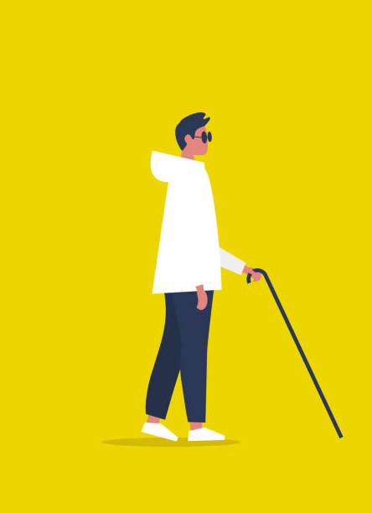
Introduction
There are approx. 2.2 billion people who are visually impaired or blind, according to 2022 World Health Organization (WHO) research on disability.
Our aim is to create a small eye glass that will be able to detect face and recognize people.
It can also detect obstacles and calculate distance to alert the user.
Face Recognition
Normal Eye Glass
Smart Eye Glass
Obstacle Detection

Slide 4
Block Diagram
Power
Supply
Raspberry Pi3
Earphone or
Speaker
Camera
Ultrasonic
Sensor

Slide 5
Working
If obstacle is detected
If human
Check if it’s a human or not
Run facial recognition model
Smart Eye Glass
If not
Calculate distance
Repeat
Alert the user using voice

Slide 6
Obstacle Detection
Ultrasonic Sensor
Working Principle
Distance Calculation
Raspberry Pi pin
Connection

Slide 7
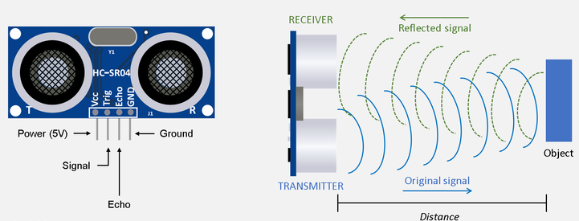

Ultrasonic Sensor && Working Principle
The HC-SR04 Ultrasonic sensor has four pins.
Vcc
TRIG (input)
ECHO (output)
GND
Here, time taken = transmitter to object +
object to receiver
Thus, we need to consider half of the time taken
(time taken/2) to calculate distance.
Finally, distance = speed of sound x (time taken/2)

Slide 8
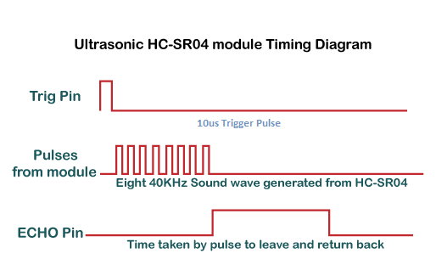
Distance Calculation
Speed of Sound = 343 m/sec = 34300 cm/sec
Distance Detected = (speed * time) / 2
= (34300 * time) / 2
= 17150 * time
Distance Detected = (17150 * time ) cm/sec
Here,
time = Time duration when echo pin is high
= echo_pulse_end – echo_pulse_start
Set the trig pin high for some time(3 to 100 us)
As soon as trig pin is low, the sensor send pulses and set echo pin to high
When the sensor gets the reflected pulses, it set the echo pin to low.
We need to measure time for which echo pin was high.

Slide 9
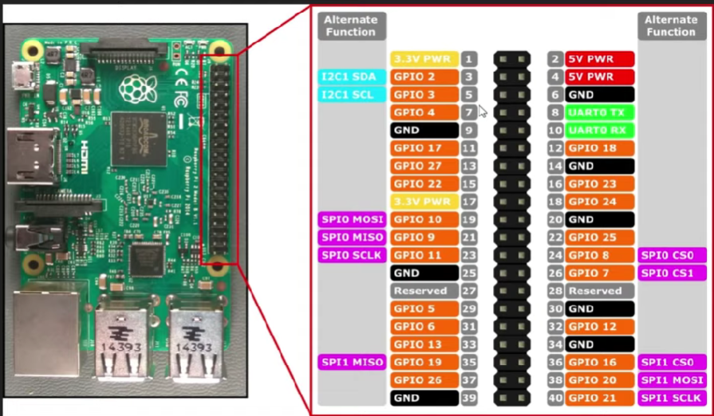
Raspberry Pi pin
GPIO (General Purpose Input Output)
5v PWR
3.3v PWR
Reserved
GND
It has 40 pins

Slide 10
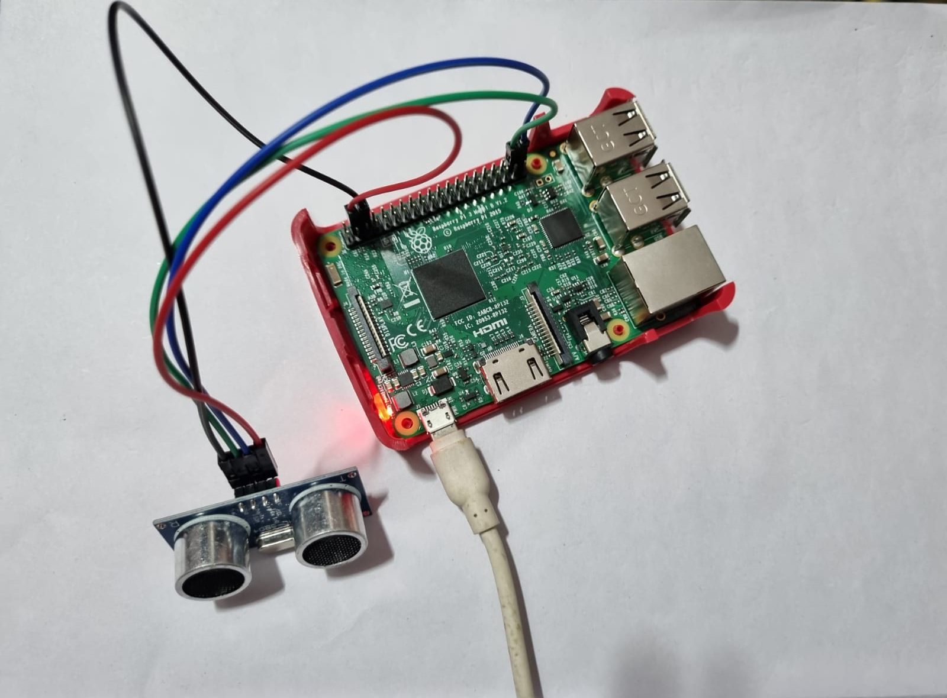
Connection
Ultrasonic Sensor with Raspberry Pi3
Trig → 21 GPIO pin (40th pin)
Echo → 20 GPIO pin (38th pin)
VCC → 5V PWR pin ( 4th pin)
GND → GND pin (6th pin)

Slide 11
Face Recognition
Connection
Overall Connection
The Smart Eye Glass

Slide 12
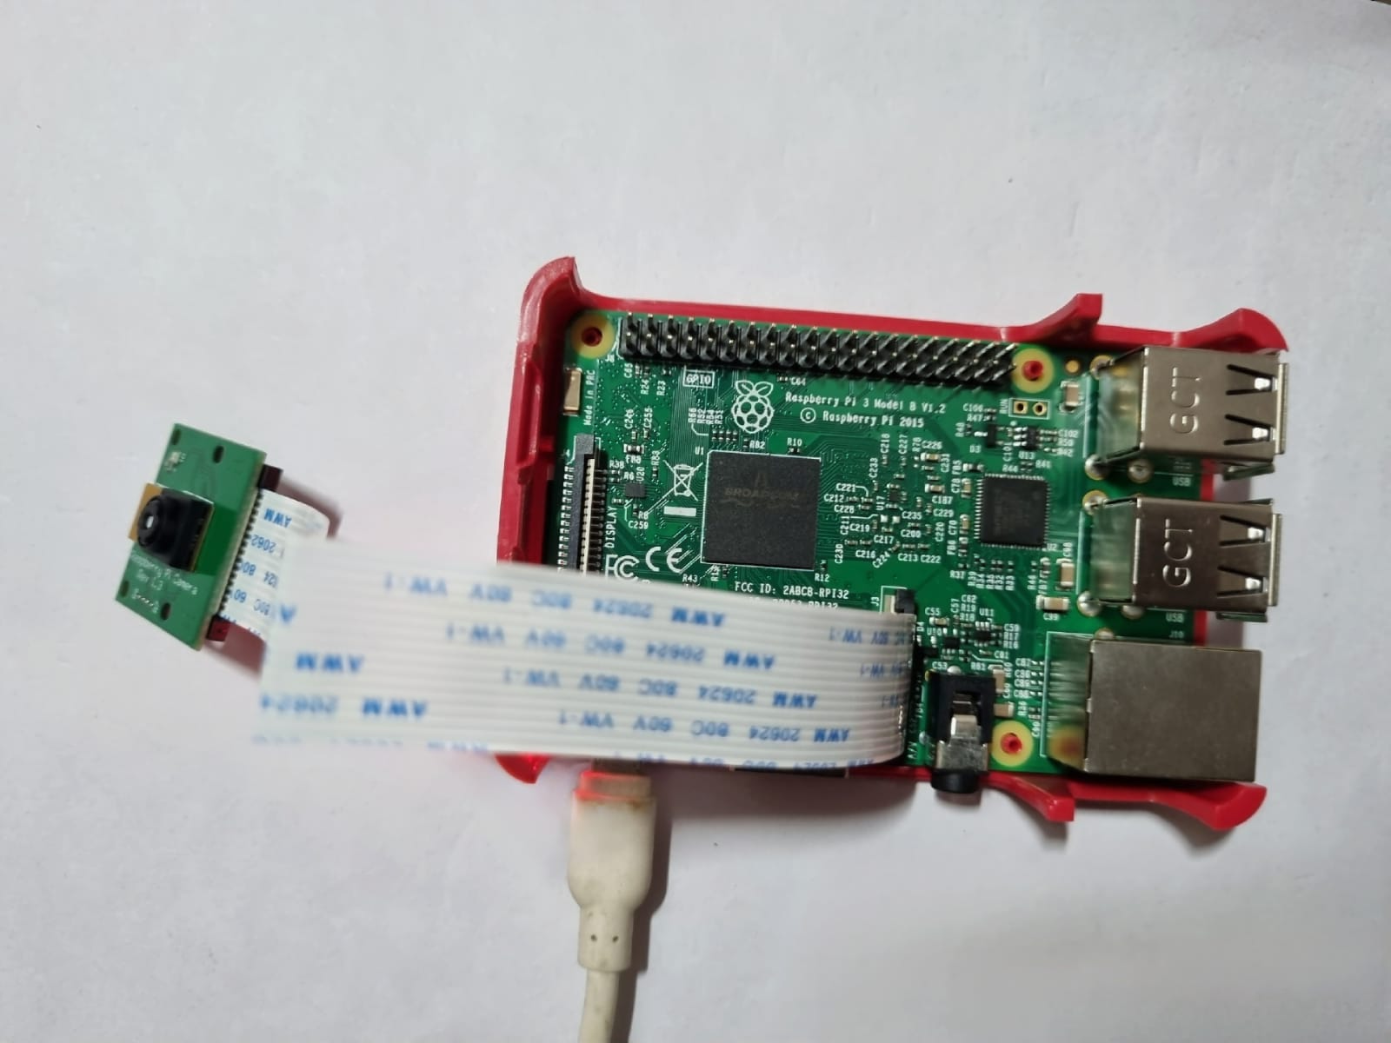
Connection
Camera with Raspberry Pi3

Slide 13
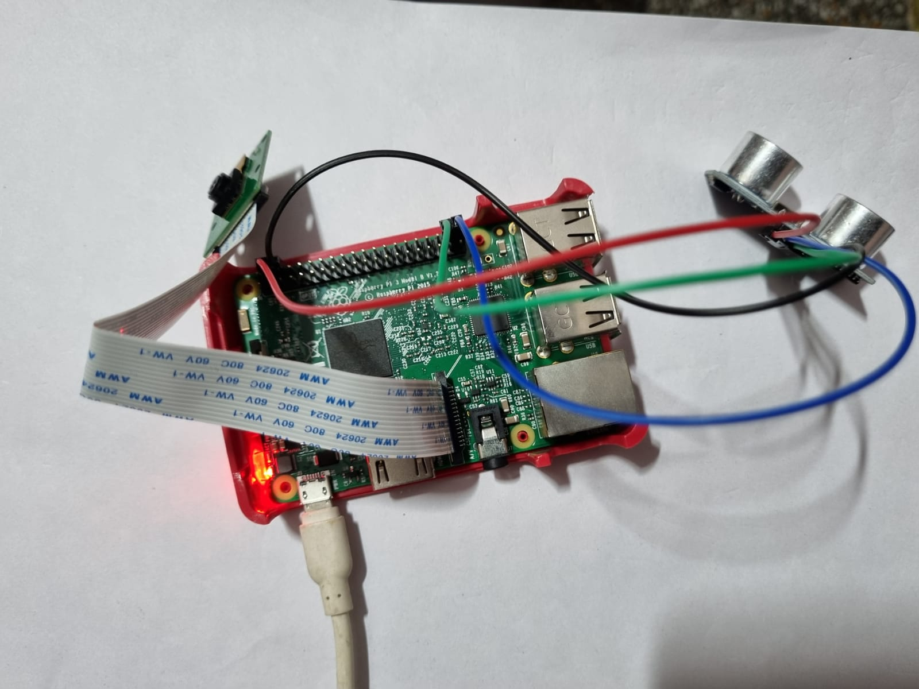
Overall Connection
Finally, the sensor HC-SR04 and the camera are connected to Raspberry Pi3

Slide 14
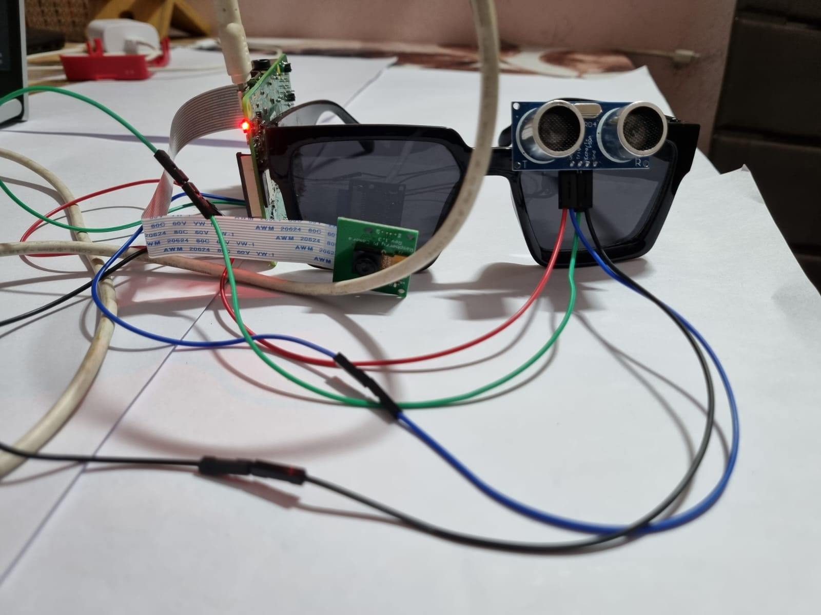
The Smart Eye Glass

Slide 15
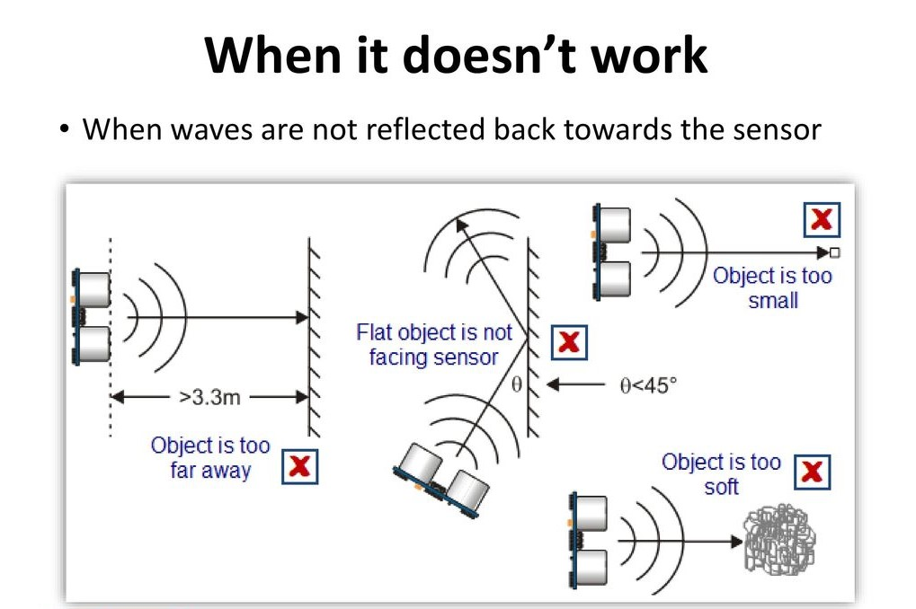
Limitations
In the Following 4 cases:
Object is too far away
Flat object is not facing sensor
Object is too small
Object is too soft
Case i
Case ii
Case iii
Case iv

Slide 16
References
[1] https://www.who.int/news-room/fact-sheets/detail/blindness-andvisualimpairment#:~:text=Globally%2C%20at%20least%202.2%20billi on,near%20or%20distance%20vision%20impairment.
[2] Ultrasonic Smart Spectacles for Visually Impaired and Blind People
Authors: L. Shashitha (Department of Electronics and Communication Engineering, Institute of Aeronatical Engineering College Dundigal, Hyderabad, Telangana) P. Ashok Babu (Department of Electronics and Communication Engineering, Institute of Aeronatical Engineering College Dundigal, Hyderabad, Telangana)
Published in: 2021 3rd International Conference on Advances in Computing, Communication Control and Networking (ICAC3N)
Date of Conference: 17-18 December 2021 Date Added to IEEE Xplore: 09 March 2022 Electronic
ISBN:978-1-6654-3811-7 Print on Demand(PoD)
ISBN:978-1-6654-3812-4
INSPEC Accession Number: 21666268
DOI: 10.1109/ICAC3N53548.2021.9725747
Publisher: IEEE Conference
Location: Greater Noida, India

Slide 17
Any….
Suggestions…??
From your side…..

Slide 18
Thank You….

