Slide 1

Smart Eye Glass with Face Recognition and Obstacle Detection for virtually impaired
19BCS031 Shahabuddin
19BCS014 Md Minhaaz
Group no. 1

Slide 2


Contents
Introduction
Need
AIOT
Tools & Programming Environment
Ultrasonic Sensor
Raspberry pi
Working

Slide 3
INTRODUCTION
Our aim is to create a small eye glass that will be able to detect face and recognize people.
It can also detect obstacles and calculate distance to alert the user.
Face Recognition
Normal Eye Glass
Smart Eye Glass
Obstacle Detection

Slide 4
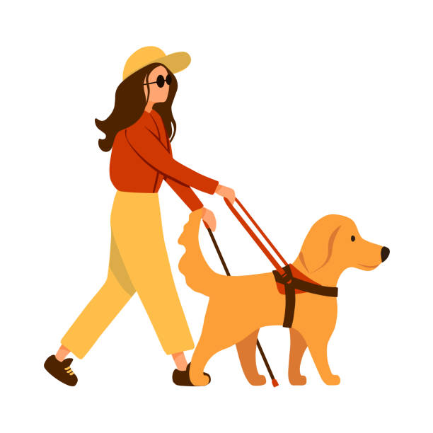
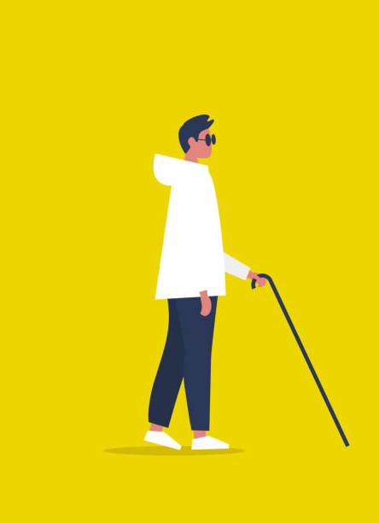
NEED
There are approx. 2.2 billion people who are visually impaired or blind, according to 2022 World Health Organization (WHO) research on disability.
As the population is growing older and as people’s habits change, chronic eye diseases like diabetic retinopathy are likely to become more common.
Such people require constant assistance from others in order to move around, making them extremely dependent on others.

Slide 5
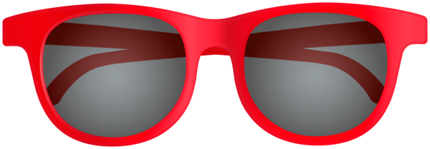
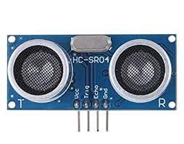
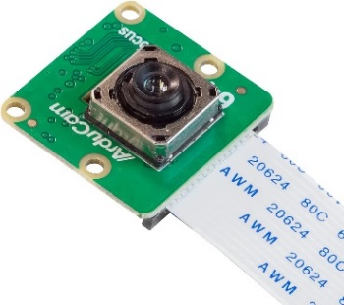
AIOT
AI + IOT = AIOT
Camera
It’ll capture the image of the face and check if the person is known.
Ultrasonic Sensor
It will detect object and measure the distance between the sensor and object, Which will used for obstacle detection

Slide 6
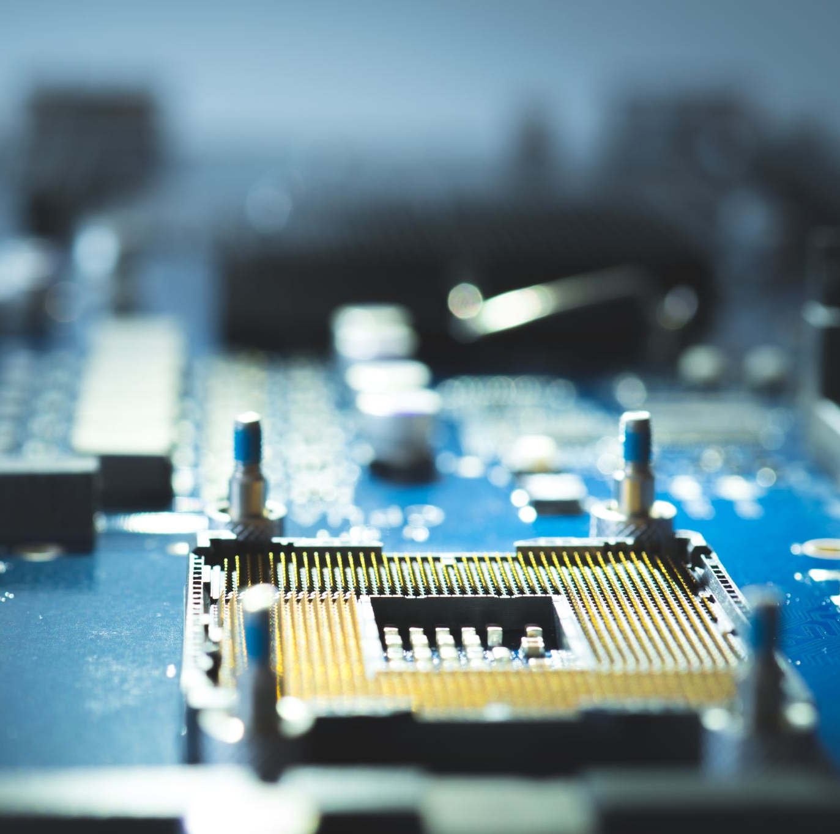
TOOLS & PROGRAMMING ENVIRONMENT
Ultrasonic Sensor
Camera
Raspberry PI
Battery
OpenCV
Python3

Slide 7
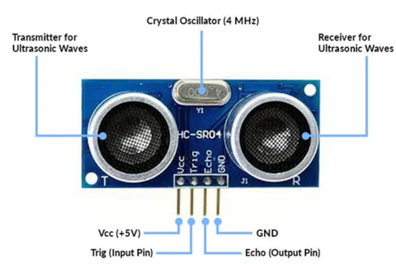
Ultrasonic Sensor
An ultrasonic sensor is a device that detects an object and measures the distance to it.
It measures the distance by emitting ultrasound and receiving the wave that the object reflects.
It has two main components
Transmitter : For sending ultrasonic sound waves
Receiver : For receiving ultrasonic sound waves(echo)
T = Transmitter
R = Receiver

Slide 8
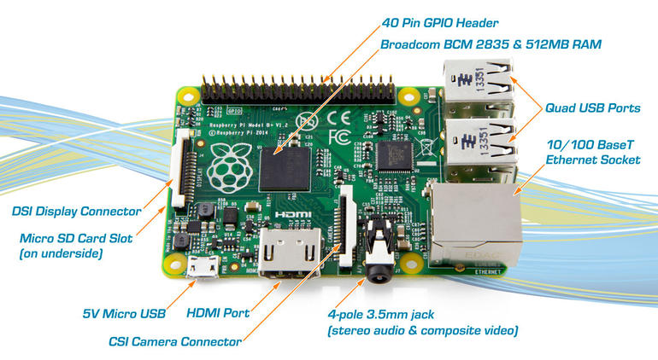
Raspberry PI
Raspberry Pi is defined as a minicomputer the size of a credit card that is interoperable with any input and output hardware device like a monitor, a television, a mouse, or a keyboard – effectively converting the set-up into a full-fledged PC at a low cost

Slide 9
WORKING
Smart Eye Glass
If obstacle is detected
Check if it’s a human or not
If human
Run facial recognition model
If not
Calculate distance
Repeat
Alert the user using voice

Slide 10


Slide 11
Thank you…

