Slide 1
From CLV Ranking to Uplift-Aware Targeting Cross-Context Evidence from Online Retail, Grocery & Supermarket Campaign Data
Vu Minh Anh Nguyen · Linh Hoang Nguyen (corresponding)
FPT University · ADY201m — Phase 2
CLV tells who is valuable · Uplift tells who is responsive · Value-adjusted uplift tells who is worth targeting

Slide 2
Agenda
1. Motivation — value vs persuadability (sure buyer vs persuadable)
2. Research questions & three datasets with separated roles
3. Methodology — Hurdle-Semantic CLV, uplift learners, value-adjusted policy
4. Results — cross-context CLV, uplift > response, value-adjusted profit
5. Honest significance, discussion & conclusion
Applied decision-support framework — integration + honest evaluation, not a new estimator.

Slide 3
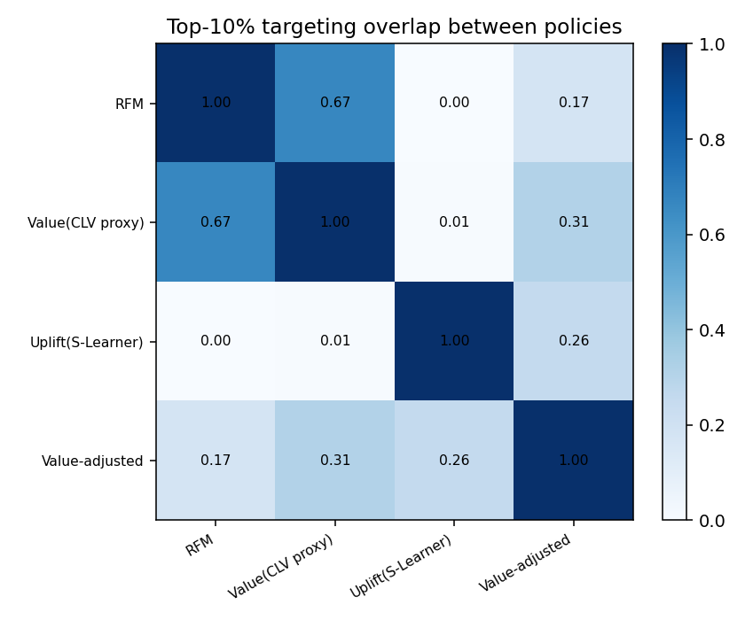
Motivation: Value ≠ Persuadability
CLV ranks the most valuable customers — often already-loyal sure buyers.
Uplift ranks the campaign-responsive — the persuadables.
A high-value sure buyer returns anyway → wasted budget.
A mid-value persuadable only buys when prompted → invisible to value models.
Question: who is BOTH valuable AND incrementally persuadable?
Top-10% chosen by value vs by uplift overlap only 0.7% — near-disjoint customers.

Slide 4
Fit with ADY201m Requirements
Requirement | Phase 2
Python pipeline | Ingest → shared features → 14 models → evaluation
SQL analysis | DuckDB: RFM, segments, balance, overlap queries
>5 ML models | 8 CLV regressors + 6 uplift learners
Dashboard / report | Targeting dashboard + Springer PDF (12 pp.)
AI Audit Log | P2-01..P2-20, Human Delta + honest reporting
Three datasets, deliberately separated roles — causal-clean design.

Slide 5
Research Questions
RQ1 — How robust is the Hurdle-Semantic CLV framework across e-commerce and grocery?
RQ2 — Do behavioural, sequence, semantic features add value beyond RFM?
RQ3 — Does uplift-aware targeting beat response- and value-based targeting?
RQ4 — Does value-adjusted uplift (τ̂·V̂) improve budget-constrained efficiency?
RQ1–RQ2: CLV ranking | RQ3: uplift | RQ4: the fusion (central contribution).

Slide 6
Three Datasets, Separated Roles
0.8M
Online Retail II tx
2,500
Dunnhumby hh
200,039
X5 clients
45.7M
X5 purchase lines
Online Retail II (UK e-commerce) — baseline CLV (read-only reuse).
Dunnhumby (US grocery) — external CLV validation.
X5 RetailHero (randomised SMS) — the only source of treatment-control uplift.
Coupon redemption deliberately NOT used as treatment (post-campaign outcome).

Slide 7
Methodology — Four Modules
A. Hurdle CLV: CLV̂ = p(return) × E[spend | return], lognormal correction.
B. Semantic profiling: PPMI co-occurrence → SVD product embeddings → taste vectors.
C. Uplift learners: S- / T- / X-Learner, class transformation vs response & random.
D. Value-adjusted uplift (central): Score = τ̂ᵢ · V̂ᵢ .
CLV = forecasting (walk-forward). Uplift = randomised cross-section (RCT).

Slide 8
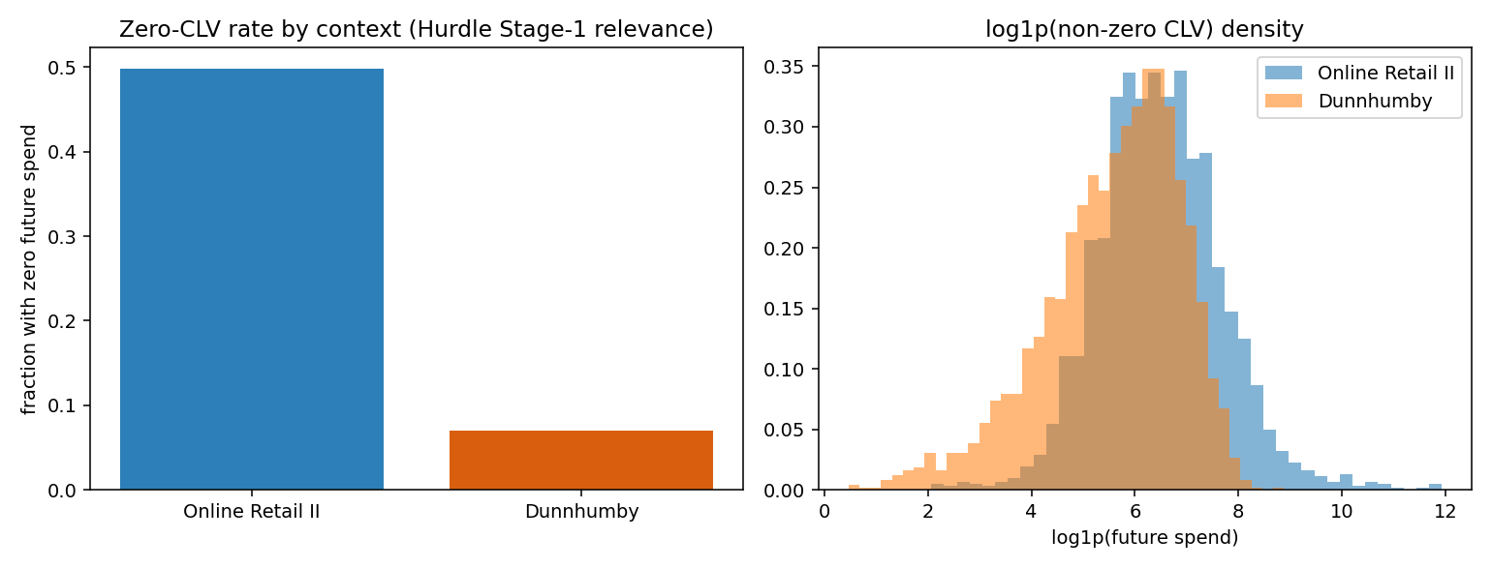
Cross-Context Structure (RQ1)
Two opposite retail regimes
E-commerce: 50% zero, skew 16.7 (heavy-tailed). Grocery: 7% zero, skew 2.5 (dense).

Slide 9
Cross-Context CLV Benchmark (RQ1, RQ2)
Walk-forward, mean ± std — aligned with Phase 1
Model | NG | RC@10
Online Retail II — Hurdle | 0.825 ± 0.05 | 59.0%
Online Retail II — Monetary | 0.822 | 60.0%
Dunnhumby — RandomForest | 0.862 | 34.3%
Dunnhumby — Hurdle | 0.855 | 34.3%
Hurdle competitive, not dominant — ties Monetary (p=0.55) / RF.
Mechanism shifts: incidence (e-com) vs sequence/magnitude (grocery).
Extra features > RFM significant in grocery (p=0.002), not e-com (p=0.17).
Semantic: interpretation, not a ranking driver (ns both contexts).

Slide 10
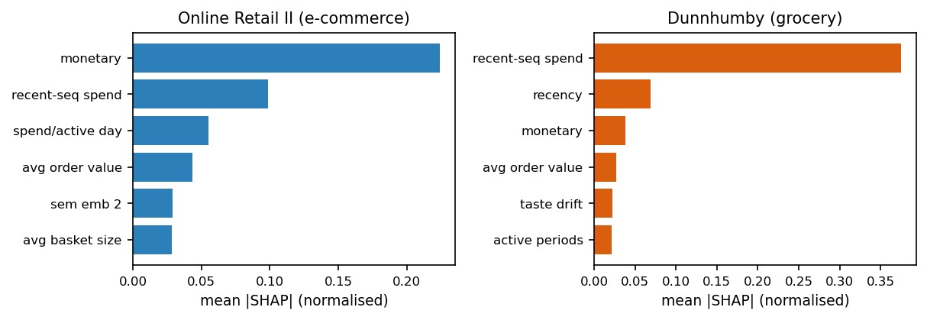
Explainability — Stage-2 SHAP (RQ2)
Monetary dominates spend in e-commerce; recent-sequence spend dominates in grocery.

Slide 11
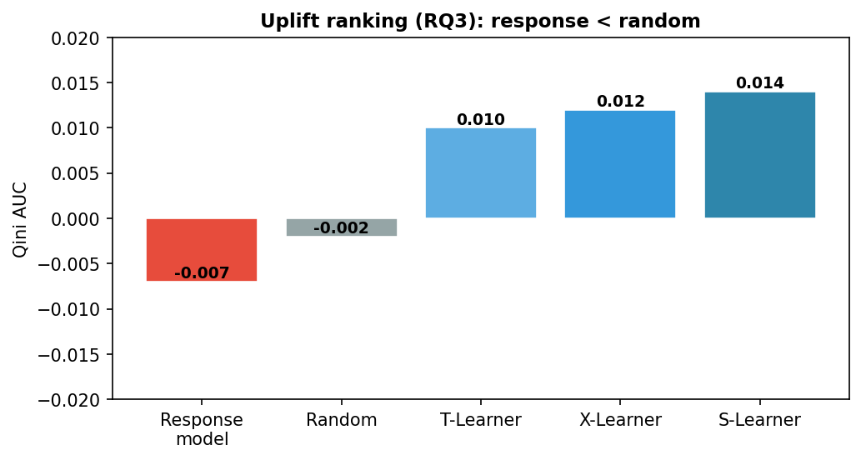
Uplift-Aware Targeting (RQ3)
Response model ranks BELOW random
Response model ("who will buy") Qini −0.007 — worse than random.
Uplift learners positive: S-Learner Qini 0.014.
Top-decile uplift ≈ 11% — ~3× the average effect.
“Likely to buy” ≠ “persuadable” (paired bootstrap p < 0.001).

Slide 12
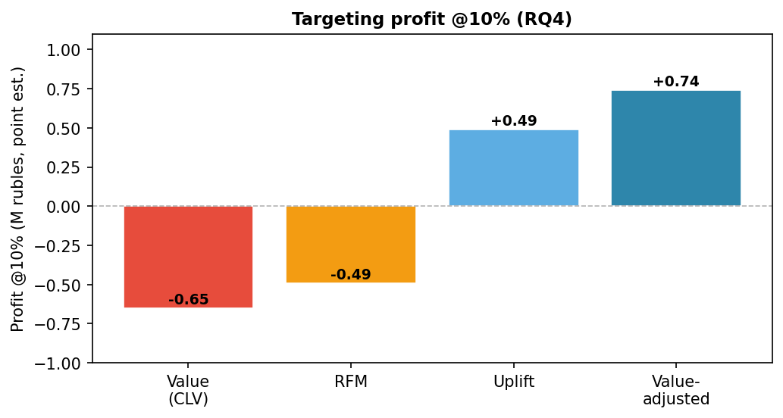
Value-Adjusted Targeting & Profit (RQ4)
Value & uplift top-10% overlap only 0.007 — different customers.
Value-only can LOSE money at 10% (sure buyers, low uplift).
Uplift-only maximises incremental conversions.
Value-adjusted: highest point-estimate profit at tight budgets
(wins all 9 cost×margin settings; differences NOT significant).

Slide 13
Honest Significance — What Holds Up
Claim | ΔNG | Evidence
Extra features > RFM (grocery) | +0.044 | p < 0.01 ✓
Extra features > RFM (e-com) | +0.009 | p = 0.17 (ns)
Semantic adds ranking | ~0.001 | ns (both)
Sequence adds ranking (grocery) | +0.021 | p < 0.01 ✓
Uplift > response model | — | p < 0.001 ✓
Policy dollar profit differences | — | not significant
Reported transparently: ranking-level claims significant; dollar-level profit is directional.

Slide 14
Discussion — Transferable Insights
Do not target on CLV alone — selects sure buyers, can lose money.
Do not target on response alone — can underperform random.
Value-adjusted uplift suits budget-constrained settings.
Explainability (SHAP) + calibrated uncertainty (CQR, 90%→90.2%/89.0%) build trust.
0.7% overlap → a single objective leads to suboptimal / loss-making targeting.
Transferable principles for budget-constrained emerging markets — not numerical transfer.

Slide 15
Conclusion
Framework transfers but mechanism is context-dependent.
Response-based targeting is worse than random for incremental campaigns.
Value-adjusted uplift = most promising rule under tight budgets (honest caveats).
Limitations: small grocery sample, single campaign, value proxy, modest signal.
CLV identifies who is valuable · uplift identifies who is responsive · value-adjusted uplift identifies who is worth targeting

