Slide 1








TRILYTICS CASE STUDY
Team Elite Sapiens
JADAVPUR
UNIVERSITY
TEAM MEMBERS:
Aritra Chakraborty
Md. Minhaz Rahaman
Arnab Dutta
B.E Mechanical Engineering
B.E Mechanical Engineering
B.E Mechanical Engineering

Slide 2

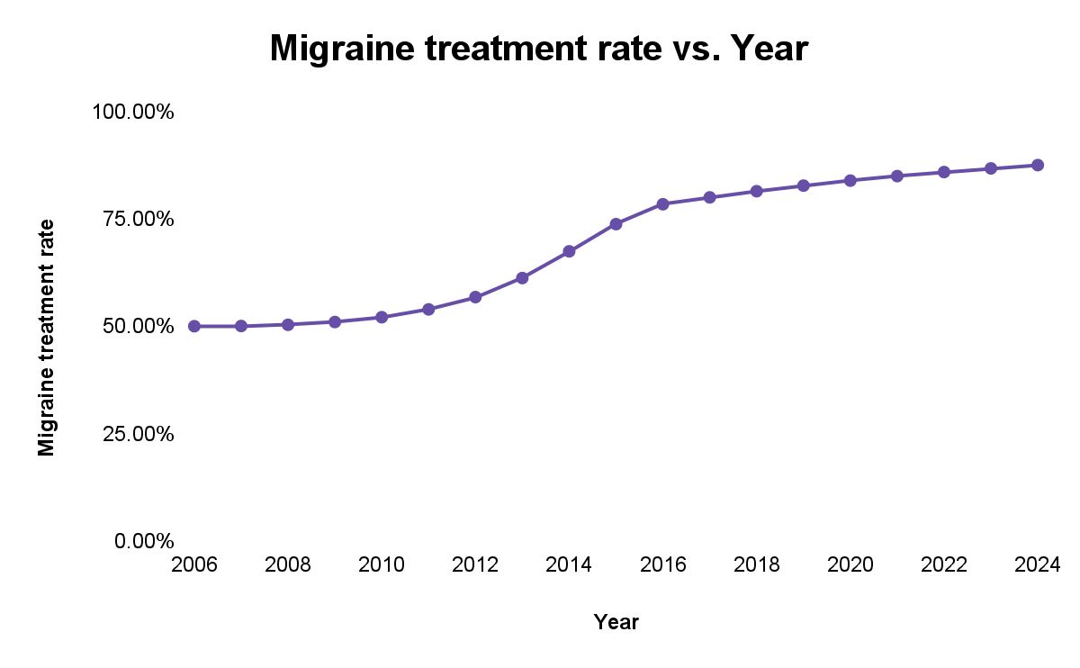
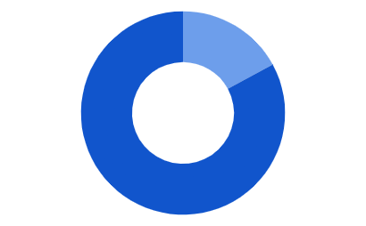
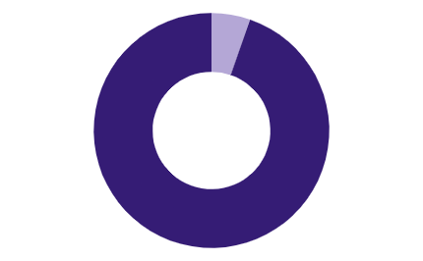
Study on Migraine is a very intriguing topic in the field of medical sciences, due to its widespread prevalence while not all are treated.
MIGRAINE
1
TREATMENT RATE
3
Migraine is a headache of varying intensity, often accompanied by nausea and sensitivity to light and sound.
Not all of those who are suffering from Migraine are treated. After analyzing the data, and using “Holt’s Method with Additive Damping”, it is forecasted that 87.51% of total migraine patients will receive a proper treatment by 2024
Episodic | Chronic
Shows a headache frequency of less than 15 days a month | Shows a headache frequency of more than 15 days a month[1]
PREVALENCE
2
According to latest reports of AMPP( American Migraine Prevalence and Prevention) study we found..[1]
Prevalence of EM among Women and 1.3% CM
Prevalence of EM among Men and 0.5% CM
17.1%
5.3%
**Code of the forecast is linked here
Reference
[1] Defining the Differences Between Episodic Migraine and Chronic Migraine - PMC
** EM = Episodic Migraine
** CM= Chronic Migraine

Slide 3
Most of the migraine patients in the US are suffering from Episodic Migraine and our client is trying to capture this market space.
WHO? | WHAT? | WHEN?
PharmaSpace is a multinational pharma company based at New Jersey Products range lie in the neural space for ailments like Seizers ,Alzheimer’s and Parkinson | Our client is planning to launch a new product named RELIEVE in the market RELIEVE therapy is capable of treating multiple pain indications such as migraine and chronic pain | PharmaSpace is going to launch RELIEVE on the fall of 2024 They are targeting to capture the market the market where acute treatment of Episodic Migraine is done
MARKET SEGMENTATION
MARKET SIZE
Migraine
From the given dataset of around 250 doctors, we obtained the market size to be as follows:
Episodic
Chronic
1000
114
**TARGET MARKET
Episodic Migraine with acute treatment
Acute Treatment
Preventive Treatment
Per patients visited
Acute + Preventive
Target Market

Slide 4
Though doctors have alternatives to treat migraine based on existing medications, ‘RELIEVE’ shows strong potential to surpass them.
DETERMINING AND COMPARING OVERALL RATINGS
POTENTIAL DRIVERS FOR RELIEVE
Minimal side effects in comparison to Triptans (most preferred alternative)
Practitioners are willing to overcome insurance hurdles,provided it’s a promising product
High unmet need for acute treatment of patients contraindicated to Triptans
The mean of all attributes from the HCP’s perception on individual treatment alternatives is calculated from the main data set
The mean importance rating is evaluated from the primary data set for all alternatives
**Calculations
Overall rating = Σ(Importance Rating xPerception rating)/49
Rating (out of 7) | NSAID | Triptan | Opioid | Barbiturate | Relieve
Pain Relief | 4.11 | 5.00 | 4.01 | 3.91 | 4.90
Pain Freedom | 3.85 | 4.80 | 3.67 | 3.83 | 4.73
% improvement | 3.71 | 4.63 | 3.46 | 3.57 | 4.62
Side Effects | 4.30 | 4.11 | 2.93 | 3.25 | 4.64
Admin. route | 4.04 | 4.31 | 3.49 | 3.46 | 4.22
Mechanism | 2.95 | 3.35 | 2.45 | 2.55 | 3.57
Efficacy | 3.84 | 4.35 | 3.82 | 3.63 | 4.62
Overall Score | 3.83 | 4.36 | 3.40 | 3.46 | 4.47
POTENTIAL BARRIERS FOR RELIEVE
Intravenous mode of treatment is economically beneficial than RELIEVE for practitioners
Unavailability of low dosage medication which is preferred by practitioners in early stage

Slide 5
Based on primary competitor analysis, and market research on pricing strategy, ‘RELIEVE’ should be priced at $8.5/pill.
PRIMARY COMPETITOR ANALYSIS[2]
COMPETITORS VS RELIEVE
The triptan with the most side effects
SumaTriptan
Higher Side Effects
Higher Recurrence
SumaTriptan
ZolmiTriptan
AlmoTriptan
RizaTriptan
ZolmiTriptan
Moderate Pain
TRIPTANS
FrovaTriptan
NaraTriptan
Mild Pain
Costly Pill
Higher Recurrence
Costlier Pill
Type of Triptan | Risk of Side Effect | Recurrence | Price per pill
SumaTriptan | HIGH | MODERATE | $8
ZolmiTriptan | HIGH | HIGH | $8.7
AlmoTriptan | LOW | LOW | $9.4
RizaTriptan | LOW | HIGH | $9.4
AlmoTriptan
RizaTriptan
PRICING THE PILL & CONSIDERATIONS
$8.5/pill
Keeping in mind the high capital investment in R&D ($2-3 billion)
Has similar benefits with negligible adverse effect from Sumatriptan
Expected to gain competitive advantage at the price point
[2] Choosing the Right Triptan

Slide 6



Certain group of doctors are showing high reliability on ‘RELIEVE’ and hence sorting the key considerations for launching[3] it in the market
Key Characteristic Identification of HCPs
SWOT ANALYSIS
For determining the characteristics we determined overall rating given by the HCPs for each categorical variables using this formula:
STRENGTHS No CV contraindication High % Pain Freedom Low Side Effects 80% people with mild or no pain after 2 hours | WEAKNESSES Only available as oral pills Only a single dosage amount IV infusions profitable for doctors
OPPORTUNITIES Those contraindicated to triptan have high unmet need Triptan , ergot not efficacious | THREATS No compliance of insurance companies
Rating =
𝚺 (Rating value * Count of HCP)/ 𝚺 count of HCPs
Physician Persona
**Calculations
Neurologists are most likely to prescribe RELIEVE as their ratings for prescribing RELIEVE is 5.90/7.
LAUNCH STRATEGY CONSIDERATIONS
Doctors who have solo- practice in an office are more likely to prescribe RELIEVE (Rating: 5.80/7)
Target Market | Episodic Migraine + acute treatment
Product and Competitor | Competitor Analysis on diff parameters
Operational considerations | Investment in Manufacturing, Supply Chain and Marketing
Market Reach | Well Established in the US market
Profitability | To be considered before launch
Doctors who have a work experience of 26-30 years are more likely to prescribe RELIEVE (Rating: 5.90/7)
[3] Rates and reasons for discontinuation of triptans and opioids in episodic migraine: Results from the American Migraine Prevalence and Prevention (AMPP) study - ScienceDirect
**HCP = Health Care Professional

Slide 7
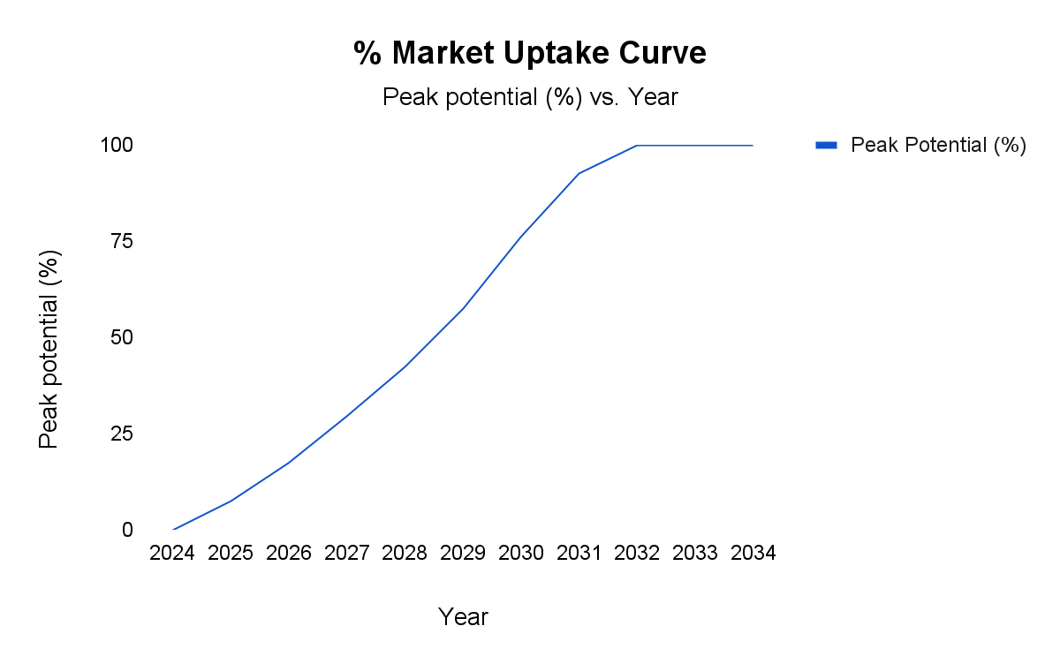
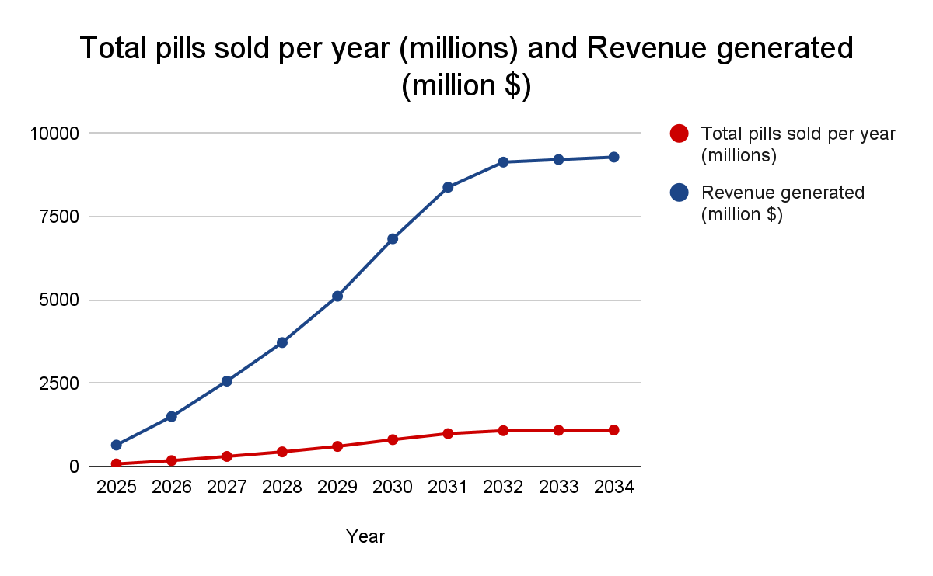
Forecasting ‘RELIEVE’ to reach its peak potential by 2032, and to generate a net revenue of $9.23 bn by 2034.
PEAK POTENTIAL FORECAST
SALES FORECAST
Population using RELIEVE=( U.S population[4] x %prevalence[1] x %episodic acute x % treatment penetration x % use of RELIEVE x % Market Uptake )
Total pills[5] = (Population using RELIEVE x 7.5 x 12)
Revenue = (Total pills in a year x $8.5)
** Calculations and Spreadsheet
DATASET
REGRESSION
PLOT
Preparing a dataset of the existing products with their duration to reach p.p
Checking out Regression models to find best model to predict the p.p
Using predicted values from Random Forest to plot uptake curve
[4] https://drive.google.com/file/d/1RbFcs0H_dVv13K9_xk1DC5g1Xye3uDgX/view?usp=sharing
[5]The acute and preventative treatment of episodic migraine - PMC **p.p= Peak Potential

Slide 8
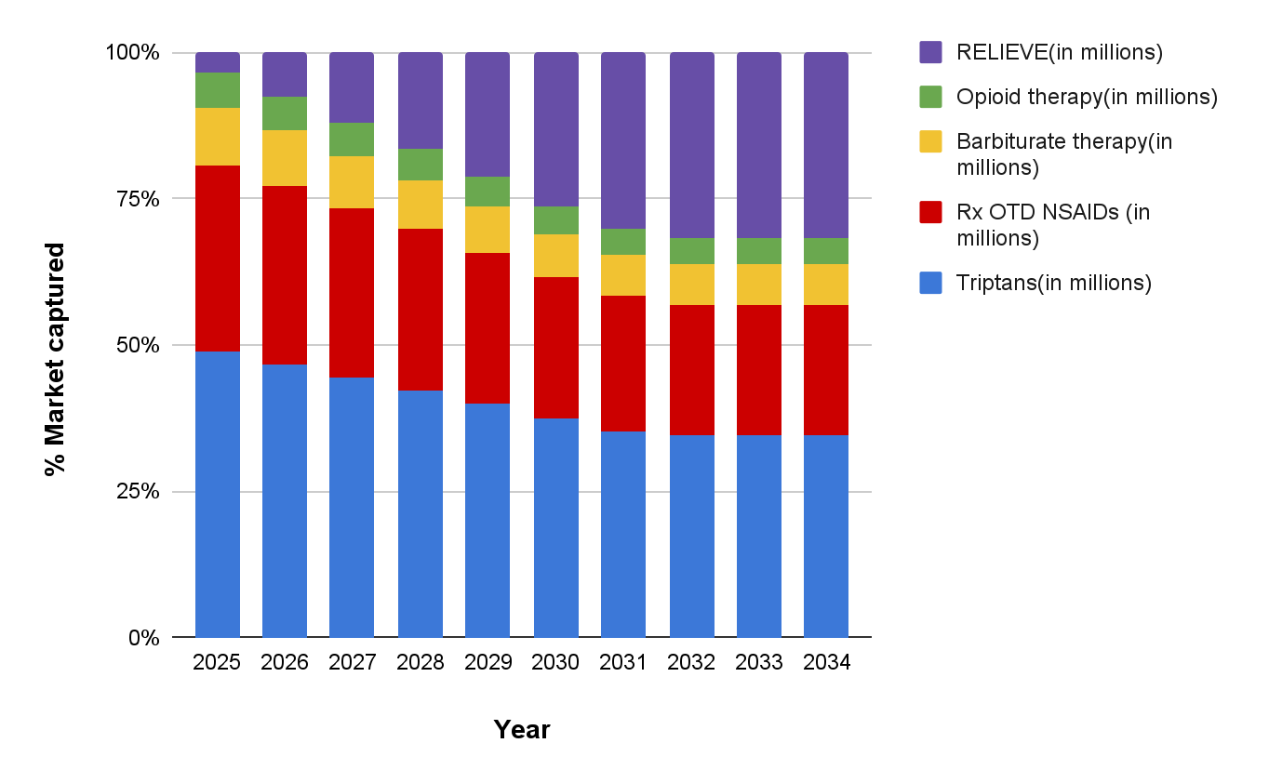
Relying on the Revenue Stream and the estimated future use of indv. Drugs, the market share of ‘RELIEVE’ is expected to reach 32% by 2034.
REVENUE STREAM
PROJECTED MARKET PENETRATION (per Drug Type)
Sales Revenue generated by the sales of RELIEVE in the market | Patent Rights Exclusive rights of RELIEVE will help in controlling the profit margin
R&D Further Research & Development of RELIEVE will improve the product contributing to greater sales | Strategic Alliance Tie up with insurance companies will help in smooth and easier claims for end consumers
Assuming that no improvements in the competitors and no new product launches over the time period, CAGR growth of RELIEVE is expected to be 30.62%
*calculations and spreadsheet

Slide 9
Summarizing the Case….
Analyzing Treatment Rates, Market Size and the Product
Migraine Treatment | Market Size | Product Comparison | Practitioner Perspective
Mainly of two types Episodic and Chronic Episodic Migraine prevalence of 17.1% in women and 5.3% in men By 2024, the migraine treatment rate is expected to reach 87.21%. | Target Market comprises of patients who are suffering from Episodic Migraine , and receive acute treatment This market is about 114 per 1000 patients who visit the doctors for an appointment | Based on the overall rating, that is calculated keeping in mind the physician perspectives for individual drug, ‘RELIEVE’ is rated to be better than the most suitable drug in the existing market ‘TRIPTAN’ | All the 250 HCPs rated, how likely they are going to prescribe RELIEVE Trends show, Neurologists, practicing for 26-30 years, as a solo office practitioner are most likely to prescribe RELIEVE
Pricing the product, Forecasting the Market Penetration and Necessary Recommendations
Pricing the pill | Product Uptake and Future Market
After comparing with RELIEVE’s main competitor the best price to be set is $8.5/ pill At this price point, RELIEVE will generate a revenue of $9.23Bn by 2034 | Based on the products launched earlier, it is predicted from the trends that RELIEVE will reach Peak Potential in 8 years 32% market share by 2034
Recommendations
PRODUCT | STRATEGIC
Developing Low Dosage pills Developing other forms of consumption | Patenting the formula to moderate profit margin Strategic alliance with insurance companies

Slide 10
Thank You
Over to the Judges for Questions

