Slide 1
Team 1 Spiral 2
Minhaz Mahmud
Kiante Brantley
Jessica Ngassa
Carlo Mogliazzi
Seth Mosgin
Notes:
This template can be used as a starter file to give updates for project milestones.
Sections
Sections can help to organize your slides or facilitate collaboration between multiple authors. On the Home tab, under Slides, click Section, and then click Add Section.
Notes
Use the Notes pane for delivery notes or to provide additional details for the audience. You can see these notes in Presenter View during your presentation.
Keep in mind the font size (important for accessibility, visibility, videotaping, and online production)
Coordinated colors
Pay particular attention to the graphs, charts, and text boxes.
Consider that attendees will print in black and white or grayscale. Run a test print to make sure your colors work when printed in pure black and white and grayscale.
Graphics, tables, and graphs
Keep it simple: If possible, use consistent, non-distracting styles and colors.
Label all graphs and tables.

Slide 2
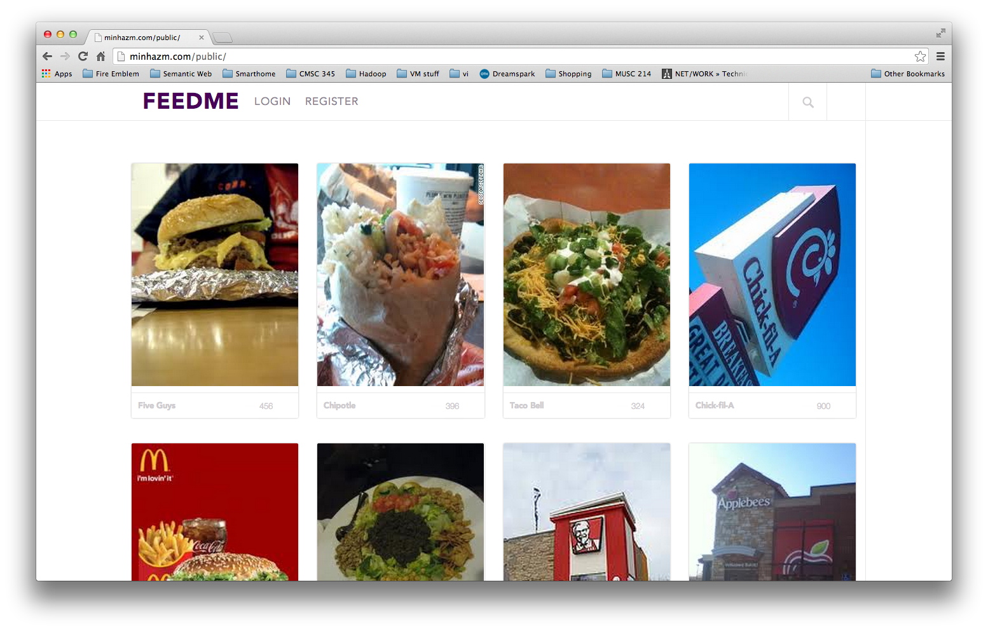
Project Overview
Our website is called FeedMe
Our project is designed to share user input on food quality on and around the UMBC campus
The user will be able to upload picture of the places where they ate or the food that they had.
Users will also be able to comment and “like” other’s posts, and earn “points” from commenting.
Notes:
What is the project about?
Define the goal of this project
Is it similar to projects in the past or is it a new effort?
Define the scope of this project
Is it an independent project or is it related to other projects?
* Note that this slide is not necessary for weekly status meetings

