Slide 1
Team 1 Spiral 1
Minhaz Mahmud
Kiante Brantley
Jessica Ngassa
Carlo Mogliazzi
Seth Mosgin
Notes:
This template can be used as a starter file to give updates for project milestones.
Sections
Sections can help to organize your slides or facilitate collaboration between multiple authors. On the Home tab, under Slides, click Section, and then click Add Section.
Notes
Use the Notes pane for delivery notes or to provide additional details for the audience. You can see these notes in Presenter View during your presentation.
Keep in mind the font size (important for accessibility, visibility, videotaping, and online production)
Coordinated colors
Pay particular attention to the graphs, charts, and text boxes.
Consider that attendees will print in black and white or grayscale. Run a test print to make sure your colors work when printed in pure black and white and grayscale.
Graphics, tables, and graphs
Keep it simple: If possible, use consistent, non-distracting styles and colors.
Label all graphs and tables.

Slide 2
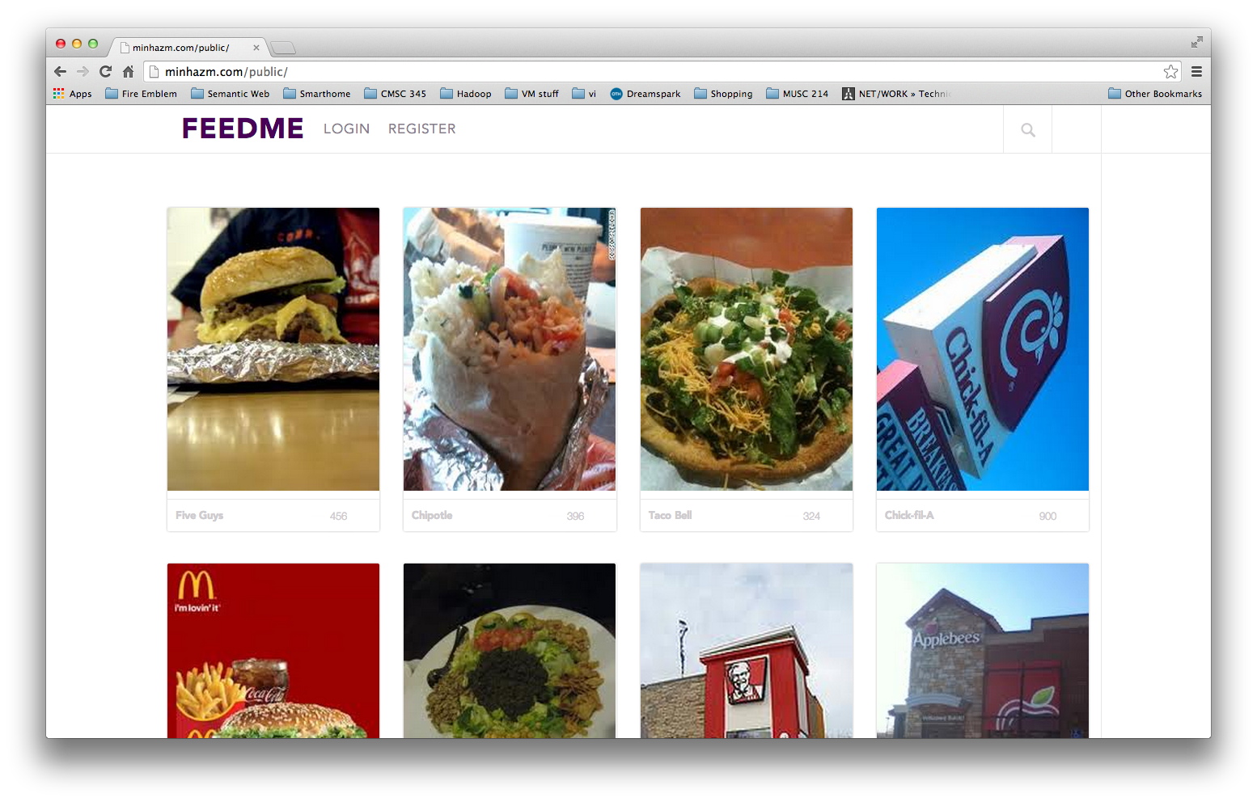
Project Overview
Our website is called FeedMe
Our project is designed to share user input on food quality on and around the UMBC campus
The user will be able to upload picture of the places where they ate or the food that they had.
Users will also be able to comment and “like” other’s posts, and earn “points” from commenting.
Notes:
What is the project about?
Define the goal of this project
Is it similar to projects in the past or is it a new effort?
Define the scope of this project
Is it an independent project or is it related to other projects?
* Note that this slide is not necessary for weekly status meetings

Slide 3
Current Status
What progress has been made since the previous milestone?
Mockups designed and completed
Website created with basic login and logout functionality
MySQL Database connected
Project is currently on schedule
Notes:
* If any of these issues caused a schedule delay or need to be discussed further, include details in next slide.

Slide 4
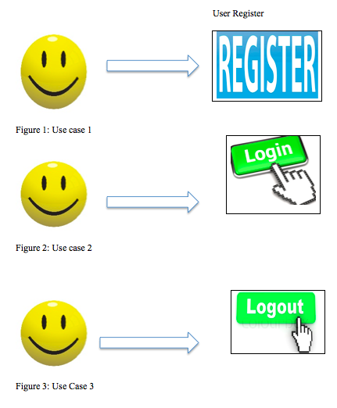
Use Cases

Slide 5
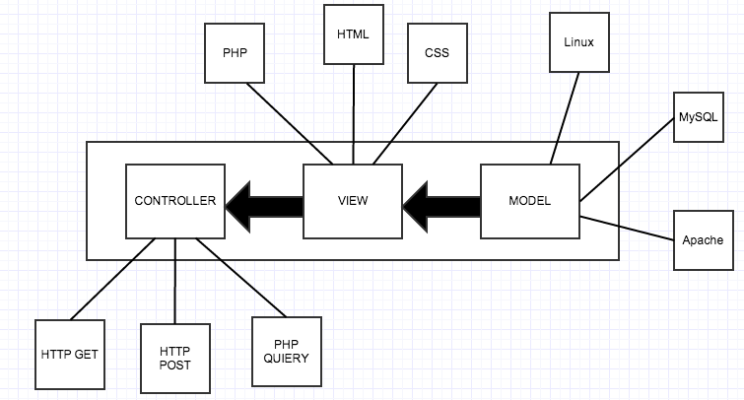
Architectural Design
The FeedMe website will be built using the LAMP(Linux, Apache, MySQL, PHP) solution stack.
The basic components of LAMP include Models, Views, and Templates, which follows a Model View Controller architecture (MVC).

Slide 6
Continued…
The model layer consists of the Linux (The operating system), Apache (The web server), and MySQL (The database). All of the data used in our website will be stored on the MySQL server.
The view layer mostly consists of the front-end code involved with the website. HTML and CSS are used to design each web page, and PHP is used to populate the information dynamically into HTML, and then generate the actual HTML to be sent to the browser.
The controller layer, which talks to the model, would be HTTP GET/POST requests, as well as PHP queries to our database.

Slide 7
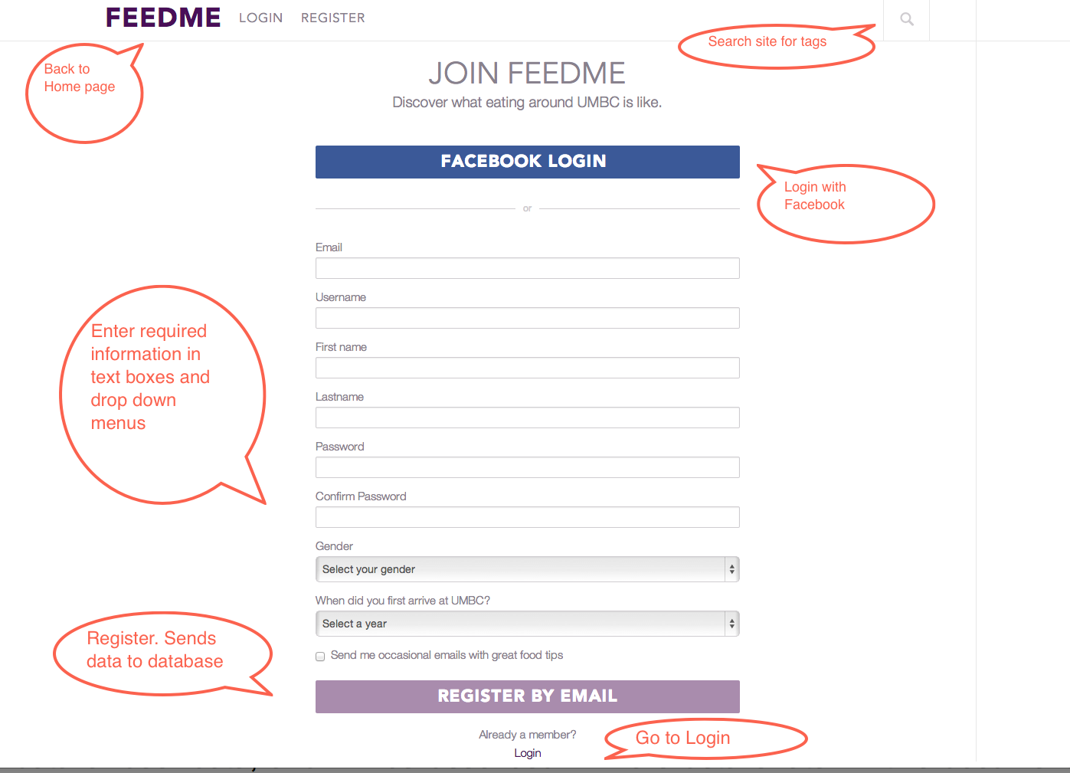
Registration Demo

Slide 8
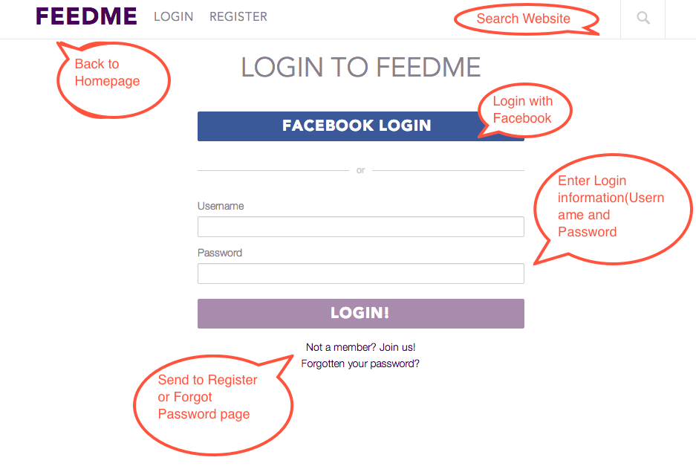
Login Process

Slide 9
Issues and Resolutions
Description of the issue
How was it resolved?
What and how did it impact the project?
Time
Cost
Other
Notes:
Duplicate this slide as necessary if there is more than one issue.
This and related slides can be moved to the appendix or hidden if necessary.

Slide 10
Timeline
Milestone 1
Milestone 2
Milestone 3
Date 1
Date 2
Milestone 4
Date 4
Date 3
Notes:
The following slides show several examples of timelines using SmartArt graphics.
Include a timeline for the project, clearly marking milestones, important dates, and highlight where the project is now.

Slide 11
Timeline
Date 1
Date 2
Date 3
Date 4

Slide 12
Timeline
Date 1
Date 2
Date 3
Date 4

Slide 13

Looking Ahead
When is the next milestone?
What are the expected deliverables?
Known risks and issues
What is the investigation timeline for these issues?
What are the immediate next steps?

Slide 14
Dependencies and Resources
Project
Vendors
Manufacturing
Sales
Engineering
Remote Teams
Notes:
What are the dependencies that affect the timeline, cost, and output of this project?

Slide 15
Appendix
Notes:
Prepare slides for the appendix in the event that more details or supplemental slides are needed. The appendix is also useful if the presentation is distributed later.

Slide 16
Appendix
Budget
Design documents
Marketing plan
Supplemental documents
Contact information

