Slide 1
Advancement Report on Fuzzy Time Series Analysis of the Covid-19 Epidemic
Team Members:
Mohammad Minhazul Alam (1935365650)
S.M. Shahadat Hossain (1935190650)
Md. Romman Riyadh Shishir (2016652650)
Md. Abdul Motaleb (1935369650)
Sabrina Yeasmin (1935074650)
Sadman Hasan (2016160050)
Eumna Huda (1925395050)

Slide 2
Fuzzy Time Series Analysis of Covid-19: Our Initial Project Goal
Fuzzy Time Series (FTS) Analysis using up-to-date dataset containing US, EU, and Asian data of the Covid-19 infection
Using different algorithms of FTS and comparing the result with other Machine Learning algorithms
Comparing the data of different countries with different demography, weather and economic status to find pattern
Helping the policy makers by providing with a usable prediction model

Slide 3
Fuzzy Time Series Analysis of Covid-19: Datasets - Introduction
COVID-19 Data Repository by Johns Hopkins CSSE
https://github.com/CSSEGISandData/COVID-19
Time series data of state/country wise number of confirmed cases, recovered cases and death
Uncover COVID-19 challenge dataset
https://www.kaggle.com/roche-data-science-coalition/uncover
Includes Apple & Google Mobility Trends data, Infection spread data, Test data, country health ranking, etc. of US, Canada, and some other countries
Will be helpful for analyzing exogenous variables and data normalization

Slide 4
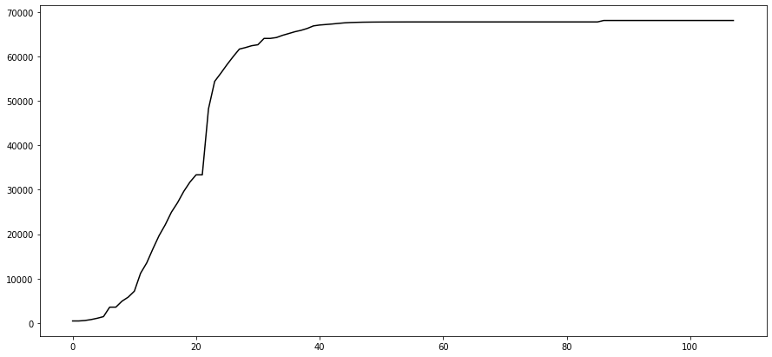
Fuzzy Time Series Analysis of Covid-19: Initial Data Exploration
Cumulative confirmed cases of Hubei China
January 22 – May 8, 2020 (day wise)

Slide 5
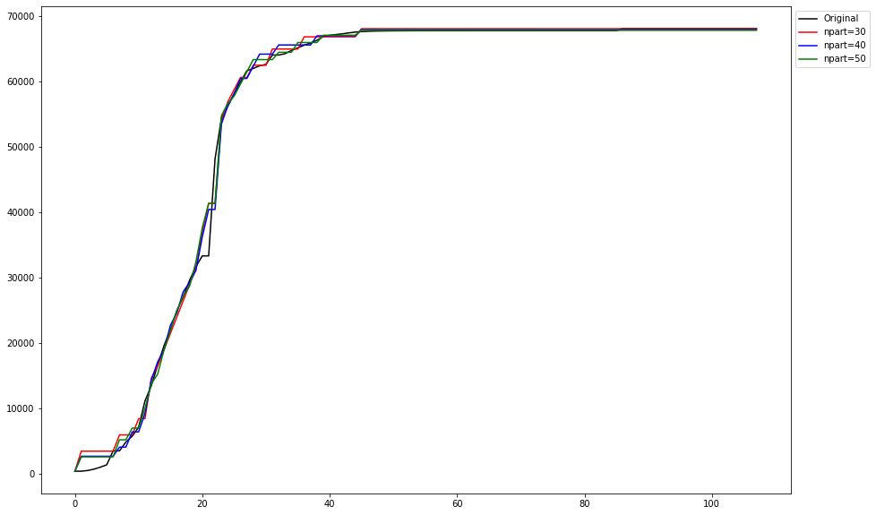

Fuzzy Time Series Analysis of Covid-19: Initial Data Exploration
Effect of Partition Number on FTS prediction of 1 day look ahead (Hubei, China data)

Slide 6
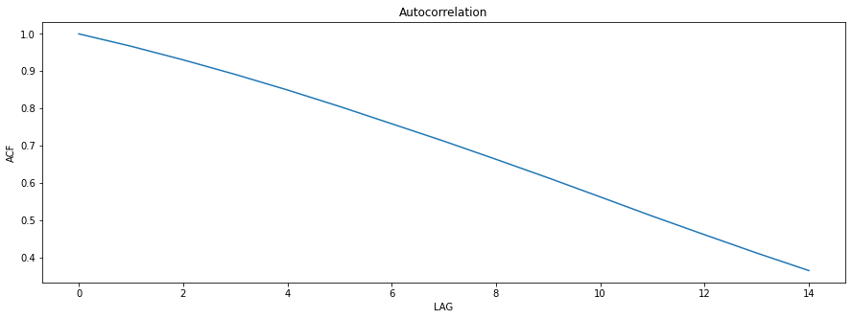
Fuzzy Time Series Analysis of Covid-19: Initial Data Exploration
- Calculating Lag using ACF (Hubei, China data)

Slide 7
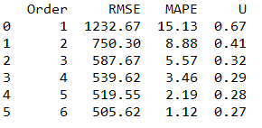
Fuzzy Time Series Analysis of Covid-19: Initial Data Exploration
As seen from ACF analysis and RMSE - order is natural and more than six lags may not be necessary
the number of data is small (per region) so we can use Probabilistic Weighted High Order FTS and let the model choose lag weights

Slide 8
Fuzzy Time Series Analysis of Covid-19: FTS Algorithms Used
Algorithms used for prediction:
High Order Fuzzy Time Series (HOFTS)
Weighted High Order Fuzzy Time Series (WHOFTS)
Probabilistic Fuzzy Time Series (PWOFTS)
Partition used: 40 – 80
Order used: 2 - 6

Slide 9
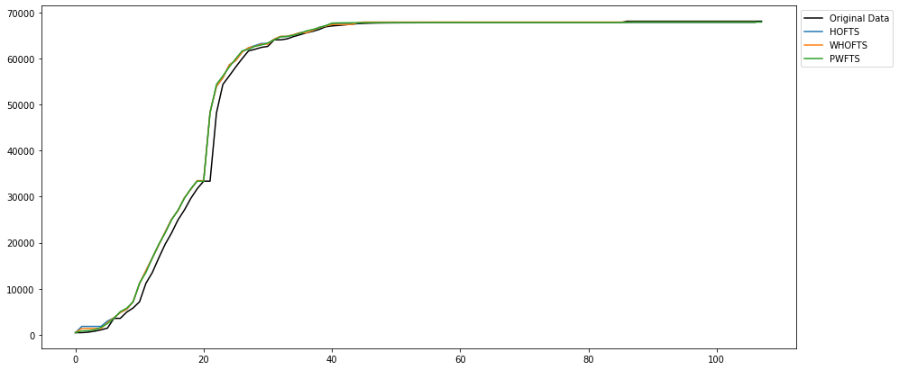

Fuzzy Time Series Analysis of Covid-19: FTS Algorithms Used
- Result of various algorithms -

Slide 10
Fuzzy Time Series Analysis of Covid-19: Next Target
Dataset Normalization & Exogenous variable detection
Different country/state has different extraneous conditions
Conditions include weather, healthcare situation, social awareness levels, population density, etc.
Some of these variables will be used to normalize the data (both x and y axes)
Some others will be used as Exogenous variables if enough correlation found
Multi-variable FTS will be used to model these data and tested

Slide 11
Fuzzy Time Series Analysis of Covid-19: Next Target
We shall compare the result of FTS with Machine Learning models like PNN+cf, LSTM, etc.
Result will be compared with the Fuzzy counterparts

Slide 12
Fuzzy Time Series Analysis of Covid-19: Our Codebase
https://github.com/minhazul-alam/Fuzzy_Systems

Slide 13
Thank You

