Slide 1
A Project Progress Report on ”Automatic Bengali News Generation”
Machine Learning (MS - CSE 533)
North South University
Presented by:
Mohammad Minhazul Alam (St. ID: 1935 365 650)

Slide 2
Automatic Bengali News Generation – Overview
Goal: Automatically generate a piece of news article from a corpus of articles
Figure: Sample Architecture for Text Generation
with LSTM Network
Seed
LSTM
Clean Data
Tokenized Data
Output
Raw Data
LSTM
LSTM
LSTM
Generated Document

Slide 3
Automatic Bengali News Generation – Work Progress
Figure: Bengali Text Generation with LSTM Network
Work Progress
Seed
LSTM
A Single Bengali News Article
Cleaned by Hand
Tokenized & 1 Hot Encoded
Output
LSTM
LSTM
LSTM
Generated Document

Slide 4
Automatic Bengali News Generation – My Target
Figure: Bengali Text Generation with LSTM Network
Future Work
Try some variations
Seed
500 Article Corpus
~40 Articles Gathered
Cleanup Code –
Part done
Try: Bag of Words, Word2Vec, Glove, etc.
LSTM
A Single Bengali News Article
Cleaned by Hand
Tokenized & 1 Hot Encoded
Output
LSTM
LSTM
LSTM
Generated Document

Slide 5
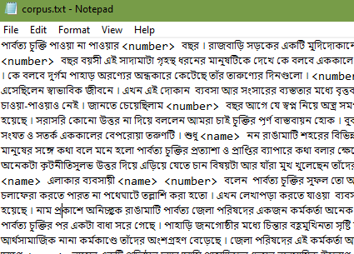
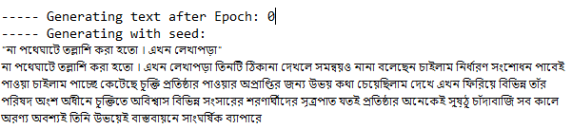
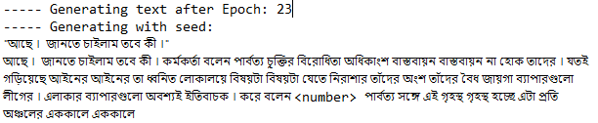
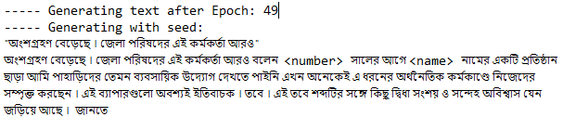
Automatic Bengali News Generation – Sample Input - Output
Sample Input (Clean)
Output after epoch: 0, 23, 49

Slide 6
Automatic Bengali News Generation – References
Related Works:
Automatic Text Generation in Macedonian Using Recurrent Neural Networks (Springer Nature Switzerland, August 2019)
Dataset 1: News article collection of 2.5 Million words
Dataset 2: Macedonian poetry consisting of 7k+ words
Generated News Articles and Poems using various techniques and compared performance
https://github.com/enriqueav/lstm_lyrics
Word-level LSTM text generator to create Automatic Song Lyrics with Neural Networks
Dataset: 5k lyrics of Mexican Banda Music with ~ 5 Million characters

