Slide 1
A Project Progress Report on ”Automatic Bengali News Generation”
Machine Learning (MS - CSE 533)
North South University
Presented by:
Mohammad Minhazul Alam (St. ID: 1935 365 650)
S.M. Shahadat Hossain (St. id: 1935 190 650)

Slide 2
Automatic Bengali News Generation – Overview
Goal: Automatically generate a piece of news article from a corpus of articles
Figure: Sample Architecture for Text Generation
with LSTM Network
Seed
LSTM
Clean Data
Tokenized Data
Output
Raw Data
LSTM
LSTM
LSTM
Generated Document

Slide 3
Automatic Bengali News Generation – Submitted Work
Figure: Bengali Text Generation with Word2Vec & LSTM
Network – Submitted Project
Seed
LSTM
A Corpus of 41 Bengali News Articles
Cleaned and Tokenized
Word2Vec Embedded
Output Sampling
LSTM
LSTM
LSTM
Generated Document

Slide 4
Automatic Bengali News Generation – Future Target
 | Current Work | Future Target
1. | Corpus: Currently contains 12,514 words | Want to train a corpus of at least 1 Million words
2. | Small Corpus: poor Word2Vec mapping Used dimension size: 500 (3.3k unique words) High dimension resulted in over fitting Low dimension results in low accuracy | Have to collect bigger corpus to increase accuracy and generalization without over fitting the training data
3.
4. | Testing done with human eye | Will try K-fold cross validation

Slide 5
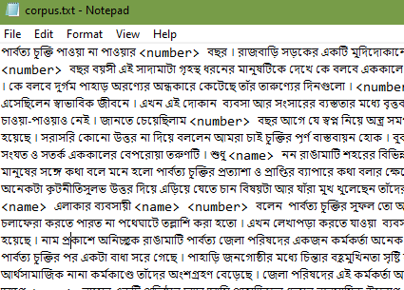
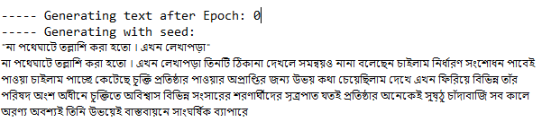
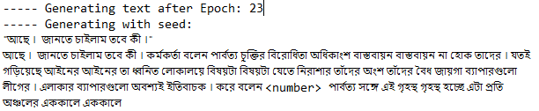
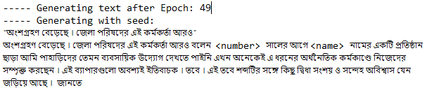
Automatic Bengali News Generation – Sample Input - Output
Sample Input (Clean)
Output after epoch: 0, 23, 49

Slide 6
Automatic Bengali News Generation – References
Related Works:
Automatic Text Generation in Macedonian Using Recurrent Neural Networks (Springer Nature Switzerland, August 2019)
Dataset 1: News article collection of 2.5 Million words
Dataset 2: Macedonian poetry consisting of 7k+ words
Generated News Articles and Poems using various techniques and compared performance
https://github.com/enriqueav/lstm_lyrics
Word-level LSTM text generator to create Automatic Song Lyrics with Neural Networks
Dataset: 5k lyrics of Mexican Banda Music with ~ 5 Million characters

