Slide 1
A Project Progress Report on ”Automatic Bengali News Generation”
Machine Learning (MS - CSE 533)
North South University
Presented by:
Mohammad Minhazul Alam (St. ID: 1935 365 650)
S.M. Shahadat Hossain (St. id: 1935 190 650)

Slide 2
Automatic Bengali News Generation – Our Work
Figure: Bengali Text Generation with Word2Vec & LSTM
Network – Submitted Project
Seed
LSTM
A Corpus of 41 Bengali News Articles
Cleaned and Tokenized
Word2Vec Embedded
Output Sampling
LSTM
LSTM
LSTM
Generated Document

Slide 3
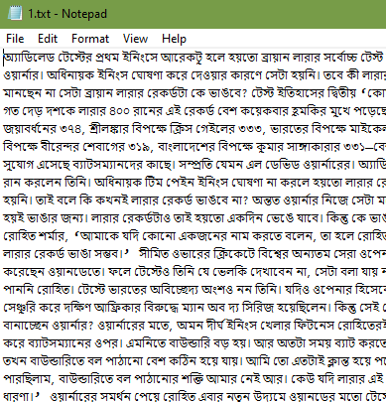
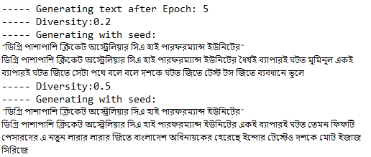
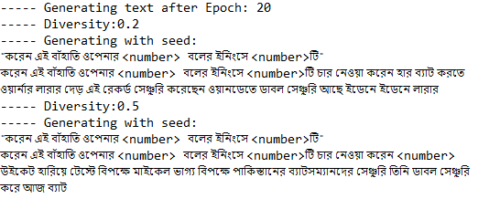
Automatic Bengali News Generation – Sample Input - Output
Sample Input
Output after epoch: 5, and 20

Slide 4
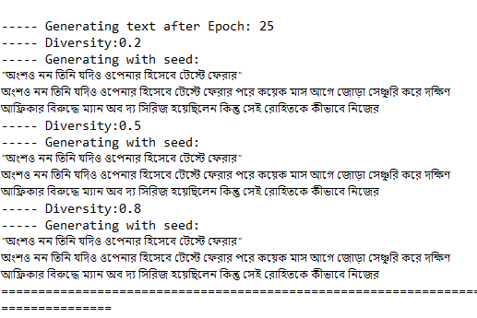
Automatic Bengali News Generation – Output Analysis
Increase of Training Accuracy per epoch
Over fitting after epoch 25 – Diversity value has no effect

Slide 5
Automatic Bengali News Generation – Future Target
 | Current Work | Future Target
1. | Corpus: Currently contains 12,514 words | Want to train a corpus of at least 1 Million words
2. | Small Corpus: poor Word2Vec mapping Used dimension size: 500 (3.3k unique words) High dimension resulted in over fitting Low dimension results in low accuracy | Have to collect bigger corpus to increase accuracy and generalization without over fitting the training data
3. | Memorizing the data set after some epochs | With a fairly large data set, will try to generalize the learning and then generate words with high temperature (diversity value)
4. | No Test data set maintained | Will try K-fold cross validation

Slide 6
Automatic Bengali News Generation – References
Related Works:
Automatic Text Generation in Macedonian Using Recurrent Neural Networks (Springer Nature Switzerland, August 2019)
https://github.com/enriqueav/lstm_lyrics (Word-level LSTM text generator to create Automatic Song Lyrics with Neural Networks)
https://pynlp.wordpress.com/2013/12/10/unit-5-part-ii-working-with-files-ii-the-plain-text-corpus-reader-of-nltk/
https://rare-technologies.com/deep-learning-with-word2vec-and-gensim/
https://intellipaat.com/community/12732/using-pre-trained-word2vec-with-lstm-for-word-generation
https://github.com/cogniinsight/Word-embedding-model-for-Bangla
Tried Transfer Learning from their word2vec model, but not successful

Slide 7
Our GitHub Repo:
https://github.com/minhazul-alam/News_Gen/tree/master/Minhaz_Shahadat
Thank You!

