Slide 1
COMPUTATIONAL GEOMETRY · CASE STUDY
Evaluating Utility-Service Accessibility
in Dhaka City using Voronoi Diagrams
Partitioning the city by nearest facility to measure service coverage — and to locate, quantitatively, where a new facility would help most.
6 services · 75 facilities · 217 km² | Group members: ________________

Slide 2
PROBLEM & OBJECTIVE
Why measure accessibility?
The problem
Dhaka is one of the world's densest cities and its utility services have grown unevenly. Some neighbourhoods reach a hospital, metro or fire station within a few hundred metres; others travel several kilometres.
Objective
Evaluate the spatial accessibility of utility services in Dhaka using Voronoi diagrams, identify well-served vs underserved areas, and recommend where new facilities should be added.
The idea in one line
A Voronoi diagram assigns every point to its
nearest facility.
So its cells are the service catchments, and the distance to the cell's facility is the travel burden a resident bears.
Voronoi Accessibility Analysis · Dhaka City
02

Slide 3
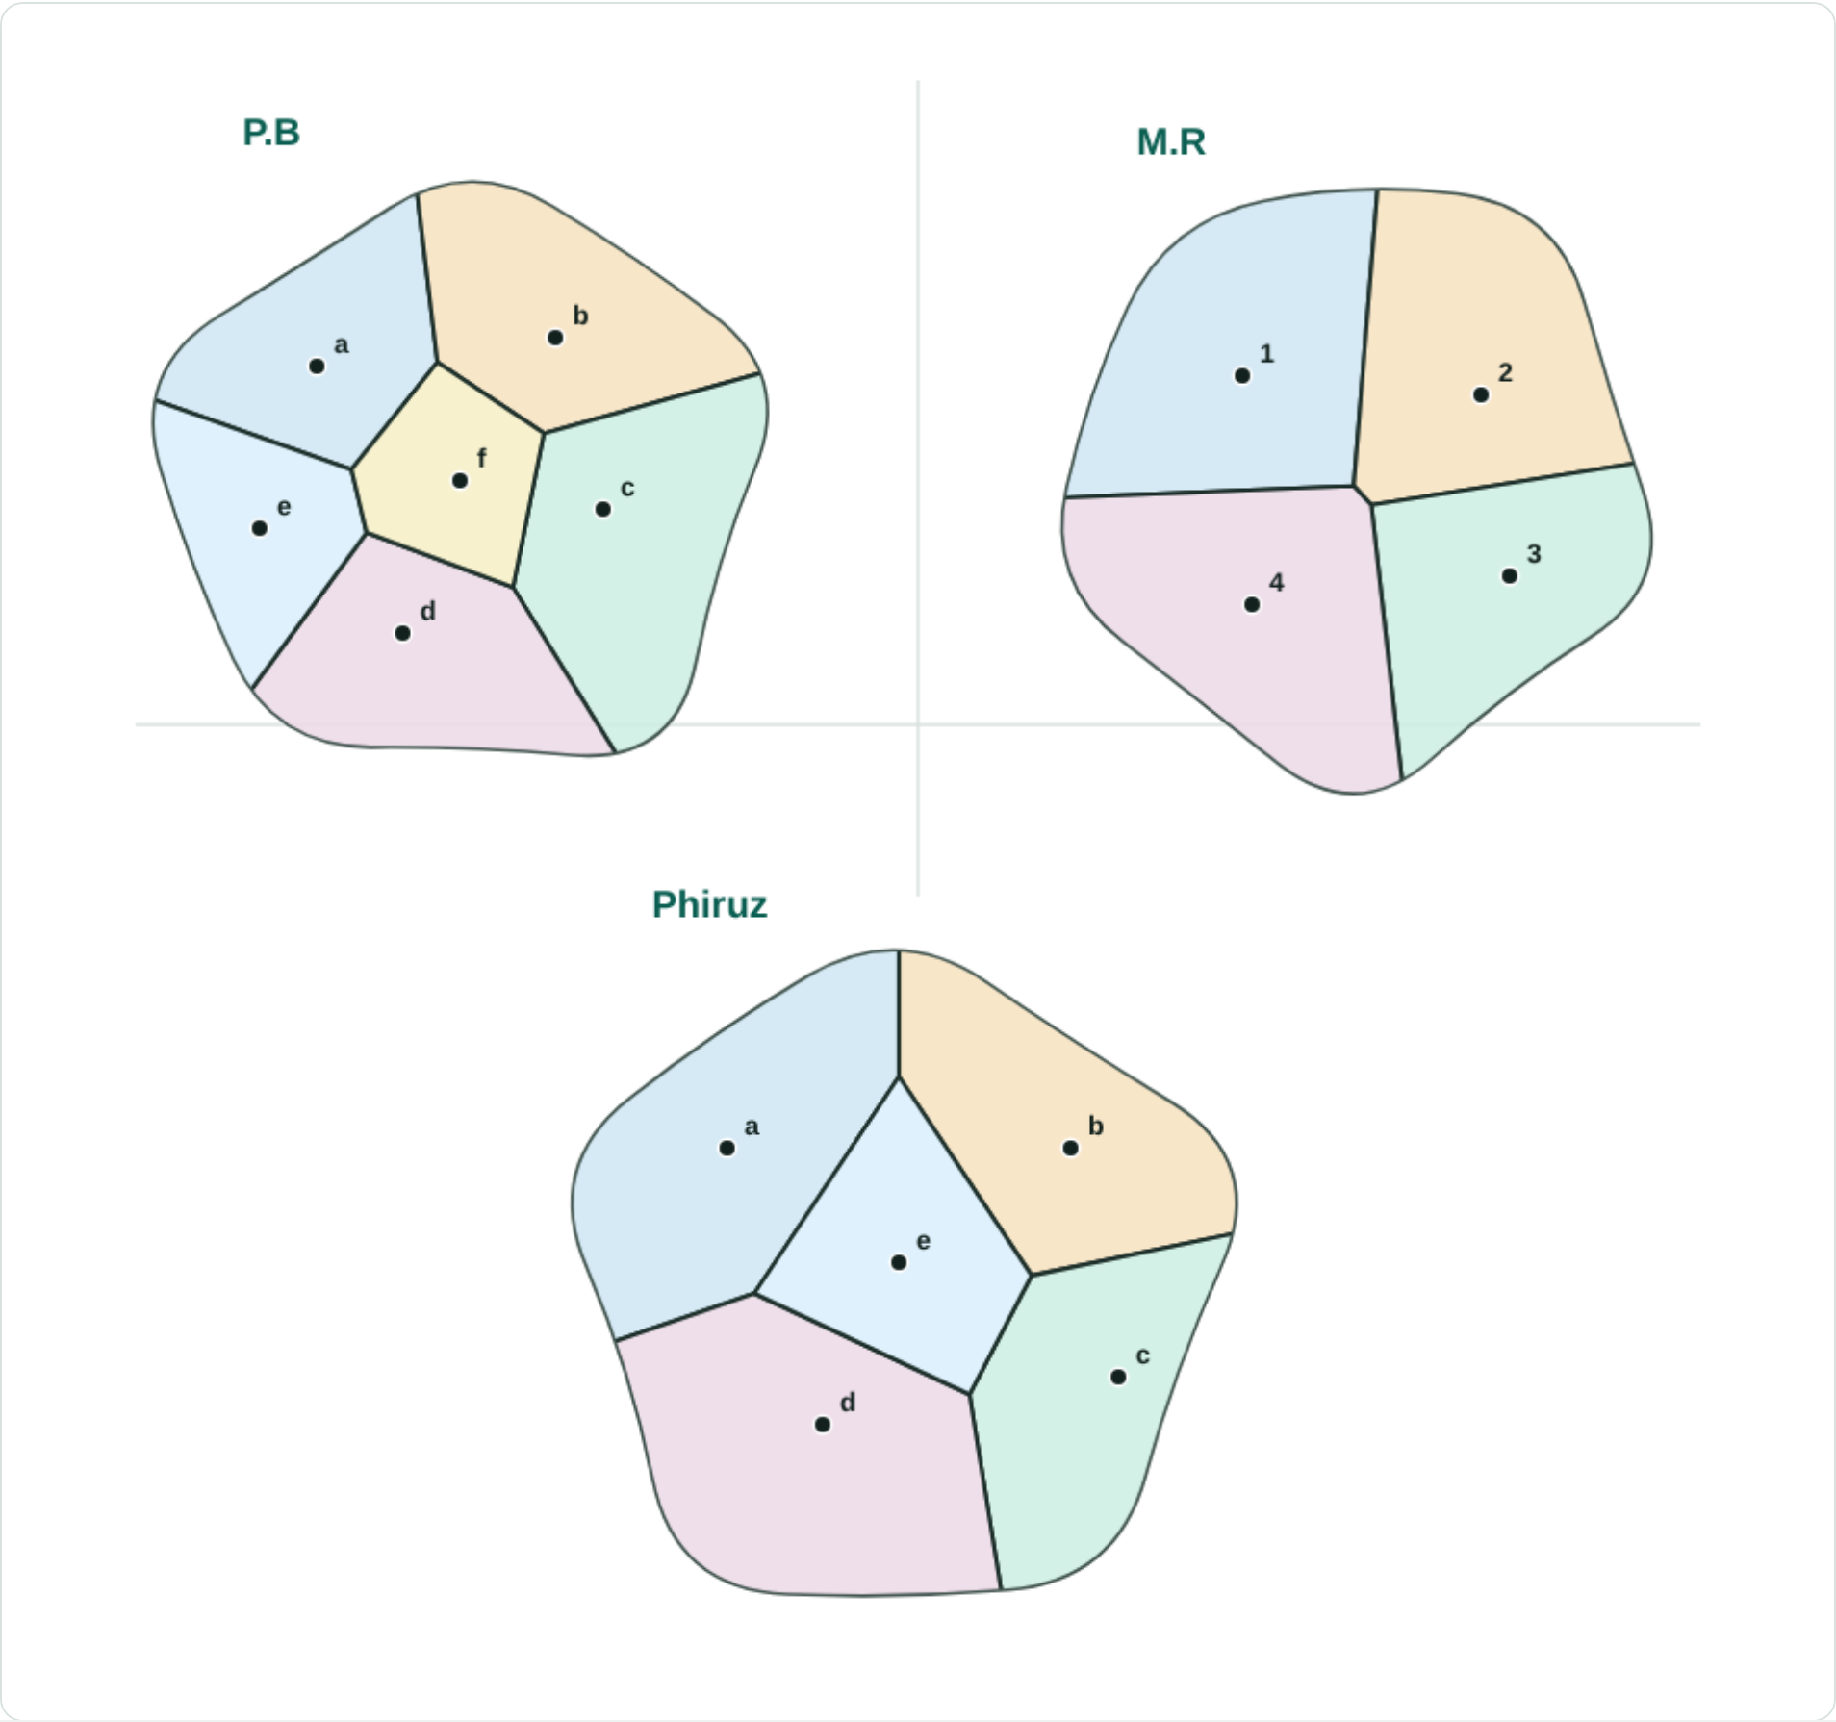
CONCEPT
What is a Voronoi diagram?
Given a set of points (seeds), the plane is split into cells: every location belongs to the cell of its nearest seed.
Done properly (Euclidean distance):
• each boundary is the perpendicular bisector of two seeds — a straight line
• exactly three cells meet at each vertex
• one seed per cell
This is exactly the geometry of “which facility is closest” — the natural tool for accessibility.
Voronoi Accessibility Analysis · Dhaka City
03

Slide 4
CONSTRUCTION
From freehand sketch to a proper diagram
The three hand-drawn sketches, reconstructed as geometrically exact Voronoi diagrams — straight bisector edges, correct vertices, one seed per cell.
Voronoi Accessibility Analysis · Dhaka City
04

Slide 5
METHOD
How the analysis works
1
2
3
4
Collect points
Tessellate
Score access
Recommend
Approximate longitude/latitude of every facility, per service, across Dhaka.
Assign every point in the city to its nearest facility — the Voronoi partition (a fine distance raster over the city boundary).
Distance-to-nearest-facility (km) per location → mean / median / worst access and the share of the city beyond a threshold.
Greedy largest-empty-circle: place new sites where the current gap is largest.
Projection: equirectangular about 23.78°N (1° lat ≈ 110.6 km, 1° lon ≈ 101.9 km). Distances are straight-line.
Voronoi Accessibility Analysis · Dhaka City
05

Slide 6
STUDY AREA & DATA
Six services, 75 facilities across 217 km²
Service | Facilities | Notes
Metro (MRT-6) | 16 | Line-6 stations, Uttara North → Motijheel
Hospitals | 15 | Major general & specialist hospitals
Water (WASA) | 10 | Treatment plants & zonal points
Fuel / CNG | 12 | Filling & CNG stations
Bus stops | 14 | Terminals & major stops
Fire stations | 8 | Fire Service & Civil Defence
Data note
Coordinates are hand-compiled approximations for a methodological case study — not an official register.
Distances are straight-line, not road-network.
Voronoi Accessibility Analysis · Dhaka City
06

Slide 7
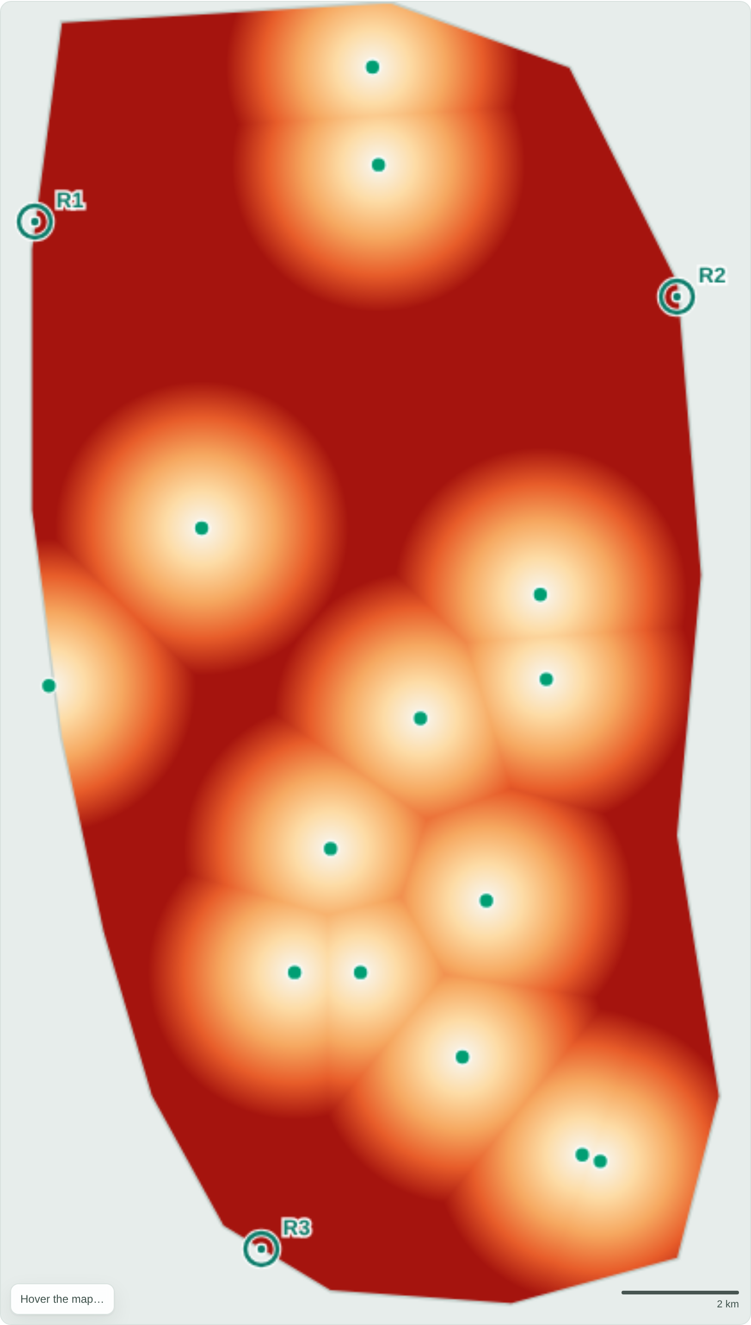
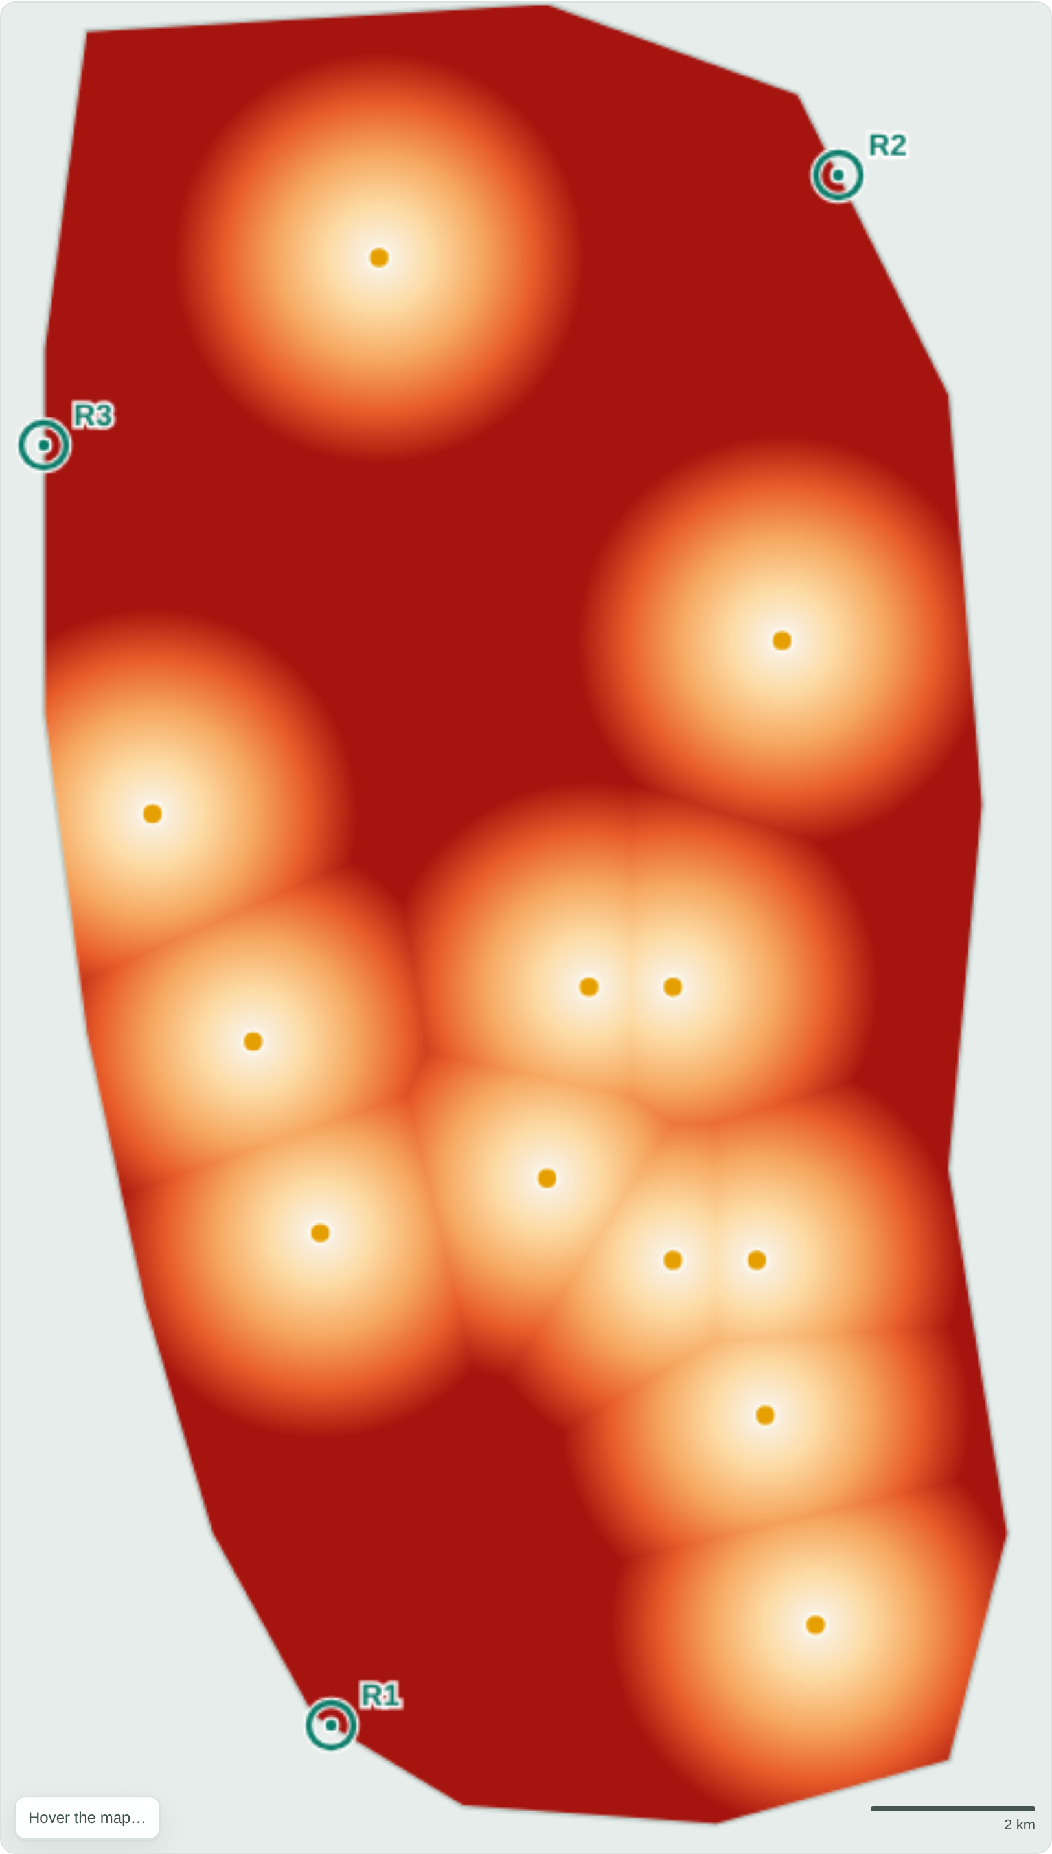
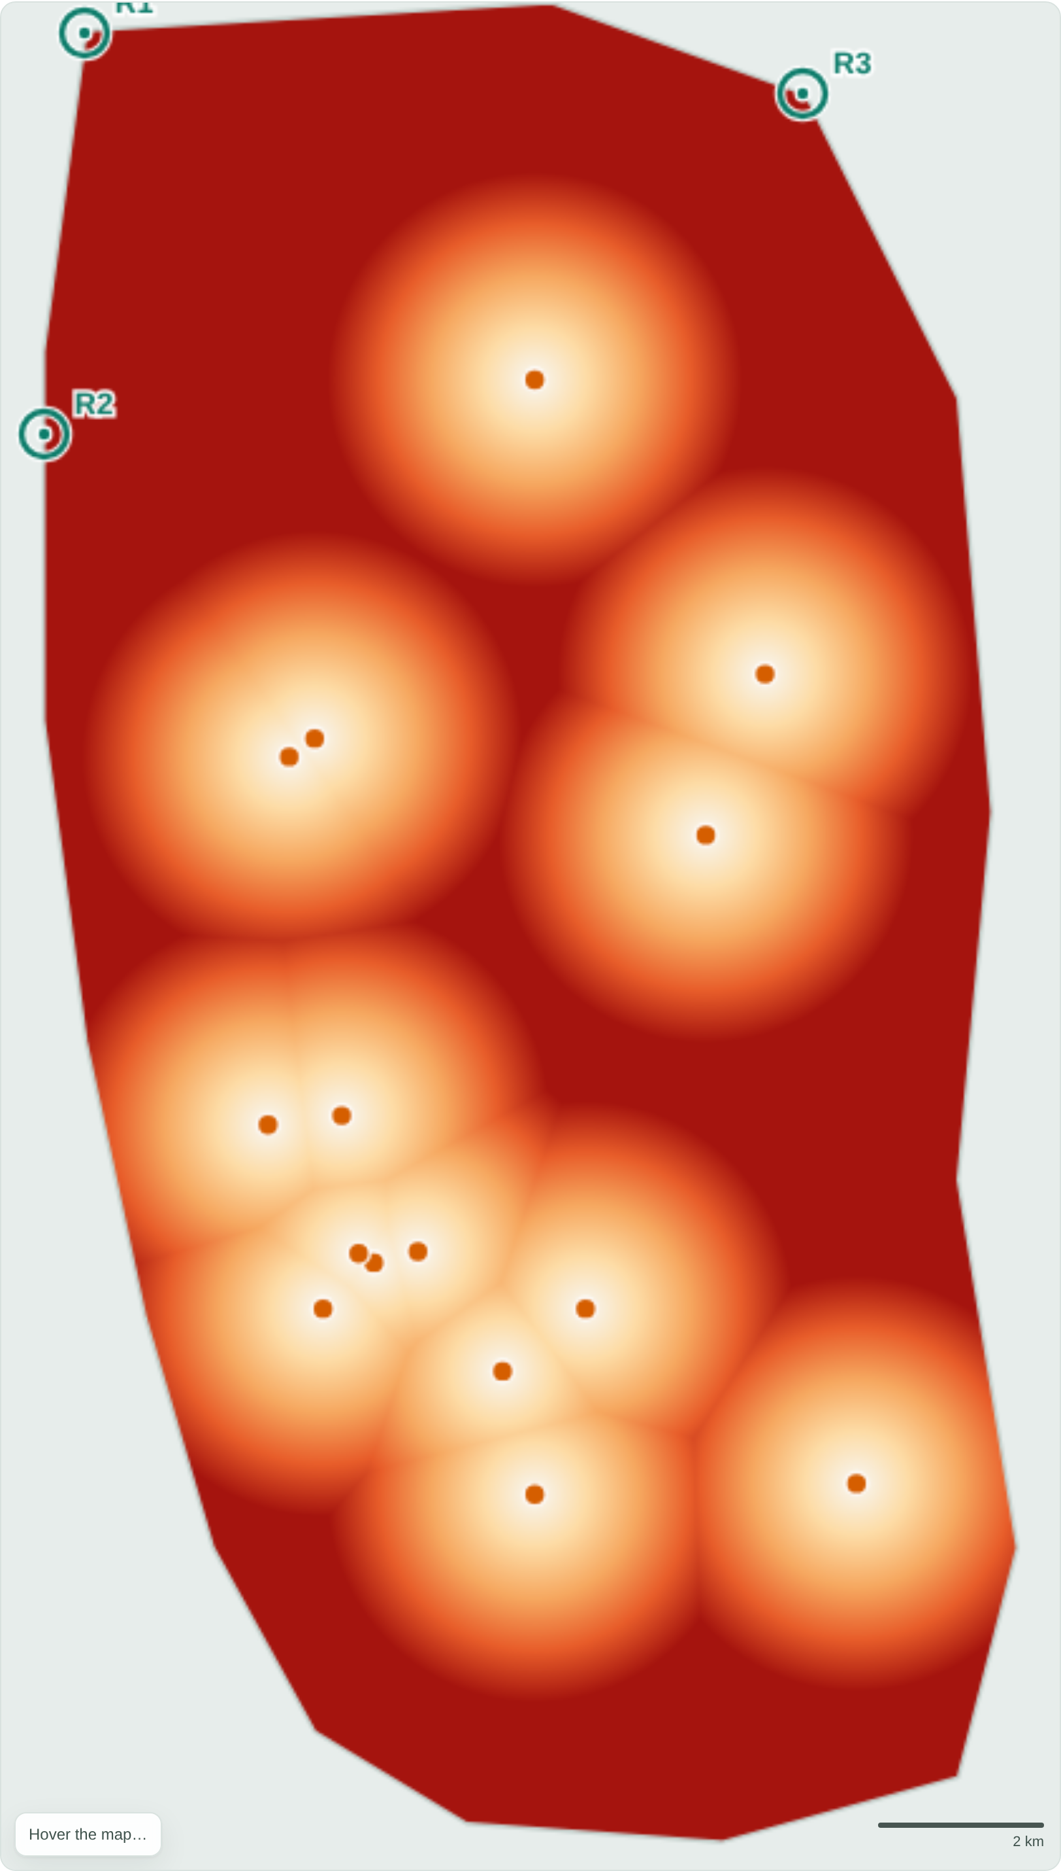
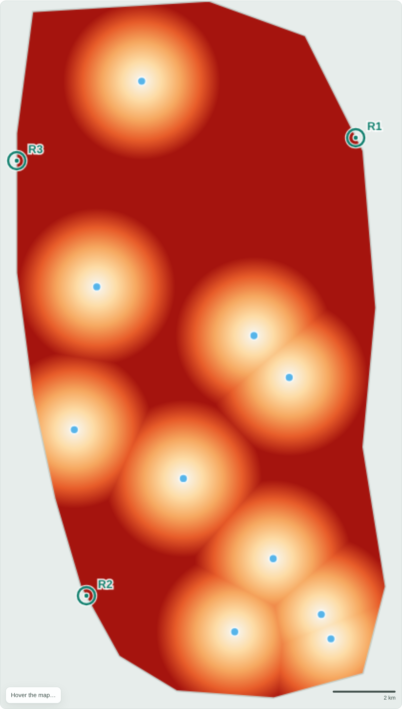
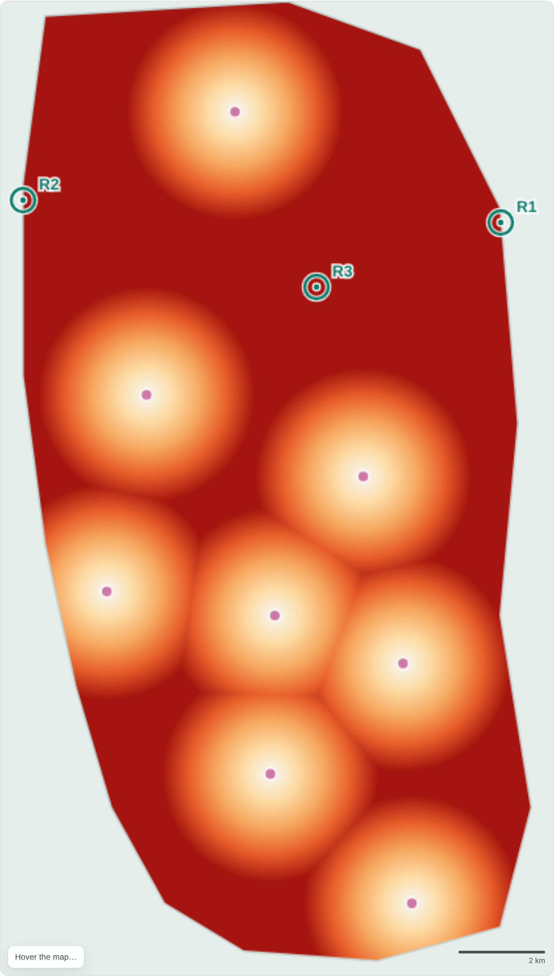
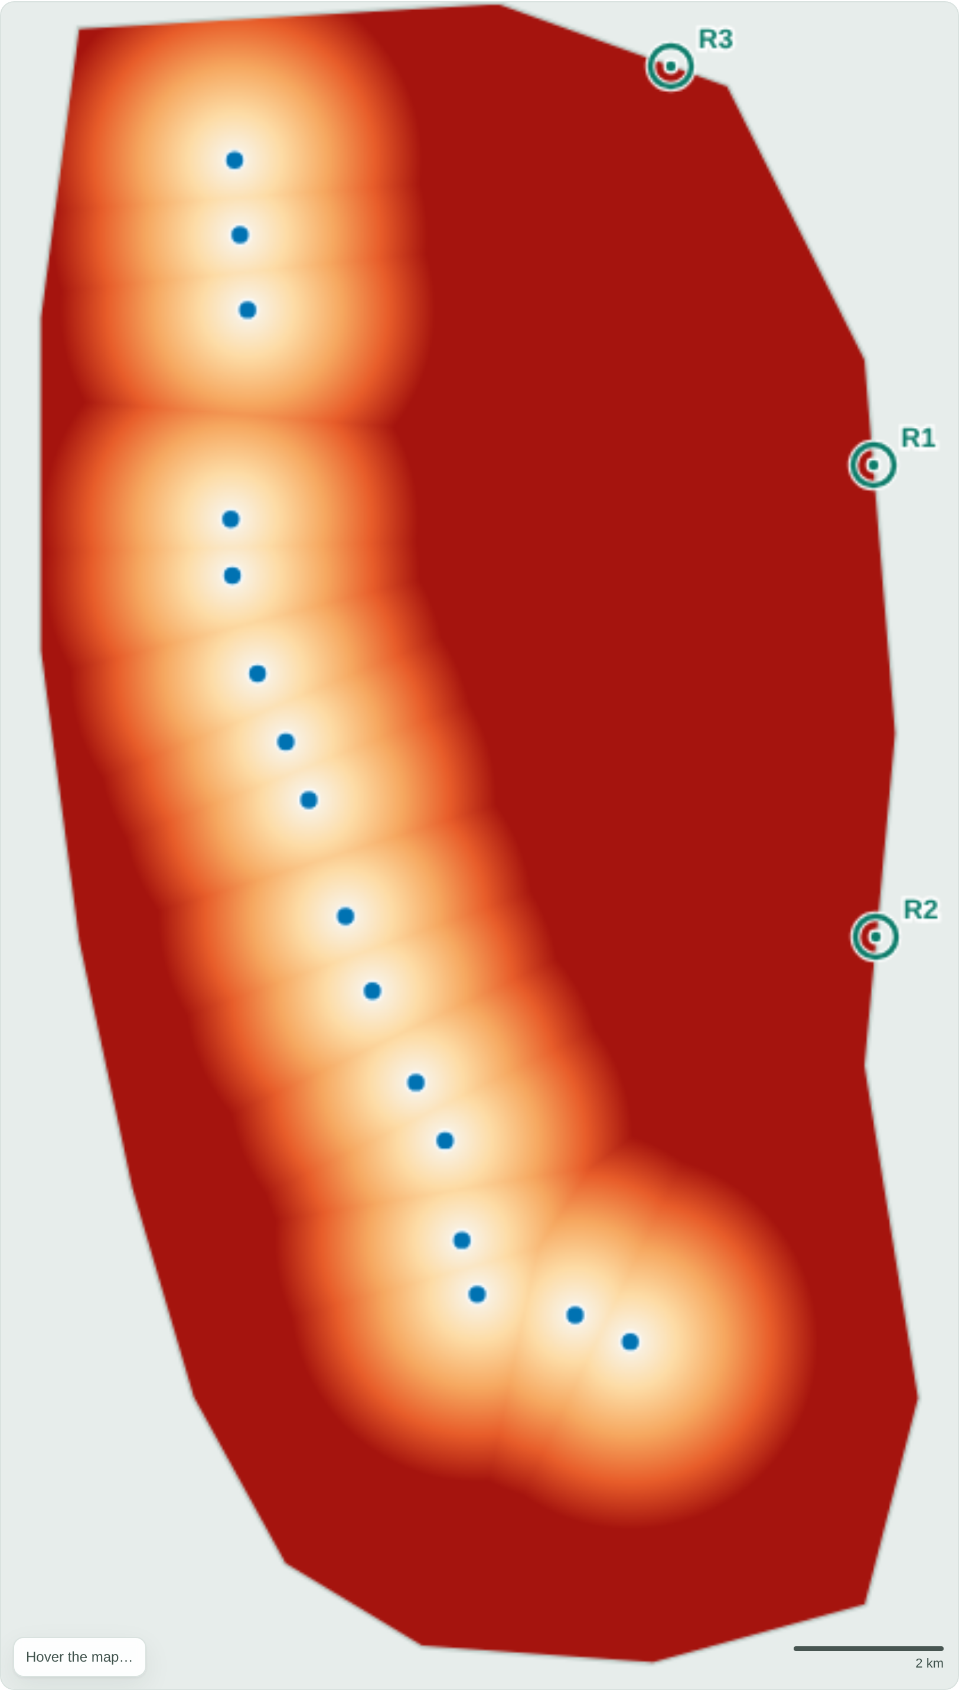
RESULTS
Coverage heatmaps — all six services
Bus
Fuel/CNG
Hospitals
Water
Fire
Metro
Light = close to a facility (well served); deep red = far (underserved). Teal rings = recommended new sites. The eastern & peripheral red zones recur across every service.
Voronoi Accessibility Analysis · Dhaka City
07

Slide 8
RESULTS
Accessibility, ranked by service
Service | Facilities | Mean km | Median km | Worst km | > 1.5 km
Bus stops | 14 | 2.15 | 2.01 | 5.91 | 66.0%
Fuel / CNG | 12 | 2.18 | 2.05 | 5.99 | 67.6%
Hospitals | 15 | 2.23 | 2.09 | 6.82 | 69.7%
Water (WASA) | 10 | 2.33 | 2.15 | 7.05 | 71.7%
Fire stations | 8 | 2.34 | 2.19 | 6.65 | 74.5%
Metro (MRT-6) | 16 | 2.92 | 2.57 | 8.60 | 73.4%
Key insight: the metro has the most facilities (16) yet the worst accessibility — its stations are collinear (a line), so the entire eastern half of the city falls far from any station.
Voronoi Accessibility Analysis · Dhaka City
08

Slide 9
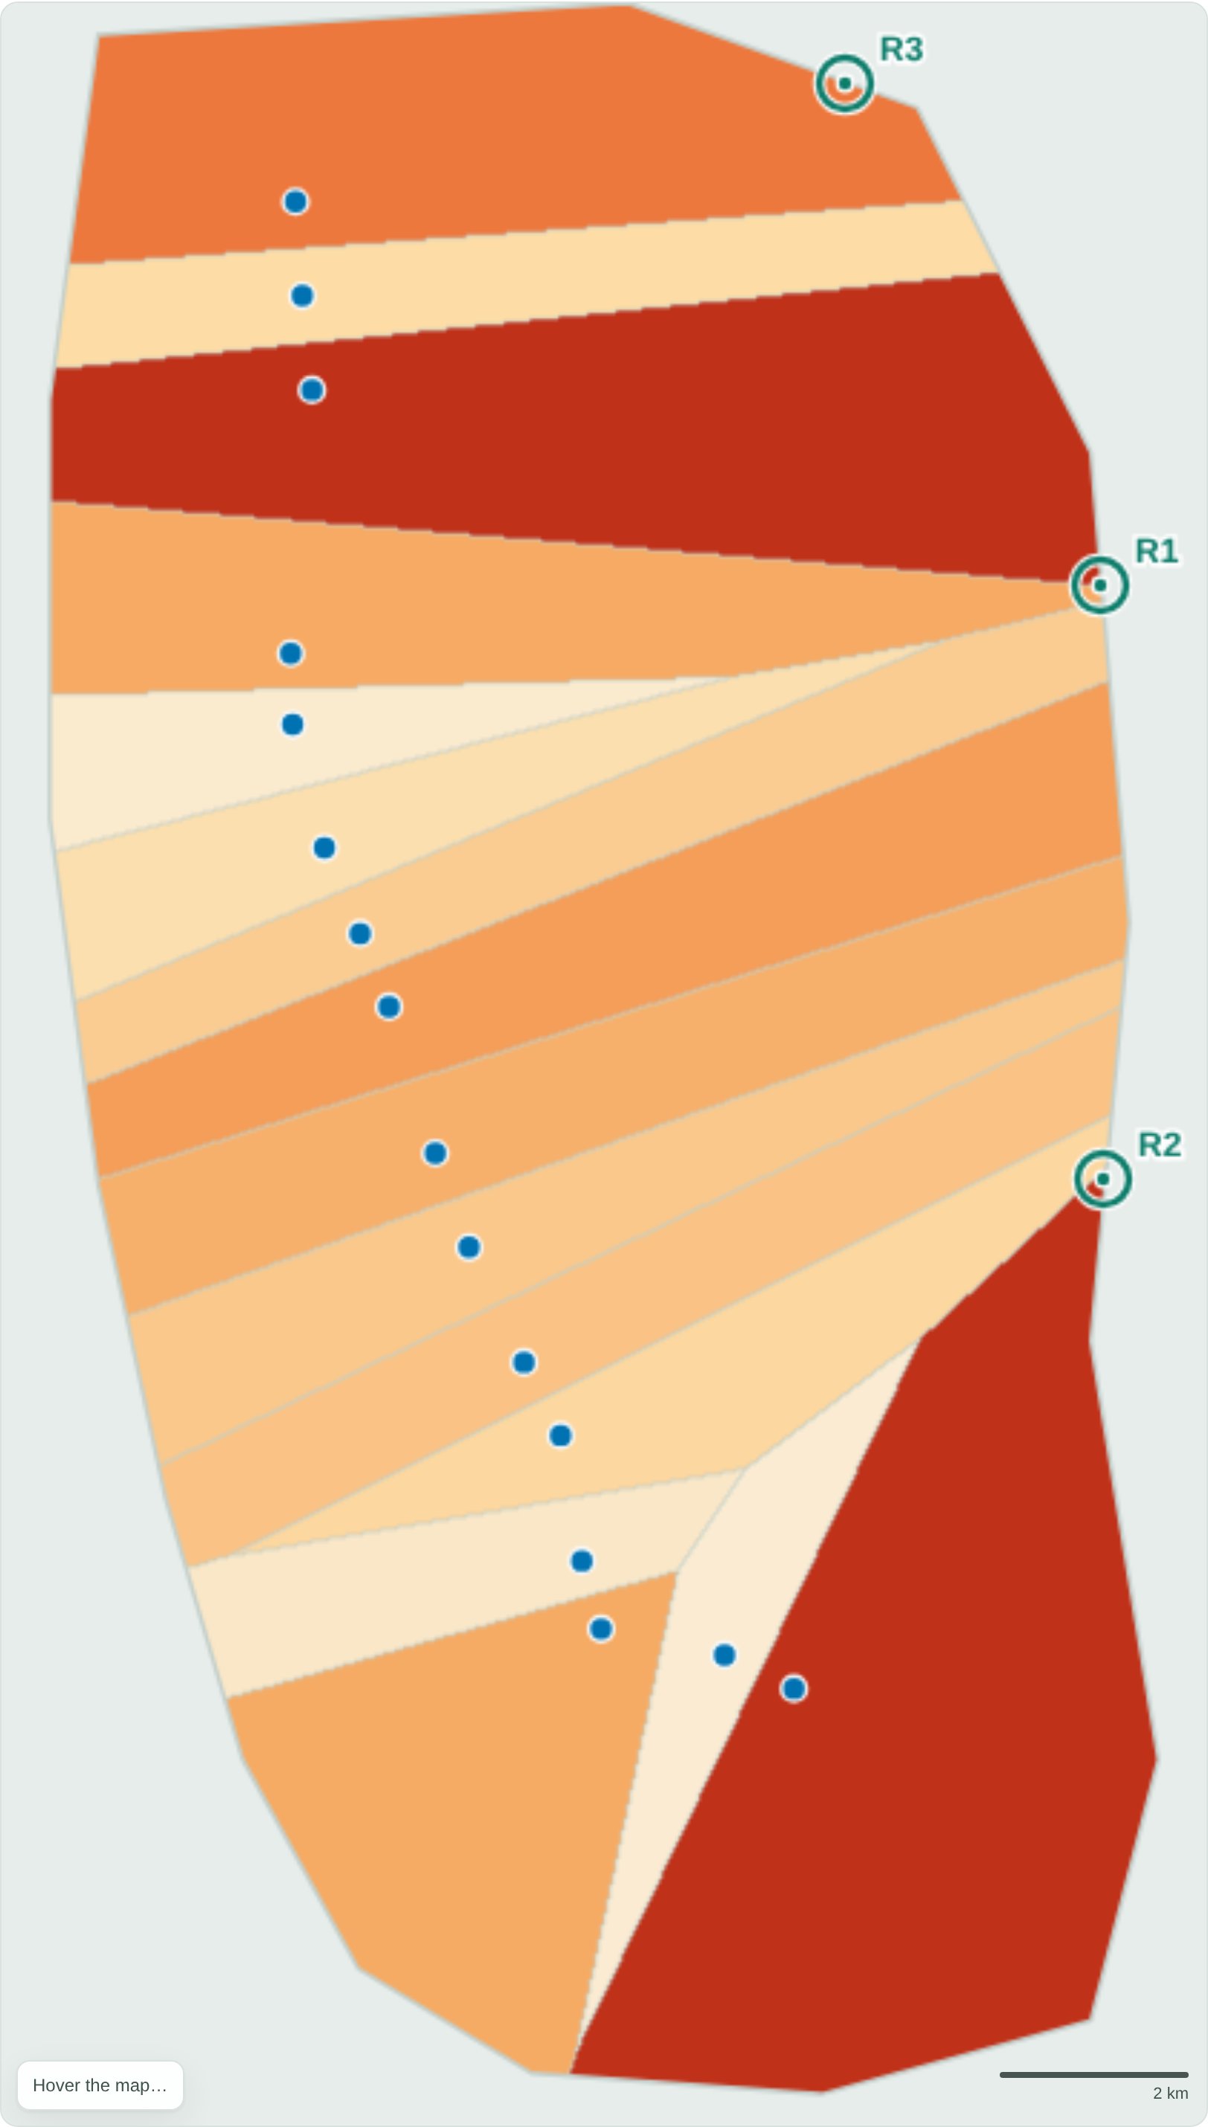
WORKED EXAMPLE
The metro coverage gap
The metro line hugs the west and centre. Its eastern Voronoi cells are the largest in the study — Gulshan, Badda and Bashundhara sit kilometres from any station.
Worst-served: 8.6 km from a station.
Coverage heatmap
Voronoi regions (by cell size)
Voronoi Accessibility Analysis · Dhaka City
09

Slide 10
FINDINGS
The same areas are underserved everywhere
Across all six services, 66–75% of the city lies more than 1.5 km from the nearest facility.
Consistently underserved:
• Eastern belt — Bashundhara, Vatara, Badda
• Northern fringe — Dakshinkhan, Uttarkhan, Abdullahpur
• North-west — Turag
• South-west — Kamrangirchar, Hazaribagh
Well served: the Motijheel–Shahbagh–Dhanmondi–Farmgate core, where every service clusters.
Voronoi Accessibility Analysis · Dhaka City
10

Slide 11
RECOMMENDATIONS
Where to build next
Service | Site 1 (gap km) | Site 2 | Site 3
Metro | Bashundhara (8.6) | Badda (6.3) | Dakshinkhan (6.0)
Hospitals | Turag (6.8) | Turag S (4.9) | Dakshinkhan (4.7)
Water | Dakshinkhan (7.1) | Kamrangirchar (4.8) | Turag (4.7)
Fuel / CNG | Kamrangirchar (6.0) | Dakshinkhan (5.7) | Turag (4.6)
Bus | Turag (5.9) | Bashundhara (5.6) | Kamrangirchar (4.7)
Fire | Bashundhara (6.7) | Turag (5.3) | Cantonment (4.5)
Priority zones (build once, help several)
Priority 1
Eastern belt — Bashundhara / Badda
Priority 2
Northern fringe — Dakshinkhan / Uttarkhan
Priority 3
Turag & Kamrangirchar
Voronoi Accessibility Analysis · Dhaka City
11

Slide 12
LIMITATIONS
What this analysis does not capture
Approximate data. Coordinates are hand-compiled, not surveyed; counts are representative. Conclusions are about method and pattern, not exact metres.
Straight-line distance. Real travel follows roads, rivers and congestion — Euclidean distance under-states true travel time.
Demand-blind. Weights area, not population. A population-weighted Voronoi is the natural next step.
Capacity-blind. Nearest ≠ adequate — a close but overloaded hospital still under-serves.
Voronoi Accessibility Analysis · Dhaka City
12

Slide 13
CONCLUSION
Voronoi diagrams turn a scatter of facilities
into a measurable map of who is underserved —
and where to build next.
• 66–75% of Dhaka is >1.5 km from the nearest facility of each service.
• The east (Bashundhara–Badda) and the northern/NW fringe are underserved across the board.
• Priority sites are identified for each service by the largest-empty-circle rule.
Interactive tool, report and data accompany this deck.

