Slide 1




INFO 445: Advanced DBMS Design
Gregory T. Hay January 16th 2018

Slide 2

Agenda
Announcements
Review
Control of Flow
Error Handling
CART Processing

Slide 3



Slide 4
Announcements
Quiz 1 on Thursday
No code
ERD challenge based on business scenario
Husky Tours will be presented in Lab

Slide 5
Announcements
Project status
Revised ERD due tomorrow
Proper PK/FK
3NF
Follow ‘ID, Name & Description’ template
Bring questions to office hours ☺

Slide 6
Announcements
Office hours
Wednesday evenings at 6:00 PM
We will practice for Quiz ☺
https://washington.zoom.us/j/386633611

Slide 7
Announcements
Project status
Begin thinking about stored procedures
Parameters
Variables
Explicit transaction
Error-handling
Sub-queries
Goal is to get 4 by end of quarter for each student

Slide 8
Announcements
Lab at 1:30
Practice on ERD
No deliverable

Slide 9
Announcements
Internship Opportunity
7 Spoons needs ~10 interns
Database modeling
Database development
Web development
Mobile development
Interviews tomorrow
Resume
Take survey

Slide 10

Questions?

Slide 11

Review: Error Handling
What is ‘error-handling’?
Why do we do it?
When do we do it?
How do we do it?

Slide 12
Error Handling Take-aways
Anticipate mistakes
People
Process
Code
Understand what will cause a transaction to fail
look to ensure those conditions do not exist

Slide 13
Error Handling Take-aways
Communicate
Let client know how/why/where there was failure
Assists in troubleshooting
** be aware of security concerns ☺

Slide 14
Error Handling Take-aways
Fail Early! Avoid doing extra work
Before transaction
Avoids affecting other transactions
‘cascading rollbacks’
Long-duration blocking

Slide 15

Questions?

Slide 16
How do we process M:M?
What are the challenges?

Slide 17
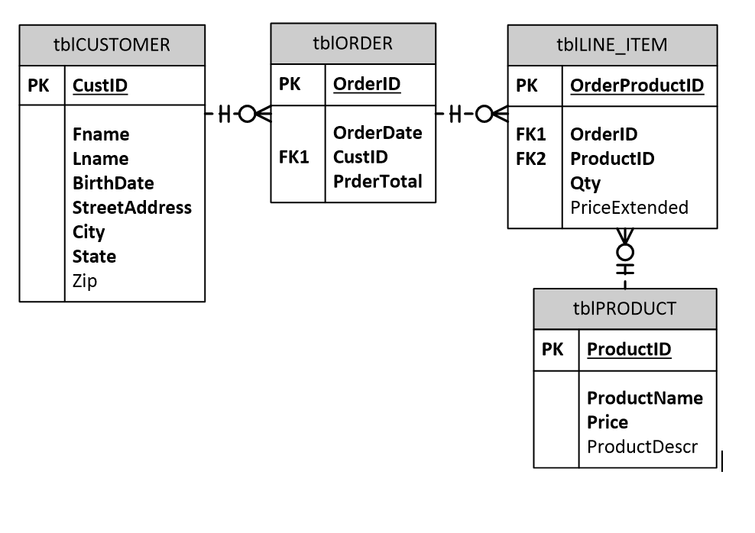

Slide 18
How do we process a new ORDER?
What are the challenges?
How do we keep the same OrderID across many rows in tblORDER_PRODUCT?
How do we allow users to add/drop same product at different times before checkout?
How do we persist browsing over months/years?
How do we maintain transactional integrity?

Slide 19
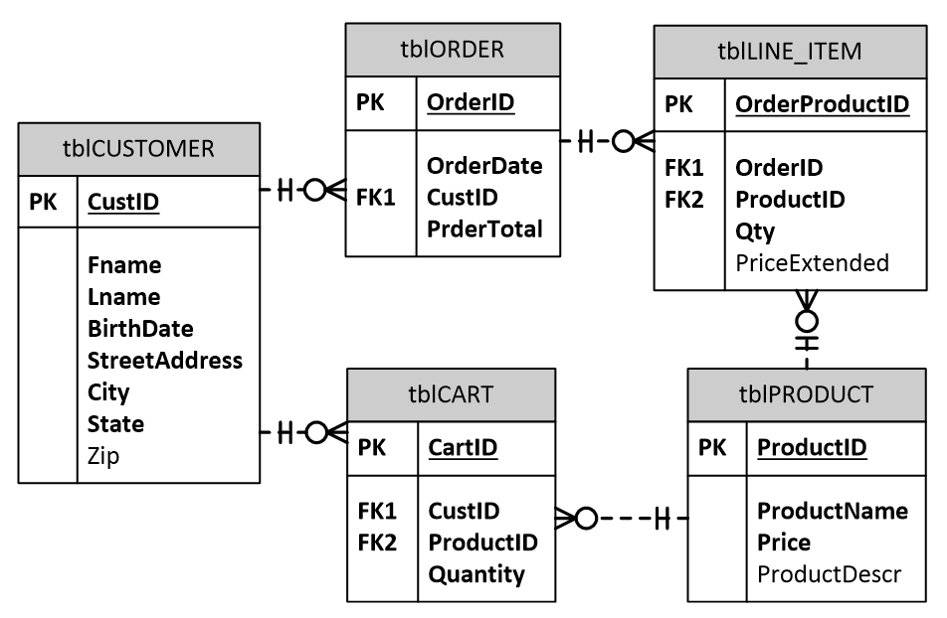

Slide 20

Let’s see a demo

Slide 21
Questions?

Slide 22
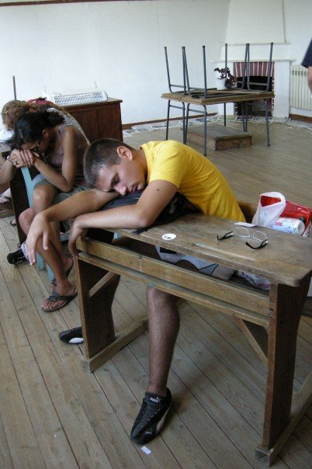

Break: 10-minutes

Slide 23
High Availability vs Scalability
What is the difference?

Slide 24

High Availability

Slide 25

Scalability

Slide 26



High Availability
High-Availability
Goal
Provide continuous use of mission-critical data
degrees of HA (NOT all or nothing)
99.9% = 8.7 hours of downtime/year
Measurement
Looks Alive
Is Alive

Slide 27

High Availability
Uptime
Ability to complete a transaction or read data
Measured in minutes\seconds per year
May include data loss and still be acceptable
Often includes ‘automatic failover’ but does not have to

Slide 28
High Availability
Scalability
Scale Up
Adding hardware to a single node
Upgrading to a larger node
Scale Out
Adding more nodes
Spreading the data and workload among them

Slide 29
High Availability
Throughput
Ability to add more users and\or work to an application
‘Transactions per second’
‘Concurrent users’

Slide 30
High Availability
Downtime
Can be planned or unplanned
Data Loss
Highly available does not rule out data loss
Acceptable depending on application needs

Slide 31
High Availability
Synchronous
Communications are serial
In database terms, transactions wait for commit confirmation
Asynchronous
Communications are parallel
Transactions do not wait for commit confirmation

Slide 32
Failover
Fault Tolerance
Ability of system to continue functioning after failure
Alleviates problems caused by component failures
disk subsystems (RAID)
symmetric multiple processors (SMP)
redundant power supplies with separate power sources
uninterruptible power supplies
redundant network adapters
Quorum
Used to determine ‘owner’ of Clusters and mirroring
Avoids ‘split-brain’

Slide 33

Questions?

Slide 34


Slide 35


