Slide 1



INF0 445: Adv. Database Management Lecture 11
Instructor: Greg Hay
February 27, 2018

Slide 2

Agenda
Announcements
Review
Maintenance
Monitoring

Slide 3



Slide 4
Announcements
Week 9
Last week of ‘new’ material scheduled
Database Administration
Monitoring
Optimization

Slide 5
Announcements
Week 10
Online
Lectures will be live on ZOOM
link will be posted

Slide 6
Announcements
Week 10
Troubleshooting Lab: Team 1 hour
Schedule with me anytime before March 8
4-5 synthetic transactions running at same time
500,000 + calls each

Slide 7

Questions?

Slide 8


Slide 9


NoSQL
Explain the motivations behind the development of NoSQL.

Slide 10
Maintenance
Explain the conditions outlined in lecture that make for successful database maintenance.

Slide 11
Questions?

Slide 12

Monitoring Databases
SQL Server Profiler
System monitor (“PerfMon”)
Activity Monitor
Task Manager
Brief intro into DMVs

Slide 13
Know Database Environment
Transactions
Data flow
Customers (internal and external)
Hardware
Database objects
Skills of DBA staff

Slide 14
Monitoring SQL Server
Plethora of Tools
SQL Server Profiler
System Monitor (‘PerfMon’)
Dynamic Management Views and Functions

Slide 15
High-Level Question
Why should I monitor SQL Server performance?

Slide 16
High-Level Answer
Why should SQL performance be monitored?
Monitoring SQL Server allows a DBA to proactively
address concerns before they escalate into customer
impacting issues

Slide 17
High-Level Question
What scenarios should SQL Server performance be monitored?

Slide 18
High-Level Answer
What scenarios should SQL Server performance be monitored?
when there is a performance issue within SQL Server
when there is NOT (benchmarking)

Slide 19
High-Level Question
How can I monitor SQL Server performance?

Slide 20
High-Level Answer
How can I monitor SQL Server performance?
SQL Server performance can be monitored with several
tools available with SQL Server as well as other 3rd-
party applications:
SQL Profiler
System Monitor
DMVs
DMFs

Slide 21
High-Level Question
What is SQL Profiler?

Slide 22
High-Level Answer
What is SQL Profiler?
SQL Profiler is a popular monitoring tool available with
SQL Server that allows viewing and capturing all
transactional activity in SQL Server

Slide 23
Working with SQL Server Profiler
Trace
Subsystem of SQL Profiler
Leverages external API
Flexibility in calling subsystem in addition to applying filters to data capture

Slide 24
Working with SQL Server Profiler
Defining a Trace
Have a plan!!
Data scope
Filters
Events and Data Columns
Start with a predefined template
Different scenarios have distinct template
Build a set of templates to capture info quickly

Slide 25
Working with SQL Server Profiler
Executing a Trace
Client-side
Incurs substantial resource overhead
Avoid if at all possible
Server-side
Less impactful to the server being monitored
Usually initiated via command line or script

Slide 26
Working with SQL Server Profiler
Saving a Trace
File
Greater flexibility in managing data output
Built-in function fn_trace_gettable allows converting multiple files in to single table
Table
Incurs substantial resource overhead
Avoid if possible

Slide 27
Working with SQL Server Profiler
Defining a Trace
Narrow data collection to fit purpose
Avoid collecting too much data
Apply filters

Slide 28
Working with SQL Server Profiler
Starting, Pausing and Stopping a Trace
Starting a Trace
Data begins to be collected
Pausing a Trace
Data collection is simply suspended
Easier to read data on screen
Stopping a Trace
Trace session is terminated

Slide 29
Working with SQL Server Profiler
Saving a Trace Log
Trace Definition
Create via GUI then save
Allows for a job to be created to run in SQL Agent
Trace Data
Able to save as XML as well

Slide 30
Working with SQL Server Profiler
Creating a Replay Trace
Synchronize with Database Backup
Exact transactions are captured to be replayed in sequence from a point in time
Synching backup allows most-accurate comparison
Can be code only or simulated replay (with delays)
SQL Server authentication due to inability to imitate a Windows user

Slide 31
Questions?

Slide 32


Break: 10-minutes

Slide 33

Demo: SQL Server Profiler

Slide 34
High-Level Question
What is System Monitor?

Slide 35
High-Level Answer
What is System Monitor?
System Monitor (a.k.a. ‘PerfMon’) is a Windows
O/S tool; it measures the consumption of
system resources with 100 of events
and counters

Slide 36
High-Level Question
When would I want to use System Monitor?

Slide 37
High-Level Answer
When would I want to use System Monitor?
System Monitor is the best tool to capture baseline
activity to measure ‘normal’ system behavior.
Also, when contention of resources
becomes an issue, System Monitor can
capture current consumption levels.

Slide 38
System Monitor
Correlate Transactional Activity
Tie resource consumption to events or code
Together with Profiler can provide full context of server state in response to specific queries

Slide 39
System Monitor
Capture data to a Counter Log
Required to fully analyze data
Only slight overhead when capturing more counters

Slide 40

Questions?

Slide 41
Demo: System Monitor

Slide 42
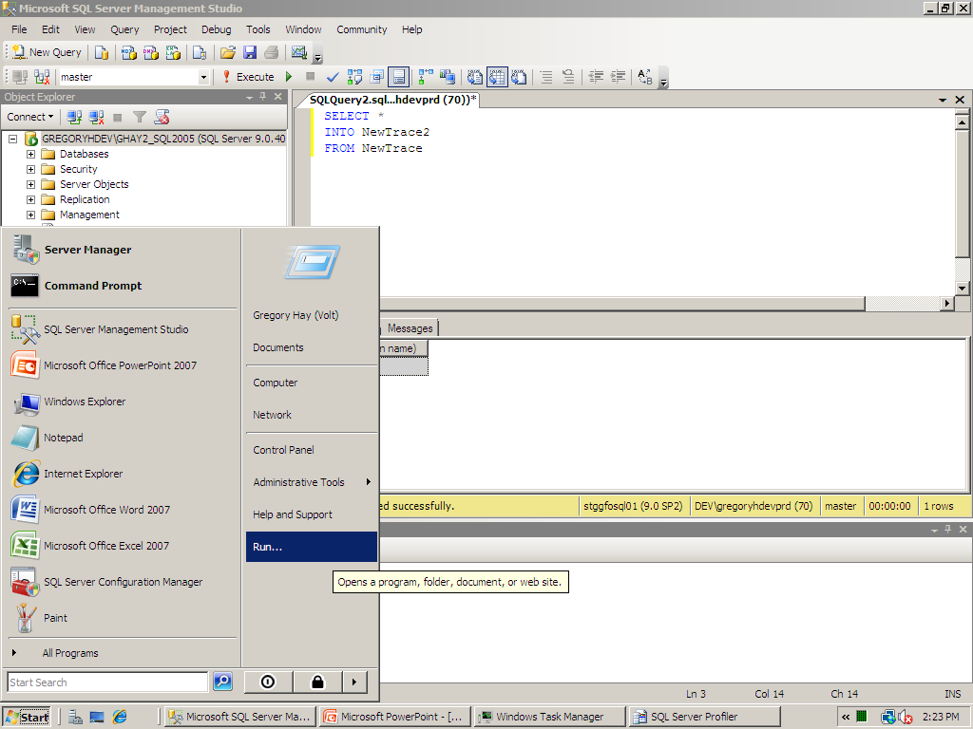

Slide 43
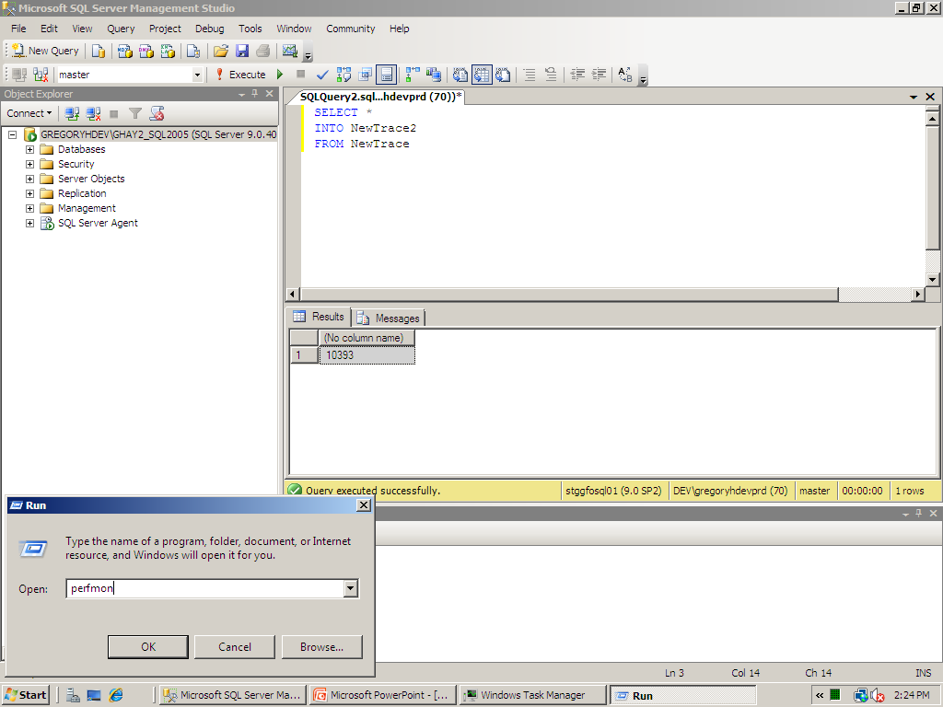

Slide 44
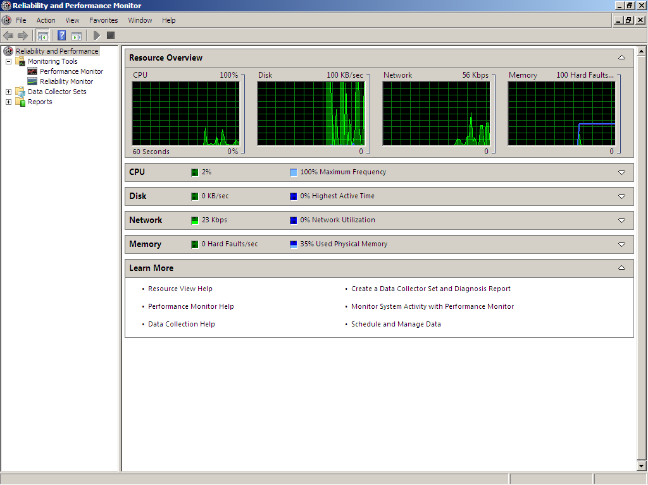

Slide 45
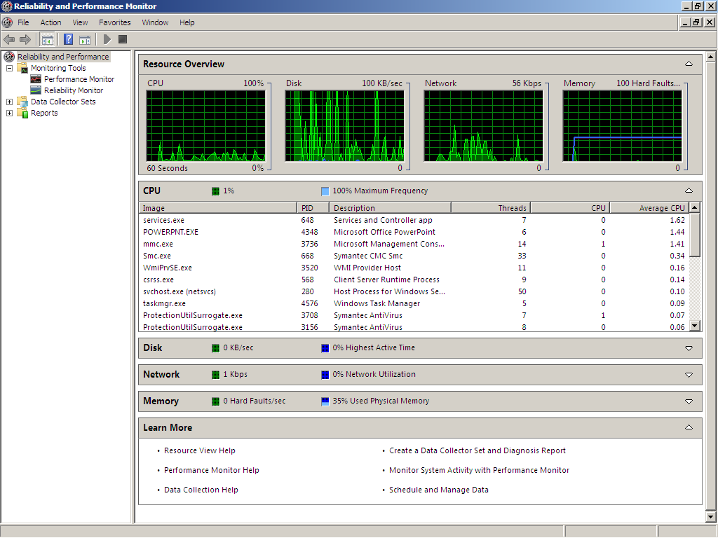

Slide 46
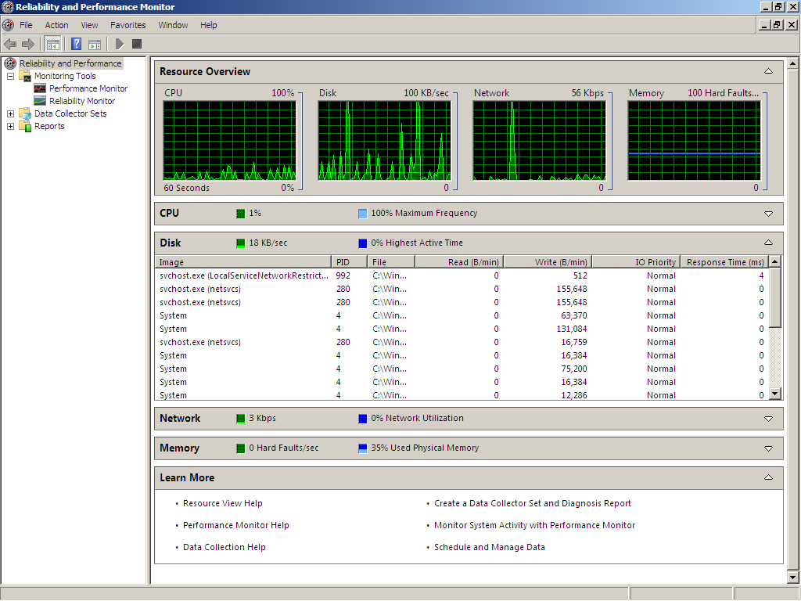

Slide 47
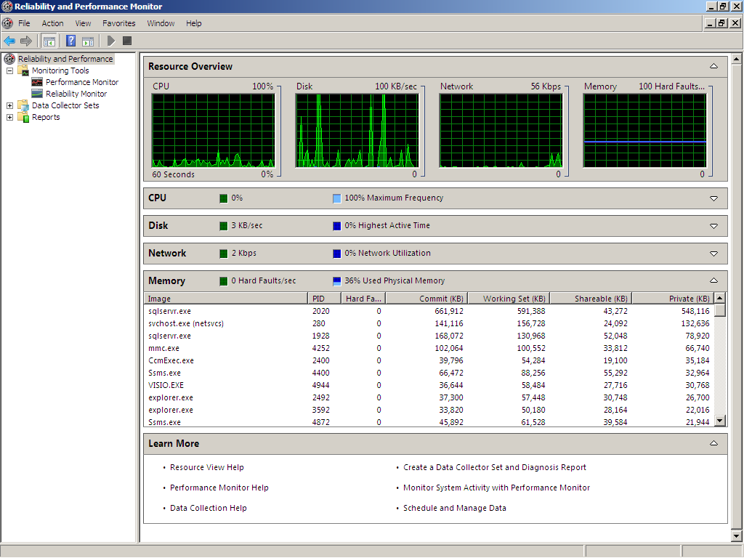

Slide 48
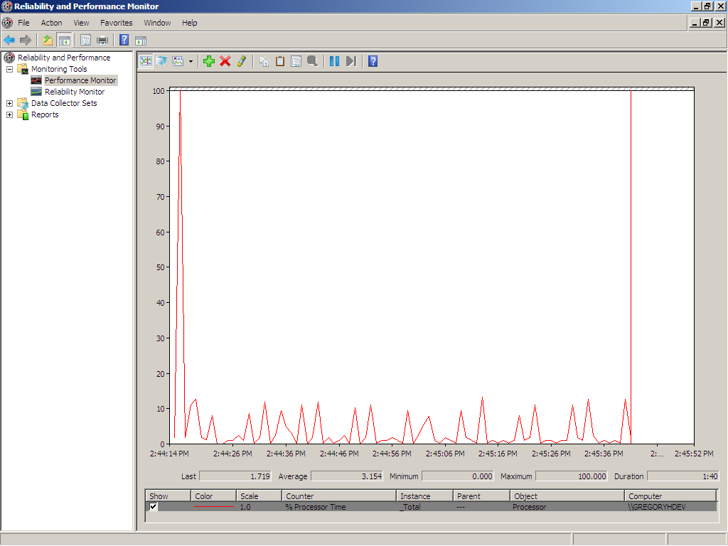

Slide 49
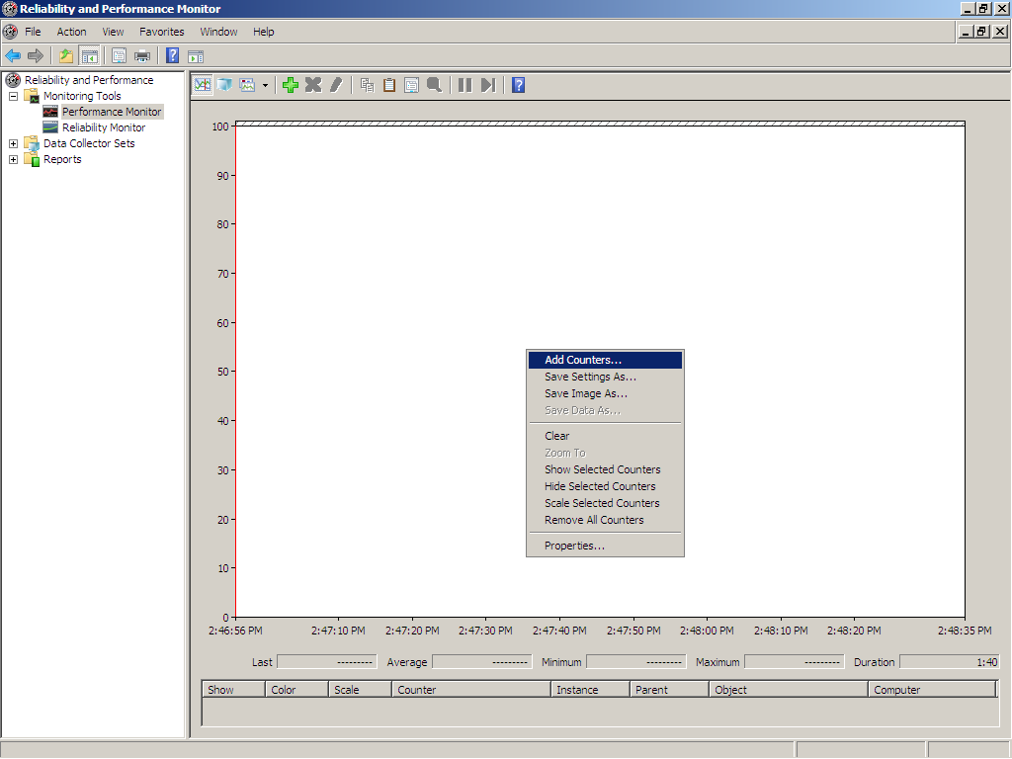

Slide 50
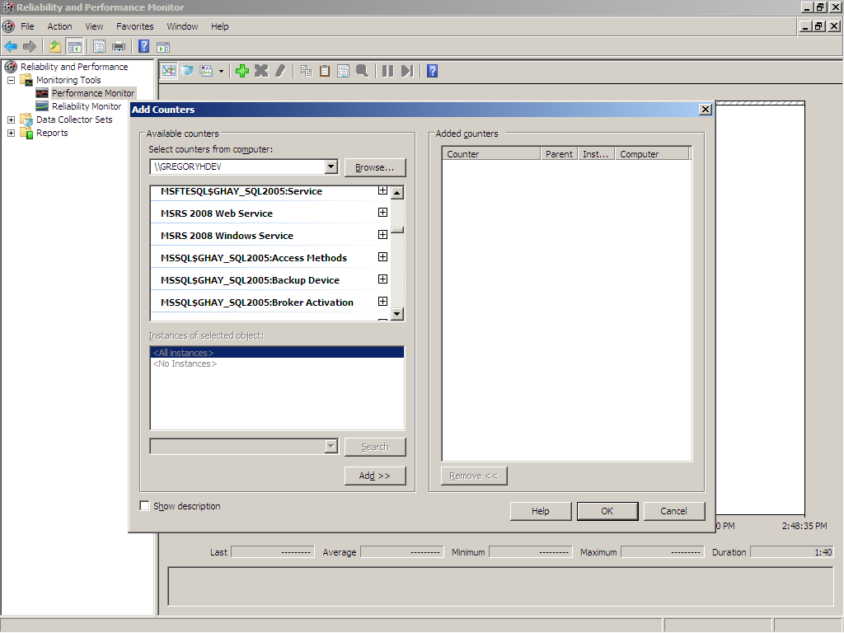

Slide 51
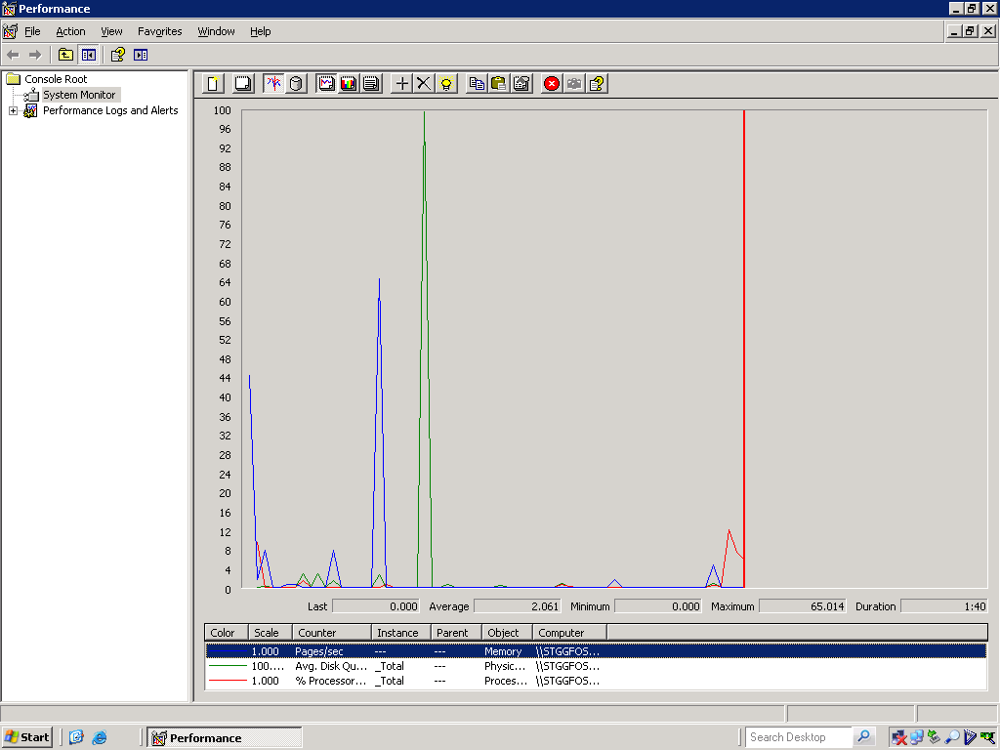

Slide 52
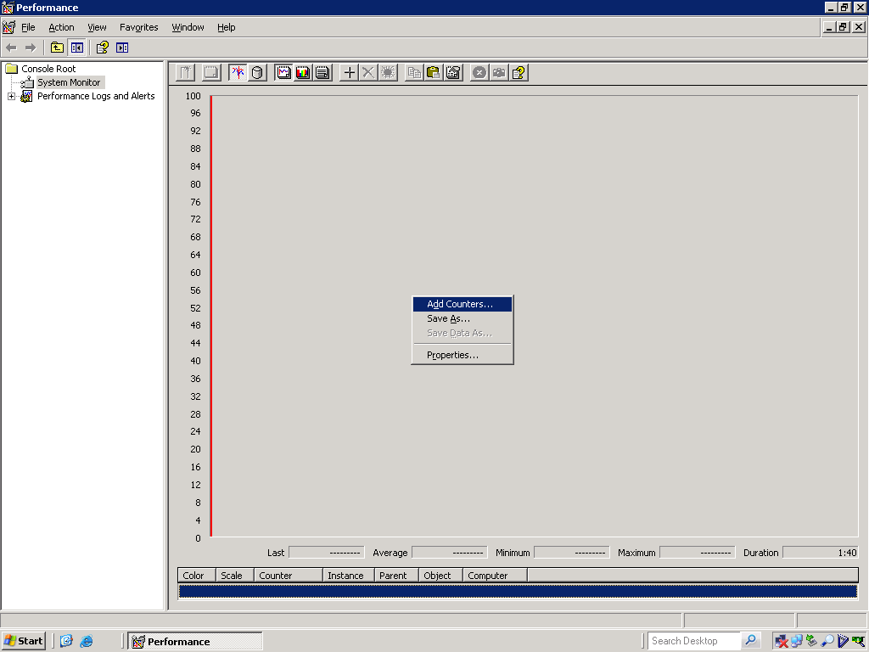

Slide 53
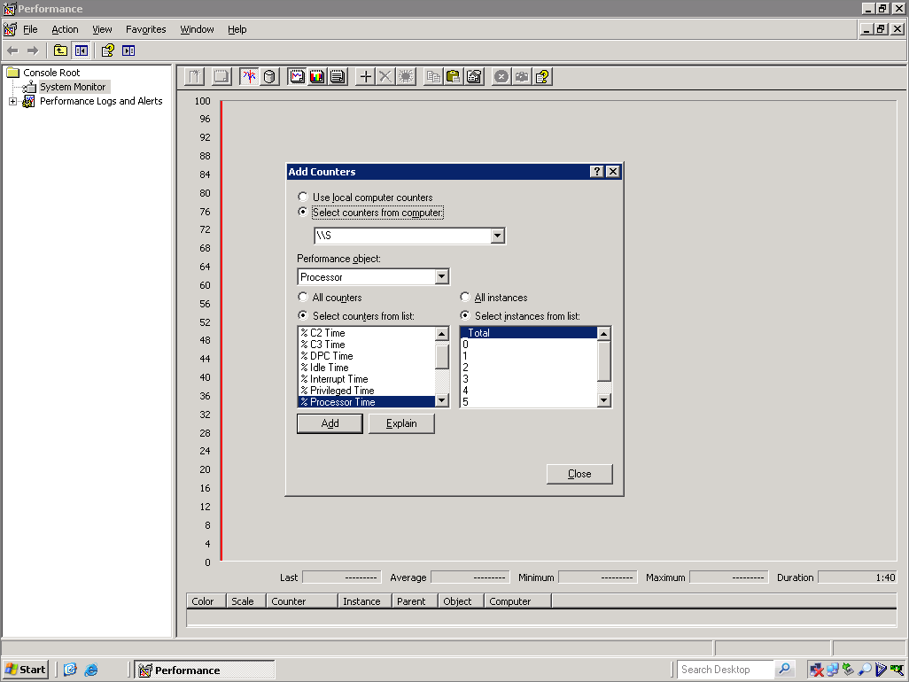

Slide 54
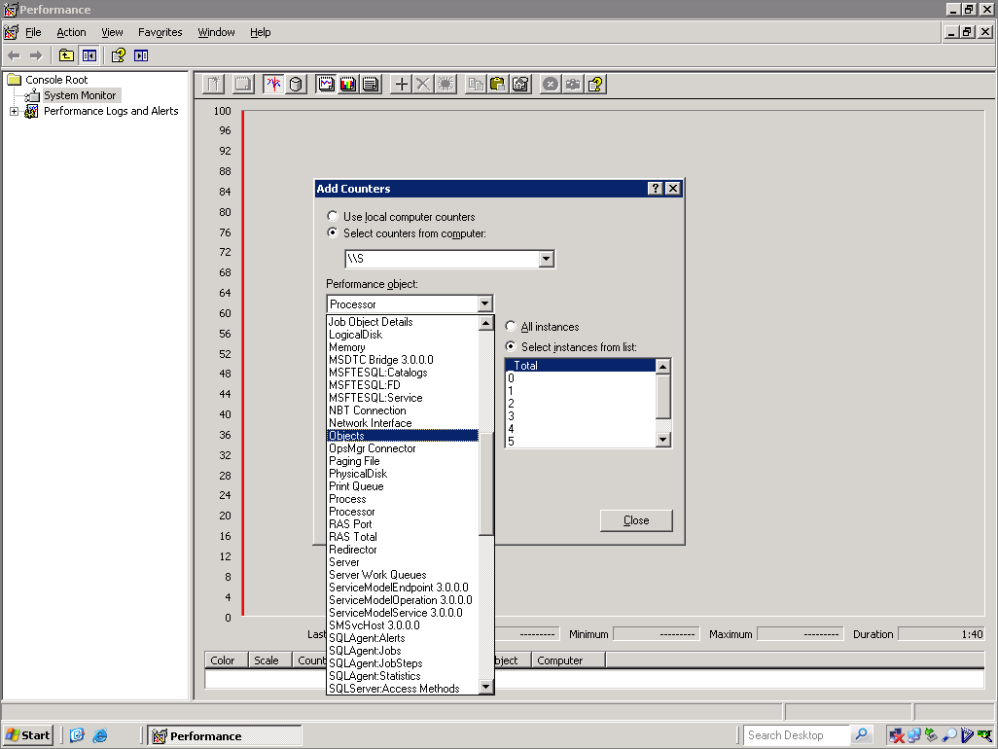

Slide 55
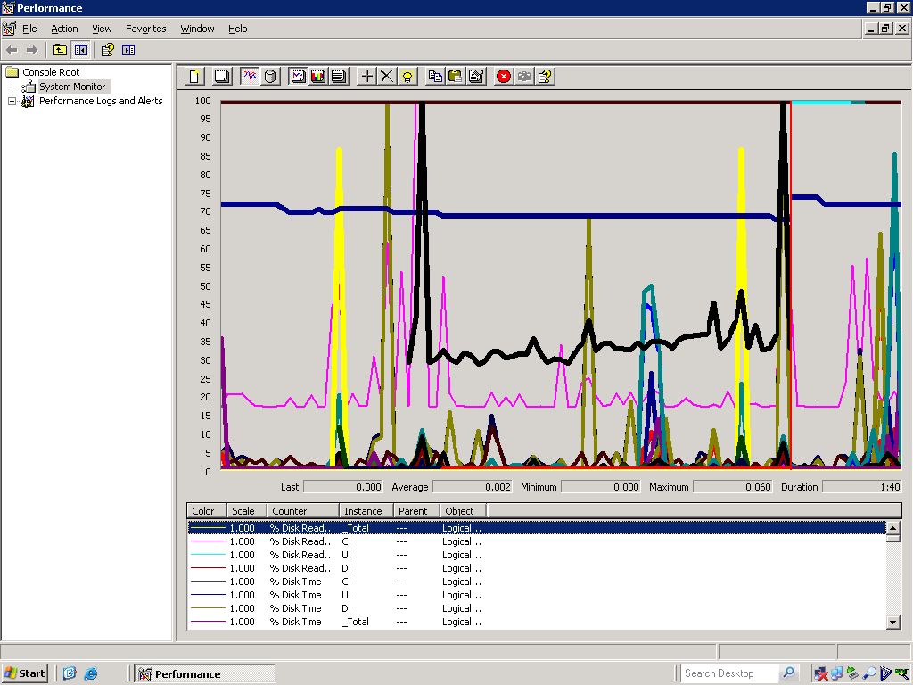

Slide 56
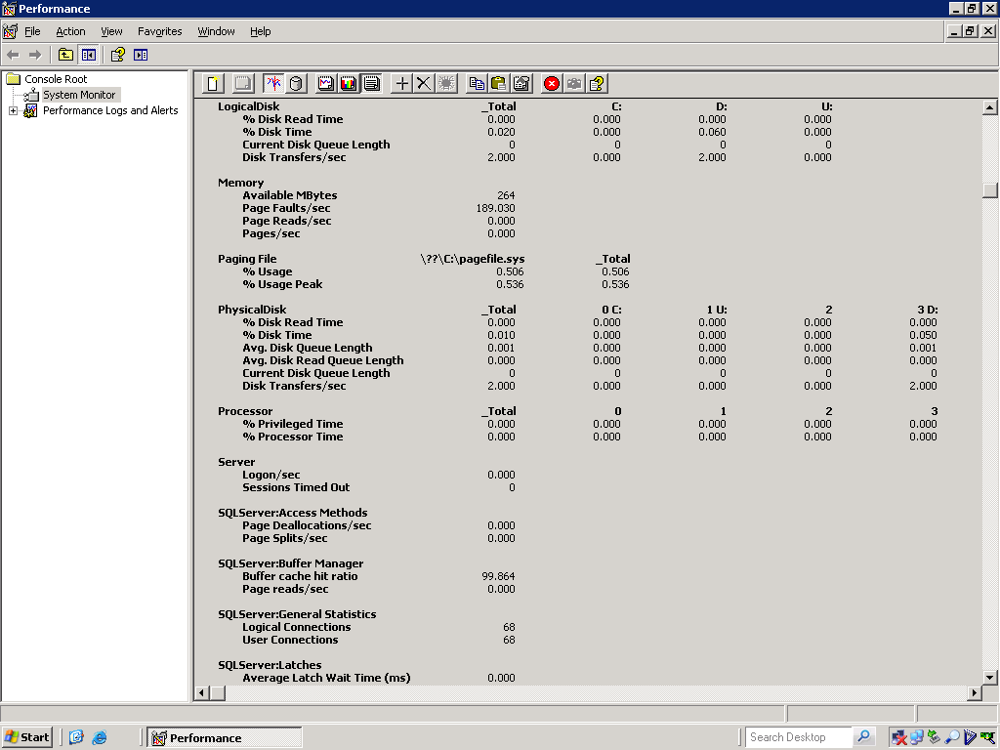

Slide 57
Questions?

Slide 58
System Monitor
Counter Logs
Runs in the background to identify trends
Resource consumption

Slide 59
Demo: Counter Logs in Perfmon

Slide 60
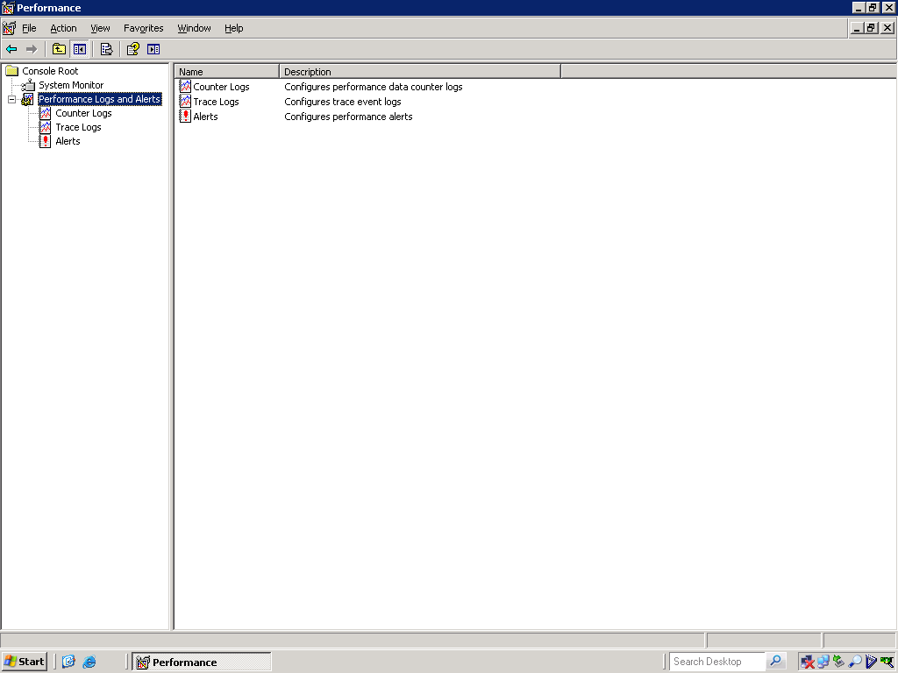

Slide 61
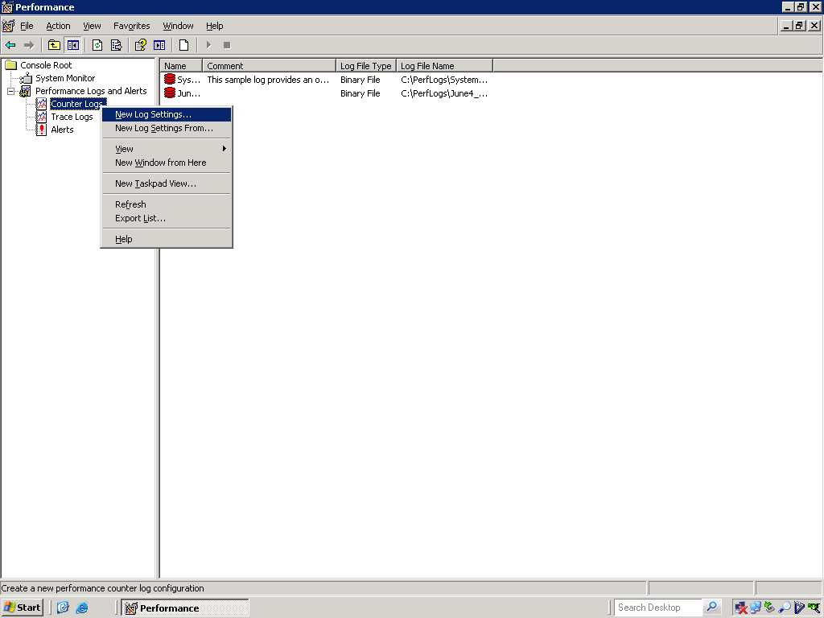

Slide 62
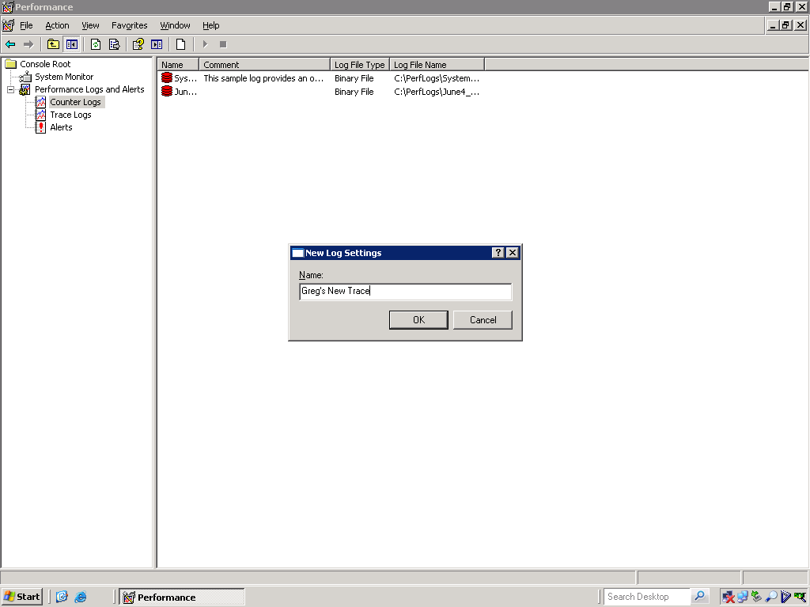

Slide 63
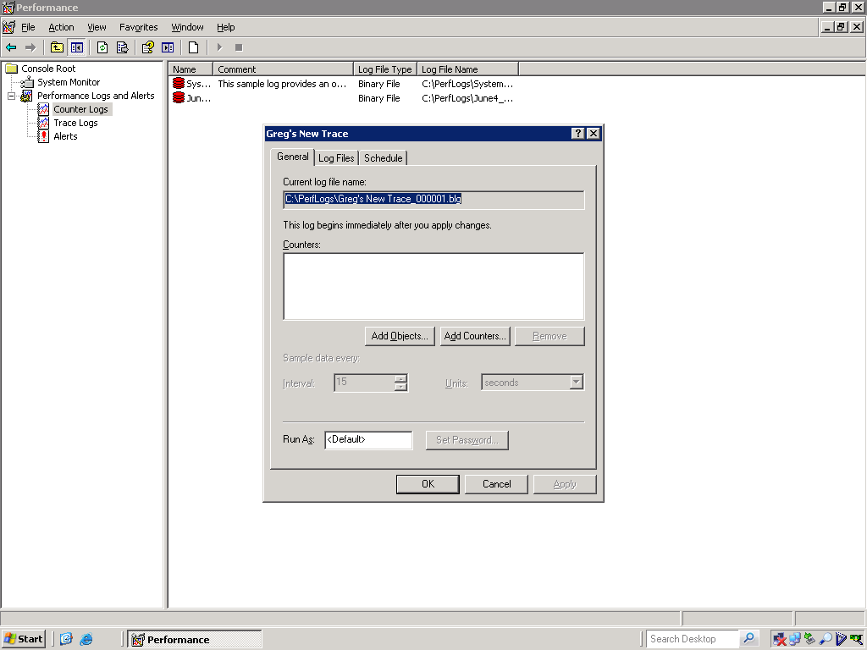

Slide 64
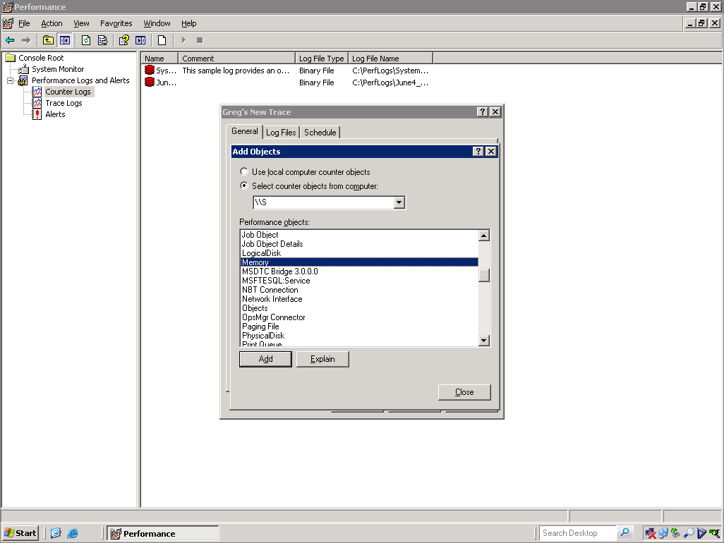

Slide 65
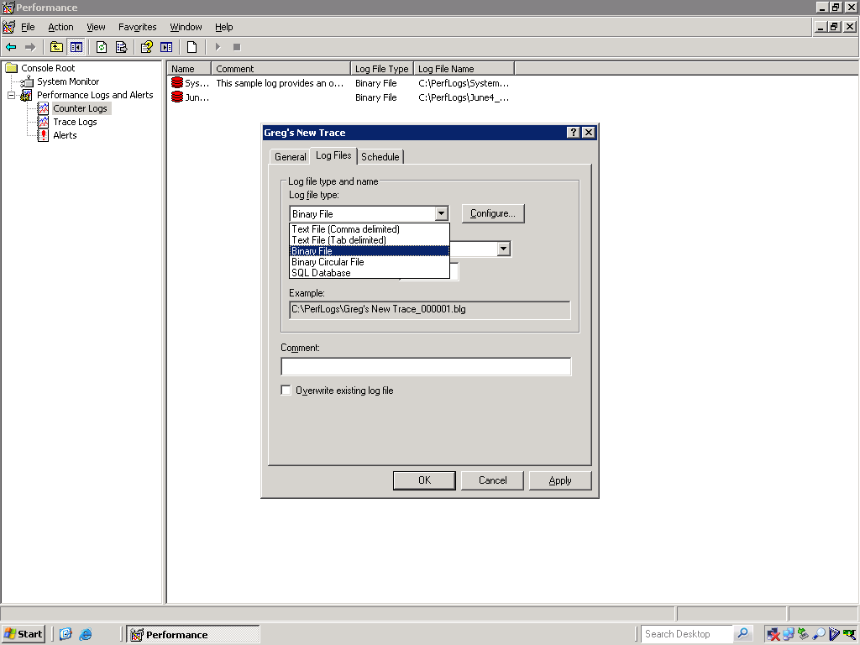

Slide 66
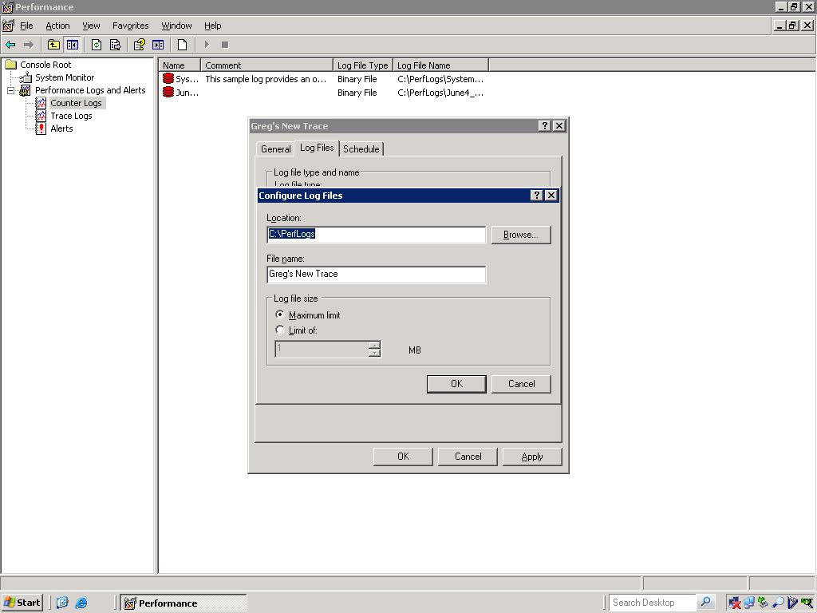

Slide 67
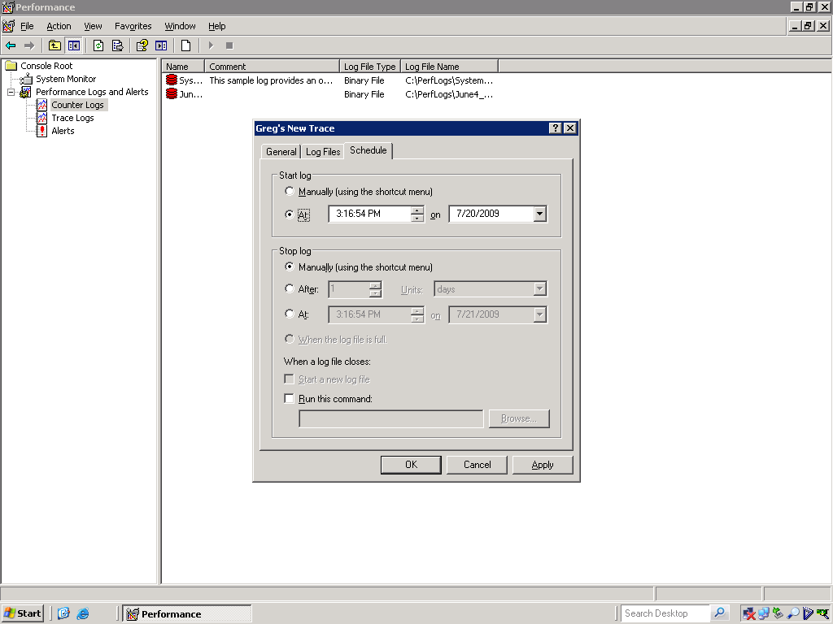

Slide 68
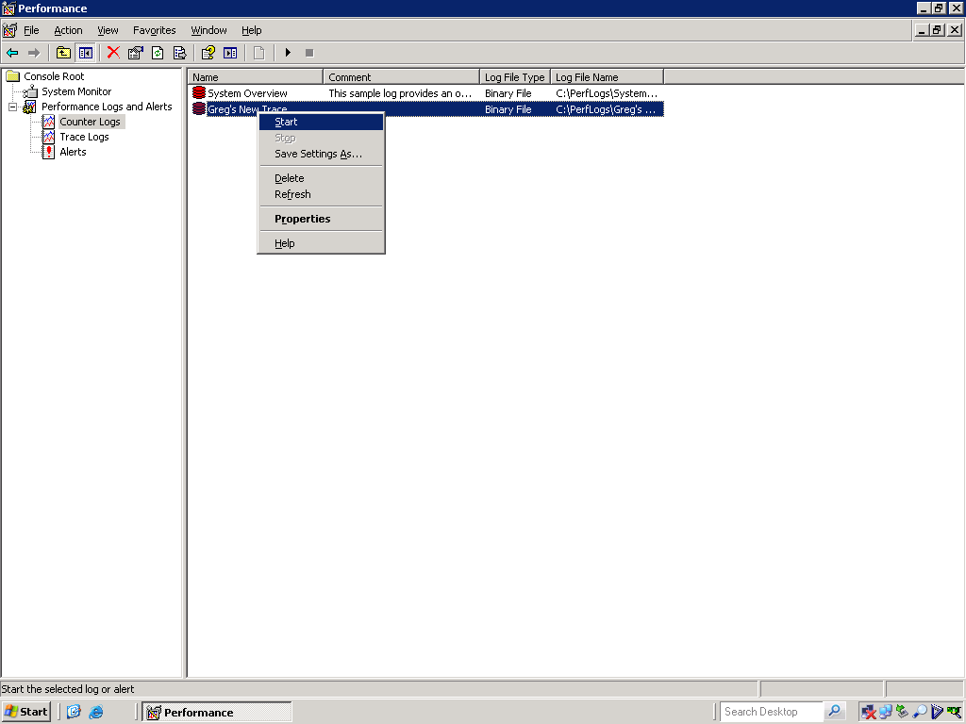

Slide 69
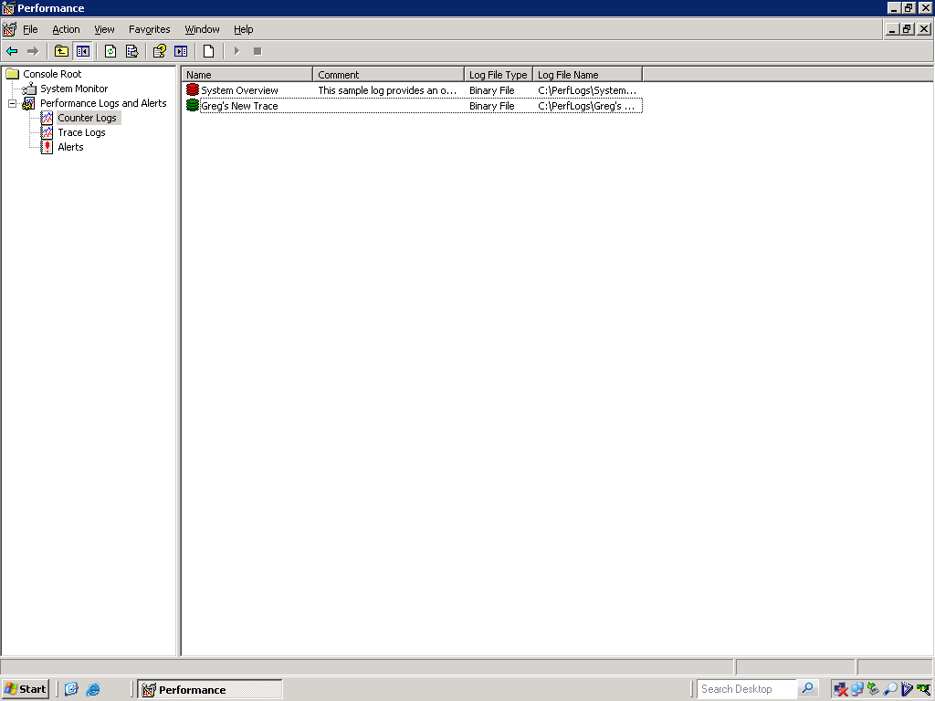

Slide 70
Questions?

Slide 71
System Monitor
Alerts
Able to be proactive
Early notification of thresholds passed

Slide 72
Demo: System Monitor Alerts

Slide 73
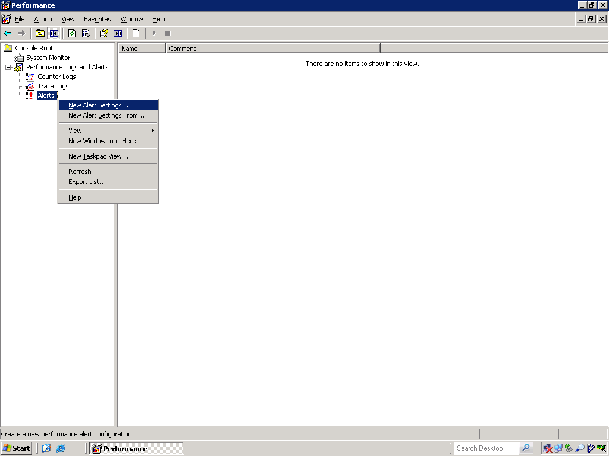

Slide 74
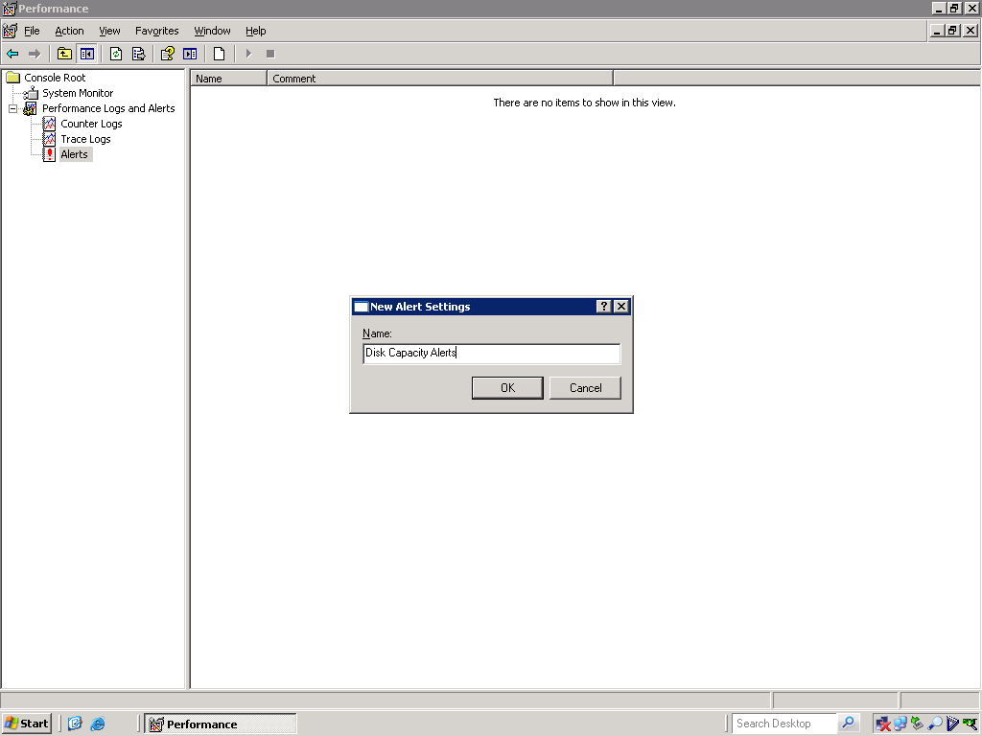

Slide 75
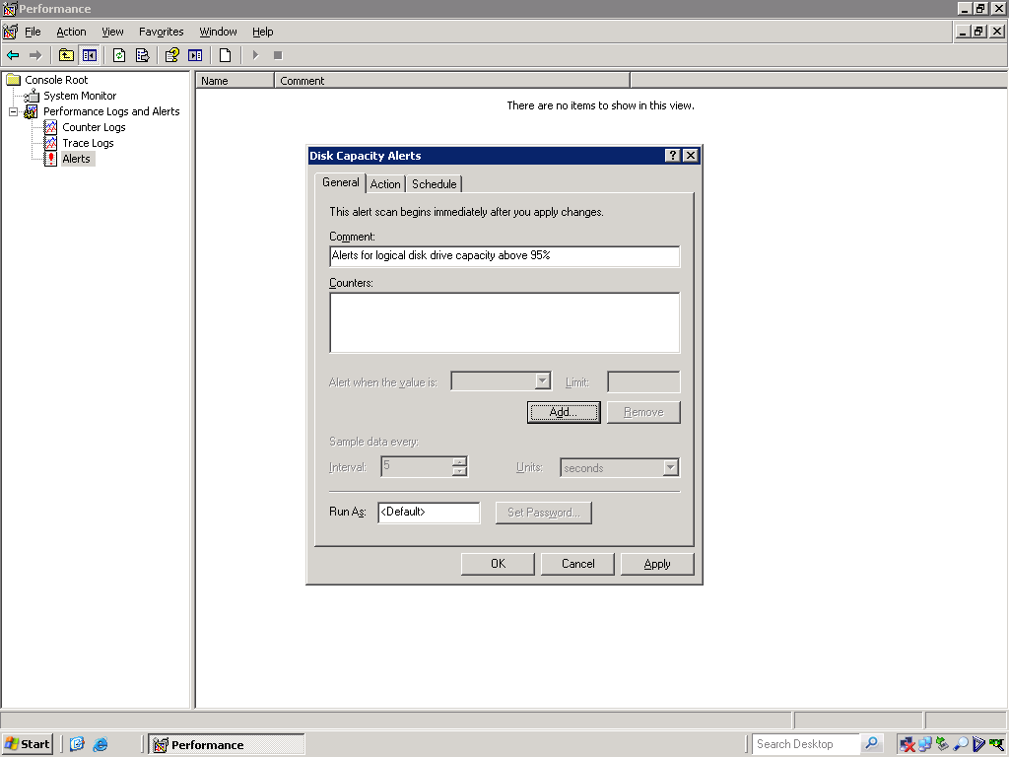

Slide 76
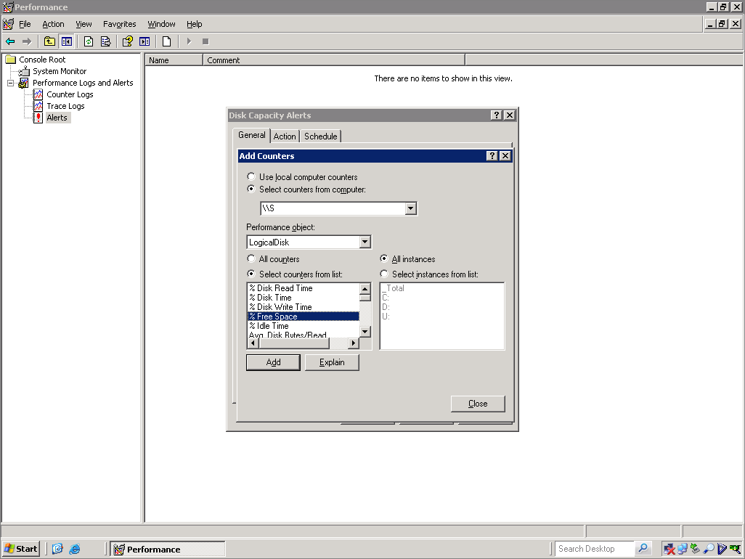

Slide 77
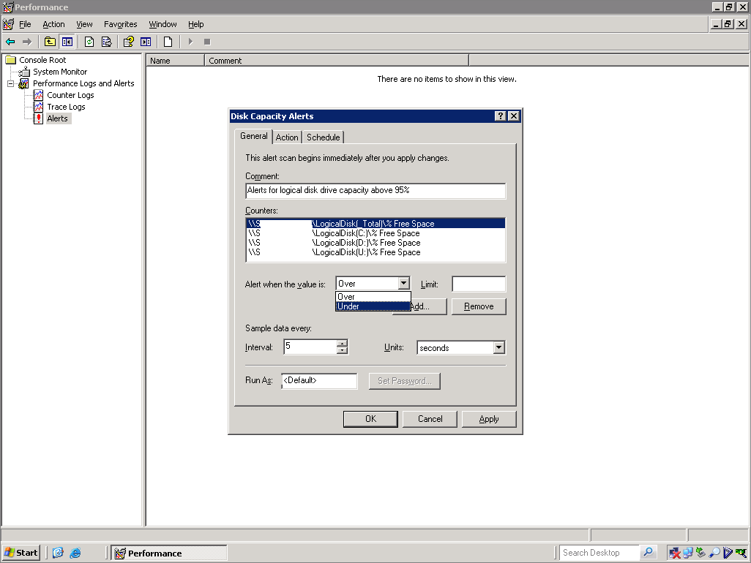

Slide 78
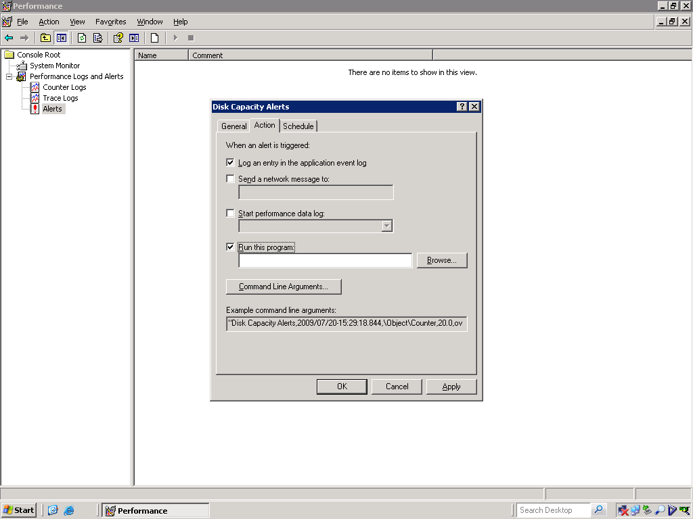

Slide 79
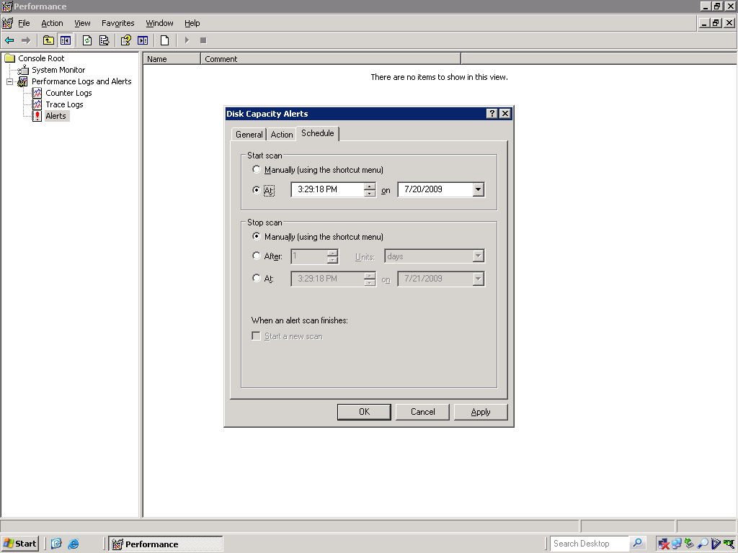

Slide 80
Questions?

Slide 81
Reliability Monitor
Reporting capability
Quick reporting on uptime
Lets administrators measure failures

Slide 82
Demo: Reliability Monitor

Slide 83
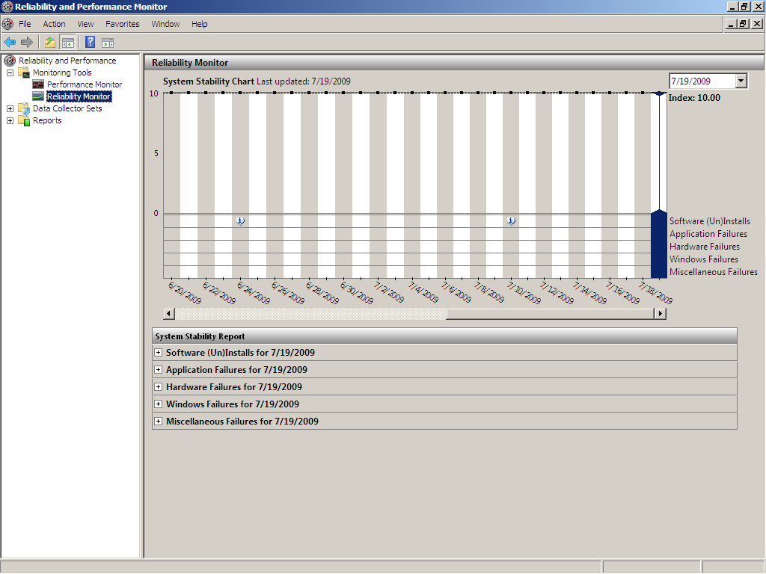

Slide 84
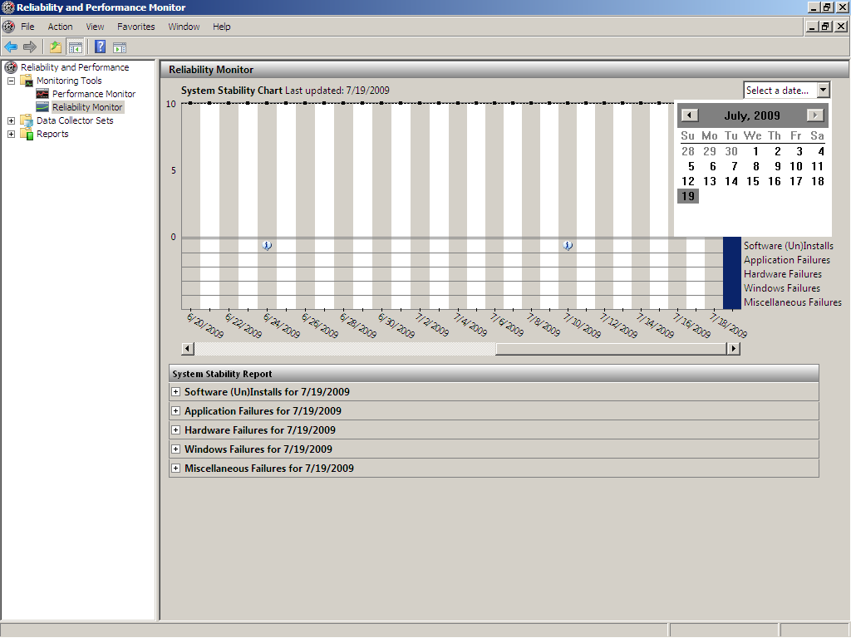

Slide 85
Questions?

Slide 86
Task Manager
Quick look at system resources
Often the best point to begin troubleshooting

Slide 87
Demo: Task Manager

Slide 88
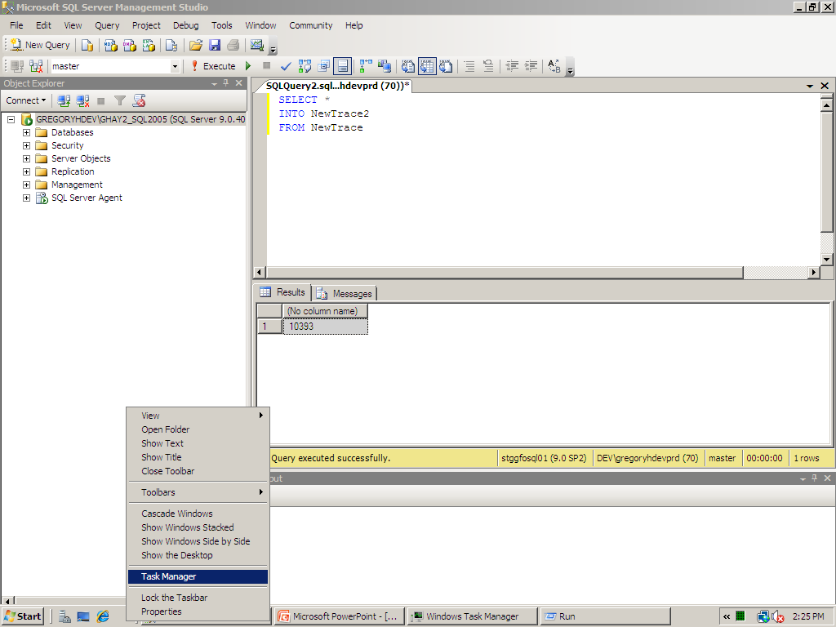

Slide 89
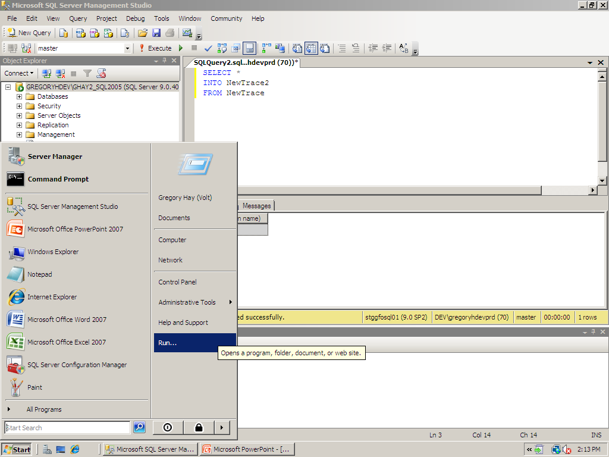

Slide 90
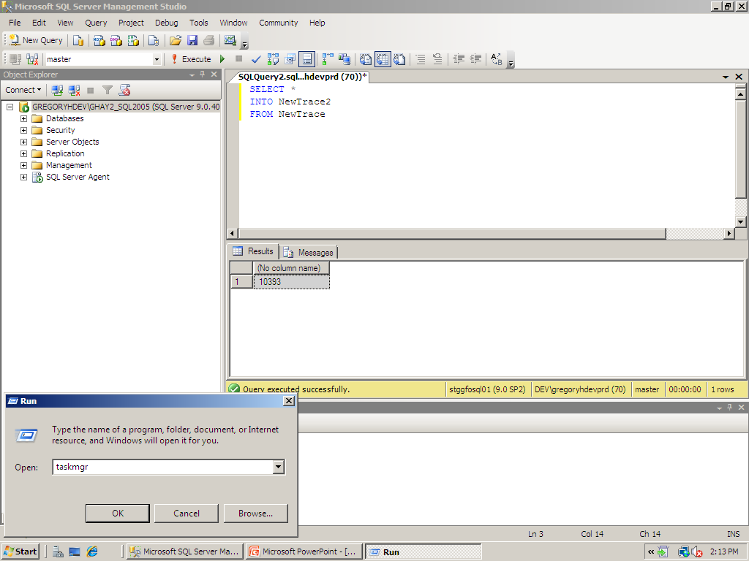

Slide 91
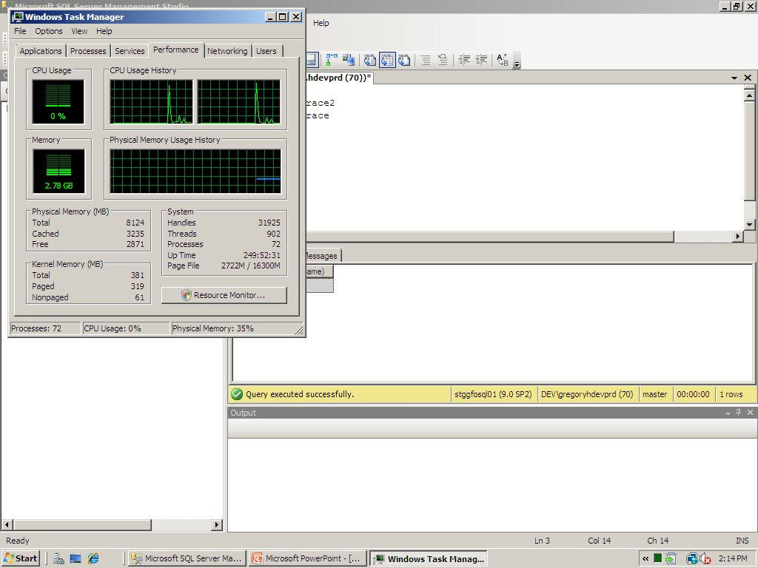

Slide 92
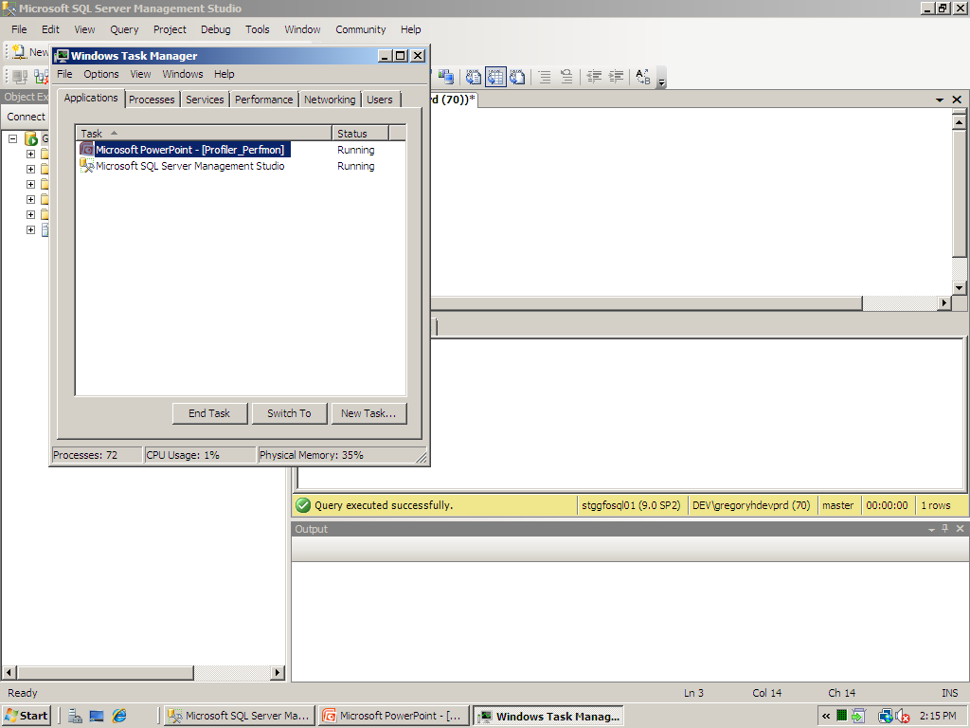

Slide 93
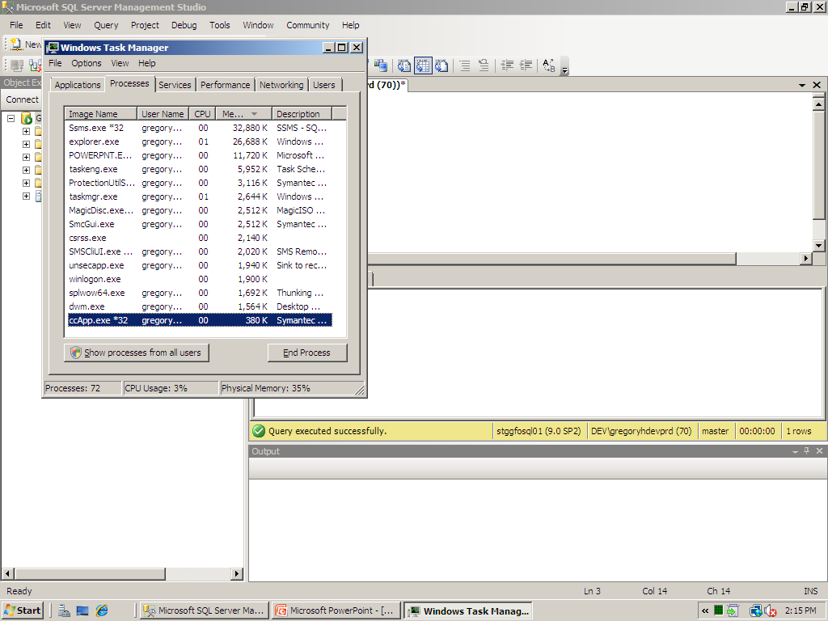

Slide 94
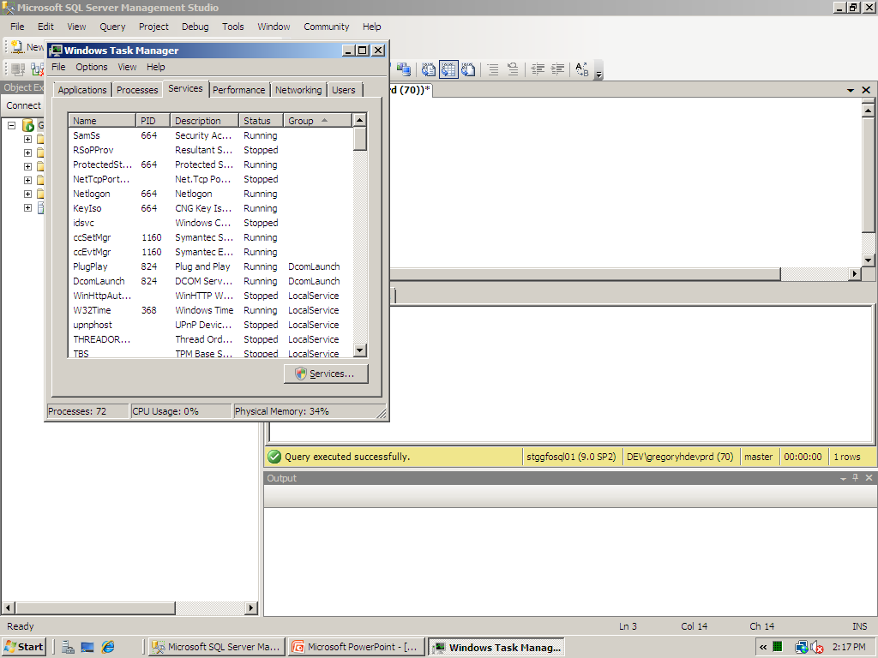

Slide 95
Questions?

Slide 96

Dynamic Management Views

Slide 97
Dynamic Mgt Views & Functions
Key Performance\Monitoring DMVs & DMFs
DMV and DMF Prefixes
dm_db_*
dm_exec_*
dm_io_*
dm_os_*

Slide 98
Dynamic Mgt Views & Functions
dm_db_*
Range of database statistics
Space and index utilization

Slide 99
Dynamic Mgt Views & Functions
dm_exec_*
Range of Query statistics
Replaces ‘old school’ code sp_who2 and sp_lock

Slide 100
Dynamic Mgt Views & Functions
dm_io_*
Range of I/O statistics
Current data previously required System Monitor

Slide 101
Dynamic Mgt Views & Functions
dm_os_*
Range of hardware-level information
Fantastic measurements most-effective

Slide 102
Dynamic Mgt Views & Functions
Database Statistics
sys.dm_db_index_usage_stats (DMV)
Contains core statistics about each index in db
sys.dm_db_index_operational_stats (DMF)
Takes 4 parameters
Database_id
Object_id
Index_id
Partition_id
Displays all current info on locking\latching

Slide 103
Dynamic Mgt Views & Functions
Database Statistics
sys.dm_db_index_physical_stats (DMF)
Takes 5 parameters
Database_id
Object_id
Index_id
Partition_id
Mode
Replaces DBCC SHOWCONTIG

Slide 104
Dynamic Mgt Views & Functions
Database Statistics
sys.dm_db_missing_index_*
sys.dm_db_missing_index_details
sys.dm_db_missing_index_group_stats
sys.dm_db_missing_index_groups
Able to assess where indexes could be best
Not as robust as DTA but VERY quick

Slide 105
Dynamic Mgt Views & Functions
Query Statistics
sys.dm_exec_sessions
Covers functionality for connections to instance
Replaces sp_who2
sys.dm_exec_requests
Covers functionality for queries inside engine
Basis for resolving many performance issues
Query settings
Query execution
Transaction
Resource allocation

Slide 106
Dynamic Mgt Views & Functions
I/O Statistics
sys.dm_io_virtual_file_stats
Similar to fn_virtual_filestats() function in SQL 2000
More granular
I/O stats are cumulative since SQL was started
sys.dm_io_pending_io_requests
One row for each request waiting for I/O

Slide 107
Dynamic Mgt Views & Functions
Hardware Statistics
sys.dm_os_performance_counters
Allows similar but easier data to System Monitor
sys.dm_os_wait_stats
Replaces DBCC SQLPERF(WAITSTATS)
Review wait types

Slide 108

Questions?

Slide 109
Working with SQL Server Profiler
Defining a Trace
Have a plan!!
Data scope
Filters
Events and Data Columns
Start with a predefined template
Different scenarios have distinct template
Build a set of templates to capture info quickly

Slide 110
Dynamic Mgt Views & Functions
Database Statistics
sys.dm_db_index_usage_stats (DMV)
Contains core statistics about each index in db
sys.dm_db_index_operational_stats (DMF)
Takes 4 parameters
Database_id
Object_id
Index_id
Partition_id
Displays all current info on locking\latching

Slide 111
Dynamic Mgt Views & Functions
Database Statistics
sys.dm_db_index_physical_stats (DMF)
Takes 5 parameters
Database_id
Object_id
Index_id
Partition_id
Mode
Replaces DBCC SHOWCONTIG

Slide 112
Dynamic Mgt Views & Functions
Database Statistics
sys.dm_db_missing_index_*
sys.dm_db_missing_index_details
sys.dm_db_missing_index_group_stats
sys.dm_db_missing_index_groups
Able to assess where indexes could be best
Not as robust as DTA but VERY quick

Slide 113
Dynamic Mgt Views & Functions
Query Statistics
sys.dm_exec_sessions
Covers functionality for connections to instance
Replaces sp_who2

Slide 114
Dynamic Mgt Views & Functions
Query Statistics
sys.dm_exec_requests
Covers functionality for queries inside engine
Basis for resolving many performance issues
Query settings
Query execution
Transaction
Resource allocation

Slide 115
Dynamic Mgt Views & Functions
I/O Statistics
sys.dm_io_virtual_file_stats
Similar to fn_virtual_filestats() function
More granular
I/O stats are cumulative since SQL was started
sys.dm_io_pending_io_requests
One row for each request waiting for I/O

Slide 116
Dynamic Mgt Views & Functions
Hardware Statistics
sys.dm_os_performance_counters
Allows similar but easier data to System Monitor
sys.dm_os_wait_stats
Replaces DBCC SQLPERF(WAITSTATS)
Review wait types

Slide 117
Creating Performance Baseline
Defines what is currently ‘normal’
PerfMon
Create a log
Capture measurements 2-3 times a minute
Standard Counters
Become familiar with what is important for YOU

Slide 118
Measuring Memory
Memory
Available MB: Average > 10MB
Pages/sec: Average < 50
SQL Server: Buffer Mgr
Buffer Cache Hit Ratio: Average > 90%
Free Pages: Min Value > 640
SQLServer: Memory Manager
Memory Grants Pending: Average = 0
Target Server Memory: Close to physical memory
Total Server Memory: Close to Target Server memory

Slide 119
Measuring Disk I/O
PhysicalDisk
% Disk Time: < 5%
Current Disk Queue Length: < 2 per disk
Avg Disk Queue Length: < 2 per disk
Disk Transfers/sec: Max Value < 100
Disk Bytes/sec: Max Value <10 MB/sec

Slide 120
Measuring CPU
Processor (_Total)
% Processor Time: Average < 80%
% Privileged Time: Average < 10%
System
Proc Queue Length: Average < 2
Context Switches/sec: Avg < 1000 per processor
SQLServer: SQL Statistics
Compilations/sec: ~ 0
Re-Compilations/sec: ~ 0

Slide 121
Miscellaneous
SQLServer: Access Methods
Free Space Scans/sec: ~ 0
Full Scans/sec: ~ 0
Page Splits/sec < 12,000/sec
SQL Server: General Statistics
User Connections: varies by load
SQLServer: Latches
Total Latch Wait time: ~ 0
SQLServer: Locks
Lock Timeouts/sec: 0 (!)
Lock Wait time: ~ 0
Number of Deadlocks/sec: 0 (!)

Slide 122

Key Points: Creating a Baseline
Invaluable when troubleshooting
Able to identify trends and avert problems
Makes technicians pay attention

Slide 123

Questions?

Slide 124


Slide 125


