Slide 1



INF0 445: Adv. Database Management Lecture 9
Instructor: Greg Hay
February 13, 2018

Slide 2

Agenda
Announcements
Review
Mid-term
NoSQL

Slide 3



Slide 4
Announcements
Lab 4: Synthetic Transaction
Due Friday
Individual assignment
Wrapper around existing transactional procedure
Usually has at least two FKs
Leverage GetID/nested stored procedures

Slide 5
Announcements
Quiz 3 moved to next week (Feb 22)
NoSQL
Synthetic Transaction
Database Monitoring

Slide 6
Announcements
Project Status
Look-up tables populated (save your scripts)
Synthetic transactions by weekend
Take a full back-up please ☺

Slide 7
Announcements
Project Status
Each team member must code 2 of each of the following (8 objects per student):
Stored procedure
Check constraint
Computed column
Views

Slide 8
Announcements
Project Status
Grading will be based on complex skills
explicit transactions
multiple JOINs, GROUP BY, ORDER BY, TOP, RANK
error-handling
passing of appropriate parameters
subqueries
variables

Slide 9
Announcements
Extra Credit Thursday: 2 Points
In-class design of dimensional model
Review structure of star schema versus snowflake schema

Slide 10

Questions?

Slide 11


Slide 12


Question 1
Compare database mirroring, log shipping and replication; when is each the preferred tool of use?

Slide 13
Question 2
Explain the concept of error-handling (try and be complete: briefly explain what is it, when it happens, why it happens and how it happens). Touch on the benefits of error-handling as well.

Slide 14
Question 3
Normalization seeks to eliminate several different types of data anomalies; please identify what these data anomalies are and how normalization eliminates them.

Slide 15
Question 4
Explain the difference between the concepts of ‘high-availability’ and ‘scalability’ in regard to relational database systems: What are the terms and tools used? How do we measure effectiveness?

Slide 16
Questions?

Slide 17

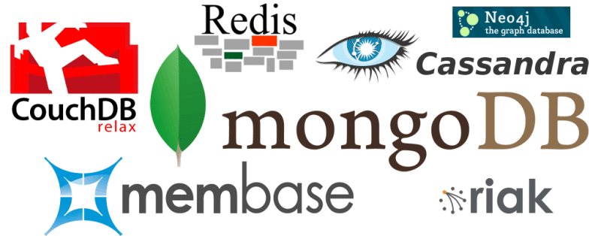

Slide 18
NoSQL
What is NoSQL?

Slide 19
NoSQL
What is NoSQL?
Simply another structure of database
Just like before relational design…
NoSQL is a way to manage data based on different organizing principles
There are many types of data management issues

Slide 20
NoSQL
Consider entire development history of databases
What have been challenges?

Slide 21
NoSQL
What is the crux of relational databases?
Where are they ‘exceptionally well designed’?

Slide 22
NoSQL
What are the advantages of relational databases?

Slide 23
NoSQL
What are the limitations of relational databases?
The same advantages and strengths are also disadvantages and limiting features under different conditions

Slide 24
NoSQL
What technological advances have caused need for different ‘organizing principles’?

Slide 25


Slide 26
NoSQL
What are potential work-arounds to limitations of relational databases?

Slide 27
NoSQL
Motivations for NoSQL databases
Scalability
Cost
Flexibility
Availability

Slide 28
NoSQL: Motivations
Scalability
“Ability to meet the demands of varying workloads”
Quickly add more resources as needed
‘scale-up’ versus ‘scale-out’

Slide 29
NoSQL: Motivations
Scale-up
Adding additional resources to single server
CPUs
Memory
Storage capacity
Scale-out
Adding additional servers to application
Can be complex as additional software required

Slide 30
NoSQL: Motivations
‘Scale-out’ is more flexible than ‘Scale-up’
Databases designed to work across multiple servers
Once complex management software is implemented, adding/dropping servers is dynamic
NoSQL systems adjust with minimal intervention
Scale-Up not dynamic at volume
Labor intensive
Requires migration of data or downtime

Slide 31
NoSQL: Motivations
Cost
Hardware
Commodity
Economies of scale
Software
Licenses were based on number of concurrent users
Also known as ‘seats’
With spikes of web traffic, potential for excessive charges
Growth made planning uncertain
Majority of NoSQL database systems are open source

Slide 32
NoSQL: Motivations
Flexibility
Address a range of data management problems
Cross-industry / application
Structure will change quickly and often
Fixed table structure not required
Relational databases love when requirements are fixed
Schema (‘shape’) of table is defined ahead of time
Few/no schema changes
Few NULL data values (well-designed/appropriate schema)

Slide 33
NoSQL: Motivations
Availability
Designed to take advantage of multiple servers
Low cost/’commodity’ hardware
Similar to RAID /striping across servers

Slide 35

Relational Principles
4-letter acronym for transaction management?

Slide 36

Relational Principles
4-letter acronym for transaction management?

Slide 37
Relational Principles
ACID principles
Foundation of relational databases
Transaction management with ‘strict’ consistency

Slide 38
ACID
ACID principles
Atomicity
Consistency
Isolation
Durability
We should know already ☺

Slide 39

What is opposite of ACID?

Slide 40
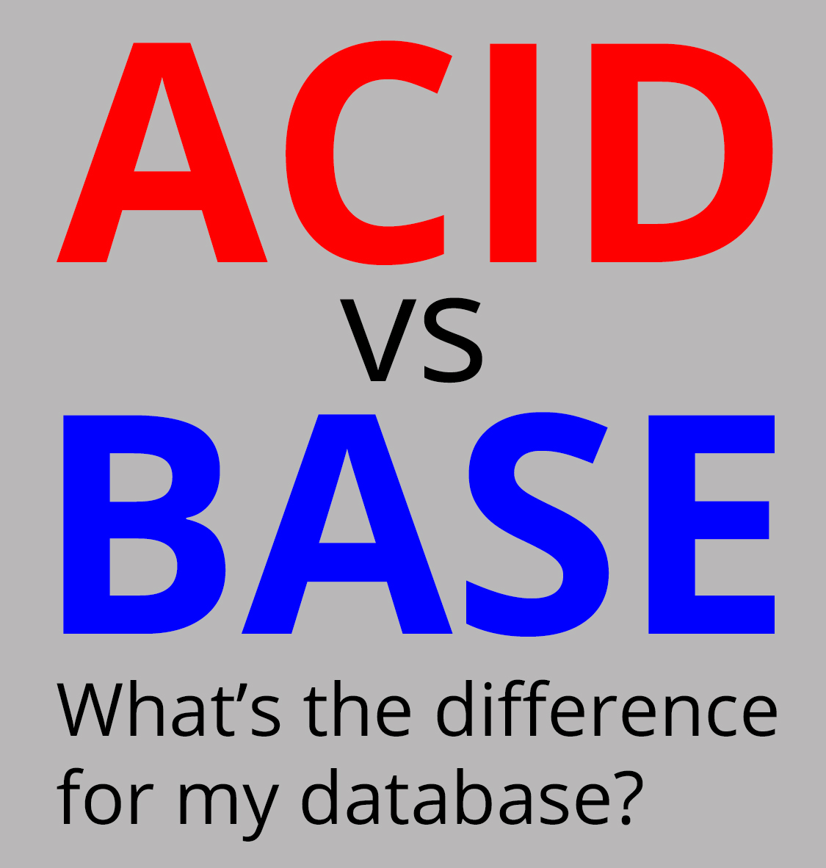

Slide 41
BASE
Foundation of NoSQL databases
Distributed management of data
loose consistency

Slide 42
BASE Principles
BA
Basically Available
S
Soft State
E
Eventually Consistent

Slide 43
NoSQL: Review
ACID
‘Strict-consistency’
Absolute and immediate (transaction by transaction)
Accuracy more important than speed/throughput
BASE
‘Eventual consistency’
Speed/throughput more important than accuracy

Slide 44

When do we prefer NoSQL over ‘regular’ SQL?

Slide 45
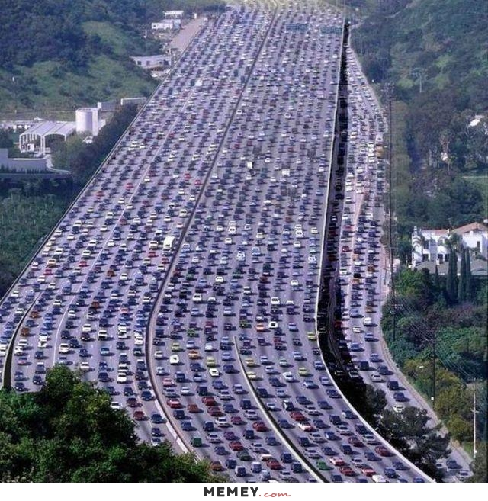
What affects throughput?

Slide 46
NoSQL
What affects throughput?
load/volume of read and write activities (no ‘transaction’)
Speed of network
Number & distance of replicas
Size of trx

Slide 47
NoSQL: Review
Quorum
Two-Phase Commit (2PC)
Scale-up vs scale-out
Ability to add attributes w/o schema changes

Slide 48
NoSQL
Data Model | Performance | Scalability | Flexibility | Complexity | Functionality
Key–Value Store | high | high | high | none | variable (none)
Column-Oriented Store | high | high | moderate | low | minimal
Document-Oriented Store | high | variable (high) | high | low | variable (low)
Graph Database | variable | variable | high | high | graph theory
Relational Database | variable | variable | low | moderate | relational algebra

Slide 49



Slide 50

How does BASE work?

Slide 51
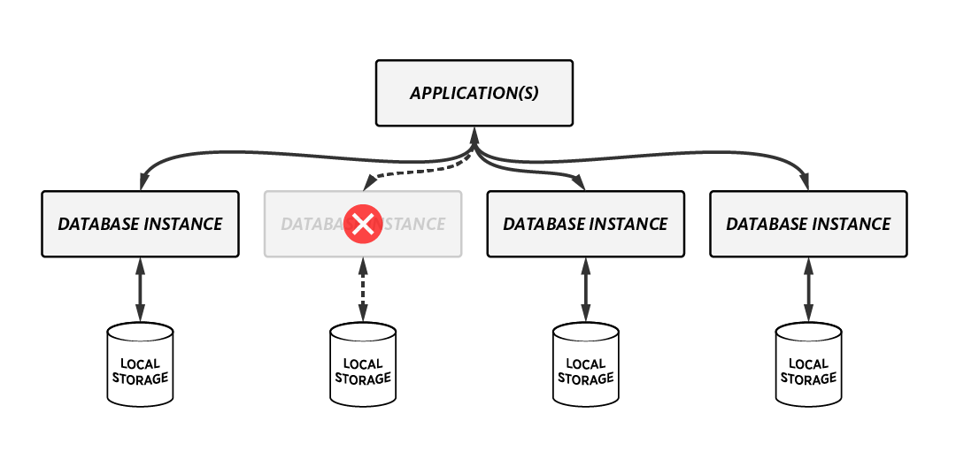
How does BASE work?

Slide 52
NoSQL: Eventual Consistency
Five types
Casual
Read-your-writes
Session
Monotonic read
Monotonic write

Slide 53
NoSQL: Eventual Consistency
Casual
Database operations are applied in sequential order
Guarantees values represent ‘point-in-time’

Slide 54
NoSQL: Eventual Consistency
Read-your-writes
All updates we make are guaranteed in future reads of the same records
Not subject to threshold quorum

Slide 55
NoSQL: Eventual Consistency
Session
Guarantees ‘read-your-writes’ for life of session
If session ends there is potential to ‘forget’

Slide 56
NoSQL: Eventual Consistency
Monotonic Read
Query results will be consistent across multiple reads
Results will not vary if executed several times

Slide 57
NoSQL: Eventual Consistency
Monotonic Write
If multiple write operations are issued, they will be executed in sequential order
Perhaps most-important consistency principle

Slide 59
NoSQL: Categories
Four categories of NoSQL Databases
Key-Value
Document
Column Family
Graph

Slide 60
NoSQL: Key-Value
Characteristics
Data is represented as a collection of key-value pairs
Each possible key appears at most once in set
Each attribute & value (‘cell’) has a PK assigned and is stored separately

Slide 61
NoSQL: Key-Value
Keys
The KEY is often sequential
Follows structure of TablePK.ColumnName
Cust436.LastName

Slide 62
NoSQL: Key-Value
Values
Stored along with keys
Can be string, number or image/blob
Strings can vary in length
Values can vary in type
Similar to ‘tags’ on luggage

Slide 63
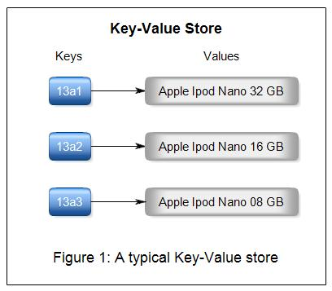

Slide 64
NoSQL: Key-Value
Characteristics
Simplicity
Speed
Scalability

Slide 65
NoSQL: Key-Value
Simplicity
Bare-minimum array structure
Applications do not always need complex storage
Easy to add attributes as needed
Simple syntax for manipulation
“Right tool for the job”

Slide 66
NoSQL: Key-Value
Speed
Data is very easy to manage in memory
Least Recently Used algorithm (LRU)

Slide 67
NoSQL: Key-Value
Scalability models
‘Master-replica’
‘Masterless’

Slide 68
NoSQL: Key-Value
‘Master-replica’ model
Hierarchical replication
Write-activity sent to primary server
Inserts/Updates are replication to pool of replicas
Read requests are distributed among replicas

Slide 69
NoSQL: Key-Value
‘Master-replica’ model
Advantages
Simplicity
Each replica communicates with the primary server only
Disadvantages
Single-point of failure if primary server fails
Does not scale in environments with heavy write activity

Slide 70
NoSQL: Key-Value
‘Masterless’ Model
All nodes accepts reads & writes
No single node has all updates
Servers will work in groups to improve consistency
Each server replicates to its immediate neighbor as well as one two hops away

Slide 71
NoSQL: Key-Value
Common products
Aerospike
Couchbase
Dynamo
FoundationDB
HyperDex
MUMPS, Oracle NoSQL Database
Redis
Riak
Berkeley DB

Slide 73
NoSQL: Document
Characteristics
Multiple attributes & values stored as a ‘document’
JSON: JavaScript Object Notation
XML: eXtensible Markup Language

Slide 74
NoSQL: Document
Characteristics
Each individual ‘Document’ has specific definition
Documents are addressed in the database via a unique key that represents that document
API or query language that retrieves documents based on their contents

Slide 75
NoSQL: Document
Characteristics
Different implementations offer different ways of organizing and/or grouping documents:
Collections
Tags
Non-visible metadata
Directory hierarchies

Slide 76
NoSQL: Document
Characteristics
collections
could be considered ‘tables’
documents
Could be compared to ‘records’ or rows
Can have multiple values in document (historical records)
Eliminates need for JOINs

Slide 77
NoSQL: Document
Comparing to relational model
records in a relational table have identical schema
documents in a collection may have varied schema
Burden on programmers to manage restrictions

Slide 78
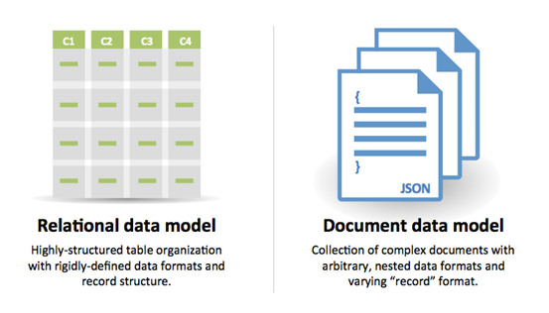
NoSQL: Document

Slide 79
NoSQL: Document
Common products
Clusterpoint
Couchbase
CouchDB
DocumentDB
Lotus Notes
MarkLogic
MongoDB
Qizx
XML-databases

Slide 81
NoSQL: Column-Family
Characteristics
Basic principle is a set of columns make up a row
Different rows can have different set of columns
When there tends to be variation/range of attributes, associated columns can be grouped
Example:
FirstName
MiddleName
LastName
BirthDate

Slide 82
NoSQL: Column-Family
Characteristics
Column-family databases are typically de-normalized
May include a timestamp to track sequence
Not unusual for these to support millions of columns
Perhaps most complex NoSQL database category

Slide 83
NoSQL: Column-Family
Common products
Accumulo
Cassandra
Druid
Hbase
Vertica

Slide 85
NoSQL: Graph
Characteristics
Instead of using column/row structure, systems use ‘nodes’ and ‘relationships’
Node:
Object that has identifier and a set of attributes
Also known as ‘vertices’
Relationship
Link between two related nodes
Also known as ‘edge’
Most-specialized NoSQL database category

Slide 86
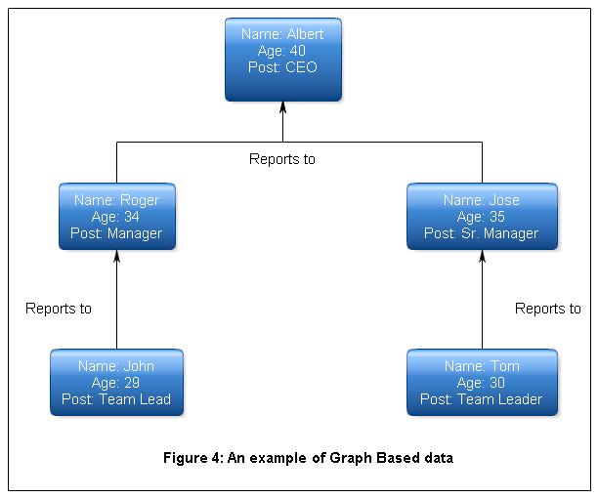
NoSQL: Graph

Slide 87
Questions?

Slide 88
NoSQL: Challenge
What are the four types of NoSQL databases?
Which is considered the most-common?
Which is considered the most-complex?
Which is considered the simplest?

Slide 89


Slide 90


