Slide 1
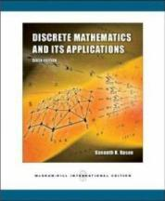
Discrete Mathematics
Chapter 10.4-10.5
Spanning Trees

Slide 2
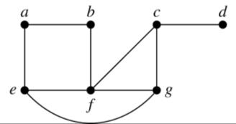
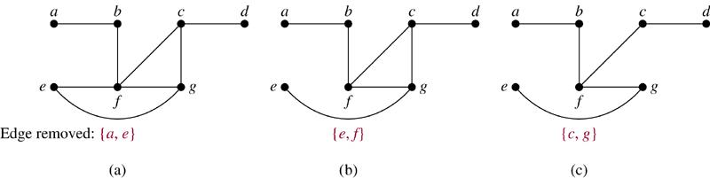
10.4 Spanning Trees
Introduction
Def. Let G be a simple graph. A spanning tree of G is a subgraph of G that is a tree containing every vertex of G.
Example 1 Find a spanning tree of G.
Sol.
Remove an edge from any circuit. (repeat until no circuit exists)

Slide 3
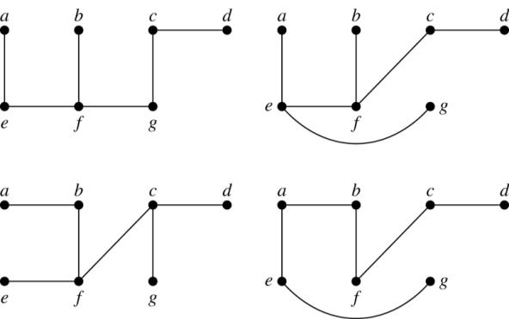
Four spanning trees of G:
Exercise : 1, 8, 11
Theorem 1. A simple graph is connected if and only if it has a spanning tree.
Exercise : 24, 25

Slide 4
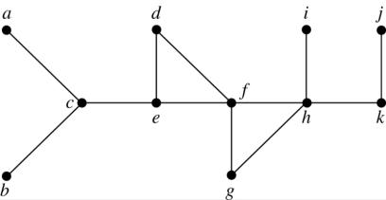
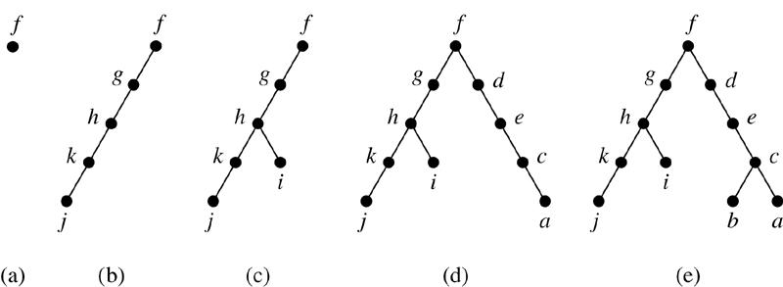
Depth-First Search (DFS)
Example 3. Use depth-first search to find a spanning tree for the graph.
Sol. (arbitrarily start with the vertex f)

Slide 5
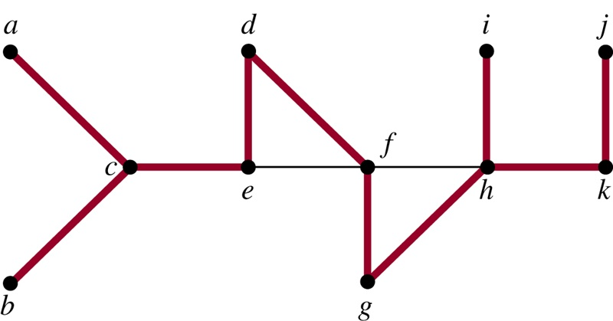
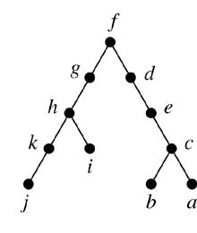
The edges selected by DFS of a graph are called tree edges. All other edges of the graph must connect a vertex to an ancestor or descendant of this vertex in the tree. These edges are called back edges.
Example 4
⇒
The tree edges (red) and back edges (black)

Slide 6
Algorithm 1 (Depth-First Search)
Procedure DFS(G: connected graph with vertices v₁, v₂, …, v_{n})
T := tree consisting only of the vertex v₁
visit(v₁)
procedure visit(v: vertex of G)
for each vertex w adjacent to v and not yet in T
begin
add vertex w and edge {v, w} to T
visit(w)
end
Exercise : 13

Slide 7
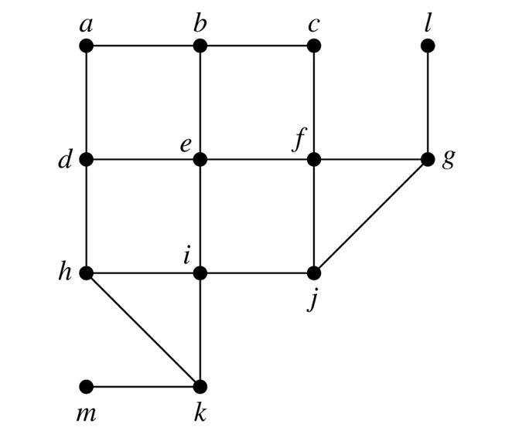
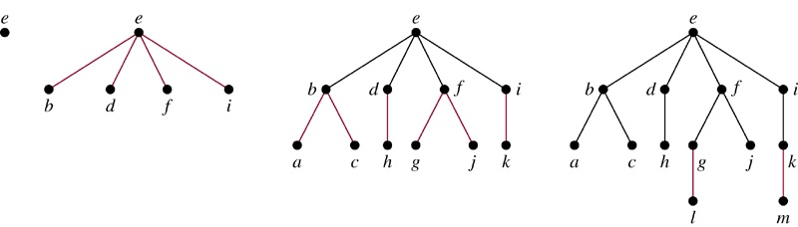
Breadth-First Search (BFS)
Example 5. Use breadth-first search to find a spanning tree for the graph.
Sol. (arbitrarily start with the vertex e)

Slide 8
Algorithm 2 (Breadth-First Search)
Procedure BFS(G: connected graph with vertices v₁, v₂, …, v_{n})
T := tree consisting only of vertex v₁
L := empty list
put v₁ in the list L of unprocessed vertices
while L is not empty
begin
remove the first vertex v from L
for each neighbor w of v
if w is not in L and not in T then
begin
add w to the end of the list L
add w and edge {v, w} to T
end
end
Exercise : 16

Slide 9
Backtracking Applications
There are problems that can be solved only by performing an exhaustive search of all possible solutions.
Decision tree: each internal vertex represents a decision, and each leaf is a possible solution.
To find a solution via backtracking: decision tree root decision leaf leaf solution parent

Slide 10
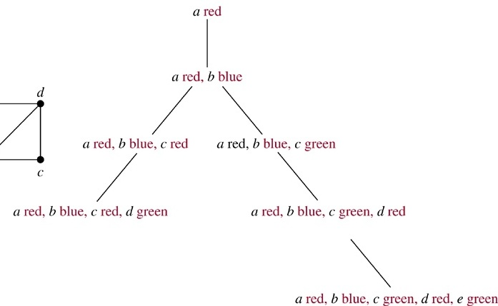
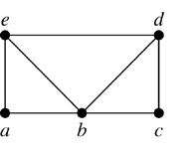
Example 6 (Graph Colorings). How can backtracking be used to decide whether the following graph can be colored using 3 colors?
Sol.

Slide 11
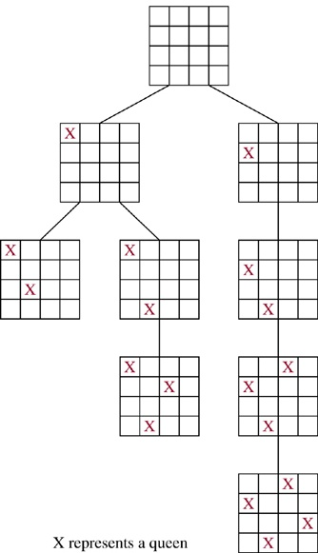
Example 7 (The n-Queens Problem). The n-queens problem asks how n queens can be placed on an n×n chessboard so that no two queens can attack on another. How can backtracking be used to solve the n-queens problem.
Sol.
n=4
3rd column

Slide 12
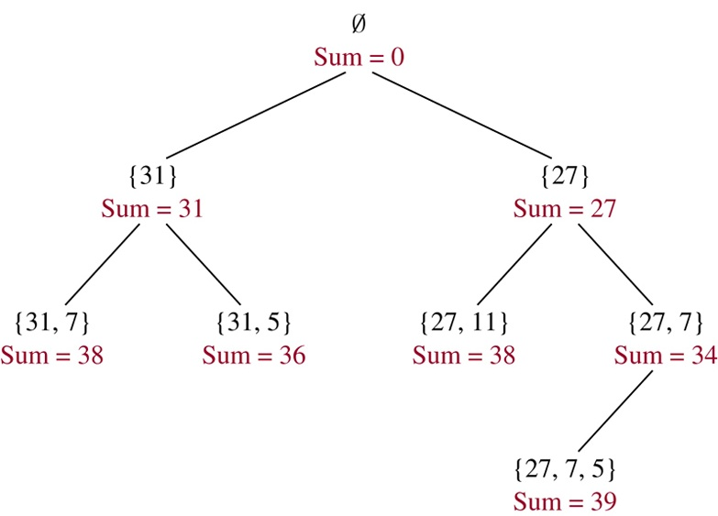
Example 8 (Sum of Subsets). Give a set S of positive
integers x₁, x₂, …, x_{n}, find a subset of S that has M as its
sum. How can backtracking be used to solve this
problem.
Sol.
S = {31, 27, 15, 11, 7, 5} M = 39
Exercise : 30

Slide 13
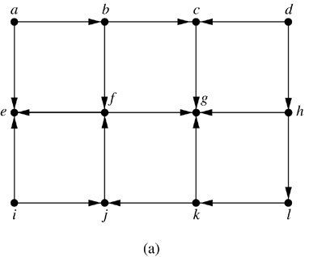
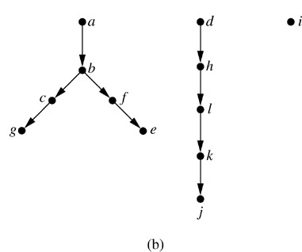
Depth-First Search in Directed Graphs
Example 9. What is the output of DFS given the graph G?
Sol.

Slide 14
10.5 Minimum Spanning Trees
G: connected weighted graph (each edge has an weight ≥ 0)
Def. minimum spanning tree of G: a spanning tree of G with smallest sum of weights of its edges.
Algorithms for Minimum Spanning Trees
Algorithm 1 (Prim’s Algorithm)
Procedure Prim(G: connected weighted undirected graph with n vertices)
T := a minimum-weight edge
for i := 1 to n−2
begin
e := an edge of minimum weight incident to a vertex in T and not forming a simple circuit in T if added to T
T := T with e added
end {T is a minimum spanning tree of G}

Slide 15
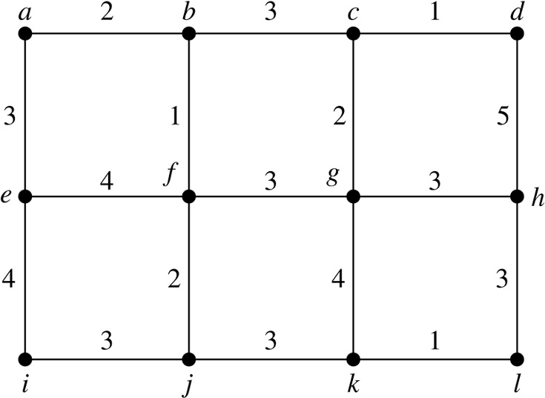
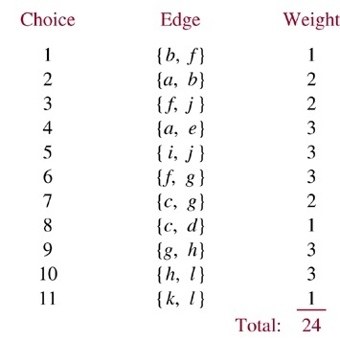
Example 2. Use Prim’s algorithm to find a minimum spanning tree of G.
Sol.
(tree)
Exercise: 3

Slide 16
Algorithm 2 (Kruskal Algorithm)
Procedure Kruskal(G: connected weighted undirected graph with n vertices)
T := empty graph
for i := 1 to n−1
begin
e := any edge in G with smallest weight that does not form a simple circuit when added to T
T := T with e added
end {T is a minimum spanning tree of G}

Slide 17
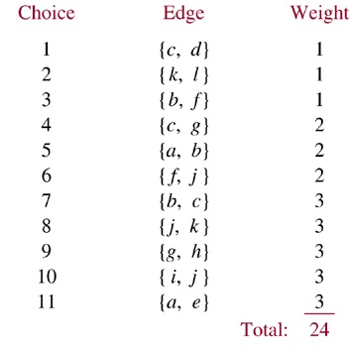
Example 3. Use Kruskal algorithm to find a minimum spanning tree of G.
Sol.
(tree)
Exercise: 7

