Slide 1
CHAPTER 1 The essential of software requirement

Slide 2
Objectives
Understand some key terms used in the software requirements domain.
Distinguish product requirements from project requirements.
Distinguish requirements development from requirements management.
Be alert to several requirements-related problems that can arise

Slide 3
Contents
Why is requirement engineering?
Software requirements defined
Requirements development and management
When bad requirements happen to good people
Benefits from a high-quality requirements process

Slide 4
Why is requirement engineering?
Distribution of Defects
Distribution of Effort to Fix Defects
Code
7%
Code
1%
Other
4%
Requirements
56%
Other
10%
Design
13%
Requirements
82%
Design
27%
Source: Martin & Leffinwell

Slide 5
Software requirements defined
Brian Lawrence: “anything that drives design choices” (Lawrence 1997)
“ Requirements are a specification of what should be implemented. They are descriptions of how the system should behave, or of a system property or attribute. They may be a constraint on the development process of the system” Ian Sommerville and Pete Sawyer (1997)

Slide 6
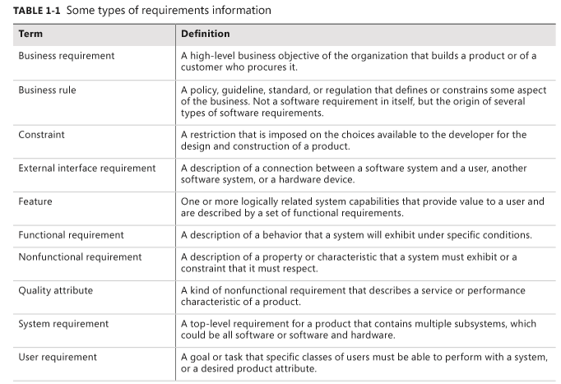
Types of requirements

Slide 7
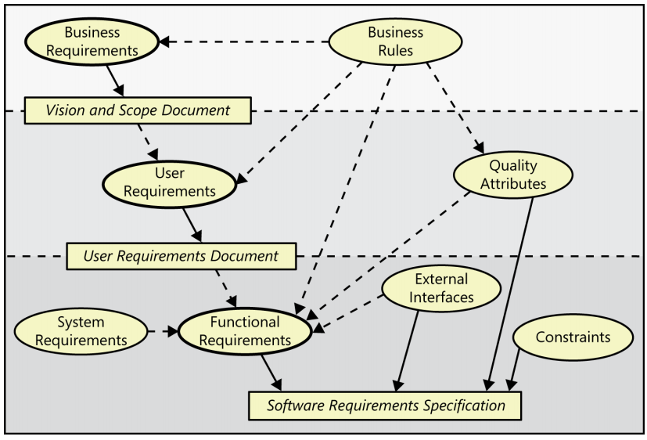
Levels and types of requirements

Slide 8
Levels and types of requirements
The ovals represent types of requirements information,
rectangles indicate documents in which to store that information.
The solid arrows indicate that a certain type of information typically is stored in the indicated document. (Business rules and system requirements are stored separately from software requirements, such as in a business rules catalog or a system requirements specification, respectively.)
The dotted arrows indicate that one type of information is the origin of or influences another type of requirement.

Slide 9
Levels and types of requirements
Business requirements describe why the organization is implementing the system—the business benefits the organization hopes to achieve. The focus is on the business objectives of the organization or the customer who requests the system. Suppose an airline wants to reduce airport counter staff costs by 25 percent

Slide 10
Levels and types of requirements
User requirements describe goals or tasks the users must be able to perform with the product that will provide value to someone. The domain of user requirements also includes descriptions of product attributes or characteristics that are important to user satisfaction. Ways to represent user requirements include use cases (Kulak and Guiney 2004), user stories (Cohn 2004), and event-response tables. Ideally, actual user representatives will provide this information. User requirements describe what the user will be able to do with the system.
An example of a use case is “Check in for a flight” using an airline’s website or a kiosk at the airport. Written as a user story, the same user requirement might read: “As a passenger, I want to check in for a flight so I can board my airplane.” It’s important to remember that most projects have multiple user classes, as well as other stakeholders whose needs also must be elicited.

Slide 11
Levels and types of requirements
Functional requirements specify the behaviors the product will exhibit under specific conditions. They describe what the developers must implement to enable users to accomplish their tasks (user requirements), thereby satisfying the business requirements. This alignment among the three levels of requirements is essential for project success. Functional requirements often are written in the form of the traditional “shall” statements: “The Passenger shall be able to print boarding passes for all flight segments for which he has checked in” or “If the Passenger’s profile does not indicate a seating preference, the reservation system shall assign a seat.

Slide 12
Levels and types of requirements
The business analyst (BA)1 documents functional requirements in a software requirements specification (SRS), which describes as fully as necessary the expected behavior of the software system. The SRS is used in development, testing, quality assurance, project management, and related project functions. People call this deliverable by many different names, including business requirements document, functional spec, requirements document, and others. An SRS could be a report generated from information stored in a requirements management tool. Because it is an industry-standard term, we will use “SRS” consistently throughout this book (ISO/IEC/IEEE 2011). See Chapter 10, “Documenting the requirements,” for more information about the SRS.

Slide 13
Levels and types of requirements
System requirements describe the requirements for a product that is composed of multiple components or subsystems (ISO/IEC/IEEE 2011). A “system” in this sense is not just any information system. A system can be all software or it can include both software and hardware subsystems

Slide 14
Levels and types of requirements
System requirements describe the requirements for a product that is composed of multiple components or subsystems (ISO/IEC/IEEE 2011). A “system” in this sense is not just any information system. A system can be all software or it can include both software and hardware subsystems
A good example of a “system” is the cashier’s workstation in a supermarket. There’s a bar code scanner integrated with a scale, as well as a hand-held bar code scanner. The cashier has a keyboard, a display, and a cash drawer. You’ll see a card reader and PIN pad for your loyalty card and credit or debit card, and perhaps a change dispenser. You might see up to three printers for your purchase receipt, credit card receipt, and coupons you don’t care about. These hardware devices are all interacting under software control. The requirements for the system or product as a whole, then, lead the business analyst to derive specific functionality that must be allocated to one or another of those component subsystems, as well as demanding an understanding of the interfaces between them.

Slide 15
Levels and types of requirements
Business rules include corporate policies, government regulations, industry standards, and computational algorithms. Business rules are not themselves software requirements because they have an existence beyond the boundaries of any specific software application. However, they often dictate that the system must contain functionality to comply with the pertinent rules. Sometimes, as with corporate security policies, business rules are the origin of specific quality attributes that are then implemented in functionality.

Slide 16
Levels and types of requirements
Business rules include corporate policies, government regulations, industry standards, and computational algorithms. Business rules are not themselves software requirements because they have an existence beyond the boundaries of any specific software application. However, they often dictate that the system must contain functionality to comply with the pertinent rules. Sometimes, as with corporate security policies, business rules are the origin of specific quality attributes that are then implemented in functionality.

Slide 17
Levels and types of requirements
In addition to functional requirements, the SRS contains an assortment of nonfunctional requirements. Quality attributes are also known as quality factors, quality of service requirements, constraints, and the “–ilities.” They describe the product’s characteristics in various dimensions that are important either to users or to developers and maintainers, such as performance, safety, availability, and portability. Other classes of nonfunctional requirements describe external interfaces between the system and the outside world. These include connections to other software systems, hardware components, and users, as well as communication interfaces. Design and implementation constraints impose restrictions on the options available to the developer during construction of the product.

Slide 18
Levels and types of requirements
A feature consists of one or more logically related system capabilities that provide value to a user and are described by a set of functional requirements. A customer’s list of desired product features is not equivalent to a description of the user’s task-related needs. Web browser bookmarks, spelling checkers, the ability to define a custom workout program for a piece of exercise equipment, and automatic virus signature updating in an anti-malware product are examples of features. A feature can encompass multiple user requirements, each of which implies that certain functional requirements must be implemented to allow the user to perform the task described by each user requirement. Figure 1-2 illustrates a feature tree, an analysis model that shows how a feature can be hierarchically decomposed into a set of smaller features, which relate to specific user requirements and lead to specifying sets of functional requirement.

Slide 19
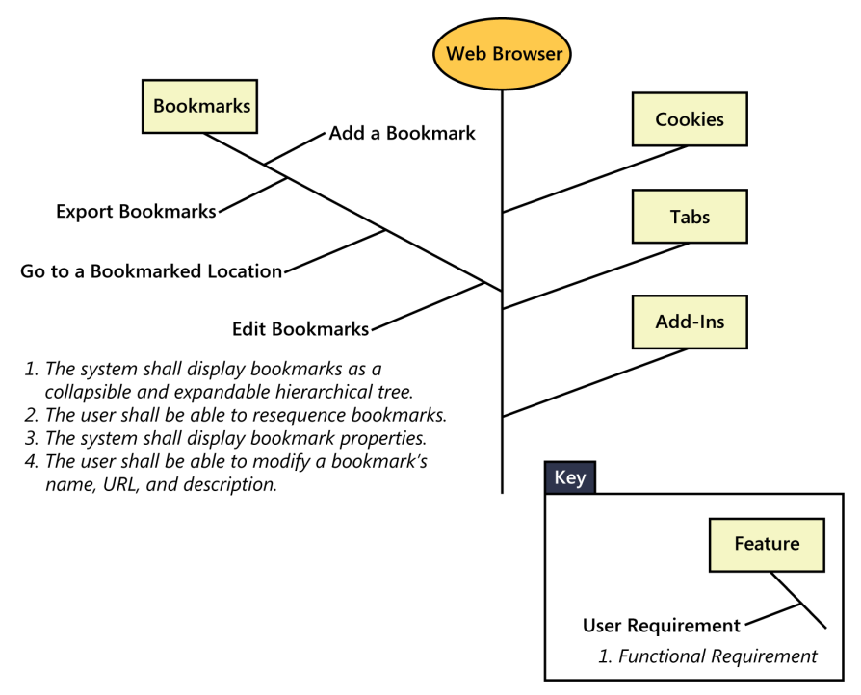
Levels and types of requirements

Slide 20
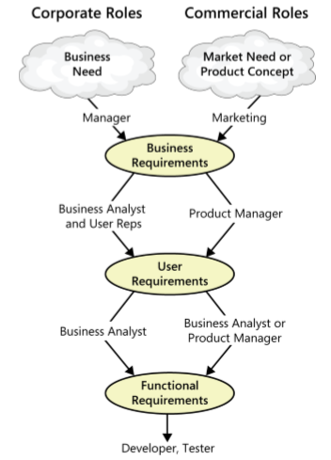
The participation of stakeholders in requirements development
Notes:
Working with three levels

Slide 21
The participation of stakeholders in requirements development
Based on an identified business need, a market need, or an exciting new product concept, managers or marketing define the business requirements for software that will help their company operate more efficiently (for information systems) or compete successfully in the marketplace (for commercial products). In the corporate environment, a business analyst then typically works with user representatives to identify user requirements. Companies developing commercial products often identify a product manager to determine what features to include in the new product. Each user requirement and feature must align with accomplishing the business requirements. From the user requirements, the BA or product manager derives the functionality that will let users achieve their goals. Developers use the functional and nonfunctional requirements to design solutions that implement the necessary functionality, within the limits that the constraints impose. Testers determine how to verify whether the requirements were correctly implemented.
Notes:
Working with three levels

Slide 22
Product vs. project requirements
Product requirements:
properties of a software system to be built
Projects requirements:
do have other expectations and deliverables that are not a part of the software the team implements, but that are necessary to the successful completion of the project as a whole
Notes:
Teacher should explain more detail about every type of requirements

Slide 23
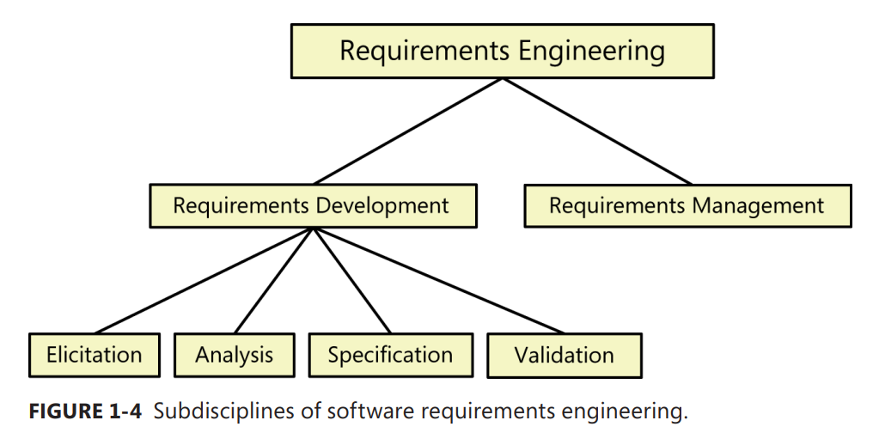
Requirements development and management
Notes:
Teacher should explain every step

Slide 24
Requirements development and management
Elicitation encompasses all of the activities involved with discovering requirements, such as interviews, workshops, document analysis, prototyping, and others. The key actions are:
Identifying the product’s expected user classes and other stakeholders.
Understanding user tasks and goals and the business objectives with which those tasks align.
Learning about the environment in which the new product will be used.
Working with individuals who represent each user class to understand their functionality needs and their quality expectations
Notes:
Teacher should explain every step

Slide 25
Requirements development and management
Analyzing requirements involves reaching a richer and more precise understanding of each requirement and representing sets of requirements in multiple ways. Following are the principal activities: - Analyzing the information received from users to distinguish their task goals from functional requirements, quality expectations, business rules, suggested solutions, and other information - Decomposing high-level requirements into an appropriate level of detail - Deriving functional requirements from other requirements information Understanding the relative importance of quality attributes - Allocating requirements to software components defined in the system architecture - Negotiating implementation priorities - Identifying gaps in requirements or unnecessary requirements as they relate to the defined scope
Notes:
Decomposing: Phân chia
Negotiating: Đàm phán

Slide 26
Requirements development and management
Requirements specification involves representing and storing the collected requirements knowledge in a persistent and well-organized fashion. The principal activity is: - Translating the collected user needs into written requirements and diagrams suitable for comprehension, review, and use by their intended audiences
Notes:
Teacher should explain every step

Slide 27
Requirements development and management
Requirements validation confirms that you have the correct set of requirements information that will enable developers to build a solution that satisfies the business objectives. The central activities are: - Reviewing the documented requirements to correct any problems before the development group accepts them. - Developing acceptance tests and criteria to confirm that a product based on the requirements would meet customer needs and achieve the business objectives.
Notes:
Teacher should explain every step

Slide 28
Requirements development and management
Requirements management activities include the following:
Defining the requirements baseline, a snapshot in time that represents an agreed-upon, reviewed, and approved set of functional and nonfunctional requirements, often for a specific product release or development iteration
Evaluating the impact of proposed requirements changes and incorporating approved changes into the project in a controlled way
Keeping project plans current with the requirements as they evolve
Negotiating new commitments based on the estimated impact of requirements changes
Defining the relationships and dependencies that exist between requirements
Tracing individual requirements to their corresponding designs, source code, and tests
Tracking requirements status and change activity throughout the project
Notes:
Teacher should explain every step

Slide 29
Requirements development and management
Requirements management activities include the following:
Defining the requirements baseline, a snapshot in time that represents an agreed-upon, reviewed, and approved set of functional and nonfunctional requirements, often for a specific product release or development iteration
Evaluating the impact of proposed requirements changes and incorporating approved changes into the project in a controlled way
Keeping project plans current with the requirements as they evolve
Negotiating new commitments based on the estimated impact of requirements changes
Defining the relationships and dependencies that exist between requirements
Tracing individual requirements to their corresponding designs, source code, and tests
Tracking requirements status and change activity throughout the project
Notes:
Teacher should explain every step

Slide 30
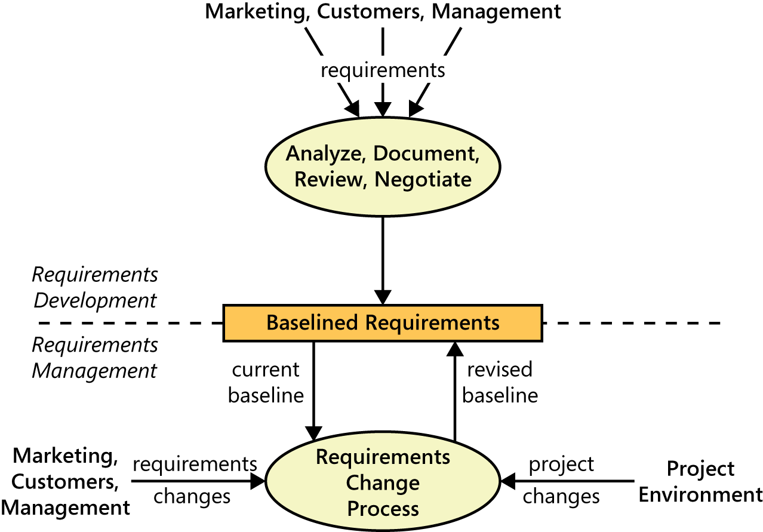
the boundary between RD and MR
Notes:
Teacher should explain every step

Slide 31
the boundary between RD and MR
Notes:
Teacher should explain every step

Slide 32
When bad requirements happen to good people
Insufficient user involvement: to late-breaking requirements that generate rework and delay completion.
Inaccurate planning:
Creeping user requirements: As requirements evolve during development, projects often exceed their planned schedules and budgets. To manage scope creep, begin with a clear statement of the project’s business objectives, strategic vision, scope, limitations, and success criteria. Agile projects take the approach of adjusting the scope for a certain iteration to fit into a defined budget and duration for the iteration.

Slide 33
When bad requirements happen to good people
Ambiguous requirements: Ambiguity leads to different expectations on the part of various stakeholders. Testers who expect the product to behave differently from what the developers built waste time resolving the differences. One way to ferret out ambiguity is to have people who represent different perspectives inspect the requirements
Gold plating takes place when a developer adds functionality that wasn’t in the requirements specification (or was deemed out of scope) but which the developer believes “the users are just going to love.”
Overlooked stakeholders: Most products have several groups of users who might use different subsets of features, have different frequencies of use, or have varying levels of experience. If you don’t identify the important user classes for your product early on, some user needs won’t be met. After identifying all user classes, make sure that each has a voic

Slide 34
Benefits from a high-quality requirements process
Fewer defects in requirements and in the delivered product.
Reduced development rework.
Faster development and delivery.
Fewer unnecessary and unused features
Lower enhancement costs
Fewer miscommunications.
Reduced scope creep.
Reduced project chaos.
Higher customer and team member satisfaction.
Products that do what they’re supposed to do.

