Slide 1
CHAPTER 2 Requirements from the customer’s perspective

Slide 2
Objectives
After finish this chapter, student should understand that the customer-development relationship is so critical to software project success.
This chapter also discusses the critical issue of reaching agreement on a set of requirements planned for a specific release or development iteration
Requirements Bill of Rights for Software Customers and a corresponding Requirements Bill of Responsibilities for Software Customers could bring to student the importance of customer—and specifically end user—involvement in requirements development.

Slide 3
Contents
The expectation gap
Who is the customer
The customer-development partnership
Requirements Bill of Rights for Software Customers
Requirements Bill of Responsibilities for Software Customers
Creating a culture that respects requirements
Identifying decision makers
Reaching agreement on requirements

Slide 4
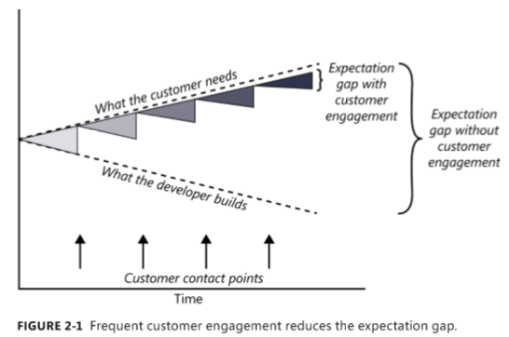
The expectation gap

Slide 5
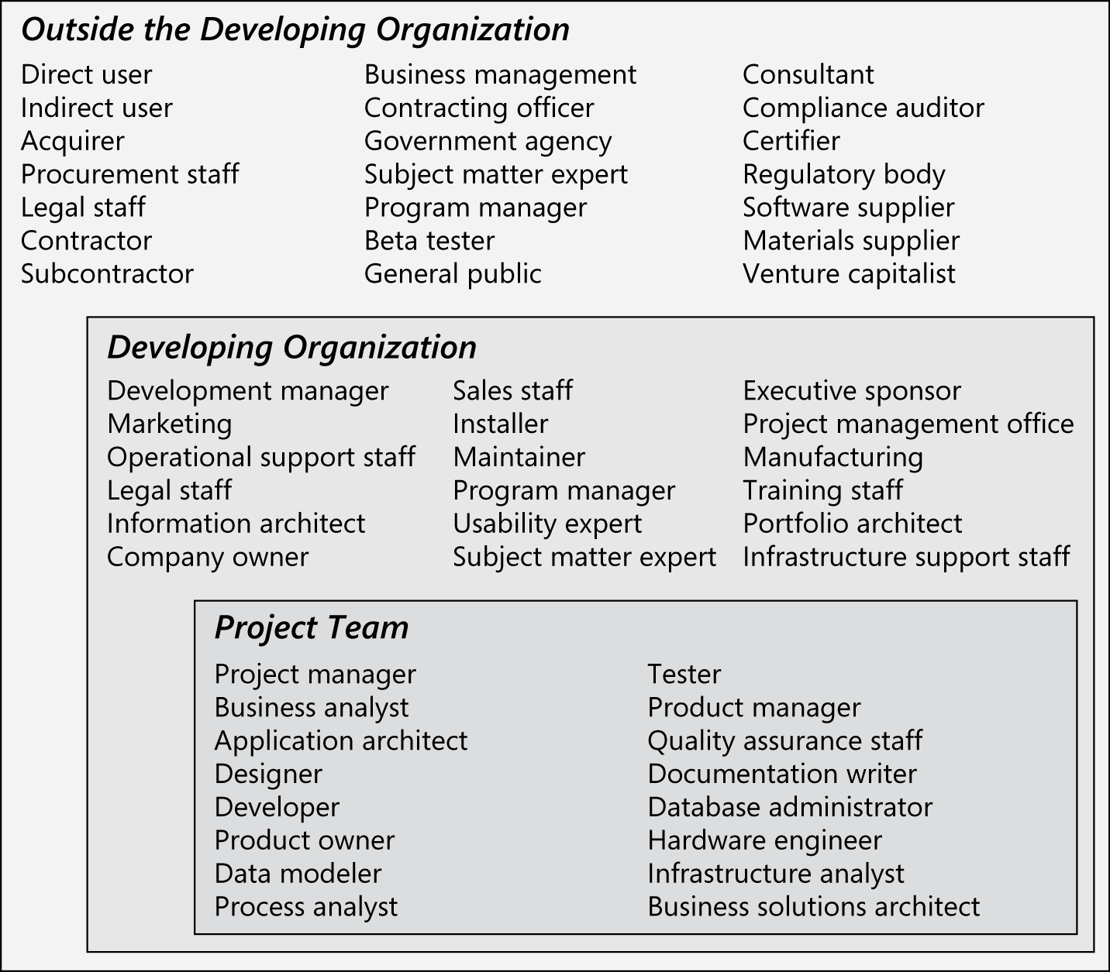
Who is the customer?

Slide 6
Stakeholders-Customers
A stakeholder is a person, group, or organization that is actively involved in a project, is affected by its process or outcome, or can influence its process or outcome. Stakeholders can be internal or external to the project team and to the developing organization.
Customers are a subset of stakeholders. A customer is an individual or organization that derives either direct or indirect benefit from a product. Software customers could request, pay for, select, specify, use, or receive the output generated by a software product.

Slide 7
Stakeholders-Customers
A stakeholder is a person, group, or organization that is actively involved in a project, is affected by its process or outcome, or can influence its process or outcome. Stakeholders can be internal or external to the project team and to the developing organization.
Customers are a subset of stakeholders. A customer is an individual or organization that derives either direct or indirect benefit from a product. Software customers could request, pay for, select, specify, use, or receive the output generated by a software product.

Slide 8
The customer-development partnership
Customers have the right to:
Expect BAs to speak your language.
Expect BAs to learn about your business and your objectives.
Expect BAs to record requirements in an appropriate form.
Receive explanations of requirements practices and deliverables.
Change your requirements.
Expect an environment of mutual respect.
Hear ideas and alternatives for your requirements and for their solution.
Describe characteristics that will make the product easy to use.
Hear about ways to adjust requirements to accelerate development through reuse.
Receive a system that meets your functional needs and quality expectations.
Notes:
Teacher should explain every the right of customers in requirements engineering activities

Slide 9
The customer-development partnership
Customers have the responsibility to:
Educate BAs and developers about your business.
Dedicate the time that it takes to provide and clarify requirements.
Be specific and precise when providing input about requirements.
Make timely decisions about requirements when asked.
Respect a developer’s assessment of the cost and feasibility of requirements.
Set realistic requirement priorities in collaboration with developers.
Review requirements and evaluate prototypes.
Establish acceptance criteria.
Promptly communicate changes to the requirements.
Respect the requirements development process
Notes:
Teacher should explain every the responsibility of customers in requirements engineering activities

Slide 10
Identifying decision makers
The decision-making group needs to identify its decision leader and to select a decision rule, which describes how they will arrive at their decisions. There are numerous decision rules to choose from, including the following:
The decision leader makes the choice, either with or without discussion with others.
The group votes and the majority rules.
The group votes, but the result must be unanimous to approve the decision.
The group discusses and negotiates to reach a consensus. Everyone can live with the decision and commits to supporting it.
The decision leader delegates authority for making the decision to one individual.
The group reaches a decision, but some individual has veto authority over that decision.

Slide 11
Identifying decision makers
There is no globally correct or appropriate decision rule. A single decision rule won’t work in
every situation, so the group must establish guidelines so they know when to vote, when to reach
consensus, when to delegate, and so on. The people who will be making requirements-related
decisions on each of your projects should choose a decision rule before they confront their first
significant decision.

Slide 12
Reaching agreement on requirements
Reaching agreement on the requirements for the product to be built, or for a specific portion of it, is at the core of the customer-developer partnership. Multiple parties are involved in this agreement:
Customers agree that the requirements address their needs.
Developers agree that they understand the requirements and that they are feasible.
Testers agree that the requirements are verifiable.
Management agrees that the requirements will achieve their business objectives.

Slide 13
Reaching agreement on requirements
The requirements baseline is a set of requirements that has been reviewed and agreed upon and serves as the basis for further development
What if you don’t reach agreement?
Agreeing on requirements on agile projects
Agile projects do not include a formal sign-off action. Agile projects generally maintain requirements in the form of user stories in a product backlog. The product owner and the team reach an agreement on what stories will be developed in the next iteration in a planning session. The set of stories is chosen based on their priority and the team’s velocity (productivity). After that set has been established and agreed to, the stories contained in the iteration are frozen. Requested changes that come in are considered for future iterations.

