Slide 1
CHAPTER 3 Requirements engineering good practices

Slide 2
Objectives
Student should enhance every stage in the requirement development process framework and how to implement these stages.
Student should obtain a wide range of good practice in software requirements to prepare for the next chapters
Need to help student understand these practices aren’t suitable for every situation, so use good judgment, common sense, and experience. Even the best practices need to be selected, applied, and adapted thoughtfully to appropriate situations by skilled business analysts.
Student must enhance that different practices might be most appropriate for understanding the requirements for different portions of a given project.
Use cases and user interface prototypes might help for the client side, whereas interface analysis is more valuable on the server side…etc.

Slide 3
Contents
Requirements engineering good practices
A requirements development process framework
Elicitation
Analysis
Specification
Validation
A representative requirements development process
Requirements management

Slide 4
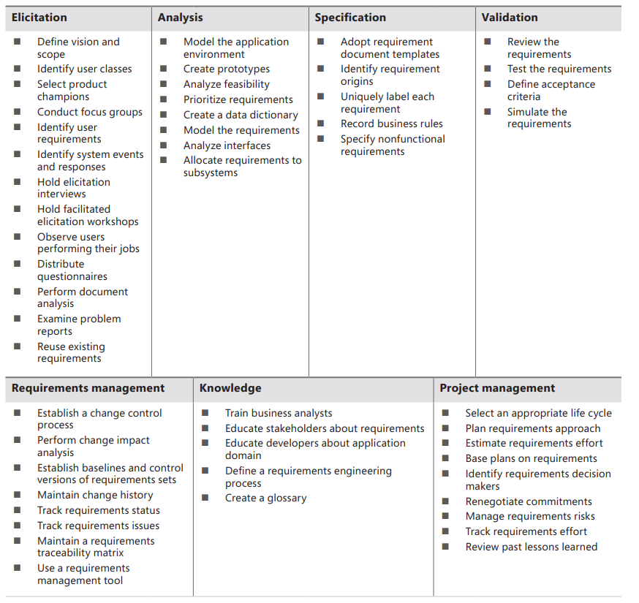
Requirements engineering good practices

Slide 5
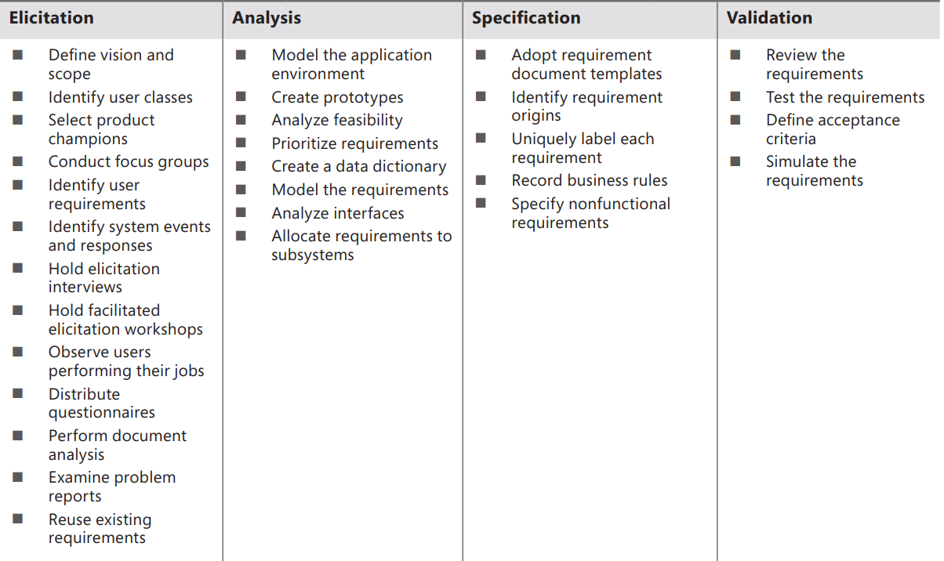
Requirements engineering good practices

Slide 6
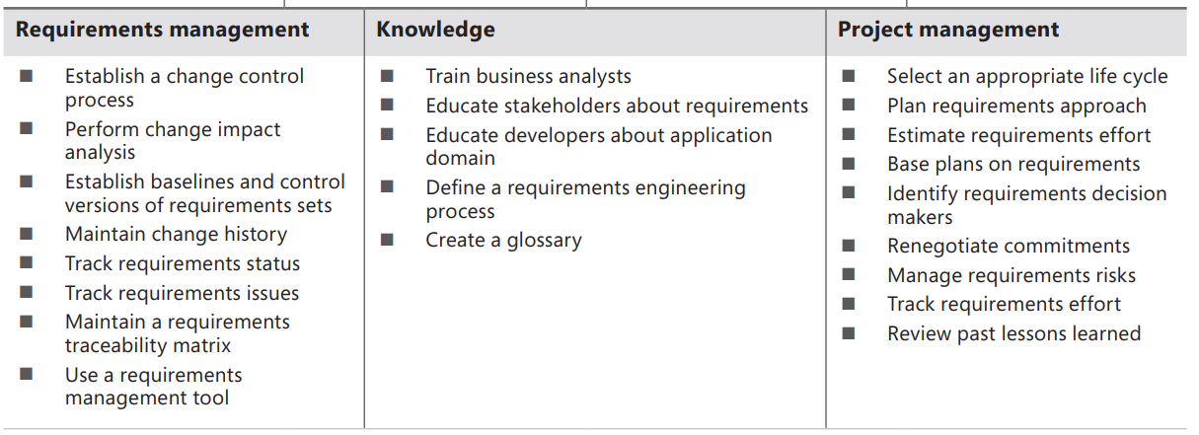
Requirements engineering good practices

Slide 7
Requirements engineering good practices

Slide 8
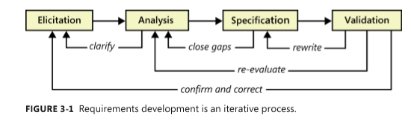
A requirements development process framework
Don’t expect to perform these activities in a simple linear, one-pass sequence, though. In practice, these activities are interwoven, incremental, and iterative

Slide 9
A requirements development process framework
If you’re the BA, you’ll be asking customers questions, listening to what they say, and watching what they do (elicitation). You’ll process this information to understand it, classify it in various categories, and relate the customer needs to possible software requirements (analysis). Your analysis might lead you to realize that you need to clarify some requirements, so you go back and do more elicitation. You’ll then structure the customer input and derived requirements as written requirement statements and diagrams (specification). While writing requirements, you might need to go back and do some additional analysis to close gaps in your knowledge. Next, you’ll ask some stakeholders to confirm that what you’ve captured is accurate and complete and to correct any errors (validation).

Slide 10
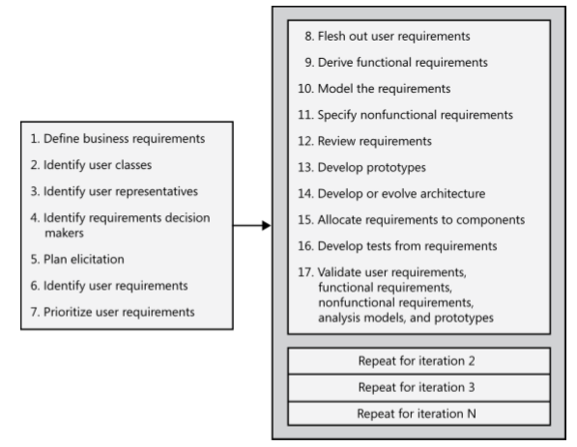
A representative requirements development process

Slide 11
A representative requirements development process
These steps are generally performed approximately in numerical sequence, but the process is not strictly sequential. The first seven steps are typically performed once early in the project (although the team will need to revisit all of these activities periodically). The remaining steps are performed for each release or development iteration. Many of these activities can be performed iteratively, and they can be interwoven. For instance, you can perform steps 8, 9, and 10 in small chunks, performing a review (step 12) after each iteration.

Slide 12
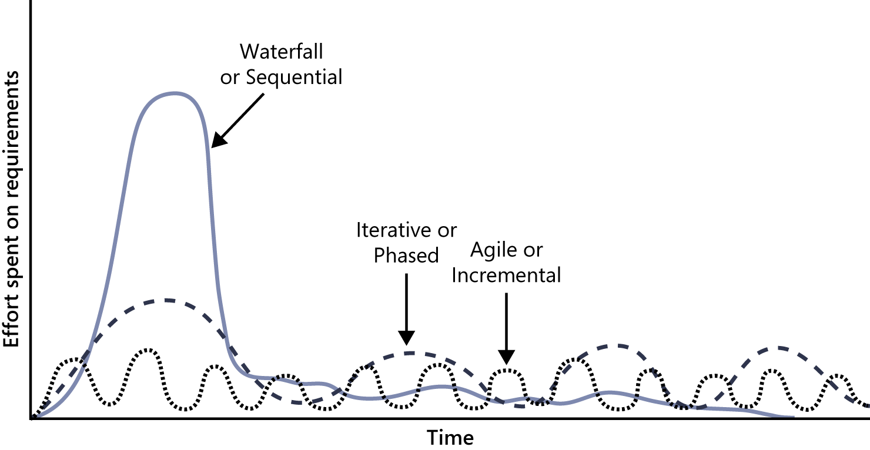
The distribution of requirements development effort over time varies for projects
In the pure waterfall life cycle, you plan to do only one major release, so most of the requirements development effort is allocated for the beginning of the project.

Slide 13
The distribution of requirements development effort over time varies for projects
Projects that follow an iterative development process, such as the Rational Unified Process, will work on requirements on every iteration through the development process, with a heavier emphasis in the first iteration.. This is also the case if you are planning a series of phased releases, each of which delivers a significant fraction of the product’s ultimate functionality.

Slide 14
The distribution of requirements development effort over time varies for projects
Agile and other incremental development projects aim to release functionality every few weeks. They will have frequent but small requirements development efforts. Such projects begin by doing a first cut at collecting user requirements in the form of simple user stories that describe major objectives the user wants to accomplish with the help of the system

Slide 15
Requirements elicitation
Define product vision and project scope
Identify user classes and their characteristics
Select a product champion for each user class
Conduct focus groups with typical users
Work with user representatives to identify user requirements
Identify system events and responses
Hold elicitation interviews
Hold facilitated elicitation workshops
Observe users performing their jobs
Distribute questionnaires
Perform document analysis
Examine problem reports of current systems for requirement ideas
Reuse existing requirements

Slide 16
Requirements analysis
Model the application environment
Create user interface and technical prototypes
Analyze requirement feasibility
Prioritize the requirements
Create a data dictionary
Model the requirements
Analyze interfaces between your system and the outside world
Allocate requirements to subsystems

Slide 17
Requirements specification
Adopt requirement document templates
Identify requirement origins
Uniquely label each requirement
Record business rules
Specify nonfunctional requirements

Slide 18
Requirements validation
Review the requirements
Test the requirements
Define acceptance criteria
Simulate the requirements

Slide 19
Requirements management
Establish a requirements change control process
Perform impact analysis on requirements changes
Establish baselines and control versions of requirements sets
Maintain a history of requirements changes
Track the status of each requirement
Track requirements issues
Maintain a requirements traceability matrix
Use a requirements management tool

Slide 20
Knowledge
Train business analysts
Educate stakeholders about requirements
Educate developers about the application domain
Define a requirements engineering process
Create a glossary

Slide 21
Project management
Select an appropriate software development life cycle
Plan requirements approach
Estimate requirements effort
Base project plans on requirements
Identify requirements decision makers
Renegotiate project commitments when requirements change
Analyze, document, and manage requirements-related risks
Track the effort spent on requirements
Review lessons learned regarding requirements on other projects

