Slide 1
Test Management
Chapter 5
Software Testing
1 Principles
2 Lifecycle
3 Static testing
4 Dynamic test
techniques
5 Management
6 Tools

Slide 2
Contents
1
2
3
ISTQB / ISEB Foundation Exam Practice
4
5
6
Test Management
Organisation
Configuration Management
Test estimation, monitoring and control
Risk and Testing
Incident management

Slide 3
Importance of Independence
No. faults
Release to
End Users
Time

Slide 4
Organisational structures for testing
Developer responsibility (only)
Development team responsibility (buddy system)
Tester(s) on the development team
Dedicated team of testers (not developers)
Internal test consultants (advice, review, support, not perform the testing)
Outside organisation (3rd party testers)

Slide 5
Testing by developers
Pro’s:
  know the code best
  will find problems that the testers will miss
  they can find and fix faults cheaply
Con’s
  difficult to destroy own work
  tendency to 'see' expected results, not actual results
  subjective assessment

Slide 6
Testing by development team
Pro’s:
  some independence
  technical depth
  on friendly terms with “buddy” - less threatening
Con’s
  pressure of own development work
  technical view, not business view
  lack of testing skill

Slide 7
Tester on development team
Pro’s:
  independent view of the software
  dedicated to testing, no development responsibility
  part of the team, working to same goal: quality
Con’s
  lack of respect
  lonely, thankless task
  corruptible (peer pressure)
  a single view / opinion

Slide 8
Independent test team
Pro’s:
  dedicated team just to do testing
  specialist testing expertise
  testing is more objective & more consistent
Con’s
  “over the wall” syndrome
  may be antagonistic / confrontational
  over-reliance on testers, insufficient testing by developers

Slide 9
Internal test consultants
Pro’s:
  highly specialist testing expertise, providing support and help to improve testing done by all
  better planning, estimation & control from a broad view of testing in the organisation
Con’s
  someone still has to do the testing
  level of expertise enough?
  needs good “people” skills - communication
  influence, not authority

Slide 10
Outside organisation (3rd party)
Pro’s:
  highly specialist testing expertise (if out-sourced to a good organisation)
  independent of internal politics
Con’s
  lack of company and product knowledge
  expertise gained goes outside the company
  expensive?

Slide 11
Usual choices
Component testing:
  done by programmers (or buddy)
Integration testing in the small:
  poorly defined activity
System testing:
  often done by independent test team
Acceptance testing:
  done by users (with technical help)
  demonstration for confidence

Slide 12
So what we have seen thus far..
independence is important
  not a replacement for familiarity
different levels of independence
  pro's and con's at all levels
test techniques offer another dimension to independence (independence of thought)
test strategy should use a good mix
  "declaration of independence”
balance of skills needed

Slide 13
Skills needed in testing
Technique specialists
Automators
Database experts
Business skills & understanding
Usability expert
Test environment expert
Test managers

Slide 14
Contents
1
2
3
ISTQB / ISEB Foundation Exam Practice
4
5
6
Test Management
Organisation
Configuration Management
Test estimation, monitoring and control
Risk and Testing
Incident management

Slide 15
Problems resulting from poor configuration management
can’t reproduce a fault reported by a customer
can’t roll back to previous subsystem
one change overwrites another
emergency fault fix needs testing but tests have been updated to new software version
which code changes belong to which version?
faults which were fixed re-appear
tests worked perfectly - on old version
“Shouldn’t that feature be in this version?”

Slide 16
A definition of Configuration Management
“The process of identifying and defining the configuration items in a system,
controlling the release and change of these items throughout the system life cycle,
recording and reporting the status of configuration items and change requests,
and verifying the completeness and correctness of configuration items.”
  ANSI/IEEE Std 729-1983, Software Engineering Terminology

Slide 17
Configuration Management
An engineering management procedure that includes
  configuration identification
  configuration control
  configuration status accounting
  configuration audit
    Encyclopedia of Software Engineering, 1994

Slide 18
Configuration identification
Configuration
Identification
Configuration
Control
Status
Accounting
Configuration
Auditing
CI Planning
Configuration
Structures
CI: Configuration item: stand alone,
test alone, use alone element
Selection
criteria
Naming
Conventions
Version/issue
Numbering
Baseline/release
Planning

Slide 19
Configuration control
Configuration
Identification
Configuration
Control
Status
Accounting
Configuration
Auditing
Controlled
Area/library
Problem/fault
Reporting
Change
Control
Configuration
Control Board
CI
Submission
Investigation
Impact
Analysis
Status/version
Control
Clearance
Authorised
Amendment
Withdrawal/
Distribution
control
Review/
Test

Slide 20
Status accounting & Configuration Auditing
Configuration
Identification
Configuration
Control
Status
Accounting
Configuration
Auditing
Status Accounting
Database
Procedural
Conformance
Input to SA
Database
CI
Verification
Traceability,
impact
analysis
Queries and
Reports
Agree with
customer what
has been built,
tested & delivered
Data
Analysis

Slide 21
Products for CM in testing
test plans
test designs
test cases:
  test input
  test data
  test scripts
  expected results
actual results
test tools
CM is critical
for controlled
testing
What would not be under
configuration management?
Live data!

Slide 22
Contents
1
2
3
ISTQB / ISEB Foundation Exam Practice
4
5
6
Test Management
Organisation
Configuration Management
Test estimation, monitoring and control
Risk and Testing
Incident management

Slide 23
Estimating testing is no different
Estimating any job involves the following
  identify tasks
  how long for each task
  who should perform the task
  when should the task start and finish
  what resources, what skills
  predictable dependencies
    task precedence (build test before running it)
    technical precedence (add & display before edit)
Notes:
Software being tested has internal dependencies
- calling hierarchy
- messages passed
- use of data
- visibility features (display / print)
Testing is dependent on the development schedule
- test order should determine planned build order
- actual build order depends on internal development aspects
Testing is dependent on the quality of the software
- faults found => retesting

Slide 24
Estimating testing is different
Additional destabilising dependencies
  testing is not an independent activity
  delivery schedules for testable items missed
  test environments are critical
Test Iterations (Cycles)
  testing should find faults
  faults need to be fixed
  after fixed, need to retest
  how many times does this happen?
Notes:
The Test Effort includes development activities as well as test activities

Slide 25
Test cycles / iterations
Theory:
Test
Iden
Des
Bld
Ex
Ver
Retest
Practice:
Test
Debug
Retest
D
R
D
R
3-4 iterations is typical

Slide 26
Estimating iterations
past history
number of faults expected
  can predict from previous test effectiveness and previous faults found (in test, review, Inspection)
  % faults found in each iteration (nested faults)
  % fixed [in]correctly
time to report faults
time waiting for fixes
how much in each iteration?

Slide 27
Time to report faults
If it takes 10 mins to write a fault report, how many can be written in one day?
The more fault reports you write, the less testing you will be able to do.
Test
Fault analysis & reporting
Mike Royce: suspension criteria: when testers spend > 25% time on faults

Slide 28
Measuring test execution progress 1
tests planned
what would
you do?
tests run
tests passed
what does this
mean?
now
release
date

Slide 29
Diverging S-curve
Possible causes
Potential control actions
poor test entry criteria
ran easy tests first
insufficient debug effort
common faults affect all tests
software quality very poor
tighten entry criteria
cancel project
do more debugging
stop testing until faults fixed
continue testing to scope software quality
Note: solutions / actions will impact other
things as well, e.g. schedules

Slide 30
Measuring test execution progress 2
tests
planned
run
passed
action
taken
old release
date
new release
date

Slide 31
Measuring test execution progress 3
tests
planned
run
passed
action
taken
old release
date
new release
date

Slide 32
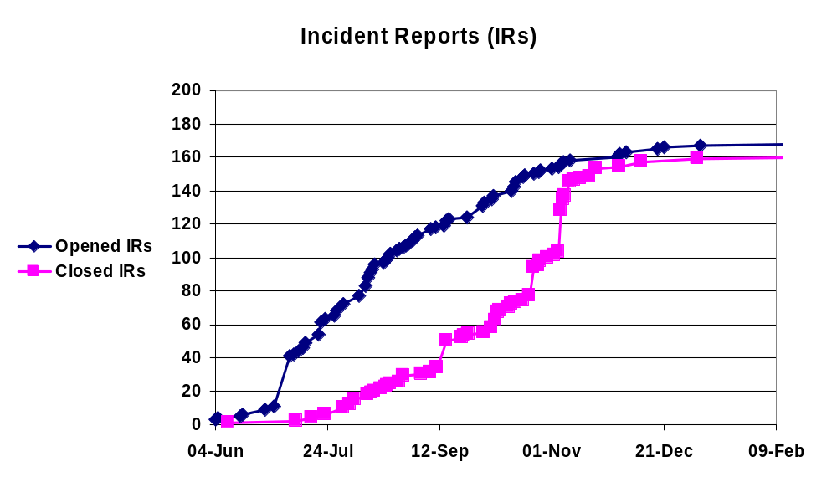
Case history
Source: Tim Trew, Philips, June 1999

Slide 33
Control
Management actions and decisions
  affect the process, tasks and people
  to meet original or modified plan
  to achieve objectives
Examples
  tighten entry / exit criteria
  reallocation of resources
Feedback is essential to see the effect of actions and decisions

Slide 34
Entry and exit criteria
Test
Phase 2
is it ready for my testing?
"tested"
Test
Phase 1
Phase 2
Phase 1
Entry criteria
Exit criteria
Acceptance
criteria
Completion
criteria

Slide 35
Entry/exit criteria examples
poor
clean compiled
programmer claims it is working OK
lots of tests have been run
tests have been reviewed / Inspected
no faults found in current tests
all faults found fixed and retested
specified coverage achieved
all tests run after last fault fix, no new faults
better

Slide 36
What actions can you take?
What can you affect?
  resource allocation
  number of test iterations
  tests included in an iteration
  entry / exit criteria applied
  release date
What can you not affect:
  number of faults already there
What can you affect indirectly?
  rework effort
  which faults to be fixed [first]
  quality of fixes (entry criteria to retest)

Slide 37
Contents
1
2
3
ISTQB / ISEB Foundation Exam Practice
4
5
6
Test Management
Organisation
Configuration Management
Test estimation, monitoring and control
Risk and Testing
Incident management

Slide 38
Risk and Testing
Risks and levels of risk
  It's the possibility of a negative or undesirable outcome.
Product risks
  The possibility that the system or software might fail to satisfy some reasonable customer, user, or stakeholder expectation
  Risk-based testing is the idea that we can organize our testing efforts in a way that reduces the residual level of product risk when the system ships.

Slide 39

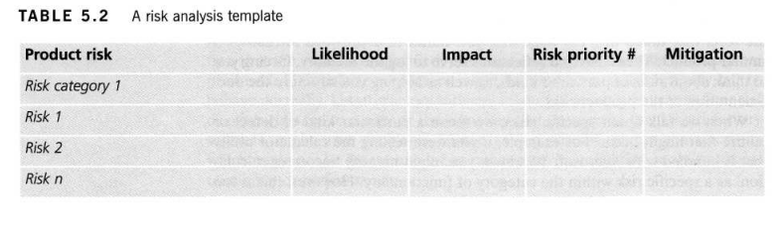
Risk Analysis

Slide 40
Risk and Testing
Project risks
  For any risk, product or project, you have four typical options:
    Mitigate, Contingency, Transfer, Ignore
Tying it all together for risk management

Slide 41
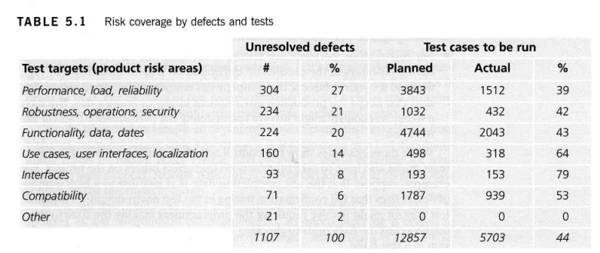
Risk coverage by defects and tests

Slide 42
Contents
1
2
3
ISTQB / ISEB Foundation Exam Practice
4
5
6
Test Management
Organisation
Configuration Management
Test estimation, monitoring and control
Risk and Testing
Incident management

Slide 43
Incident management
Incident: any event that occurs during testing that requires subsequent investigation or correction.
  actual results do not match expected results
  possible causes:
    software fault
    test was not performed correctly
    expected results incorrect
  can be raised for documentation as well as code

Slide 44
Incidents
May be used to monitor and improve testing
Should be logged (after hand-over)
Should be tracked through stages, e.g.:
  initial recording
  analysis (s/w fault, test fault, enhancement, etc.)
  assignment to fix (if fault)
  fixed not tested
  fixed and tested OK
  closed

Slide 45
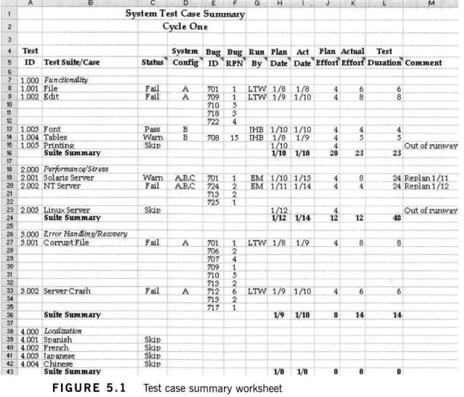
Test case summary worksheet

Slide 46
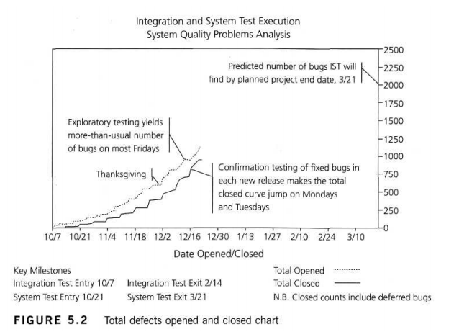
Total Defect Opened/Closed Chart

Slide 47
Use of incident metrics
We’re better
than last year
Is this testing approach “wearing out”?
What happened
in that week?
How many faults
can we expect?

Slide 48
Report as quickly as possible?
incident
report
test
re-test
fault fixed
10
5
20
dev
5
reproduce
fix
report
can’t reproduce - “not a fault” - still there
test
10
dev
5
can’t reproduce, back to test to report again
can’t
reproduce
insufficient information - fix is incorrect

Slide 49
What information about incidents?
Test ID
Test environment
Software under test ID
Actual & expected results
Severity, scope, priority
Name of tester
Any other relevant information (e.g. how to reproduce it)

Slide 50
Severity versus priority
Severity
  impact of a failure caused by this fault
Priority
  urgency to fix a fault
Examples
  minor cosmetic typo
  crash if this feature is used
company name,
board member:
priority, not severe
Experimental,
not needed yet:
severe, not priority

Slide 51
Incident Lifecycle
Tester Tasks
Developer Tasks
1 steps to reproduce a fault
2 test fault or system fault
3 external factors that influence the symptoms
4 root cause of the problem
5 how to repair (without introducing new problems)
6 changes debugged and properly component tested
7 is the fault fixed?
Source: Rex Black “Managing the Testing Process”, MS Press, 1999

Slide 52
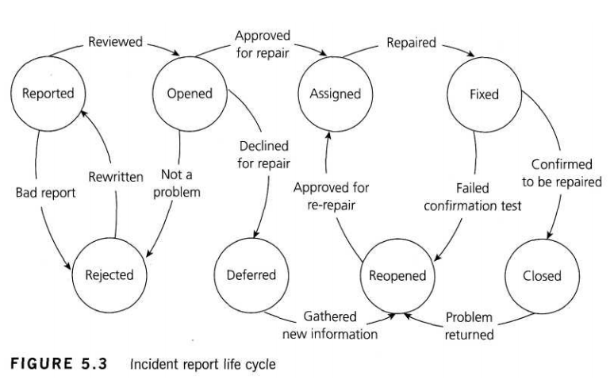
Incident Report Life Cycle

Slide 53
An email notifies about an incident
Read and create an incident report from its content
Notes:
Hi there!
Well, I nearly caused a panic today because I thought I had found a mega
showstopper on the trading system we are testing. The test manager and others got
involved examining databases first on the server and then on the gateway that feeds
the clients, checking update logs from processes that ran overnight as well as
checking data passed to the client. Eventually I found the problem. I had mis-clicked
on a .bat file when running up a client and had run up the wrong client environment.
By that time the test manager was ready to say a few short words in my ear,
particularly as the development people had started to get involved and they have zero
tolerance for mistakes made by testers. The only saving grace was that I found the
mistake and not one of the developers.
It was, objectively, an interesting mistake. When you log into the server test
environments, the panels always show the environment to which you are
connected. In our case we have two test environments called Systest14 and
Systest15 and my tests were set up in Systest15. To run up the clients, we have to
run .bat files for either a 14 or 15 client. I had started two clients, that is two
exchange participants, so I could do some trading between them.
It appears I started the first client OK in environment 15 but when I started the
second, I accidentally moved the mouse a fraction so it ran the 14 .bat file that is next
to it in the Explorer file list. To make matters worse, the client screens do not show the
environment to which you are attached.
At first I felt a bit stupid having caused much hectic and wasted activity. On
reflection I thought that if I, as a reasonably competent person, can make a mistake
like this then something is wrong. On the server side when I log on to a test
environment, I have to enter the environment name and it's shown on all the panels.
On the client side, I run a client test environment by selecting a .bat file from a list of
many and have to ensure I click on the right file. There is neither a display nor the
ability to determine the client environment in which I am working.
So I am going to log this as a high priority, or even showstopper, error - the client
does not show the environment. In real life terms, it means a real user could be
connected to the production system and think he is connected to a test system and
screw up trading. I know this happened once on the equities trading system, when a
trader entered a load of test transactions into the production system by mistake and
caused mayhem.
As an addendum to this story, a couple of days later one of the testers found what
appeared to be another mega showstopper. He and the test manager spent three
hours crawling all over the system before they discovered the 'error'. A new filter had
been added to the client software to filter transactions displayed in panels by
geographical market. Unknown to them, it was set to a default of the German market,
whereas they thought they were in the UK market. Consequently, at first sight, it
appeared there were fundamental problems with the network transaction bus and the
message-broadcasting systems. Apart from the issue that they should have been
informed of this change, it raised a similar problem to the one I had experienced -the
client system does not display the market in which you are trading.
Well - I'm off for another happy day at the
office! All the best

Slide 54
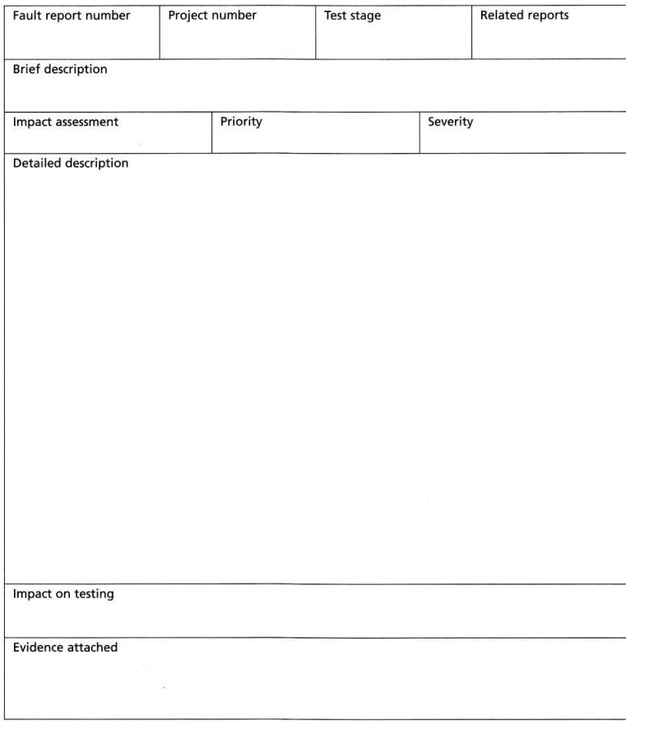
Incident Report

Slide 55
Metrics Example Good Quality Management
Goal: Estimate Defect Density < 2 defects per KloC
  Q1: What is the size of the software?
    M1.1: KloC per module
  Q2: How many defects in code?
    M2.1: Estimation of # defects
  Q3: How many defects found?
    M3.1: # defects in Review and Inspection
    M3.2: # defects in subsequent tests
  Q4: What is the yield of the tests done?
    M4.1: # defects (M3) divided by estimation (M2)

Slide 56
Metrics Exercise
Goal: In ST, do an optimal check in minimum time based on the 3 customers for Regeression
  Priority of processes used by customers
  Coverage of the processes
  Incidents found
  Severity of incidents
  Time planned and spent

Slide 57
Summary: Key Points
1
2
3
ISTQB / ISEB Foundation Exam Practice
4
5
6
Test Management
Independence can be achieved by different organisational structures
Configuration Management is critical for testing
Tests must be estimated, monitored and controlled
Risk and Testing
Incidents need to be managed

