Slide 1
Real Estate Price Prediction
Minh Phuong

Slide 2
STEP 1: IDENTIFY PROBLEM
Context: A local Vermont/New Hampshire real estate firm is looking into modeling closed prices for houses.
Question: CAN YOU PREDICT CLOSED PRICE OF A PROPERTY USING THEIR LISTING FEATURES

Slide 3
STEP 2: OBTAINING DATA
Data was obtained from Kaggle.com
This dataset contains features of houses in three towns in Vermont, which make up a sizable chunk of the real estate firm's business.
MLS.com is the real estate information platform that is publicly available. Features were exported from an MLS web platform. (Perhaps webscraping)

Slide 4
STEP 3: UNDERSTANDING THE DATA
Features in Data Frame:
Features | Type
Id, bedrooms_total, baths_total, acres, sq_ft_tot_fn, tax_gross_amount, assessment_value_town, garage_capacity, year_built, total_stories, water_frontage_length, rooms_total, | Numeric
Address, city ,garage_type , surveyed , seasonal , water_body_type , short_sale , flood_zone , easements , current_use , covenants , common_land_acres, basement_access_type,basement,price_closed | String

Slide 5
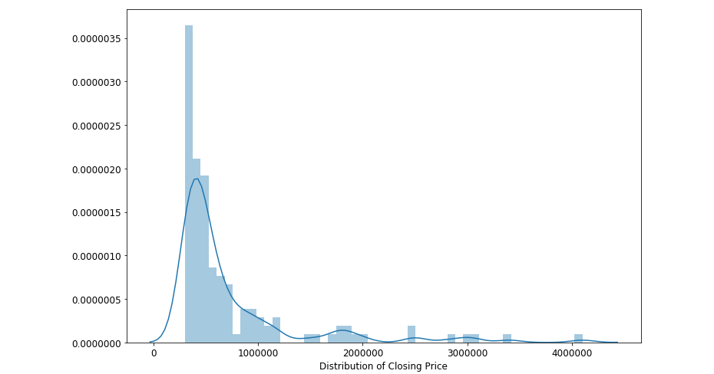
STEP 3: UNDERSTANDING THE DATA
Distribution of Closing Price
Almost normal distribution with a long tail

Slide 6
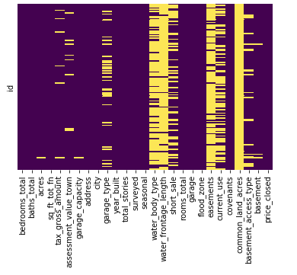
STEP 3: UNDERSTANDING THE DATA
Missing values: Using Seaborn heatmap
Most prominent:
common_land_acres
water_frontage_length
easements
water_body_type

Slide 7
STEP 4: PREPARING THE DATA
Drop features that are missing from more than 80% of the data set
df = df.drop(['common_land_acres','water_frontage_length','easements','water_body_type'],axis=1)
Filled the rest with mean (numerical)
for col in ['acres','garage_capacity','tax_gross_amount','assessment_value_town']: df[col] = df[col].fillna(df[col].mean())

Slide 8
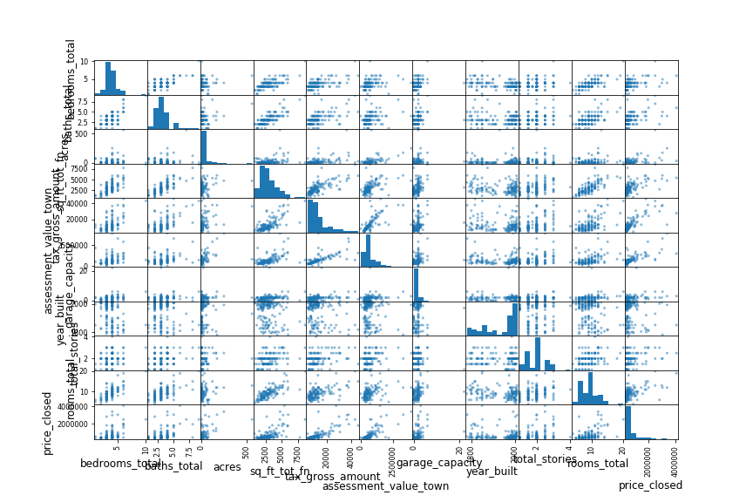
STEP 5: VISUALIZATION
Explore relationships:

Slide 9
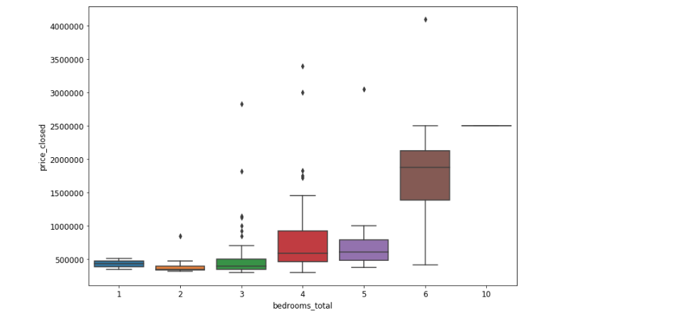
STEP 5: VISUALIZATION
Narrow down to features with regression:

Slide 10
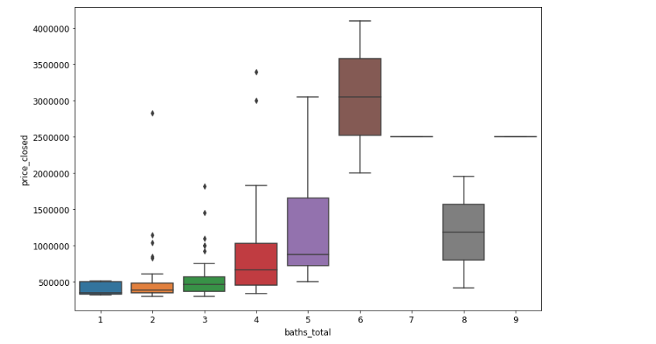
STEP 5: VISUALIZATION
Narrow down to features with regression:

Slide 11
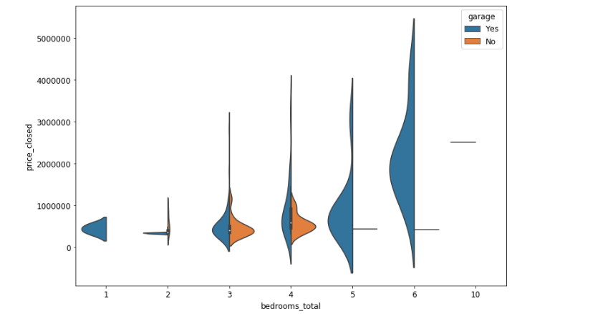
STEP 5: VISUALIZATION
Narrow down to features with regression:

Slide 12
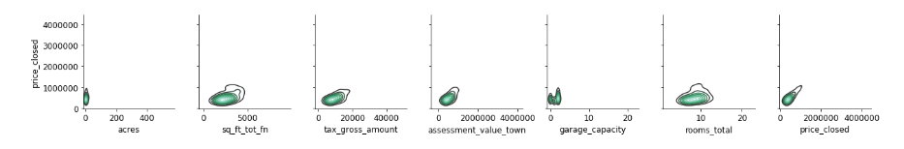
STEP 5: VISUALIZATION
Narrow down to features with no clear regression:

Slide 13
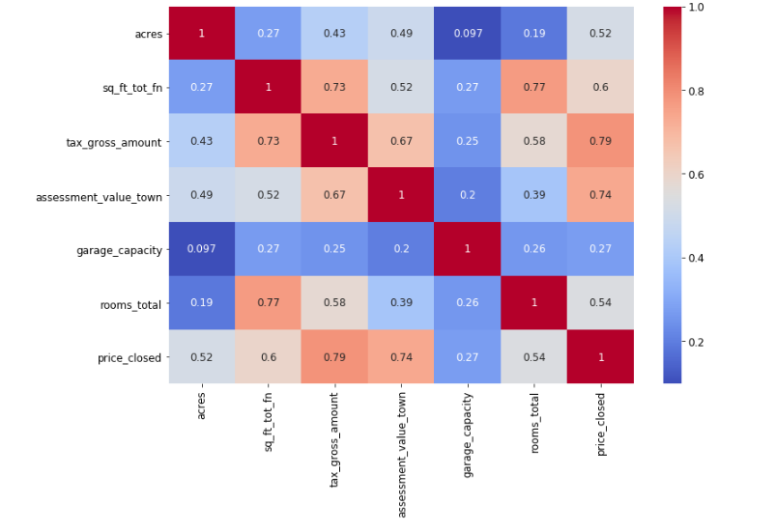
STEP 5: VISUALIZATION
Find out correlation:

Slide 14
Next step:
Feature engineering
Try creating cluster as a feature
Modeling techniques: Regression
Experiment with dimensionality reduction and deep learning (TensorFlow)

