Slide 1
MULTIVARIATE REGRESSION ON REAL ESTATE PRICE PREDICTION
Minh Phuong

Slide 2
OBJECTIVE
Apply what I learned in class
Explore new models that I have not used
Portfolio piece for job search (Yay employment!)

Slide 3
LITERATURE REVIEW
“Real estate price prediction demand models that are capable of accurately and efficiently predicting property values. Models such as Artificial Neural Networks (ANN), Adaptive Neuro-Fuzzy Inference Systems (ANFIS) and Fuzzy Least-Squares Regression (FLSR) are used. Simulation results show that FLSR provides a superior prediction function as compared to ANN and FIS in capturing the functional relationship between dependent and independent real estate variables and has the lowest computational complexity.”
APPLICATION OF FUZZY REGRESSION MODEL FOR REAL ESTATE PRICE PREDICTION
Abdul Ghani Sarip, Muhammad Burhan Hafez and Md. Nasir Daud

Slide 4
LITERATURE REVIEW
“This process involves five steps: (a) apply the Best Subsets procedure to select the variables; (b) build linear regression models from the selected variables; (c) conduct diagnostics to find if the residual errors are normally distributed; (d) apply Box-Cox transformation to fix the non-Gaussian residual problem found in the diagnosis; and (e) restart the analysis to build the final model. This is a typical process of building regression models that may apply to many applications where predictive modeling is the goal.”
MULTIVARIATE REGRESSION MODELING FOR HOME VALUE ESTIMATES WITH EVALUATION USING MAXIMUM INFORMATION COEFFICIENT
Gongzhu Hu, Jinping Wang, and Wenying Feng

Slide 5
LITERATURE REVIEW
“Even though the hedonic price model has been widely recognized, issues such as model specification procedures, multicollinearity, independent variable interactions, heteroscedasticity, non-linearity and outlier data points can seriously hinder the performance of the hedonic price model in real estate valuations”
HOUSE PRICE PREDICTION: HEDONIC PRICE MODEL VS. ARTIFICIAL NEURAL NETWORK
Visit Limsombunchai, Christopher Gan and Minsoo Lee

Slide 6
INITIAL THOUGHT PROCESS
Some of the proven methods to real estate price predictions are hedonic pricing model, Artificial Neural Networks and Fuzzy Regression.
Challenges to model accuracy and performance include: Overfitting of trained data, heterogenous weights of all variables as well as multicollinearity and outlier data points
In this project, I will attempt to build a predictive model by reducing factors into meaningful features that hold maximum information, while reducing the issue of overfitting and over-complex models.
Selecting features, simplifying coefficients and reducing noise are critical. Models should also be consistently retrained and reevaluated to study the different effects on accuracy.

Slide 7
IDENTIFY PROBLEM
Context: A local Vermont/New Hampshire real estate firm is looking into modeling closed prices for houses.
Question: CAN YOU PREDICT CLOSED PRICE OF A PROPERTY USING THEIR LISTING FEATURES

Slide 8
WORKFLOW
Train model
Try different parameters, preprocessing and transformation (dimensionality reduction), inverse transformation
Repeat until best model found; create ensemble
Fine tune on testing accuracy

Slide 9
STEP 2: OBTAINING DATA
Data was obtained from Kaggle.com
This dataset contains features of houses in three towns in Vermont, which make up a sizable chunk of the real estate firm's business.
MLS.com is the real estate information platform that is publicly available. Features were exported from an MLS web platform. (Perhaps webscraping)

Slide 10
STEP 3: UNDERSTANDING THE DATA
Features in Data Frame:
Features | Type
Id, bedrooms_total, baths_total, acres, sq_ft_tot_fn, tax_gross_amount, assessment_value_town, garage_capacity, year_built, total_stories, water_frontage_length, rooms_total, | Numeric
Address, city ,garage_type , surveyed , seasonal , water_body_type , short_sale , flood_zone , easements , current_use , covenants , common_land_acres, basement_access_type,basement,price_closed | String

Slide 11
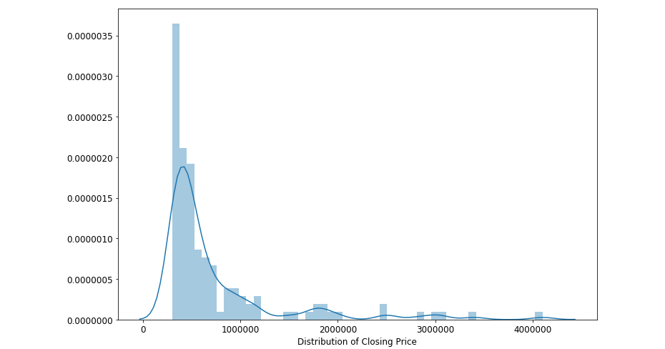
STEP 3: UNDERSTANDING THE DATA
Distribution of Closing Price
Almost normal distribution with a long tail

Slide 12
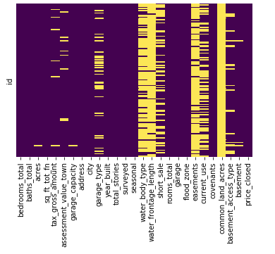
STEP 3: UNDERSTANDING THE DATA
Missing values: Using Seaborn heatmap
Most prominent:
common_land_acres
water_frontage_length
easements
water_body_type

Slide 13
STEP 4: PREPARING THE DATA
Drop features that are missing from more than 80% of the data set
df = df.drop(['common_land_acres','water_frontage_length','easements','water_body_type'],axis=1)
Filled the rest with mean (numerical)
for col in ['acres','garage_capacity','tax_gross_amount','assessment_value_town']: df[col] = df[col].fillna(df[col].mean())

Slide 14
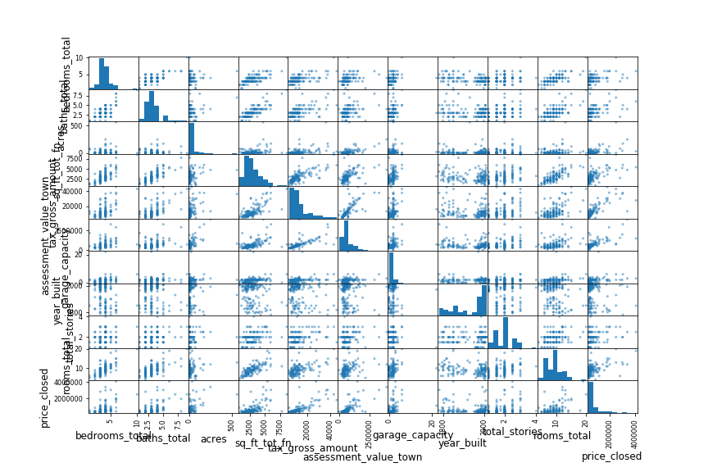
STEP 5: VISUALIZATION
Explore relationships:

Slide 15
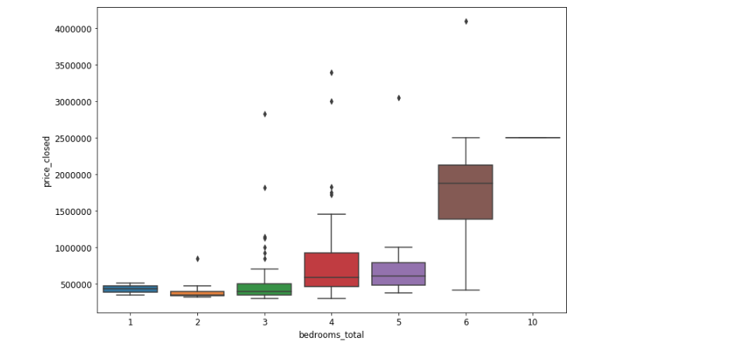
STEP 5: VISUALIZATION
Narrow down to features with regression:

Slide 16
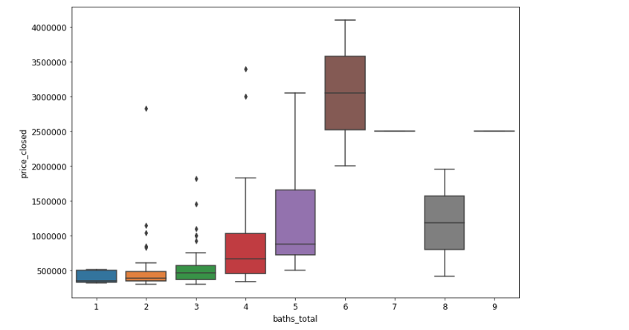
STEP 5: VISUALIZATION
Narrow down to features with regression:

Slide 17
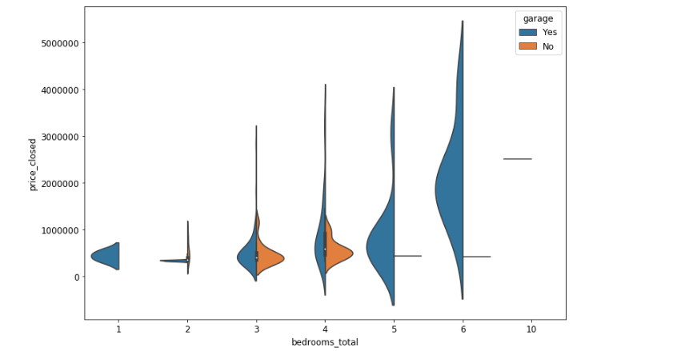
STEP 5: VISUALIZATION
Narrow down to features with regression:

Slide 18
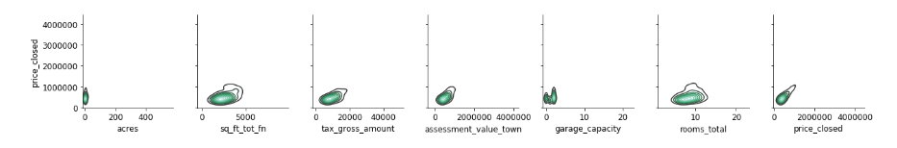
STEP 5: VISUALIZATION
Narrow down to features with no clear regression:

Slide 19
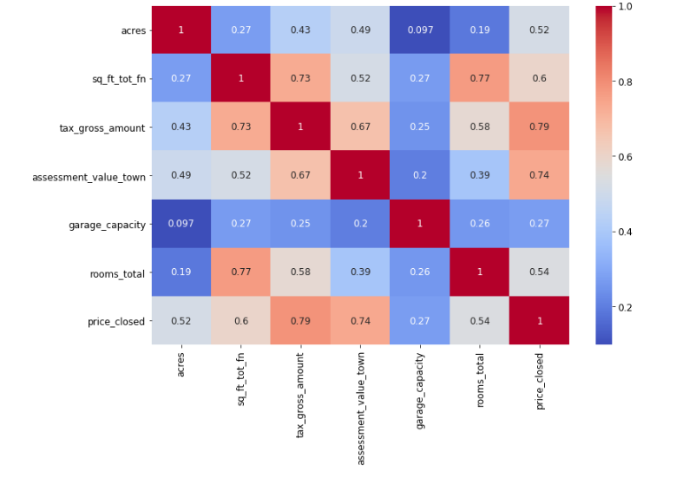
STEP 5: VISUALIZATION
Find out correlation:

Slide 20
Simple Linear Regression
Metrics such as mean absolute errors, mean squared errors and root mean squared errors are used to evaluate this first run:
MAE: 314120.6
MSE: 262121390014.0
RMSE: 511977.9
Null Accuracy: 649444.9
Testing Accuracy: RMSE == 451590.9 (NEEDS IMPROVEMENT)

Slide 21
Continue to clean up data set, Feature Engineering
K Nearest Neighbors estimator is used to impute values for missing values using their closest 5 neighbor rows
Mapping is also used on some of the smaller missing values on features
Clean dataset is exported out to be used in the next step
Entire process from preliminary and current step is repeated on the testing set

Slide 22
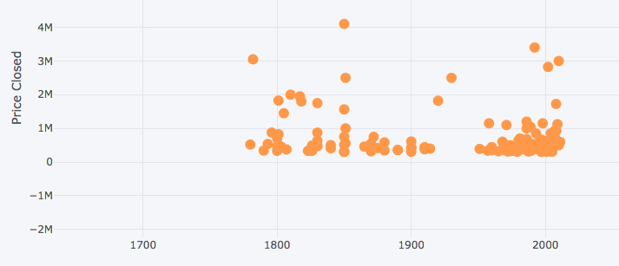
Further EDA
Look for linear relationship, outliers and clusters

Slide 23
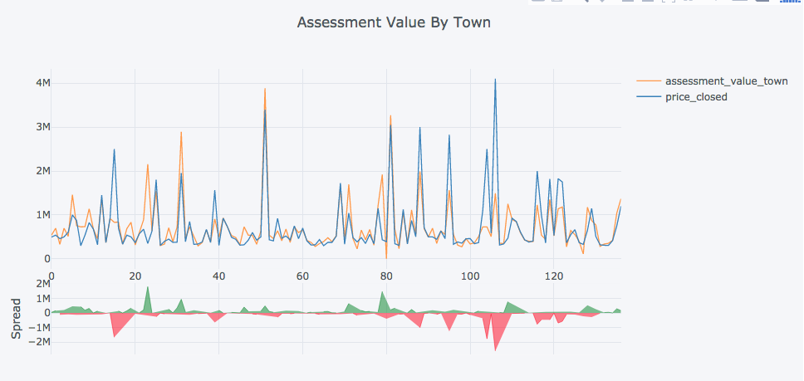
Further EDA
Look for linear relationship, outliers and clusters

Slide 24
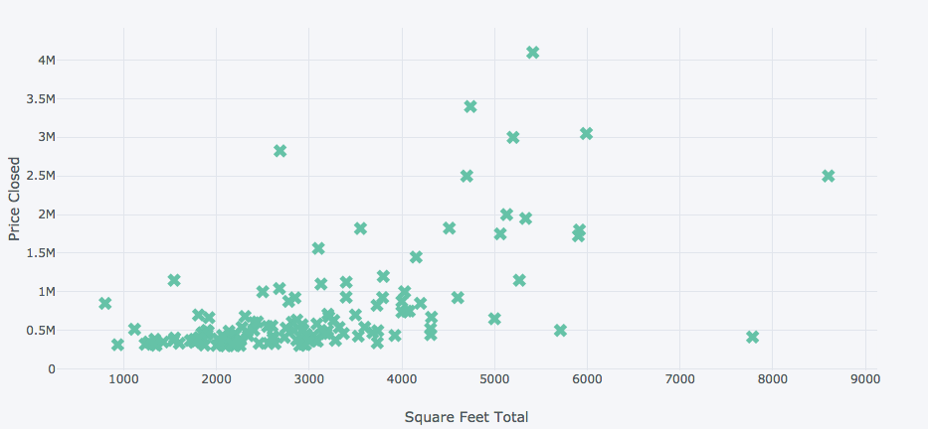
Further EDA
Look for linear relationship, outliers and clusters

Slide 25
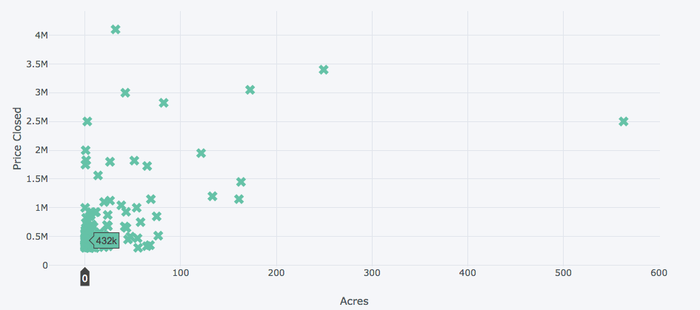
Further EDA
Look for linear relationship, outliers and clusters

Slide 26
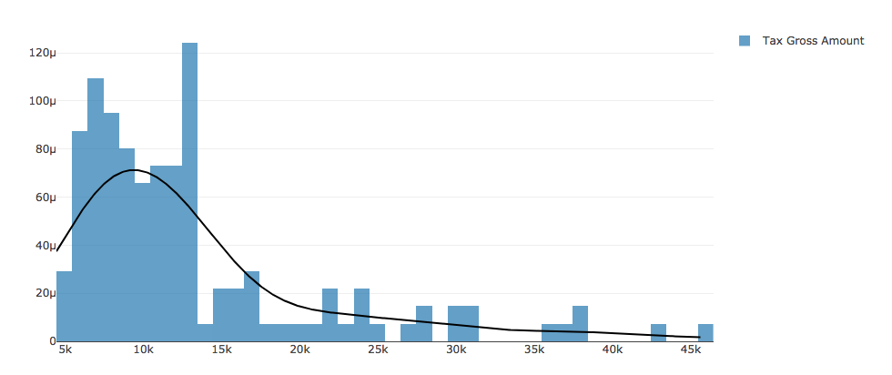
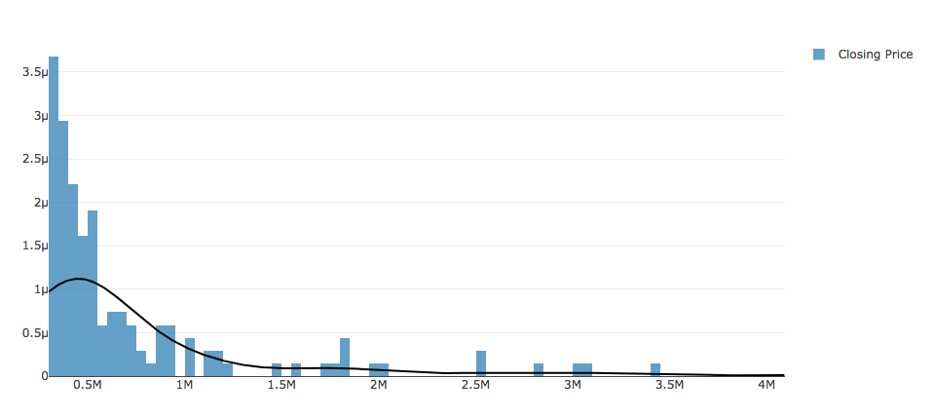
Further EDA
Look for linear relationship, outliers and clusters

Slide 27
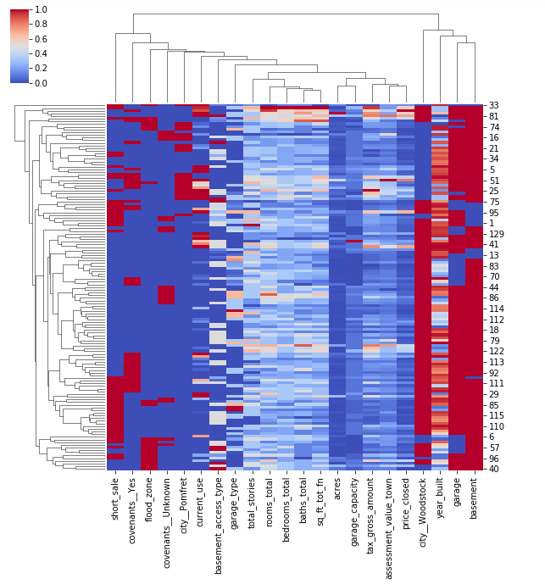
Further EDA
Seaborn cluster: Potential challenge

Slide 28
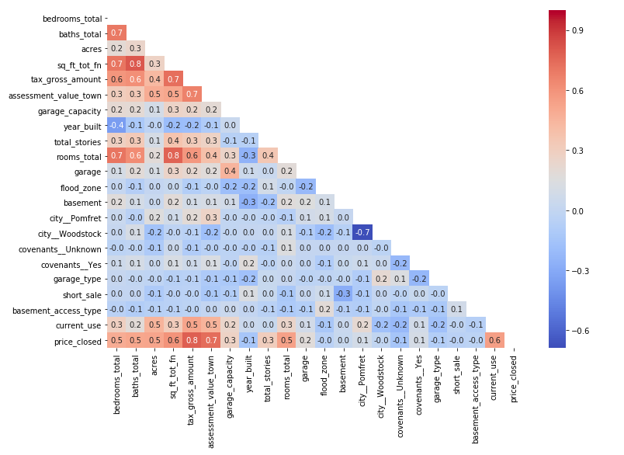
Further EDA
Correlation
Important graph!

Slide 29
Dimensional Reduction Data Normalization
Linear Regression is run using newly engineered features, returned an improved result
Principal Component Analysis is used to extract latent features and reduce noises
Standard Scaler and Principal Component Analysis are then experimented separately, then combined, to improve the performance of our linear regression model.
Polynomial Feature preprocessing is experimented at this step to confirm if it's necessary for that. It's not required since errors were higher

Slide 30
Proposal
Simple Model:
Linear Regression
Alternative Complex Model:
Random Forest Regressor
Support Vector Regression (Linear)

Slide 31
Random Forest Regressor
Random Forest Regressor is chosen for an alternative model
I am also interested in its ability to improve variance by averaging outcomes from multiple fully grown trees on variants of training set.
Random subset of the features at each split, as well as bootstrapping my datasets with replacement, to improve selection and validation for my model

Slide 32
Random Forest Regressor
Random subset of the features at each split, as well as bootstrapping my datasets with replacement, to improve selection and validation for my model
Simple loop and GridSearch CV is used to tune hyper parameters of the model
Model is fitted with best parameters, calculation of out-of-bag scores and features importance. Rerun on filtered features

Slide 33
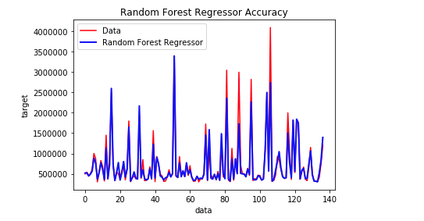
Overfitting complex models

Slide 34
Support Vector Regressor
SVR is also chosen as a model. We can, however, see that there is a potential overfitting with low bias and high variance.

Slide 35
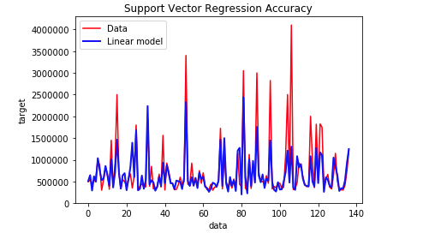
Overfitting complex models

Slide 36
Thus although the model performs well on training set, it might actually be worse off on new data

Slide 37
Results
Simple Linear Regression is best performer with RMSE == 352325.48, PCA did not perform as well as expected
Random Forest Regressor does not do well with RMSE == 424775.70, this confirms our hypothesis about the overfitting models underperform.
Support Vector Regression, although takes the longest to train, is worst performer with RMSE == 763346.11
Complexity of the models thus adversely affect its performance
Stacking the estimators create a worse off result

Slide 38
Regularization
Overfitting, as evident from our experiments, is a great issue. Largely due to our small datasets and many parameters relatively to the amount of data. Some of our estimators are overtuned on the training data and thus were not giving good prediction.
Since we cannot obtain more data, we want to have a decent bias-variance tradeoff. Regularization is an approach that involves imposing a penalty on complex models. We want the least complex models to capture all the information in our data.

Slide 39
Regularization
The data suffers from multicollinearity ( independent variables are highly correlated).This is actually applicable because the numbers of bedrooms will highly correlate with numbers of rooms, areas, thus tax values, etc...
Using scipy, some of the coefficients are truly significant and can affect the target response tremendously. The data set has a positive skew which means it has a longer right tail, which was evident from our visualization.
Kurtosis is high as well, indicating great peakedness, which was also confirmed from our visualization in steps above. Some of the t and p values of features like acres, square foot total... are also small, indicating why our linear regression was able to perform so well based on highly correlated features to have high probability and low errors. We can reject the null hypothesis of independence for those features.

Slide 40
We can proceed to experiment with models such as Ridge Regression, LASSO and Elastic Net. These estimators regularize by tweaking the coefficients of our model to prevent overfitting and reduce variance. Some bias will be introduced by default.

Slide 41
Regression, Ensemble and Stacking
We continue to explore PCA and scaling on LASSO, Ridge Regression and Elastic Net, using the same procedures as with the previous models.
The effect is minimal as the model itself already regularize the dataset
Best performance model is Elastic Net, which combines the power of LASSO and Ridge Regression. RMSE == 347195.12

Slide 42
Regression, Ensemble and Stacking
Manual Ensemble:Using Object Oriented Programming, TransformerMixin and Feature Union inheritance classes are created to aggregate the accuracy of all the model.
By creating my custom class, I can also optimize model hyper parameters or pipeline. It can helps to save and load from this pre-trained models
The Machine Learning Extension Library is also utilized to create a more sophisticated stacking of different regression models

Slide 43
Regression, Ensemble and Stacking
The result is an improved performance in our testing prediction: We can therefore conclude that the issue of overfitting has been reduced.
RMSE Manual Ensemble == 348585.29
RMSE Stacking Regressor == 368604.82

Slide 44
Real time prediction
Attempting to predict closing prices of current properties on the market using models we created. The actual price is obtain from the Internet from websites such as realtor.com, zillow.com, etc...
Some models work better than others, Elastic Net seems to be the best performing one of all
Linear Regression, Ridge and Lasso follows each other really closely
Stacking Regression is more accurate for large real estate values
Although there are errors, they are within the RMSE range, so this is an positive sign to continue fine tuning our models
We did not include the most updated values, as well as accounting for the changes in time
A lot of the listings do not have information available on the Internet

Slide 45
Next steps
Extra exploration: XGB, Artificial Neural Network with TensorFlow
Does not perform as well as our less complex regression models.
Perhaps to run it on simplified models or only most useful features, maximizing the functional relationship
Fine tune learning rates
Improve models from Pickles, keep training.
Better feature selection algorithm

Slide 46
Next steps
Further feature engineering
Much more data is needed
Enhance model's performance by fine tuning stacking and ensemble
Explore boosting to reduce the overfitting issues of Random Forest Regressor, SVG, etc...
Explore PCA of only important features in Random Forest Regressor
Hyper parameter tuning for Elastic Net

Slide 47
Bibliography - Q&A
Hu, G., Wang, J., & Feng, W. (2013). Multivariate Regression Modeling for Home Value Estimates with Evaluation Using Maximum Information Coefficient. Studies in Computational Intelligence, 69-81. doi:10.1007/978-3-642-32172-6_6
Limsombunc, V., Gan, C., & Lee, M. (2004). House Price Prediction: Hedonic Price Model vs. Artificial Neural Network. American Journal of Applied Sciences, 1(3), 193-201. doi:10.3844/ajassp.2004.193.201
Sarip, A. G., Hafez, M. B., & Daud, M. N. (n.d.). Application Of Fuzzy Regression Model For Real Estate Price Prediction. Malaysian Journal of Computer Science (ISSN 0127-9084), 29(1), 15-27. Retrieved from http://mjcs.fsktm.um.edu.my/detail.asp?AID=1588

