Slide 1
Laptop Reviews
Your best decision is our will

Slide 2
Team member
Supervisor: Mr. Kiều Trọng Khánh
Võ Thị Minh Châu
Nguyễn Văn Hơn (Dropped out)
Đinh Hữu Toàn
Nguyễn Mạnh Khương

Slide 3
Outline
Scenario problem
Our solution
Demonstration
Advantages and disadvantages of current solution
Questions and answers
Future Plans

Slide 4


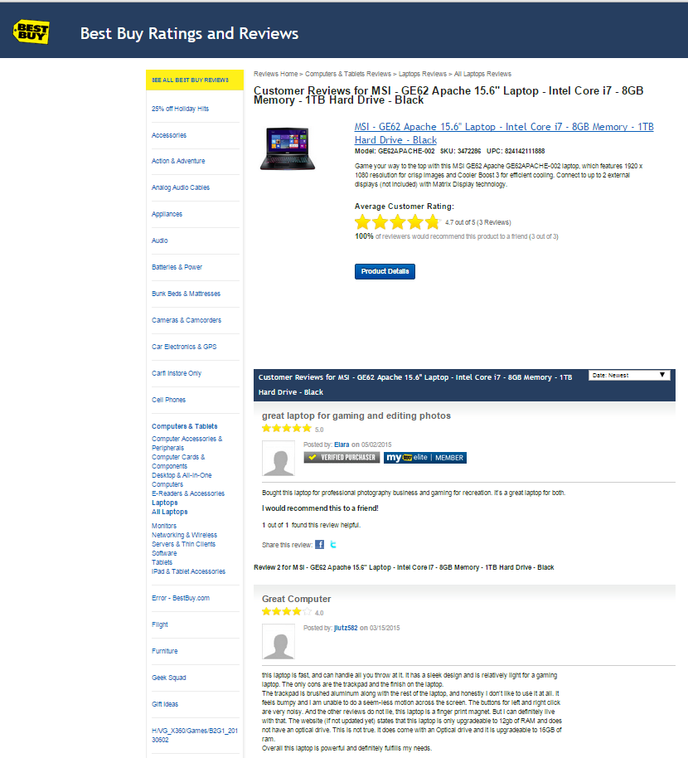
Scenario problem

Slide 5






Scenario problem
Search
Read comments
Classify
Make decision

Slide 6
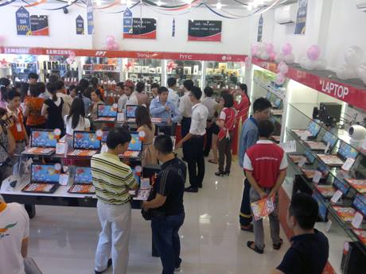


Scenario problem
1
Spend to much time to go to several electronic supermarkets

Slide 7

Scenario problem
Hard to remember exactly the information these supermarkets provide
2

Slide 8
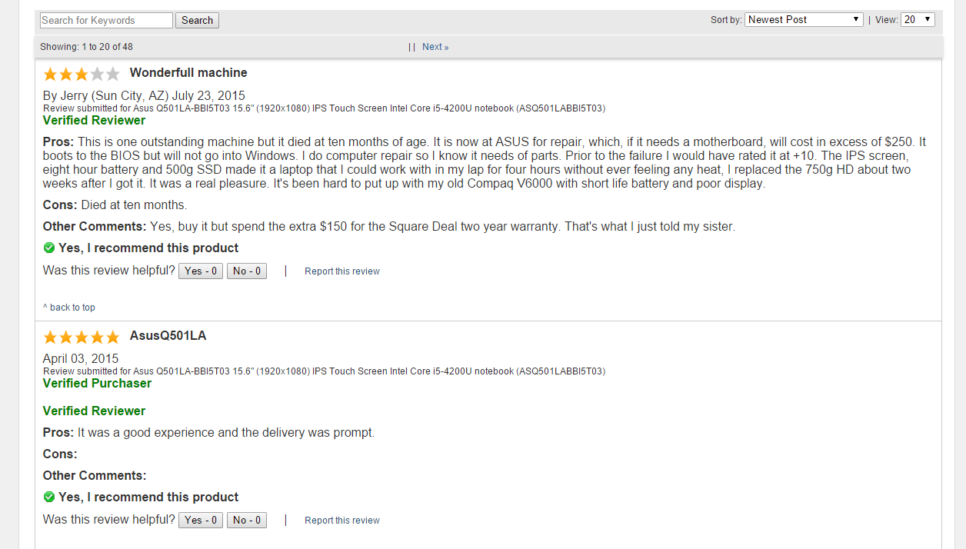
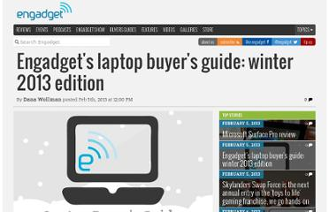
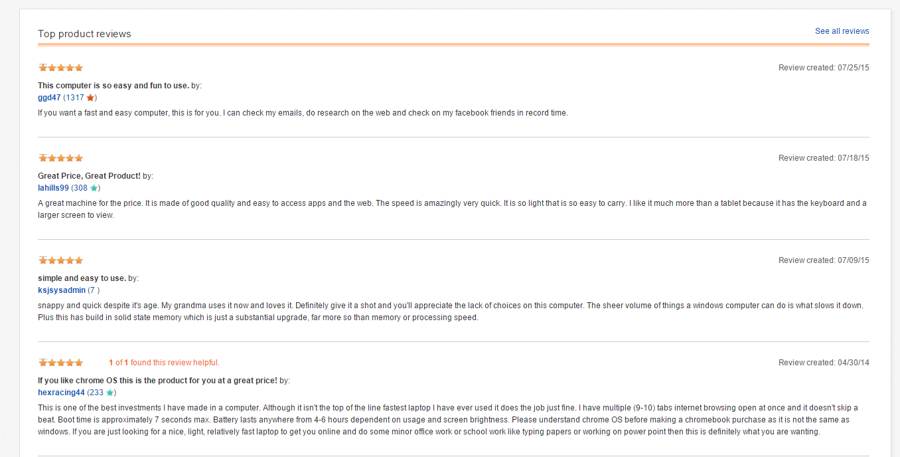
Scenario problem
Take lots of time to search for trusted websites and read all the reviews
3

Slide 9
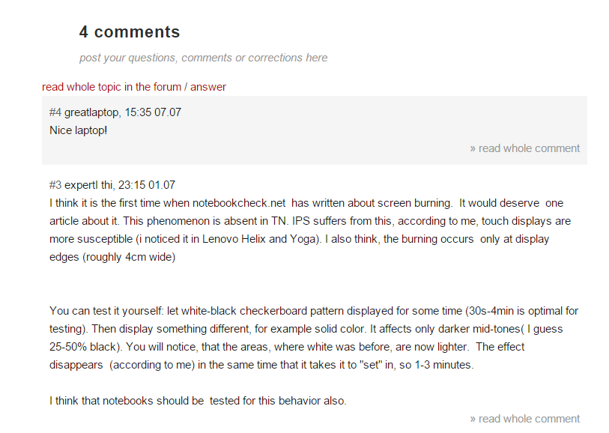

Scenario problem
4
Some reviews may be useless or not relevant.

Slide 10
Scenario problem
All of these disadvantages will make customer feel confused when they want to buy laptop.
Reviews are one of the most important factors for choosing laptop.
1
2
3
4
Notes:
According to the description above, we can realize that reviews are one of the most important factors for choosing laptop. Are the reviews relevant or not? Useful or nonsense? From the trusted website or not? Our system will help you with those problems.

Slide 11




Our idea: Collect data

Slide 12





Our idea: Collect data by parsing
Take url
Download
Remove script
Display
Inspect

Slide 13
Our idea
Collect data
Build
structure
Public to end user

Slide 14



Our solution
Collect
Classify
System
Laptops with comments
Comments

Slide 15
Features
Search
Report comment
Recommend product
Classify comment
Import Excel
Get data from web
Mobile application

Slide 16
Collect data by parsing
Build data structure
Brand
Description
1..*
Product
0..*
1
Site
Image
Last Comment Date
Name
Comment

Slide 17
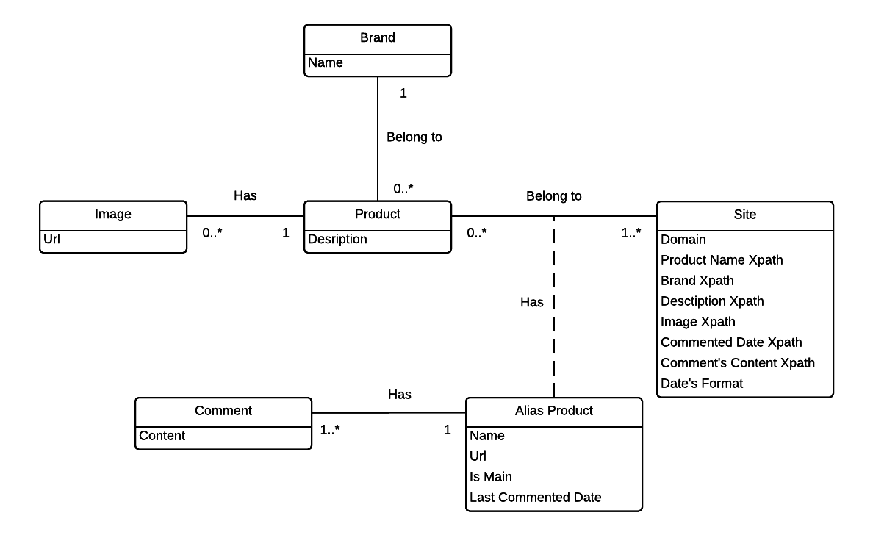
Collect data by parsing
Entities

Slide 18



Collect data by parsing
Libraries support parsing data:
Selenium
vs
HtmlAgilityPack
Create
simulator browser
Parse data
Decrease speed
Parse data

Slide 19
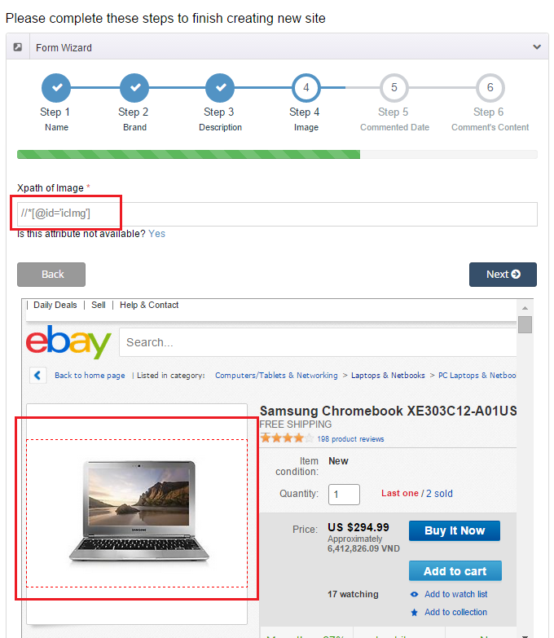

How to get data?

Slide 20
Collect data by parsing
Step 1: From clicked node
Step 2: Get parent node
Step 3: Stop when meeting “HTML” or “ID” node
Step 4: Take xPath
Step 5: Get data

Slide 21
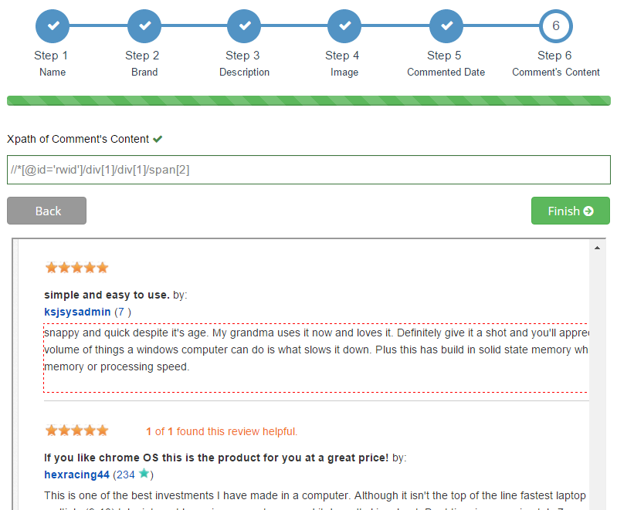
Step 1, 2 & 3: Get parent node, stop when meeting “html” or “id” node
“id” node
Parent node
Clicked node
//*[@id='rwid']/div[1]/div[1]/span[2]

Slide 22
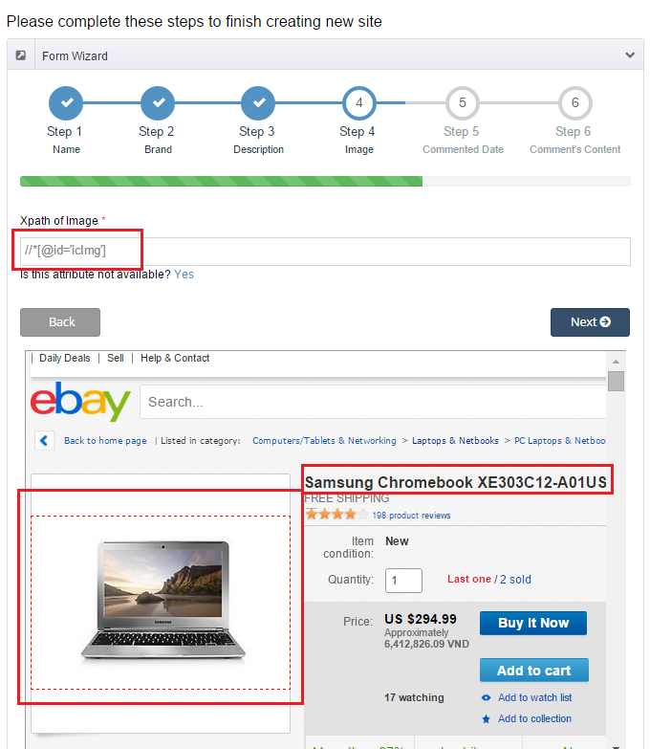
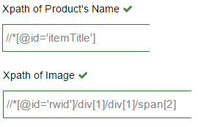

Step 4&5: Take xPath and Get data
Samsung Chromebook XE303C12-A01US

Slide 23


Detect Duplicated Product
New laptop
Data object
Database
is new
false
true

Slide 24

Analyzing Comment

Slide 25



Analyzing Comment
In real life
How can system classify the comments?
Can we train it?

Slide 26

Analyzing Comment
WORDS
Adjective/
Adverb
Noun
Negative
Verb
Meaning
Pros
Cons
Neutral

Slide 27



Analyzing Comment
Good Flag
Classified
Comment
Negative
Bad Flag
Negative
Flag
Collect and Split
into words
System
Verb
Adjective/Adverb
Noun
Pros/Cons
Totally Pros
Neutral
WORDS
Compare
Database

Slide 28

Analyzing Comment
Classified
Words
Read and classify
words
Staff
Database
Classified
comments
Compare with
classified words
System
WORDS
Collect and Split
into words
Raw Comments

Slide 29


Demonstration
Scenario 1: Search laptop and report comment
Search
Read comments
Guest
Report
Handle
Staff

Slide 30



Search and parse recommended product automatically
order by report times

Slide 31






Search and parse recommended product automatically
Url of
recommended product
Search
Parse data
Send email

Slide 32


Demonstration
Scenario 2: Search laptop and recommend laptop
Search
(no result)
Guest
Recommend
Handle
Handle
Staff
System

Slide 33
Demonstration
Scenario 3: Parse data and handle duplicated products
Parse
Handle
Staff
System

Slide 34
Mobile Application
Features
Search
Report comment
Recommend product
Write comment
Add favorite product

Slide 35


Demonstration
Scenario 4: Mobile application
Search
Guest
Read comments
Add favorite
Write

Slide 36
Advantages AND Disadvantages
Advantages:
Many resources
Classify comments
Training machine (work with duplicate products).
Subscribe

Slide 37
Advantages AND Disadvantages
Disadvantages:
Spend time for training.
Spend time for re-check reported comments.
Not support Vietnamese language.
Mobile application is developed for Android Platform.

Slide 38
Future plans
Optimize algorithm for analyze comment.
Support more mobile platforms
Support Vietnamese language

Slide 39


Slide 40
Thank You!

