Slide 1
Understanding Social Structure in Baboon Proximity Networks
09/05/2025
Chau Do

Slide 2
Data
Data by Bonnell et al.
13 baboons, 61841 observations
Mar. 2007 – Apr. 2008
Attributes: date, time, coordinates, animal ID
Animal ID: sex + dominance rank (e.g., M1 is the most dominant male)
Dominance ranks are assigned based on the outcomes of agonistic contests among individuals

Slide 3
Research focus
Correlation between metrics in proximity network and dominance hierarchy of baboons
Persistance of social signatures (distribution of time spent with connections and identity of connections) over time (Saramäki et al.) and its relationship with dominance hierarchy in baboons

Slide 4
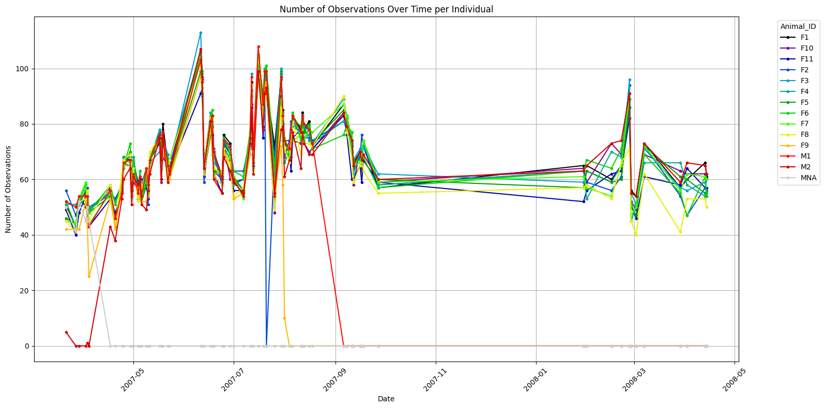
Data

Slide 5
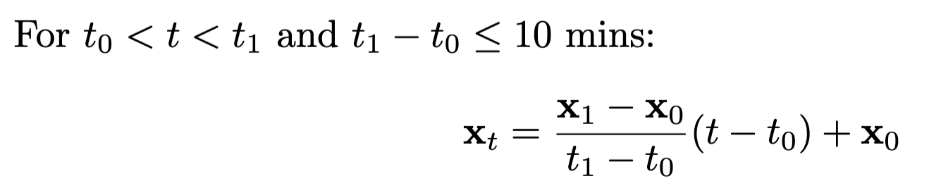
Data interpolation
For each available time point in the dataset:
  If the time interval between the two closest observations is at most 10 mins
  -> linear interpolation

Slide 6
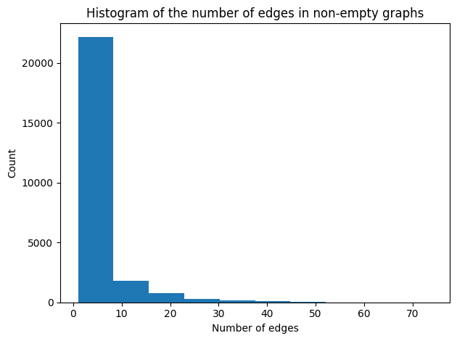
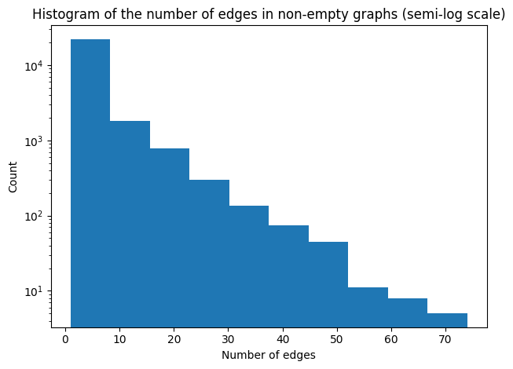
Proximity network generation
For each time point in the dataset, if the distance between 2 baboons are at most 5m, add an edge between the 2 corresponding nodes
-> 40539 graphs

Slide 7
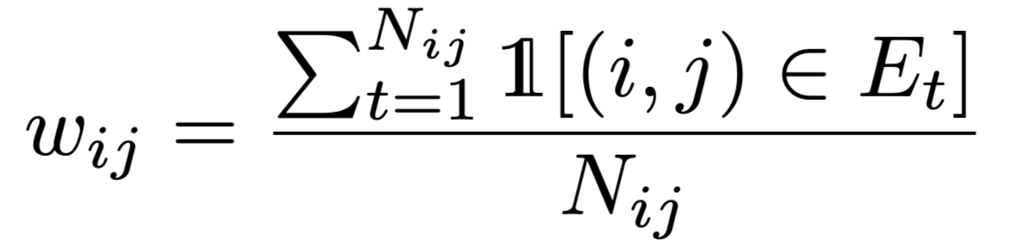
Average network
Edge weight:

Slide 8
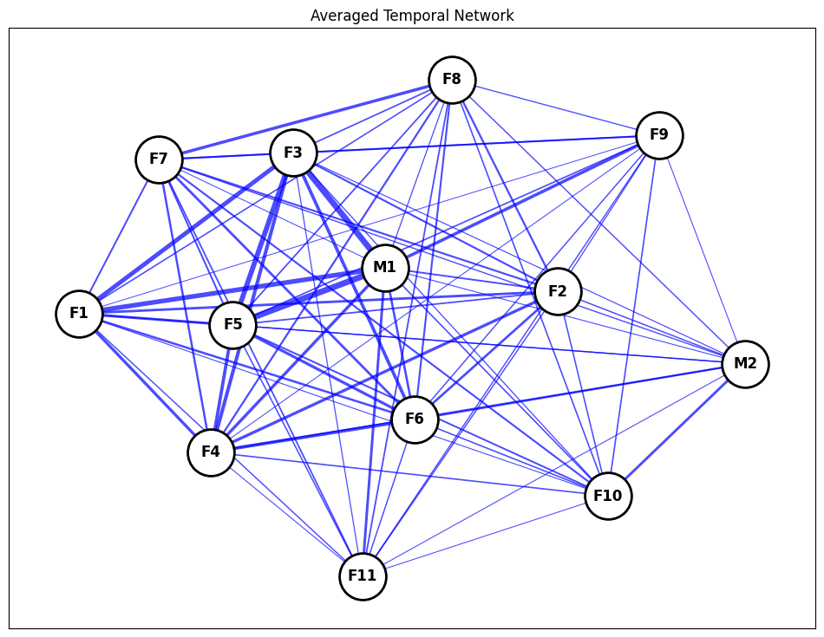
Average network

Slide 9
Correlation of node metrics with rank
Spearman’s rho, P-values from permutation tests (1000 permutations)
Female nodes only (since there are only 2 male nodes, and male and female rankings are not comparable)
Higher-ranked female nodes have higher strength, clustering, closeness, and eigenvector central
Metric | Spearman’s rho | P-value
Strength | -0.763636 | 0.003
Clustering coefficient | -0.763636 | 0.003
Betweenness centrality | -0.074536 | 0.466
Closeness centrality | -0.727273 | 0.002
Eigenvector centrality | -0.818182 | 0.000

Slide 10
Correlation of edge weight with rank difference
Spearman’s rho between edge weights and the absolute differences between the ranks of endpoint nodes = -0.559, P = 0.000
-> Baboons with larger differences in social ranks tend to spend less time together

Slide 11
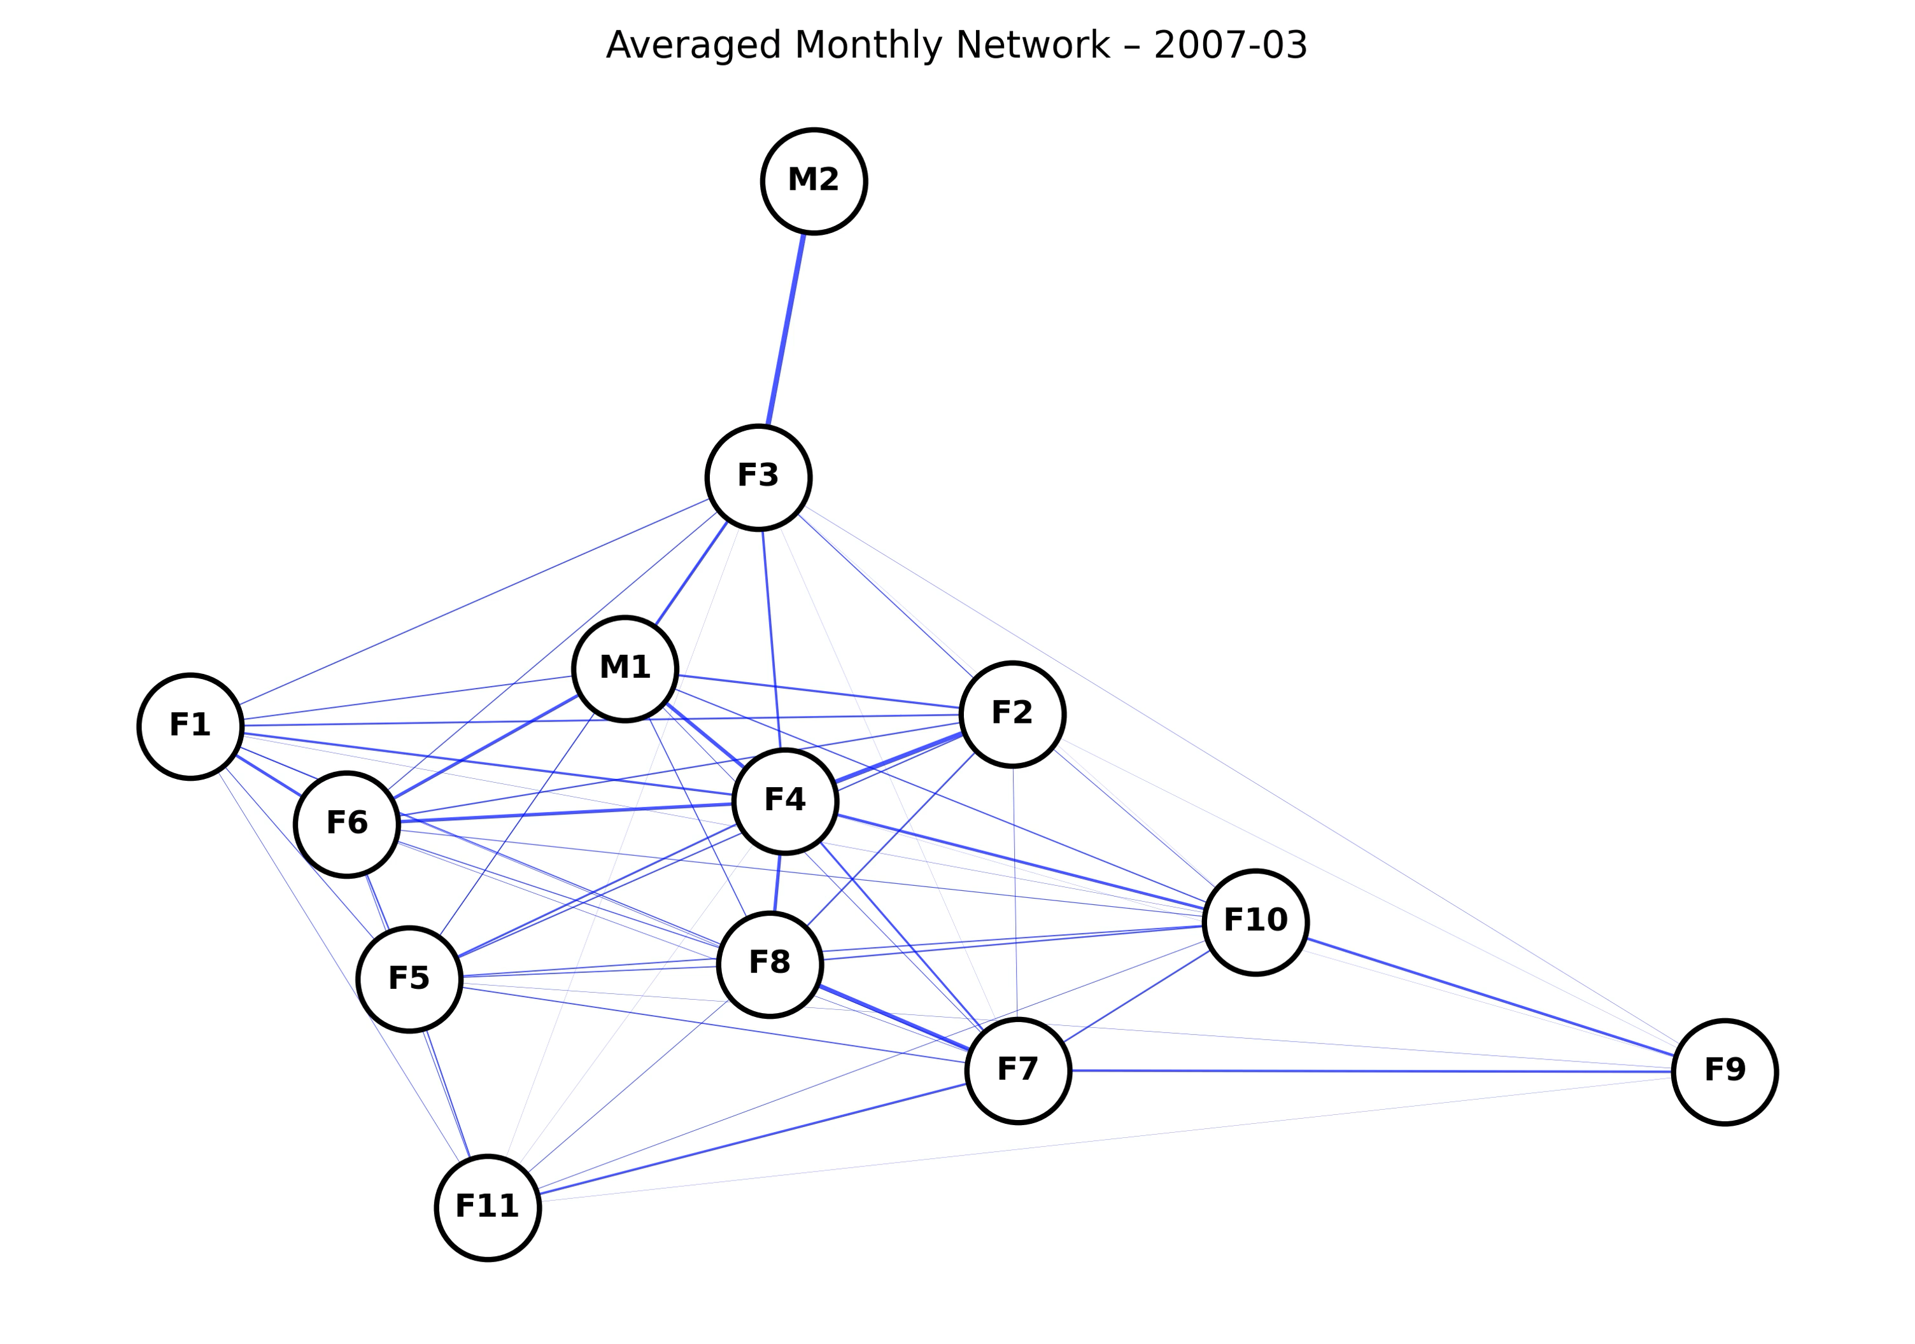
Average network by month

Slide 12
Average network by temporal block
3 blocks:
  Block 1: Mar 2007 – Jun 2007
  Block 2: Jul 2007 – Sep 2007
  Block 3: Jan 2008 – Apr 2008

Slide 13
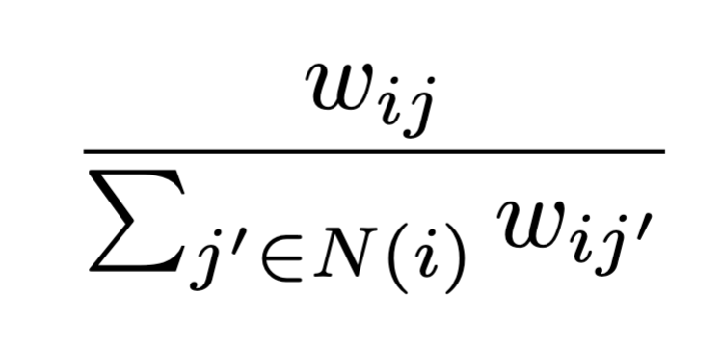
Ego plots
Ego network of node i: subgraph with only edges adjacent to i
Fraction of strength of node j in the ego network of node i:
Represents the proportion of time node i spends with node j relative to the time i spends with all other nodes

Slide 14
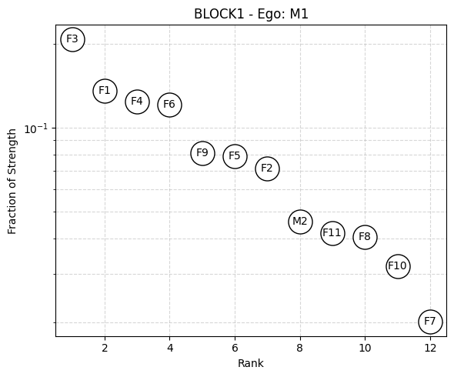
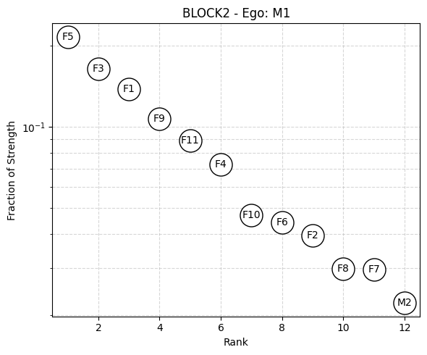
Ego plots: M1
No observation of M1 in block 3

Slide 15
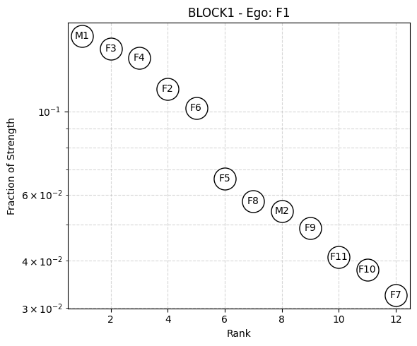
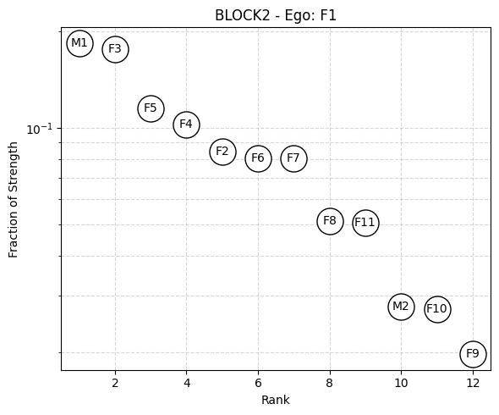
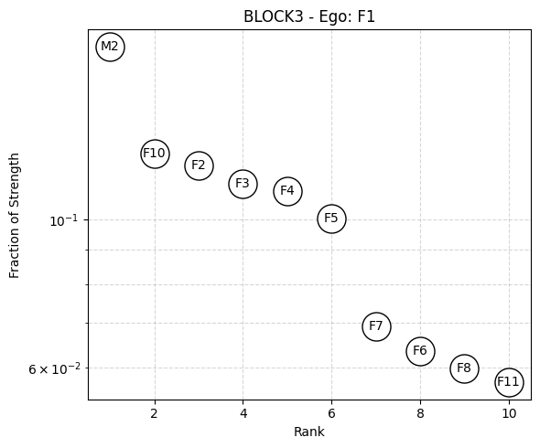
Ego plots: F1
F1 spends the most time with M1 in block 1 and 2 and with M2 in block 3

Slide 16
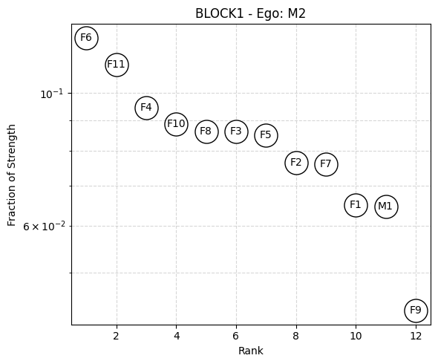
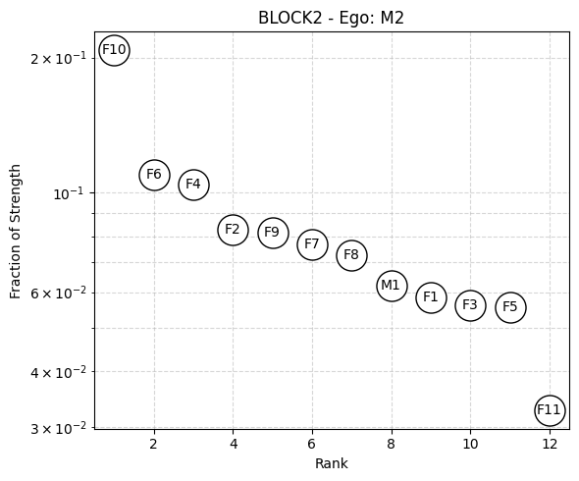
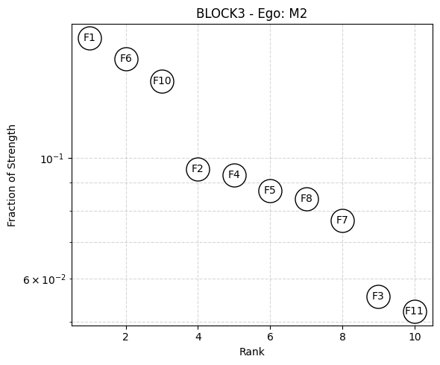
Ego plots: M2
M2 spends the most time with lower-ranking females (F6, F10, etc.) in block 1 and 2 and with F1 in block 3

Slide 17
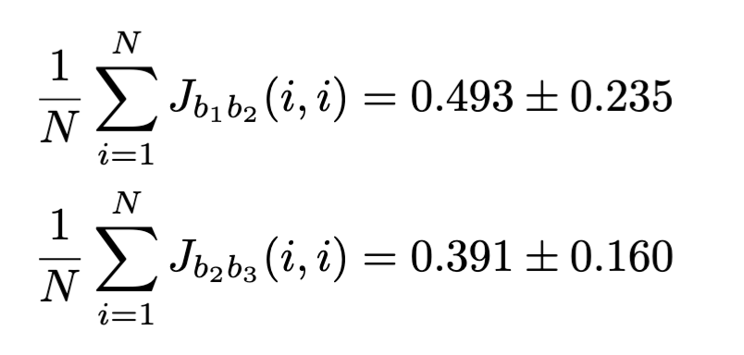
Persistance of top neighbors
Identify top 5 neighbors of each node in each block
Notation:
Calculate Jaccard index of top neighbors of each node in consecutive blocks (block 1 – block 2 and block 2 – block 3)
Average over nodes:

Slide 18
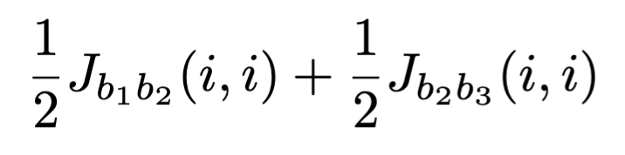
Correlation of top neighbors retention with rank
For each node, calculate the top neighbor retention
Correlation with rank (females only): Pearson’s rho -0.844, P = 0.001
-> higher-ranked female baboons tend to retain social connections better

Slide 19
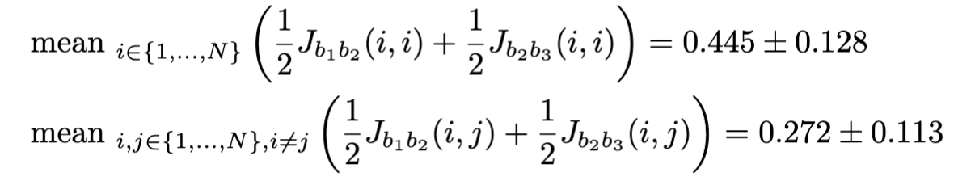
Persistance of top neighbors
Compare the average self-distance and baseline (non-self):
P-value of difference: 0.000
-> self-distance tend to be smaller, baboons tend to retain their top connections compared to baseline

Slide 20
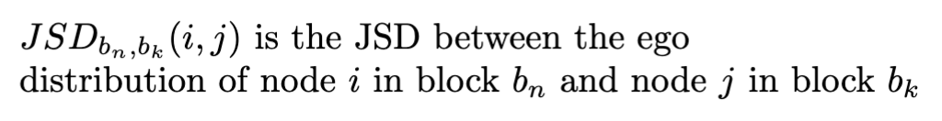
Persistance of ego plot shape
Shape of the ego plot: distribution of time spent with neighbors (ego distribution)
Jensen-Shannon divergence (JSD) to measure the shape difference between 2 ego plots
Notation:

Slide 21
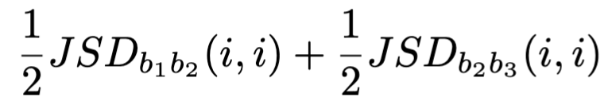
Correlation of ego plot shape retention with rank
For each node, calculate the ego plot shape retention
Correlation with rank (females only): Spearman’s rho 0.200, P = 0.567
-> not significant

Slide 22
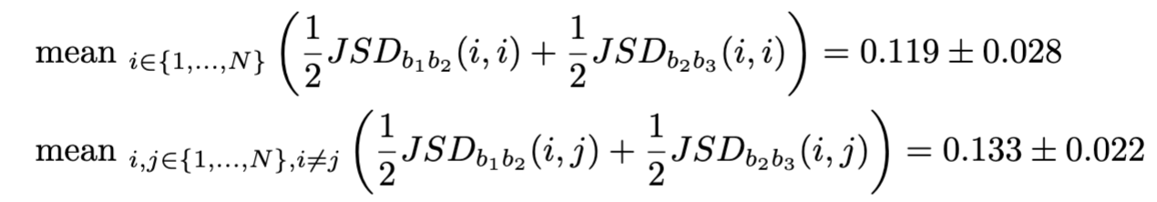
Persistance of ego plot shape
Compare the average self-distance and baseline (non-self):
P-value of difference: 0.018
-> self-distance tend to be smaller, baboons tend to retain their ego plot shape compared to baseline

Slide 23
Summary of key findings
Higher-ranked baboons are more socially central (higher strength, clustering, closeness, and eigenvector central)
Baboons with larger differences in social ranks tend to spend less time together
Higher-ranked baboons tend to better retain social connections over time, but there’s no correlation between ranking and the persistence of the distribution of time spent with connections
Baboons tend to maintain social signatures over time, both in the distribution of time spent with connections and the identity of those connections

Slide 24
Reference
Bonnell, T. R., Clarke, P. M., Henzi, S. P., & Barrett, L. (2017). Individual-level movement bias leads to the formation of higher-order social structure in a mobile group of baboons. Royal Society Open Science, 4, 170148. https://doi.org/10.1098/rsos.170148
Saramäki, J., Leicht, E. A., López, E., Roberts, S. G. B., Reed-Tsochas, F., & Dunbar, R. I. M. (2014). Persistence of social signatures in human communication. Proceedings of the National Academy of Sciences of the United States of America, 111(3), 942–947. https://doi.org/10.1073/pnas.1308540110

