Slide 1
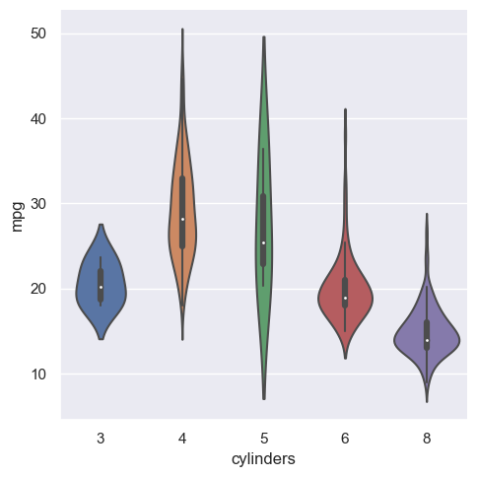
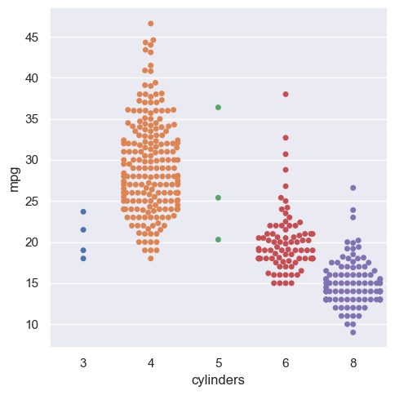
DATA SCIENCE IN PYTHON
INTRODUCTION TO MATPLOTLIB
Dr. TRUONG BA TAI
Data Scientist in Multiscale Modelling

Slide 2
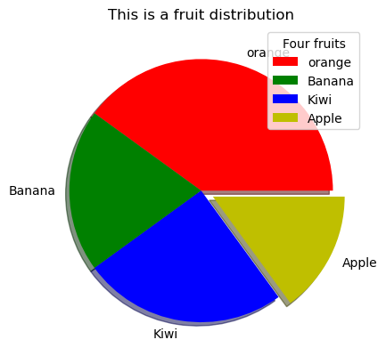
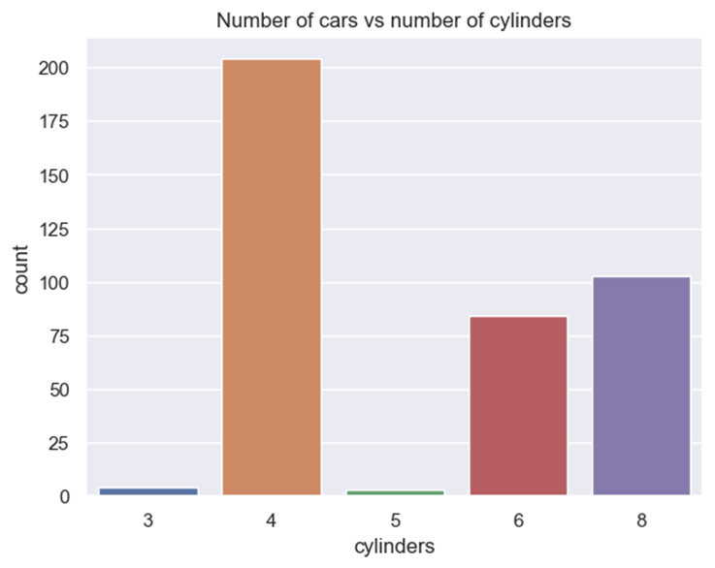
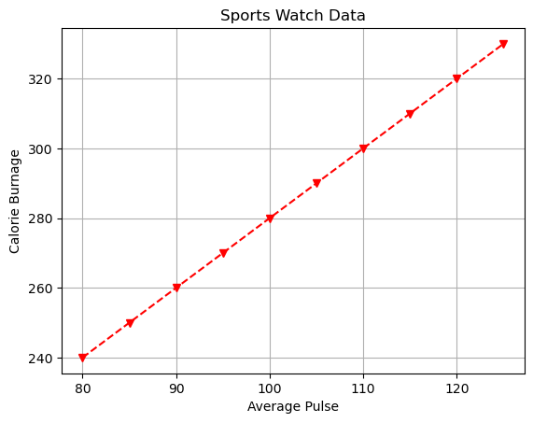
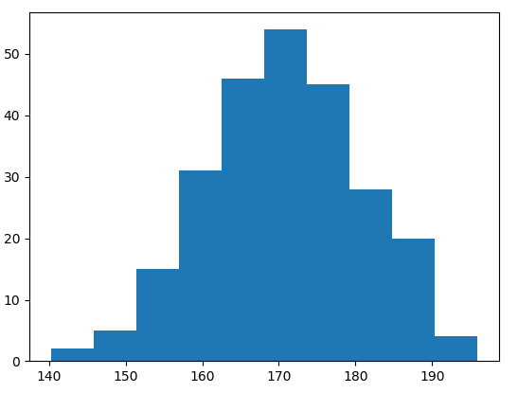
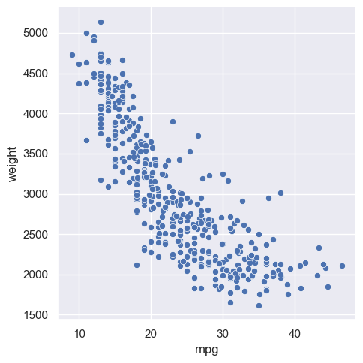
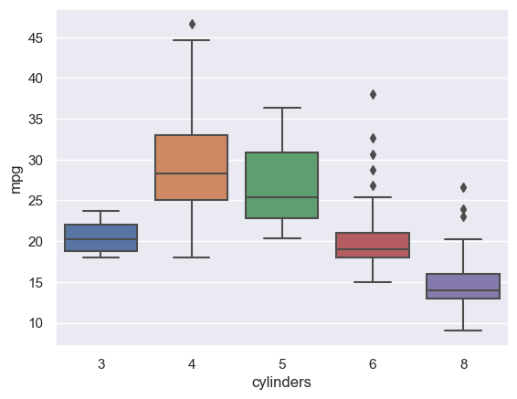
BASIC PLOTS IN DATA ANALYSIS
Line graph
Pie graph
Bar graph
Histogram
Scatter plot
Box plot
Violin plot
Swarm plot

Slide 3

plt.grid (axis = “x”)
plt.grid (axis = “y”)
plt.grid ()
plt.title (“”)
import numpy as np
import matplotlib.pyplot as plt
x = np.array([80, 85, 90, 95, 100, 105, 110, 115, 120, 125])
y = np.array([240, 250, 260, 270, 280, 290, 300, 310, 320, 330])
plt.title("Sports Watch Data")
plt.xlabel("Average Pulse")
plt.ylabel("Calorie Burnage")
plt.plot(x, y, "o:r")
plt.grid()
plt.show()
Grid
plt.ylabel (“”)
Maker: *, ●, ◊,…
Line style: solid line, dotted line…
Color: red, blue, green,..
For showing plots
Should added at final line
plt.xlabel (“”)

Slide 4
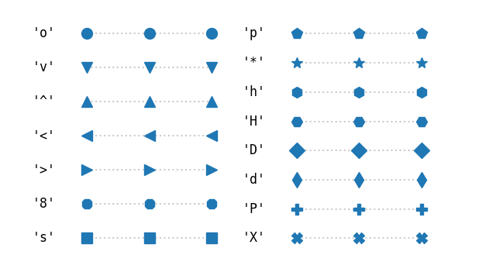
Some common makers in matplotlib

Slide 5

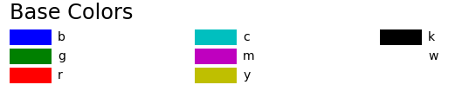
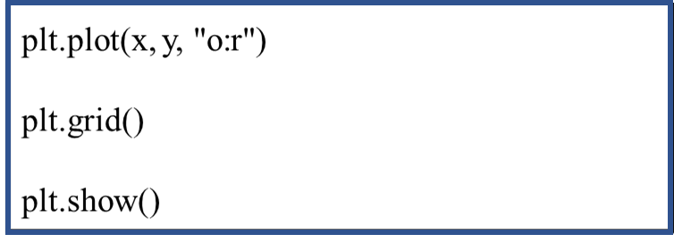
Some line styles in matplotlib
Some basic colors in matplotlib
plt.plot(x,y, maker = “o”)
plt.plot(x,y, maker = “o”, ms = 30)
plt.plot(x,y, linestyle = “dotted”)
plt.plot(x,y, ls = “:”)
plt.plot(x,y, c = “r”)

Slide 6
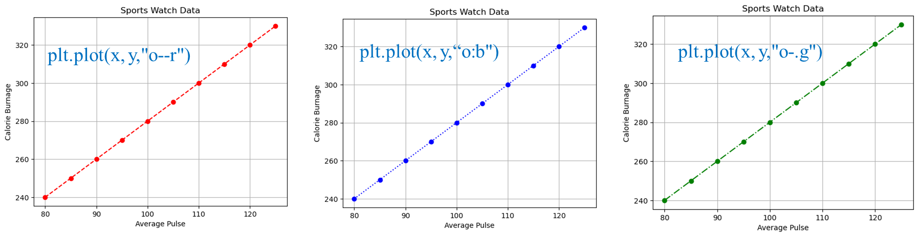
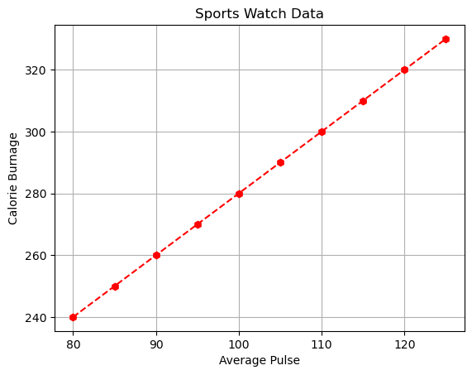

plt.plot(x, y,“v--r")
plt.plot(x, y,"h--r")
plt.plot(x, y,“+--r")

Slide 7
THANK YOU VERY MUCH

