Slide 1
Persistence API

Slide 2
Agenda
JPA Overview
Entities
Object Relational Mapping
Persistence API and Spring Data

Slide 3
JPA Overview

Slide 4
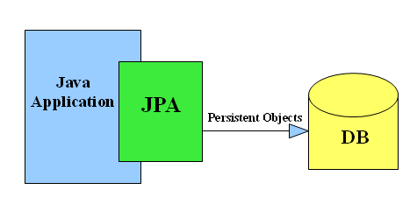
Persistence API

Slide 5
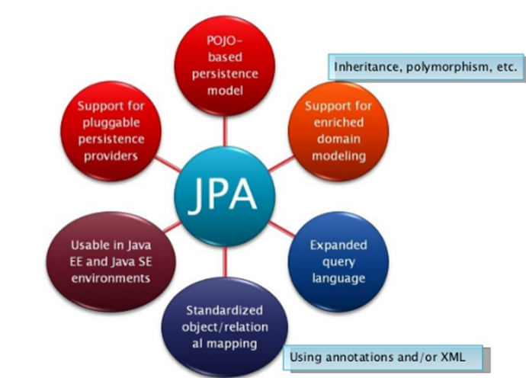

Slide 6
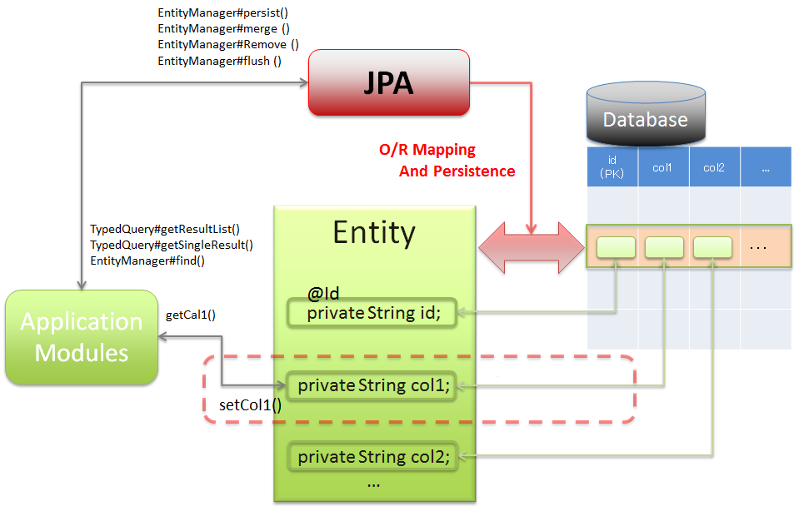

Slide 7
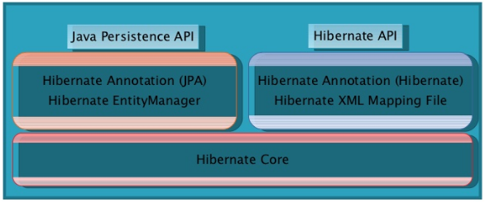
JPA & ORM Hibernate
JPA is Persistence API
ORM Hibernate is implementation

Slide 8
Entities

Slide 9
Entities
Entity represents a table in a relational database, and each entity instance corresponds to a row in table.
Primary artifact of an entity is the entity class
The class must not be declared final
The class must implement the Serializable interface
Entity must have an identity
Annotate the field with @Entity
Composite primary key
@IdClass
@EmbeddedId
@MapsId

Slide 10
Object-Relational Mapping
POJO needs something to become Entity
2 Ways : Annotations or XML
Two types of Annotations
Logical - Describes object model
@Entity, @Basic, @Temporal etc.
Physical - Describes physical schema
@Table, @Column etc.
Configuration by Exception
Optional (Almost)
Can be specified on Fields or Bean Properties
Field annotations : Getters/Setters ignored
Bare minimum : @Entity and @Id annotations

Slide 11
ID Generation
4 Types
AUTO
For prototyping only
IDENTITY
SEQUENCE
TABLE
DB agnostic
IDENTITY and SEQUENCE need DB support

Slide 12
EntityManager
Central authority
Qualifies simple POJOs into Entities
Almost entire API is built in this one interface
Provides API to
Do CRUD
Query
Synchronize with Database
Automatically sync to DB
1st Level Caching
Works with JTA in server env

Slide 13
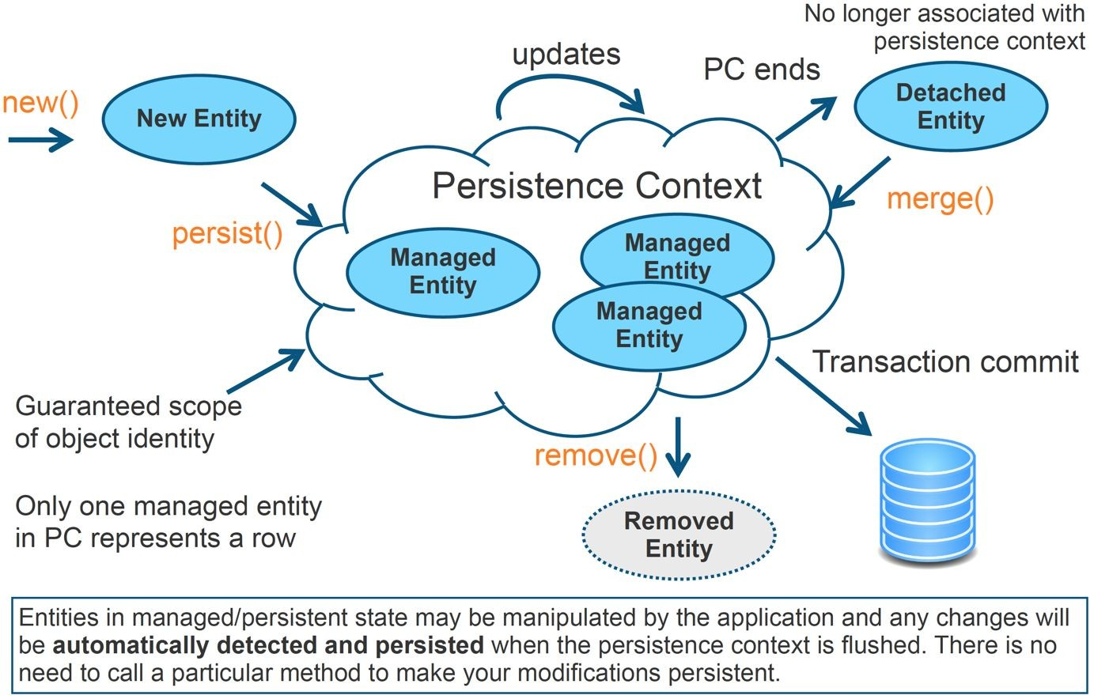

Slide 14
API Operations and Entities
List of EntityManager API operations
Persist() : Insert the state of an entity into DB
Remove(): Delete the entity state from the DB
Referesh(): Reload the entity state from the DB
Merge(): Synchronize the state of detached entity with the PC
Find(): Execute a simple PK query
CreateQuery(): Create query instance using dynamic JP QL
CreateNamedQuery(): Create instance for a predefined query
Contains(): determine if entity is managed by PC
Flush(): force synchronization of PC to DB

Slide 15
Object Relational Mapping

Slide 16
Types
One to One
One to Many
Many to One
Many to Many
Use annotations on getter of class variable , include parameters

Slide 17
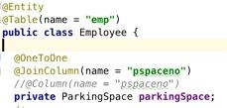
One To One
Almost similar to Many To One
@OneToOne and @JoinColumn
Table with foreign key is the owning side
@JoinColumn has to be on the side with foreign key

Slide 18

One To One Bidirectional
Source Entity already has all the information
It just needs which property on source entity has it
@OneToOne(mappedBy)

Slide 19
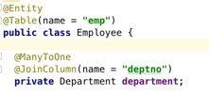
Many To One
@JoinColumn is optional
Default join column : targetTable_targetIdColumn
@Column won’t gel with these annotations

Slide 20
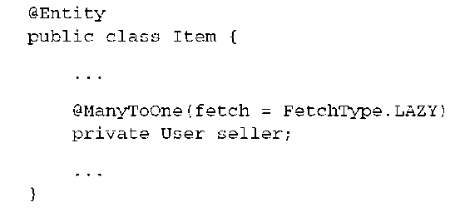
Lazy load
We didn’t know what we want
Load only required data
“Passively think about the work in future”
We’d like to divide and conquer
Load what we’d like

Slide 21
Lazy Relationships
Not specified, @ManyToOne and @OneToOne guaranteed to Eagerly load
Collection valued relationships by default is Lazily load
Provider may choose to do Eager loading

Slide 22
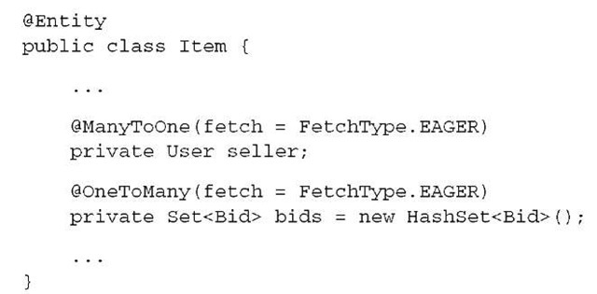
Eager load
We know what we’d like to work
Know required data in execution phases
We’d like a little
A relative small entities, no need to device to many pieces

Slide 23

One To Many
Nothing but Bidirectional ManyToOne
Always implies a ManyToOne presence
Always Bidirectional
Always on the target side i.e. Not the Source side
All configuration is in Source entity already
Just needs the Source entity property information
@OneToMany(mappedBy)

Slide 24
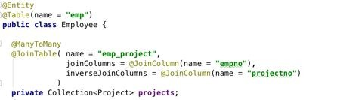
Many To Many
@JoinColumn is not sufficient
Can be achieved only by a join table
Difficult to say who is the owner
Either can be the owner
The target side will have @ManyToMany(mappedBy)
Absence of mappedBy will make them unidirectional

Slide 25

Many To Many Bidirectional
mappedBy on the target side
All it needs is the property configured in Source Entity

Slide 26
Queries
CRUD - Retrieval Rules
As expected, constructed using EntityManager
API
Query
TypedQuery
Type
Static - Annotation or XML
Dynamic
JPQL
Criteria
Dynamic queries are expensive

Slide 27
JPA & Spring Data

Slide 28
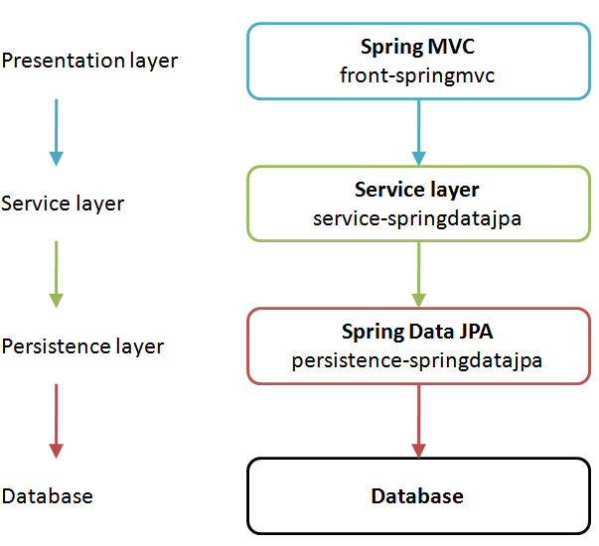
JPA & Spring Data

Slide 29
Summary
JPA Overview
Entities
Object Relational Mapping
Persistence API and Spring Data

