Slide 1
Spring jdbc
Instruction: NGUYEN ANH MINH (M. Sc.)

Slide 2
Outline
Introduction to spring jdbc
Spring jdbc development
Spring ioc intergration

Slide 3
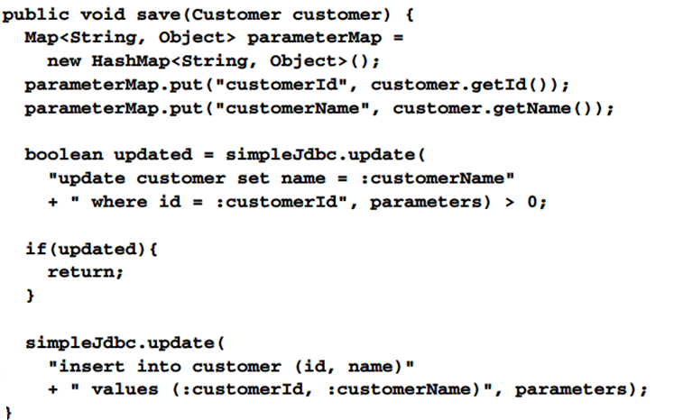
Spring jdbc solution

Slide 4
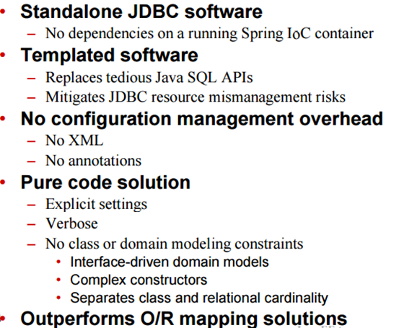
Spring JDBC

Slide 5
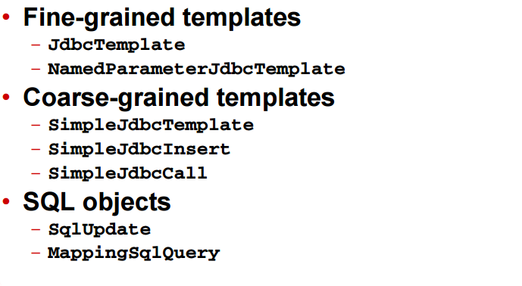
Spring JDBC templates

Slide 6
Spring IoC process review

Slide 7
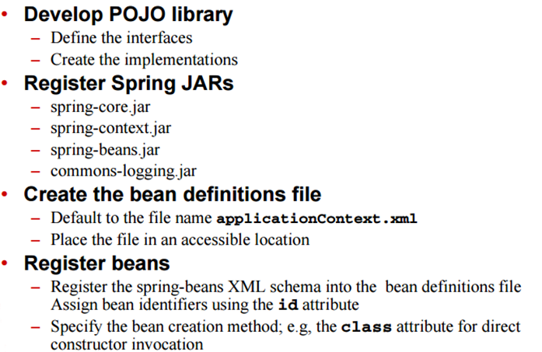
Spring IoC process

Slide 8
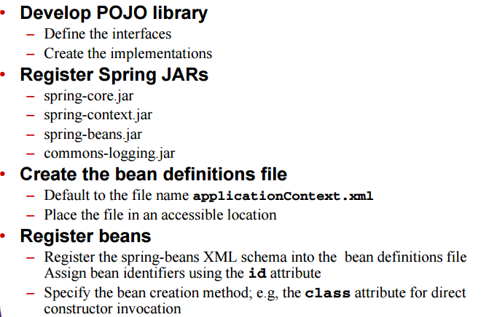
Spring IoC process

Slide 9
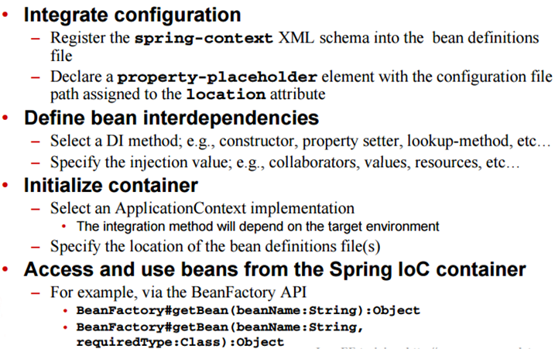
Spring IoC process

Slide 10
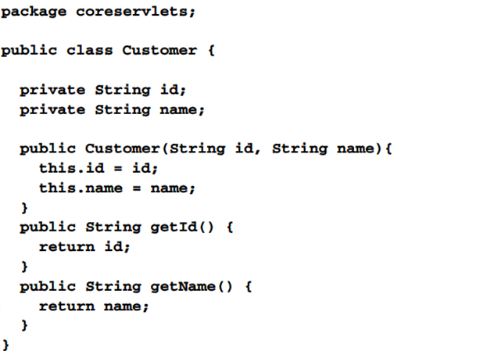
Develop pojo library

Slide 11
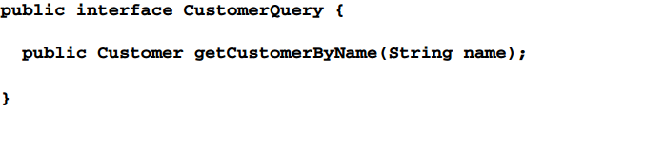
Develop pojo library

Slide 12
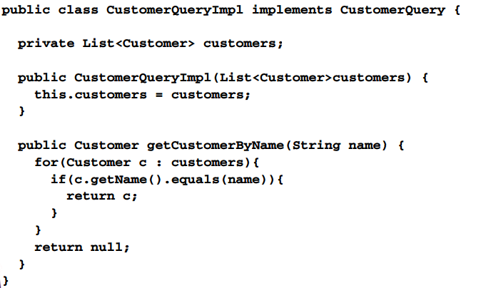
Develop pojo library

Slide 13
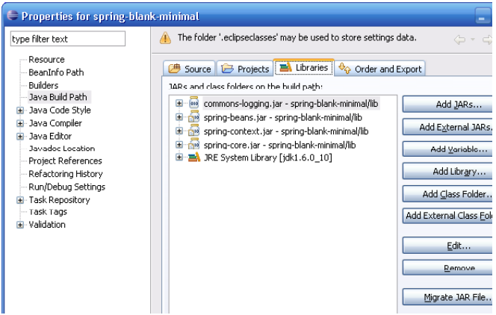
Register spring jars

Slide 14
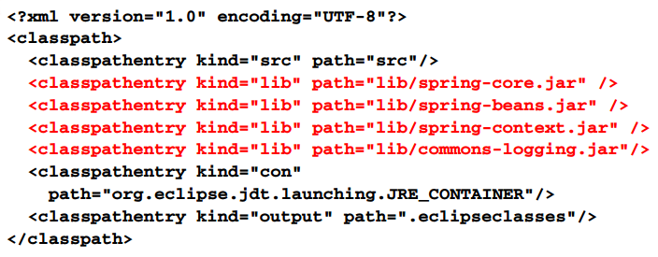
Register spring jars eclipse .classpath

Slide 15
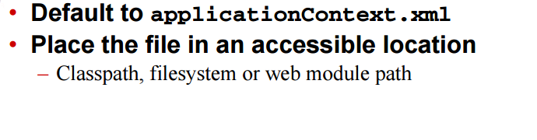
Create the bean definition file

Slide 16
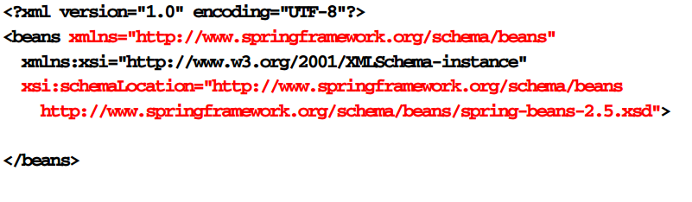
Register beans

Slide 17
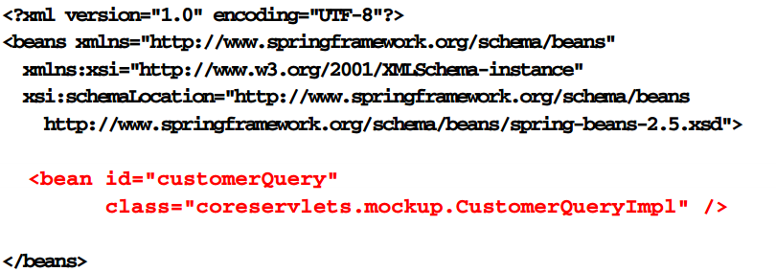
Register beans

Slide 18
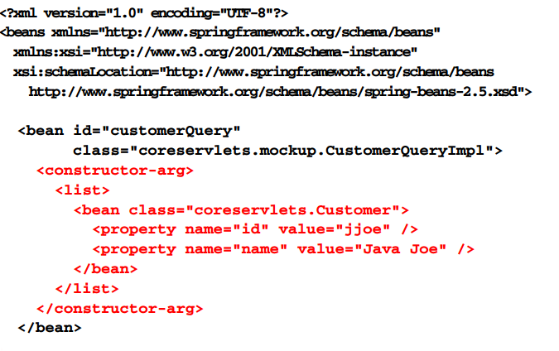
Define bean interdependencies

Slide 19
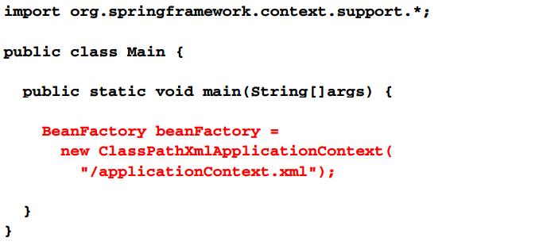
Initialize container

Slide 20
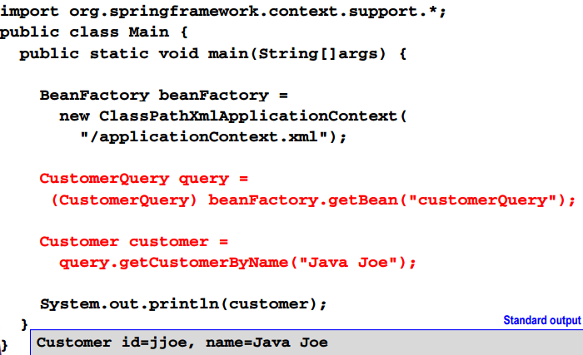
Access and use beans

Slide 21
Spring jdbc process

Slide 22
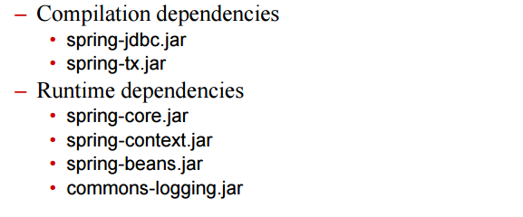
Spring jdbc process
Define persistence interfaces
Register spring jdbc jars

Slide 23
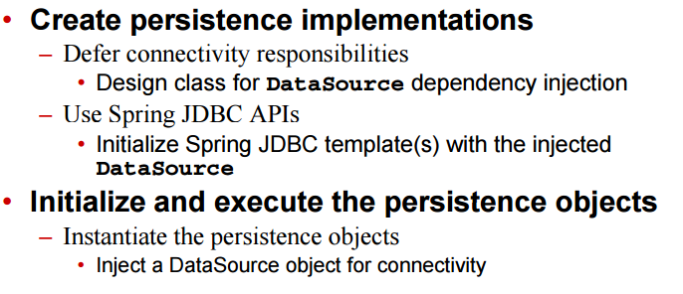
Spring jdbc process

Slide 24
Develop persistence interfaces
Public interface CustomerQuery {
Public Customer getCustomerByName(String name);
}

Slide 25
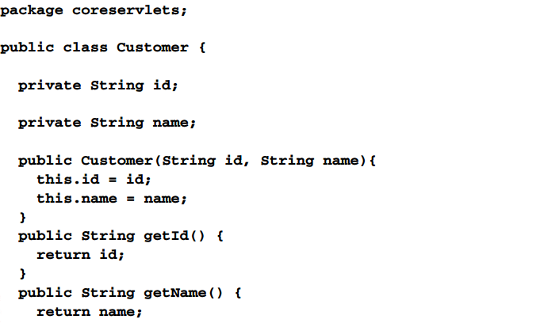
Develop persistence interfaces

Slide 26
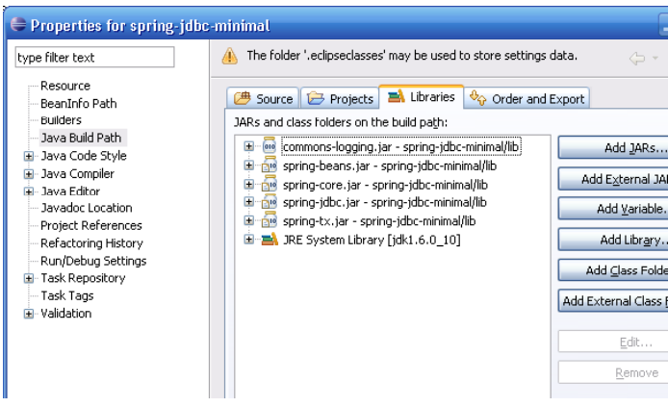
Register jdbc jars

Slide 27
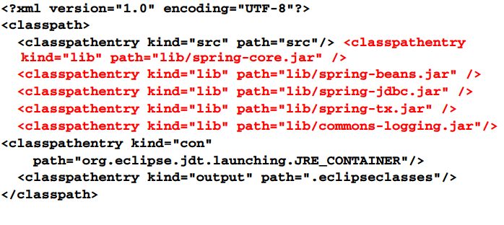
Register spring jdbc jars eclipse .classpath

Slide 28
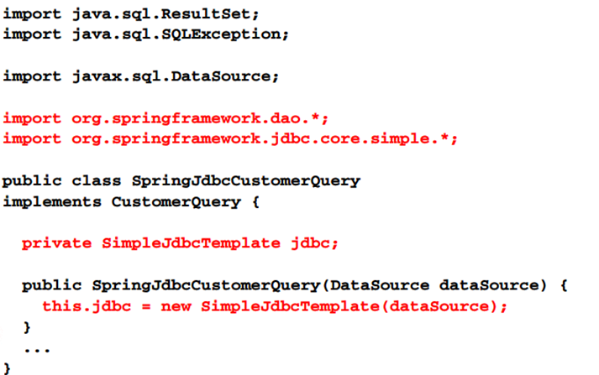
Implement persistence class

Slide 29
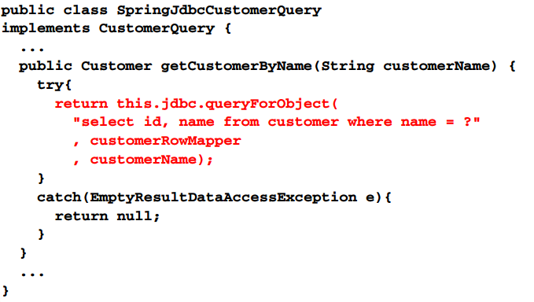
Implement persistence class

Slide 30
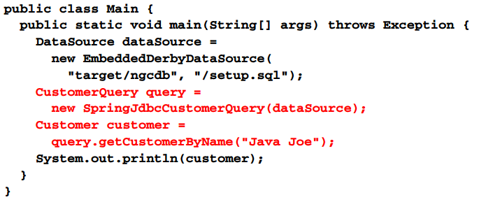
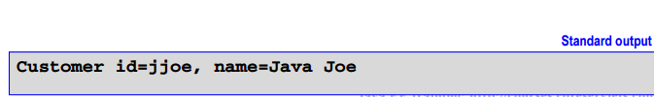
Initialize and execute persistence objects

Slide 31
Spring JDBC and spring IoC process

Slide 32
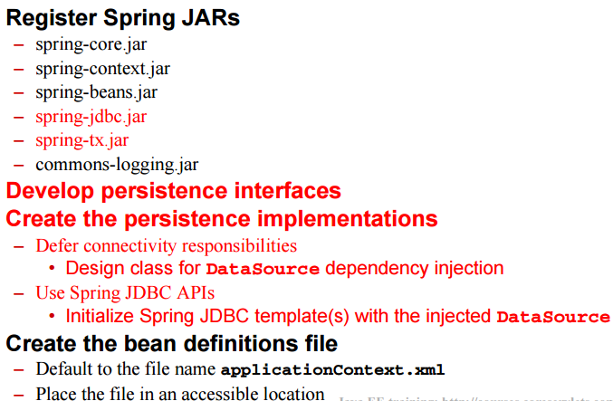
Spring JDBC and spring IoC process

Slide 33
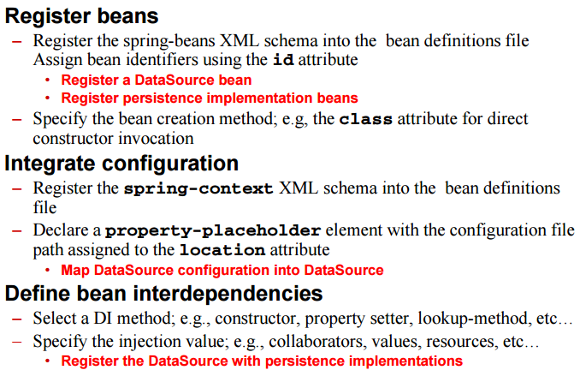
Spring JDBC and spring IoC process

Slide 34
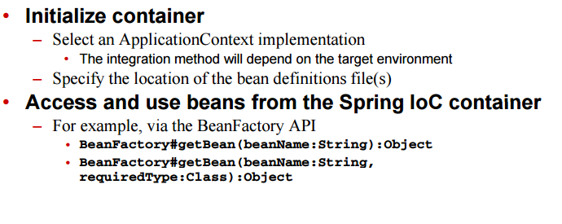
Spring JDBC and Spring IoC process

Slide 35
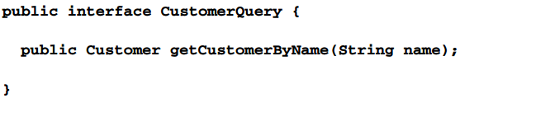
Develop persistence interfaces

Slide 36
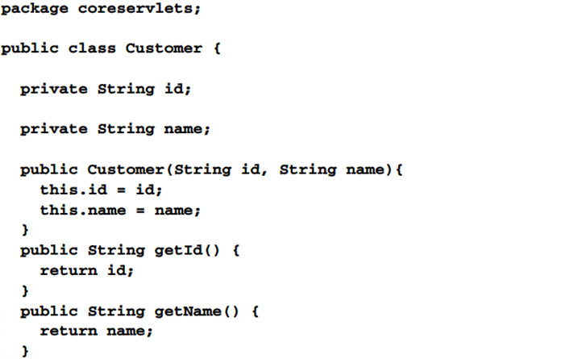
Develop persistence interfaces

Slide 37
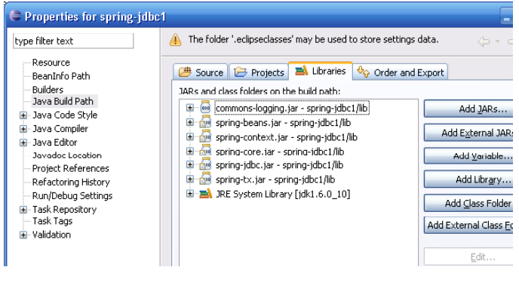
Register spring JDBC jars

Slide 38
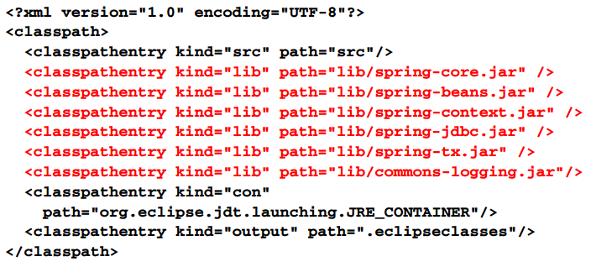
Register spring JDBC jars eclipse .classpath

Slide 39
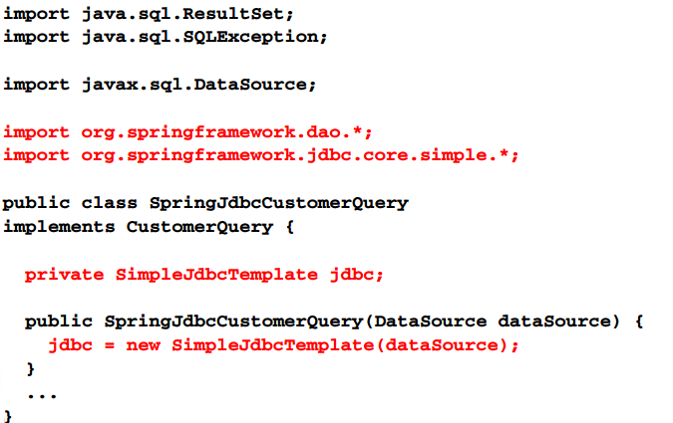
Implement persistence class

Slide 40
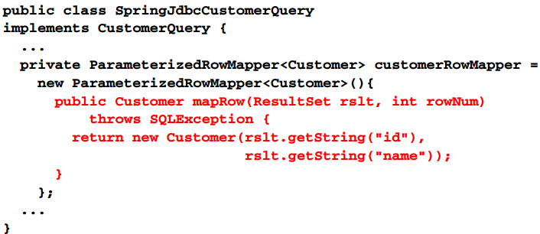
Implement persistence class

Slide 41
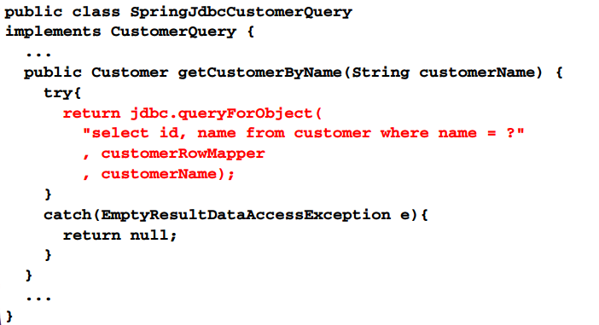
Implement persistence class

Slide 42
Create the bean definitions file
Default to applicationContext.xml
Place the file in an accessible location
Classpath, filesystem, or web module path

Slide 43
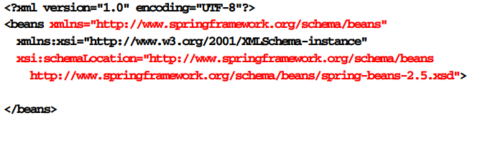
Register beans

Slide 44
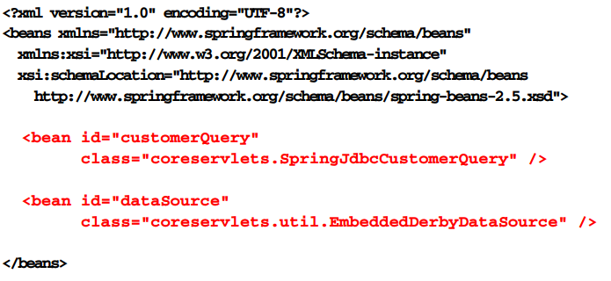
Register beans

Slide 45

Integrate configuration

Slide 46
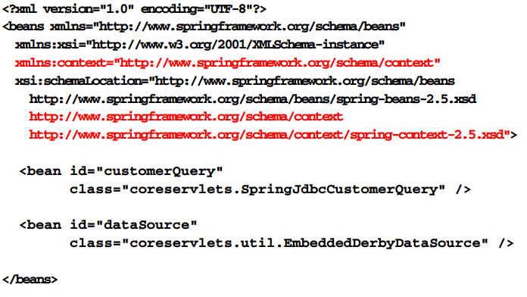
Integrate configuration

Slide 47

Integrate configuration

Slide 48
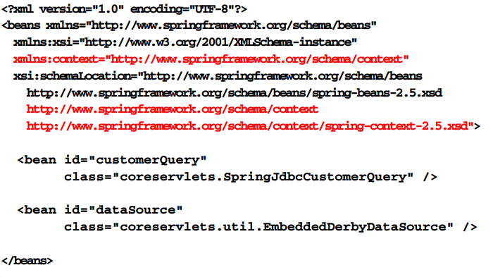
Integrate configuration

Slide 49
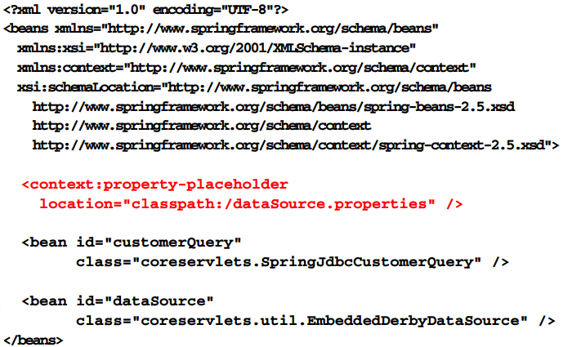
Integrate configuration

Slide 50
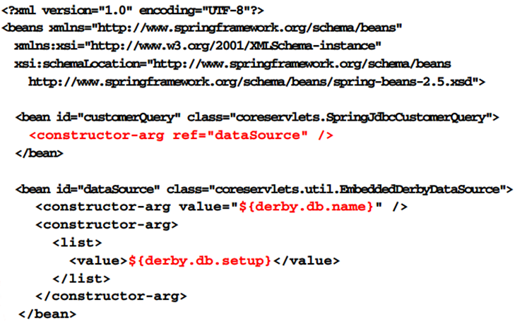
Define bean

Slide 51
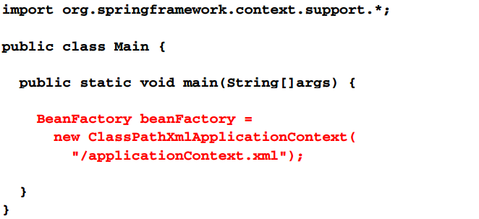
Initializer container

Slide 52
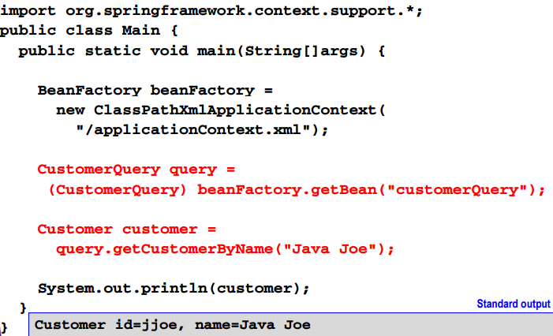
Access and use beans

Slide 53
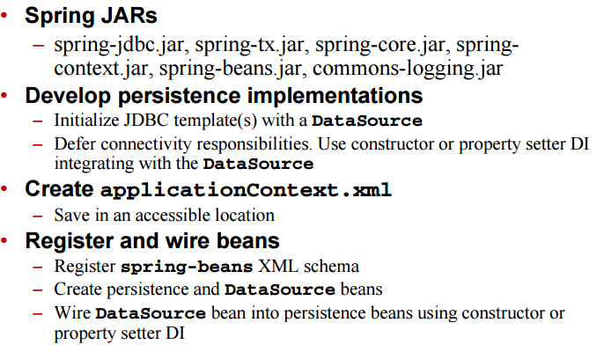
Spring JDBC and spring IoC process

Slide 54
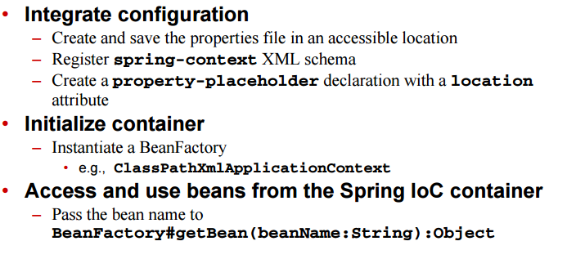
Spring JDBC and Spring IoC process

