Slide 1
Spring Integration
Instruction: NGUYEN ANH MINH (M. Sc.)

Slide 2
Outline
Managing transactions with Spring
Create transaction with test environment
Spring and JPA integration
Spring and JPA and JSF integration

Slide 3
Managing Transaction with Spring

Slide 4
Objectives
Transaction instance
Read consistency
Error recovery

Slide 5
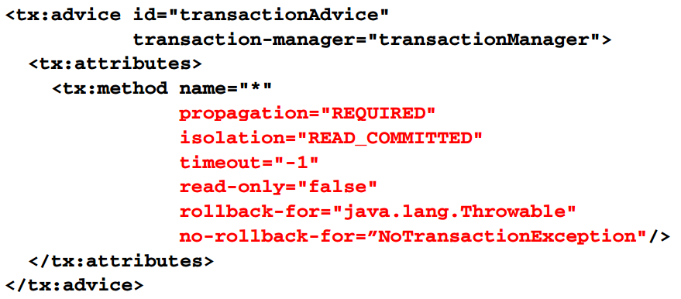
Spring aop advice transaction example

Slide 6
Propagation options
REQUIRED (default)
Adopts existing transactions
Create new transactions
SUPPORTS
Does not create new transactions
If a transaction is present , adopts existing transactions
MANDATORY
Doest not create new transaction
Adopt existing transaction
Throw an error , if a transaction is not present
NERVER
Throw an error, if a transaction is present

Slide 7
Propagations options continued
NESTED
Adopts existing transactions
Create new transactions
Commits to save points
REQUIRES_NEW
Create a new transaction for each execution scope
Suspends existing transactions
Requires JTA integration
See org.springframework.transaction.jta.JtatransactinonManager

Slide 8
Isolation
DEFAULT
Driver dependent
READ_UNCOMMITTED
Read uncommitted information
READ_COMMITTED
Expose committed information
REPEATABLE_READ
Provides consistent rows information for each read
SERIALIZABLE
Perform a full table clock
Guaranteed to delivery consistent query results
Two queries executed at differents times , sharing the same transaction scope

Slide 9
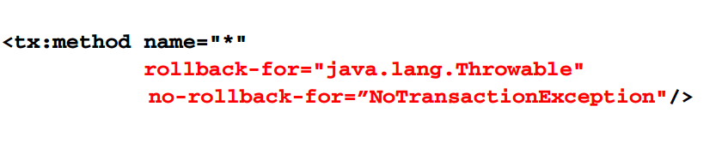
Error recovery
Recovery options
Rollback
No rollback
Mapped to error typed
Defaults to java.lang.runtimeexception

Slide 10
Other options
Timeout
Transaction time ceiling in seconds
Defaults to none, -1
Read-only
Determine if changes to database are permitted
Default to false

Slide 11
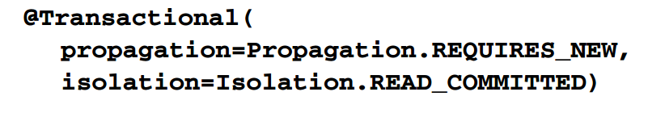
@Transactional
Class or method annotation
@transactional
Annotation properties
Fined-grained settings

Slide 12
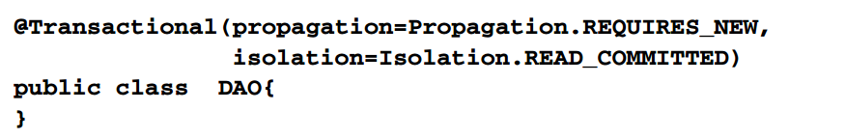
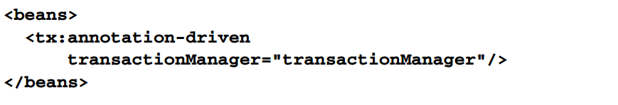
@transactional example
Annotated source
Bean definition

Slide 13
Spring transaction implication
Coordinate direct data source access with transaction management
Aquire connections via DataSourceUtils API
E.g. static method getConnection (dataSource)

Slide 14
Creating a Transactional test environment

Slide 15
General approach
Provides testing bean definitions
Mock beans
Data source
Transaction manager
Test support beans
JDBC template
Create test class
Integrate transaction managemement
@TransactionConfiguration
@Transactional
Integrate transaction management support

Slide 16
Dependencies
JDBC template support
Spring-jdbc, spring-tx, spring-core
AOP support
Spring-aop, aspectjweaver, aopalliance
IoC intergration testing
Spring-test, spring-core, spring-beans, spring-context

Slide 17
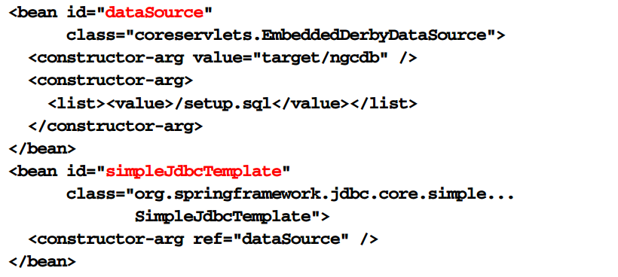
Test bean definitions

Slide 18
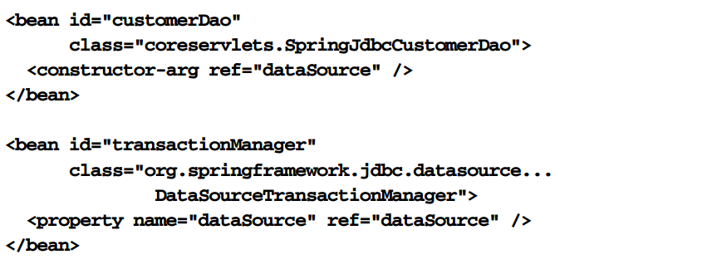
Library bean definition
Classpath :// coreservletsContext.xml

Slide 19
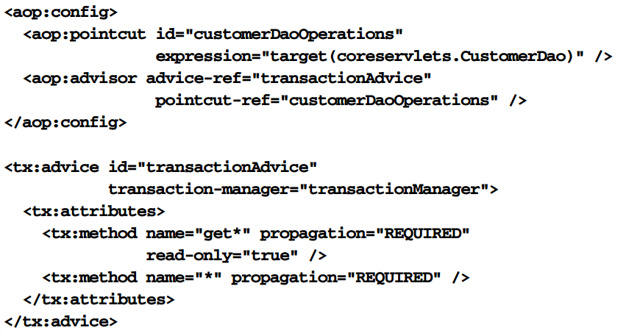
Library bean definitions

Slide 20

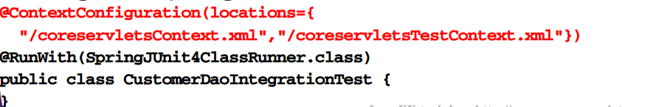
Test class
Coreservlets.customerDaoIntergrationTest
Integrate spring container
Integrate bean definitions

Slide 21
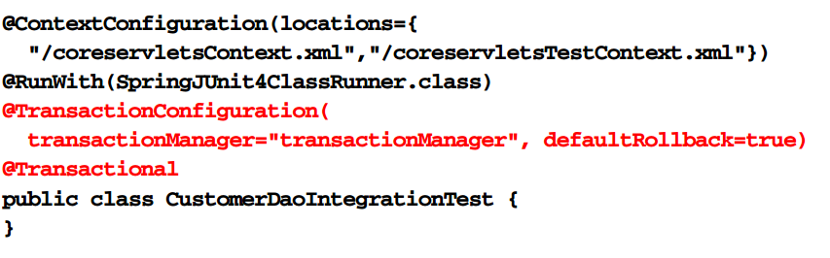
Integrate transaction management

Slide 22
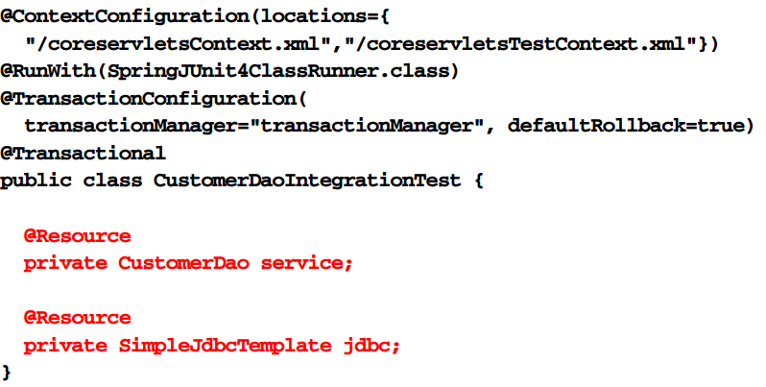
Inject test fixtures

Slide 23
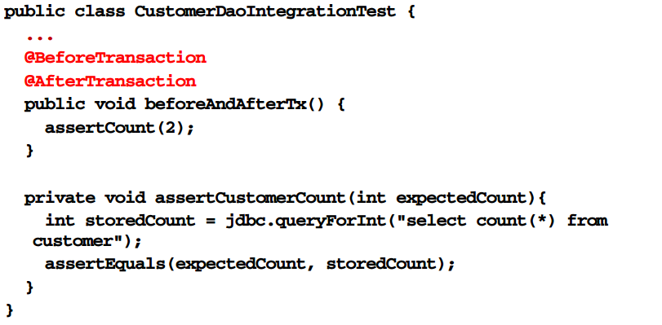
Leverage transaction support

Slide 24
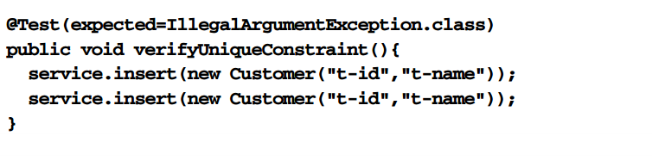
Develop test cases

Slide 25
Spring and JPA

Slide 26
Summary
Leverage spring-orm
Configure entirymanager
Integrate JPA persistence unit
Integrate JPA vendor; e.g. Hibernate
Inject entitymanager into business beans
Integrate spring transaction management

Slide 27
Process
Map class to table
JPA annotations ; e.g @entity , @table, @id, @column
Implement DAO
Define and /or inject javax.persistence.entitymanager
@persistenceContext (unit name =“unitName”)
Implement business methods
Use javax.persistence.entitymanager
Create DAO bean definition
</bean>
Add spring ORM Jar
Create persistence .xml
Classpath:/META-INF/persistence.xml

Slide 28
Process continued
Configure JPA entity manager
Persistence unit name
JPA vendor
E.g Hibernate with RDBMS client dialect
Integration transaction
Transaction advice
<tx:advice/>
Transaction manager
PlatformTransactionManager
Aspect
Define pointcut referencing application
Define aspect applying TX advice to application
Register bean post processor
PersistenceAnnotationBeanPostProcessor

Slide 29
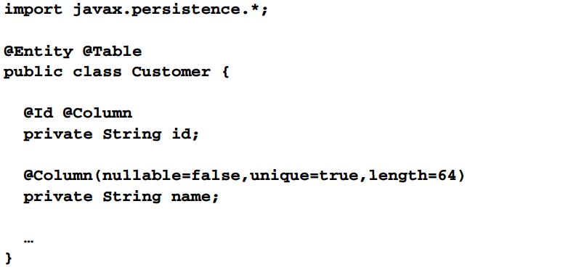
Map database table

Slide 30
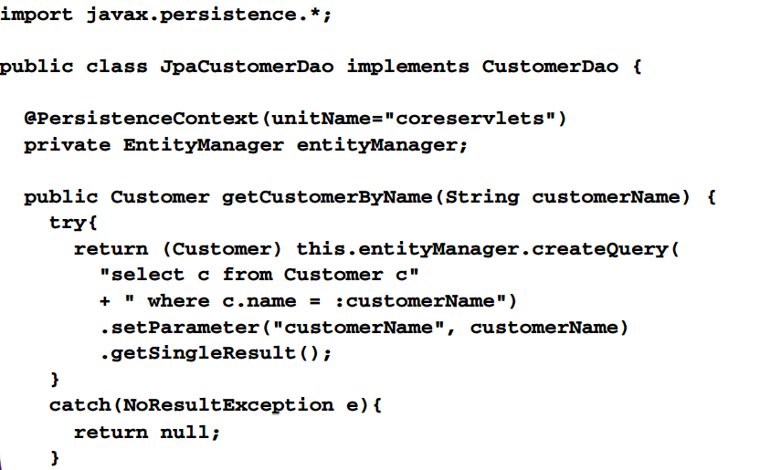
Implement DAO

Slide 31
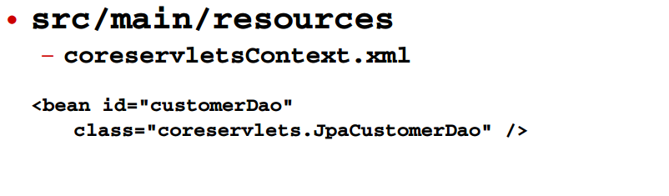
Create DAO bean definition

Slide 32
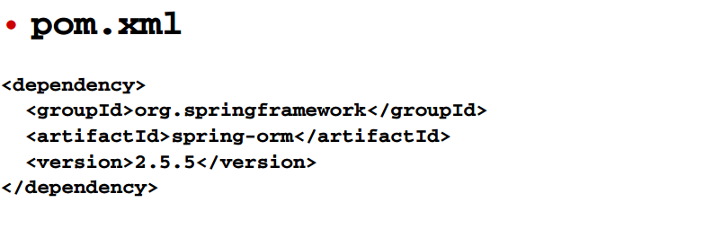
Register spring ORM dependency

Slide 33
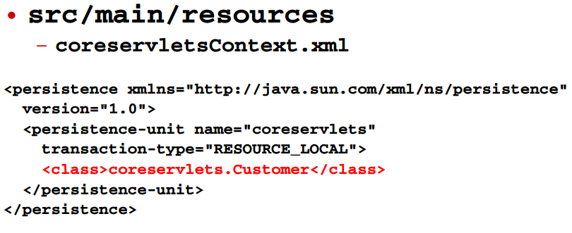
Create persistence.xml

Slide 34
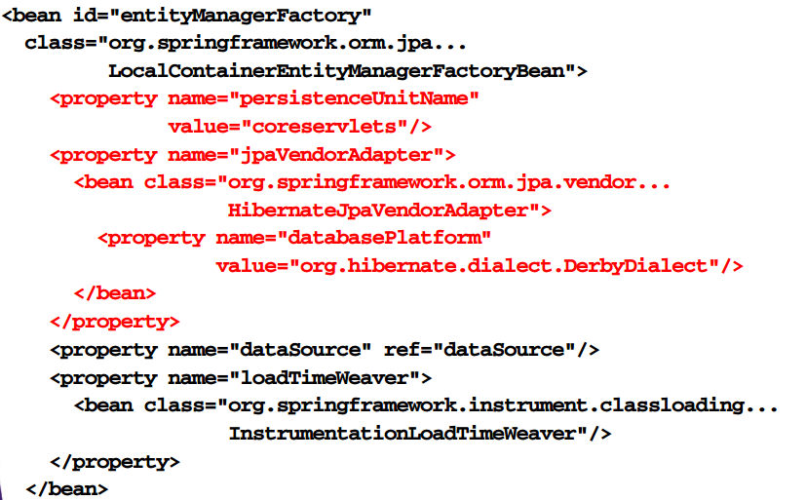
Configure JPA entity manager

Slide 35
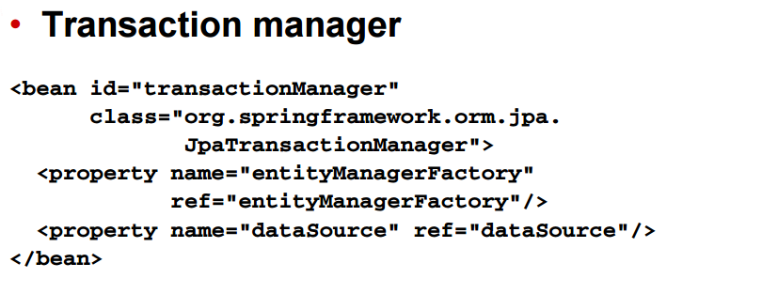
Integrate transaction management

Slide 36
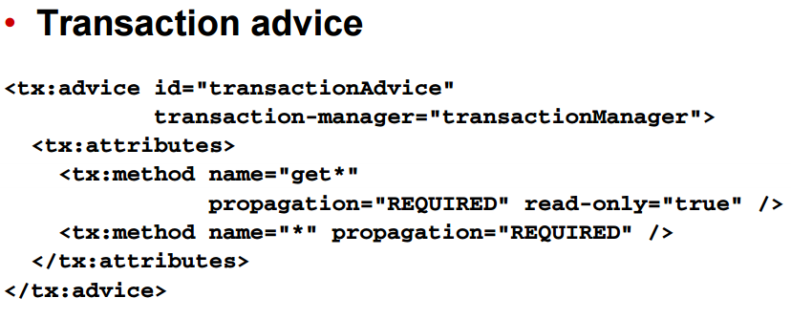
Integrate transaction management

Slide 37
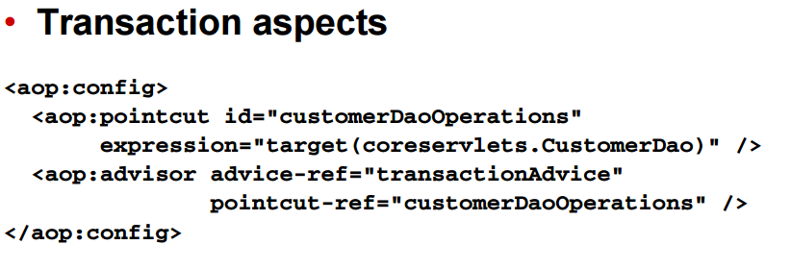
Integrate transaction management

Slide 38
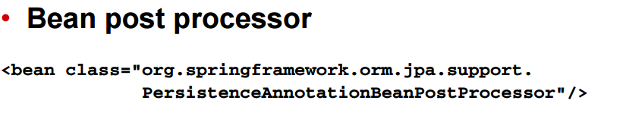
Process bean annotations

Slide 39
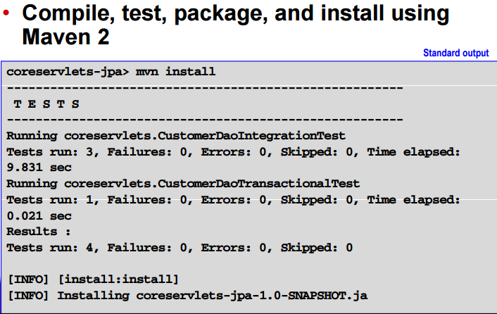
Execute integration tests

Slide 40
SPRING & JPA & JSF

Slide 41
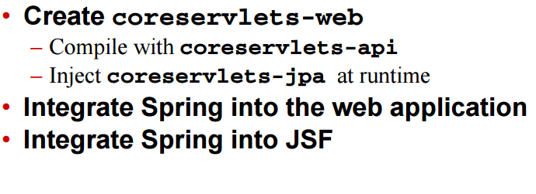
General approach

Slide 42
Process
Reference
Compile-time dependency : coreservlets-api
Runtime dependency : coreservlets-jpa
Add spring JARs
Spring-web
Edit web.xml
Add servlet context parameters
Identify bean definitions paths
<Context-param/>
Add web application listener callback
Initialize spring context
<listener/>
Edit faces-config.xml
Add spring/jsf variable resolver

Slide 43
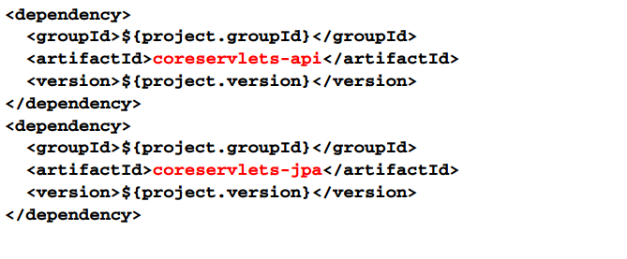
Create library

Slide 44
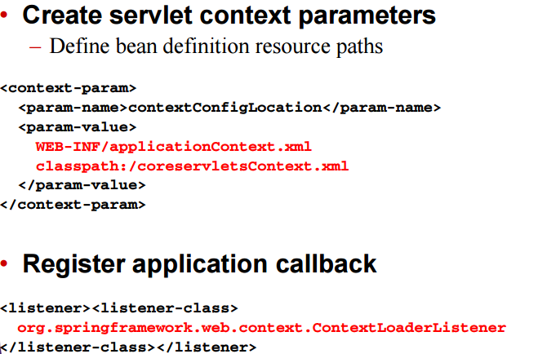
Edit web.xml

Slide 45
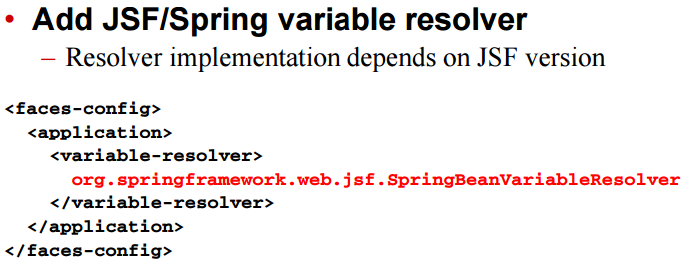
Edit faces-config.xml

Slide 46
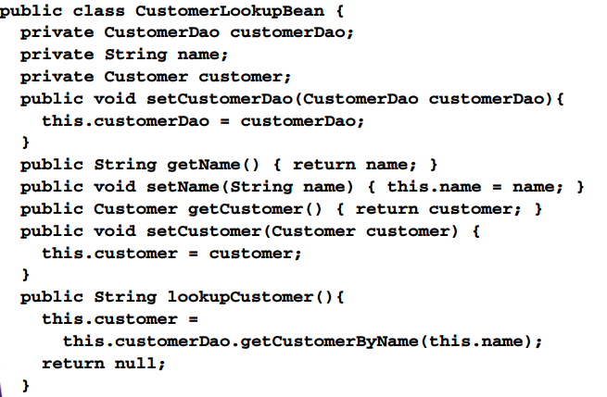
JSF backing bean example

Slide 47
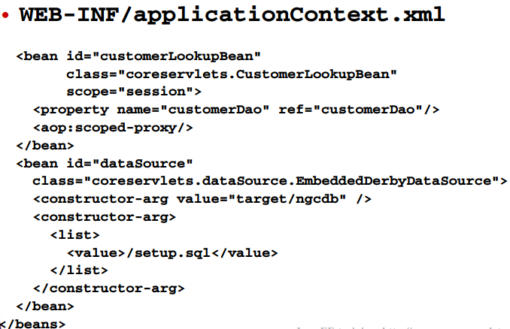
Bean definitions

Slide 48
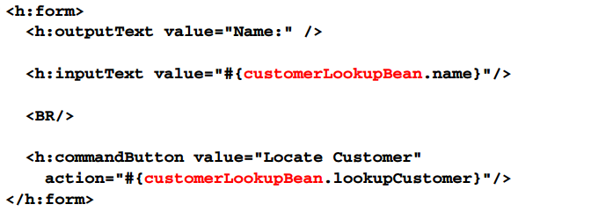
JSP form

Slide 49
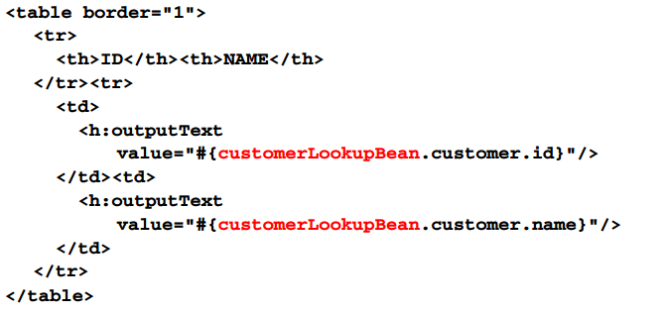
JSP results

Slide 50
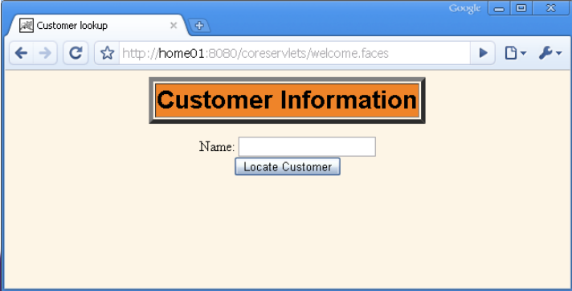
form

Slide 51
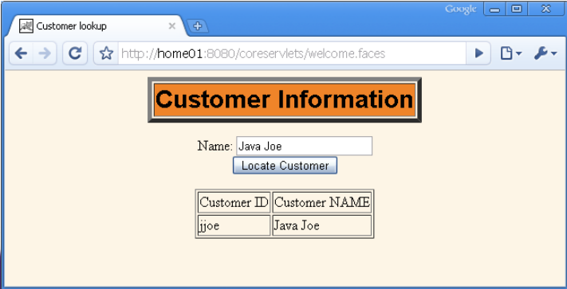
Results

Slide 52
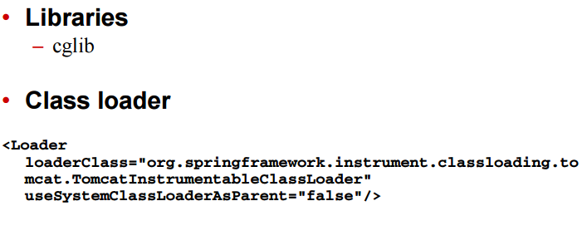
Special considerations for tomcat

Slide 53
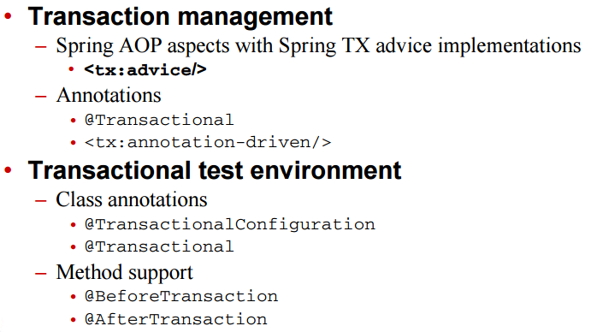
Summary

Slide 54
Summary continued

