Slide 1
Spring vdbc
Instruction: NGUYEN ANH MINH (M. Sc.)

Slide 2
Outline
Introduction to spring jdbc api
Result transformations
Parameter mapping
Updating data tables

Slide 3
Handling JDBC query results

Slide 4
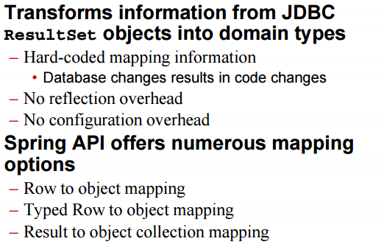
Spring JDBC resultSet

Slide 5
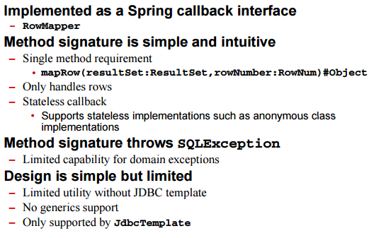
Row to Object Mapping

Slide 6
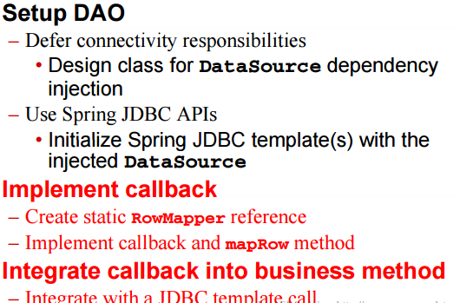
Row to Object Mapping Process

Slide 7
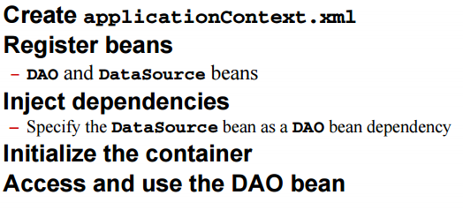
Row to object mapping process

Slide 8
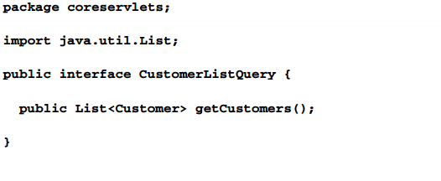
Creating DAO interface

Slide 9
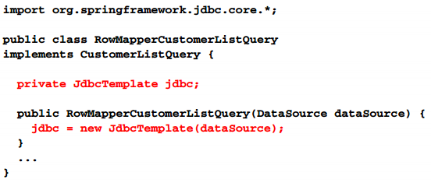
Setup DAO

Slide 10
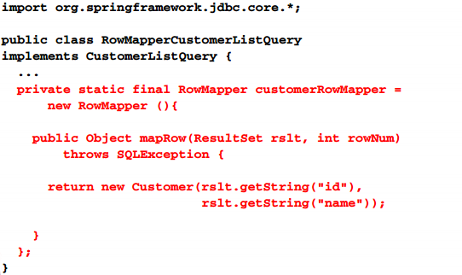
Implement callback

Slide 11
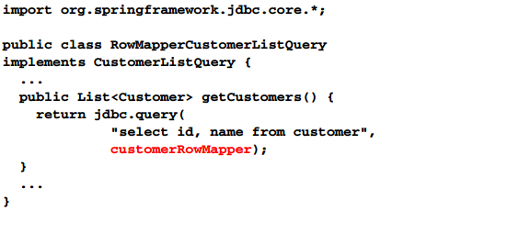
Integrate callback

Slide 12
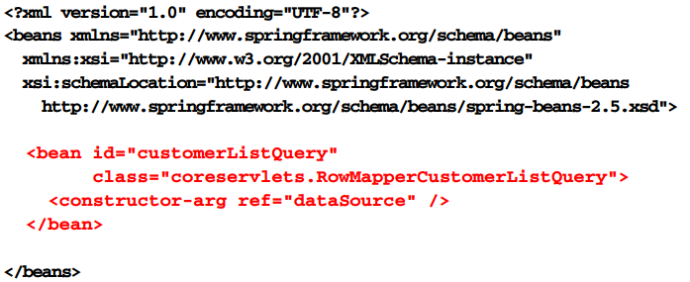
DAO Bean

Slide 13
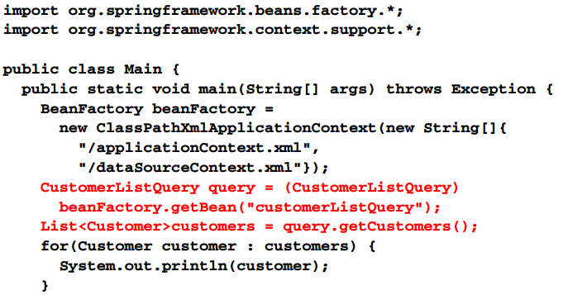
DAO Execution

Slide 14
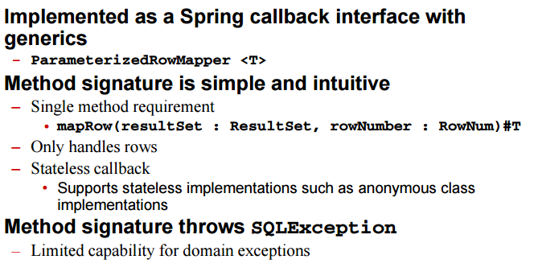
Typed row to object mapping

Slide 15
Typed Row to Object Mapping

Slide 22
Spring query object

Slide 23
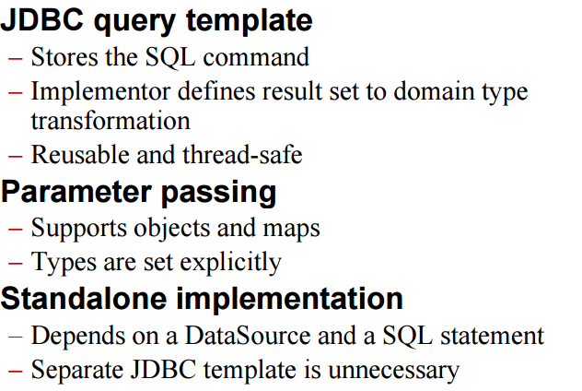
Spring query object

Slide 24
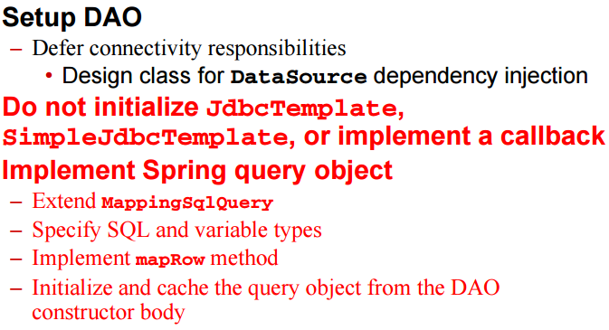
Spring query object process

Slide 25
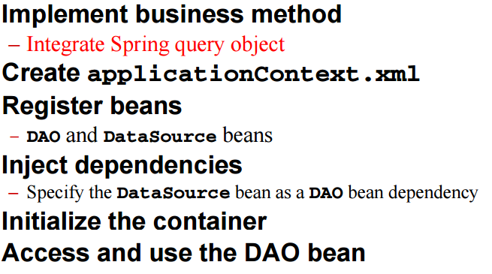
Spring query object process

Slide 26
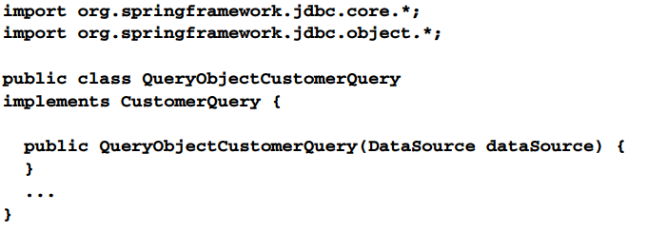
Setup DAO

Slide 27
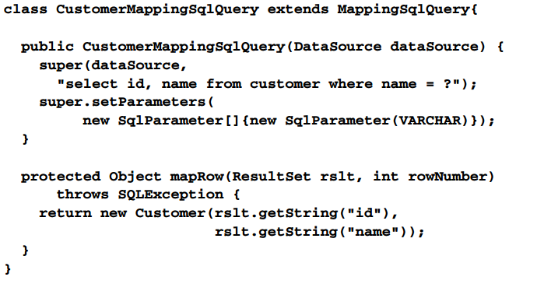
Implement spring query object

Slide 28
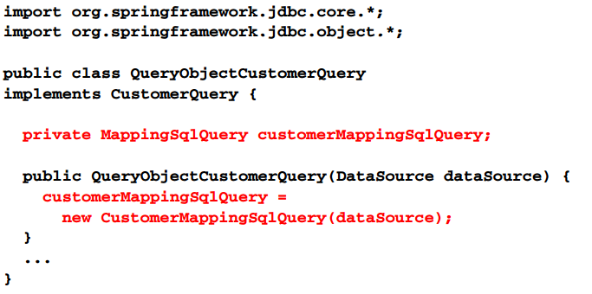
Initialize and cache spring query object

Slide 29
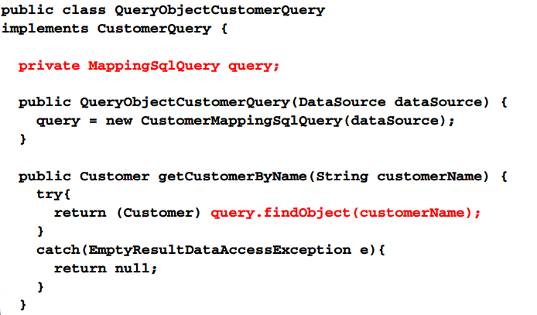
Integrate spring query object

Slide 30
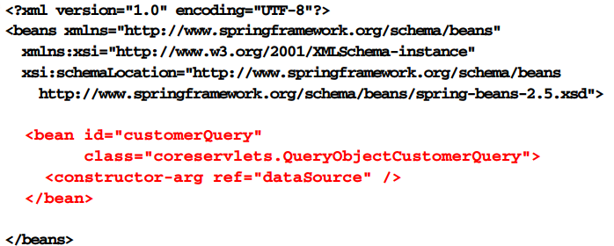
DAO Bean

Slide 31
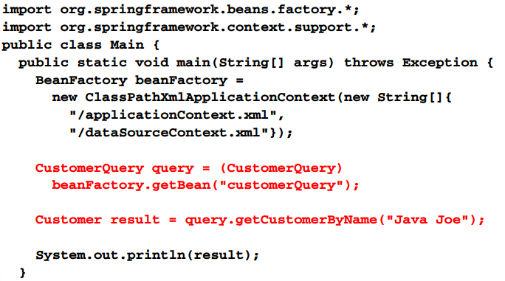
DAO Execution

Slide 32
Modifying the databases

Slide 33
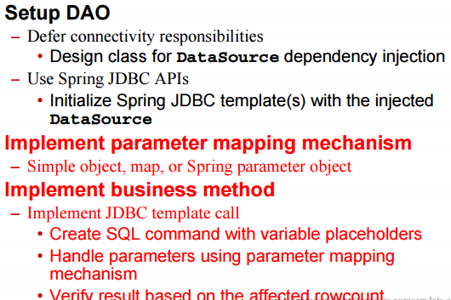
Spring JDBC table update

Slide 34
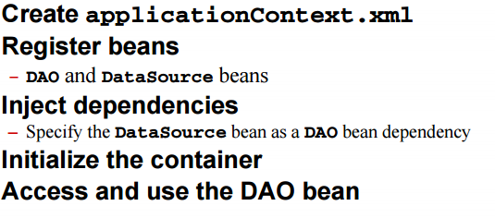
Spring JDBC table update

Slide 35
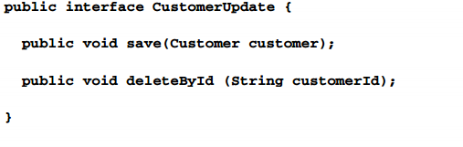
DAO interface

Slide 36
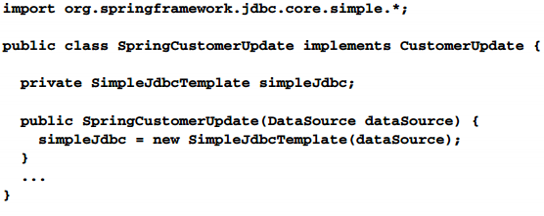
Set DAO

Slide 37
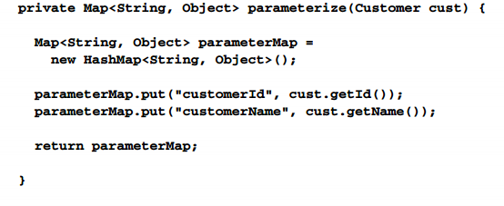
Implement parameter mapping

Slide 38
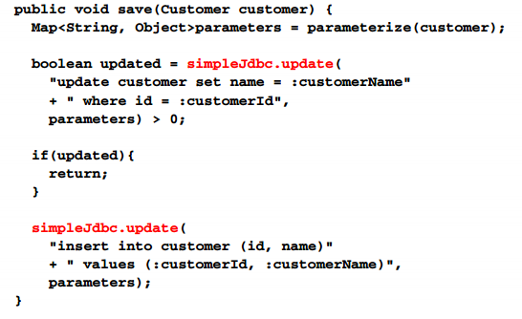
Implement save

Slide 39
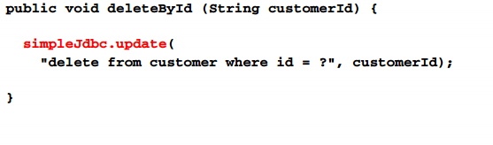
Implement delete

Slide 40
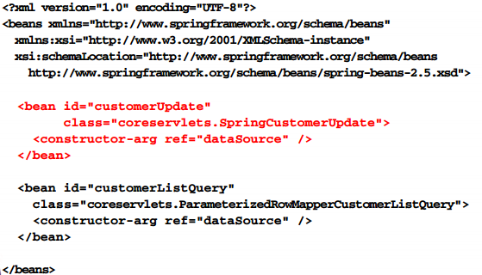
DAO Bean

Slide 41
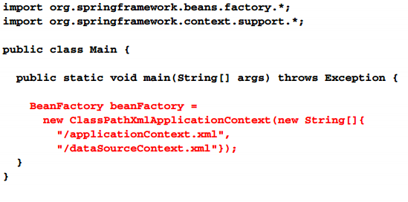
Instantiate container

Slide 42
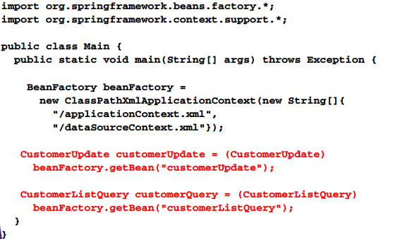
Acquire beans

Slide 43
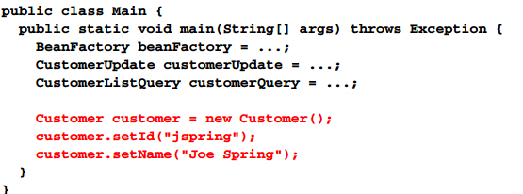
Setup customer object

Slide 44
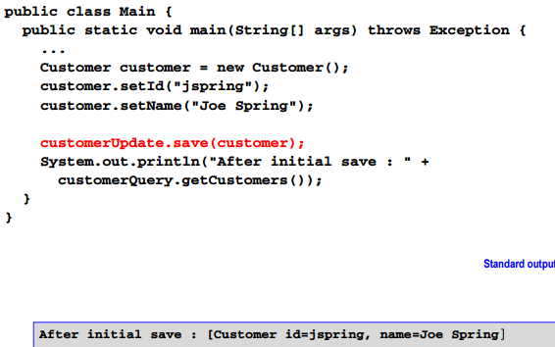
Save customer object

Slide 45
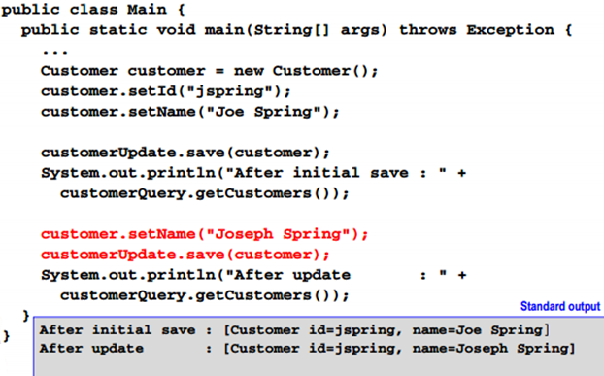
Update customer object

Slide 46
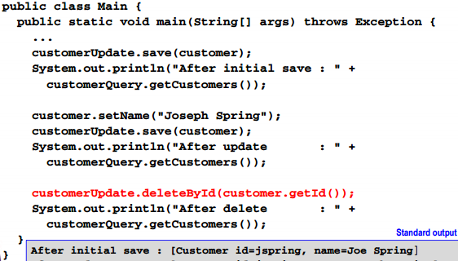
Delete customer object

Slide 47
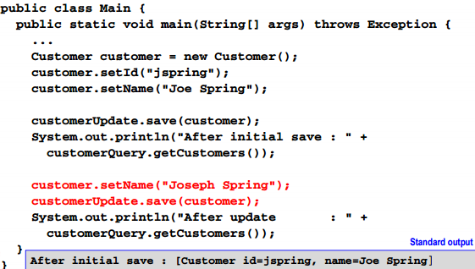
Update customer object

Slide 48
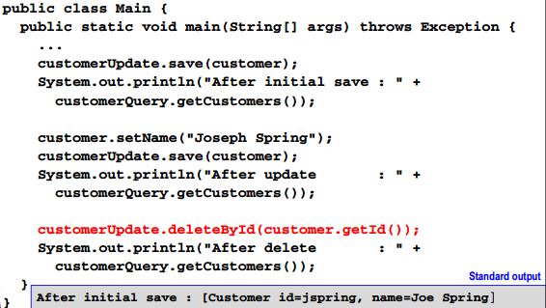
Delete customer object

Slide 49
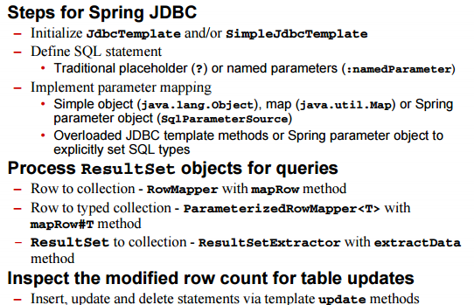
Summary

Slide 50
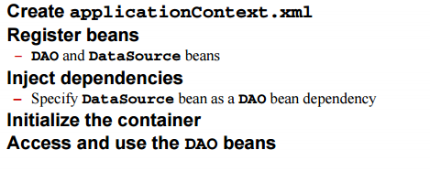
Summary

