Slide 1
Services
And
Spring Boot

Slide 2
Spring Boot and Auto-configuration
Spring Boot and We Development
Spring Boot & Microservices
Spring Framework Ecosystem
Spring Boot Administration

Slide 3
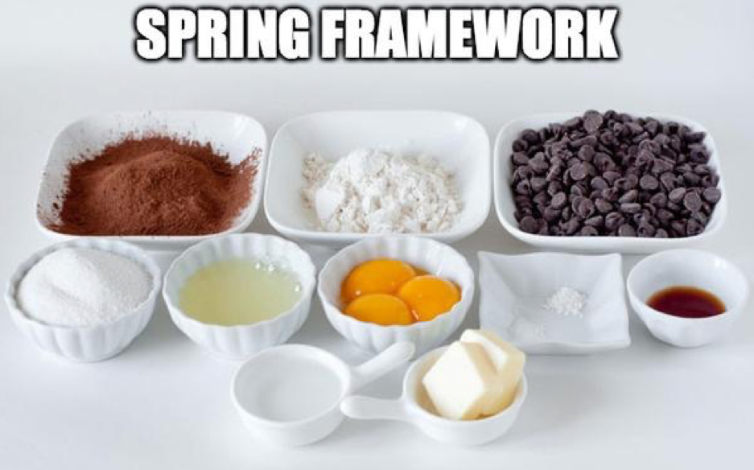

Slide 4
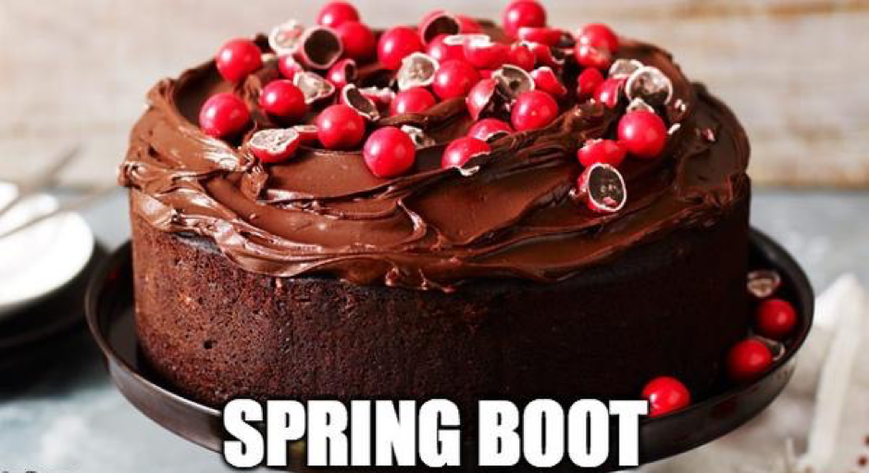

Slide 5
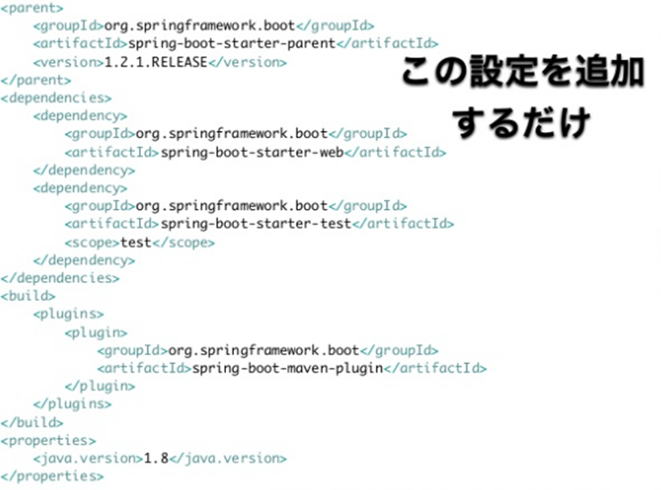
Spring Boot & Auto-configuration

Slide 6
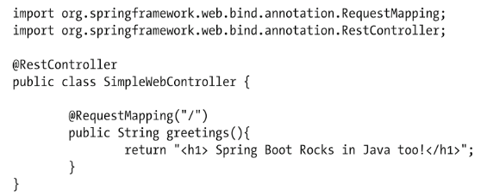
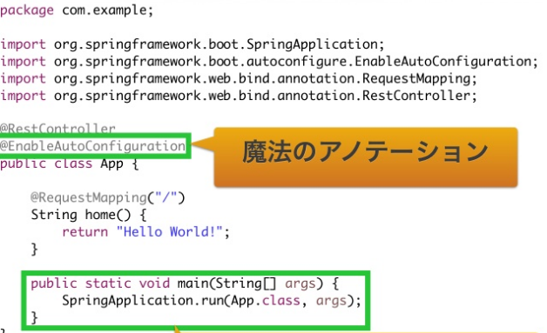
Spring Boot & Auto-configuration

Slide 7
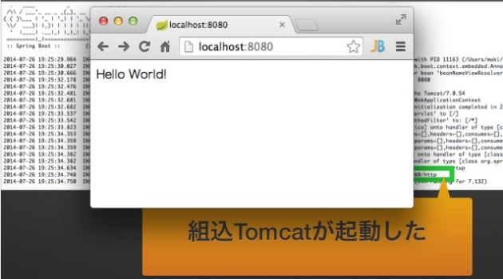
Spring Boot auto-configuration attempts to automatically configure your Spring application based on the jar dependencies that you have added.

Slide 8

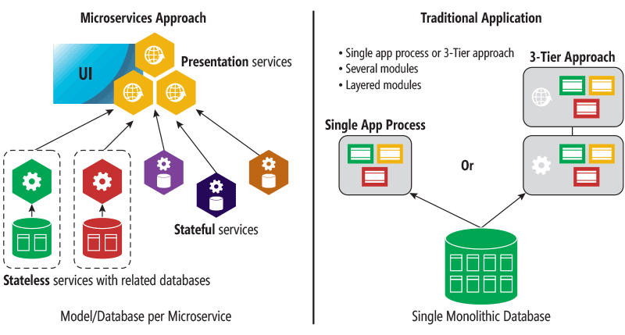

Slide 9
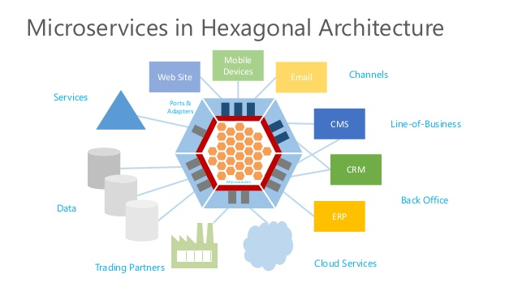
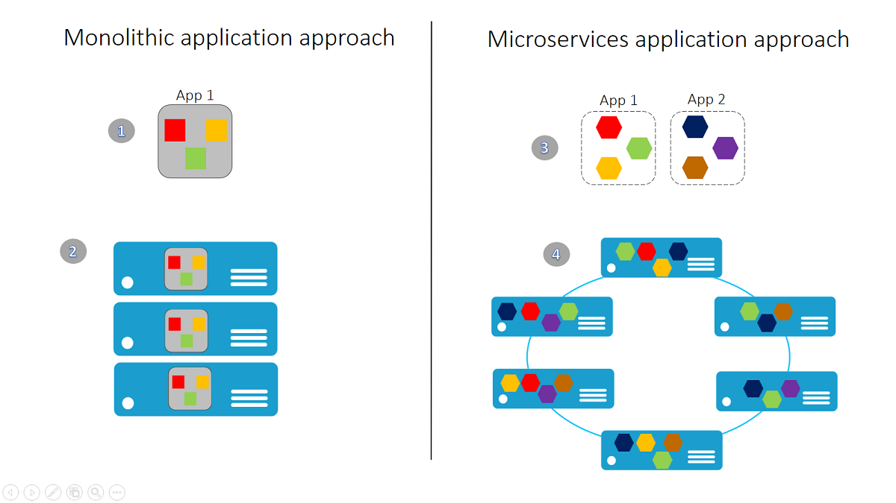
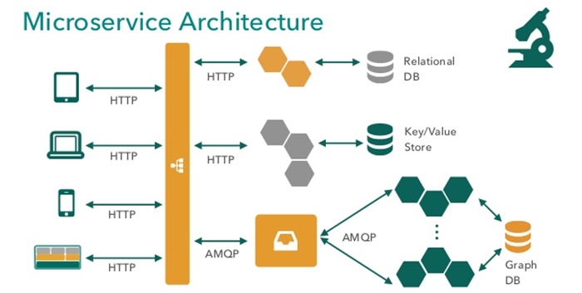
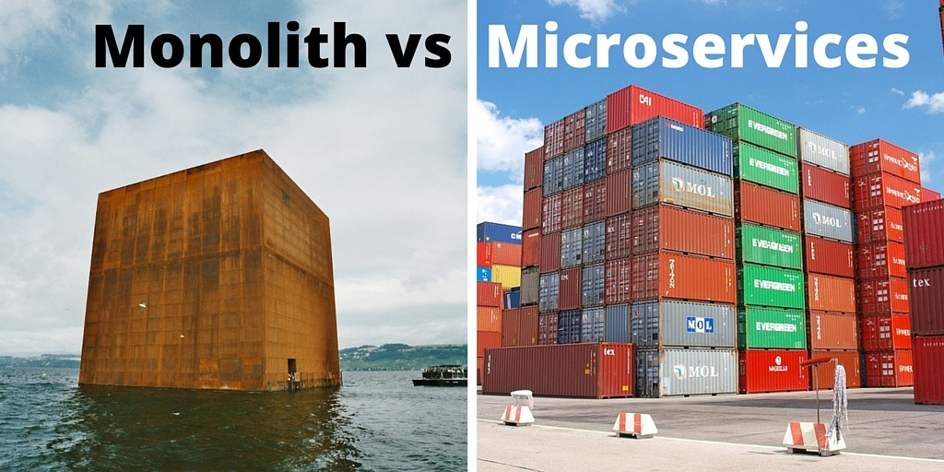

Slide 10
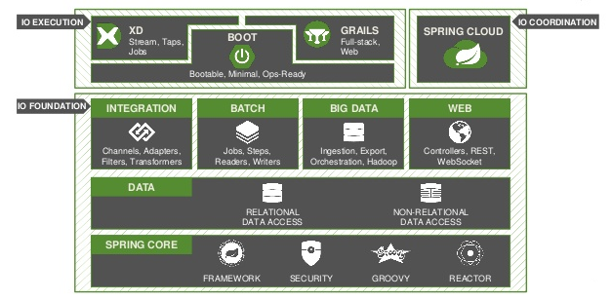

Slide 11
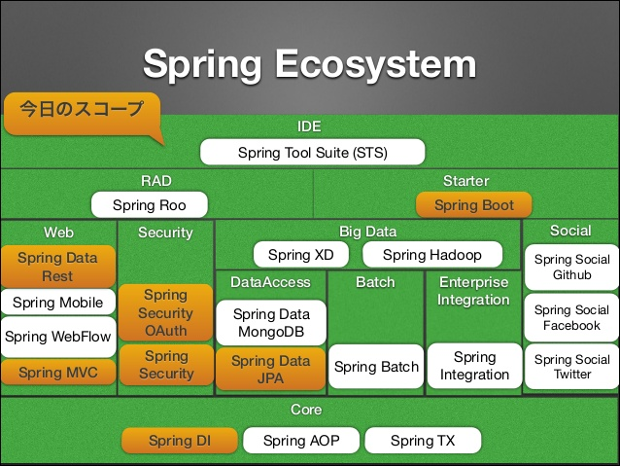

Slide 12
