Slide 1
Web Development
using Spring MVC

Slide 2
Outline
Web development history
Programming Model
Spring MVC’s DispatcherServlet
Spring MVC’s configuration
Spring MVC Development

Slide 3
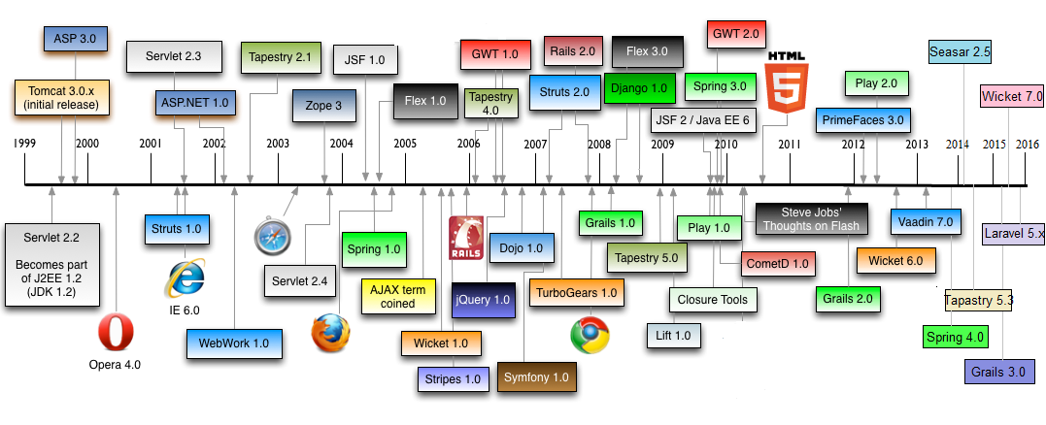
Web development history

Slide 4
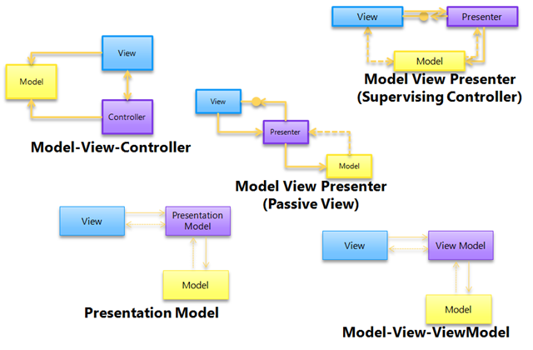
Programming Model

Slide 5

Model View Controller
A model stores data that is retrieved according to commands from the controller and displayed in the view.
A view generates new output to the user based on changes in the model.
A controller can send commands to the model to update the model's state (e.g. editing a document). It can also send commands to its associated view to
change the view's presentation of the
model (e.g. by scrolling through a document).

Slide 6
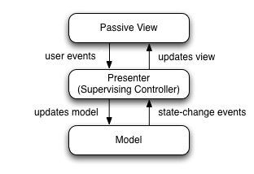
Model View Presenter
A model is an interface defining the data
to be displayed or otherwise acted upon
in the user interface.
A presenter acts upon the model and
the view. It retrieves data from repositories
(the model), and formats it for display
in the view.
A view is a passive interface that
displays data (the model) and routes
user commands to the presenter
to act upon that data.

Slide 7
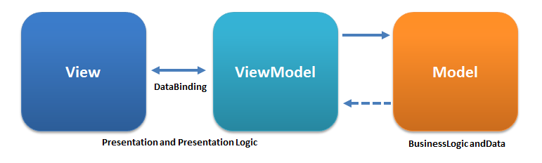
Model View View Model
Model: represents objects or POJO data
View Model: abstraction of the view exposing public properties and commands.
View: control data from users, availability user interaction

Slide 8
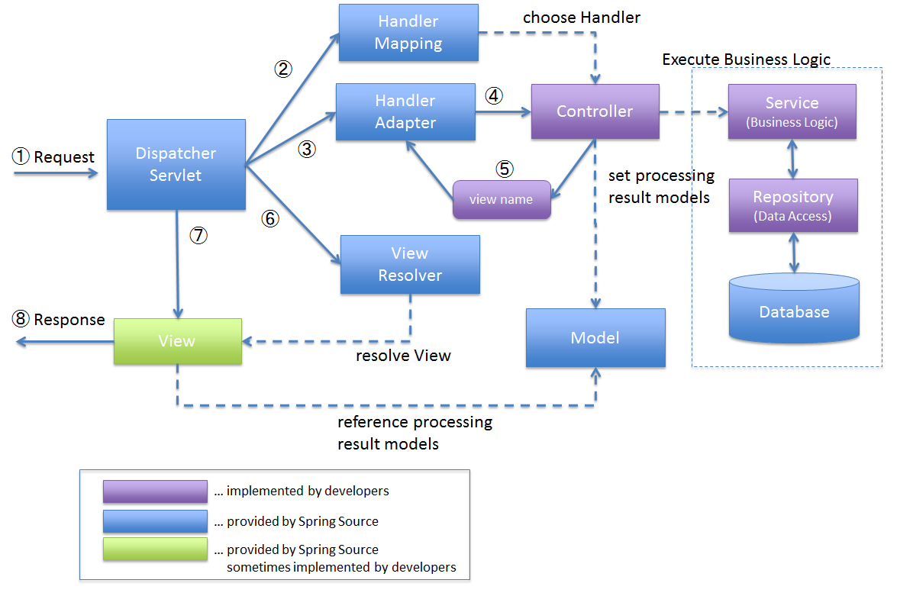
DispatcherServlet

Slide 9
DispatcherServlet
DispatcherServlet receives the request.
DispatcherServlet dispatches the task of selecting an appropriate controller to HandlerMapping selects the controller which is mapped to the incoming request URL and returns the (selected Handler) and Controller to DispatcherServlet.
DispatcherServlet dispatches the task of executing of business logic of Controller to HandlerAdapter.
HandlerAdapter calls the business logic process of Controller.
Controller executes the business logic, sets the processing result in Model and returns the logical name of view to HandlerAdapter.
DispatcherServlet dispatches the task of resolving the View corresponding to the View name to ViewResolver. ViewResolver returns the View mapped to View name.
DispatcherServlet dispatches the rendering process to returned View.
View renders Model data and returns the response.

Slide 10
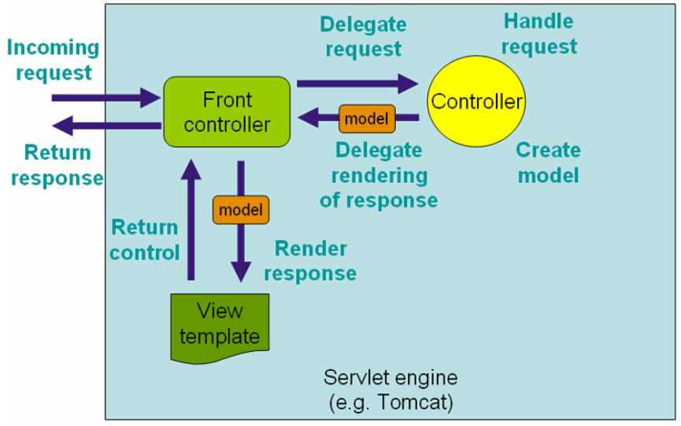
DispatcherServlet

Slide 11
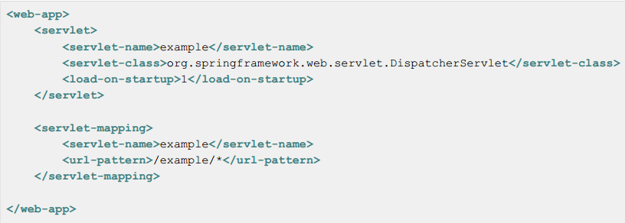
Web.xml

Slide 12
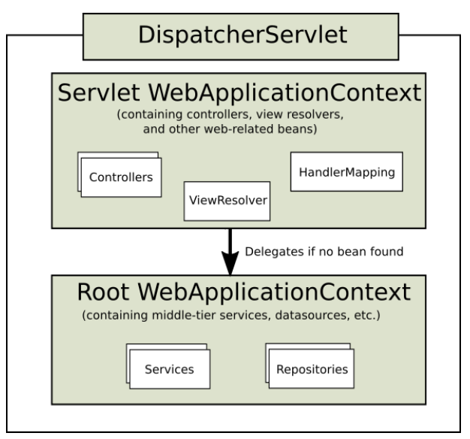
Context Hieararchy

Slide 13
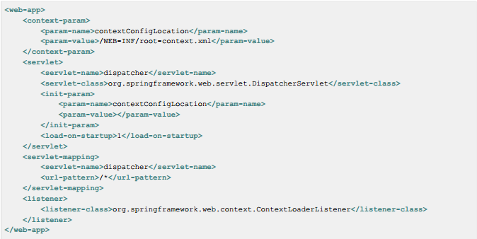
DispatcherServlet

Slide 14
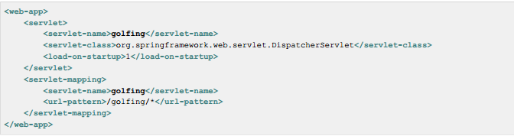
Web.xml

Slide 15
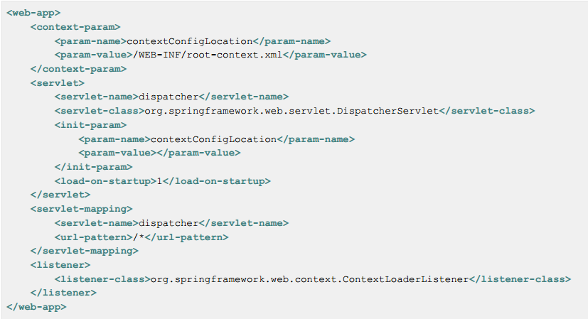
contextConfigLocation

Slide 16
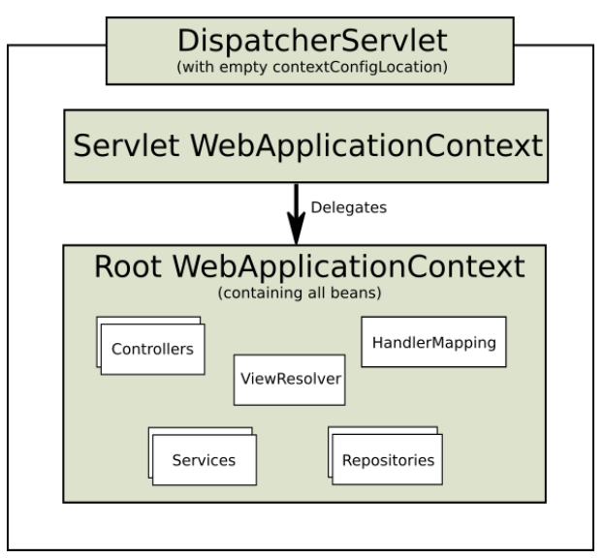
Root context

Slide 17
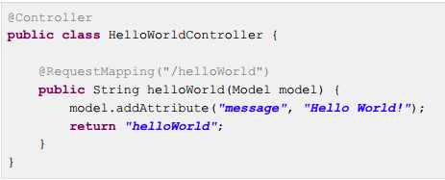
Controllers
MVC controllers that uses annotation such as @Controller

Slide 18
Mapping Requests
MVC controllers that uses annotation such as @RequestMapping, @RequestParam, @ModelAttribute

Slide 19
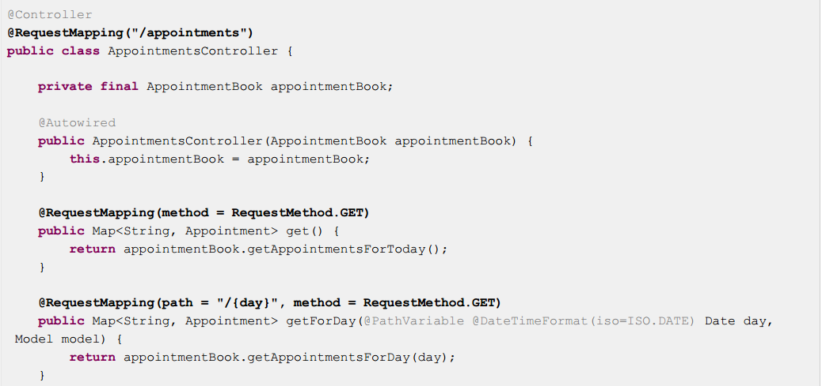
Mapping Requests

Slide 20
Summary
Web development history
Programming Model
Spring MVC’s DispatcherServlet
Spring MVC’s configuration
Spring MVC Development

