Slide 1
Spring Web flow

Slide 2
Outline
Spring MVC and Ajax/JSON
Configure ViewResolver
Spring Web Flows
Design Web Flows

Slide 3
Spring MVC and Ajax/JSON

Slide 4
(POST) Ajax/Json
client
$(“employees”).submit(function() {
Var employees = $(this).serializeObject() ;
$postJSON(“employees”, employees, function(data) {
$(“name”).val(data.id);
}); return false;
})
server
$RequestMapping(method=RequestMethod.POST)
Public @ResponseBody Map<String, ?extends Object>
Create(@RequestBody Employees employees) {
Return Collection.singletonMap(“name”, employees.getName());
}

Slide 5
(GET) Ajax/Json
server
@RequestMapping (value=”employees”,method=RequestMethod.GET)
public @ResponseBody EmployeeStatus getAvailaibiltity(@RequestParam String name) {
Return EmployeeStatus.AVAILABLE;
}
client
Function checkEmployee() () {
$.getJSON(“employees”), {name: $('#name').val(), function (employee)
{
…
}

Slide 6
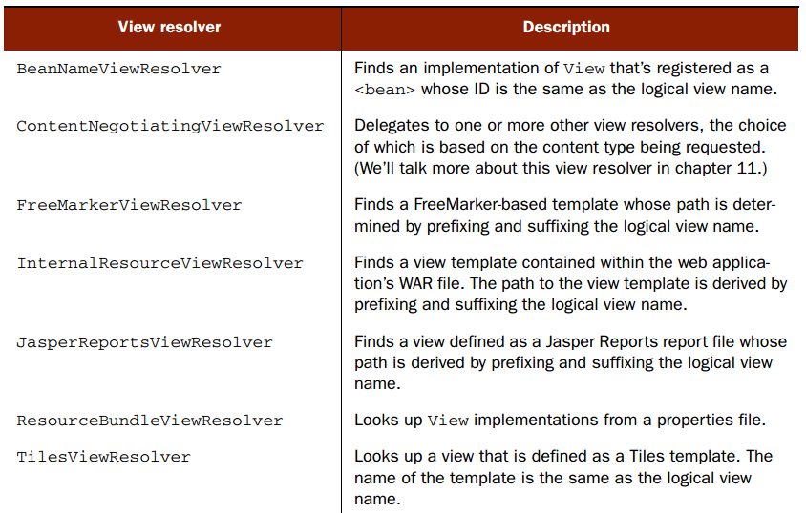
View resolver

Slide 7
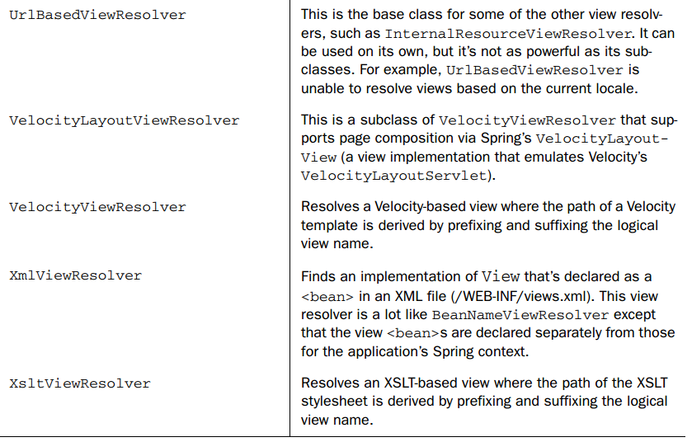
View resolver

Slide 8
<bean class=
"org.springframework.web.servlet.view.InternalResourceViewResolver">
<property name="prefix" value="/WEB-INF/views/"/>
<property name="suffix" value=".jsp"/>
</bean>

Slide 9
Spring Web flow

Slide 10
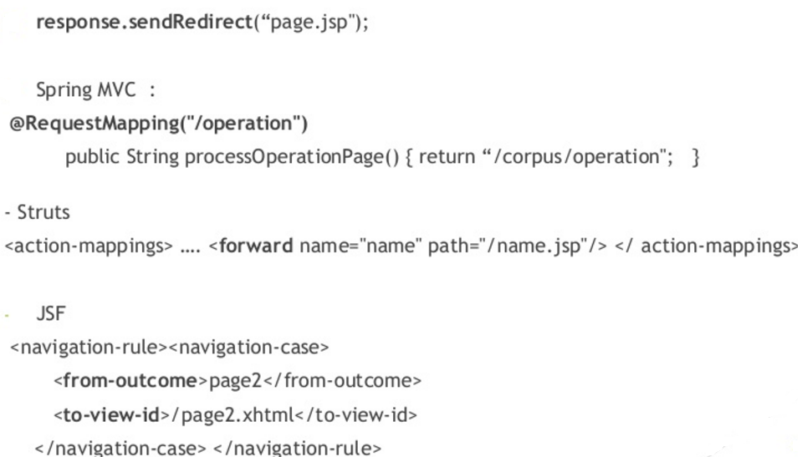
Navigation Issues

Slide 11
Navigation Issues
☹ Visualizing the flow is very difficult
☹ Mixed navigation and view
☹ Overall navigation rules complexity
☹ Lack of state control / navigation customisation
☺ Spring web flow solutions
☺ Spring MVC extension
☺ Reusable web flows as patterns
☺ Visualization flow chart

Slide 12
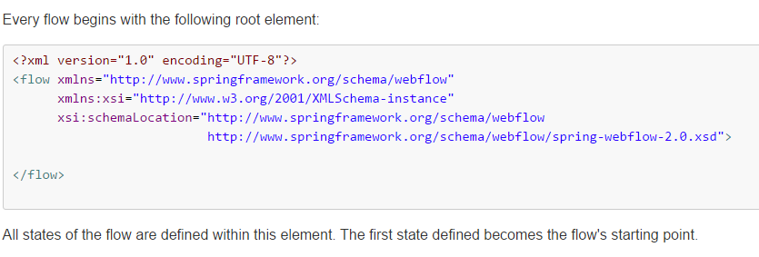
Flow

Slide 13
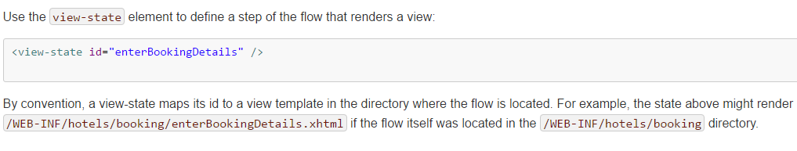
State

Slide 14
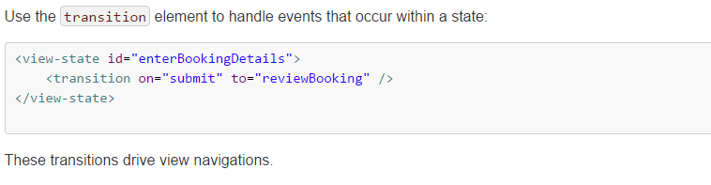
Transition

Slide 15
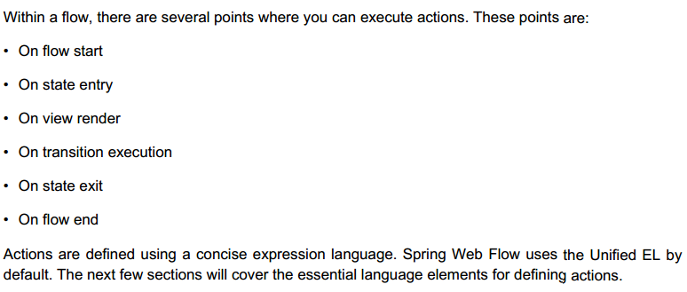
Actions

Slide 16
Expression language
Web Flow uses EL to access its data model and to invoke actions.
EL is used for many things within a flow including:
Access client data such as declaring flow inputs or referencing request parameters.
Access data in Web Flow's RequestContext such as flowScope or currentEvent.
Invoke methods on Spring-managed objects through actions.
Resolve expressions such as state transition criteria, subflow ids, and view names.
EL is also used to bind form parameters to model objects and reversely
to render formatted form fields from the properties of a model object.
That however does not apply when using Web Flow with JSF in which case
the standard JSF component lifecyle applies.

Slide 17
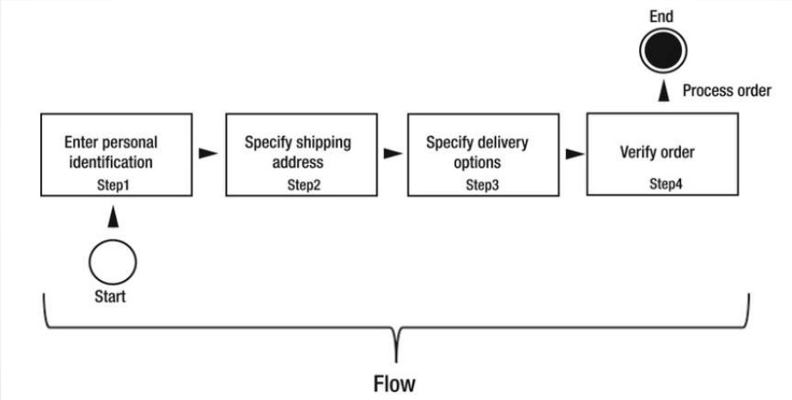
Flow

Slide 18
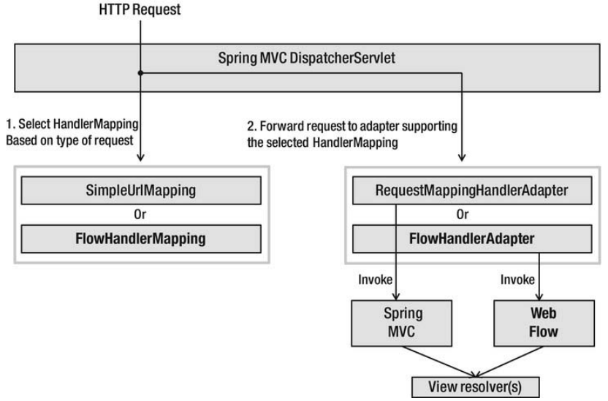
DispatchServlet

Slide 19
Definition of flows
XML document with predefined elements
Flow definition is composed of set of states
Each state has one or more transitions that are used to another state
A transition is triggered by an event

Slide 20
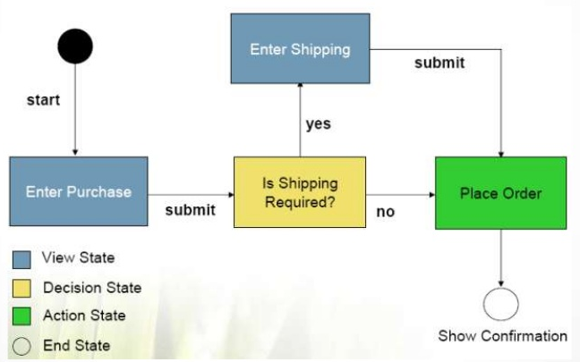
Definition of flows
Defines a conversion or dialogue between users and server meets business goals

Slide 21
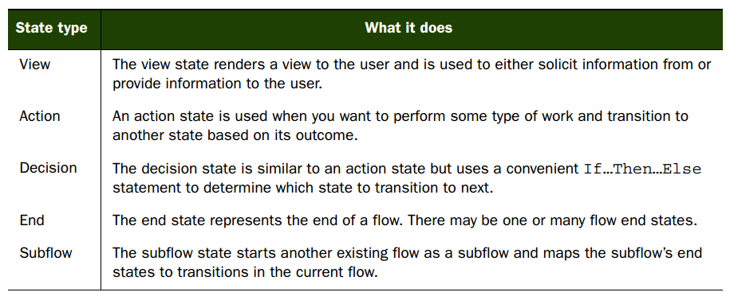
States

Slide 22
Applied field
Booking service
Shopping carts
Adaptive surveys or questionnaires
Multistep product configuration

Slide 23
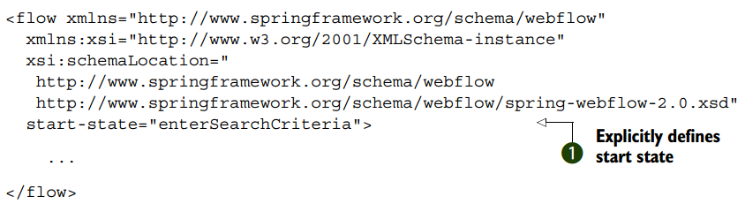

Slide 24
Design of Web flow

Slide 25
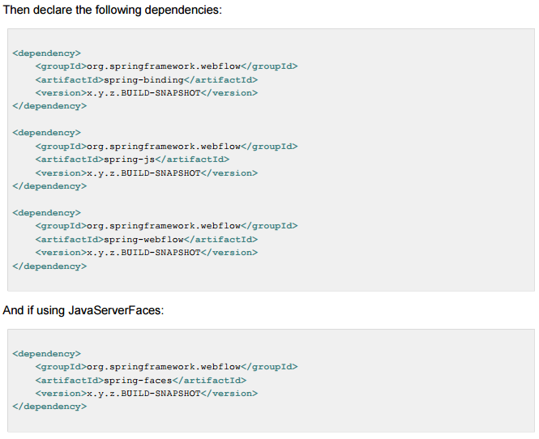

Slide 26
<var name="order" class="com.emusicstore.model.CustomerOrder" />
<action-state id="addCartToOrder">
<evaluate expression="cartDaoImpl.validate(requestParameters.cartId)" result="order.cart" />
<transition to="InvalidCartWarning" on-exception="java.io.IOException" />
<transition to="collectCustomerInfo" />
</action-state>
<view-state id="collectCustomerInfo" view="collectCustomerInfo.jsp" model="order">
<transition on="customerInfoCollected" to="collectShippingDetail" />
</view-state>
<view-state id="collectShippingDetail" view="collectShippingDetail.jsp" model="order">
<transition on="shippingDetailCollected" to="orderConfirmation" />
<transition on="backToCollectCustomerInfo" to="collectCustomerInfo" />
</view-state>
<view-state id="orderConfirmation">
<transition on="orderConfirmed" to="processOrder" />
<transition on="backToCollectShippingDetail" to="collectShippingDetail" />
</view-state>
<action-state id="processOrder">
<evaluate expression="cartItemDaoImpl.removeAllCartItems(order.cart)" />
<transition to="thankCustomer" />
</action-state>
<view-state id="thankCustomer" model="order">
<transition to="endState" />
</view-state>
<end-state id="endState" />
<view-state id="invalidCartWarning">
<transition to="endState" />
</view-state>
<end-state id="cancelCheckout" view="checkOutCancelled.jsp" />
<global-transitions>
<transition on="cancel" to="cancelCheckout" />
</global-transitions>
</flow>

Slide 27
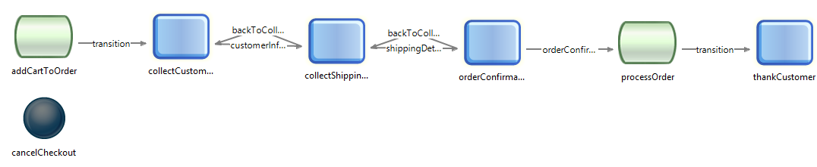
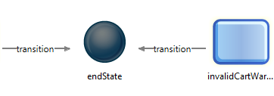

Slide 28
Summary
Spring MVC and Ajax/JSON
Configure ViewResolver
Spring Web Flows
Design Web Flows

