Slide 2
Content
Spring MVC and Ajax/JSON
Configure ViewResolver
Spring Web Flows
Design Web Flows

Slide 3
Spring MVC and Ajax/JSON

Slide 4
(GET) Ajax/Json
server
@RequestMapping (value=”employees”,method=RequestMethod.GET)
public @ResponseBody EmployeeStatus getAvailaibiltity(@RequestParam String name) {
Return EmployeeStatus.AVAILABLE;
}
client
Function checkEmployee() () {
$.getJSON(“employees”), {name: $('#name').val(), function (employee)
{
…
}

Slide 5
(POST)Ajax/Json
client
$(“employees”).submit(function() {
Var employees = $(this).serializeObject() ;
$postJSON(“employees”, employees, function(data) {
$(“name”).val(data.id);
});
return false;
})
server
$RequestMapping(method=RequestMethod.POST)
Public @ResponseBody Map<String, ?extends Object>
Create(@RequestBody Employees employees) {
Return Collection.singletonMap(“name”, employees.getName());
}

Slide 6
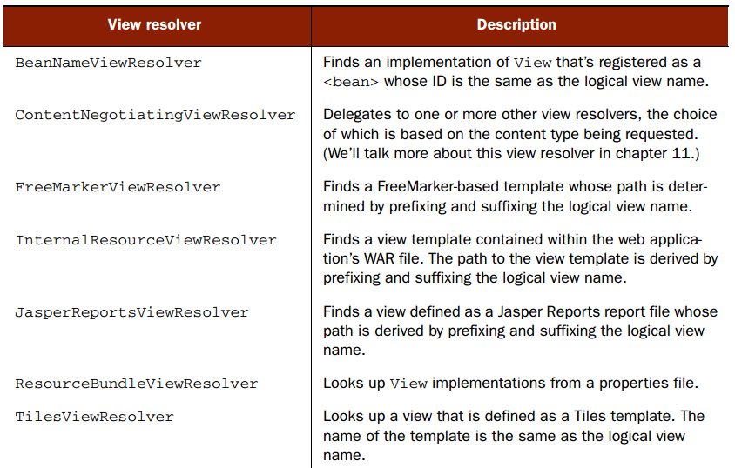
View resolver

Slide 7
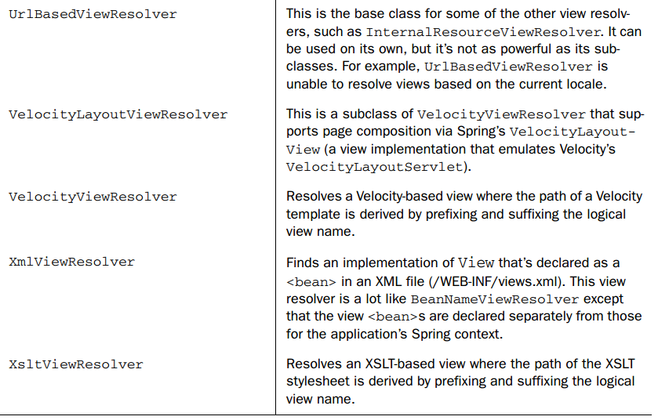
View resolver

Slide 8
View resolver
AbstractCachingViewResolver : Abstract view resolver that caches views. Often views need preparation before they can be used; extending this view resolver provides caching.
XmlViewResolver : Implementation of ViewResolver that accepts a configuration file written in XML with the same DTD as Spring’s XML bean factories. The default configuration file is /WEB-INF/views.xml.
ResourceBundleViewResolver : Implementation of ViewResolver that uses bean definitions in a ResourceBundle, specified by the bundle base name. Typically you define the bundle in a properties file, located in the classpath. The default file name is views.properties.
UrlBasedViewResolver : Simple implementation of the ViewResolver interface that effects the direct resolution of logical view names to URLs, without an explicit mapping definition. This is appropriate if your logical names match the names of your view resources in a straightforward manner, without the need for arbitrary mappings.
InternalResourceViewResolver : Convenient subclass of UrlBasedViewResolver that supports InternalResourceView (in effect, Servlets and JSPs) and subclasses such as JstlView and TilesView. You can specify the view class for all views generated by this resolver by using setViewClass(..).
VelocityViewResolver/FreeMarkerViewResolver : Convenient subclass of UrlBasedViewResolver that supports VelocityView (in effect, Velocity templates) or FreeMarkerView ,respectively, and custom subclasses of them.
ContentNegotiatingViewResolver : Implementation of the ViewResolver interface that resolves a view based on the request file name or Accept header.

Slide 9
<bean class=
"org.springframework.web.servlet.view.InternalResourceViewResolver">
<property name="prefix" value="/WEB-INF/views/"/>
<property name="suffix" value=".jsp"/>
</bean>

Slide 10
Spring Web Flows

Slide 11
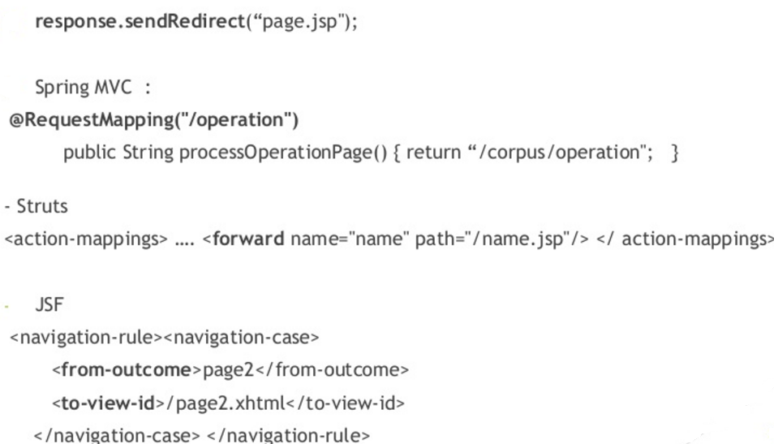
Navigation Issues

Slide 12
Navigation Issues
Visualizing the flow is very difficult
Mixed navigation and view
Overall navigation rules complexity
Lack of state control / navigation customisation
Spring web flow is
Spring MVC extension
Reusable web flows
UML diagram

Slide 13
Flow elements
State
Transition
Flow data
Expression language

Slide 14
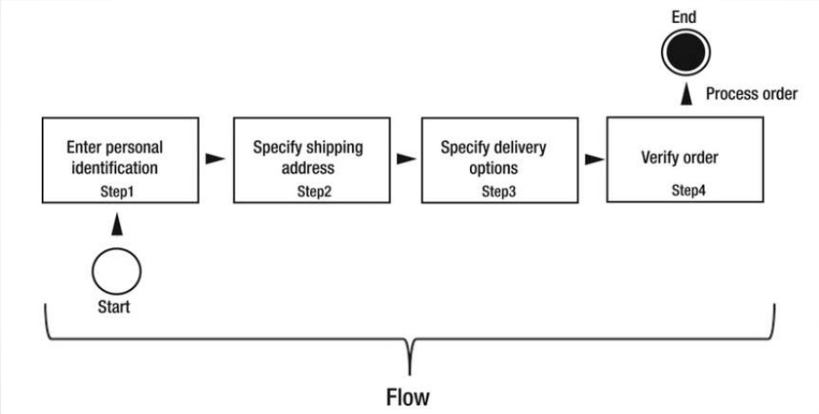
Flow

Slide 15
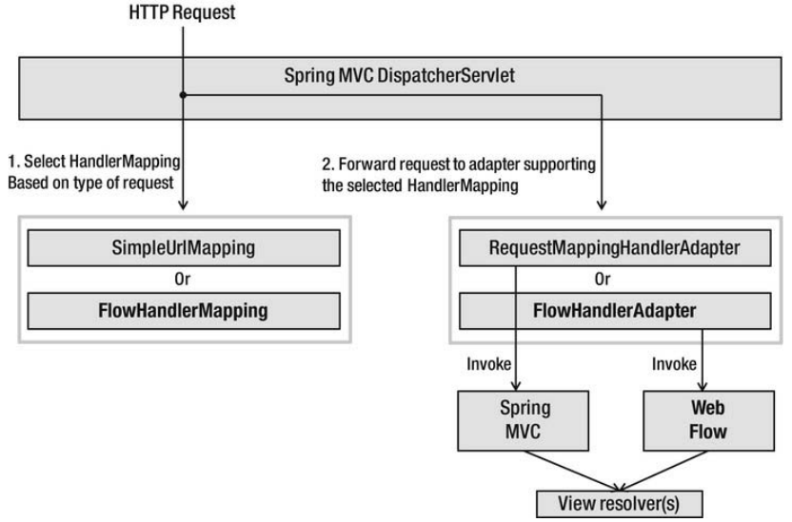
Request

Slide 16
Definition of flows
XML document with predefined elements
Flow definition is composed of set of states
Each state has one or more transitions that are used to another state
A transition is triggered by an event
XML

Slide 17
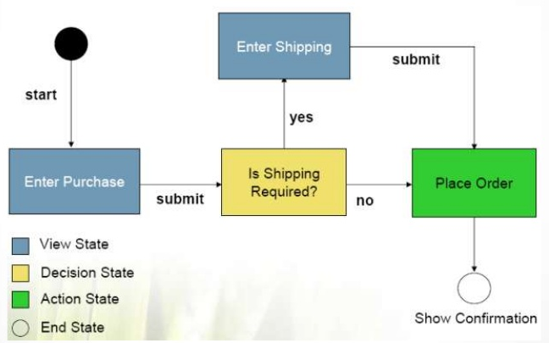
Definition of flows
Defines a conversion or dialogue between users and server meets business goals

Slide 18
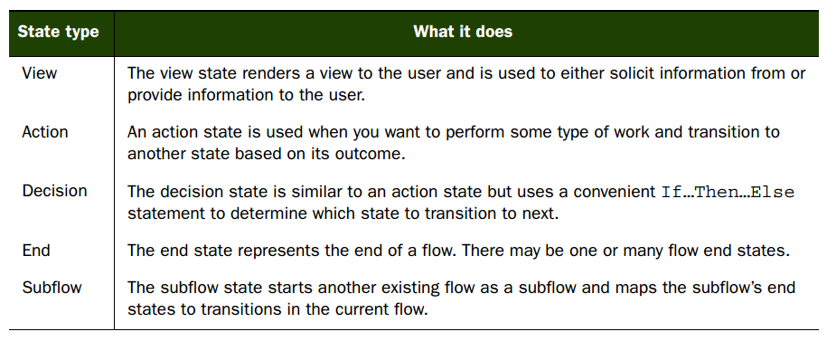
States

Slide 19
Applied field
Booking service
Shopping carts
■ Adaptive surveys or questionnaires
■ Multistep product configuration

Slide 20
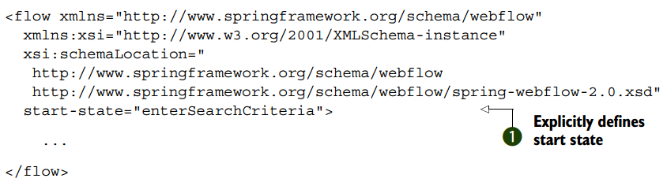

Slide 21
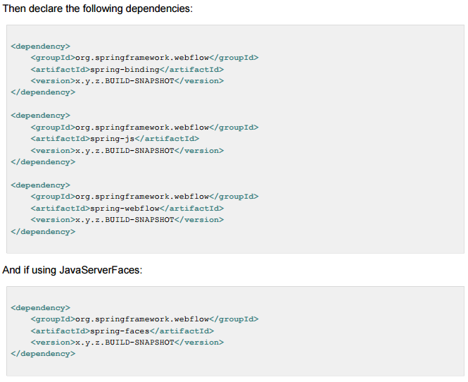

Slide 22
<?xml version="1.0" encoding="UTF-8"?>
<flow xmlns="http://www.springframework.org/schema/webflow"
xmlns:xsi="http://www.w3.org/2001/XMLSchema-instance"
xsi:schemaLocation="
http://www.springframework.org/schema/webflow
http://www.springframework.org/schema/webflow/spring-webflow-2.0.xsd">
<var name="searchCriteria" class="org.springframework.webflow.samples.booking.SearchCriteria"/>
<view-state id="enterSearchCriteria">
<on-render>
<evaluate expression="bookingService.findBookings(currentUser?.name)"
result="viewScope.bookings" result-type="dataModel" />
</on-render>
<transition on="search" to="reviewHotels"/>
<transition on="cancelBooking">
<evaluate expression="bookingService.cancelBooking(bookings.selectedRow)" />
</transition>
</view-state>
<view-state id="reviewHotels">
<var name="hotels" class="org.springframework.webflow.samples.booking.HotelLazyDataModel"/>
<on-render>
<evaluate expression="hotels.setSearchCriteria(searchCriteria)" />
</on-render>
<transition on="select" to="reviewHotel">
<set name="flowScope.hotel" value="hotels.selected" />
</transition>
<transition on="changeSearch" to="enterSearchCriteria" />
</view-state>
<view-state id="reviewHotel">
<transition on="book" to="bookHotel" />
<transition on="cancel" to="reviewHotels" />
</view-state>
<subflow-state id="bookHotel" subflow="booking">
<input name="hotelId" value="hotel.id" />
<transition on="bookingConfirmed" to="finish" />
<transition on="bookingCancelled" to="enterSearchCriteria" />
</subflow-state>
<end-state id="finish" />
</flow>

Slide 23
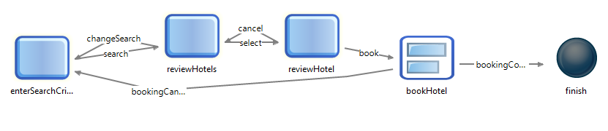

Slide 24


