Slide 1
Hibernate

Slide 2
Content
Spring MVC and Ajax/JSON
Configure ViewResolver
Spring Web Flows
Design Web Flows

Slide 3
Spring MVC and Ajax/JSON

Slide 4
(POST) Ajax/Json
client
$(“employees”).submit(function() {
Var employees = $(this).serializeObject() ;
$postJSON(“employees”, employees, function(data) {
$(“name”).val(data.id);
});
return false;
})
server
$RequestMapping(method=RequestMethod.POST)
Public @ResponseBody Map<String, ?extends Object>
Create(@RequestBody Employees employees) {
Return Collection.singletonMap(“name”, employees.getName());
}

Slide 5
(GET) Ajax/Json
client
$(“employees”).submit(function() {
Var employees = $(this).serializeObject() ;
$postJSON(“employees”, employees, function(data) {
$(“name”).val(data.id);
});
return false;
})
server
$RequestMapping(method=RequestMethod.POST)
Public @ResponseBody Map<String, ?extends Object>
Create(@RequestBody Employees employees) {
Return Collection.singletonMap(“name”, employees.getName());
}

Slide 6
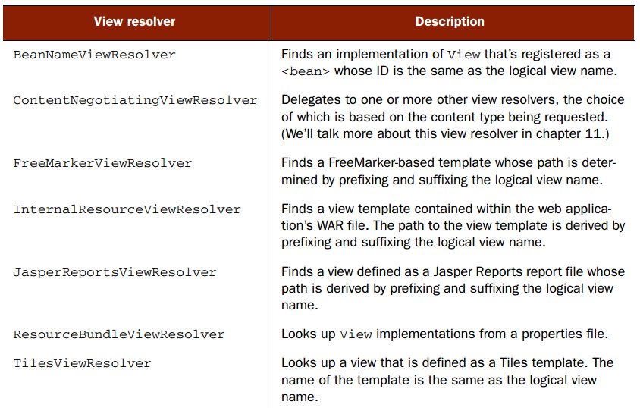
View resolver

Slide 7
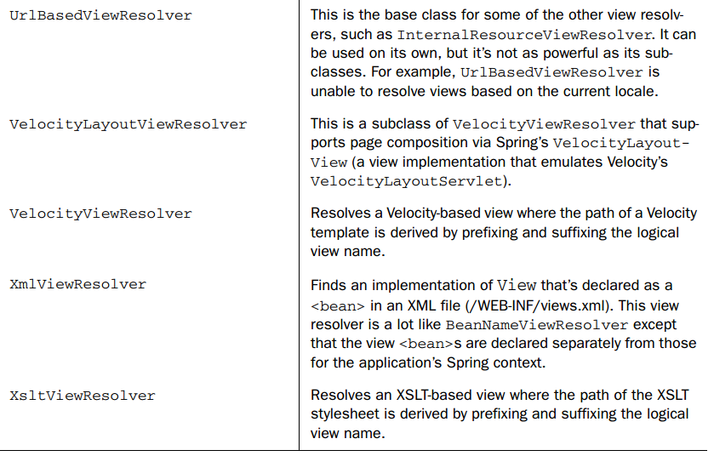
View resolver

Slide 8
<bean class=
"org.springframework.web.servlet.view.InternalResourceViewResolver">
<property name="prefix" value="/WEB-INF/views/"/>
<property name="suffix" value=".jsp"/>
</bean>

Slide 9
Spring Web Flows

Slide 10
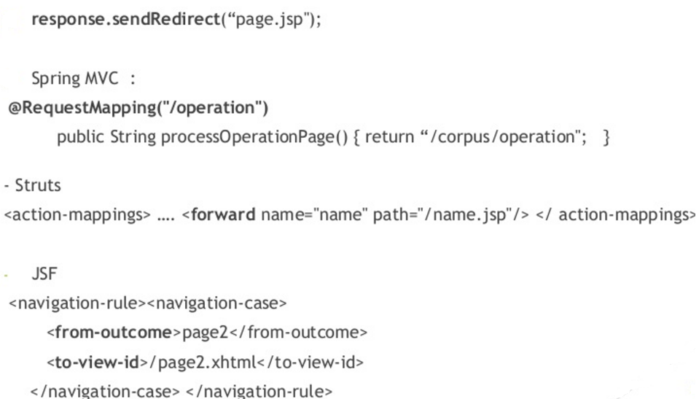
Navigation Issues

Slide 11
Navigation Issues
Visualizing the flow is very difficult
Mixed navigation and view
Overall navigation rules complexity
Lack of state control / navigation customisation
Spring web flow is
Spring MVC extension
Reusable web flows
UML diagram

Slide 12
Flow elements
State
Transition
Flow data
Expression language

Slide 13
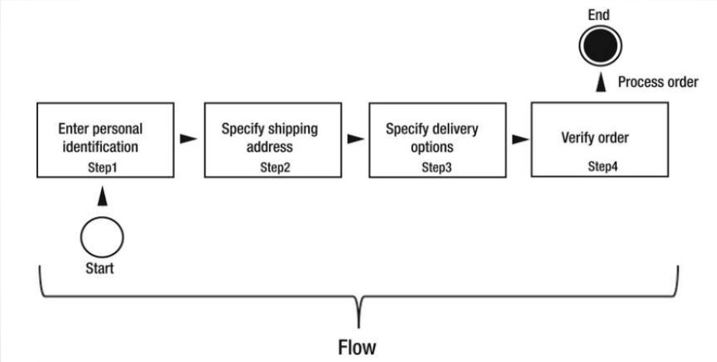
Flow

Slide 14
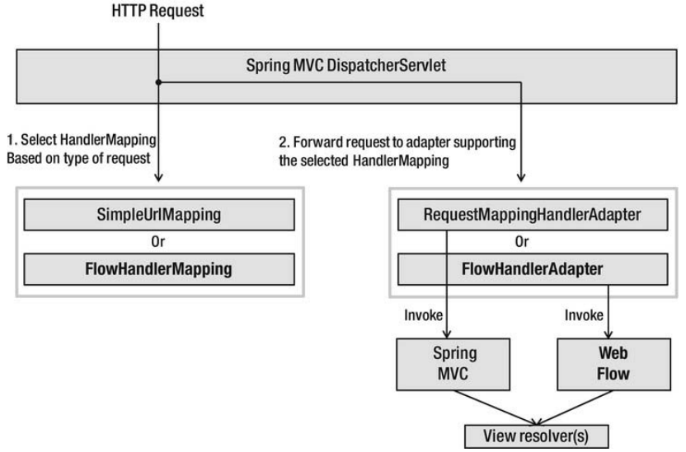
Request

Slide 15
Definition of flows
XML document with predefined elements
Flow definition is composed of set of states
Each state has one or more transitions that are used to another state
A transition is triggered by an event
XML

Slide 16
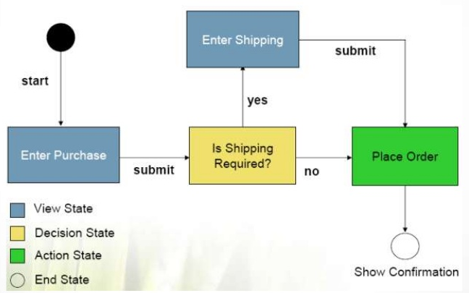
Definition of flows
Defines a conversion or dialogue between users and server meets business goals

Slide 17
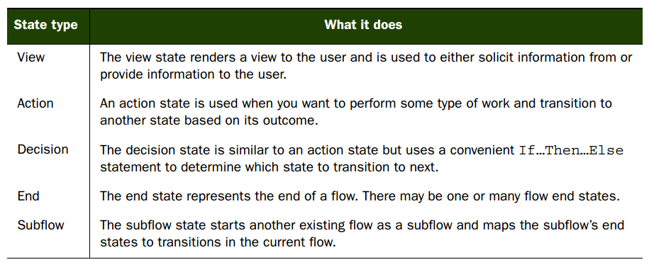
States

Slide 18
Applied field
Booking service
Shopping carts
■ Adaptive surveys or questionnaires
■ Multistep product configuration

Slide 19
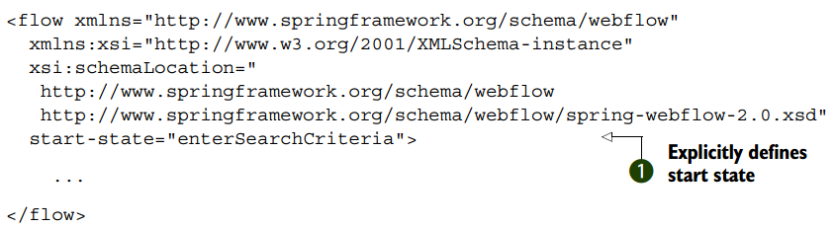

Slide 20
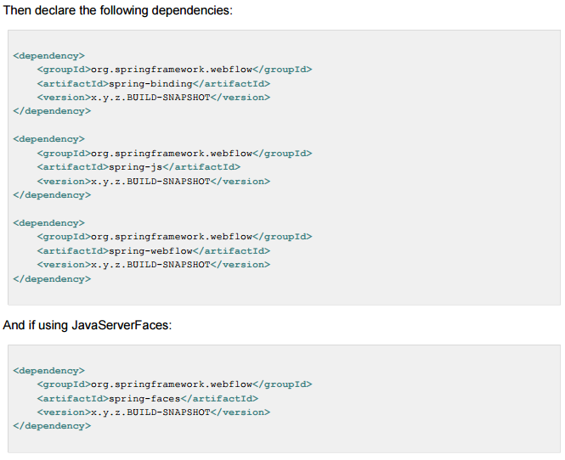

Slide 21
<?xml version="1.0" encoding="UTF-8"?>
<flow xmlns="http://www.springframework.org/schema/webflow"
xmlns:xsi="http://www.w3.org/2001/XMLSchema-instance"
xsi:schemaLocation="
http://www.springframework.org/schema/webflow
http://www.springframework.org/schema/webflow/spring-webflow-2.0.xsd">
<var name="searchCriteria" class="org.springframework.webflow.samples.booking.SearchCriteria"/>
<view-state id="enterSearchCriteria">
<on-render>
<evaluate expression="bookingService.findBookings(currentUser?.name)"
result="viewScope.bookings" result-type="dataModel" />
</on-render>
<transition on="search" to="reviewHotels"/>
<transition on="cancelBooking">
<evaluate expression="bookingService.cancelBooking(bookings.selectedRow)" />
</transition>
</view-state>
<view-state id="reviewHotels">
<var name="hotels" class="org.springframework.webflow.samples.booking.HotelLazyDataModel"/>
<on-render>
<evaluate expression="hotels.setSearchCriteria(searchCriteria)" />
</on-render>
<transition on="select" to="reviewHotel">
<set name="flowScope.hotel" value="hotels.selected" />
</transition>
<transition on="changeSearch" to="enterSearchCriteria" />
</view-state>
<view-state id="reviewHotel">
<transition on="book" to="bookHotel" />
<transition on="cancel" to="reviewHotels" />
</view-state>
<subflow-state id="bookHotel" subflow="booking">
<input name="hotelId" value="hotel.id" />
<transition on="bookingConfirmed" to="finish" />
<transition on="bookingCancelled" to="enterSearchCriteria" />
</subflow-state>
<end-state id="finish" />
</flow>

Slide 22
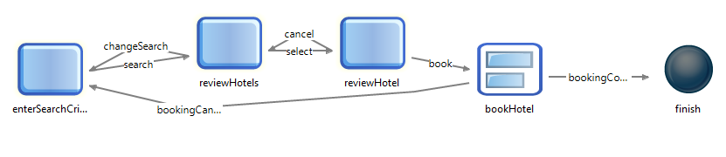

Slide 23
Summary

