Slide 1
Concurrency in Java 8 Languages
Java best practices

Slide 2
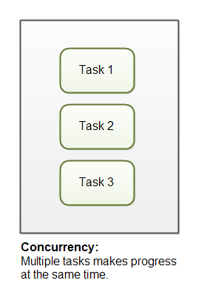
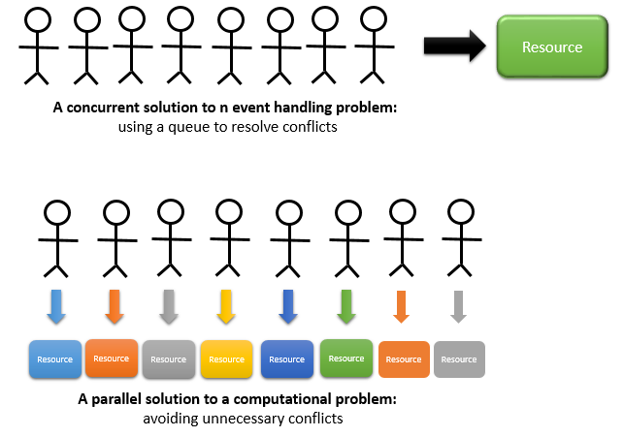
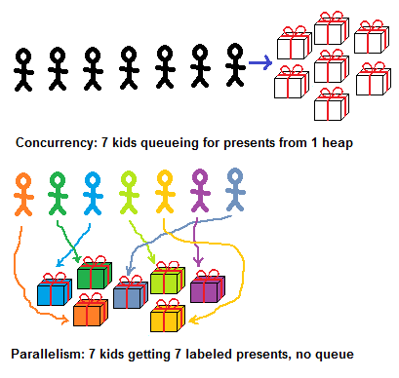
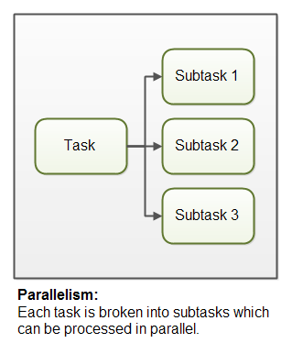
Concurrency & Paralleism
Java best practices

Slide 3
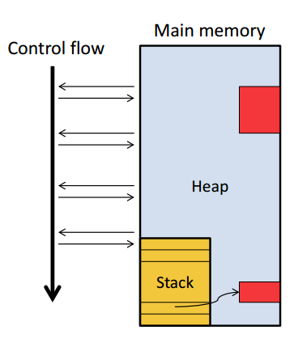
Running a Sequential Code
Executable Machine instructions to be performed
• Program counter Next instruction to be executed
• Stack Current variable definitions
• Heap Dynamically allocated data structures
• Control flow Sequence of instructions performed
during an execution
Java best practices

Slide 4
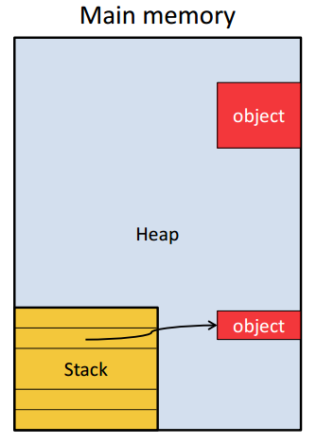
Java Memory Model
Stack
Local variables
Method parameters
• Heap
Objects!
Every call to new allocates space on heap
Class-typed variables reference heap or null
Java best practices

Slide 5
Concurrent Programs
Multiple control flows!
• Programs with multiple control flows can be
– Concurrent
– Parallel
– Distributed
• Control flows are either
– Processes
– Threads
Java best practices

Slide 6
Concurrent Collections
Provide high performance and scalability
Unsynchronized | Concurrent
HashMap | ConcurrentHashMap
HashSet | ConcurrentHashSet
TreeMap | ConcurrentSkipListMap
TreeSet | ConcurrentSkipListSet
Java best practices

Slide 7
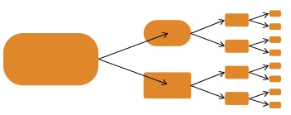
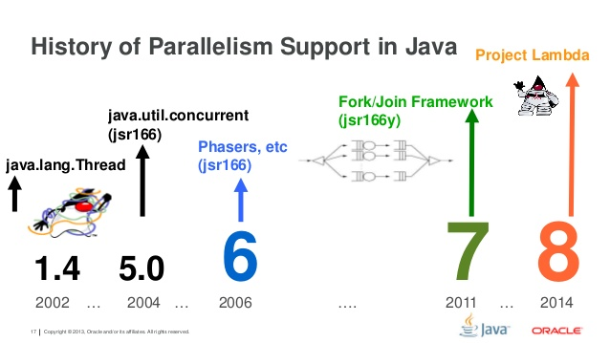


Parallelism
Java 8 Lambda/Streams
Java best practices

Slide 8
Function objects in Java 5
Arrays.sort(words, new Comparator<String>() { public int compare(String s1, String s2) {
return s1.length() - s2.length();
}
});
Java best practices

Slide 9
Function objects in Java 8
Arrays.sort(words,
(s1, s2) -> s1.length() - s2.length());
They feel like lambdas, and they’re called lambdas
Method has name, class does not
Java best practices

Slide 10
No function types in Java, only Functional Interfaces
Interfaces with only one explicit abstract method
AKA SAM interface (Single Abstract Method)
Optionally annotated with @FunctionalInterface
Do it, for the same reason you use @Override
Some Functional Interfaces you know
java.lang.Runnable
java.util.concurrent.Callable
java.util.Comparator
java.awt.event.ActionListener
Many, many more in package java.util.function

Slide 11
Streams
Java best practices

Slide 12
What is a stream?
A bunch of data objects, typically from a collection, array, or input device
Typically processed by a pipeline
A single stream generator (data source)
Zero or more intermediate stream operations
A terminal stream operation
Supports mostly-functional data processing
Enables painless parallelism
Simply replace stream with parallelStream
Java best practices

Slide 13
Stream examples (1)
static List<String> stringList = ...; stringList.stream()
.forEach(System.out::println);
IntStream.range(0, 10)
.forEach(System.out::println);
// Puzzler: what does this print? "Hello world!".chars()
.forEach(System.out::print);
"Hello world!".chars()
.forEach(x -> System.out.print((char) x));
Java best practices

Slide 14
Lambdas, streams and parallelism
With the introduction of Java 8 Oracle was aiming to make it more attractive and simpler for developers to use Java in parallel programming. The inclusion of features such as lambda functions and the Streams API was to be seen as part of this push. How successful that becomes, time will tell.
Collections support operations such as add(), remove(), and contains()
that work on a single element.
Streams, in contrast, have bulk operations such as forEach(),
filter(), map(), and reduce() that access all elements in a sequence.
The notion of a Java stream is inspired by functional programming
languages, where the corresponding abstraction is typically called
a sequence, which also has filter-map-reduce operations.
Java best practices

Slide 15
Stream examples (2)
Try (Stream<String> linesInFile = Files.lines(Paths.get(fileName))) {
linesInFile.forEach(System.out::println);
}
Java best practices
Java best practices

Slide 16
Stream examples (3)
boolean allMatch = stringList.stream()
.allMatch(s -> s.length() == 3); System.out.println(allMatch);
boolean anyMatch = stringList.stream()
.anyMatch(s -> s.length() == 3); System.out.println(anyMatch);
Java best practices

Slide 17
Stream examples(4)
List<String> filteredList = stringList.stream()
.filter(s -> s.length() > 3)
.collect(Collectors.toList()); System.out.println(filteredList);
List<String> mappedList = stringList.stream()
.map(s -> s.substring(0,1))
.collect(Collectors.toList()); System.out.println(mappedList);
List<String> filteredMappedList = stringList.stream()
.filter(s -> s.length() > 4)
.map(s -> s.substring(0,1))
.collect(Collectors.toList()); System.out.println(filteredMappedList);
Java best practices

Slide 18
Stream examples (5)
List<String> dupsRemoved = stringList.stream()
.map(s -> s.substring(0,1))
.distinct()
.collect(Collectors.toList()); System.out.println(dupsRemoved);
List<String> sortedList = stringList.stream()
.map(s -> s.substring(0,1))
Java best practices

Slide 19
parallel stream
Consider this for-loop (.96 s runtime; dual-core laptop)
long sum = 0;
for (long j = 0; j < Integer.MAX_VALUE; j++) sum += j;
Equivalent stream computation (1.5 s)
long sum = LongStream.range(0, Integer.MAX_VALUE).sum();
Equivalent parallel computation (.77 s)
long sum = LongStream.range(0, Integer.MAX_VALUE).parallel().sum();
Fastest handcrafted parallel code I could write (.48 s)
– You don't want to see the code. It took hours.
Java best practices

Slide 20
Parallel streams
Distributing and performing parallel operations on collections
Java 8 uses parallel streams to partition streams into smaller sub-tasks,
and distributes them onto multi-core processors where they are joined up with
the aggregated sum. Implementing parallelism on multi-cores is now just a
matter of invoking a parallel command on the stream itself
private void performParallel() {
trades
.stream()
.parallel().forEach(t->actSomething(t) );
}
By adding a parallel() method to the stream, we are asking the
library to deal with the complexities of threading.
The library will take charge and control the process of forking out the tasks
by utilizing and running the operations at the same time on all cores using
whatever strategy it can find.
https://docs.oracle.com/javase/tutorial/collections/streams/parallelism.html

Slide 21
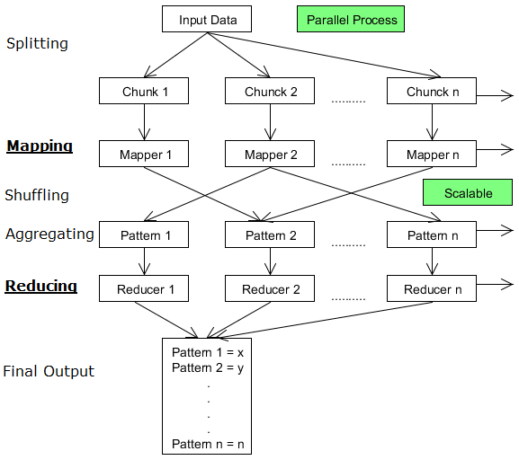
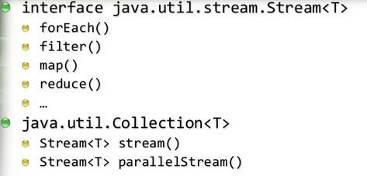
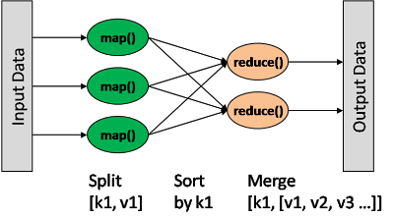
ParallelISM streams
Create streams and then transform them using three widely used higher-order algorithms

