Slide 1
Java 8 Advanced Practices
Instruction: NGUYEN ANH MINH (M. Sc.)
Java SE 8 Best Practices

Slide 2
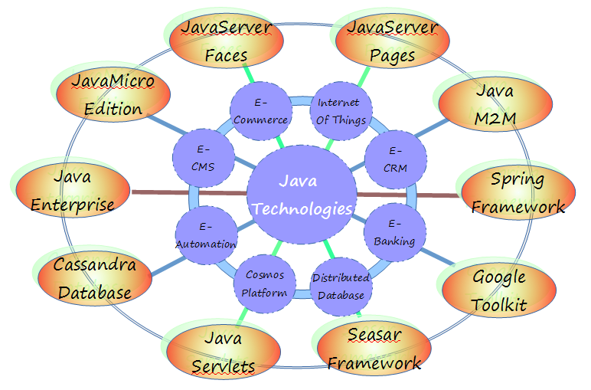
Java SE 8 Best Practices

Slide 3
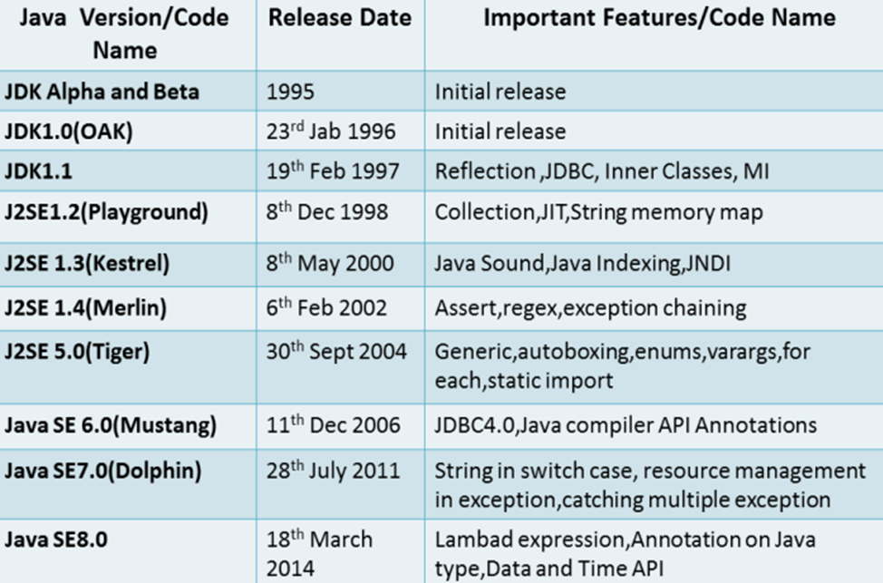
Java Version History
Java SE 8 Best Practices

Slide 4


Java SE 8 (JSR 377)
➲ JSR 114: JDBC Rowsets
JSR 308: Annotations on types
➲ JSR 160: JMX Remote API
JSR 310: Date and Time API
➲ JSR 199: Java Compiler API
JSR 335: Lambda expressions
➲ JSR 173: Streaming API for XML
➲ JSR 206: Java API for XML
Processing
➲ JSR 269: Pluggable Annotation -Processing API
Java SE 8 Best Practices

Slide 5

Why Lambda Expression in Java
Why lambda expression?
Before
Comparator<Apple> byWeight =
new Comparator<Apple>() {
public int compare(Apple a1, Apple a2){
return a1.getWeight()
.compareTo(a2.getWeight());
}
};
Leveraging functional programming
Easy to distribute processing of collections when programming in threaded environments
Succinctness, Clean code rather than using Anonymous Inner Class
Definition of Lambda Expressions
After
(with lambda expressions)
Leveraging functional programming
Easy to distribute processing of collections when programming in threaded environments
Succinctness, Clean code rather than using Anonymous Inner Class
Anonymous: doesn’t have an explicit name
Function: As lambda isn’t associated with a particular class like a method is
Passed around: lambda expression can be passed as argument to a method or stored in variable
Concise: don’t need to write a lot of boilerplate like doing for anonymous classes
Comparator<Apple> byWeight =
(Apple a1, Apple a2) -> a1.getWeight()
.compareTo(a2.getWeight());
Java SE 8 Best Practices

Slide 6
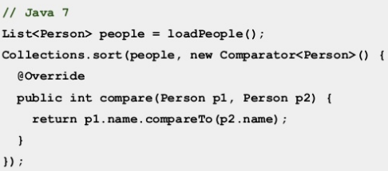
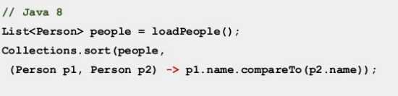
Usage lambdas in Java 8
Java SE 8 Best Practices

Slide 7
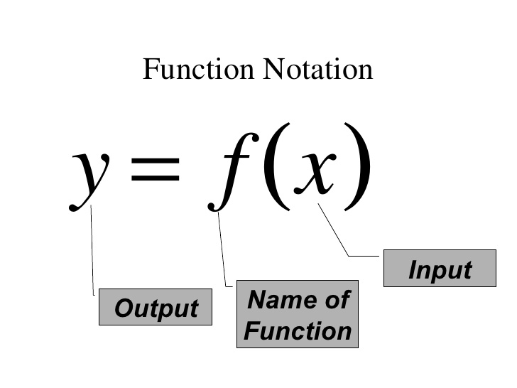
Lambda Functions
Lambda Functions: Syntax
Lambda Expressions
LambdaParameters -> LambdaBody
LambdaBody can be an expression or a block. The body could consist of single statement (in that case no explicit curly braces defining a block are required); such a lambda body is known as "expression lambda." If there are many statements in a lambda body, they need to be in a block of code; such a lambda body is known as “block lambda.
Lambda | Description
( )->10; | Takes no value and return 10
( ) -> 3*x | Takes a number and returns the result of tripling it
(x,y)->x-y | Takes two numbers and returns their difference
(int x, int y)->x+y | Take two integers and return their sum
(string s)-> { System.out.print(“YES”+s); System.out.print(“YES”+s); | Takes a string and prints it to console and err output with “YES” suffix
Java SE 8 Best Practices

Slide 8
Built-in Functional Interfaces
Function | Description | Method | Example
Supplier<T> | Return value to caller | T get() | Supplier<String> stringSupplier=String::new; String newInteger =stringSupplier.get()//creates new String
Function<T,R> | Take an argument and return result | R apply(T t) | Function<String,Integer> toInteger=Integer::valueOf; Integer test=toInteger.apply(“2016”);
Consumer<T> | Take an argument and return nothing | Void accept(T t) | List<String>one=Arrays.asList(“A”,”AB”,”ABA”,”ABBA”); Consumer<String>style=(String s)->System.out.println(“item:”+s); One.forEach(style);
Predicate<T> | Check a condition and return a Boolean value as result | Boolean test(T t) | Predicate<Double> isNegative=x->x<0; System.out.println(“isNegative.test(new Double(“1”)));
Java SE 8 Best Practices

Slide 9
Composition Function Interfaces
@FunctionalInterface
private interface DTOSender {
void sendToCustomer01(String accountId, DTO dto);
}
void sendDTO(BisnessModel object, DTOSender dtoSender) {
//some logic for sending...
...
dtoSender.send(id, dto);
...
}
Now, we can call the method sendDTO, passing in different lambdas to achieve different behavior, like this:
sendDTO(object, ((accountId, dto) -> sendToCustomer01(accountId, dto)));
sendDTO(object, ((accountId, dto) -> sendToCustomer02(accountId, dto)));
Java SE 8 Best Practices

Slide 10
Lambda Best Practices
//best practice
(p1,p2)->p1.name.compareTo(p2.name);
//avoid
(Person p1, Person p2) -> p1.name.compareTo(p2.name)
Specify the types when compiler needs it
Function Interface Best Practices
//best practice
public Foo parse (Locale locale, Function<Locale,Foo> fn);
//avoid
public Foo parse (Function<Locale,Foo> fn , Locale locale);
Prefer to have functional interface as post position
Java SE 8 Best Practices

