Slide 1
Spring batch
Instruction: NGUYEN ANH MINH (M. Sc.)

Slide 2
Outline
What is batch processing
Core spring batch
Spring batch configuration
Read from file, database

Slide 3
What is batch processing

Slide 4
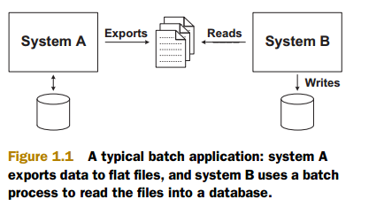
What is batch processing
Batch processing processes large amounts of data in automation manner
The most common scenario for batch processing is export data to other storage
The online store software is a good example of two systems communications to exchange data

Slide 5
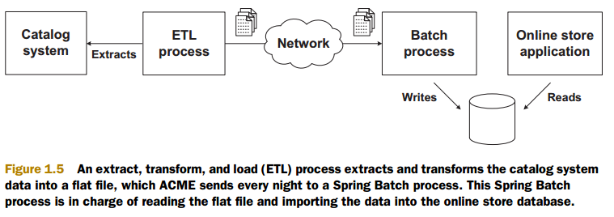
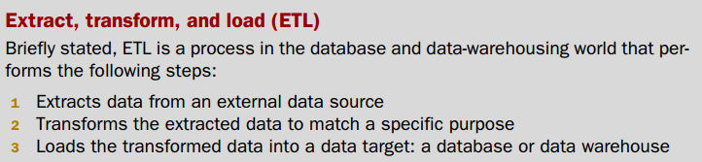
Transform data in spring batch

Slide 6
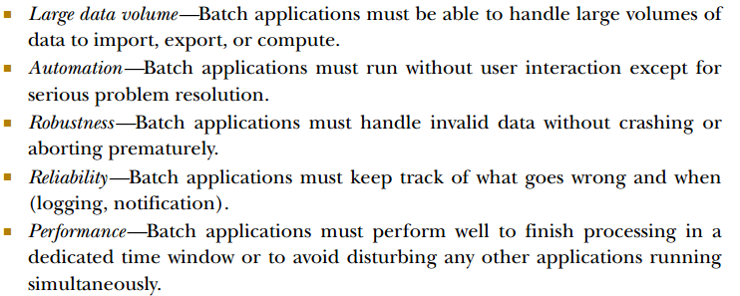
Batch processing features

Slide 7
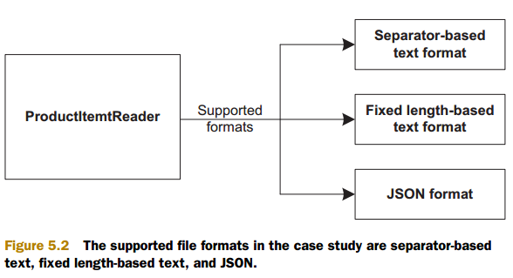
Read data uses spring batch
The first data source we describe to input data in batch processing.
Flat files are pure data files and contain little or no metadata information. Some flats file formats

Slide 8
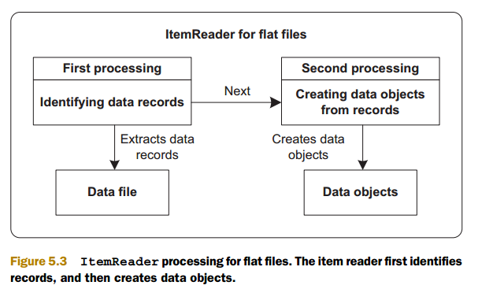

Slide 9
Spring bath processing

Slide 10
Spring batch is a component for batch processing of the Spring portfolio of projects.
Spring batch comes with number of components for a variety of technologies.
Its objective is to build a batch application by solely using the provided components

Slide 11
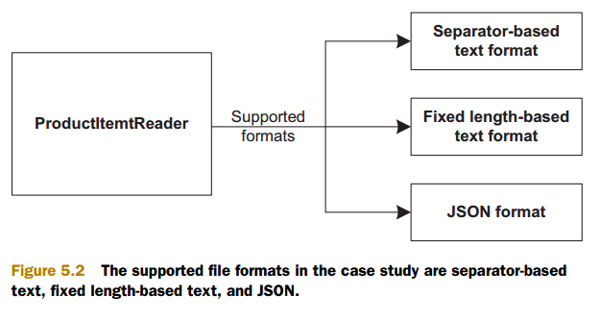

Slide 12
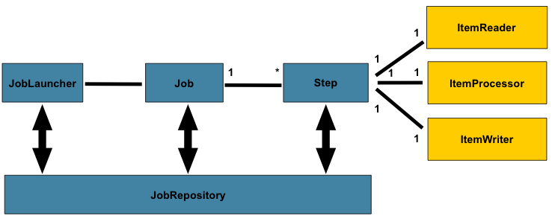
Spring batch processing

Slide 13
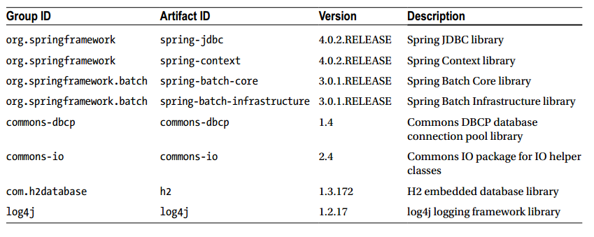
Spring batch dependencies

Slide 14
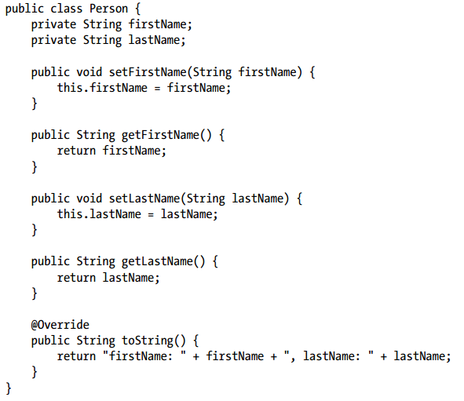
Code
With our dependencies in place, we create domain object that represents a person based on the we will read

