Slide 1

Spring Core
Instruction: NGUYEN ANH MINH (M. Sc.)

Slide 2
Outline
Spring ioc container
Interface-oriented development
Spring framework composition
Spring container instantiation
Spring bean definitions

Slide 3
Spring ioc container

Slide 4
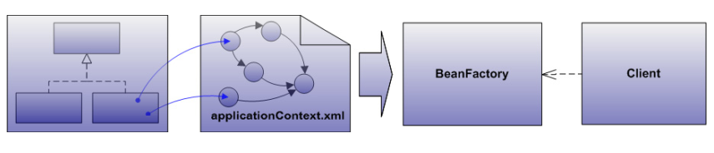
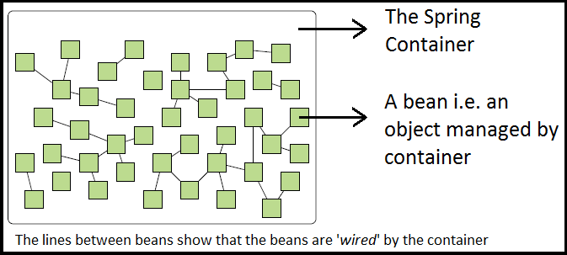
Spring ioc container
Fundamental features
Registration system(applicationcontext.xml)
Complex initialization
Object creation
Dependency injection
Application configuration
Access api
Using ApplicationContext
Using BeanFactory

Slide 5
Spring IoC container relevance
Inversion of control
Move object creation and dependency resolution responsibilities out of business logic
Enables business logic to be portable
Allows components to be reconfigured with minimal efforts
Loose coupling
Client are insulated from implementations
Implementation technicalities are invisible to clients
Client are only aware of the interface contract and unaware of :
Concrete type selections
Concreate type initialization mechanism

Slide 6
Spring ioc container and pojo instantiation
Integrate spring ioc container
Replace custom ServiceProviderFramework with BeanFactory
Delegate to Spring IoC container
Object creation

Slide 7
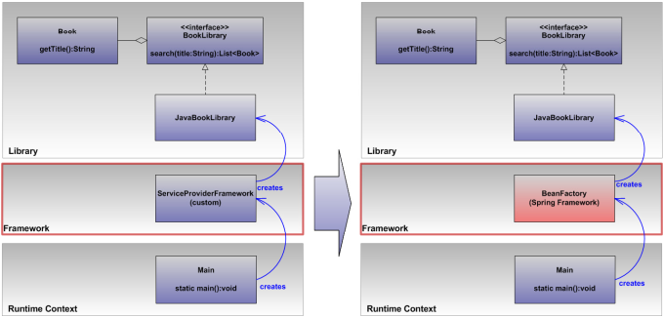

Slide 8
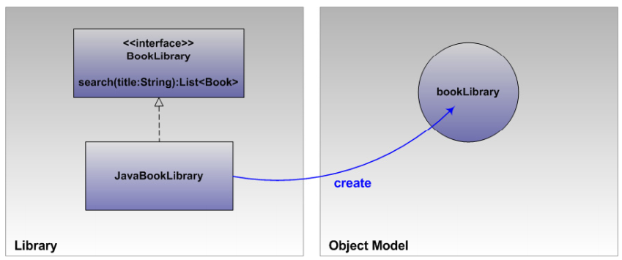
Spring ioc objective
Create a BookLibrary object based on the JavaBookLibary class

Slide 9
Spring IoC Process
Create an xml file conforming to spring-beans.xsd
Name the file
Conventional name is applicationcontext.xml
However, any name will suffice
Place the file in accessible location
For example , in a file system directory which will be accessible from the class path
Register objects
Object are registered by declaring bean xml elements
Conventional approach is to use bean attributes
Access object(s) managed by the spring IoC container
Initiate a BeanFactory implementation
Uses interfaces such as BeanFactory#getBean(…):Object

Slide 10
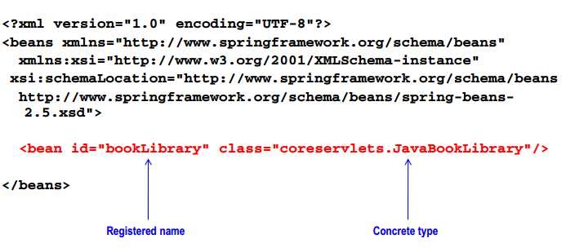
Spring IoC configuration
Object registration process

Slide 11
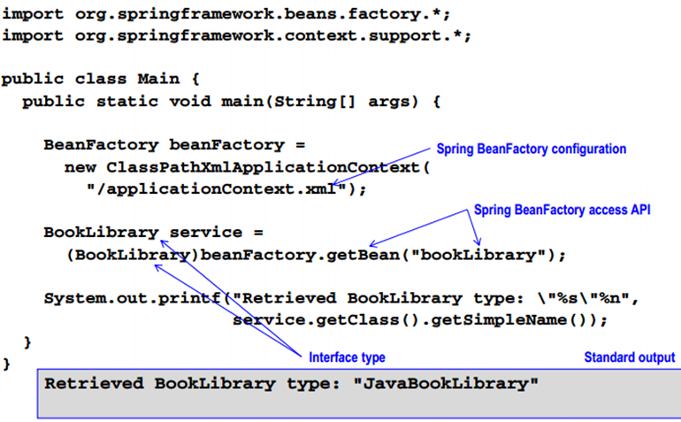
Spring IoC BeanFactory

Slide 12
Spring IoC container summary
Loaded
Bean defined from applicationcontext.xml
Created
Coreservlets.javabooklibrary instatite
Registered
Object under the name bookLibrary
Requested
A Booklibrary object from the spring ioc container using access api, BeanFactory#getBean(..)
Received
An instance of java book library , a booklibrary implementation

Slide 13
Model analysis
Dynamic implementation choices
Implementation types are executed from the program
Portable model configuration
Object model configuration is encapsulated within the framework
Flexible model configuration
Object model configuration is declarative systems based on spring-beans.xsd

Slide 14
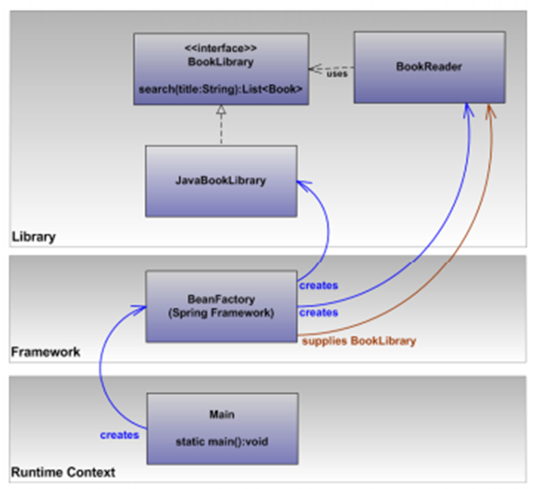
Spring ioc container and dependency injection
Delegate to
spring IoC container
Object initiation
Dependency injection

Slide 15
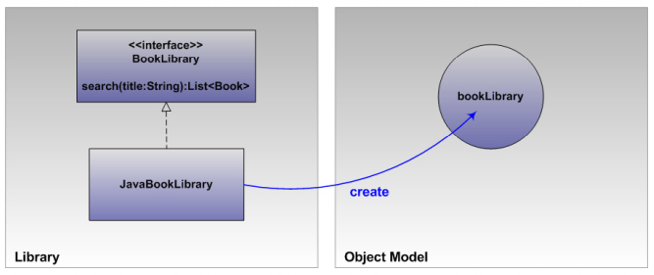
Spring IoC objective
Create a BookLibrary object based on the JavaBookLibrary class
Create a Bookreader object based on the JavaBookLibrary class

Slide 16
Spring ioc process
Create an XML file conforming to spring-beans.xsd
Name the file
Place the file an accessible location such as the path
Register objects using xml bean elements
Add bean dependency injection instructions
Add references to beans , values, collections, or configuration properties
Also know as wiring the application
As object(s) managed by the Spring IoC container
Instantiate a BeanFactory implementation
Use interfaces such as BeanFactory#getBean(…):objects

Slide 17
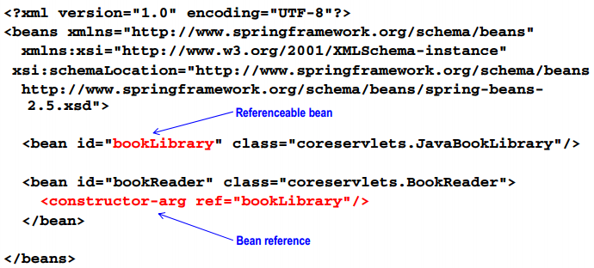
Spring xml configuration
Object registration process

Slide 18
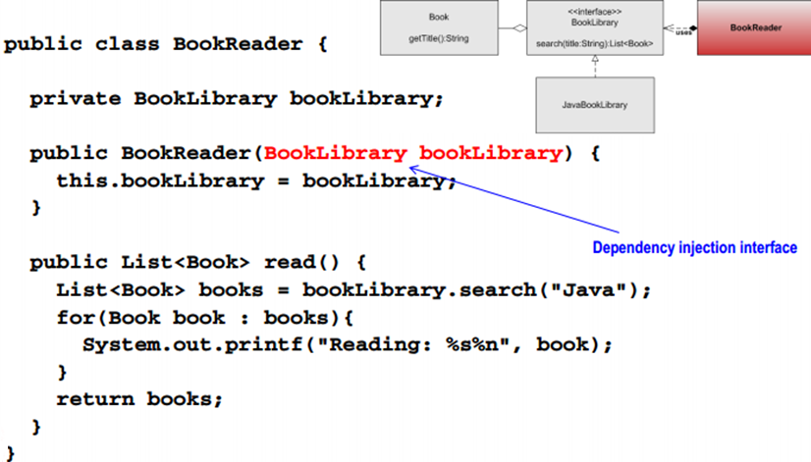
BookReader constructor

Slide 19
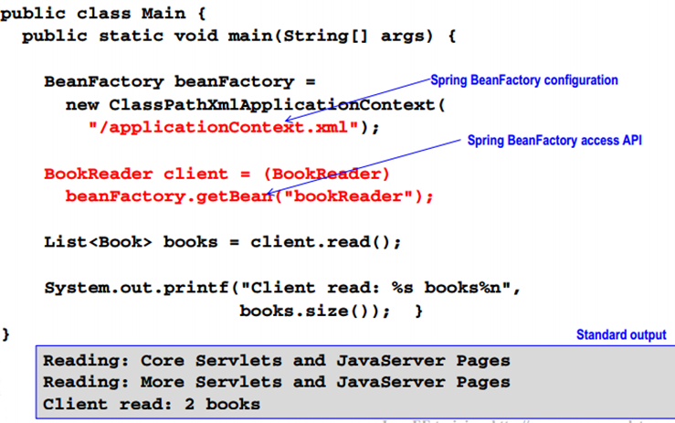
Spring BeanFactory

Slide 20
Spring ioc container summary
Loaded
Bean definitions from applicationcontext.xml
Created
Coreservlet.JavaBookLibrary instance
Coreservlet.bookreader instance
Registered
Object under the name booklibrary
Object under the name bookReader
Injected dependency
bookLibrary implementation instance,
JavaBookLibrary, into the bookreader objects

Slide 21
Spring ioc container summary
Requested
A bookreader object from the spring ioc container using the access api, beanfactory#getBean(…)
Received
An instance of bookreader
Used
The booklibrary dependency was previously fulfilled during the injection step
BookReader used BookLibrary interfaces to access and read Book information

Slide 22
Model analysis
Dynamic implementation choices
Implementation types are executed from the program
Decoupled design allows new types to be configured into program without having to recompile
Portable model configuration
Object model configuration is encapsulated within the framework
Flexible model configuration
Object model configuration is a declarative system based on spring-beans.xsd
BeanFactory clients are also decoupled from the bean types accessed from the container

Slide 23
Interface object development

Slide 24
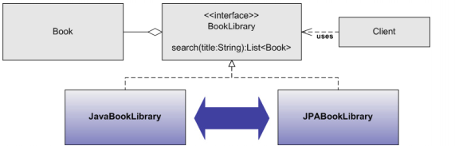
Interface oriented development
Take advantage of type-poly morphism
Flexible architecture
Tolerant to changes
Enables new capabilities with minimal effort
Commit to interfaces , not implementations
Included , but not limited to, compiled interactions
Declarative interfaces

Slide 25
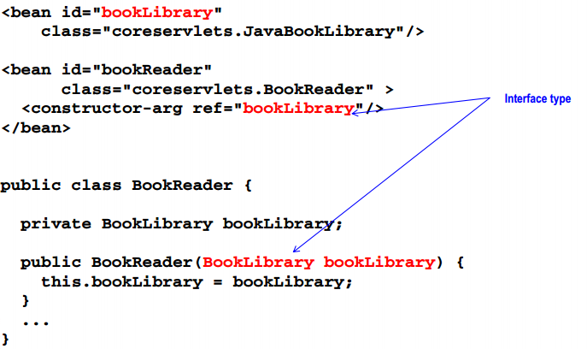
Interface-oriented example

Slide 26
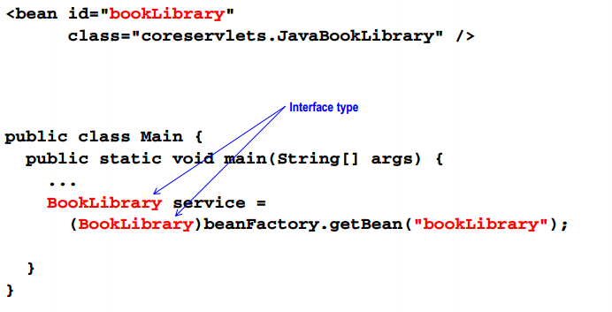
Interface oriented example

Slide 27
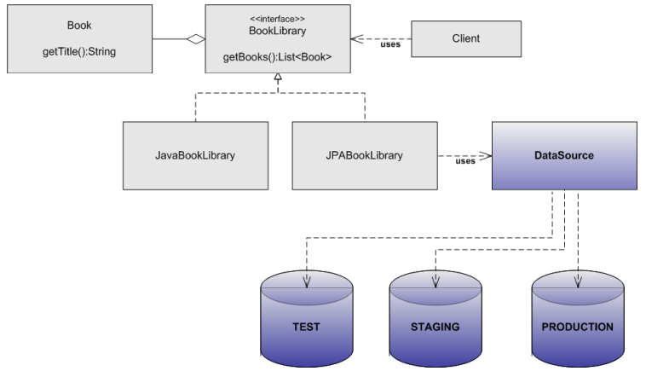
Service abstraction
Abstract elements such as third-party apis and infrastructure
Decouple business logic enabling portability

Slide 28
Spring framework composition

Slide 29
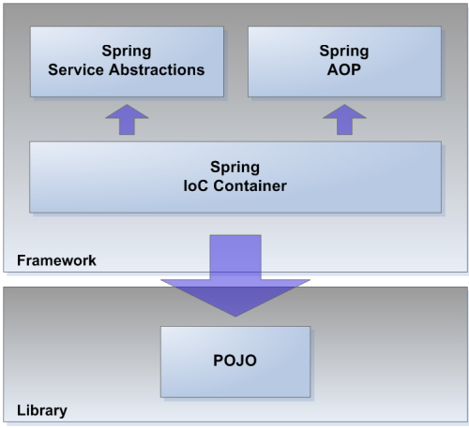
Spring framework composition
IoC container
Core libraries
Spring-core
Spring-beans
Integration extensions
Spring-context
Spring-web

Slide 30
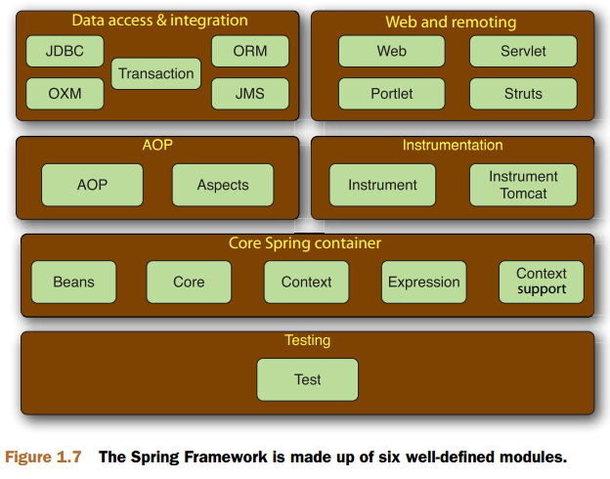
Spring framework modules
Aspect-oriented programming
Spring-aop
Service abstractions
JDBC templates and transaction management
Spring-jdbc
Spring-tx
O/R mapping framework
Spring-orm
JMS
Spring-jms
JEE , EJB, JMX, JNDI, etc.
Spring-context
Javamail, quartz, etc…
Spring-context-support

Slide 31
Spring framework composition
Test support
Testng and junit, IoC container , and transaction management integration
Spring-test
Web application framework
Spring web mvc , freemaker, and jasper reports
Spring-webmvc

Slide 32
Spring bean

Slide 33
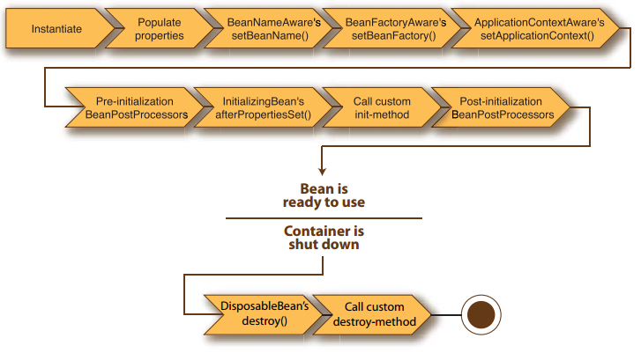
Spring bean lifecycle

Slide 34
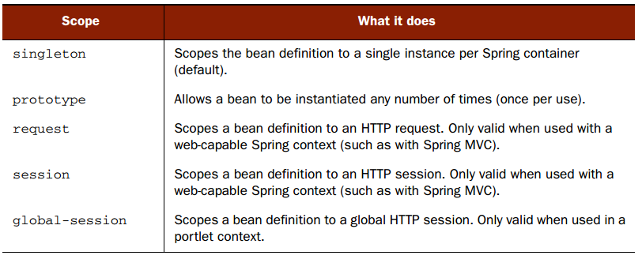
Spring bean scope

Slide 35
Bean factory
BeanFactory
Defines core but non-specific functionality
Application context
Context resources
Bundle resources
Event listeners
Post processors
Feature | BeanFactory | ApplicationContext
Bean instantiation/wiring | Yes | Yes
Automatic BeanPostProcessor registration | No | Yes
Automatic BeanFactoryPostProcessor registration | No | Yes
Convenient MessageSource access (for i18n) | No | Yes
ApplicationEvent publication | No | Yes

Slide 36
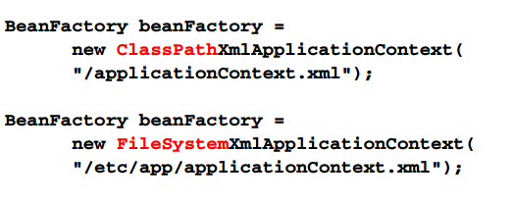
Coarse-gained interfaces
Covers typical integration scenarios
Automated but implicit functionality
Committed to specific integration strategies

Slide 37
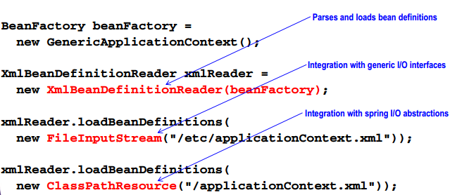
Fine-grained interfaces
Fine integration control
Bean configuration abstraction
I/O abstraction

Slide 38
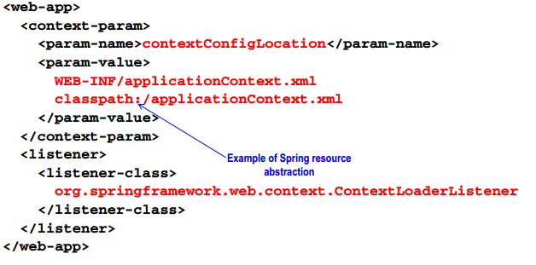
Servlet integration

Slide 39
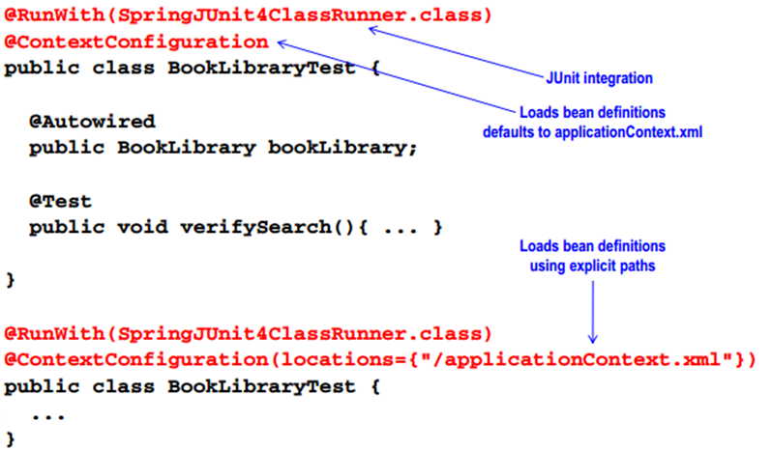
Junit Test integration

Slide 40
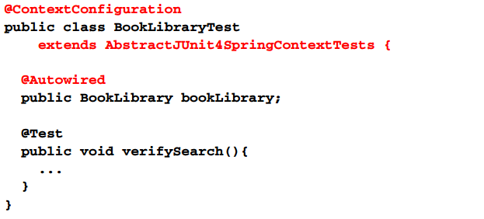
Junit test integration

Slide 41
Container event listener
Lifecycle event model
Event listener interface
Org.springframework.context.applicationlistener
Event objects
Org.springframework.context.applicationevent
Contextrefreshevent
Contextstartedevent
Contextstoppedevent
Contextclosedevent
Registration model
Enabled by registering new listener instances as container-managed beans

Slide 42
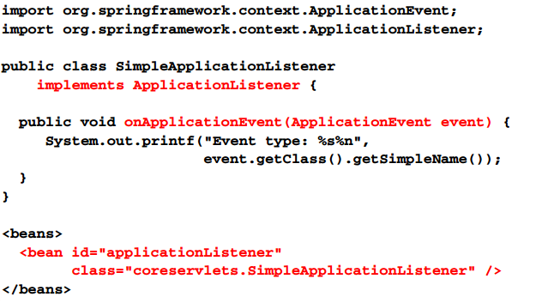
Container eventlistener example

Slide 43
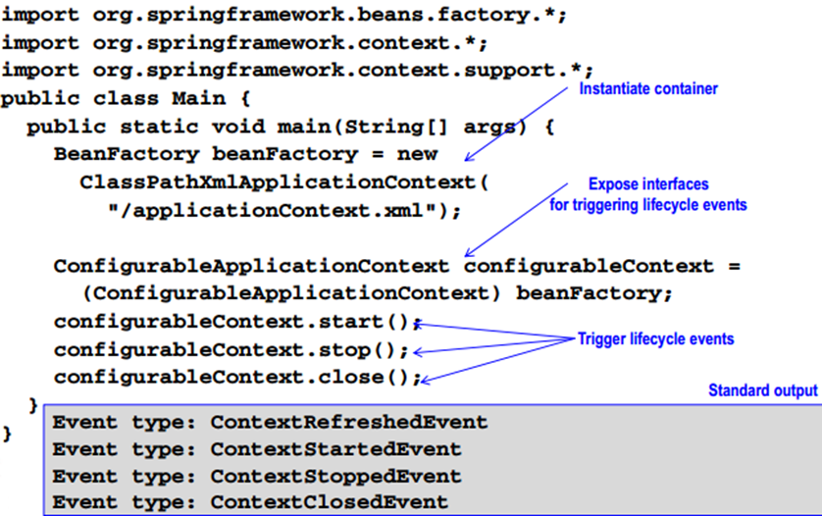
Container eventlistener example

Slide 44
Bean definition

Slide 45
Bean definitions
Default bean definition
Factory bean
Static factory method
Abstract bean

Slide 46
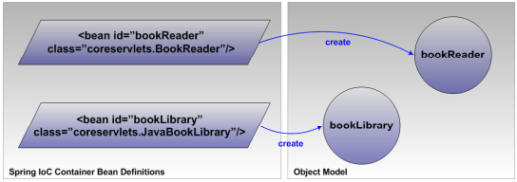
Default bean definition
Create container-managed objects directly out of bean elements
Standard bean definitions:
Xml bean elements. Child to document root, bean
Inner bean definitions
Xml bean definitions
Xml bean elements . Child to property or constructor –arg elements

Slide 47
Default bean definition
Standard bean element
Referenceable , aka collaborator, beans
Inner bean
Anonymous
Prototype
Used to fulfill dependency injection settings
Invocation prerequisites (s) one combination required
Class
Class and factory method
Factory-bean and factory-method
Abstract bean attribute set to true

Slide 48
Default bean definition
Optional bean properties
Id and name
Defaults to a generated and unique value
Scope
Defaults to singleton
Abstract/lazy-init/primary
Default to false
Autowire
Defaults to none
Dependency-check defaults
Parents/depends-on /autowire-candidate/init-method/destroy-method
Defaults to null

Slide 49
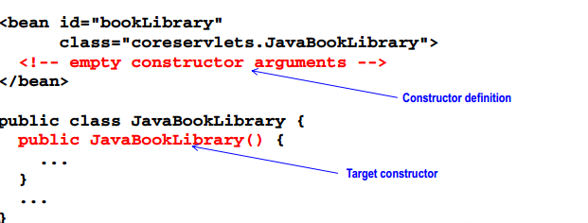
Standard bean
Matches on a constructor
See java.lang.class and java.lang.reflect
Invokes the constructor
Analogous to the new keyword , invoking a constructor is the same as invoking the new operator

Slide 50
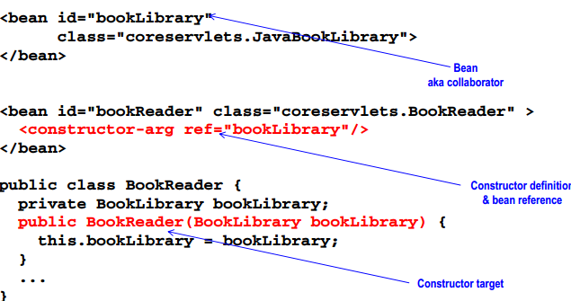
Standard bean
Matches on a constructor by type

Slide 51
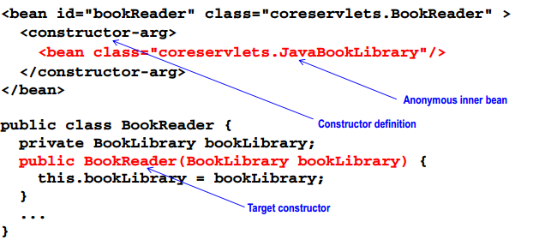
Inner bean element
Nested bean definition

Slide 52
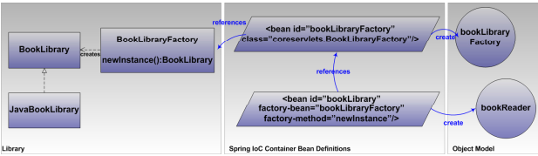
Factory bean
The invocation of a method on a container-managed factory bean to create other container-managed beans
References to the target bean class are excluded
The class information for the target bean is unnecessary

Slide 53
Factory bean
Factory bean
A container-managed bean responsible for instantiating other container-managed beans
Referenced by a bean element attribute, factory-bean
Factory method
The factory bean exposes a method for instantiating the target bean type
Referenced by a bean element attribute, factory-method
Target bean
The bean declaration uses factory-bean and factory-method to map its origin to the factory method
The factory information substitutes the xml class attribute specification

Slide 54
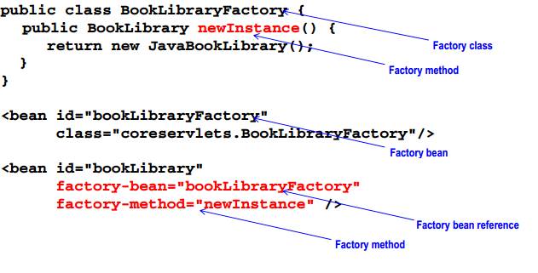
Factory bean example

Slide 55
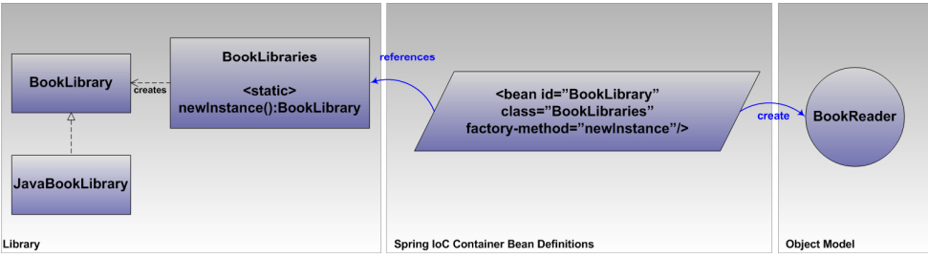
Static factory method
The invocation of static factory method to create the container –managed bean
Separate container –managed bean is not required
The target bean references the class and method information as the origin

Slide 56
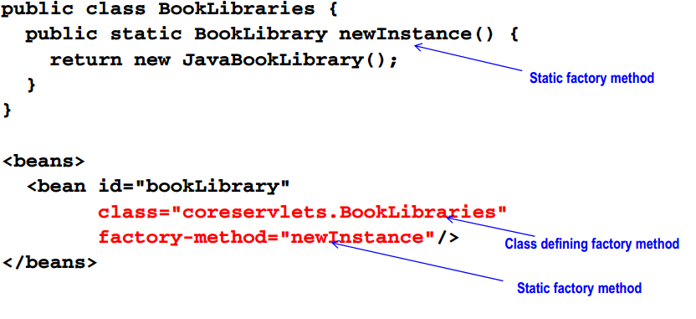
Static factory method example

Slide 57
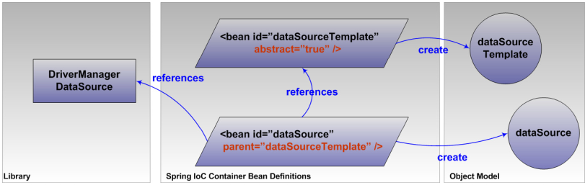
Abstract bean
Bean templating facility
Establishes default bean properties
Constructor arguments , property setter parameters, bean lifecycle callbacks
Candidate classes for abstract bean definitions

Slide 58
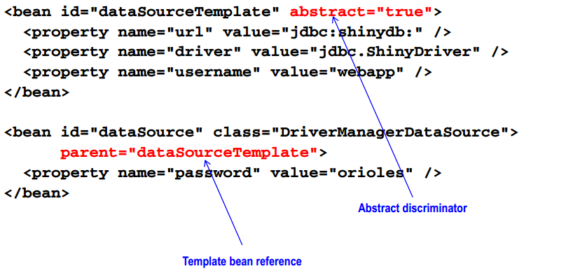
Abstract bean example

Slide 59
General approach
Develop pojos
Implementation creational patterns as needed
Assume the framework will accommodate the creational patterns required by the system
Plan on using a framework to manage the initiation of all pojos
Create the xml bean definitions file
This file is typically named
Applicationcontext.xml
For large projects comprised of numerous modules , develop a predictable naming system for context files

Slide 60
General approach
Declare bean definitions with interdependencies
Spring ioc provides comprehensive support for instantiation patterns
Constructor
Factory method
Static factory method
Template beans
Include the bean definitions file as part of distribution
This file will serve as a default , but optional, blueprint

Slide 61
Summary
Select a spring Ioc container integration approach to match runtime context
Broad integration options are available to use
Programmatic contexts
Classpathxmlapplicationcontext
Filesystemxmlapplicationcontext
Platform-specific contexts
Contextloaderlistener
Test contexts
Abstractjunit4springcontexttests
Applicationcontext is favored over bean factory implementations
Improved defaults, integration extensions and automated behavior

