Slide 1

Spring AOP
Instruction: NGUYEN ANH MINH (M. Sc.)

Slide 2
Outline
Aspect oriented programming
Introduction
Integration with Spring IoC
Program integration using pointcuts

Slide 3
Aspect oriented programming

Slide 4
Aspect oriented programming
Inversion of Controlling
Aspect-oriented programming
Integrating Abstraction
Modularizes responsibility
Applied broad application responsibilities
Logging management
Transaction management
Security management
E.g logging, transaction
The encapsulation of a responsibility is an advice elements

Slide 5
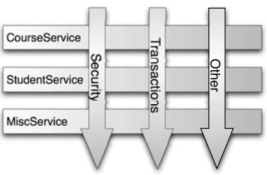
Aspect oriented programming
Identify program facets
Use mechanism beyond OO models
E.g. All POJO getter methods from
Target execution point is the joint point
E.g. constructor or method invocation
Program component linking the execution target is point cut
Applies advisor to program facets
An aspect is a single unit association and typing an advice to point cuts
Aspects modularize cross-cutting concerns, spans objects

Slide 6
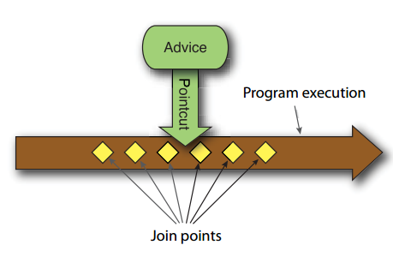
Spring AOP
Programming models
Method –only interceptors
Advisor
Captures advice behavior using plain POJO
AspectJ APIs
Annotation and library APIs
Advice beans are well-formed
Conform to method conventions but not special interfaces
AOP alliance APIs
Advice beans implement interfaces
Spring AOP xml schema advice types

Slide 7
Spring AOP
Pointcut
Is the combination of different joint points where the advice needs to be applied
Aspect
Is applying the Advice at the point cuts
Advice
Defines what needs to be applied and when needs to be applied

Slide 8
Spring AOP
Weaver
Is construction code by injecting calls to aspects
Jointpoint
Is where the advice is applied

Slide 9
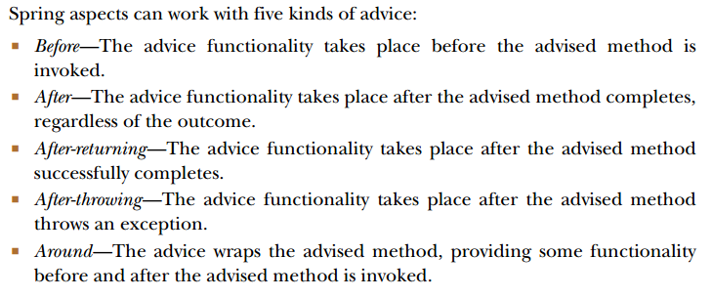
Advices

Slide 10
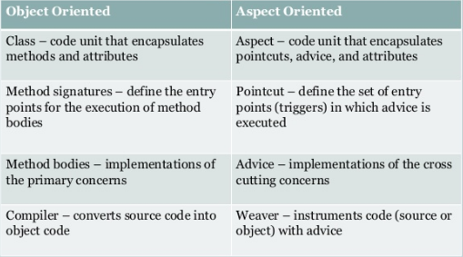
Spring AOP

Slide 11
General Spring IoC

Slide 12
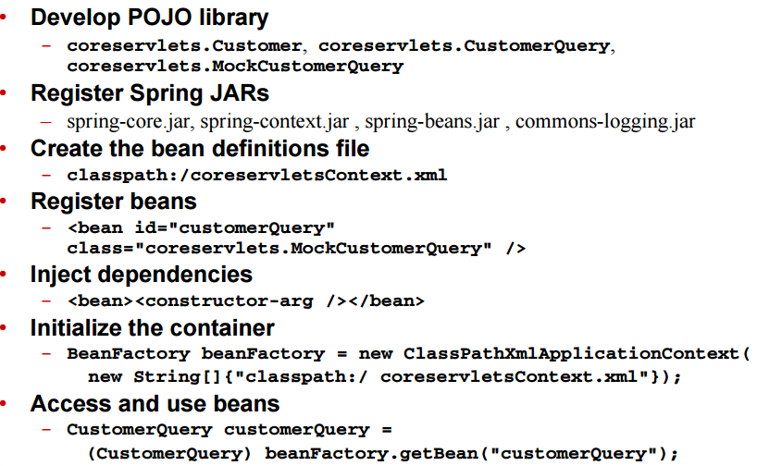
Spring Ioc Process

Slide 13
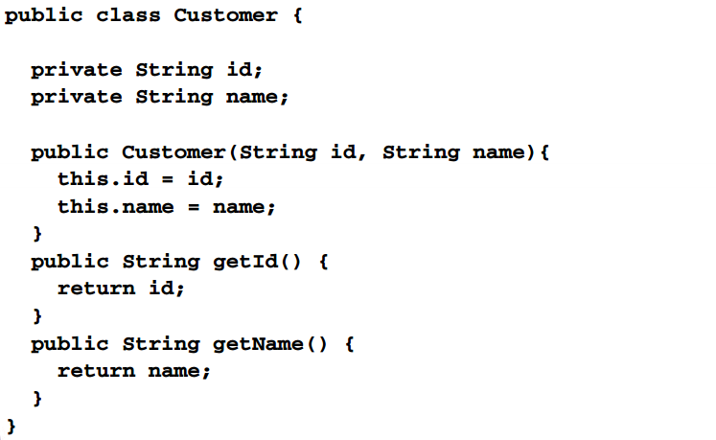
Develop POJO library

Slide 14
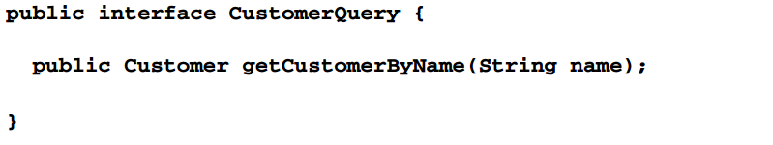
Develop POJO library

Slide 15
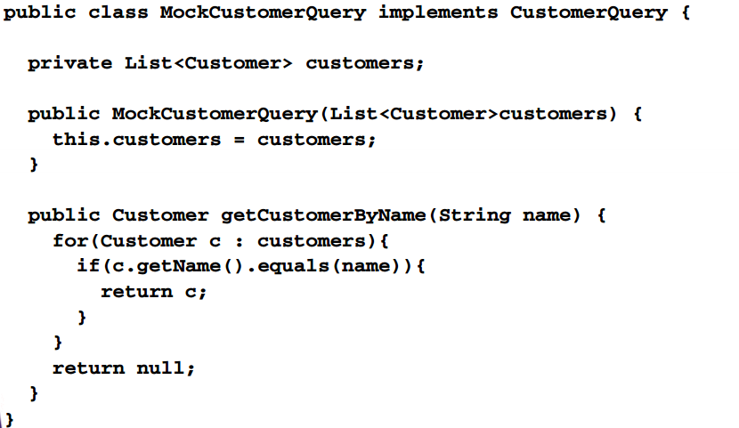
Develop POJO library

Slide 16
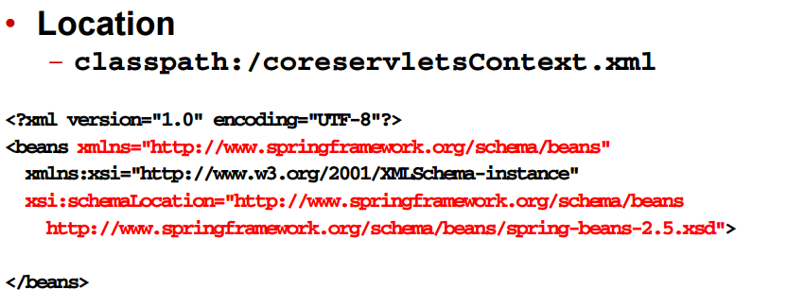
Create bean definitions

Slide 17
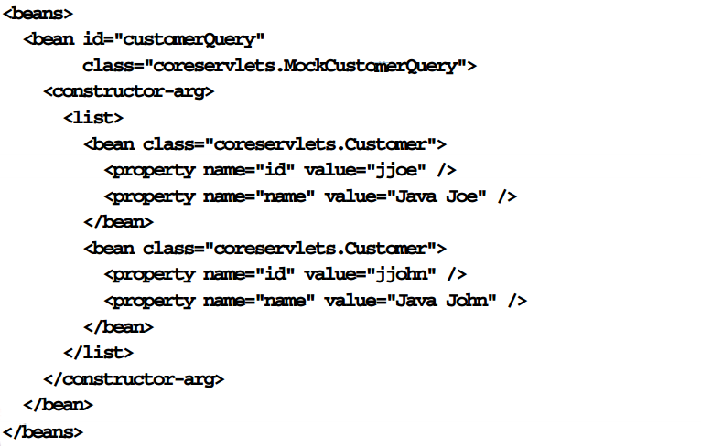
Registering beans and interdependencies

Slide 18
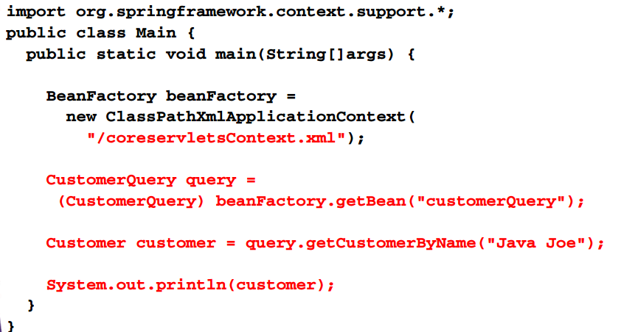

Access and use Beans

Slide 19
Spring AOP helloworld

Slide 20
Spring AOP jars
Spring-aop.jar
Aopalliance.jar
Aspectjweaver.jar
Cglib.jar

Slide 21
Spring AOP helloworld process
Identify concern
Select join pointcuts
All methods exposed by coreservlets.CustomerQuery
Create advice
E.g implement org.aopalliance.intercepts.MethodInterceptor
Create AOP definitions file
Create file classpath://coreservletsAopContext.xml
Register advice beans
<bean/>
Create pointcut definitions
Identify join points
<aop:config><aop:pointcut/></aop:config>
Define aspects
<aop:config><aop:advisor/></aop:config>

Slide 22
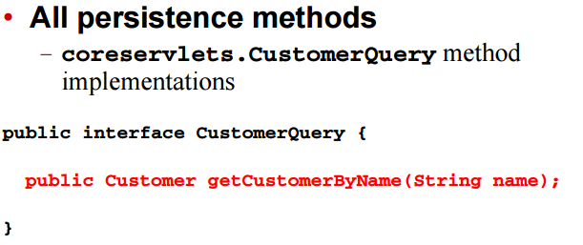
Select join points

Slide 23
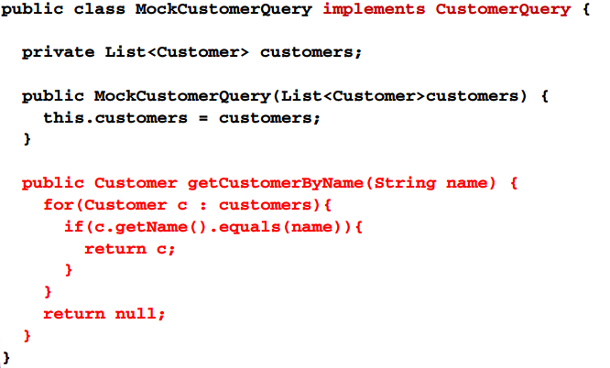
Select join points

Slide 24
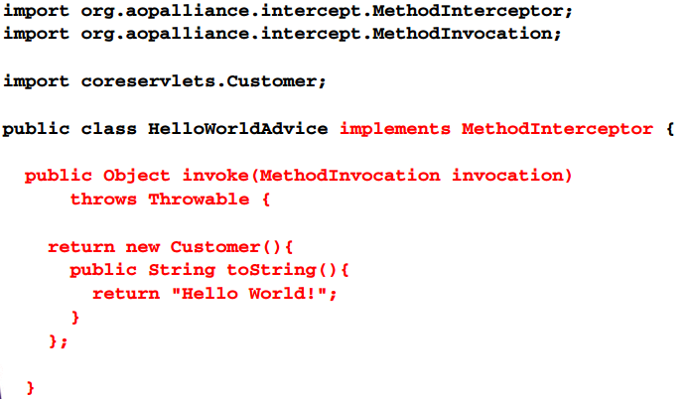
Create advice

Slide 25
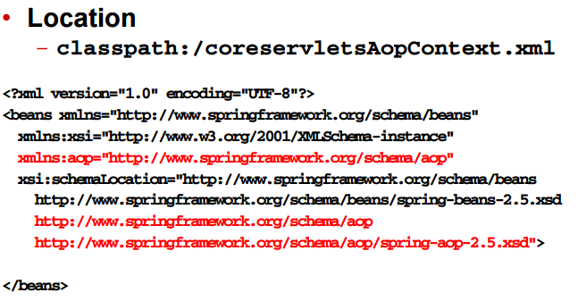
Create AOP definition file

Slide 26
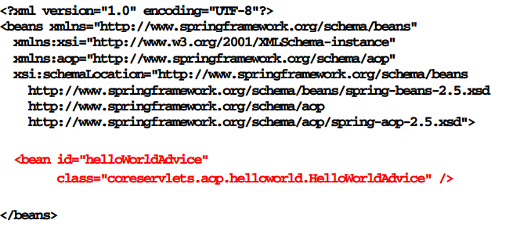
Register advice beans

Slide 27
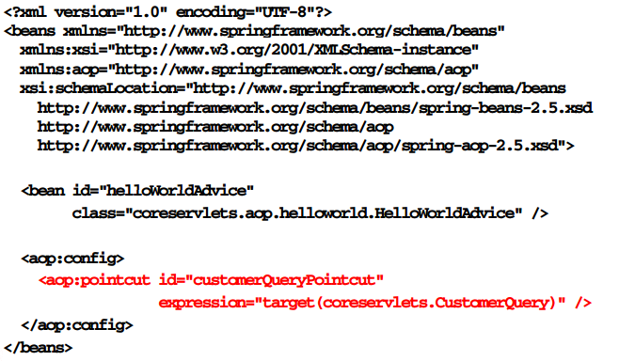
Create pointcut definitions

Slide 28
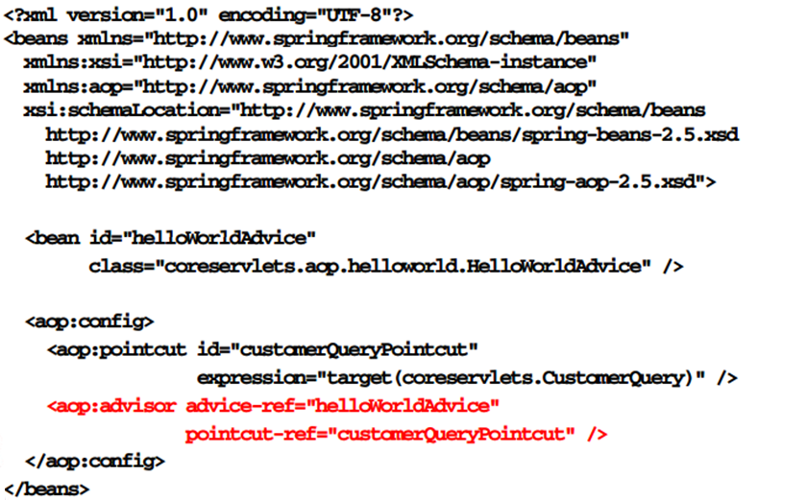
Define aspects

Slide 29
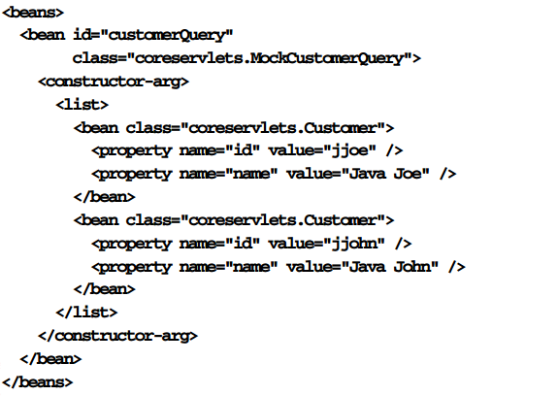
Domain beans

Slide 30
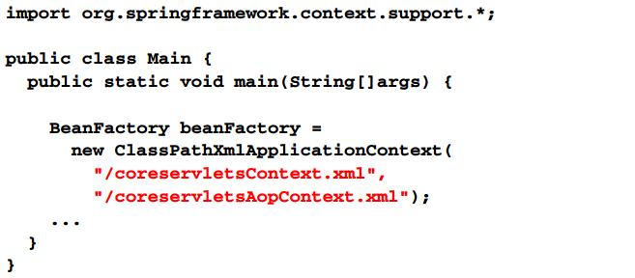
Initialize Spring IoC container

Slide 31
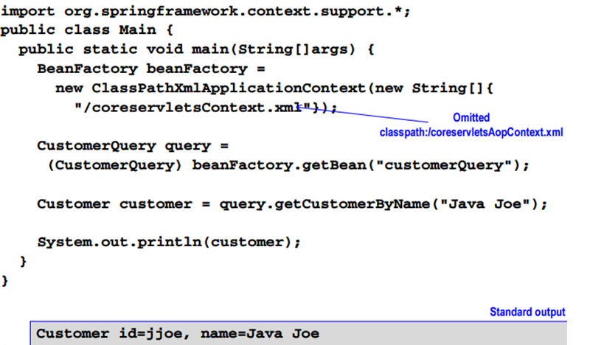
Access and use beans without spring AOP

Slide 32
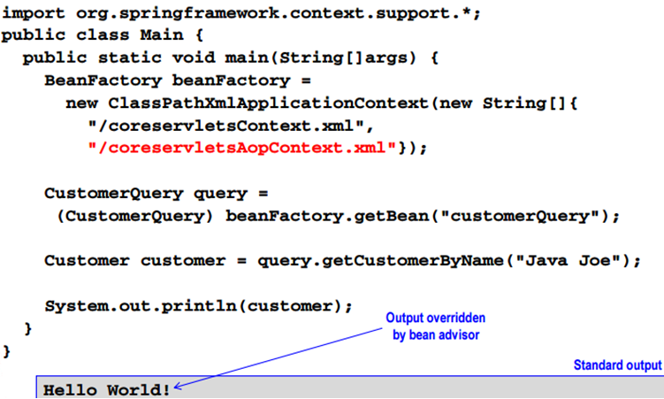
Access and use Beans with spring AOP

Slide 33
Integrated process spring ioc and AOP

Slide 34
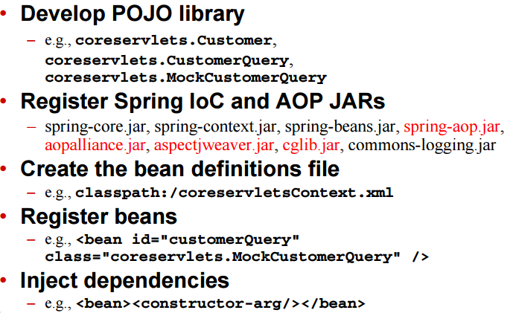
Integrated spring IoC and AOP, step 1

Slide 35
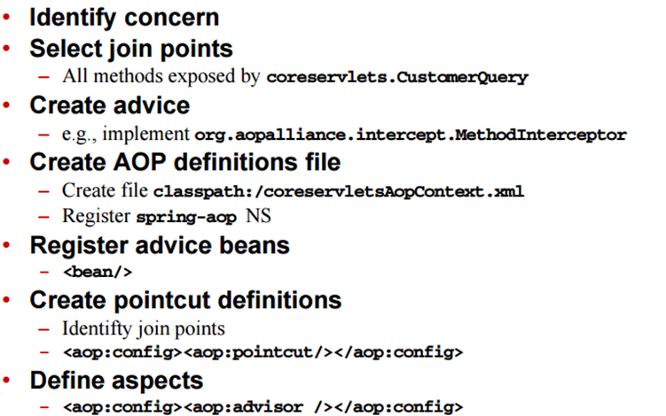
Integrated spring IoC and AOP, step2

Slide 36
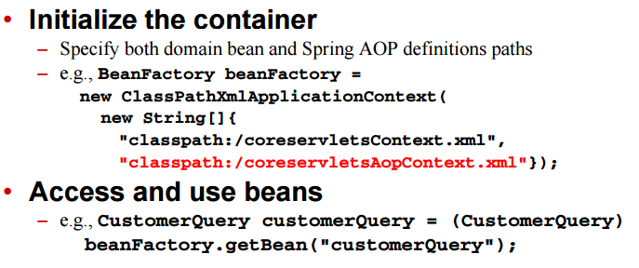
Integrated spring IoC and AOP , Step3

Slide 37
Addressing the application

Slide 38
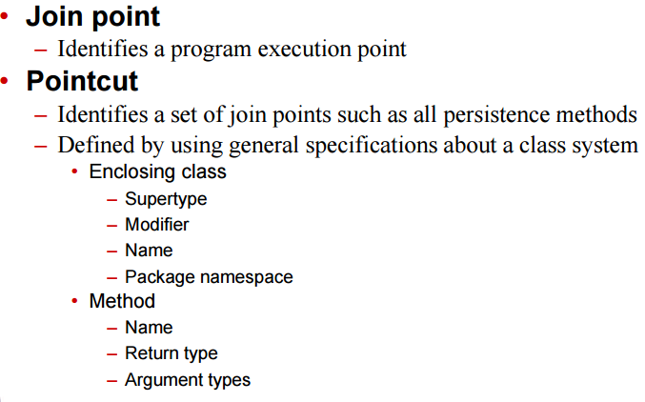
Pointcuts

Slide 39
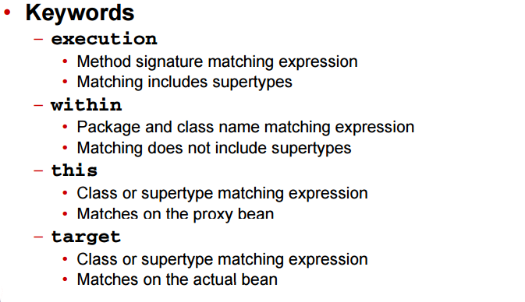
Pointcut definition (PCD)

Slide 40
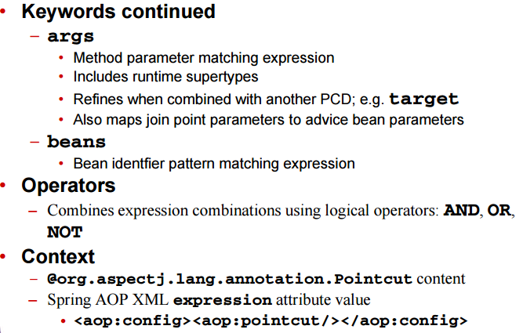
Pointcut definition (PCD)

Slide 41
Execution PCD

Slide 42
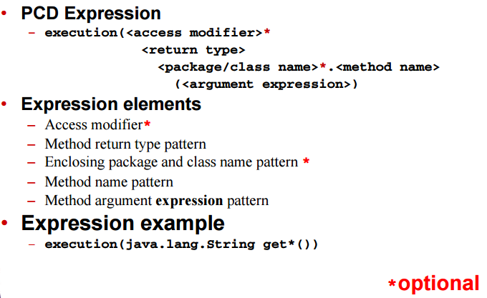
Execution PCD details

Slide 43
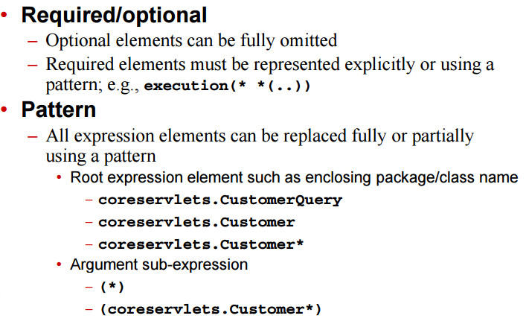
Execution PCD guidelines

Slide 44
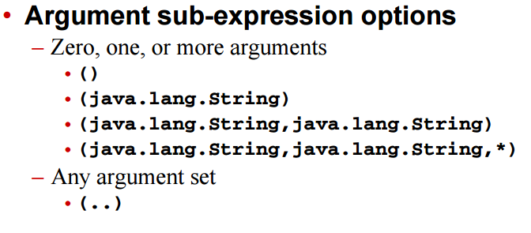
Execution PCD guidelines

Slide 45
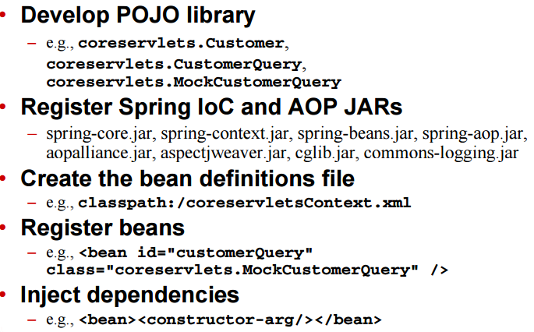
Integrated PCD guidelines, Step1

Slide 46
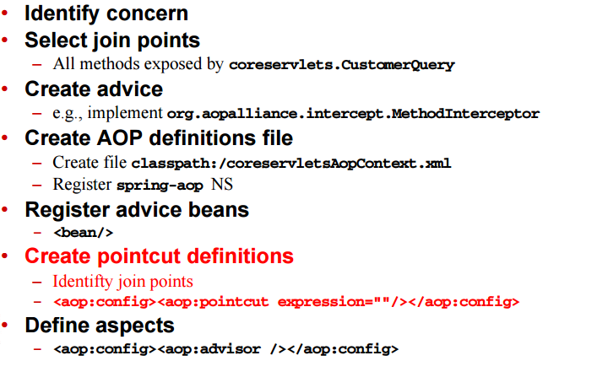
Integrated Spring IoC and AOP, Step2

Slide 47
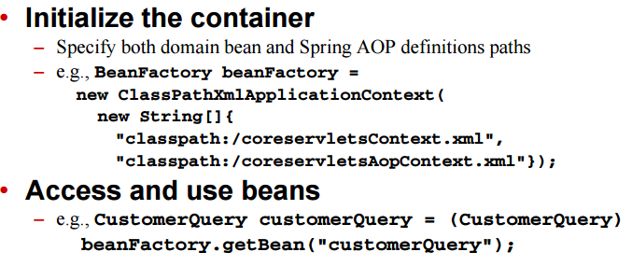
Integrated spring IoC and AOP ,step3

Slide 48
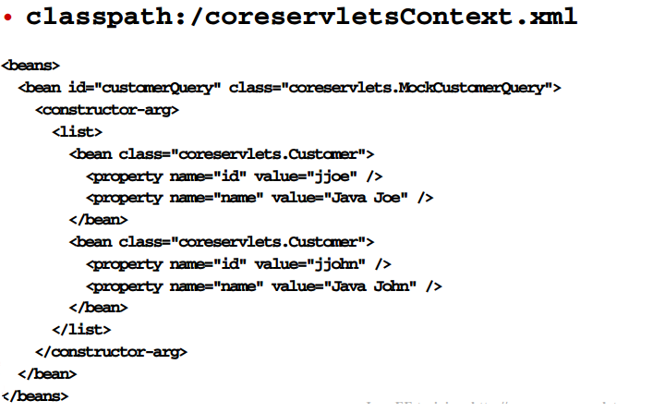
Execution PCD process , Step1 highlights

Slide 49
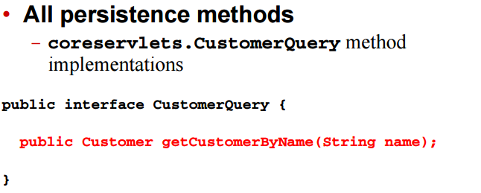
Select join points

Slide 50
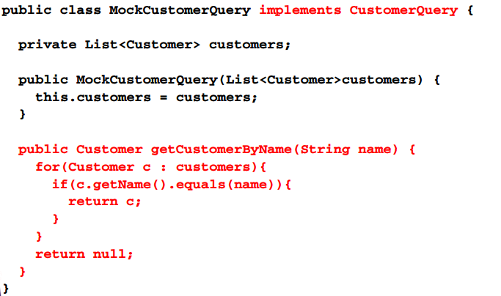
Select join points

Slide 51
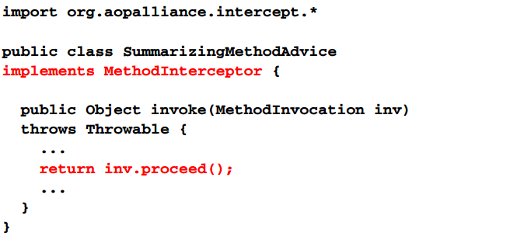
Create advice

Slide 52
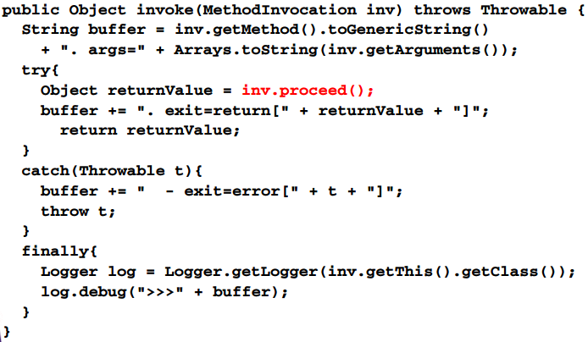
Create advice

Slide 53
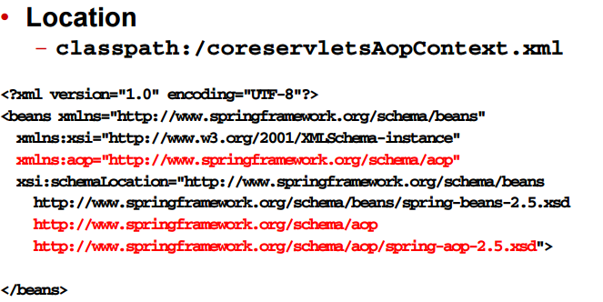
Create AOP definitions

Slide 54
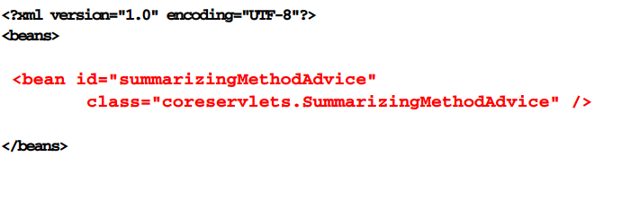
Register advice beans

Slide 55
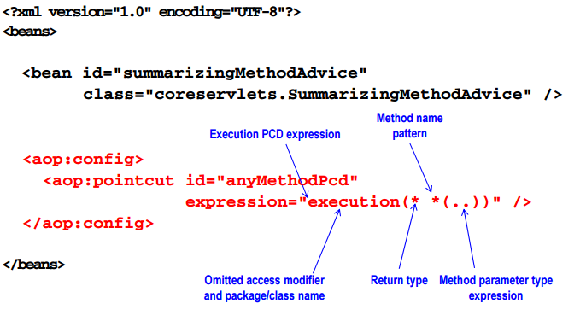
Define pointcuts

Slide 56
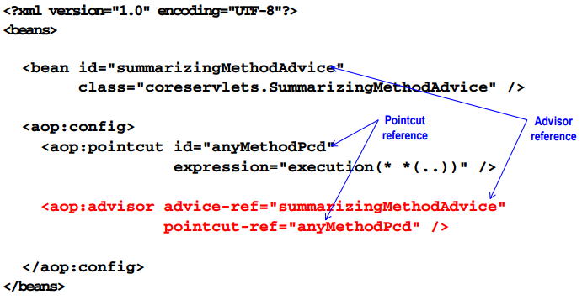
Define aspects

Slide 57
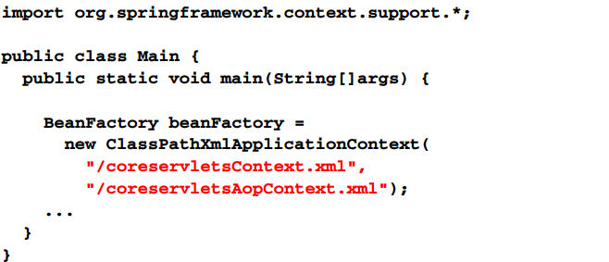
Initialize spring IoC container

Slide 58
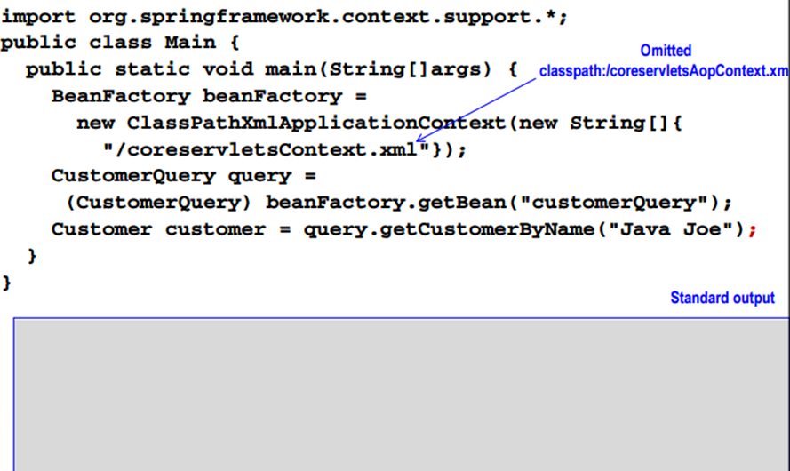
Access and use beans without spring AOP

Slide 59
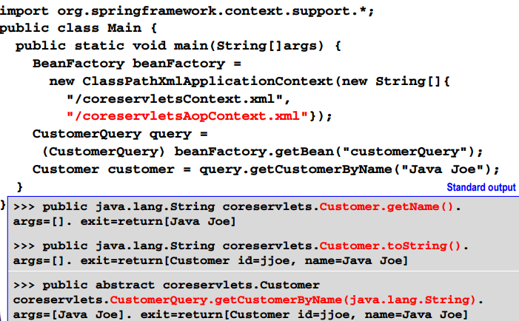
Access and use beans with spring AOP

Slide 60
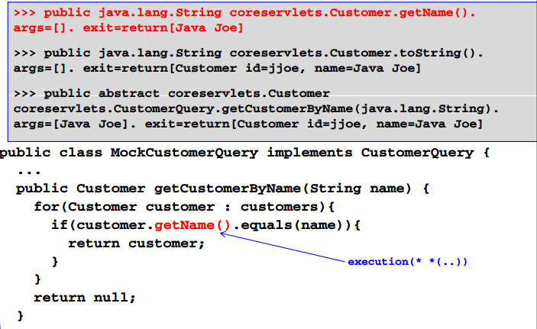
Execution PCD match origins

Slide 61
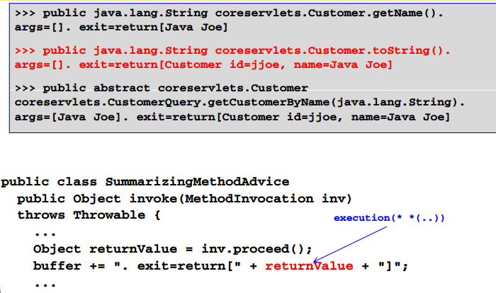
Execution PCD match origins

Slide 62
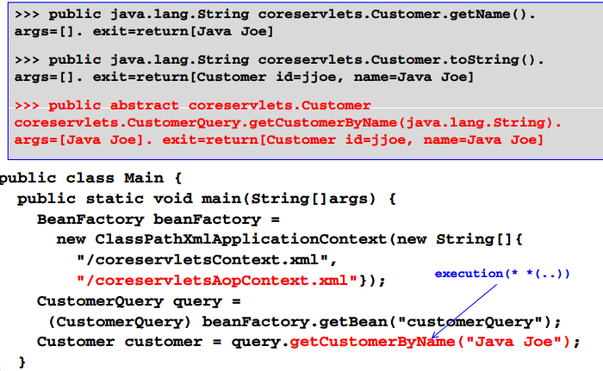
Execution PCD match origins

Slide 63
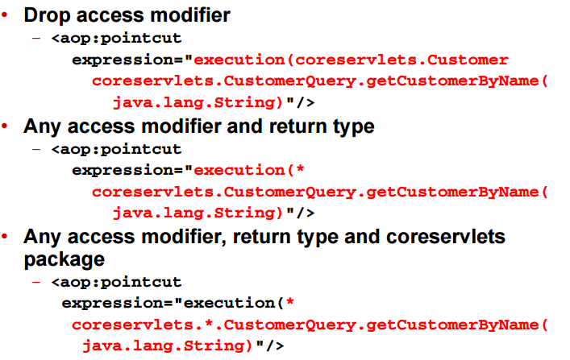
More execution PCD examples

Slide 64

More execution PCD examples

Slide 65
Summary
Manage AOP code and definition of separation
Identify concerns and joint points
Create advice
Create AOP definitions file
Register advice beans
Create point cuts definition
Define aspects

