Slide 1

Spring integration
Instruction: NGUYEN ANH MINH (M. Sc.)

Slide 2
Outline
Managing transactions with spring
Creating a transactional test environment
Spring and JPA integration
Spring , JPA, and JSF integration

Slide 3
Mapping transitions with spring

Slide 4
Objectives
Transaction instance
Read consistency
Error recovery

Slide 5
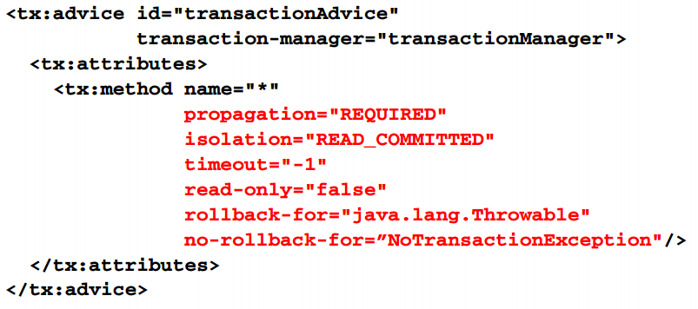
Spring aop advice transactional example

Slide 6
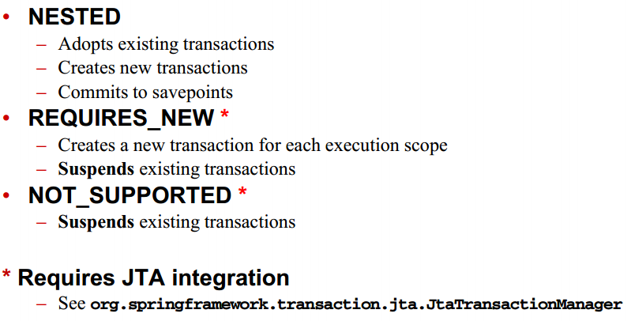
Propagation options continue

Slide 7
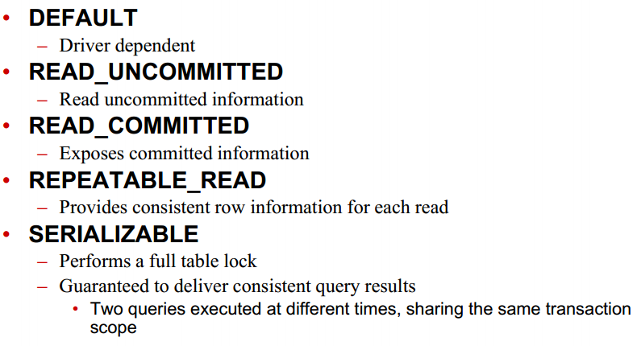
Isolation

Slide 8
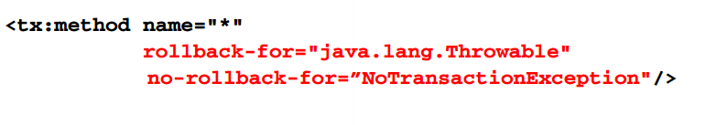
Error recovery
Recovery options
Rollback
No rollback
Mapped to error type
Defaults to java.lang.runtimeexception

Slide 9
Other options
Timeout
Transaction time ceiling in seconds
Default to none, -1
Read only
determines if changes to the database are permitted
Defaults to false

Slide 10
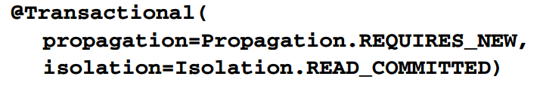
@transactional
Class or method innotation
@transactional
Annotation properties
Fine-grained settings

Slide 11
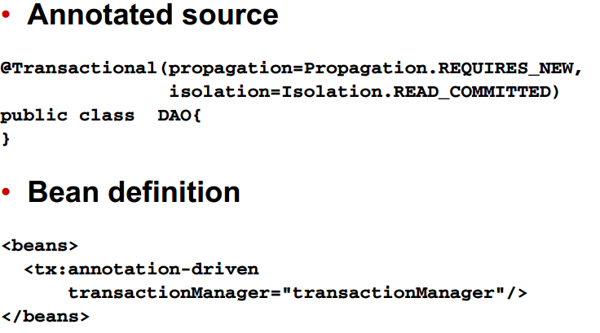
@Transactional example

Slide 12
Creating a transactional test environment

Slide 13
Spring transaction implication
Coordinate direct datSource access with transaction management
Acquire connections via DataSourceUtils API
E.g. static method getConnection (dataSource)

Slide 14
Dependencies
JDBC template support
Spring-jdbc, spring-tx, spring-core
AOP support
Spring-aop, aspectjweaver, aoplliance
Ioc intergration testing
Spring test , spring core, spring beans, spring context

Slide 15
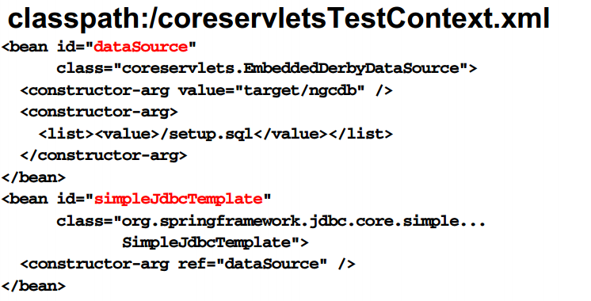
Test bean definitions

Slide 16
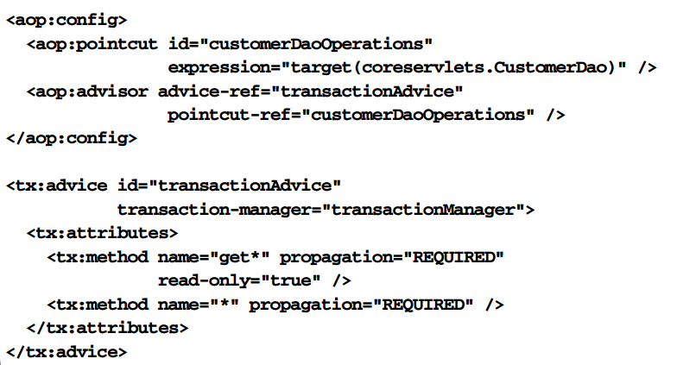
Library bean definitions

Slide 17
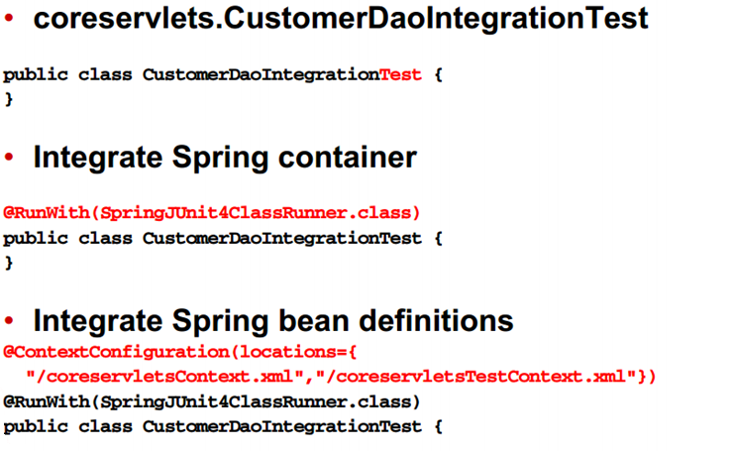
Test class

Slide 18
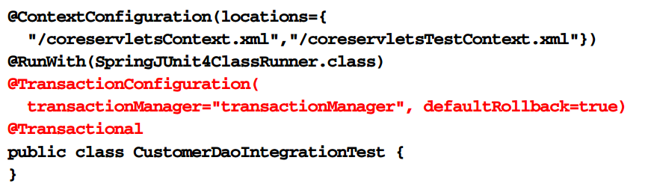
Integrate transaction management

Slide 19
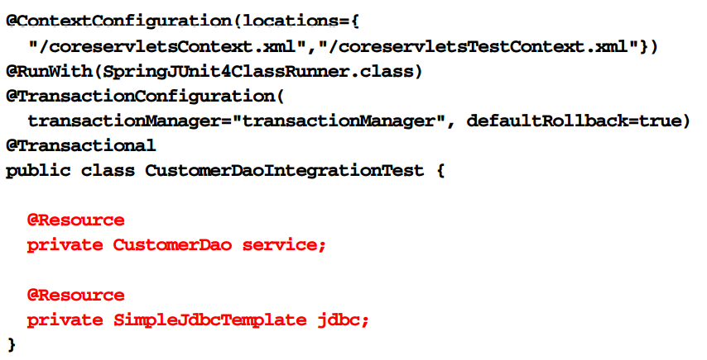
Inject test features

Slide 20
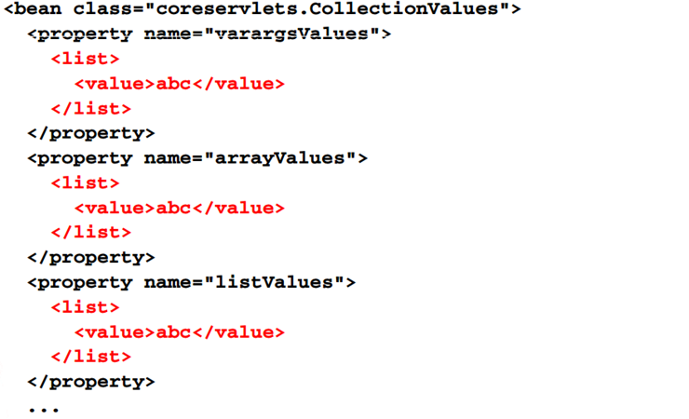
List collection example

Slide 21
Collection type conversion
Inspect the target type
Collection generic type
Array type
Converts the element type before assignment to the data structure
Conversion based on value property editor support

Slide 22
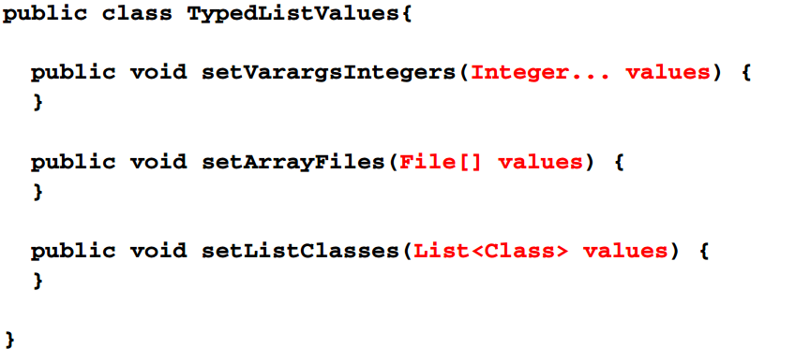
Collection type conversion example

Slide 23
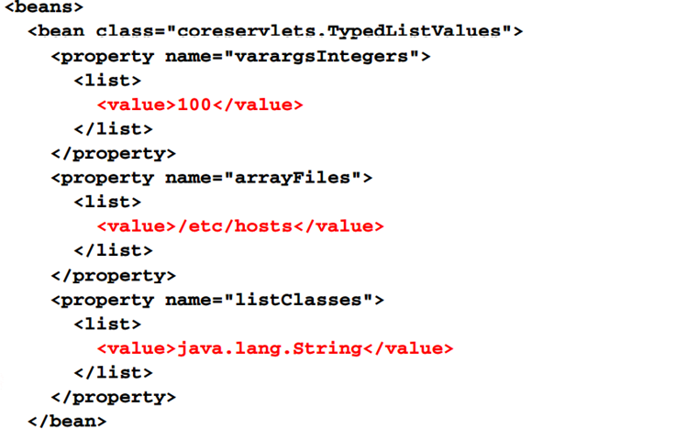
Collection type conversion example

Slide 24
Dictionary collections
Enables dictionary data structure declarations in bean definitions
Supports data structure type conversation to target collection types
Provides element type conversation to generic and array types

Slide 25
Map collections
Configure
Data structure
Xml element type map
Elements
Xml element type entry and key elements
Collection type conversation
Java.util.map
Element type conversion
Generics
Array type
Xml child elements types
Bean , ref, idref, value, null, list, set, map, props

Slide 26
Map collections process
Identify the DI target
For example , property setter or constructor
Verify the parameter type
Must be an array type, java.util.Map
Declare the XML element map
Declare the map elements using XML child element type entry

Slide 27
Properties collection
Enables simple dictionary data structure declarations in bean definitions to be
Provides simplified interface for configuring property sets
No type conversion support

Slide 28
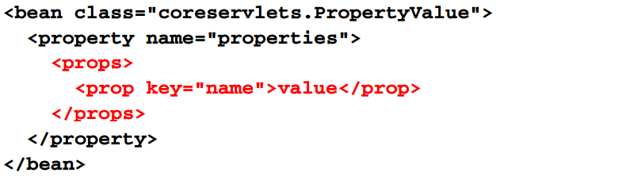
Properties collection example

Slide 29
Properties collection process
Identify the DI target
For example , property setter or constructor
Verify the parameter type
Must be an array type, java.util.Map or java.util.Properties
Declare the xml elements props
Declare the map elements using xml child element type props

Slide 30
General approach review continued
Add the bean definitions continued
Inject plain values using the value attribute or elements
Reference values sourced from application configuration files using the expression formats $name
Integrate properties files using property –place holder elements supplied by sping context
Inject collections by defining data structures directly with the bean definitions configuration
List , set, map or properties structures
Access and use container-managed beans
The access and integration method is context-dependent

Slide 31
Summary
General collaborator references
Flexible but fragle
Process
Xml element type ref with the bean attribute
Xml attribute ref
Local collaborator refererences
Improved validation but inflexible
Process
Xml element type ref with the local attribute
Xml attribute ref

Slide 32
Summary
Resource integration
Falcilited inline when specifying path information using scheme prefixes file, classpath, http
No prefix results in ApplicationContext dependent behavior
Collections
Xml parents elements type list, set, map, and property

