Slide 1
Spring Integration
Instruction: NGUYEN ANH MINH (M. Sc.)

Slide 2
Outline
Maven 2 build system overview
General build procedure
Multi-module project build process
Spring ioc integration
Testing with maven 2 and spring

Slide 3
Build system

Slide 4
Conventions
Variables ${KEY}
Home directory ${HOME}
Linux : $HOME or ~
Windows %HOMEPATH%
Path separator /
Linux – “/”
Windows – “\”

Slide 5
General goals
Manage source and configuration files
Distributes and execute in a test environment
Integrate third-party libraries
Package and distribute project

Slide 6
Maven 2 build system
Implements best practices into build defaults
Comprehensive build system
Compile
Test
Package
Distribute
Version
IDE integration
Report generation
Customizable behavior

Slide 7
Maven 2 architecture
Maven client
Plugin execution framework
Project
Source tree
Maven configuration
Repository
Addressable (URL) file repository
Local repository cache
Plugin download
Direct and transitive dependencies
Defaults to ${HOME} /.m2/repository
Edit settings.xml for alternatives
<settings> <localREpository/></settings>

Slide 8
Client personalziation
Global
Maven 2 installation root
Conf/settings.xml
User
${HOME} /.m2/settings.xml

Slide 9
Maven 2 installation process
Verify perquisites
JDK
JAVA_HOME set JDK installation root
Download maven
http://maven.apache.org/download.html
Unpack download
Extract to target installation path
Contains bin, boot, conf , and lib directories
Add M2_HOME/bin to PATH environment setting
Verify repository settings
Official , mirror, or coporate

Slide 10
Verify repository settings
Default
Official repository , a.k.a central
http://repo1.maven.org/maven2
Mirror
Tradition mirror
Redundant site
Corporate repository
Private network
Without internet accesss

Slide 11
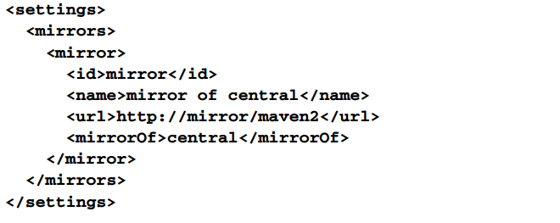
Repository mirror

Slide 12
Build process

Slide 13
General approach
Compile source
Reference third-party libraries
Reference peer modules
Integrated project with IDE
Test binaries
Package source for distribution

Slide 14
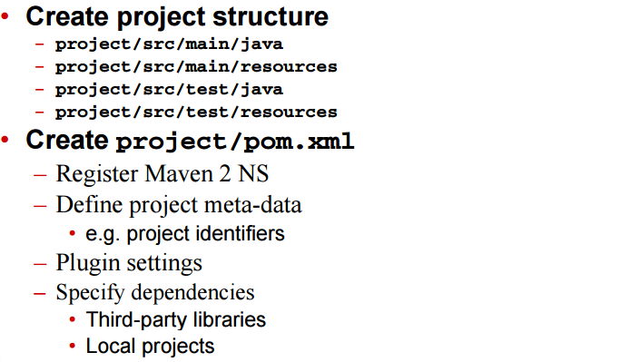
Process

Slide 15
Process continued
Integrate with IDE
Prepare for eclipse mvn eclipse:eclipse
Plugins available for netbeans and intellij
Referesh or import project into IDE
Develop source
Src/main/java
E.g. coreservlets.mockcustomerdao
Perform build activities
Compile , test, package, generate reports, and more….
E.g. mvn clean install

Slide 16
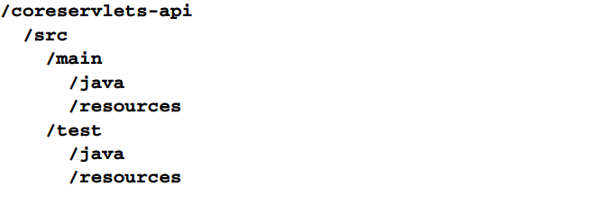
Create project structure

Slide 17
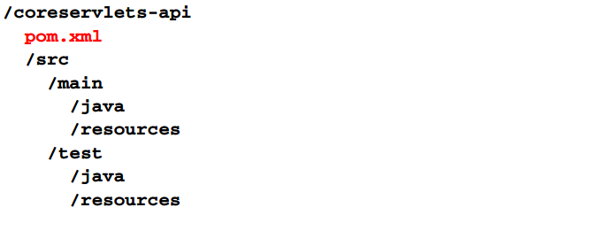
Create pom.xml

Slide 18
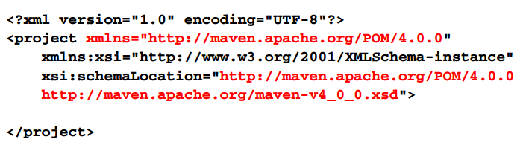
Create pom.xml

Slide 19
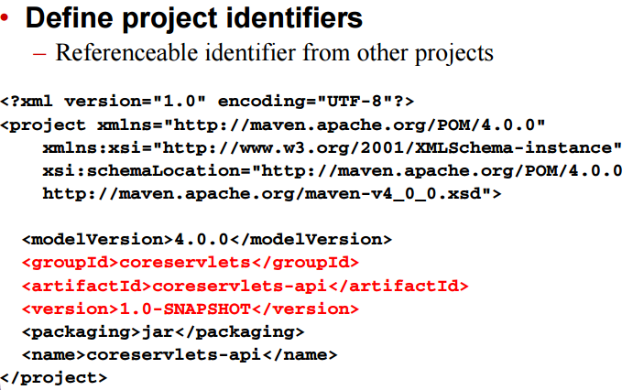
Create pom.xml

Slide 20
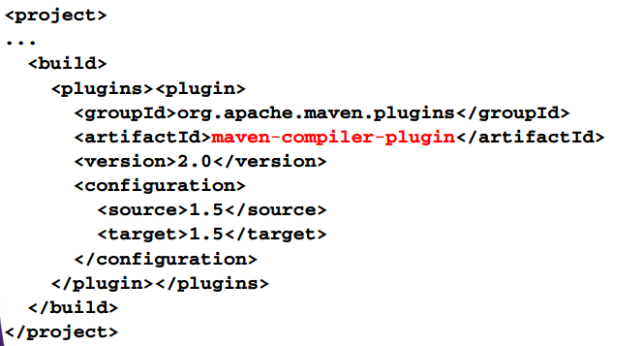
Create pom.xml
Define compiler settings

Slide 21
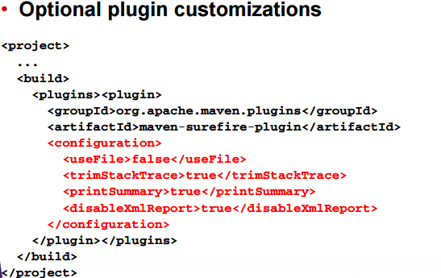
Create pom.xml

Slide 22
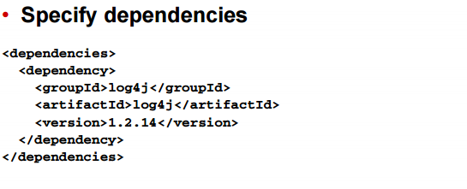
Create pom.xml

Slide 23
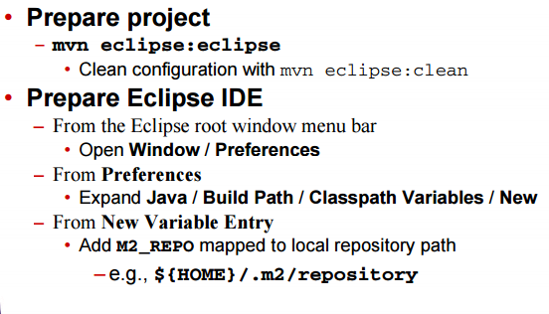
Integrate with eclipse IDE

Slide 24
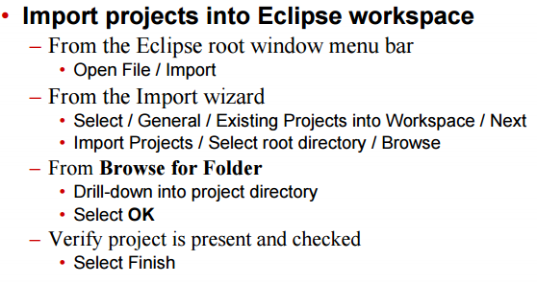
Integrate with eclipse IDE

Slide 25
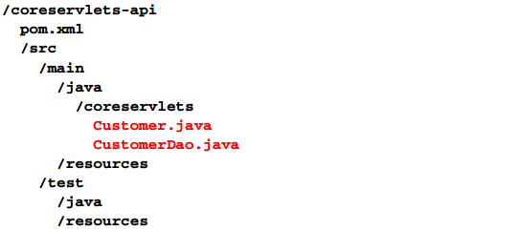
Develop source

Slide 26
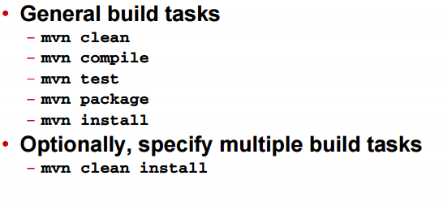
Perform build activities

Slide 27
Build artifacts
Project coreservlets-api
JAR
Coreservlets-api-1.0-SNAPSHOT.jar

Slide 28
Multi-mode projects

Slide 29
multi-module project structure
Project one
Pom.xml
Src/main/java
Project two
Pom.xml
Src/main/java
Project N
Pom.xml
Src/main/java
Pom.xml

Slide 30
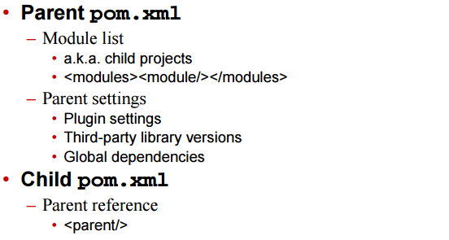
Configuration

Slide 31
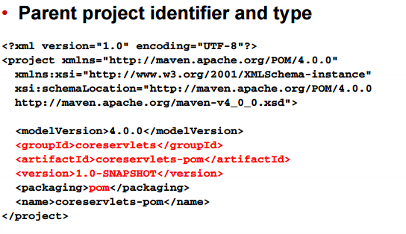
Parent pom.xml
Parent project identifier and type

Slide 32
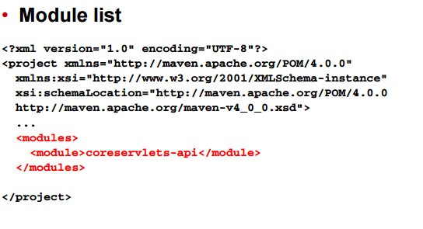
Parent pom.xml
Module list

Slide 33
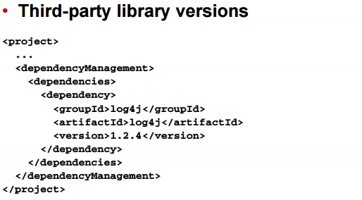
Parent pom.xml

Slide 34
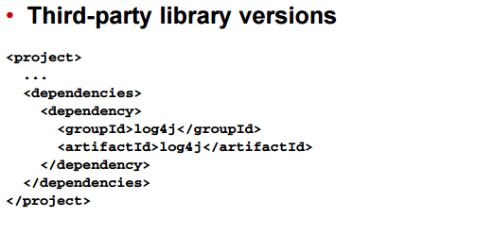
Parent pom.xml

Slide 35
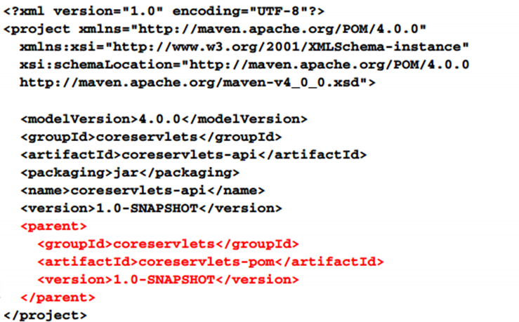
Child project pom.xml

Slide 36
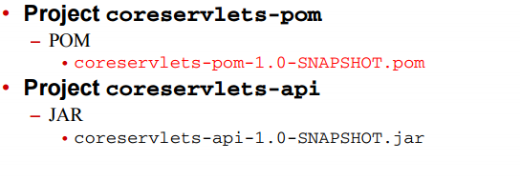
Build artifacts

Slide 37
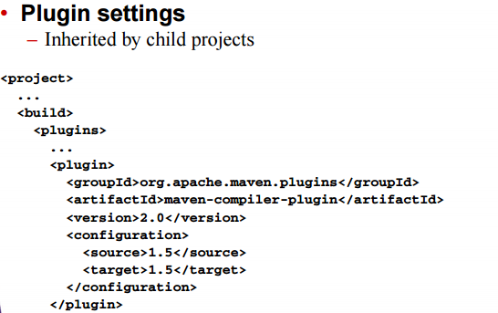
Parent pom.xml

Slide 38
Implementation project

Slide 39
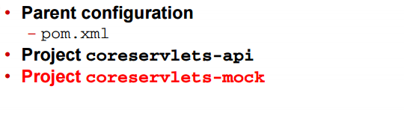
API implementation project

Slide 40
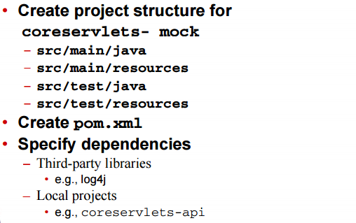
Process

Slide 41
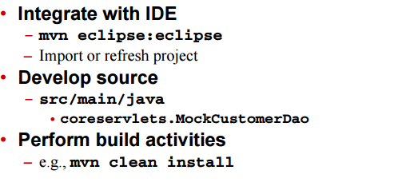
Process continued

Slide 42
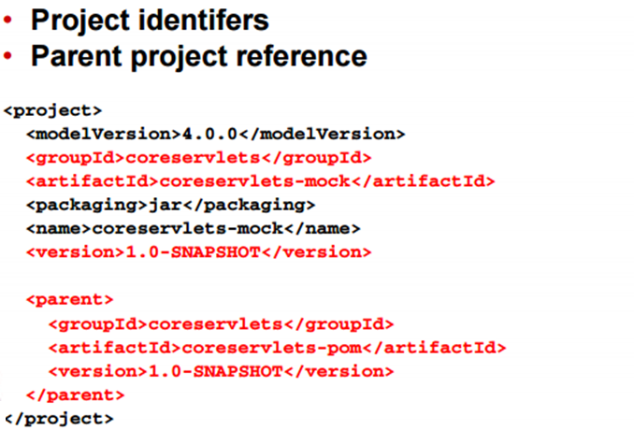
Create pom.xml

Slide 43
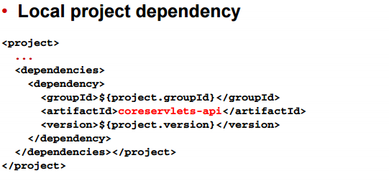
Create pom.xml

Slide 44
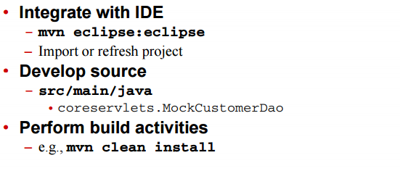
Complete process

Slide 45
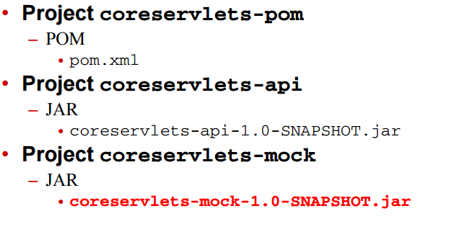
Build artifacts

Slide 46
Deployment

Slide 47
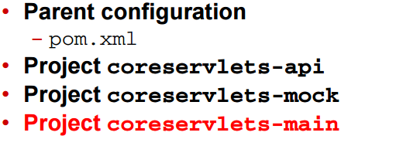
Deployment project

Slide 48
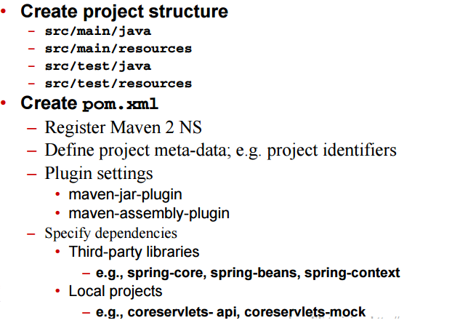
Process

Slide 49
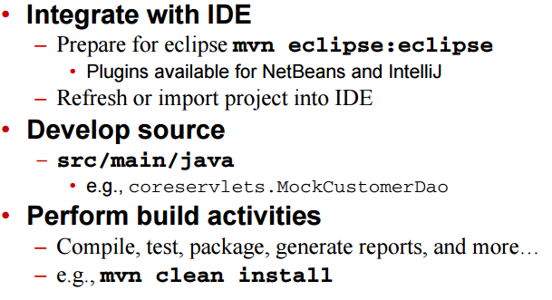
Process continued

Slide 50
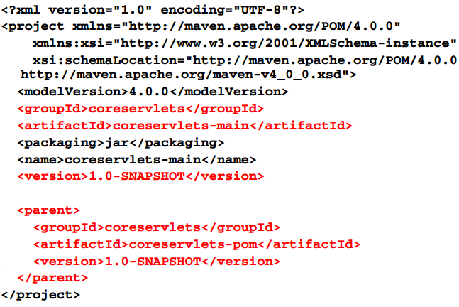
Create pom.xml

Slide 51
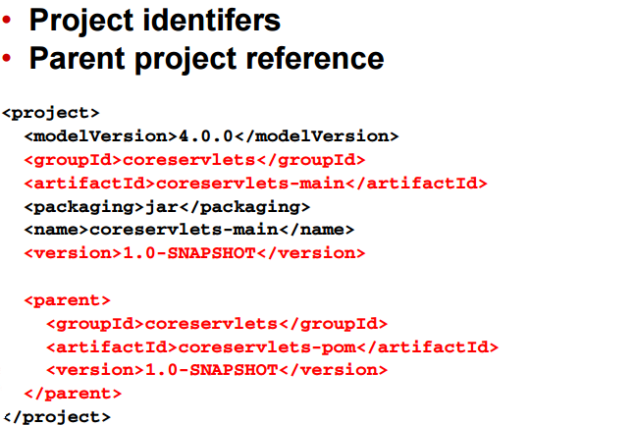
Create pom.xml

Slide 52
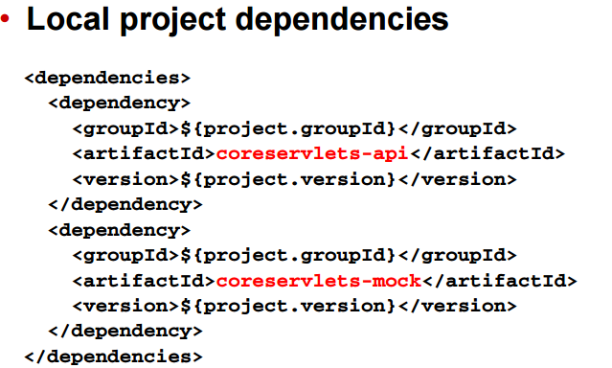
Create pom.xml

Slide 53
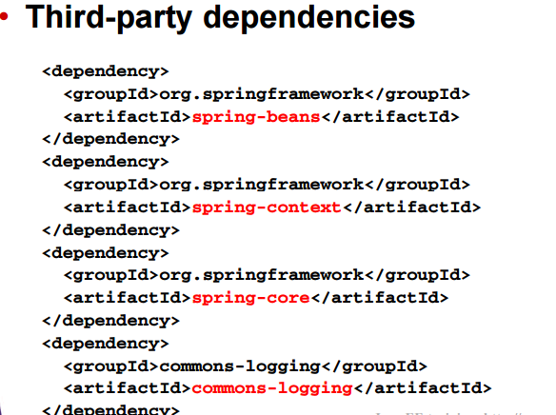
Create pom.xml

Slide 54
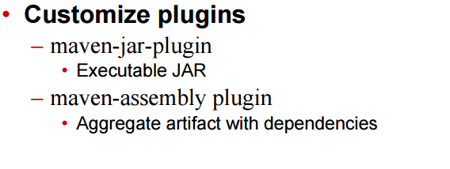
Create pom.xml

Slide 55
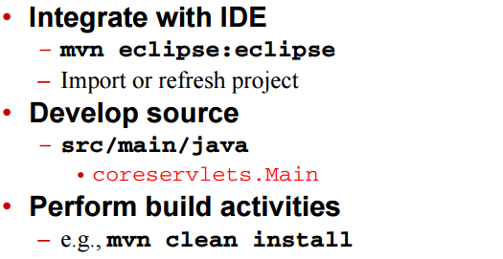
Complete process

Slide 56
Integrate spring ioc

Slide 57
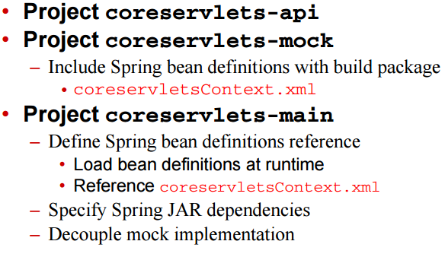
General approach

Slide 58
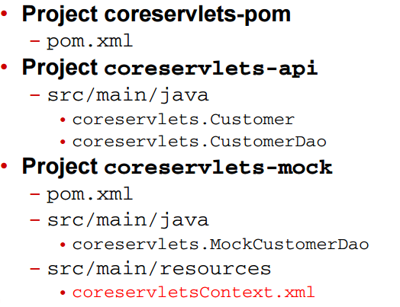
Project structure

Slide 59
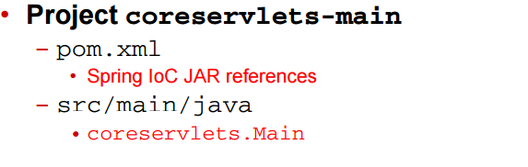
Project structure continued

Slide 60
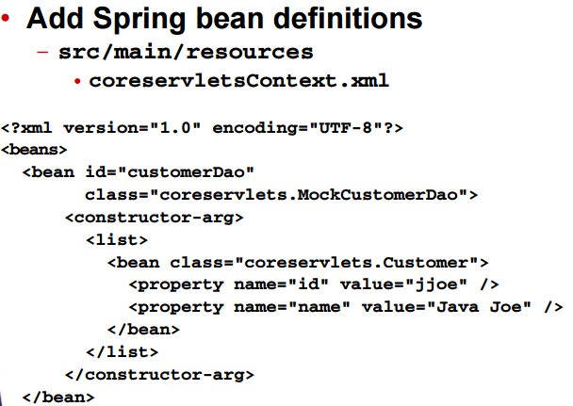
Project coreservlets-mock

Slide 61
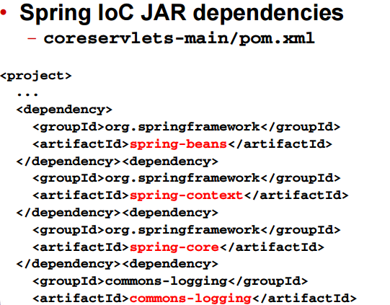
Project coreservlets-main

Slide 62
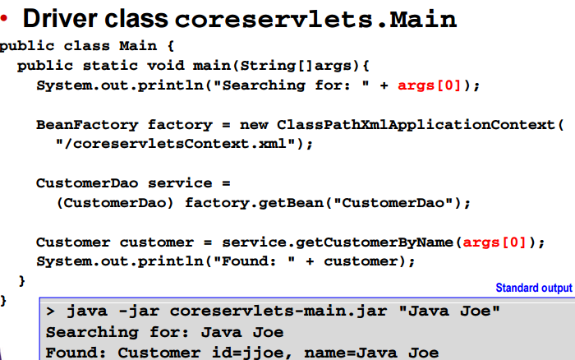
Project coreservlets-main

Slide 63
Spring library integration

Slide 64
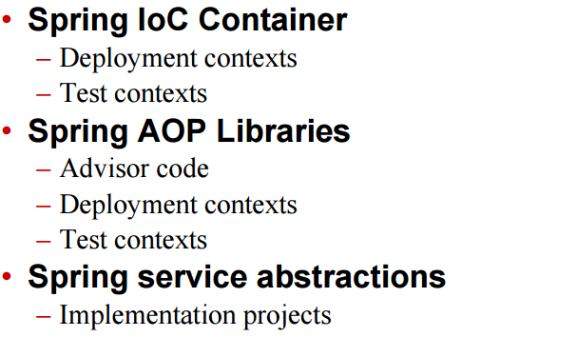
General approach

Slide 65
Test with maven2 and spring

Slide 66
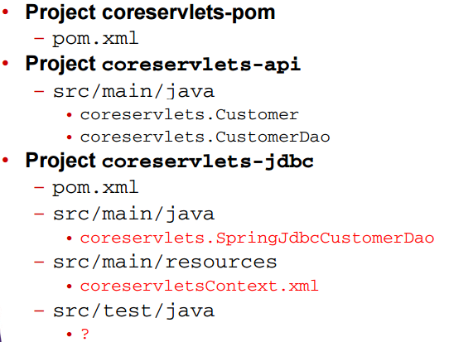
Project structure

Slide 67
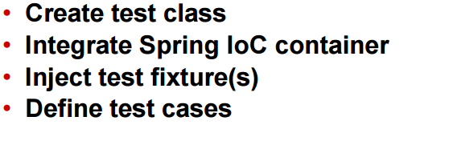
General approach

Slide 68
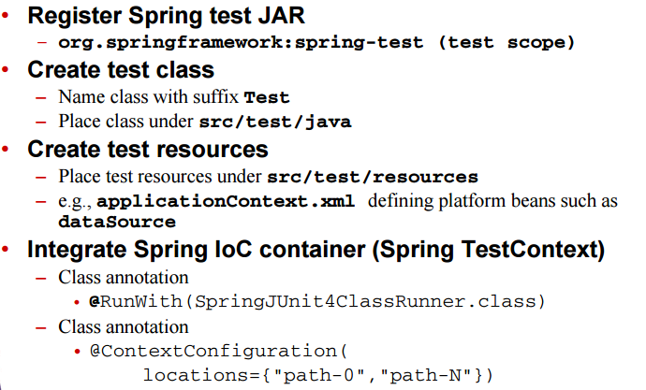
Process

Slide 69
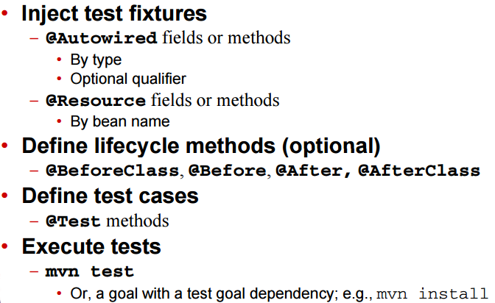
Process continued

Slide 70
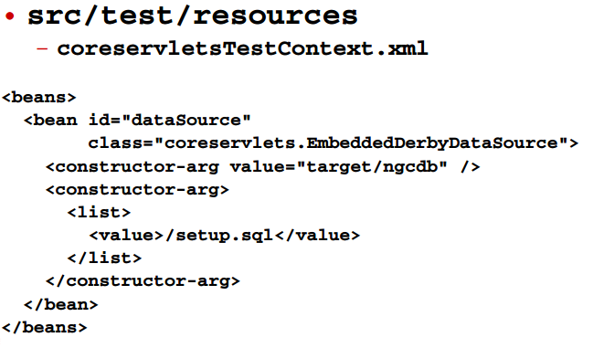
Create test resources

Slide 71
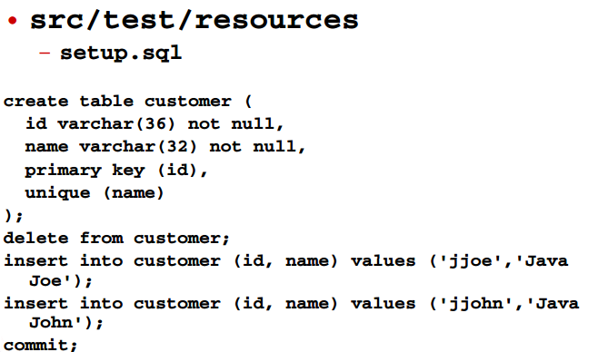
Create test resources

Slide 72

Create test class

Slide 73

Create test class

Slide 74

Integrate ioc container

Slide 75

Inject test fixture

Slide 76

Inject test fixture with @resource

Slide 77

Create lifecycle methods

Slide 78

Create test case

Slide 79

Summary

Slide 80

Summary

