Slide 1
Spring introduction
Instruction: NGUYEN ANH MINH (M. Sc.)

Slide 2
Outline
Motivation of using Spring platform
Set up Spring Development
Start code Spring Hello World
Start code POJO development
Loading environment
Dependency injection
Inversion of control

Slide 3
Motivation of using Spring Platform

Slide 4







Slide 5
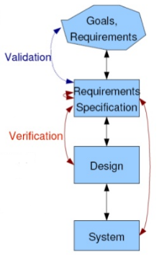
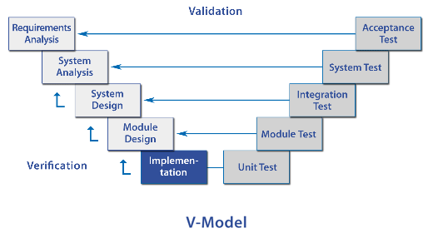
Software Model
Solutions are complex
Requirements are constantly in flux
Software architecture must be flexible
Software components must be verifiable
Software product must be easy validate

Slide 6
EJB approach
Complex products
Unmaintainable systems
Non-portable , framework committed business components
Unpredictable systems

Slide 7
Spring approach
Products based on simplicity
Maintainable systems
Framework-independent software
Portable components
Testable components
Reliable and predictable systems

Slide 8
Pure java
Founded on pojo-based development
Ordinary java classes that no special APIs
Non-invasive for pre-existing pojos
Rewards framework indenpendent business logic
Encourages new software to be written as pojos
Results in highly portable , reusable, and veriable software

Slide 9
More with less custom code
Expand capibilities with less code
Entensive and tested service abstractions
Mail, jms, jmx, jsf, jdbc,
Replaces generic corporate libraries
Mitigates custom integration because spring platform is easy to use

Slide 10
Modular
Help only where needed
Modularity allows only relevant components to be introduced to the application
For instance choose one:
Spring bean factory
Spring jmx
Spring jdbc
Framework can be interfaced in deep or shallow layers
Interfaces are consistent at each layer
Turn-key solution
Spring components can be integrated fast, with minimal effort and predictable results
Interfaces are clear and consistent

Slide 11
Widely available
Spring is integrated into numerous framework
Broad adoption possible because the container is portable and lightweight
The container is itself is pojo class
Integration without third-party support
Performance overhead is rarely a consideration

Slide 12
Spring development environment setup

Slide 13
Spring download
http://www.springframework.org/download
Spring Documentation:
http://www.springframework.org/documentation
Online Book:
Spring in action
Pro spring, Spring * in action
http://www.coreservlets.com
Development Environment:
Spring Tool Suite : https://spring.io/tools
Eclipse with Spring Plugin
Spring IDE : https://marketplace.eclipse.org/content/spring-ide

Slide 14
Start code Spring hello world

Slide 15
Spring hello world
Code a plain java class model
Use the interface pattern by coding helloworld interface and helloworldimpl implementation
Configure the spring ioc container
Instantiate the spring ioc container
Acquire the object from the spring ioc container
The client must only have knowledge of the interface, helloworld

Slide 16
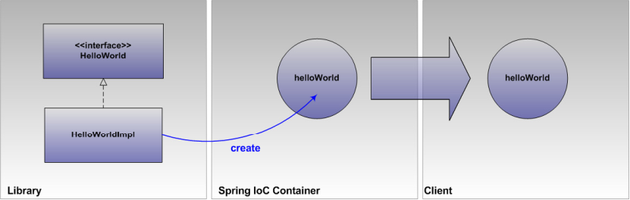

Slide 17
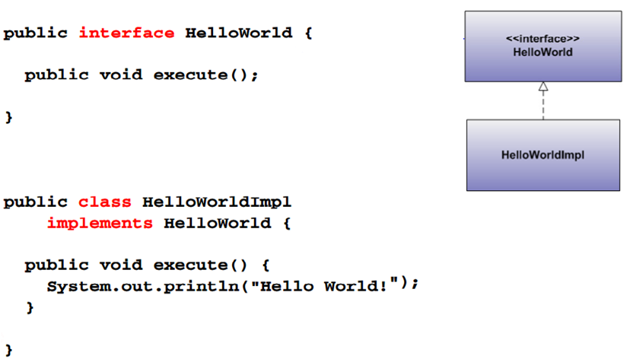
Plain java class model

Slide 18
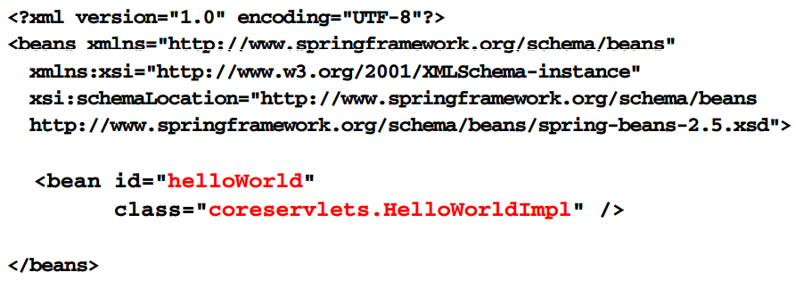
Spring ioc configuration

Slide 19
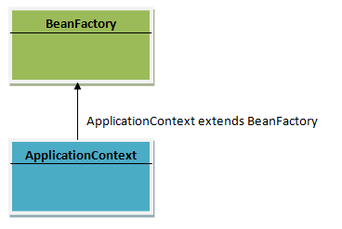
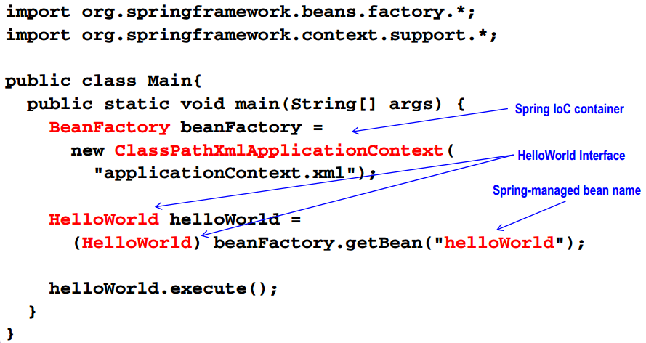
Executing spring hello world

Slide 20
Pojo development
Plain old java object
What isit?
Business logic
Framework independent
What it’s not
Limited to the value object pattern
Framework implementation software
Features
Poratable, testable, flexible

Slide 21
Pojo development process
Describe the system agents and interactions
Pojo behavior classes , domain model, and dependencies
Determine components responsibilities
Method
Identify information items discovered during program execution
Method parameters
Identify information available during initialization
Initialization parameters for constructors, setters, factories

Slide 22
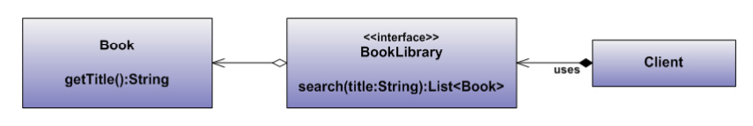
Pojo development processes example
Agents
Book library and clients
Interactions
Client uses book libraries
Book library arrogate book
Responsibility
Book library must search for book by title
Client must supply search parameters, i.e title value

Slide 23
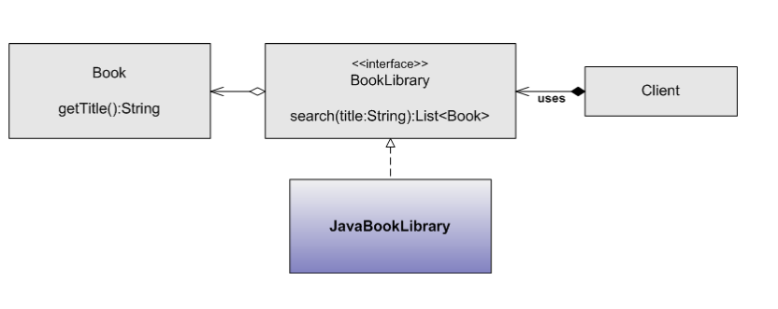
Pojo development processes
Development implementation

Slide 24
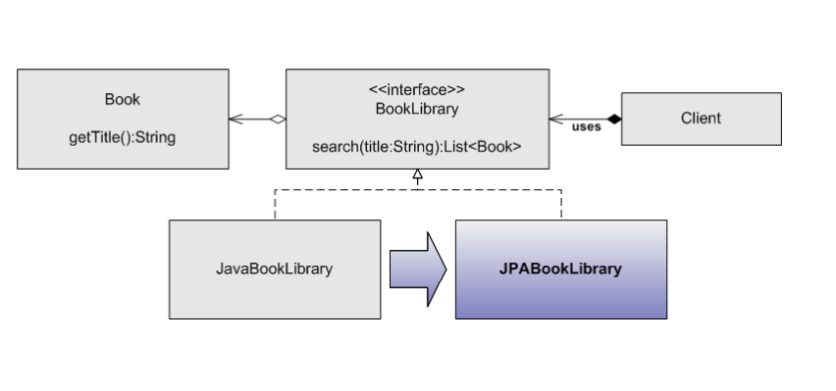
Pojo development processes
Plan for change

Slide 25
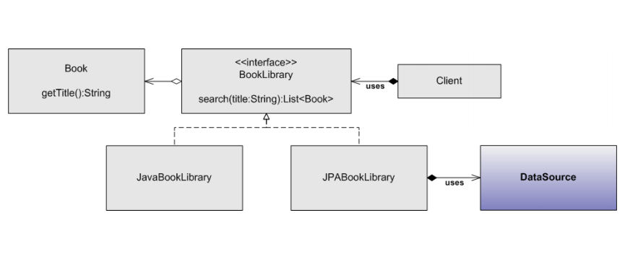
Pojo development process
Plan for new dependencies

Slide 26
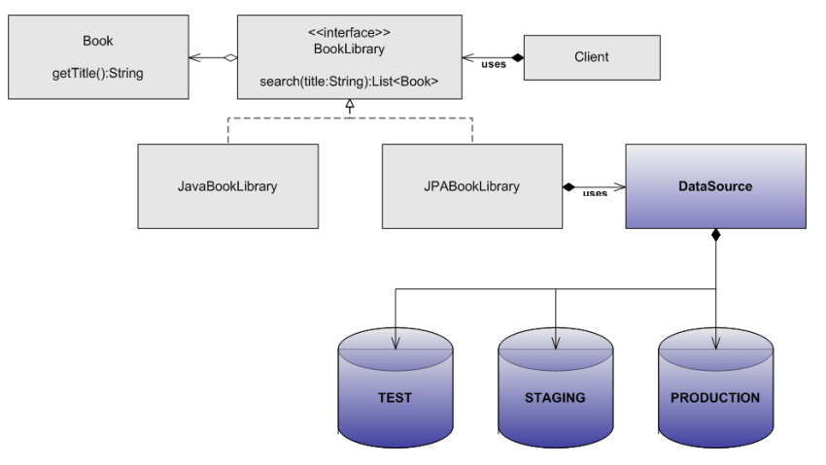
Pojo development processes
Plan for complex configuration development

Slide 27
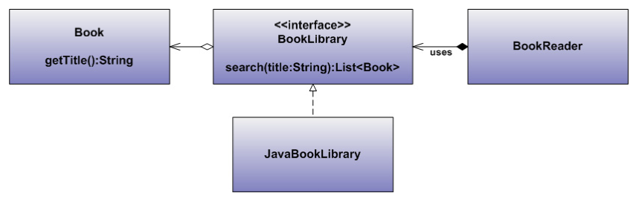
Pojo implementation example

Slide 28
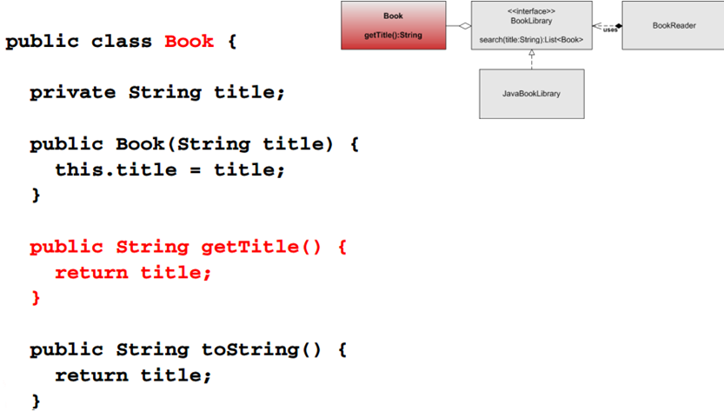
Book implementation

Slide 29
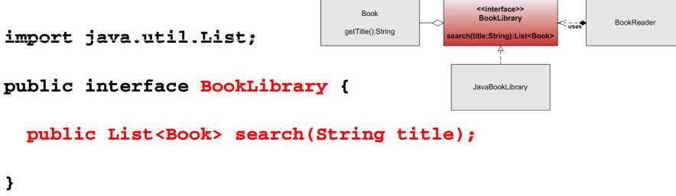
Book library implementation

Slide 30
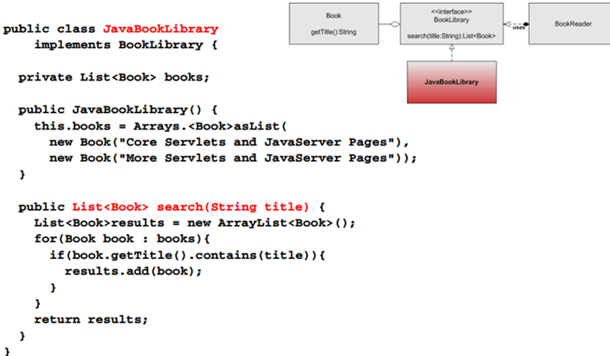
Book library implementation

Slide 31
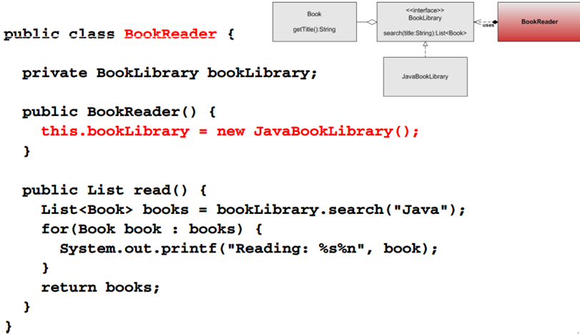
Client implementation

Slide 32
Dependency injection

Slide 33
Dependency injection
Deliveries object dependencies at runtime
Encourages the separation of responsibilities
When used with the interface pattern
Isolates implementation from clients
Minimizes the impact on clients when implementation evolve

Slide 34
Dependency injection process
Design depending types to receives implementations
Allow dependencies to be supplied using property setters and constructors
Other dependency injection methods property setters or constructors
Other dependency injection methods are also available , such as injection , but requires third-party or java reflection support
Avoid constructing objects from the clients to fulfill dependencies
For example , do not use the new operator to manage services

Slide 35
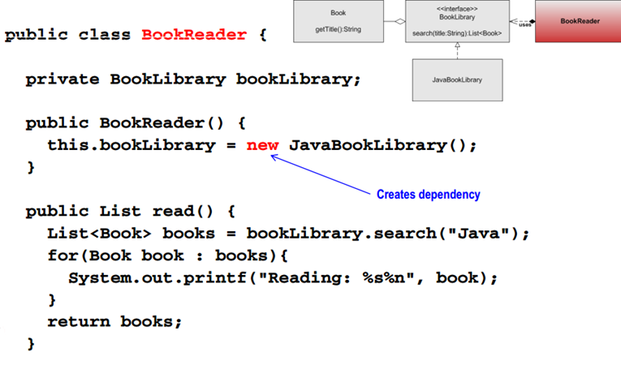
Dependency injection candidates

Slide 36
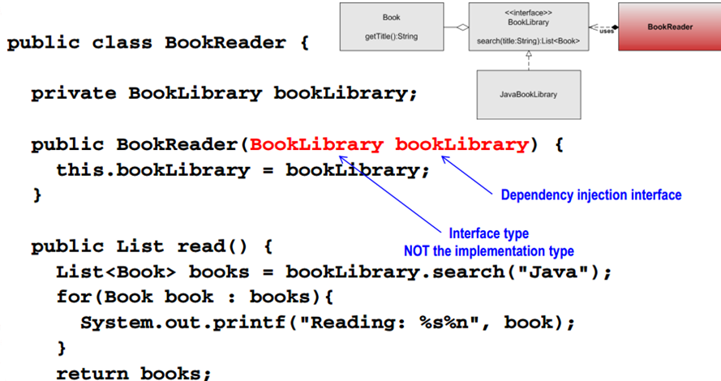
Dependency injection example

Slide 37
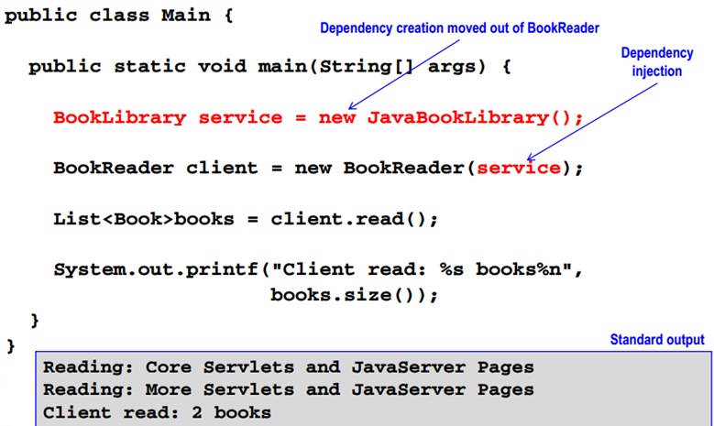
Example

Slide 38
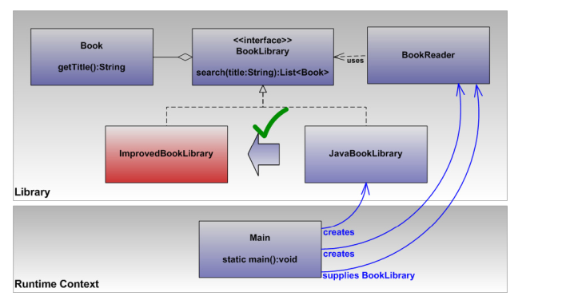
Model analysis
Dynamic implementation choices
Object model can be reconfigured
Future implementation types can used without modifying and rebuilding bookreader

Slide 39
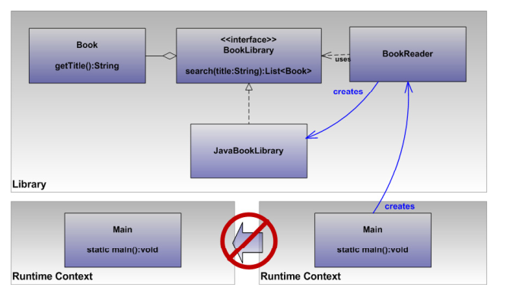
Model analysis
Hard-coded model configuration
Object model is not portable

Slide 40
Inversion control

Slide 41
Introduction
Inversion of control
Separate program control responsibilities
Object instantiation
Dependency injection
Dependency injection is type of ioc

Slide 42
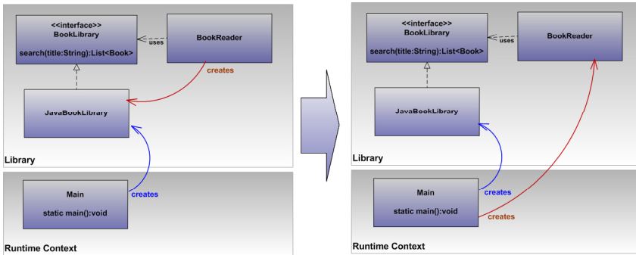
Inversion control of example
Previously use ioc
Dependency injection example demonstrated inversion of control
Moved java book library selection and initiations out of bookreader to main

Slide 43
Ioc framework
Service provider or plugin framework
Interface
Providers
Registration system
Access api
Process
Framework uses supplied api
Framework handles dependencies injection
Runtime context uses framework

Slide 44
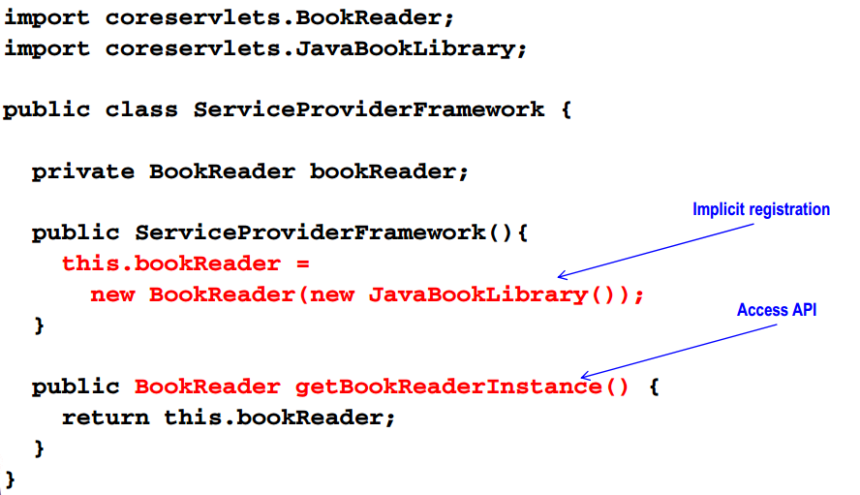
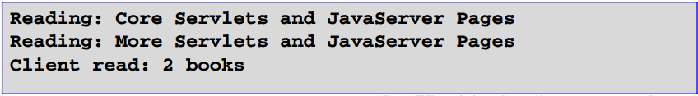
Ioc framework example

Slide 45
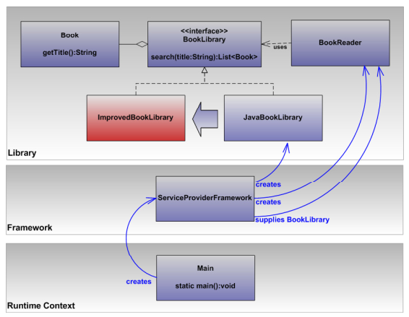
Model analysis
Dynamic implementation choices
Portable model configuration

Slide 46
Summary
Develop pojos
Avoid framework dependencies
Capture business logic
Avoid implementation commitments by using inversion of control and dependency injection patterns
Create a new xml file, applicationcontext.xml, based on spring-beans.xsd
Place applicationcontext.xml in the class path
Register pojos
Declare pojos using xml bean elements
Use bean attributes id and classes for specifying the name and the type

Slide 47
Summary
Instantiate a spring ioc container
Use the ApplicationContext/BeanFactory implementation
Classpathxmlapplicationcontext for integration with configuration files located in the classpath
Access the spring ioc container
Retrieve objects from the spring ioc container using the bean access methods
For exemple , beanfactory#getbean:object
Specifying the object name for the method parameters
context.getBean(“bookLibrary);
beanFactory.getBean(“bookLibrary”);

