Slide 1
Managing and Monitoring Spring Integration

Slide 2
Spring integration
Spring integration architecture
Enterprise integration patterns
Able to use AOP/Inversion of control
Integration via spring gateway

Slide 3
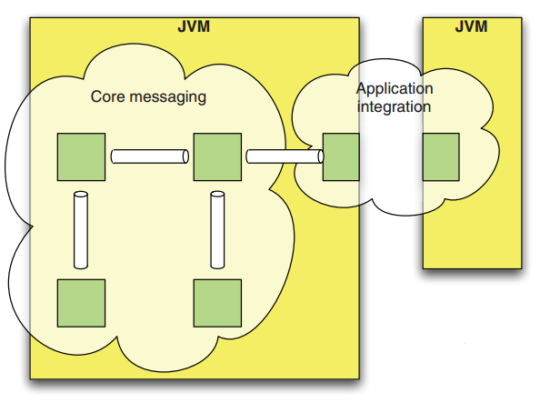
Spring integration
Enterprise integration patterns
Integration with external systems using declarative adapters
Adapter-based platform supports flexible integration across the enterprise
Inter-application and intra-application integration

Slide 4
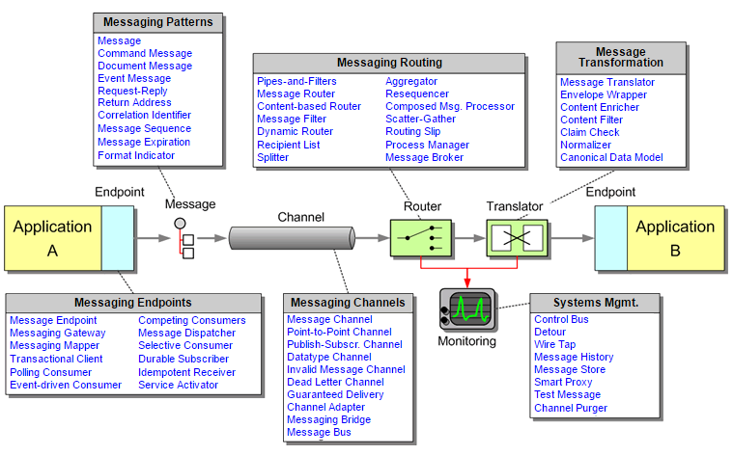
Integration types
Business to Business (B2B)
Inter Application integration (EAI)
Intra Application Integration

Slide 5
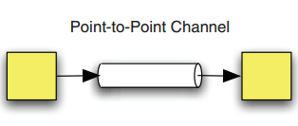
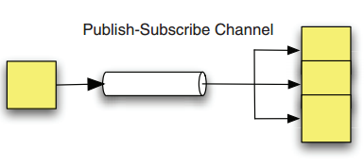
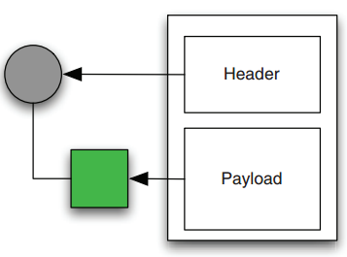
Enterprise integration patterns
Channels
Payload

Slide 6
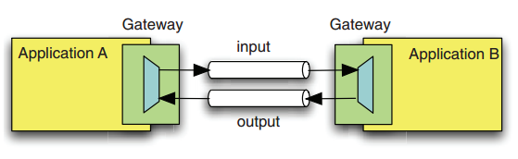
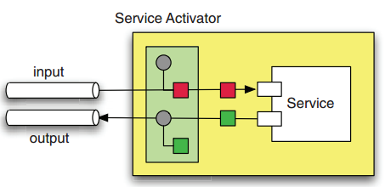
Endpoints
Messaging Gateway
Service Activator

Slide 7
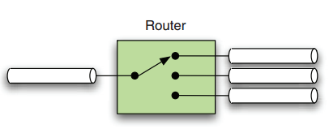
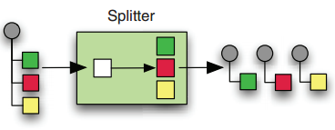
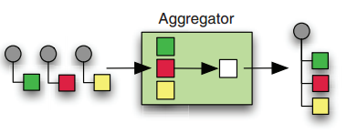
Enterprise integration patterns
Router
Splitter
Aggregator

Slide 8
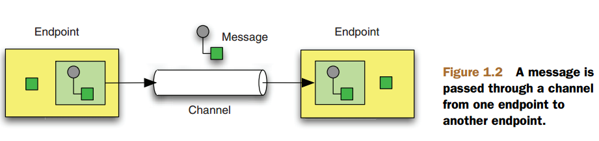
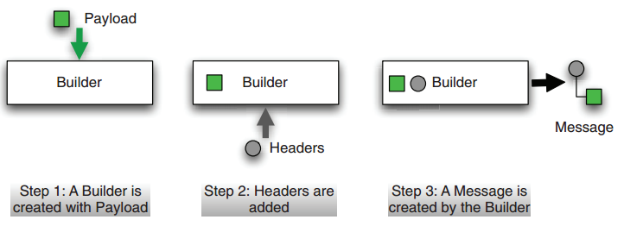
Enterprise integration patterns
Enterprise integration patterns

Slide 9
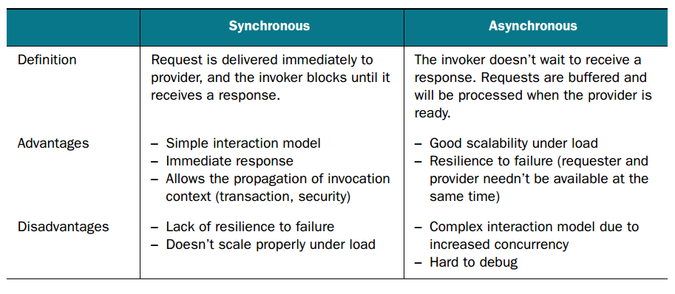
Communication Mode

Slide 10
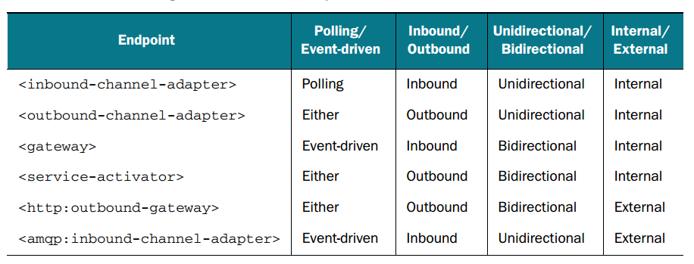
Communication Mode

Slide 11
Summary
Spring integration architecture
Enterprise integration patterns
Able to use AOP/Inversion of control
Integration via spring gateway
Communication Mode

