Slide 1
Managing and Monitoring Spring Integration

Slide 2
Spring integration
Filter controller
Index processing
Routing and filtering
APIs for routing and filtering

Slide 3
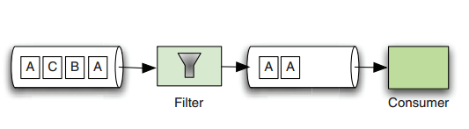
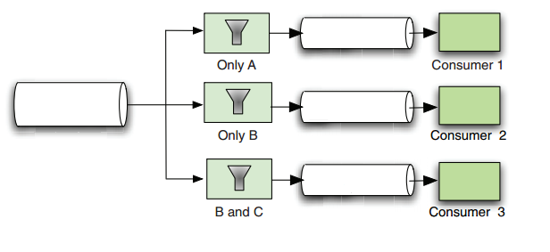
Filter
Consumer isn’t interested in all packets
Enable the selective consumption of packets, a special type of message handler is Filter
Filter evaluates packets without transforming them and return output channel only packets ruled a given policy
A
C
B
B
A

Slide 4
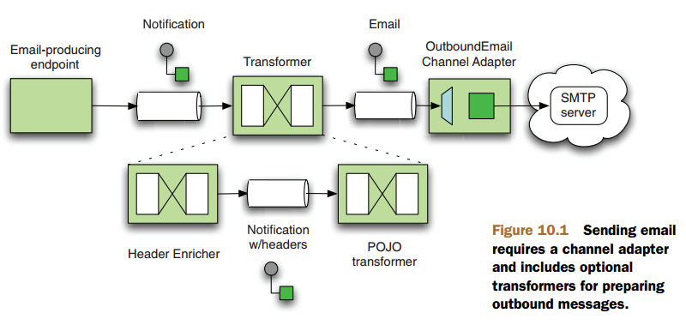
Email-based integration

Slide 5
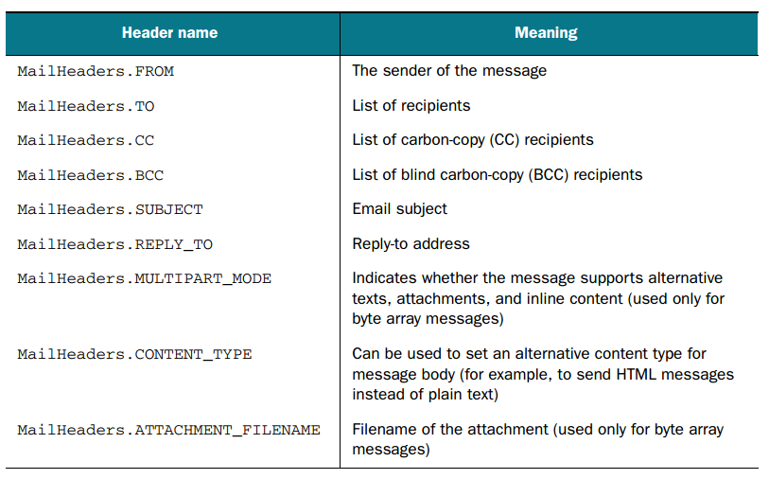
Email-based integration

Slide 6
Email-based integration
End Points (Process)
Channels
Messages

Slide 7
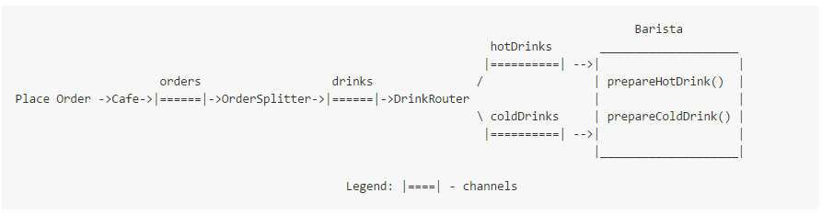
Coffee shop example

Slide 8
