Slide 1
Managing and Monitoring
Spring Security

Slide 2
Spring Security
What is Spring Security
Authentication
Authorization
Form security
Custom form security

Slide 3
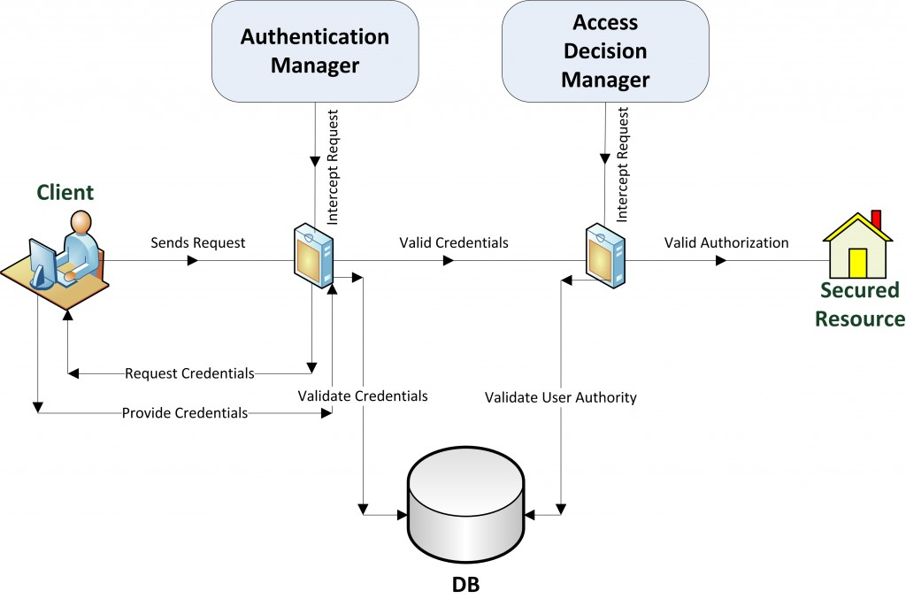
What is Spring Security
Spring Security provides comprehensive security services for Java EE-based enterprise software applications
Spring + Authentication + Authorization

Slide 4
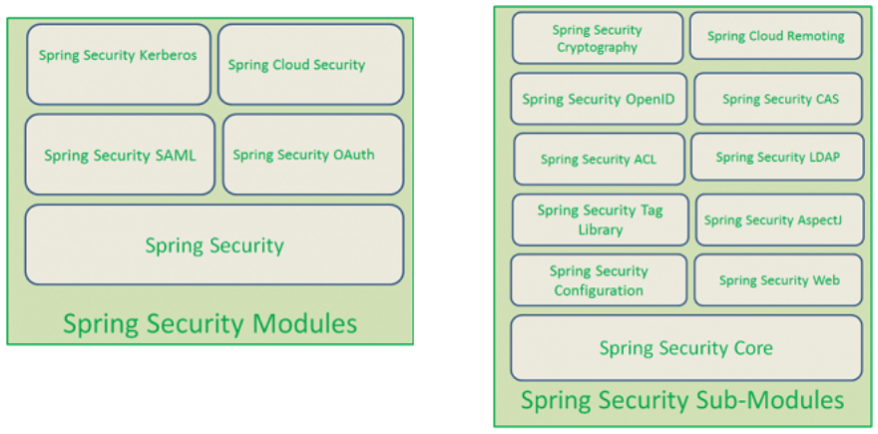
What is Spring Security

Slide 5
Filter

Slide 6
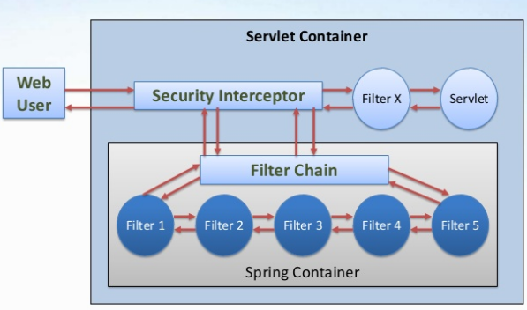
Filter

Slide 7
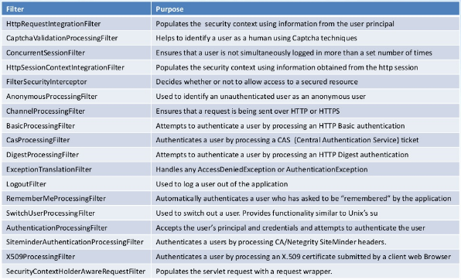
Filter

Slide 8
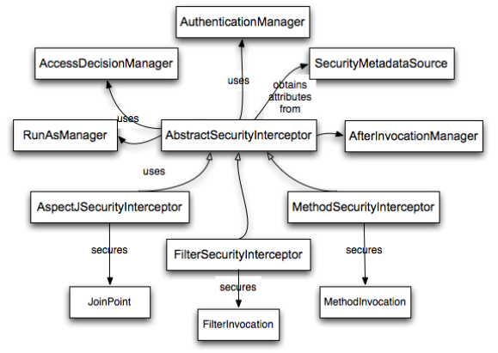
Interceptor

Slide 9
Authentication

Slide 10
Authentication
one of the two key security concepts that you must internalize when developing secure applications (the other being authorization).
Authentication identifies who is attempting to request a resource. You may be familiar with authentication in your daily online and ofﬂine life, in very different contexts:

Slide 11
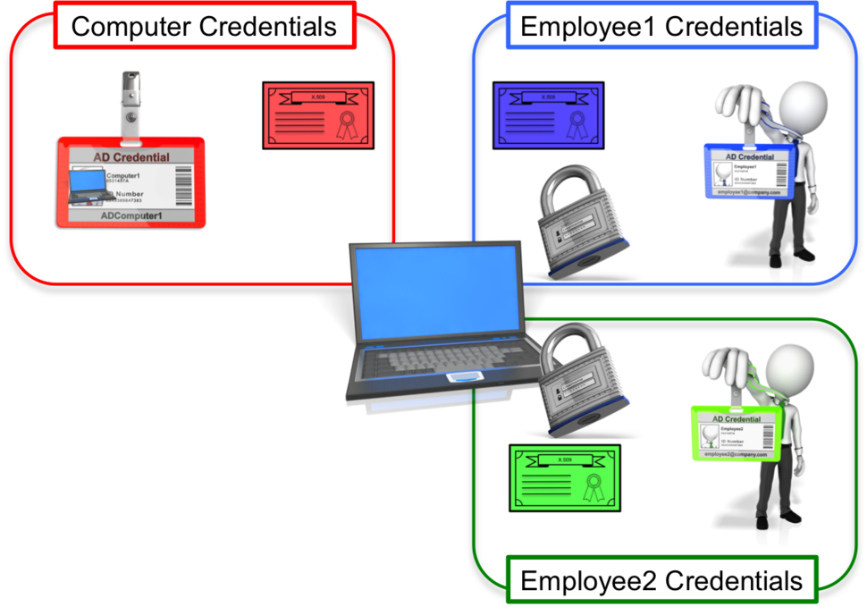

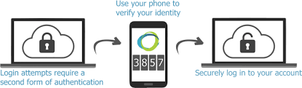
Authentication
Credential-based authentication
Hardware authentication
Two-factor authentication

Slide 12
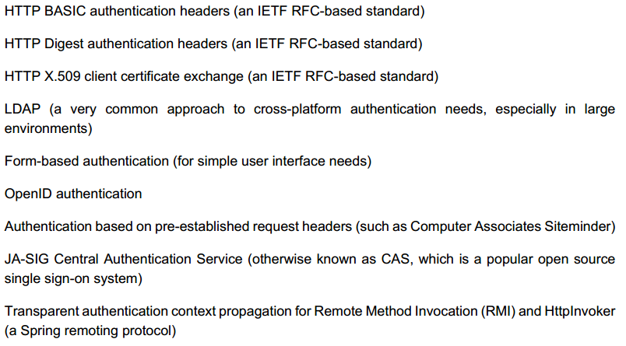
Technologies

Slide 13
Authorization

Slide 14

Authorization
uses the information that was validated during authentication to determine if access should be granted to a particular resource
Authorization uses the information that was validated during authentication to determine if access should be granted to a particular resource.

Slide 15
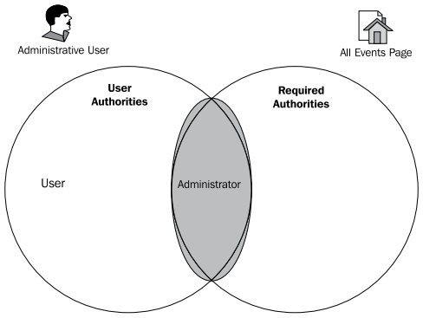
Authorization
If we think about how a decision might be made when a site administrator attempts to access the protected resource, we'd imagine that the examination of actual authority versus required authority might be expressed concisely in terms of the set theory. We might then choose to represent this decision as a Venn diagram for the administrative user:

Slide 16
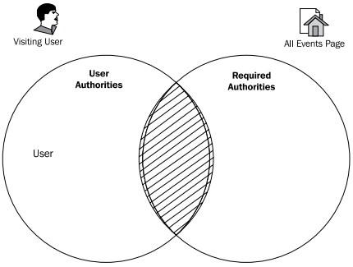
Authorization
The sets of authorities are disjoint, and have no common elements. So, the user is denied access to the page. Thus, we have demonstrated the basic principle of authorization of access to resources.

Slide 17
Security form

Slide 18
Security form
<filter>
<filter-name>springSecurityFilterChain</filter-name>
<filter-class> org.springframework.web.filter.DelegatingFilterProxy </filter-class>
</filter>
<filter-mapping>
<filter-name>springSecurityFilterChain</filter-name>
<url-pattern>/*</url-pattern>
</filter-mapping>

Slide 19
Security form
@Configuration
@EnableWebMvcSecurity
public class WebSecurityConfig
extends WebSecurityConfigurerAdapter {
...
}

Slide 20
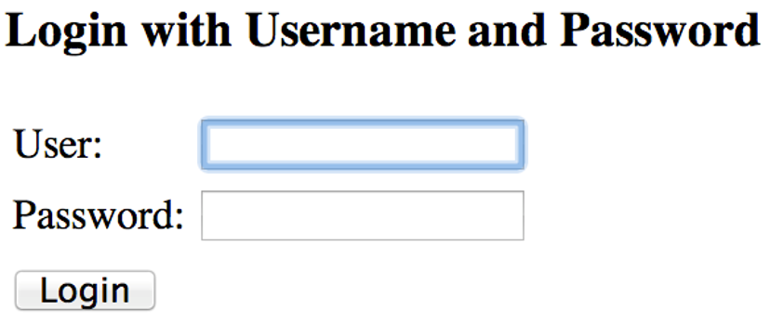
Security form

Slide 21
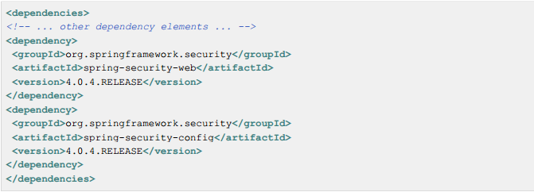
Security form
The first step is to create our Spring Security Java Configuration. The configuration creates a Servlet Filter known as the springSecurityFilterChain

Slide 22
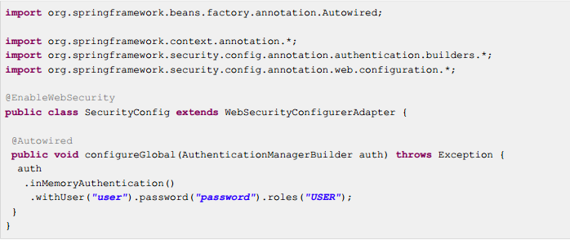
Web security configuration

Slide 23
Security configuration
@Configuration
@EnableWebMvcSecurity
public class WebSecurityConfig
extends WebSecurityConfigurerAdapter {
...
}

Slide 24
Security configuration
@Autowired public void configureGlobal( AuthenticationManagerBuilder auth) throws Exception {
auth
.inMemoryAuthentication() .withUser("admin”) .password("password”) .roles("ADMIN","USER") .and() .withUser("user") .password("password") .roles("USER");
}

Slide 25
Active form
@Override protected void configure(HttpSecurity http) throws Exception {
http .authorizeRequests() .anyRequest().authenticated() .and() .formLogin().and() .httpBasic();
}

Slide 26
Active form
http .authorizeRequests() .anyRequest().authenticated() .and() .formLogin().and() .httpBasic();
<http use-expressions="true">
<intercept-url pattern="/**" access="authenticated"/>
<form-login />
<http-basic />
</http>

Slide 27
Java configuration
http
.authorizeRequests() .anyRequest().authenticated() .and() .formLogin() .loginPage("/login”) .permitAll() .and() .logout() .permitAll();

Slide 28
Security configuration
http
.authorizeRequests() .antMatchers("/resources/**”).permitAll() .anyRequest().authenticated() .and() .formLogin() .loginPage("/login”) .permitAll() .and() .logout() .permitAll();

Slide 29
Custom form security

Slide 30
Custom authentication
public interface UserDetailsService {
UserDetails loadUserByUsername(String username) throws UsernameNotFoundException;
}

Slide 31
Custom authentication
public interface UserDetails extends Serializable {
Collection<? extends GrantedAuthority> getAuthorities();
String getPassword();
String getUsername();
boolean isAccountNonExpired();
boolean isAccountNonLocked();
boolean isCredentialsNonExpired();
boolean isEnabled();
}

Slide 32
Custom authentication
@Entity
public class User implements Serializable {
@Id @GeneratedValue(strategy = GenerationType.AUTO) private Long id;
private String firstName;
private String lastName;
private String email;
private String password;
...
}

Slide 33
Custom authentication
pubic class CustomUserDetails extends User implements UserDetails {
public CustomUserDetails(User u) { super(user); }
public Collection getAuthorities() { return AuthorityUtils.createAuthorityList("ROLE_USER"); }
public String getUsername() { return getEmail(); }
public boolean isEnabled() { return true; }
...

Slide 34
Custom authentication
public UserDetails loadUserByUsername(String username) throws UsernameNotFoundException {
User user = userRepository.findByEmail(username); if(user == null) { throw new UsernameNotFoundException(…); }
return new CustomUserDetails(user);
}
...

Slide 35
Custom authentication
@Autowired public void configureGlobal( AuthenticationManagerBuilder auth, UserDetailsService userDetailsService) throws Exception {
auth .userDetailsService(userDetailsService);
}

Slide 36
Custom authentication
@RequestMapping(method=RequestMethod.GET) public ModelAndView list() { SecurityContext ctx = SecurityContextHolder.getContext();
Authentication authentication = ctx.getAuthentication();
User custom = authentication == null ? null : (User) authentication.getPrincipal();
...
}

Slide 37
Custom authentication
@RequestMapping(method=RequestMethod.GET) public ModelAndView list(Authentication authentication) { User custom = authentication == null ? null : (User) authentication.getPrincipal();
...
}

Slide 38
Custom authentication
@RequestMapping(method=RequestMethod.GET) public ModelAndView list( @AuthenticationPrincipal User currentUser) {
...
}

Slide 39
Summary
What is Spring Security
Authentication
Authorization
Form security
Custom form security

