Slide 1
Managing and Monitoring
Spring Security

Slide 2
Outline
Software Design
Security OAuth
CSRF Protection

Slide 3
Software Design
Design of ecommerce
Remote Engine
Core Engine

Slide 4
Software Design
Oauth Standard for authorization in Microsoft, Services
Dependency Injection
Spring security OAuth
Hibernate ORM Flexible
Angular JS
REST/JSON
Maven automation
CDN Platform

Slide 5
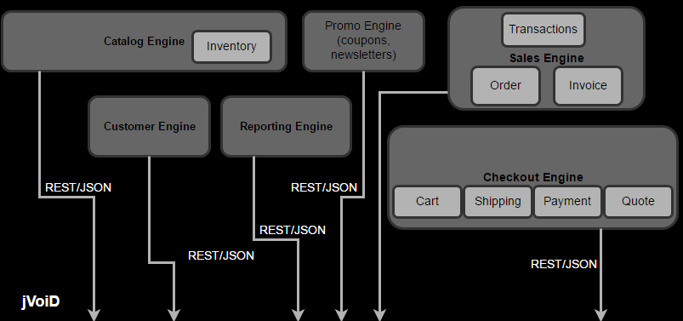
Remote Engine

Slide 6
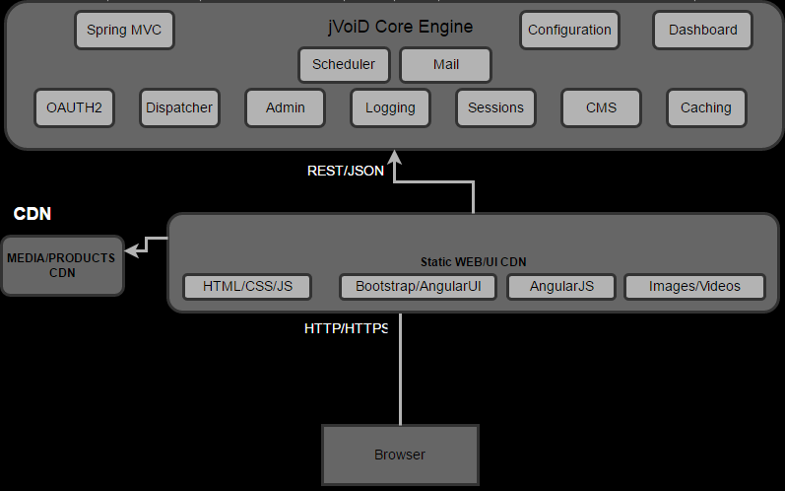
Core Engine

Slide 7
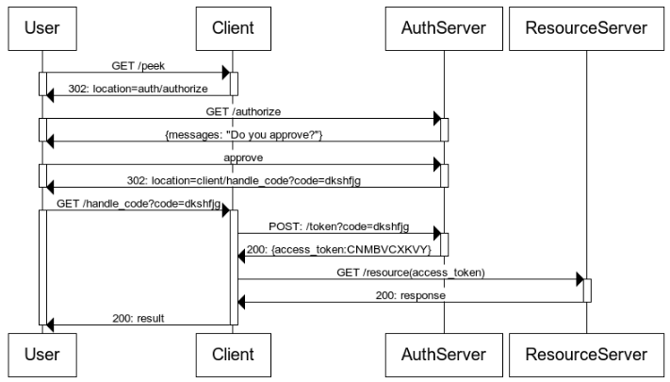
Oauth

Slide 8
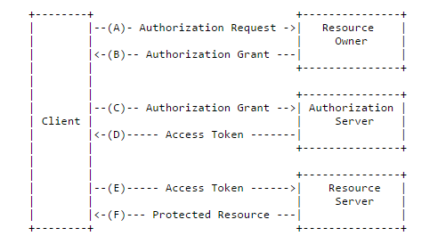
Oauth

Slide 9
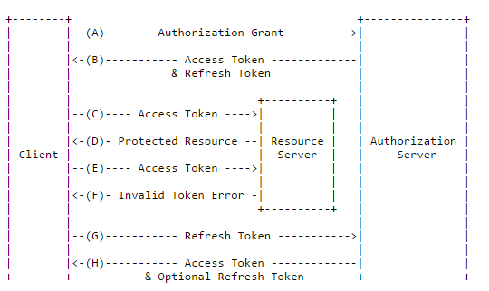
Oauth

Slide 10
CSRF Protection

Slide 11
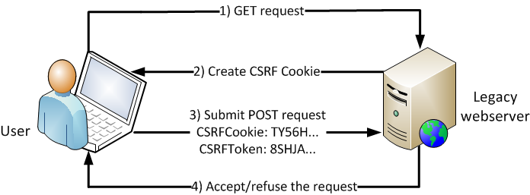
CSRF Protection

Slide 12
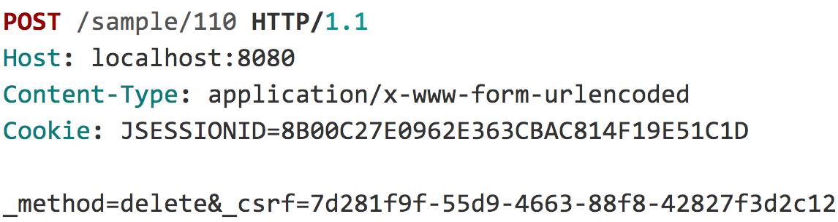
CSRF Protection

Slide 13
CSRF Protection

Slide 14
CSRF Protection
<form ... method="post" enctype="text/plain">
<input type='hidden'
name=’{"summary":"Hi", … "ignore_me":"' value='test"}' />
</form>

Slide 15
CSRF Protection
{ "summary": "Hi",
"message": "New Message",
"to": "luke@example.com",
"ignore_me": "=test"
}

Slide 16
CSRF Protection
<form ... method="post" enctype="text/plain">
<input type='hidden'
name=’{"summary":"Hi", … "ignore_me":"' value='test"}' />
</form>

Slide 17
CSRF Protection
<form ... method="post">
...
<input type="hidden"
name="${_csrf.parameterName}"
value="${_csrf.token}"/>
</form>

Slide 18
CSRF Protection
<form ... method="post">
...
<input type="hidden" name="_csrf" value="f81d4fae-…"/>
</form>

Slide 19
Summary
Software Design
Security OAuth
CSRF Protection

