Slide 1



Chapter 9: Subnetting IP Networks
Introduction to Networks
Instructor:
Nguyen Anh Minh
M.Sc CCNP TOGAF
Presentation_ID
© 2008 Cisco Systems, Inc. All rights reserved.
Cisco Confidential
<number>

Slide 2
Chapter 9
Introduction
Subnetting an IPv4 Network
Addressing Schemes
Design Considerations for IPv6
Summary
Presentation_ID
© 2008 Cisco Systems, Inc. All rights reserved.
Cisco Confidential
<number>

Slide 3
Chapter 9: Objectives
Upon completion of this chapter, you will be able to:
Explain why routing is necessary for hosts on different networks to
communicate.
Describe IP as a communication protocol used to identify a single device on a network.
Given a network and a subnet mask, calculate the number of host
addresses available.
Calculate the necessary subnet mask in order to accommodate the requirements of a network.
Describe the benefits of variable length subnet masking (VLSM).
Explain how IPv6 address assignments are implemented in a business network.
Presentation_ID
© 2008 Cisco Systems, Inc. All rights reserved.
Cisco Confidential
<number>

Slide 4
9.1 Subnetting an IPv4 Network
Presentation_ID
© 2008 Cisco Systems, Inc. All rights reserved.
Cisco Confidential
<number>

Slide 5
Network Segmentation
Reasons for Subnetting
Subnetting is the process of segmenting a network into multiple smaller network spaces called subnetworks or subnets.
Large networks must be segmented into smaller subnetworks,
creating smaller groups of devices and services to:
Control traffic by containing broadcast traffic within each subnetwork.
Reduce overall network traffic and improve network performance.
Communication Between Subnets
A router is necessary for devices on different networks and subnets to communicate.
Each router interface must have an IPv4 host address that belongs to the network or subnet that the router interface is connected.
Devices on a network and subnet use the router interface attached to their LAN as their default gateway.
Presentation_ID
© 2008 Cisco Systems, Inc. All rights reserved.
Cisco Confidential
<number>

Slide 6
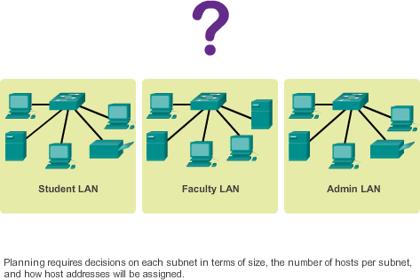
IP Subnetting is FUNdamental
The Plan
Planning the Network
Presentation_ID
© 2008 Cisco Systems, Inc. All rights reserved.
Cisco Confidential
<number>

Slide 7
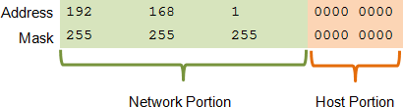
Subnetting an IPv4 Network
Basic Subnetting
Borrowing Bits to Create Subnets
Borrowing 1 bit 2¹ = 2 subnets
Borrowing 1 Bit from the host portion creates 2 subnets with the same subnet mask
Subnet 0
Network 192.168.1.0-127/25 Mask: 255.255.255.128
Subnet 1
Network 192.168.1.128-255/25 Mask: 255.255.255.128
Presentation_ID
© 2008 Cisco Systems, Inc. All rights reserved.
Cisco Confidential
<number>

Slide 8
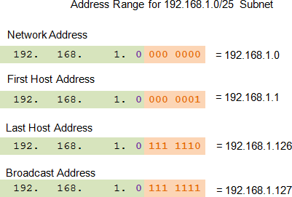
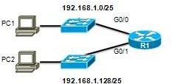
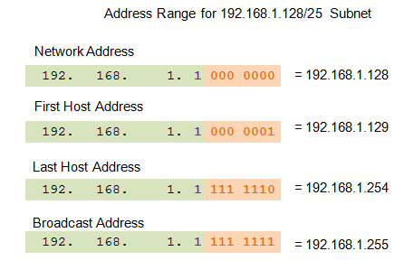
Subnetting an IPv4 Network
Subnets in Use
Subnets in Use
Subnet 0
Network 192.168.1.0-127/25
Subnet 1
Network 192.168.1.128-255/25
Presentation_ID
© 2008 Cisco Systems, Inc. All rights reserved.
Cisco Confidential
<number>

Slide 9
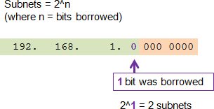


Subnetting an IPv4 Network
Subnetting Formulas
Calculate number of subnets
Calculate number of hosts
Presentation_ID
© 2008 Cisco Systems, Inc. All rights reserved.
Cisco Confidential
<number>

Slide 10
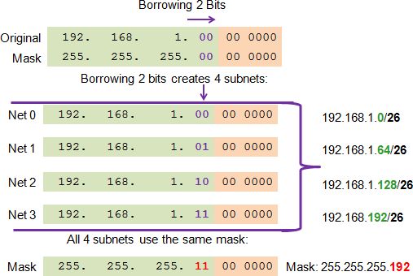
Subnetting an IPv4 Network
Creating 4 Subnets
Borrowing 2 bits to create 4 subnets. 2² = 4 subnets
Creating 4 Subnets
Presentation_ID
© 2008 Cisco Systems, Inc. All rights reserved.
Cisco Confidential
<number>

Slide 11
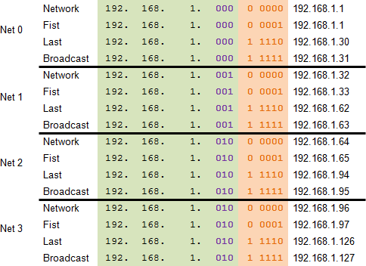
Subnetting an IPv4 Network
Creating Eight Subnets
Borrowing 3 bits to Create 8 Subnets. 2³ = 8 subnets
Presentation_ID
© 2008 Cisco Systems, Inc. All rights reserved.
Cisco Confidential
<number>

Slide 12
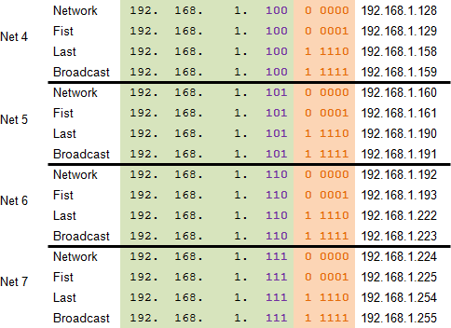
Subnetting an IPv4 Network
Creating Eight Subnets (Cont.)
Presentation_ID
© 2008 Cisco Systems, Inc. All rights reserved.
Cisco Confidential
<number>

Slide 13
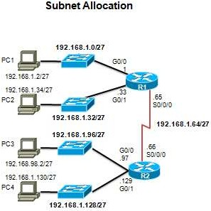
Subnetting an IPv4 Network
Creating Eight Subnets (Cont.)
Presentation_ID
© 2008 Cisco Systems, Inc. All rights reserved.
Cisco Confidential
<number>

Slide 14
Determining the Subnet Mask
Subnetting Based on Host Requirements
Two considerations when planning subnets:
Number of subnets required
Number of host addresses required
Formula to determine number of usable hosts: 2^n-2
2^n (where n is the number of remaining host bits) is used to calculate the number of hosts.
-2 (The subnetwork ID and broadcast address cannot be used on each subnet.)
Presentation_ID
© 2008 Cisco Systems, Inc. All rights reserved.
Cisco Confidential
<number>

Slide 15

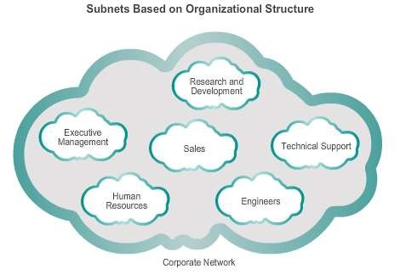
Determining the Subnet Mask
Subnetting Network-Based Requirements
Calculate the
number of subnets:
2^n (where n is the number of bits borrowed)
Subnet needed for
each department.
Presentation_ID
© 2008 Cisco Systems, Inc. All rights reserved.
Cisco Confidential
<number>

Slide 16

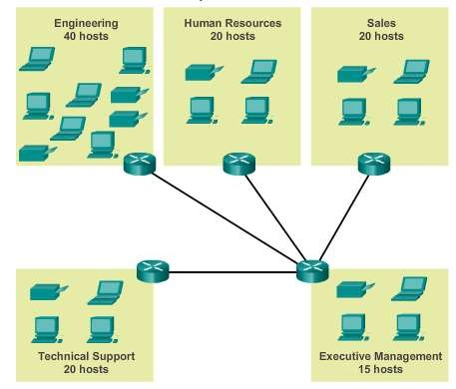
Determining the Subnet Mask
Subnetting To Meet Network Requirements
Balance the required number of subnets and hosts for the largest subnet.
Design the addressing scheme to accommodate the maximum number of hosts for each subnet.
Allow for growth in
each subnet.
Presentation_ID
© 2008 Cisco Systems, Inc. All rights reserved.
Cisco Confidential
<number>

Slide 17
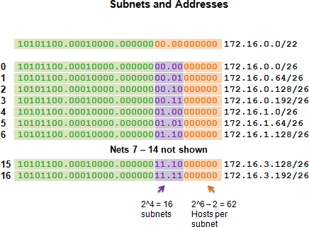
Determining the Subnet Mask
Subnetting To Meet Network Requirements
Presentation_ID
© 2008 Cisco Systems, Inc. All rights reserved.
Cisco Confidential
<number>

Slide 18

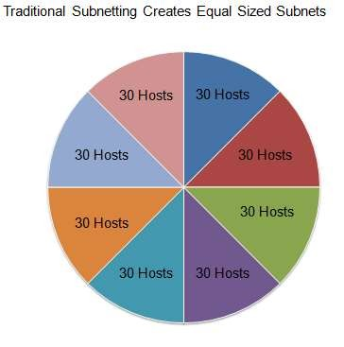
Benefits of Variable Length Subnet Masking
Traditional Subnetting Wastes Addresses
Traditional subnetting – Uses the same number of addresses is allocated for each subnet.
Subnets that require fewer addresses have unused (wasted) addresses; for example, WAN links only need two addresses.
Presentation_ID
© 2008 Cisco Systems, Inc. All rights reserved.
Cisco Confidential
<number>

Slide 19

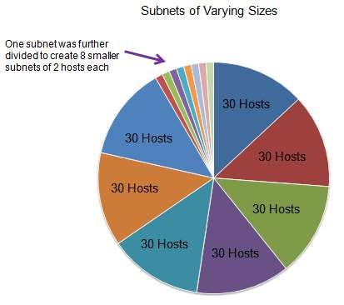
Benefits of Variable Length Subnet Masking
Variable Length Subnet Masks (VLSM)
The variable-length subnet mask (VLSM) or subnetting a subnet provides more efficient use of addresses.
VLSM allows a network space to be divided in unequal parts.
Subnet mask varies, depending on how many bits have been borrowed for a particular subnet.
Network is first subnetted, and then the subnets are resubnetted.
Presentation_ID
© 2008 Cisco Systems, Inc. All rights reserved.
Cisco Confidential
<number>

Slide 20
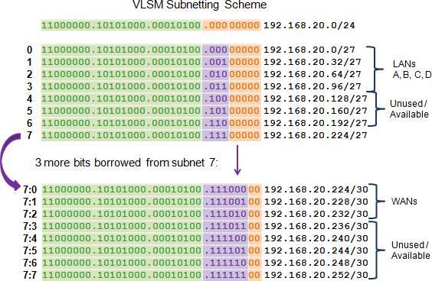
Benefits of Variable Length Subnet Masking
Basic VLSM
Presentation_ID
© 2008 Cisco Systems, Inc. All rights reserved.
Cisco Confidential
<number>

Slide 21
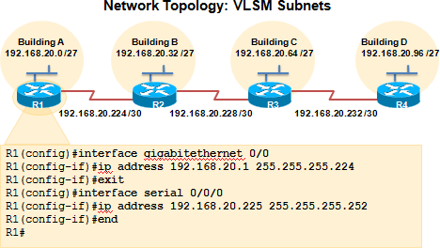
Benefits of Variable Length Subnet Masking
VLSM in Practice
Using VLSM subnets, the LAN and WAN segments in example below can be addressed with minimum waste.
Each LANs will be assigned a subnet with /27 mask.
Each WAN link will be assigned a subnet with /30 mask.
Presentation_ID
© 2008 Cisco Systems, Inc. All rights reserved.
Cisco Confidential
<number>

Slide 22
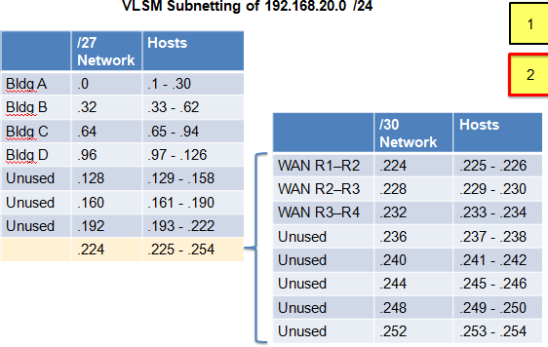
Benefits of Variable Length Subnet Masking
VLSM Chart
Presentation_ID
© 2008 Cisco Systems, Inc. All rights reserved.
Cisco Confidential
<number>

Slide 23
9.2 Addressing Schemes
Presentation_ID
© 2008 Cisco Systems, Inc. All rights reserved.
Cisco Confidential
<number>

Slide 24
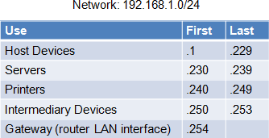
Structured Design
Planning to Address the Network
Allocation of network addresses should be planned and documented for the purposes of:
Preventing duplication of addresses
Providing and controlling access
Monitoring security and performance
Client addresses – Usually dynamically assigned using the Dynamic
Host Configuration Protocol (DHCP).
Sample Network Addressing Plan
Presentation_ID
© 2008 Cisco Systems, Inc. All rights reserved.
Cisco Confidential
<number>

Slide 25
9.3 Design Considerations for IPv6
Presentation_ID
© 2008 Cisco Systems, Inc. All rights reserved.
Cisco Confidential
<number>

Slide 26
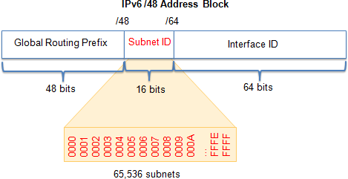
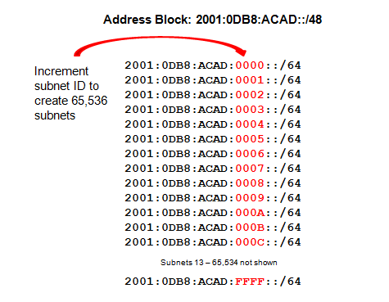
Subnetting an IPv6 Network
Subnetting Using the Subnet ID
An IPv6 Network Space is subnetted to support hierarchical, logical design of the network
Presentation_ID
© 2008 Cisco Systems, Inc. All rights reserved.
Cisco Confidential
<number>

Slide 27
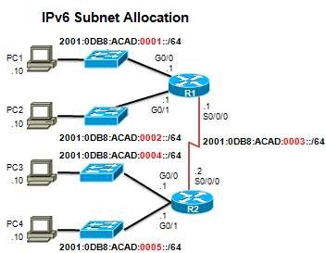
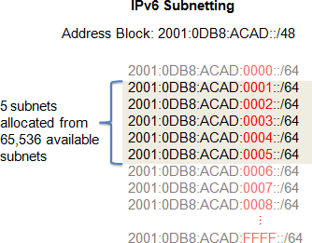
Subnetting an IPv6 Network
IPV6 Subnet Allocation
Presentation_ID
© 2008 Cisco Systems, Inc. All rights reserved.
Cisco Confidential
<number>

Slide 28
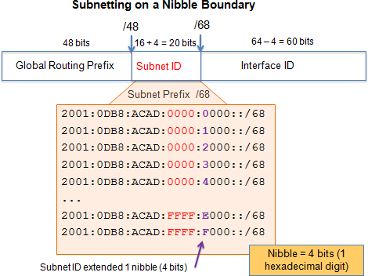
Subnetting an IPv6 Network
Subnetting into the Interface ID
IPv6 bits can be borrowed from the interface ID to create additional IPv6 subnets.
Presentation_ID
© 2008 Cisco Systems, Inc. All rights reserved.
Cisco Confidential
<number>

Slide 29
9.3 Summary
Presentation_ID
© 2008 Cisco Systems, Inc. All rights reserved.
Cisco Confidential
<number>

Slide 30
Chapter 9: Summary
In this chapter, you learned that:
Subnetting is the process of segmenting a network, by dividing it into
multiple smaller network spaces.
Subnetting a subnet, or using VLSM, was designed to avoid wasting addresses.
IPv6 address space is subnetted to support the hierarchical, logical
design of the network.
Size, location, use, and access requirements are all considerations in the address planning process.
IP networks must be tested to verify connectivity and operational
performance.
Presentation_ID
© 2008 Cisco Systems, Inc. All rights reserved.
Cisco Confidential
<number>

Slide 31
Presentation_ID
© 2008 Cisco Systems, Inc. All rights reserved.
Cisco Confidential
<number>

