Slide 1
Chapter 1:
Exploring the Network
Introduction to Networks
Instructor:
Nguyen Anh Minh
M.Sc CCNP TOGAF
Presentation_ID
© 2008 Cisco Systems, Inc. All rights reserved.
Cisco Confidential
<number>

Slide 2
Chapter 1: Objectives
After completing this chapter, students will be able to:
Explain how multiple networks are used in everyday life.
Explain the topologies and devices used in a small- to medium- sized business network.
Explain the basic characteristics of a network that supports
communication in a small- to medium-sized business.
Explain trends in networking that will affect the use of networks in small to medium-sized businesses.
Presentation_ID
© 2008 Cisco Systems, Inc. All rights reserved.
Cisco Confidential
<number>

Slide 3
Chapter 1
Globally Connected
LANs, WANs, and the Internet
The Network as a Platform
The Changing Network Environment
Summary
Presentation_ID
© 2008 Cisco Systems, Inc. All rights reserved.
Cisco Confidential
<number>

Slide 4



1.1 Globally Connected
Presentation_ID
© 2008 Cisco Systems, Inc. All rights reserved.
Cisco Confidential
<number>

Slide 5
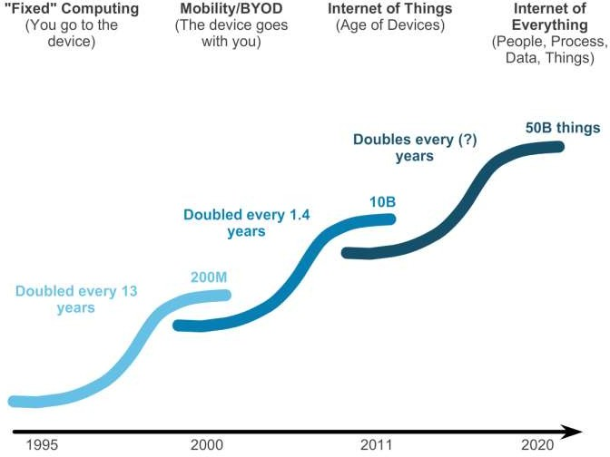
Networking Today
Networks in Our Past and Daily Lives
Presentation_ID
© 2008 Cisco Systems, Inc. All rights reserved.
Cisco Confidential
<number>

Slide 6
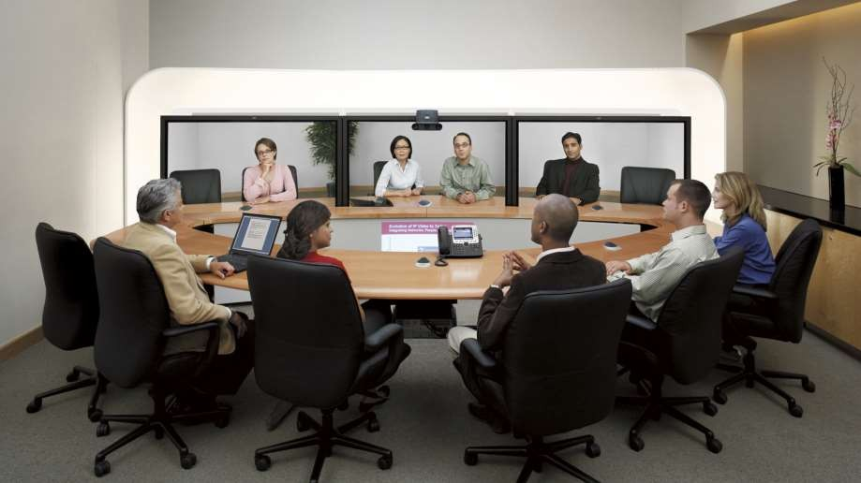
Networking Today
The Global Community
Presentation_ID
© 2008 Cisco Systems, Inc. All rights reserved.
Cisco Confidential
<number>

Slide 7
Interconnecting Our Lives
Networking Impacts in Our Daily Lives
Networks support the way we learn.
Networks support the way we communicate.
Networks support the way we work.
Networks support the way we play.
Presentation_ID
© 2008 Cisco Systems, Inc. All rights reserved.
Cisco Confidential
<number>

Slide 8
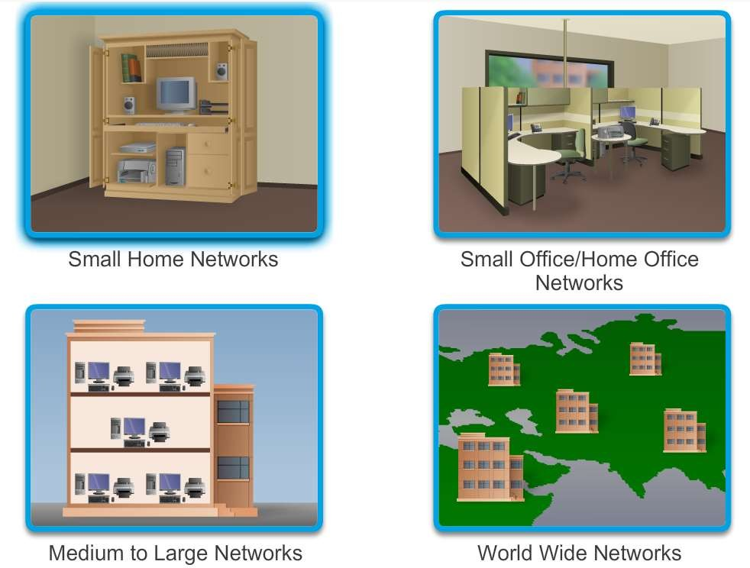
Providing Resources in a Network
Networks of Many Sizes
Presentation_ID
© 2008 Cisco Systems, Inc. All rights reserved.
Cisco Confidential
<number>

Slide 9
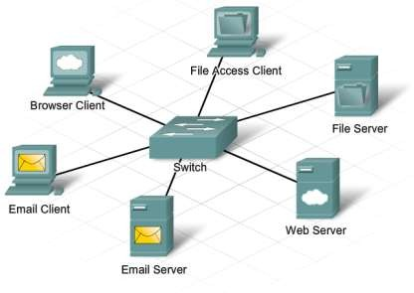
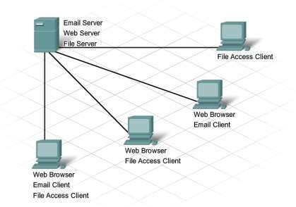
Providing Resources in a Network
Clients and Servers
Presentation_ID
© 2008 Cisco Systems, Inc. All rights reserved.
Cisco Confidential
<number>

Slide 10
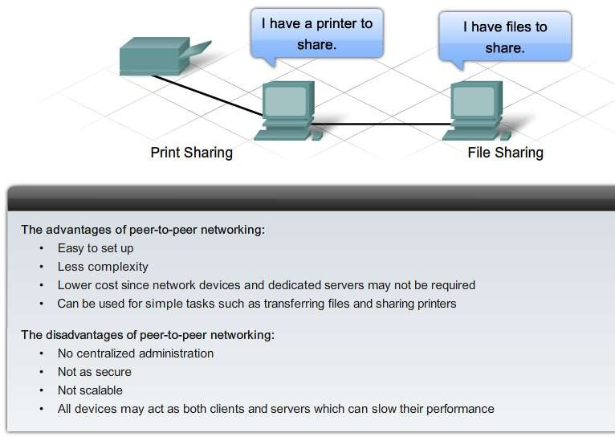
Providing Resources in a Network
Peer-to-Peer
Presentation_ID
© 2008 Cisco Systems, Inc. All rights reserved.
Cisco Confidential
<number>

Slide 11
1.2 LANs, WANs, and the Internet
Presentation_ID
© 2008 Cisco Systems, Inc. All rights reserved.
Cisco Confidential
<number>

Slide 12
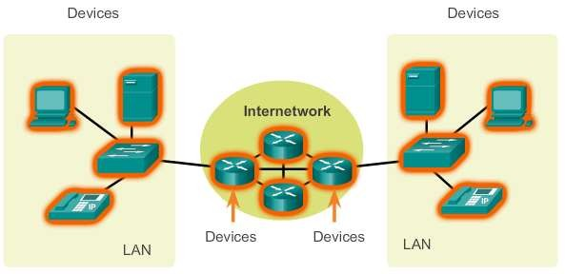
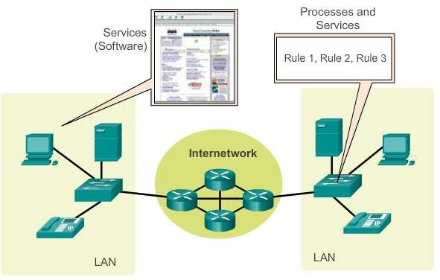
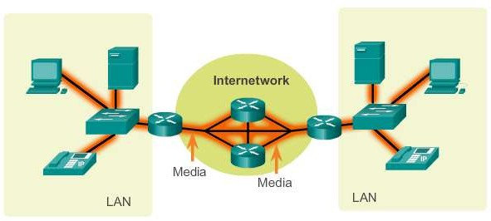
LANs, WANs, and Internets
Components of a Network
There are three categories of network components:
Devices
Media
Services
Presentation_ID
© 2008 Cisco Systems, Inc. All rights reserved.
Cisco Confidential
<number>

Slide 13
Components of a Network
End Devices
Some examples of end devices are:
Computers (work stations, laptops, file servers, web servers)
Network printers
VoIP phones
TelePresence endpoint
Security cameras
Mobile handheld devices (such as smart phones, tablets, PDAs, and
wireless debit / credit card readers and barcode scanners)
Presentation_ID
© 2008 Cisco Systems, Inc. All rights reserved.
Cisco Confidential
<number>

Slide 14
Components of a Network
Network Infrastructure Devices
Examples of intermediary network devices are:
Network Access Devices (switches, and wireless access points)
Internetworking Devices (routers)
Security Devices (firewalls)
Presentation_ID
© 2008 Cisco Systems, Inc. All rights reserved.
Cisco Confidential
<number>

Slide 15
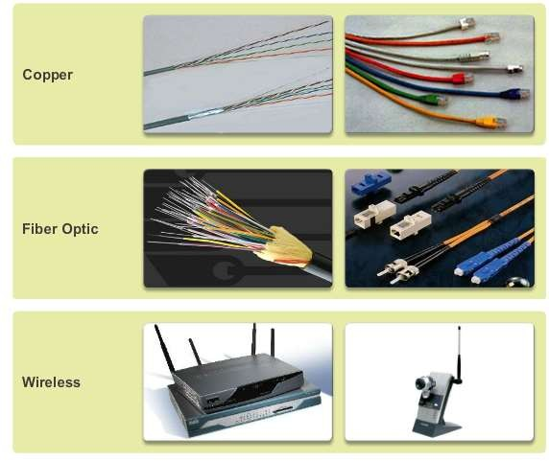
Components of a Network
Network Media
Presentation_ID
© 2008 Cisco Systems, Inc. All rights reserved.
Cisco Confidential
<number>

Slide 16
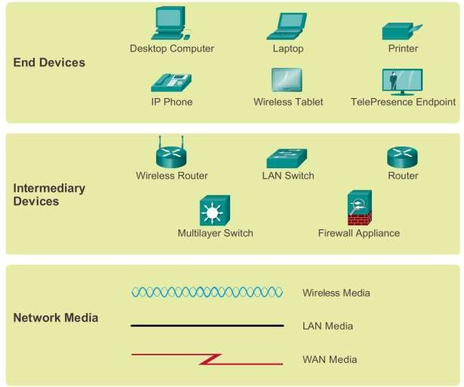
Components of a Network
Network Representations
Presentation_ID
© 2008 Cisco Systems, Inc. All rights reserved.
Cisco Confidential
<number>

Slide 17
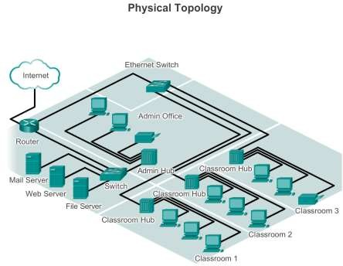
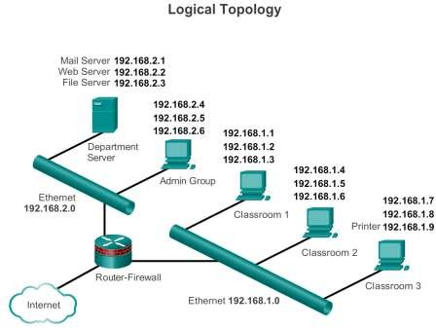
Components of a Network
Topology Diagrams
Presentation_ID
© 2008 Cisco Systems, Inc. All rights reserved.
Cisco Confidential
<number>

Slide 18
LANs and WANs
Types of Networks
The two most common types of network infrastructures are:
Local Area Network (LAN)
Wide Area Network (WAN).
Other types of networks include:
Metropolitan Area Network (MAN)
Wireless LAN (WLAN)
Storage Area Network (SAN)
Presentation_ID
© 2008 Cisco Systems, Inc. All rights reserved.
Cisco Confidential
<number>

Slide 19
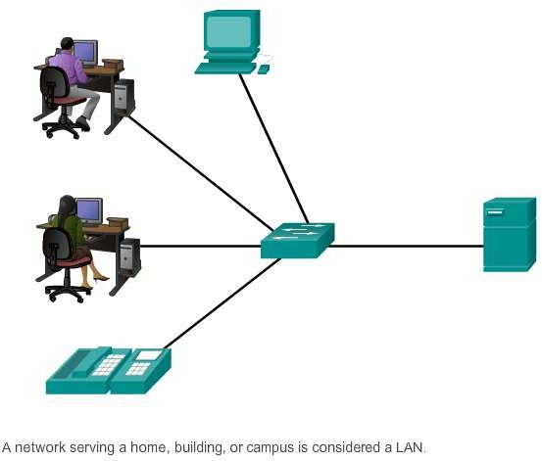
LANs and WANs
Local Area Networks (LAN)
Presentation_ID
© 2008 Cisco Systems, Inc. All rights reserved.
Cisco Confidential
<number>

Slide 20
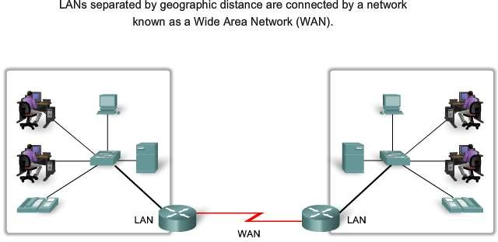
LANs and WANs
Wide Area Networks (WAN)
Presentation_ID
© 2008 Cisco Systems, Inc. All rights reserved.
Cisco Confidential
<number>

Slide 21
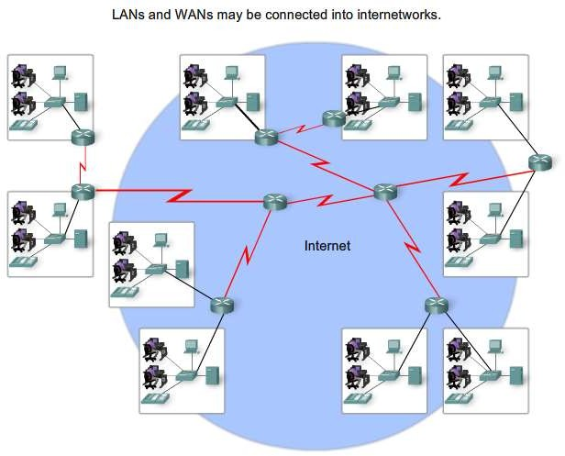
LANs, WANs, and the Internet
The Internet
Presentation_ID
© 2008 Cisco Systems, Inc. All rights reserved.
Cisco Confidential
<number>

Slide 22
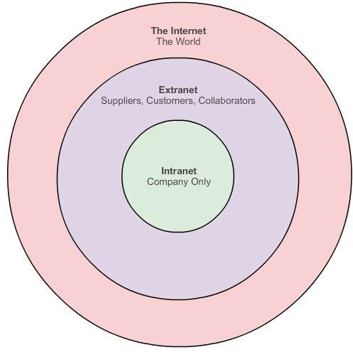
LANs, WANs, and the Internet
Intranet and Extranet
Presentation_ID
© 2008 Cisco Systems, Inc. All rights reserved.
Cisco Confidential
<number>

Slide 23
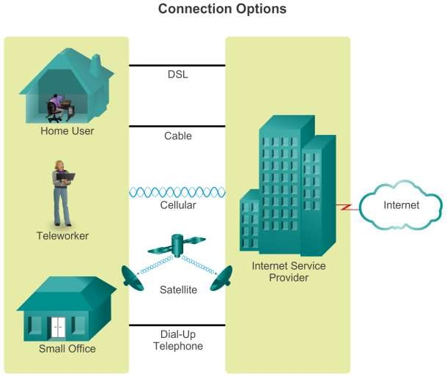
Connecting to the Internet
Connecting Remote Users to the Internet
Presentation_ID
© 2008 Cisco Systems, Inc. All rights reserved.
Cisco Confidential
<number>

Slide 24
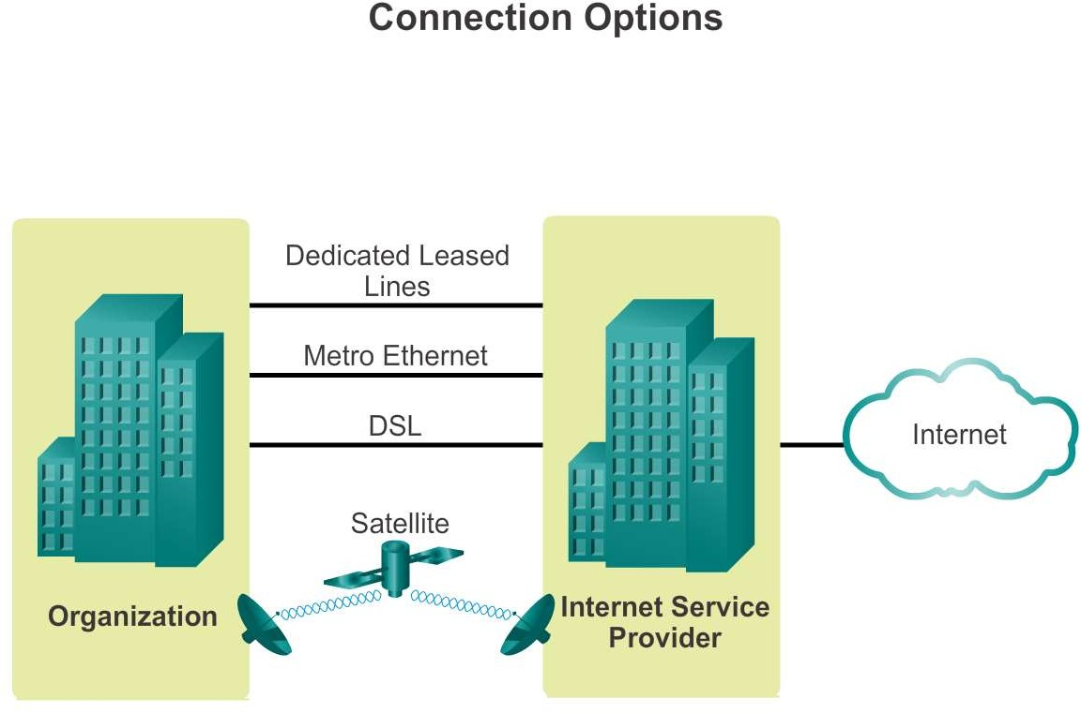
Connecting to the Internet
Connecting Businesses to the Internet
Presentation_ID
© 2008 Cisco Systems, Inc. All rights reserved.
Cisco Confidential
<number>

Slide 25
1.3 The Network as a Platform
Presentation_ID
© 2008 Cisco Systems, Inc. All rights reserved.
Cisco Confidential
<number>

Slide 26
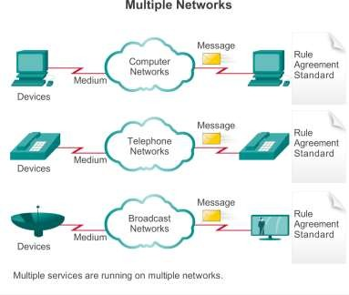
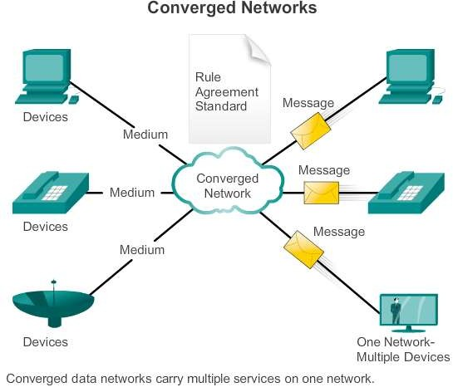
Converged Networks
The Converging Network
Presentation_ID
© 2008 Cisco Systems, Inc. All rights reserved.
Cisco Confidential
<number>

Slide 27
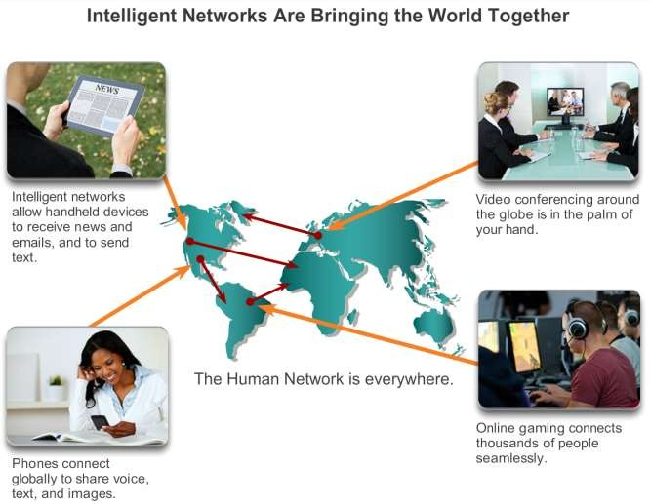
Converged Networks
Planning for the Future
Presentation_ID
© 2008 Cisco Systems, Inc. All rights reserved.
Cisco Confidential
<number>

Slide 28
Reliable Network
Supporting Network Architecture
As networks evolve, we are discovering that there are four basic characteristics that the underlying architectures need to address in order to meet user expectations:
Fault Tolerance
Scalability
Quality of Service (QoS)
Security
Presentation_ID
© 2008 Cisco Systems, Inc. All rights reserved.
Cisco Confidential
<number>

Slide 29
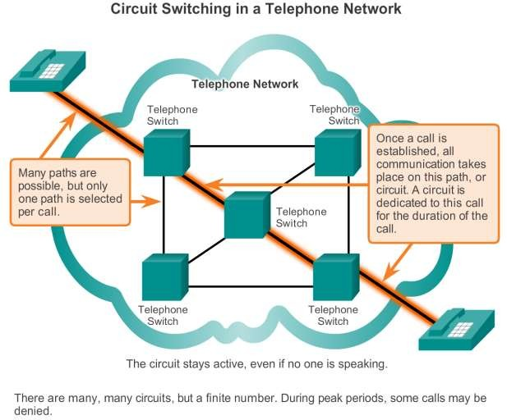
Reliable Network
Fault Tolerance in Circuit Switched Network
Presentation_ID
© 2008 Cisco Systems, Inc. All rights reserved.
Cisco Confidential
<number>

Slide 30
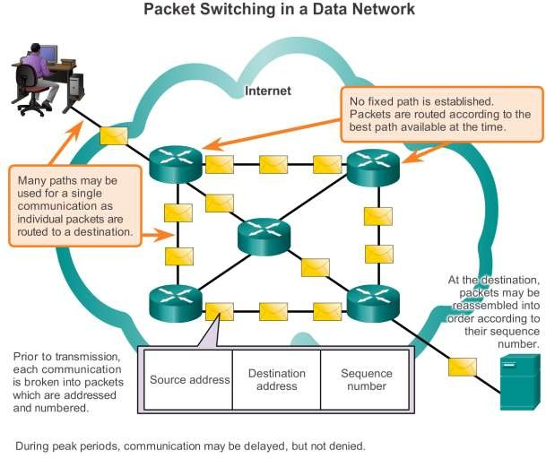
Reliable Network
Packet-Switched Networks
Presentation_ID
© 2008 Cisco Systems, Inc. All rights reserved.
Cisco Confidential
<number>

Slide 31

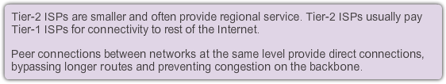
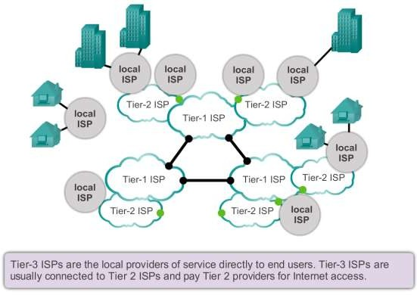
Reliable Network
Scalable Networks
Presentation_ID
© 2008 Cisco Systems, Inc. All rights reserved.
Cisco Confidential
<number>

Slide 32
Reliable Network
Providing QoS
Examples of priority decisions for an organization might include:
Time-sensitive communication - increase priority for services like telephony or video distribution.
Non time-sensitive communication - decrease priority for web page retrieval or email.
High importance to organization - increase priority for production control or business transaction data.
Undesirable communication - decrease priority or block unwanted activity,
like peer-to-peer file sharing or live entertainment.
Presentation_ID
© 2008 Cisco Systems, Inc. All rights reserved.
Cisco Confidential
<number>

Slide 33
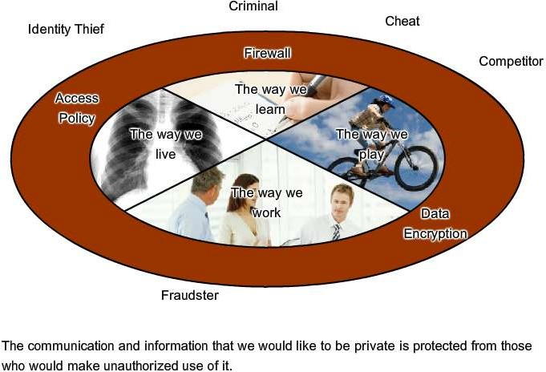
Reliable Network
Providing Network Security
Presentation_ID
© 2008 Cisco Systems, Inc. All rights reserved.
Cisco Confidential
<number>

Slide 34
1.4 The Changing Network Environment
Presentation_ID
© 2008 Cisco Systems, Inc. All rights reserved.
Cisco Confidential
<number>

Slide 35
Network Trends
New trends
Some of the top trends include:
Bring Your Own Device (BYOD)
Online collaboration
Video
Cloud computing
Presentation_ID
© 2008 Cisco Systems, Inc. All rights reserved.
Cisco Confidential
<number>

Slide 36

Network Trends
Bring Your Own Device (BYOD)
The concept of any device, to any content, in anyway is a major global
trend that requires significant changes to the way devices are used.
This trend is known as Bring Your Own Device (BYOD).
Presentation_ID
© 2008 Cisco Systems, Inc. All rights reserved.
Cisco Confidential
<number>

Slide 37
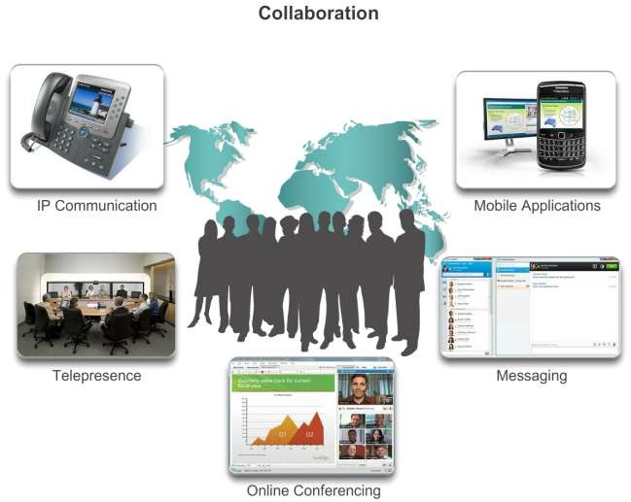
Network Trends
Online Collaboration
Presentation_ID
© 2008 Cisco Systems, Inc. All rights reserved.
Cisco Confidential
<number>

Slide 38
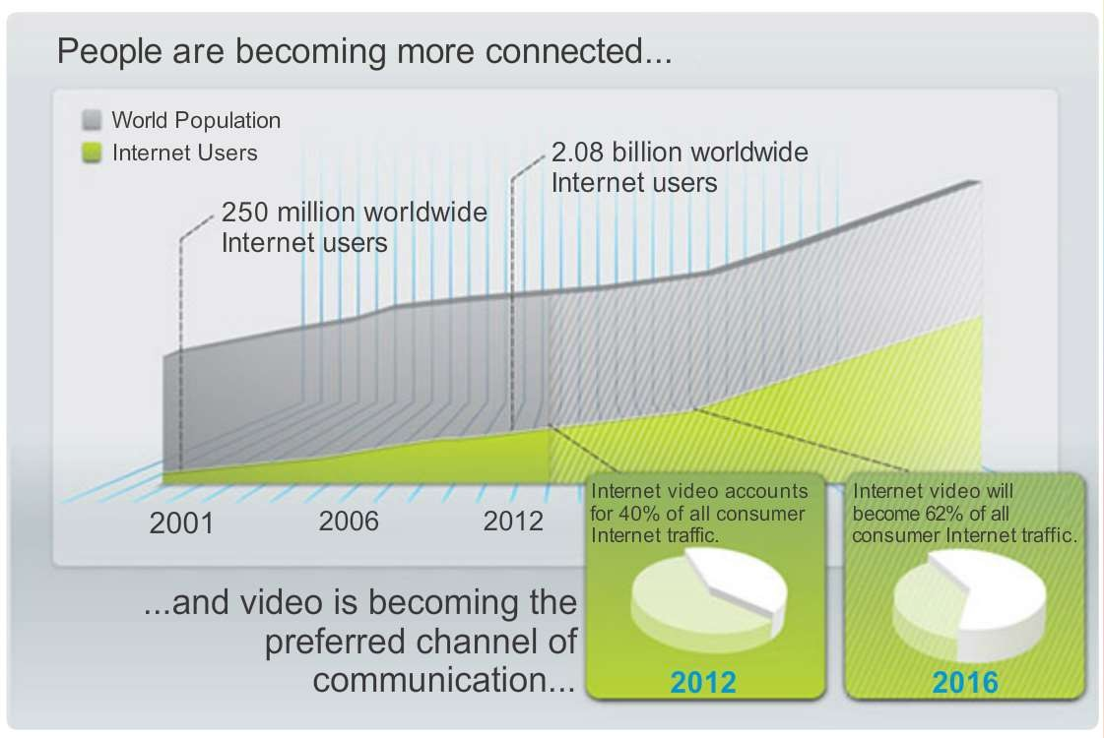
Network Trends
Video Communication
Presentation_ID
© 2008 Cisco Systems, Inc. All rights reserved.
Cisco Confidential
<number>

Slide 39
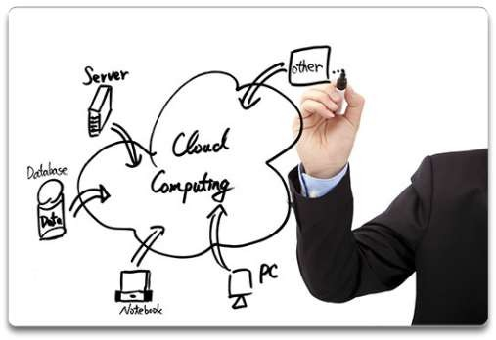
Network Trends
Cloud Computing
Cloud computing offers the following potential benefits:
Organizational flexibility
Agility and rapid deployment
Reduced cost of infrastructure
Refocus of IT resources
Creation of new business
models
Presentation_ID
© 2008 Cisco Systems, Inc. All rights reserved.
Cisco Confidential
<number>

Slide 40
Network Trends
Data Centers
A data center is a facility used to house computer systems and associated components including:
Redundant data communications connections
High-speed virtual servers (sometimes referred to as server farms or server clusters)
Redundant storage systems (typically uses SAN technology)
Redundant or backup power supplies
Environmental controls (e.g., air conditioning, fire suppression)
Security devices
Presentation_ID
© 2008 Cisco Systems, Inc. All rights reserved.
Cisco Confidential
<number>

Slide 41
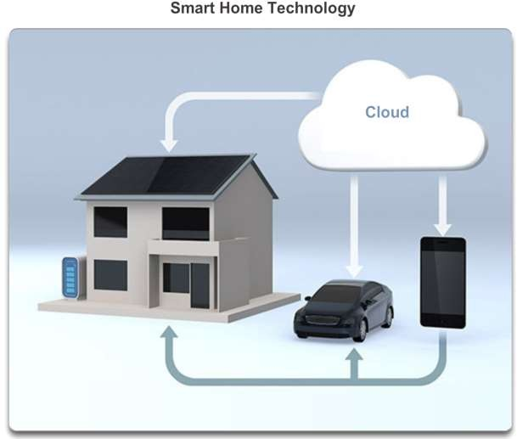
Networking Technologies for the Home
Technology Trends in the Home
Presentation_ID
© 2008 Cisco Systems, Inc. All rights reserved.
Cisco Confidential
<number>

Slide 42
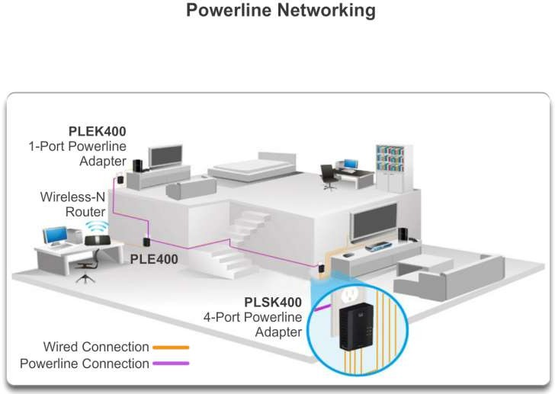
Networking Technologies for the Home
Powerline Networking
Presentation_ID
© 2008 Cisco Systems, Inc. All rights reserved.
Cisco Confidential
<number>

Slide 43
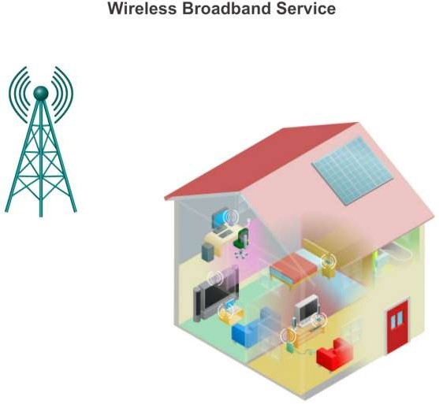
Networking Technologies for the Home
Wireless Broadband
Presentation_ID
© 2008 Cisco Systems, Inc. All rights reserved.
Cisco Confidential
<number>

Slide 44
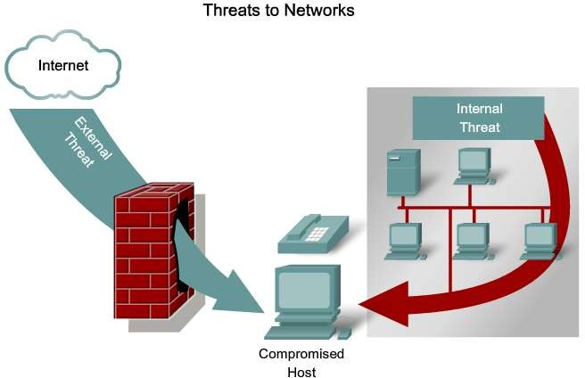
Future of Networking
Network Security
Presentation_ID
© 2008 Cisco Systems, Inc. All rights reserved.
Cisco Confidential
<number>

Slide 45
Network Security
Security Threats
The most common external threats to networks include:
Viruses, worms, and Trojan horses
Spyware and adware
Zero-day attacks, also called zero-hour attacks
Hacker attacks
Denial of service (DoS) attacks
Data interception and theft
Identity theft
Presentation_ID
© 2008 Cisco Systems, Inc. All rights reserved.
Cisco Confidential
<number>

Slide 46
Network Security
Security Solutions
Network security components often include:
Antivirus and antispyware
Firewall filtering
Dedicated firewall systems
Access control lists (ACL)
Intrusion prevention systems (IPS)
Virtual Private Networks (VPNs)
Presentation_ID
© 2008 Cisco Systems, Inc. All rights reserved.
Cisco Confidential
<number>

Slide 47
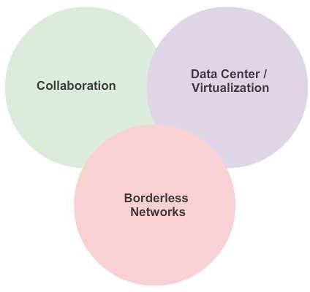
Network Architectures
Cisco Network Architectures
Presentation_ID
© 2008 Cisco Systems, Inc. All rights reserved.
Cisco Confidential
<number>

Slide 48
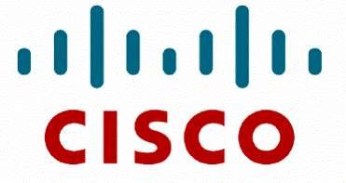
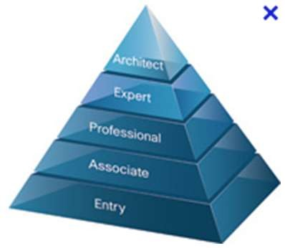
Network Architectures
Cisco Certified Network Associate (CCNA)
Presentation_ID
© 2008 Cisco Systems, Inc. All rights reserved.
Cisco Confidential
<number>

Slide 49
Exploring the Networking
Summary
In this chapter, you learned:
Networks and the Internet have changed the way we communicate, learn, work, and even play.
Networks come in all sizes. They can range from simple networks consisting of two computers, to networks connecting millions of devices.
The Internet is the largest network in existence. In fact, the term Internet means a ‘network of networks. The Internet provides the services that enable us to connect and communicate with our families, friends, work, and interests.
The network infrastructure is the platform that supports the network. It provides the stable and reliable channel over which communication can occur. It is made up of network components including end devices, intermediate devices, and network media.
Presentation_ID
© 2008 Cisco Systems, Inc. All rights reserved.
Cisco Confidential
<number>

Slide 50
Exploring the Networking
Summary (cont.)
In this chapter, you learned:
Networks must be reliable.
Network security is an integral part of computer networking, regardless of whether the network is limited to a home environment with a single connection to the Internet, or as large as a corporation with thousands of users.
The network infrastructure can vary greatly in terms of size, number of users, and number and types of services that are supported on it. The network infrastructure must grow and adjust to support the way the network is used. The routing and switching platform is the foundation of any network infrastructure.
Presentation_ID
© 2008 Cisco Systems, Inc. All rights reserved.
Cisco Confidential
<number>

Slide 51
Presentation_ID
© 2008 Cisco Systems, Inc. All rights reserved.
Cisco Confidential
<number>

