Slide 1
Chapter 6: Static Routing
Routing and Switching Essentials
Instructor:
Nguyen Anh Minh
M.Sc CCNP TOGAF
Presentation_ID
© 2008 Cisco Systems, Inc. All rights reserved.
Cisco Confidential
<number>

Slide 2
Chapter 6
Static Routing Implementation
Configure Static and Default Routes
Review of CIDR and VLSM
Configure Summary and Floating Static Routes
Troubleshoot Static and Default Route Issues
Summary
Presentation_ID
© 2008 Cisco Systems, Inc. All rights reserved.
Cisco Confidential
<number>

Slide 3
Chapter 6: Objectives
Explain the advantages and disadvantages of static routing.
Explain the purpose of different types of static routes.
Configure IPv4 and IPv6 static routes by specifying a next-hop address.
Configure an IPv4 and IPv6 default routes.
Explain the use of legacy classful addressing in network implementation.
Explain the purpose of CIDR in replacing classful
addressing.
Presentation_ID
© 2008 Cisco Systems, Inc. All rights reserved.
Cisco Confidential
<number>

Slide 4
Chapter 6: Objectives (cont.)
Design and implement a hierarchical addressing scheme.
Configure an IPv4 and IPv6 summary network address to
reduce the number of routing table updates.
Configure a floating static route to provide a backup connection.
Explain how a router processes packets when a static route is configured.
Troubleshoot common static and default route configuration issues.
Presentation_ID
© 2008 Cisco Systems, Inc. All rights reserved.
Cisco Confidential
<number>

Slide 5
Static Routing
Reach Remote Networks
A router can learn about remote networks in one of two
ways:
Manually - Remote networks are manually entered into the route table using static routes.
Dynamically - Remote routes are automatically learned using a dynamic routing protocol.
Presentation_ID
© 2008 Cisco Systems, Inc. All rights reserved.
Cisco Confidential
<number>

Slide 6
Static Routing
Why Use Static Routing?
Static routing provides some advantages over dynamic
routing, including:
Static routes are not advertised over the network, resulting in better security.
Static routes use less bandwidth than dynamic routing protocols, no CPU cycles are used to calculate and communicate routes.
The path a static route uses to send data is known.
Presentation_ID
© 2008 Cisco Systems, Inc. All rights reserved.
Cisco Confidential
<number>

Slide 7
Static Routing
Why Use Static Routing? (cont.)
Static routing has the following disadvantages:
Initial configuration and maintenance is time- consuming.
Configuration is error-prone, especially in large
networks.
Administrator intervention is required to maintain changing route information.
Does not scale well with growing networks; maintenance becomes cumbersome.
Requires complete knowledge of the whole network for proper implementation.
Presentation_ID
© 2008 Cisco Systems, Inc. All rights reserved.
Cisco Confidential
<number>

Slide 8
Static Routing
When to Use Static Routes
Static routing has three primary uses:
Providing ease of routing table maintenance in smaller networks that are not expected to grow significantly.
Routing to and from stub networks. A stub network is a network accessed by a single route, and the router has no other neighbors.
Using a single default route to represent a path to any network that does not have a more specific match with another route in the routing table. Default routes are used to send traffic to any destination beyond the next upstream router.
Presentation_ID
© 2008 Cisco Systems, Inc. All rights reserved.
Cisco Confidential
<number>

Slide 9
Types of Static Routes
Static Route Applications
Static Routes are often used to:
Connect to a specific network.
Provide a Gateway of Last Resort for a stub network.
Reduce the number of routes advertised by summarizing several contiguous networks as one static route.
Create a backup route in case a primary route link fails.
Presentation_ID
© 2008 Cisco Systems, Inc. All rights reserved.
Cisco Confidential
<number>

Slide 10
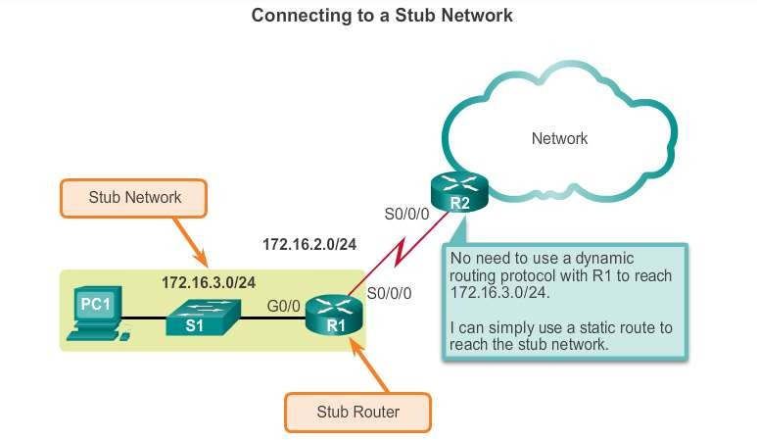
Types of Static Routes
Standard Static Route
Presentation_ID
© 2008 Cisco Systems, Inc. All rights reserved.
Cisco Confidential
<number>

Slide 11
Types of Static Routes
Default Static Route
A default static route is a route that matches all
packets.
A default route identifies the gateway IP address to which the router sends all IP packets that it does not have a learned or static route.
A default static route is simply a static route with 0.0.0.0/0 as the destination IPv4 address.
Presentation_ID
© 2008 Cisco Systems, Inc. All rights reserved.
Cisco Confidential
<number>

Slide 12
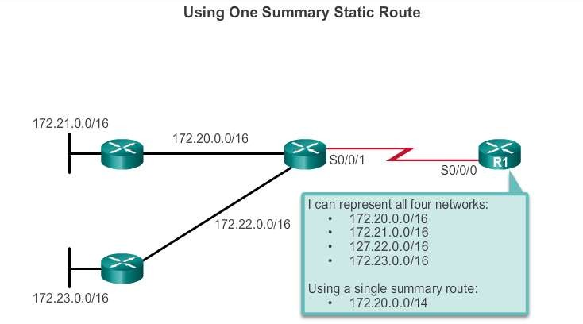
Types of Static Routes
Summary Static Route
Presentation_ID
© 2008 Cisco Systems, Inc. All rights reserved.
Cisco Confidential
<number>

Slide 13
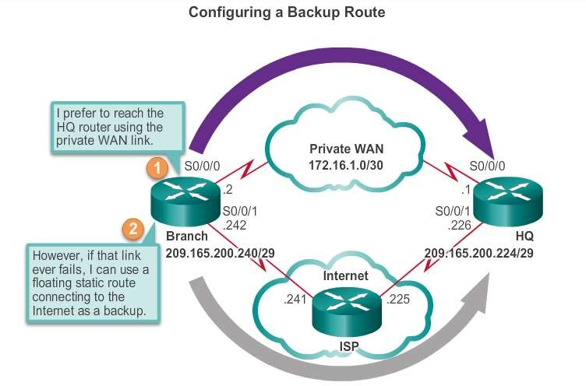
Types of Static Routes
Floating Static Route
Floating static routes are static routes that are used to provide a backup path to a primary static or dynamic route, in the event of a link failure.
The floating static route is only used when the primary route is not
available.
To accomplish
this, the floating static route is configured with a higher administrative
distance than the primary
route.
Presentation_ID
© 2008 Cisco Systems, Inc. All rights reserved.
Cisco Confidential
<number>

Slide 14
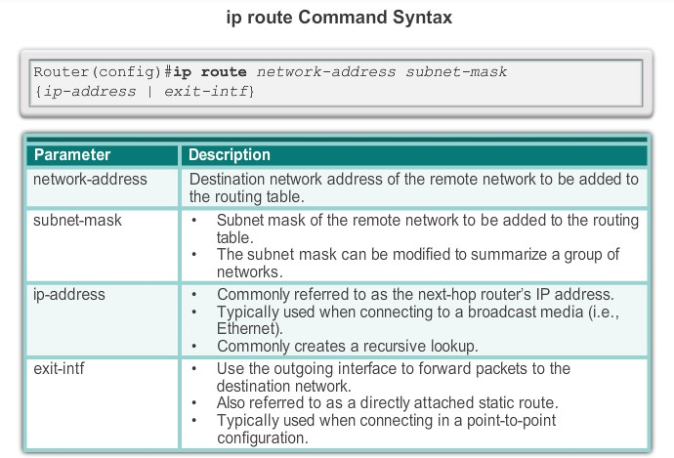
Configure IPv4 Static Routes
ip route Command
Presentation_ID
© 2008 Cisco Systems, Inc. All rights reserved.
Cisco Confidential
<number>

Slide 15
Configure IPv4 Static Routes
Next-Hop Options
The next hop can be identified by an IP address, exit interface, or both. How the destination is specified creates one of the three following route types:
Next-hop route - Only the next-hop IP address is specified.
Directly connected static route - Only the router exit interface is specified.
Fully specified static route - The next-hop IP address and exit interface are specified.
Presentation_ID
© 2008 Cisco Systems, Inc. All rights reserved.
Cisco Confidential
<number>

Slide 16
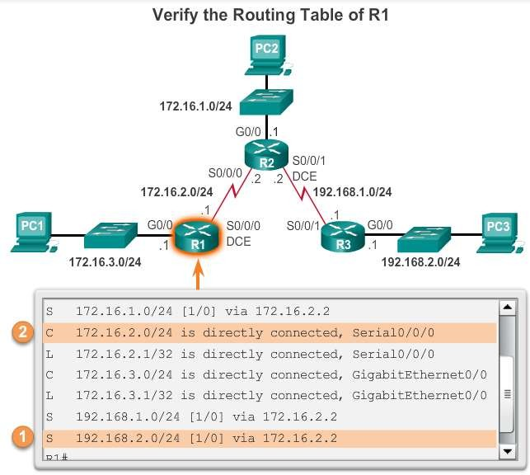
Configure IPv4 Static Routes
Configure a Next-Hop Static Route
When a packet is destined for the 192.168.2.0/24 network, R1:
Looks for a match in the routing table and finds that it has to forward the packets to the next-hop IPv4 address 172.16.2.2.
R1 must now determine how to reach 172.16.2.2; therefore, it searches a second time for a
172.16.2.2 match.
Presentation_ID
© 2008 Cisco Systems, Inc. All rights reserved.
Cisco Confidential
<number>

Slide 17
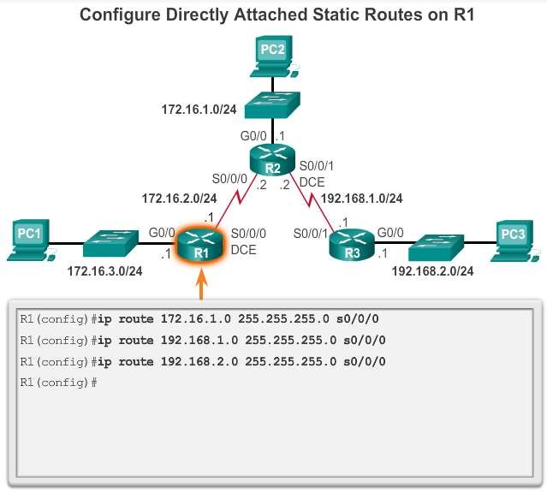
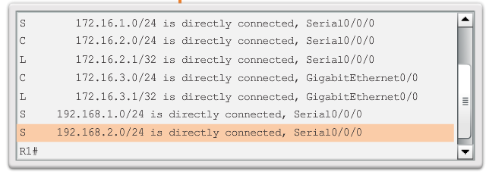
Configure IPv4 Static Routes
Configure Directly Connected Static Route
Presentation_ID
© 2008 Cisco Systems, Inc. All rights reserved.
Cisco Confidential
<number>

Slide 18
Configure IPv4 Static Routes
Configure a Fully Specified Static Route
In a fully specified static route:
Both the output interface and the next-hop IP address are specified.
This is another type of static route that is used in older
IOSs, prior to CEF.
This form of static route is used when the output interface is a multi-access interface and it is necessary to explicitly identify the next hop.
The next hop must be directly connected to the specified exit interface.
Presentation_ID
© 2008 Cisco Systems, Inc. All rights reserved.
Cisco Confidential
<number>

Slide 19
Configure IPv4 Static Routes
Verify a Static Route
Along with ping and traceroute, useful commands to
verify static routes include:
show | ip | route
show | ip | route | static
show | ip | route | network
Presentation_ID
© 2008 Cisco Systems, Inc. All rights reserved.
Cisco Confidential
<number>

Slide 20
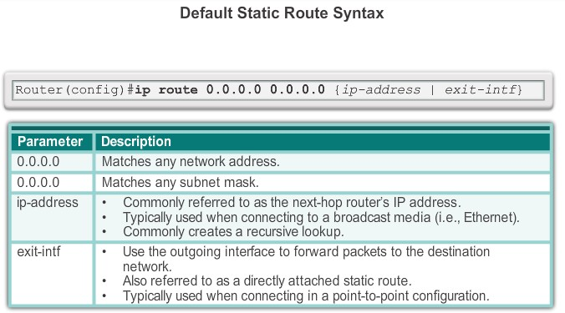
Configure IPv4 Default Routes
Default Static Route
Presentation_ID
© 2008 Cisco Systems, Inc. All rights reserved.
Cisco Confidential
<number>

Slide 21
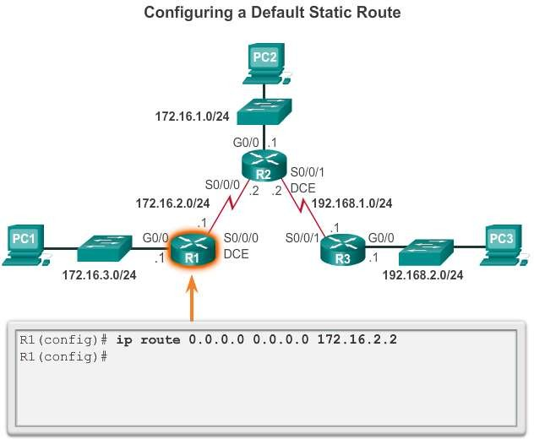
Configure IPv4 Default Routes
Configure a Default Static Route
Presentation_ID
© 2008 Cisco Systems, Inc. All rights reserved.
Cisco Confidential
<number>

Slide 22
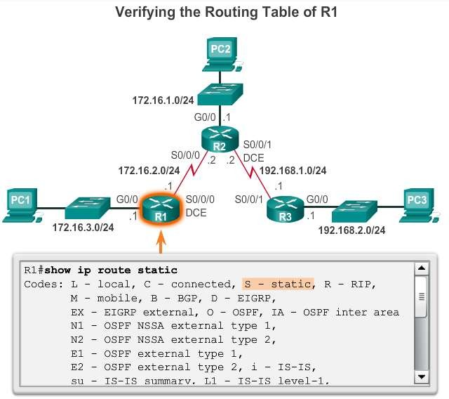
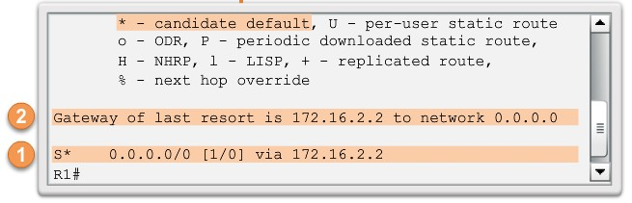
Configure IPv4 Default Routes
Verify a Default Static Route
Presentation_ID
© 2008 Cisco Systems, Inc. All rights reserved.
Cisco Confidential
<number>

Slide 23

Configure IPv6 Static Routes
The ipv6 route Command
Most of parameters are identical to the IPv4 version of the command. IPv6 static routes can also be implemented as:
Standard IPv6 static route
Default IPv6 static route
Summary IPv6 static route
Floating IPv6 static route
Presentation_ID
© 2008 Cisco Systems, Inc. All rights reserved.
Cisco Confidential
<number>

Slide 24
Configure IPv6 Static Routes
Next-Hop Options
The next hop can be identified by an IPv6 address, exit interface, or both. How the destination is specified creates one of three route types:
Next-hop IPv6 route - Only the next-hop IPv6 address is specified.
Directly connected static IPv6 route - Only the router exit interface is specified.
Fully specified static IPv6 route - The next-hop IPv6 address and exit interface are specified.
Presentation_ID
© 2008 Cisco Systems, Inc. All rights reserved.
Cisco Confidential
<number>

Slide 25
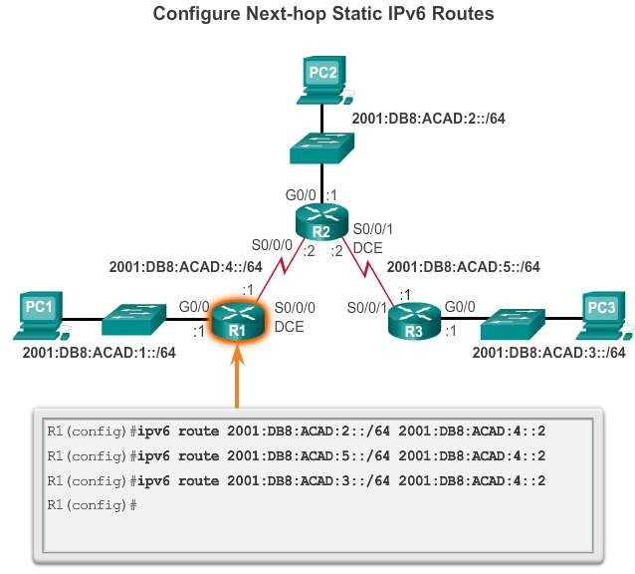
Configure IPv6 Static Routes
Configure a Next-Hop Static IPv6 Route
Presentation_ID
© 2008 Cisco Systems, Inc. All rights reserved.
Cisco Confidential
<number>

Slide 26
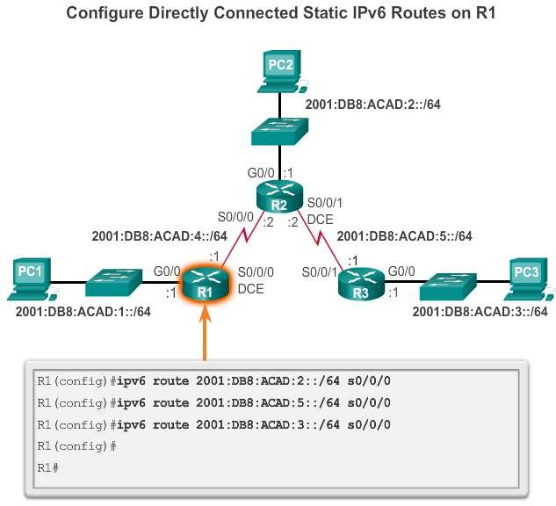
Configure IPv6 Static Routes
Configure Directly Connected Static IPv6 Route
Presentation_ID
© 2008 Cisco Systems, Inc. All rights reserved.
Cisco Confidential
<number>

Slide 27
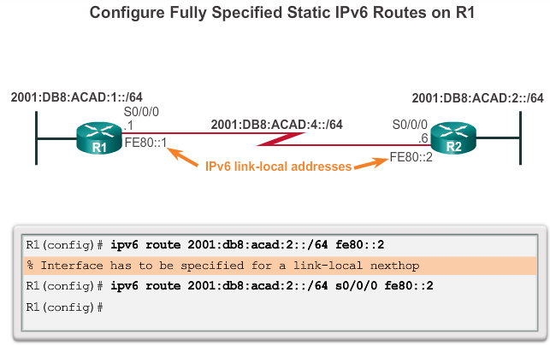
Configure IPv6 Static Routes
Configure Fully Specified Static IPv6 Route
Presentation_ID
© 2008 Cisco Systems, Inc. All rights reserved.
Cisco Confidential
<number>

Slide 28
Configure IPv6 Static Routes
Verify IPv6 Static Routes
Along with ping and traceroute, useful commands to
verify static routes include:
show | ipv6 | route
show | ipv6 | route | static
show | ipv6 | route | network
Presentation_ID
© 2008 Cisco Systems, Inc. All rights reserved.
Cisco Confidential
<number>

Slide 29
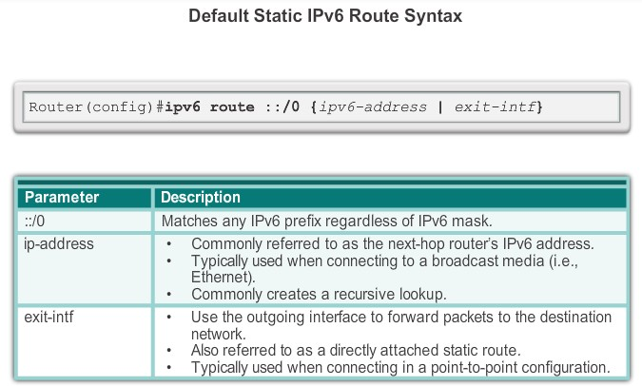
Configure IPv6 Default Routes
Default Static IPv6 Route
Presentation_ID
© 2008 Cisco Systems, Inc. All rights reserved.
Cisco Confidential
<number>

Slide 30
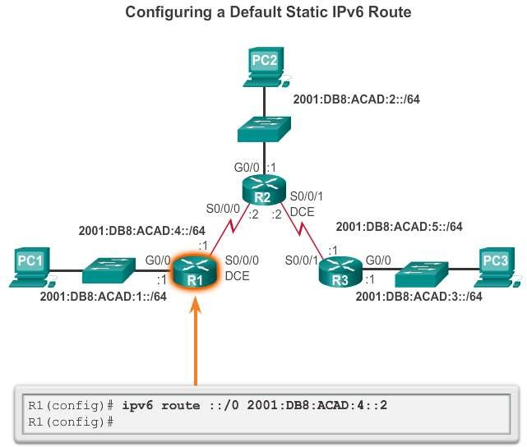
Configure IPv6 Default Routes
Configure a Default Static IPv6 Route
Presentation_ID
© 2008 Cisco Systems, Inc. All rights reserved.
Cisco Confidential
<number>

Slide 31
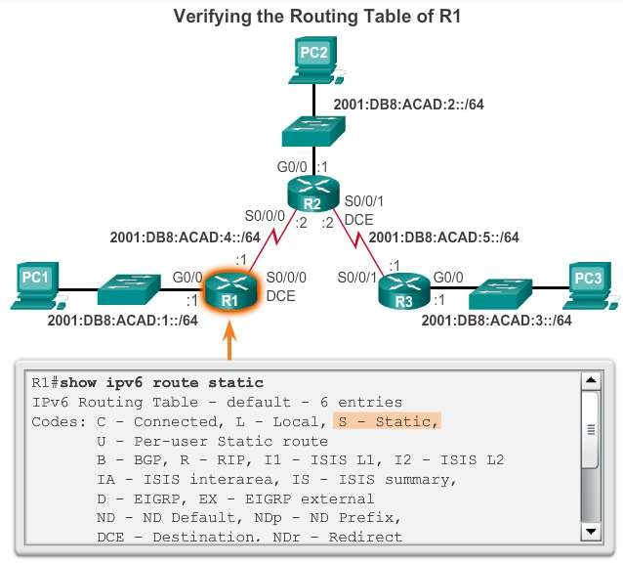
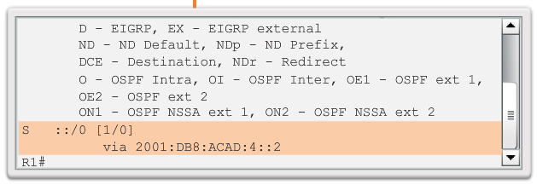
Configure IPv6 Default Routes
Verify a Default Static Route
Presentation_ID
© 2008 Cisco Systems, Inc. All rights reserved.
Cisco Confidential
<number>

Slide 32
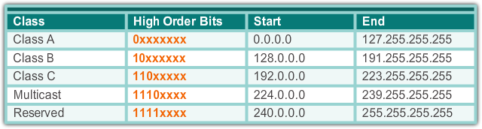
Classful Addressing
Classful Network Addressing
Presentation_ID
© 2008 Cisco Systems, Inc. All rights reserved.
Cisco Confidential
<number>

Slide 33



Classful Addressing
Classful Subnet Masks
Class A
Class B
Class C
Presentation_ID
© 2008 Cisco Systems, Inc. All rights reserved.
Cisco Confidential
<number>

Slide 34
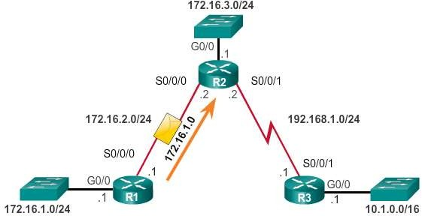
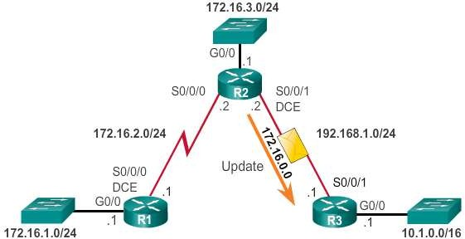
Classful Addressing
Classful Routing Protocol Example
Presentation_ID
© 2008 Cisco Systems, Inc. All rights reserved.
Cisco Confidential
<number>

Slide 35
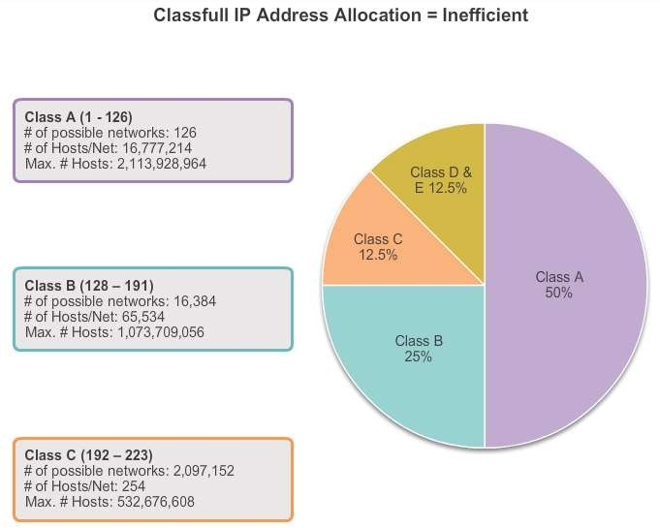
Classful Addressing
Classful Addressing Waste
Presentation_ID
© 2008 Cisco Systems, Inc. All rights reserved.
Cisco Confidential
<number>

Slide 36
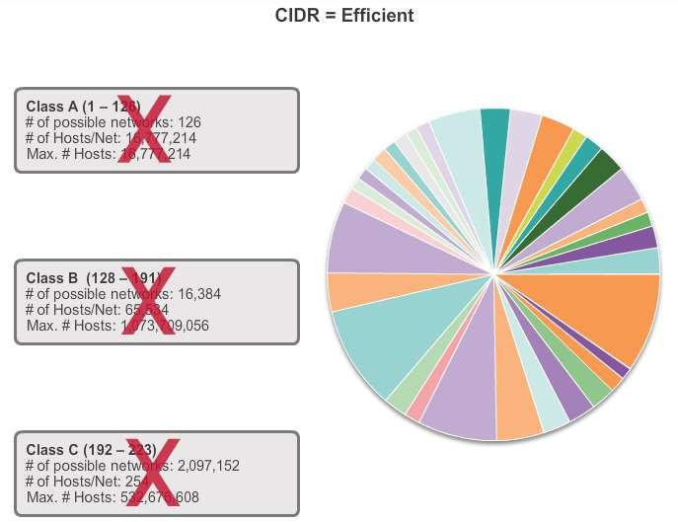
CIDR
Classless Inter-Domain Routing
Presentation_ID
© 2008 Cisco Systems, Inc. All rights reserved.
Cisco Confidential
<number>

Slide 37
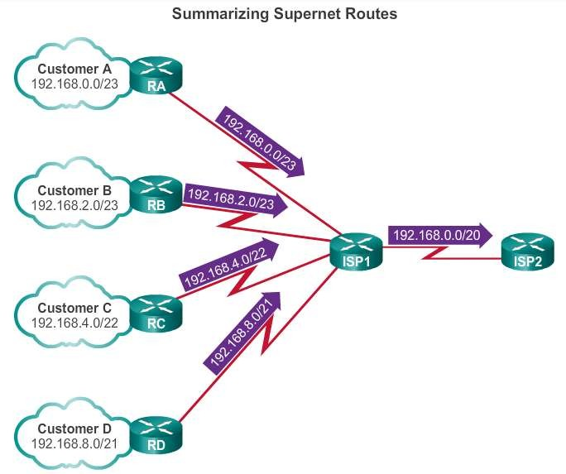
CIDR
CIDR and Route Summarization
Presentation_ID
© 2008 Cisco Systems, Inc. All rights reserved.
Cisco Confidential
<number>

Slide 38
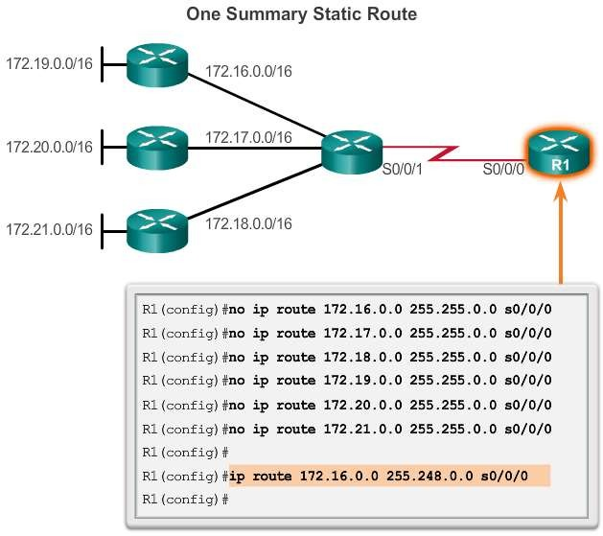
CIDR
Static Routing CIDR Example
Presentation_ID
© 2008 Cisco Systems, Inc. All rights reserved.
Cisco Confidential
<number>

Slide 39
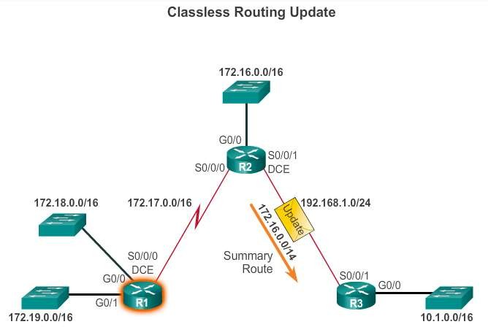
CIDR
Classless Routing Protocol Example
Presentation_ID
© 2008 Cisco Systems, Inc. All rights reserved.
Cisco Confidential
<number>

Slide 40
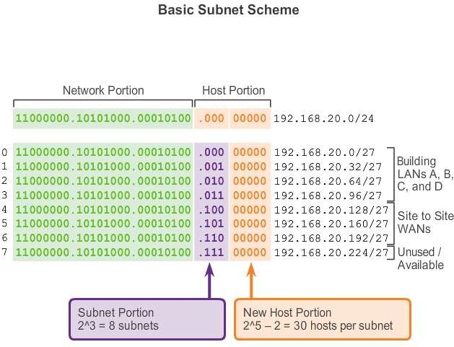
VLSM
Fixed Length Subnet Masking
Presentation_ID
© 2008 Cisco Systems, Inc. All rights reserved.
Cisco Confidential
<number>

Slide 41
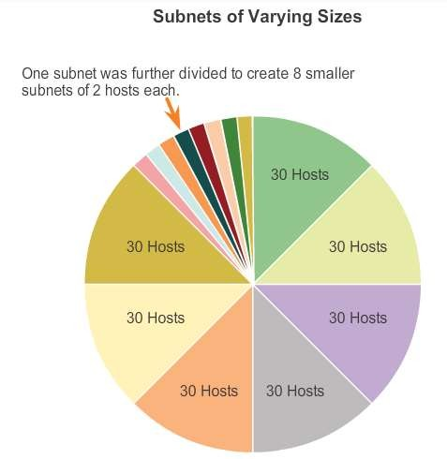
VLSM
Variable Length Subnet Masking
Presentation_ID
© 2008 Cisco Systems, Inc. All rights reserved.
Cisco Confidential
<number>

Slide 42
VLSM
VLSM in Action
VLSM allows the use of different masks for each subnet:
After a network address is subnetted, those subnets can be further subnetted.
VLSM is simply subnetting a subnet. VLSM can be
thought of as sub-subnetting.
Individual host addresses are assigned from the addresses of "sub-subnets".
Presentation_ID
© 2008 Cisco Systems, Inc. All rights reserved.
Cisco Confidential
<number>

Slide 43
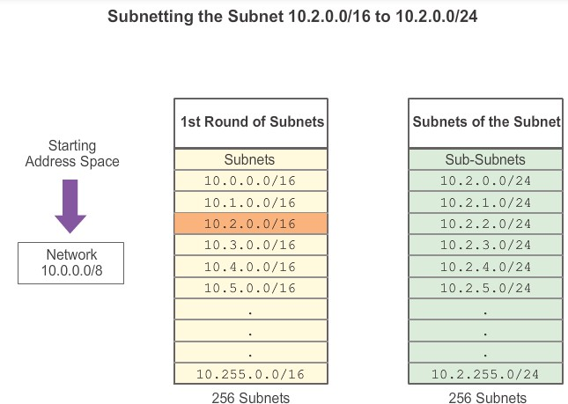
VLSM
Subnetting Subnets
Presentation_ID
© 2008 Cisco Systems, Inc. All rights reserved.
Cisco Confidential
<number>

Slide 44
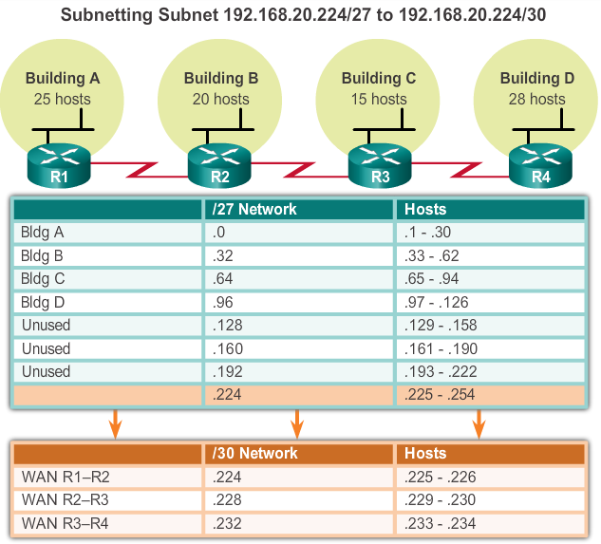
VLSM
VLSM Example
Presentation_ID
© 2008 Cisco Systems, Inc. All rights reserved.
Cisco Confidential
<number>

Slide 45
Configure IPv4 Summary Routes
Route Summarization
Route summarization, also known as route aggregation, is the process of advertising a contiguous set of addresses as a single address with a less-specific, shorter subnet mask:
CIDR is a form of route summarization and is synonymous with the term supernetting.
CIDR ignores the limitation of classful boundaries, and allows summarization with masks that are smaller than that of the default classful mask.
This type of summarization helps reduce the number of entries in routing updates and lowers the number of entries in local routing tables.
Presentation_ID
© 2008 Cisco Systems, Inc. All rights reserved.
Cisco Confidential
<number>

Slide 46
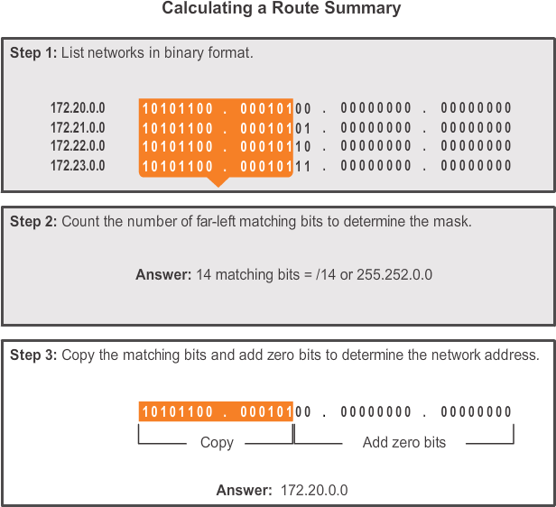
Configure IPv4 Summary Routes
Calculate a Summary Route
Presentation_ID
© 2008 Cisco Systems, Inc. All rights reserved.
Cisco Confidential
<number>

Slide 47
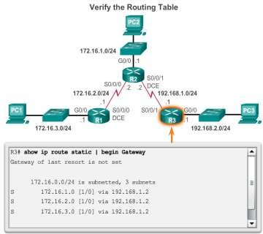
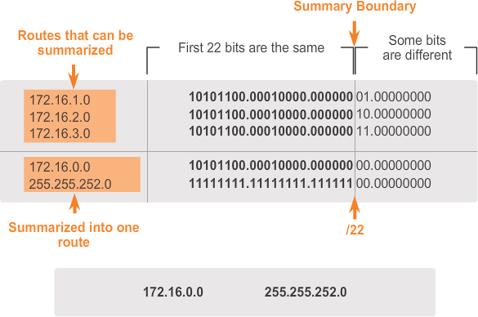
Configure IPv4 Summary Routes
Summary Static Route Example
Presentation_ID
© 2008 Cisco Systems, Inc. All rights reserved.
Cisco Confidential
<number>

Slide 48
Configure IPv6 Summary Routes
Summarize IPv6 Network Addresses
Aside from the fact that IPv6 addresses are 128 bits long and written in hexadecimal, summarizing IPv6 addresses is actually similar to the summarization of IPv4 addresses. It just requires a few extra steps due to the abbreviated IPv6 addresses and hex conversion.
Multiple static IPv6 routes can be summarized into a single static IPv6 route if:
The destination networks are contiguous and can be
summarized into a single network address.
The multiple static routes all use the same exit interface or next-hop IPv6 address.
Presentation_ID
© 2008 Cisco Systems, Inc. All rights reserved.
Cisco Confidential
<number>

Slide 49
Configure IPv6 Summary Routes
Calculate IPv6 Network Addresses
There are seven steps to summarize IPv6 networks into a single
IPv6 prefix:
Step 1. List the network addresses (prefixes) and identify the part where the addresses differ.
Step 2. Expand the IPv6 if it is abbreviated.
Step 3. Convert the differing section from hex to binary.
Step 4. Count the number of far left matching bits to determine the prefix-length for the summary route.
Step 5. Copy the matching bits and then add zero bits to determine the summarized network address (prefix).
Step 6. Convert the binary section back to hex.
Step 7. Append the prefix of the summary route (result of Step 4).
Presentation_ID
© 2008 Cisco Systems, Inc. All rights reserved.
Cisco Confidential
<number>

Slide 50
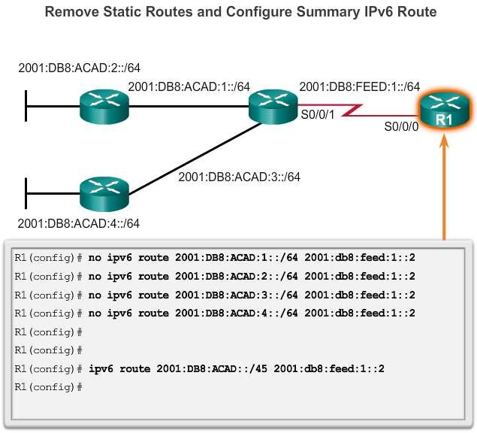
Configure IPv6 Summary Routes
Configure an IPv6 Summary Address
Presentation_ID
© 2008 Cisco Systems, Inc. All rights reserved.
Cisco Confidential
<number>

Slide 51
Configure Floating Static Routes
Floating Static Routes
Floating static routes are static routes that have an administrative distance greater than the administrative distance of another static route or dynamic routes:
The administrative distance of a static route can be increased to make the route less desirable than that of another static route or a route learned through a dynamic routing protocol.
In this way, the static route “floats” and is not used when the route with the better administrative distance is active.
However, if the preferred route is lost, the floating static route can
take over, and traffic can be sent through this alternate route.
Presentation_ID
© 2008 Cisco Systems, Inc. All rights reserved.
Cisco Confidential
<number>

Slide 52
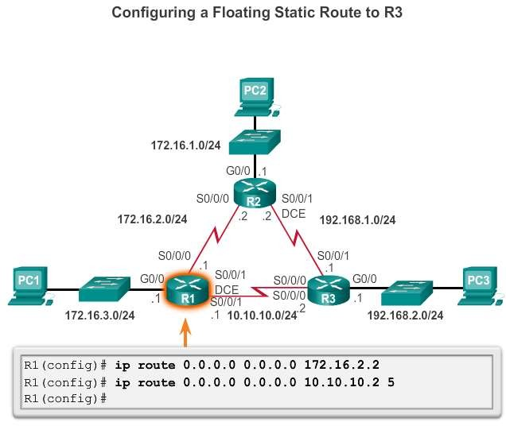
Configure Floating Static Routes
Configure a Floating Static Route
Presentation_ID
© 2008 Cisco Systems, Inc. All rights reserved.
Cisco Confidential
<number>

Slide 53
Configure Floating Static Routes
Test the Floating Static Route
To test a floating static route:
Use a show ip route command to verify that the routing table is using the default static route.
Use a traceroute command to follow the traffic flow out the
primary route.
Disconnect the primary link or shutdown the primary exit interface.
Use a show ip route command to verify that the routing table is using the floating static route.
Use a traceroute command to follow the traffic flow out the backup route.
Presentation_ID
© 2008 Cisco Systems, Inc. All rights reserved.
Cisco Confidential
<number>

Slide 54
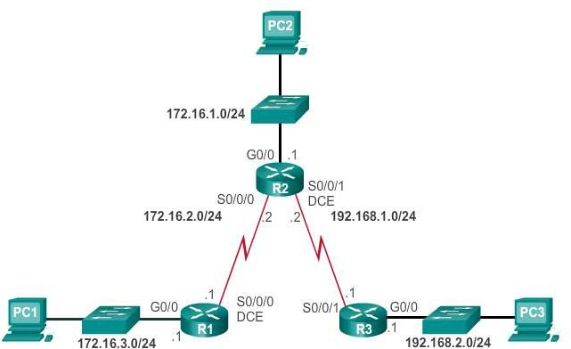
Troubleshoot Static and Default Route Issues
Static Routes and Packet Forwarding
Presentation_ID
© 2008 Cisco Systems, Inc. All rights reserved.
Cisco Confidential
<number>

Slide 55
Troubleshoot IPv4 Static and Default Route Configuration
Troubleshoot a Missing Route
Common IOS troubleshooting commands include:
ping
traceroute
show ip route
show ip interface brief
show cdp neighbors detail
Presentation_ID
© 2008 Cisco Systems, Inc. All rights reserved.
Cisco Confidential
<number>

Slide 56
Troubleshoot IPv4 Static and Default Route Configuration
Solve a Connectivity Problem
Finding a missing (or misconfigured) route is a relatively straightforward process, if the right tools are used in a methodical manner.
Use the ping command to confirm the destination can’t be
reached.
A traceroute would also reveal what is the closest router (or hop) that fails to respond as expected. In this case, the router would then send an Internet Control Message Protocol (ICMP) destination unreachable message back to the source.
The next step is to investigate the routing table. Look for missing or misconfigured routes.
Incorrect static routes are a common cause of routing problems.
Presentation_ID
© 2008 Cisco Systems, Inc. All rights reserved.
Cisco Confidential
<number>

Slide 57
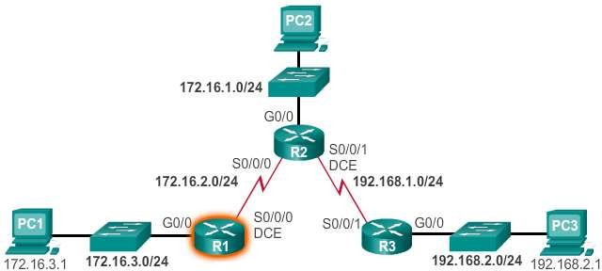
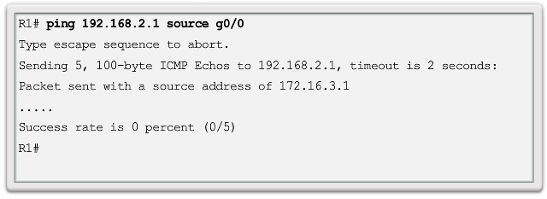
Troubleshoot IPv4 Static and Default Route Configuration Solve a Connectivity Problem (cont.)
Presentation_ID
© 2008 Cisco Systems, Inc. All rights reserved.
Cisco Confidential
<number>

Slide 58
Troubleshoot IPv4 Static and Default Route Configuration
Solve a Connectivity Problem (cont.)
Refer to the topology shown in the previous slide.
The user at PC1 reports that he cannot access resources on the R3 LAN.
This can be confirmed by pinging the LAN interface of R3 using the LAN interface of R1 as the source (see Figure 1). The results show that there is no connectivity between these LANs.
A traceroute would reveal that R2 is not responding as expected.
For some reason, R2 forwards the traceroute back to R1. R1
returns it to R2.
This loop would continue until the time to live (TTL) value decrements to zero, in which case, the router would then send an Internet Control Message Protocol (ICMP) destination unreachable message to R1.
Presentation_ID
© 2008 Cisco Systems, Inc. All rights reserved.
Cisco Confidential
<number>

Slide 59
Troubleshoot IPv4 Static and Default Route Configuration
Solve a Connectivity Problem (cont.)
The next step is to investigate the routing table of R2, because it is
the router displaying a strange forwarding pattern.
The routing table would reveal that the 192.168.2.0/24 network is configured incorrectly.
A static route to the 192.168.2.0/24 network has been configured
using the next-hop address 172.16.2.1.
Using the configured next-hop address, packets destined for the 192.168.2.0/24 network are sent back to R1.
Based on the topology, the 192.168.2.0/24 network is connected to R3, not R1. Therefore, the static route to the 192.168.2.0/24 network on R2 must use next-hop 192.168.1.1, not 172.16.2.1.
Presentation_ID
© 2008 Cisco Systems, Inc. All rights reserved.
Cisco Confidential
<number>

Slide 60
Chapter 6: Summary
Static routes can be configured with a next-hop IP address, which is commonly the IP address of the next- hop router.
When a next-hop IP address is used, the routing table process must resolve this address to an exit interface.
On point-to-point serial links, it is usually more efficient to configure the static route with an exit interface.
On multi-access networks, such as Ethernet, both a next- hop IP address and an exit interface can be configured on the static route.
Static routes have a default administrative distance of "1".
Presentation_ID
© 2008 Cisco Systems, Inc. All rights reserved.
Cisco Confidential
<number>

Slide 61
Chapter 6: Summary (cont.)
A static route is only entered in the routing table if the next-hop IP address can be resolved through an exit interface.
Whether the static route is configured with a next-hop IP address or exit interface, if the exit interface that is used to forward that packet is not in the routing table, the static route is not included in the routing table.
In many cases, several static routes can be configured as a single summary route.
Presentation_ID
© 2008 Cisco Systems, Inc. All rights reserved.
Cisco Confidential
<number>

Slide 62
Chapter 6: Summary (cont.)
The ultimate summary route is a default route, configured with a 0.0.0.0 network address and a 0.0.0.0 subnet mask.
If there is not a more specific match in the routing table, the routing table uses the default route to forward the packet to another router.
A floating static route can be configured to back up a
main link by manipulating its administrative value.
Presentation_ID
© 2008 Cisco Systems, Inc. All rights reserved.
Cisco Confidential
<number>

Slide 63
Presentation_ID
© 2008 Cisco Systems, Inc. All rights reserved.
Cisco Confidential
<number>

