Slide 1



Chapter 7: Routing Dynamically
Routing & Switching
Instructor:
Nguyen Anh Minh
M.Sc CCNP TOGAF
Presentation_ID
© 2008 Cisco Systems, Inc. All rights reserved.
Cisco Confidential
<number>

Slide 2
Chapter 7
Dynamic Routing Protocols
Distance Vector Dynamic Routing
RIP and RIPng Routing
Link-State Dynamic Routing
The Routing Table
Summary
Presentation_ID
© 2008 Cisco Systems, Inc. All rights reserved.
Cisco Confidential
<number>

Slide 3
Chapter 7: Objectives
Explain the basic operation of dynamic routing protocols.
Compare and contrast dynamic and static routing.
Determine which networks are available during an initial network discovery phase.
Define the different categories of routing protocols.
Describe the process by which distance vector routing protocols learn about other networks.
Identify the types of distance-vector routing protocols.
Configure the RIP routing protocol.
Configure the RIPng routing protocol.
Explain the process by which link-state routing protocols learn about
other networks.
Presentation_ID
© 2008 Cisco Systems, Inc. All rights reserved.
Cisco Confidential
<number>

Slide 4
Chapter 7: Objectives (cont.)
Describe the information sent in a link-state update.
Describe advantages and disadvantages of using link-state routing protocols.
Identify protocols that use the link-state routing process. (OSPF, IS-
IS)
Determine the route source, administrative distance, and metric for a given route.
Explain the concept of a parent/child relationship in a dynamically
built routing table.
Compare the IPv4 classless route lookup process and the IPv6 lookup process.
Analyze a routing table to determine which route will be used to
forward a packet.
Presentation_ID
© 2008 Cisco Systems, Inc. All rights reserved.
Cisco Confidential
<number>

Slide 5
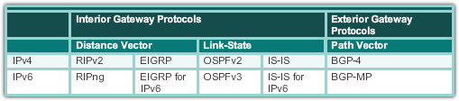
Dynamic Routing Protocol Operation
The Evolution of Dynamic Routing Protocols
Dynamic routing protocols used in networks since the late 1980s
Newer versions support the communication based on IPv6
Routing Protocols Classification
Presentation_ID
© 2008 Cisco Systems, Inc. All rights reserved.
Cisco Confidential
<number>

Slide 6
Dynamic Routing Protocol Operation
Purpose of Dynamic Routing Protocols
Routing Protocols are used to facilitate the exchange of routing information between routers.
The purpose of dynamic routing protocols includes:
Discovery of remote networks
Maintaining up-to-date routing information
Choosing the best path to destination networks
Ability to find a new best path if the current path is no longer available
Presentation_ID
© 2008 Cisco Systems, Inc. All rights reserved.
Cisco Confidential
<number>

Slide 7
Dynamic Routing Protocol Operation
Purpose of Dynamic Routing Protocols (cont.)
Main components of dynamic routing protocols include:
Data structures - Routing protocols typically use tables or databases for its operations. This information is kept in RAM.
Routing protocol messages - Routing protocols use various types of messages to discover neighboring routers, exchange routing information, and other tasks to learn and maintain accurate information about the network.
Algorithm - Routing protocols use algorithms for facilitating routing information for best path determination.
Presentation_ID
© 2008 Cisco Systems, Inc. All rights reserved.
Cisco Confidential
<number>

Slide 8
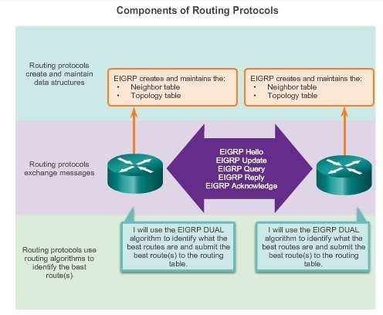
Dynamic Routing Protocol Operation
Purpose of Dynamic Routing Protocols (cont.)
Presentation_ID
© 2008 Cisco Systems, Inc. All rights reserved.
Cisco Confidential
<number>

Slide 9
Dynamic Routing Protocol Operation
The Role of Dynamic Routing Protocols
Advantages of dynamic routing include:
Automatically share information about remote networks
Determine the best path to each network and add this information
to their routing tables
Compared to static routing, dynamic routing protocols require less administrative overhead
Help the network administrator manage the time-consuming
process of configuring and maintaining static routes
Disadvantages of dynamic routing include:
Part of a router’s resources are dedicated for protocol operation,
including CPU time and network link bandwidth
Times when static routing is more appropriate
Presentation_ID
© 2008 Cisco Systems, Inc. All rights reserved.
Cisco Confidential
<number>

Slide 10
Dynamic verses Static Routing
Using Static Routing
Networks typically use a combination of both static and dynamic routing.
Static routing has several primary uses:
Providing ease of routing table maintenance in smaller networks
that are not expected to grow significantly.
Routing to and from a stub network. A network with only one default route out and no knowledge of any remote networks.
Accessing a single default router. This is used to represent a path to any network that does not have a match in the routing table.
Presentation_ID
© 2008 Cisco Systems, Inc. All rights reserved.
Cisco Confidential
<number>

Slide 11
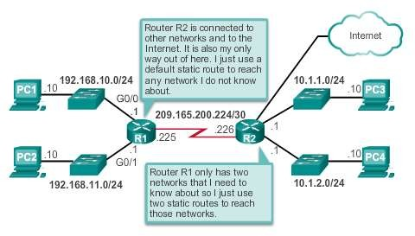
Dynamic verses Static Routing
Using Static Routing (cont.)
Presentation_ID
© 2008 Cisco Systems, Inc. All rights reserved.
Cisco Confidential
<number>

Slide 12
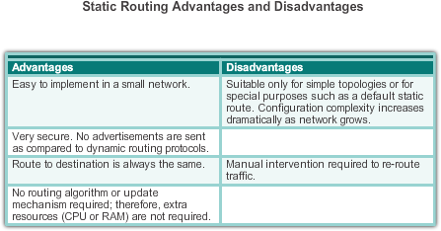
Dynamic verses Static Routing
Static Routing Scorecard
Presentation_ID
© 2008 Cisco Systems, Inc. All rights reserved.
Cisco Confidential
<number>

Slide 13
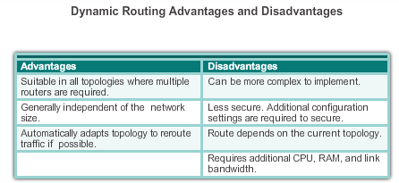
Dynamic verses Static Routing
Dynamic Routing Scorecard
Presentation_ID
© 2008 Cisco Systems, Inc. All rights reserved.
Cisco Confidential
<number>

Slide 14
Routing Protocol Operating Fundamentals
Dynamic Routing Protocol Operation
In general, the operations of a dynamic routing protocol
can be described as follows:
The router sends and receives routing messages on its interfaces.
The router shares routing messages and routing information with other routers that are using the same routing protocol.
Routers exchange routing information to learn about
remote networks.
When a router detects a topology change the routing protocol can advertise this change to other routers.
Presentation_ID
© 2008 Cisco Systems, Inc. All rights reserved.
Cisco Confidential
<number>

Slide 15
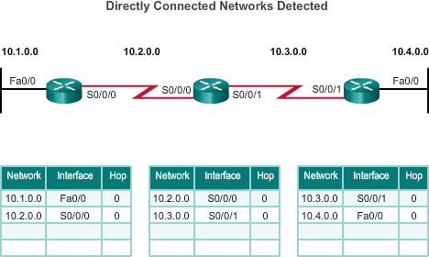
Routing Protocol Operating Fundamentals
Cold Start
R1 adds the 10.1.0.0 network available through interface FastEthernet 0/0 and
10.2.0.0 is available through interface Serial 0/0/0.
R2 adds the 10.2.0.0
network available through interface Serial 0/0/0 and 10.3.0.0 is available through interface Serial 0/0/1.
R3 adds the 10.3.0.0 network available through interface Serial 0/0/1 and 10.4.0.0 is available through interface FastEthernet 0/0.
Routers running RIPv2
Presentation_ID
© 2008 Cisco Systems, Inc. All rights reserved.
Cisco Confidential
<number>

Slide 16
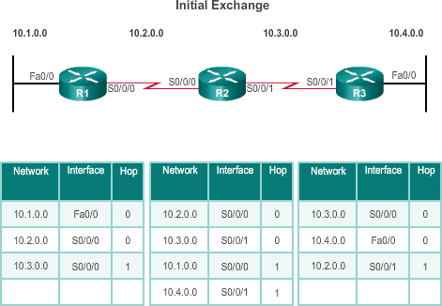
Routing Protocol Operating Fundamentals
Network Discovery
R1:
Sends an update about network 10.1.0.0 out the Serial0/0/0 interface
Sends an update about network 10.2.0.0 out the FastEthernet0/0 interface
Receives update from
R2 about network
10.3.0.0 with a metric of 1
Stores network 10.3.0.0 in the routing table with a metric of 1
Routers running RIPv2
Presentation_ID
© 2008 Cisco Systems, Inc. All rights reserved.
Cisco Confidential
<number>

Slide 17
Routing Protocol Operating Fundamentals
Network Discovery (cont.)
R2:
Sends an update about network 10.3.0.0 out the Serial 0/0/0 interface
Sends an update about network 10.2.0.0 out the Serial 0/0/1 interface
Receives an update from
R1 about network 10.1.0.0
with a metric of 1
Stores network 10.1.0.0 in the routing table with a metric of 1
Receives an update from R3 about network 10.4.0.0 with a metric of 1
Stores network 10.4.0.0 in the routing table with a metric of 1
Routers running RIPv2
Presentation_ID
© 2008 Cisco Systems, Inc. All rights reserved.
Cisco Confidential
<number>

Slide 18
Routing Protocol Operating Fundamentals
Network Discovery (cont.)
R3:
Sends an update about network 10.4.0.0 out the Serial 0/0/1 interface Sends an update about network 10.3.0.0 out the FastEthernet0/0 Receives an update from R2 about network
10.2.0.0 with a metric of 1
Stores network 10.2.0.0 in the routing table with a metric of 1
▪
▪
▪
Routers running RIPv2
Presentation_ID
© 2008 Cisco Systems, Inc. All rights reserved.
Cisco Confidential
<number>

Slide 19
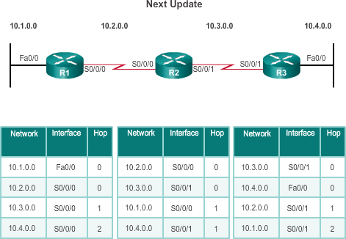
Routing Protocol Operating Fundamentals
Exchanging the Routing Information
R1:
Sends an update about network 10. 1. 0. 0 out the Serial 0/0/0 interface
Sends an update about networks 10. 2. 0. 0 and 10.
3. 0. 0 out the
FastEthernet0/0 interface
Receives an update from R2 about network 10. 4. 0. 0 with a metric of 2
Stores network 10. 4. 0. 0 in the routing table with a metric of 2
Same update from R2 contains information about network 10. 3. 0. 0 with a metric of 1. There is no change; therefore, the routing information remains
the same
Routers running RIPv2
Presentation_ID
© 2008 Cisco Systems, Inc. All rights reserved.
Cisco Confidential
<number>

Slide 20
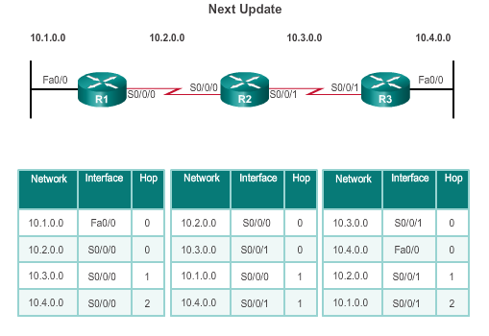
Routing Protocol Operating Fundamentals
Exchanging the Routing Information (cont.)
R2:
Sends an update about
networks 10. 3. 0. 0 and 10.
4. 0. 0 out of Serial 0/0/0 interface
Sends an update about networks 10. 1. 0. 0 and 10.
2. 0. 0 out of Serial 0/0/1
interface
Receives an update from R1 about network 10. 1. 0. 0.
There is no change; therefore, the routing information remains the
same.
Receives an update from R3 about network 10. 4. 0. 0.
▪
▪
▪
▪
Routers running RIPv2
There is no change; therefore, the routing information remains the
same.
© 2008 Cisco Systems, Inc. All rights reserved.
Presentation_ID
Cisco Confidential
<number>

Slide 21
Routing Protocol Operating Fundamentals
Exchanging the Routing Information (cont.)
R3:
Sends an update about network 10. 4. 0. 0 out the Serial 0/0/1 interface
Sends an update about networks 10. 2. 0. 0 and
10. 3. 0. 0 out the FastEthernet0/0 interface
Receives an update from R2 about network 10. 1. 0. 0 with a metric of 2
Stores network 10. 1. 0. 0 in the routing table with a metric of 2
Same update from R2
contains information about network 10. 2. 0. 0 with a metric of 1. There is no change; therefore, the
Routers running RIPv2
routing information remains
the same.
© 2008 Cisco Systems, Inc. All rights reserved. Cisco Confidential
Presentation_ID
21

Slide 22
Routing Protocol Operating Fundamentals
Achieving Convergence
The network is converged when all routers have complete and accurate information about the entire network:
Convergence time is the time it takes routers to share information,
calculate best paths, and update their routing tables.
A network is not completely operable until the network has converged.
Convergence properties include the speed of propagation of routing information and the calculation of optimal paths. The speed of propagation refers to the amount of time it takes for routers within the network to forward routing information.
Generally, older protocols, such as RIP, are slow to converge, whereas modern protocols, such as EIGRP and OSPF, converge more quickly.
Presentation_ID
© 2008 Cisco Systems, Inc. All rights reserved.
Cisco Confidential
<number>

Slide 23
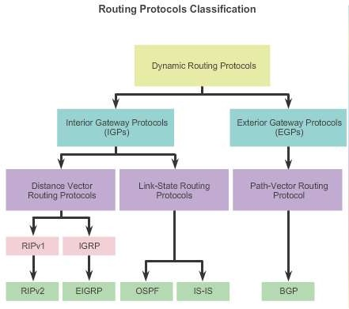
Types of Routing Protocols
Classifying Routing Protocols
Presentation_ID
© 2008 Cisco Systems, Inc. All rights reserved.
Cisco Confidential
<number>

Slide 24
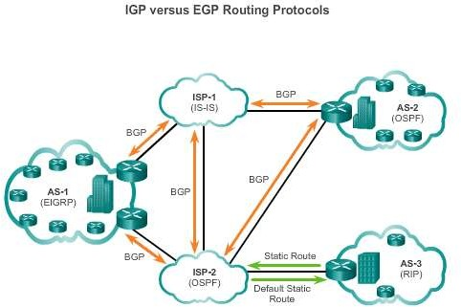
Types of Routing Protocols
IGP and EGP Routing Protocols
Interior Gateway
Protocols (IGP) -
Used for routing within an AS
Include RIP, EIGRP, OSPF, and IS-IS
Exterior Gateway
Protocols (EGP) -
Used for routing between AS
Official routing protocol used by the Internet
Presentation_ID
© 2008 Cisco Systems, Inc. All rights reserved.
Cisco Confidential
<number>

Slide 25
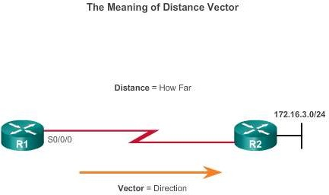
Types of Routing Protocols
Distance Vector Routing Protocols
Distance vector IPv4 IGPs:
RIPv1 - First generation
legacy protocol
RIPv2 - Simple distance vector routing protocol
IGRP - First generation
Cisco proprietary
protocol (obsolete)
EIGRP - Advanced version of distance vector routing
For R1, 172.16.3.0/24 is one hop away (distance). It can be reached through R2 (vector).
Presentation_ID
© 2008 Cisco Systems, Inc. All rights reserved.
Cisco Confidential
<number>

Slide 26
Types of Routing Protocols
Distance Vector or Link-State Routing Protocols
Distance vector protocols use routers as sign posts along the path to the final destination.
A link-state routing protocol is like having a complete map of the network topology. The sign posts along the way from source to destination are not necessary, because all link-state routers are using an identical map of the network. A link-state router uses the link-state information to create a topology map and to select the best path to all destination networks in the topology.
Presentation_ID
© 2008 Cisco Systems, Inc. All rights reserved.
Cisco Confidential
<number>

Slide 27
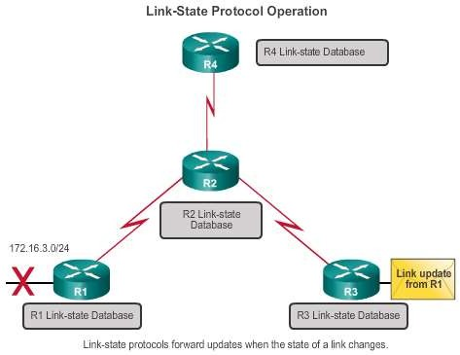
Types of Routing Protocols
Link-State Routing Protocols
Link-state IPv4 IGPs:
OSPF - Popular standards based routing protocol
IS-IS - Popular in provider networks.
Presentation_ID
© 2008 Cisco Systems, Inc. All rights reserved.
Cisco Confidential
<number>

Slide 28
Types of Routing Protocols
Classful Routing Protocols
Classful routing protocols do not send subnet mask information in their routing updates:
Only RIPv1 and IGRP are classful.
Created when network addresses were allocated based on classes (class A, B, or C).
Cannot provide variable length subnet masks (VLSMs) and classless interdomain routing (CIDR).
Create problems in discontiguous networks.
Presentation_ID
© 2008 Cisco Systems, Inc. All rights reserved.
Cisco Confidential
<number>

Slide 29
Types of Routing Protocols
Classless Routing Protocols
Classless routing protocols include subnet mask information in the routing updates:
RIPv2, EIGRP, OSPF, and IS_IS
Support VLSM and CIDR
IPv6 routing protocols
Presentation_ID
© 2008 Cisco Systems, Inc. All rights reserved.
Cisco Confidential
<number>

Slide 30
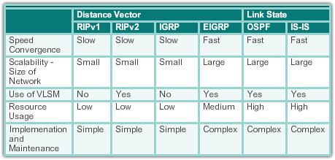
Types of Routing Protocols
Routing Protocol Characteristics
Presentation_ID
© 2008 Cisco Systems, Inc. All rights reserved.
Cisco Confidential
<number>

Slide 31
Types of Routing Protocols
Routing Protocol Metrics
A metric is a measurable value that is assigned by the routing protocol to different routes based on the usefulness of that route:
Used to determine the overall “cost” of a path from source to destination.
Routing protocols determine the best path based on the route with the lowest cost.
Presentation_ID
© 2008 Cisco Systems, Inc. All rights reserved.
Cisco Confidential
<number>

Slide 32
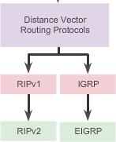
Distance Vector Routing Protocol Operation
Distance Vector Technologies
Distance vector routing protocols:
Share updates between neighbors
Not aware of the network topology
Some send periodic updates to broadcast IP 255.255.255.255 even if topology has not changed
Updates consume bandwidth and network device CPU resources
RIPv2 and EIGRP use multicast
addresses
EIGRP will only send an update when topology has changed
Presentation_ID
© 2008 Cisco Systems, Inc. All rights reserved.
Cisco Confidential
<number>

Slide 33
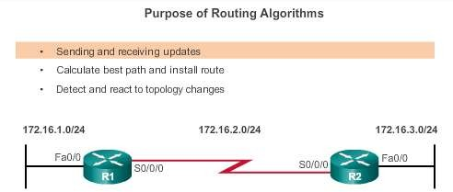
Distance Vector Routing Protocol Operation
Distance Vector Algorithm
RIP uses the Bellman-Ford algorithm as its routing algorithm.
IGRP and EIGRP use the Diffusing Update Algorithm (DUAL) routing algorithm developed by Cisco.
Presentation_ID
© 2008 Cisco Systems, Inc. All rights reserved.
Cisco Confidential
<number>

Slide 34
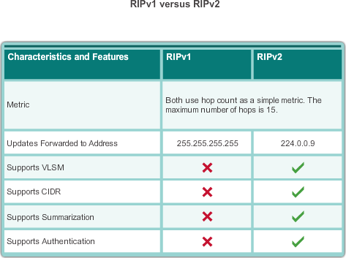
Types of Distance Vector Routing Protocols
Routing Information Protocol
Routing updates broadcasted every 30 seconds
Updates use UDP
port 520
RIPng is based on RIPv2 with a 15 hop limitation and the administrative distance of 120
Presentation_ID
© 2008 Cisco Systems, Inc. All rights reserved.
Cisco Confidential
<number>

Slide 35
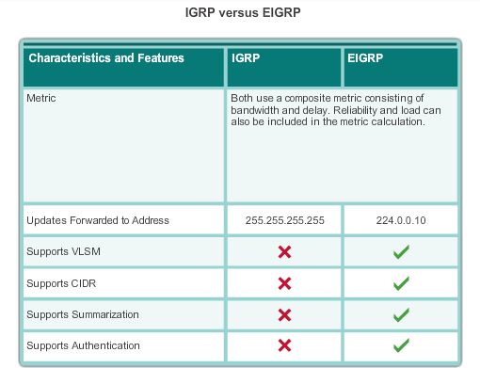
Types of Distance Vector Routing Protocols
Enhanced Interior-Gateway Routing Protocol
EIGRP:
Is bounded triggered updates
Uses a Hello keepalives mechanism
Maintains a topology table
Supports rapid convergence
Is a multiple
network layer protocol support
Presentation_ID
© 2008 Cisco Systems, Inc. All rights reserved.
Cisco Confidential
<number>

Slide 36

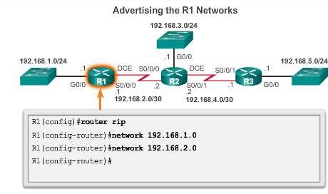
Configuring the RIP Protocol
Router RIP Configuration Mode Advertising Networks
Presentation_ID
© 2008 Cisco Systems, Inc. All rights reserved.
Cisco Confidential
<number>

Slide 37
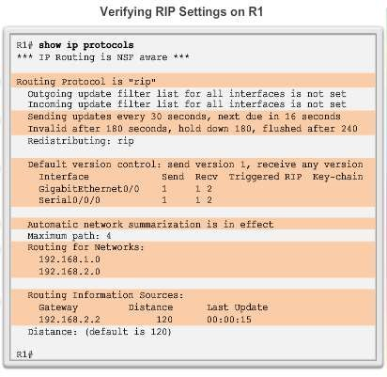
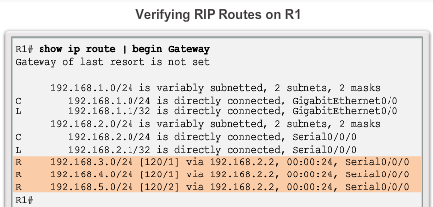
Configuring the RIP Protocol
Examining Default RIP Settings
Presentation_ID
© 2008 Cisco Systems, Inc. All rights reserved.
Cisco Confidential
<number>

Slide 38
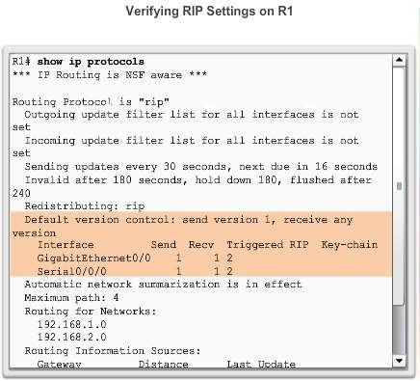
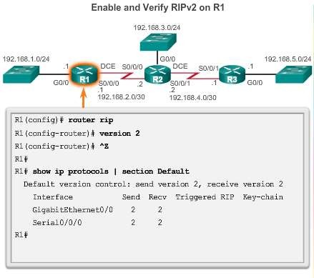
Configuring the RIP Protocol
Enabling RIPv2
Presentation_ID
© 2008 Cisco Systems, Inc. All rights reserved.
Cisco Confidential
<number>

Slide 39
Configuring the RIP Protocol
Disabling Auto Summarization
Similarly to RIPv1, RIPv2 automatically summarizes networks at major network boundaries by default.
To modify the default RIPv2 behavior of automatic summarization, use the no auto-summary router
configuration mode command.
This command has no effect when using RIPv1.
When automatic summarization has been disabled, RIPv2 no longer summarizes networks to their classful address at boundary routers. RIPv2 now includes all subnets and their appropriate masks in its routing updates.
The show ip protocols now states that automatic
network summarization is not in effect.
Presentation_ID
© 2008 Cisco Systems, Inc. All rights reserved.
Cisco Confidential
<number>

Slide 40
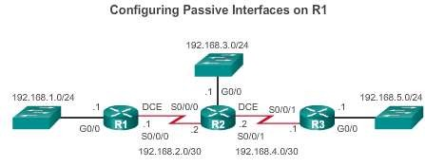
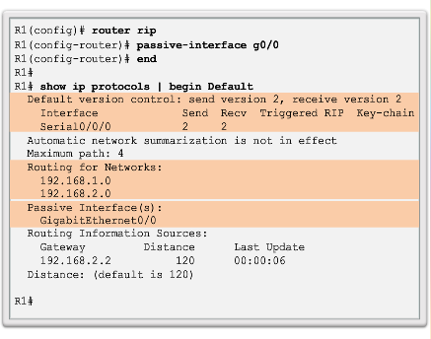
Configuring the RIP Protocol
Configuring Passive Interfaces
Sending out unneeded updates on a LAN impacts the network in three ways:
Wasted Bandwidth
Wasted Resources
Security Risk
Presentation_ID
© 2008 Cisco Systems, Inc. All rights reserved. Cisco Confidential
40

Slide 41
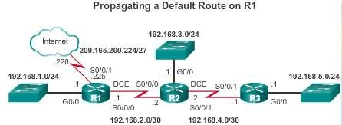
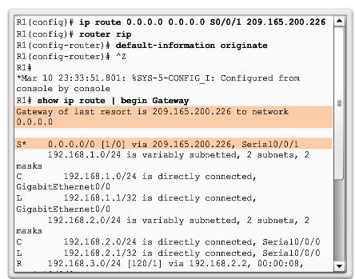
Configuring the RIP Protocol
Propagating a Default Route
Presentation_ID
© 2008 Cisco Systems, Inc. All rights reserved.
Cisco Confidential
<number>

Slide 42
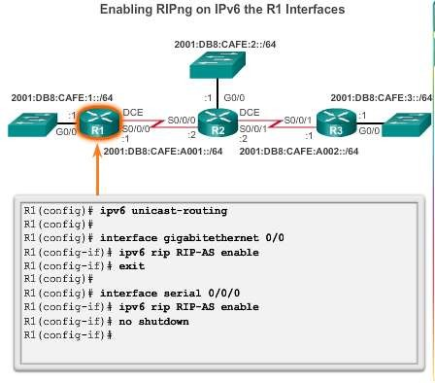
Configuring the RIPng Protocol
Advertising IPv6 Networks
Presentation_ID
© 2008 Cisco Systems, Inc. All rights reserved.
Cisco Confidential
<number>

Slide 43
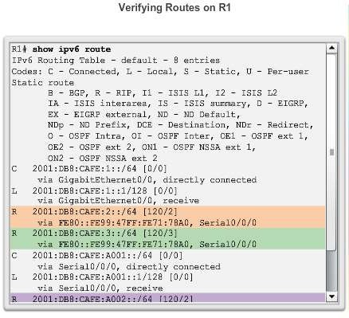
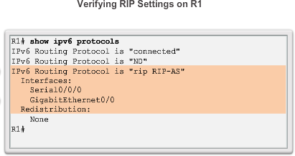
Configuring the RIPng Protocol
Examining the RIPng Configuration
Presentation_ID
© 2008 Cisco Systems, Inc. All rights reserved.
Cisco Confidential
<number>

Slide 44
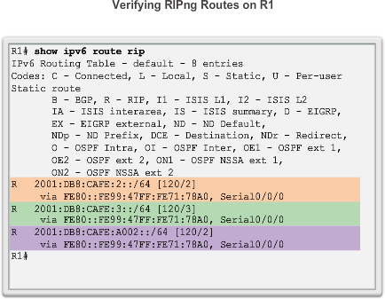
Configuring the RIPng Protocol
Examining the RIPng Configuration (cont.)
Presentation_ID
© 2008 Cisco Systems, Inc. All rights reserved.
Cisco Confidential
<number>

Slide 45
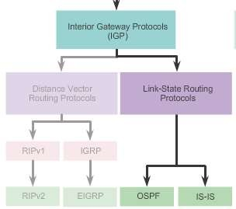
Link-State Routing Protocol Operation
Shortest Path First Protocols
Presentation_ID
© 2008 Cisco Systems, Inc. All rights reserved.
Cisco Confidential
<number>

Slide 46
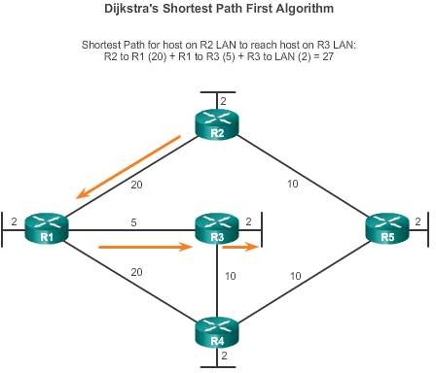
Link-State Routing Protocol Operation
Dijkstra’s Algorithm
Presentation_ID
© 2008 Cisco Systems, Inc. All rights reserved.
Cisco Confidential
<number>

Slide 47
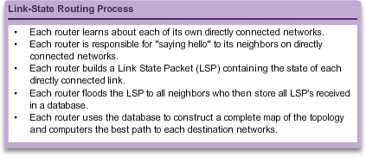
Link-State Updates
Link-State Routing Process
Presentation_ID
© 2008 Cisco Systems, Inc. All rights reserved.
Cisco Confidential
<number>

Slide 48
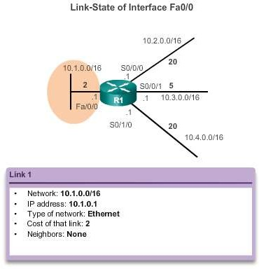
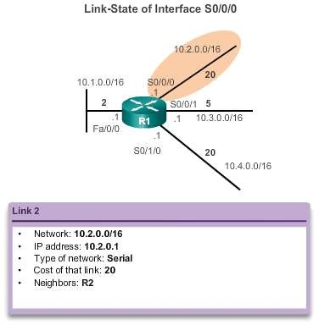
Link-State Updates
Link and Link-State
The first step in the link-state routing process is that each router learns about its own links and its own directly connected networks.
Presentation_ID
© 2008 Cisco Systems, Inc. All rights reserved.
Cisco Confidential
<number>

Slide 49
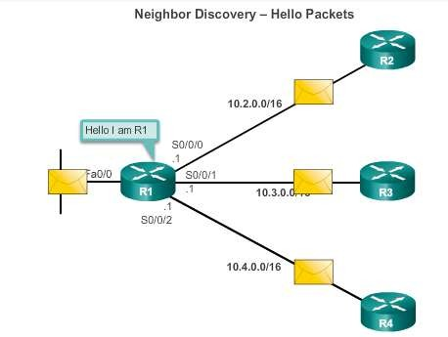
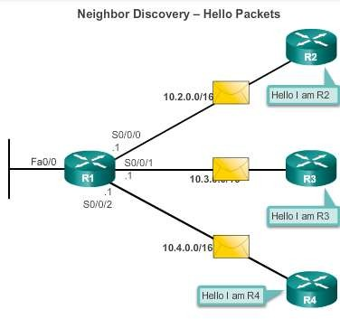
Link-State Updates
Say Hello
The second step in the link-state routing process is that each router is responsible for meeting its neighbors on directly connected networks.
Presentation_ID
© 2008 Cisco Systems, Inc. All rights reserved.
Cisco Confidential
<number>

Slide 50
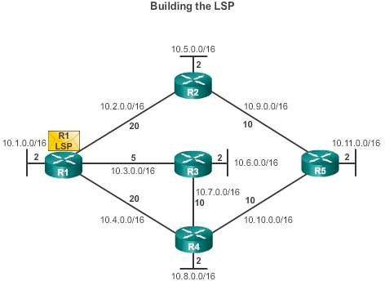
Link-State Updates
Say Hello
The third step in the link-state routing process is that each router builds a link-state packet (LSP) containing the state of each directly connected link.
R1; Ethernet network 10.1.0.0/16; Cost 2
R1 -> R2; Serial point-to- point network; 10.2.0.0/16; Cost 20
R1 -> R3; Serial point-to- point network; 10.7.0.0/16; Cost 5
R1 -> R4; Serial point-to-
point network;
10.4.0.0/16; Cost 20
Presentation_ID
© 2008 Cisco Systems, Inc. All rights reserved.
Cisco Confidential
<number>

Slide 51
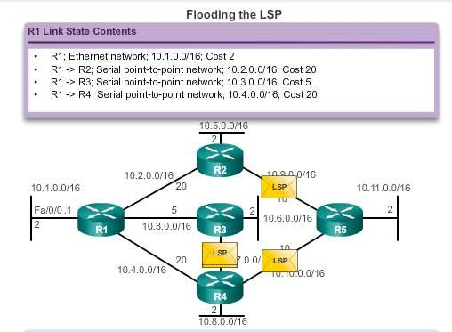
Link-State Updates
Flooding the LSP
The fourth step in the link-state routing process is that each router floods the LSP to all neighbors, who then store all LSPs received in a database.
Presentation_ID
© 2008 Cisco Systems, Inc. All rights reserved.
Cisco Confidential
<number>

Slide 52
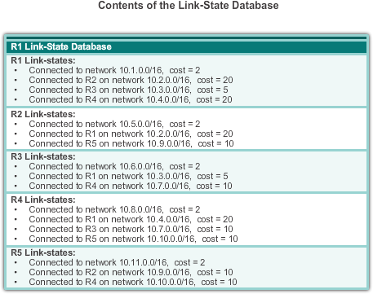
Link-State Updates
Building the Link-State Database
The final step in the link-state routing process is that each router uses the database to construct a complete map of the topology and computes the best path to each destination network.
Presentation_ID
© 2008 Cisco Systems, Inc. All rights reserved.
Cisco Confidential
<number>

Slide 53
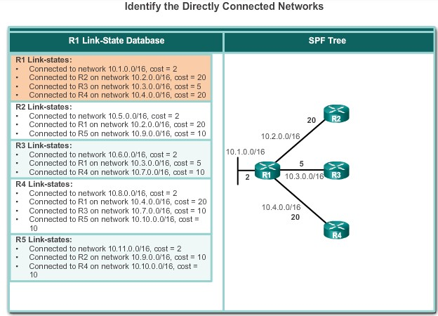
Link-State Updates
Building the SPF Tree
Presentation_ID
© 2008 Cisco Systems, Inc. All rights reserved.
Cisco Confidential
<number>

Slide 54
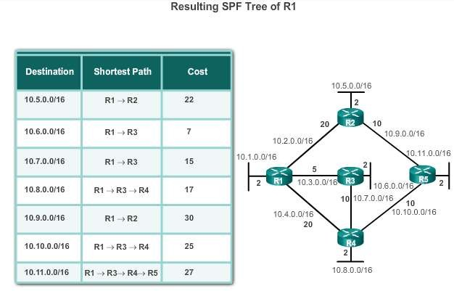
Link-State Updates
Building the SPF Tree
Presentation_ID
© 2008 Cisco Systems, Inc. All rights reserved.
Cisco Confidential
<number>

Slide 55
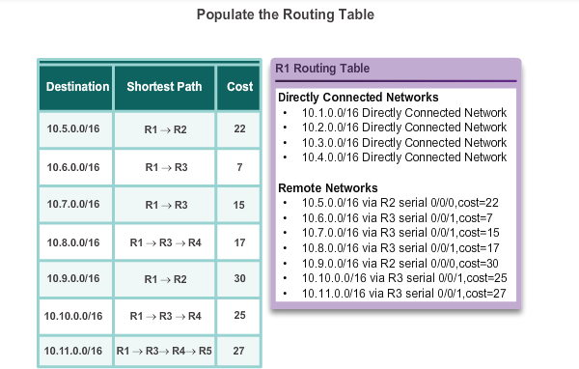
Link-State Updates
Adding OSPF Routes to the Routing Table
Presentation_ID
© 2008 Cisco Systems, Inc. All rights reserved.
Cisco Confidential
<number>

Slide 56
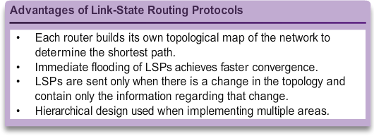
Why Use Link-State Routing Protocols
Why Use Link-State Protocols?
Presentation_ID
© 2008 Cisco Systems, Inc. All rights reserved.
Cisco Confidential
<number>

Slide 57
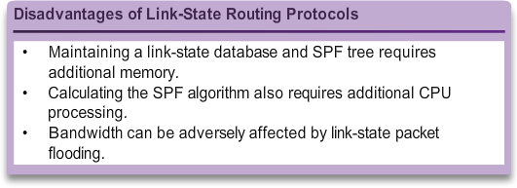
Why Use Link-State Routing Protocols
Why Use Link-State Protocols?
Presentation_ID
© 2008 Cisco Systems, Inc. All rights reserved.
Cisco Confidential
<number>

Slide 58
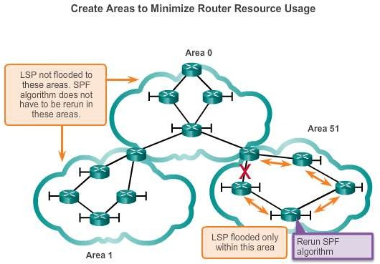
Why Use Link-State Routing Protocols
Disadvantages of Link-State Protocols
Presentation_ID
© 2008 Cisco Systems, Inc. All rights reserved.
Cisco Confidential
<number>

Slide 59
Why Use Link-State Routing Protocols
Protocols that Use Link-State
There are only two link-state routing protocols:
Open Shortest Path First (OSPF) most popular
began in 1987
two current versions
OSPFv2 - OSPF for IPv4 networks
OSPFv3 - OSPF for IPv6 networks
IS-IS was designed by International Organization for Standardization (ISO )
Presentation_ID
© 2008 Cisco Systems, Inc. All rights reserved.
Cisco Confidential
<number>

Slide 60
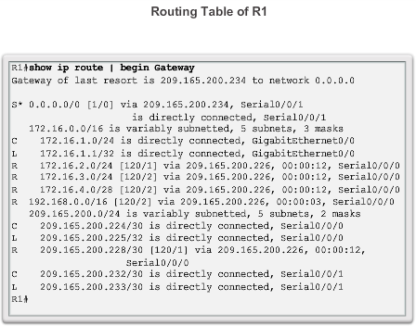
Parts of an IPv4 Route Entry
Routing Table Entries
Presentation_ID
© 2008 Cisco Systems, Inc. All rights reserved.
Cisco Confidential
<number>

Slide 61
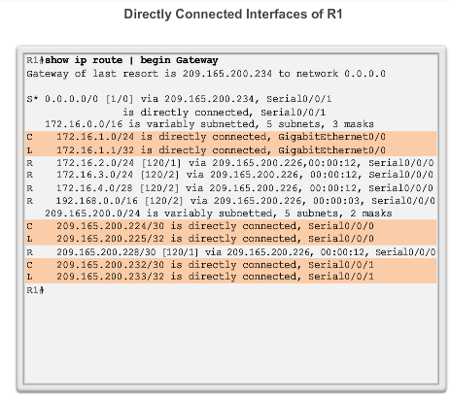
Parts of an IPv4 Route Entry
Directly Connected Entries
Presentation_ID
© 2008 Cisco Systems, Inc. All rights reserved.
Cisco Confidential
<number>

Slide 62
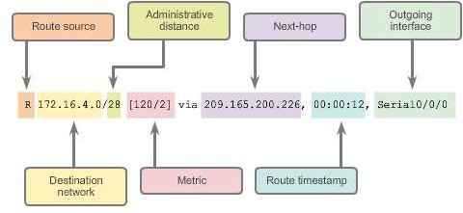
Parts of an IPv4 Route Entry
Remote Network Entries
Presentation_ID
© 2008 Cisco Systems, Inc. All rights reserved.
Cisco Confidential
<number>

Slide 63

Dynamically Learned IPv4 Routes
Routing Table Terms
Routes are discussed in terms of:
Ultimate route
Level 1 route
Level 1 parent route
Level 2 child routes
Presentation_ID
© 2008 Cisco Systems, Inc. All rights reserved.
Cisco Confidential
<number>

Slide 64

Dynamically Learned IPv4 Routes
Ultimate Route
An ultimate route is a routing table entry that contains either a next-hop IP address or an exit interface.
Directly connected, dynamically learned, and link local routes are ultimate routes.
Presentation_ID
© 2008 Cisco Systems, Inc. All rights reserved.
Cisco Confidential
<number>

Slide 65

Dynamically Learned IPv4 Routes
Level 1 Route
Presentation_ID
© 2008 Cisco Systems, Inc. All rights reserved.
Cisco Confidential
<number>

Slide 66

Dynamically Learned IPv4 Routes
Level 1 Parent Route
Presentation_ID
© 2008 Cisco Systems, Inc. All rights reserved.
Cisco Confidential
<number>

Slide 67

Dynamically Learned IPv4 Routes
Level 2 Child Route
Presentation_ID
© 2008 Cisco Systems, Inc. All rights reserved.
Cisco Confidential
<number>

Slide 68
The Routing Table
Route Lookup Process
If the best match is a level 1 ultimate route, then this route is used to forward the packet.
If the best match is a level 1 parent route, proceed to the next
step.
The router examines child routes (the subnet routes) of the parent route for a best match.
If there is a match with a level 2 child route, that subnet is used to
forward the packet.
If there is not a match with any of the level 2 child routes, proceed to the next step.
Presentation_ID
© 2008 Cisco Systems, Inc. All rights reserved.
Cisco Confidential
<number>

Slide 69
The Routing Table
Route Lookup Process (cont.)
The router continues searching level 1 supernet routes in the routing table for a match, including the default route, if there is one.
If there is now a lesser match with a level 1 supernet or default
routes, the router uses that route to forward the packet.
If there is not a match with any route in the routing table, the router drops the packet.
Presentation_ID
© 2008 Cisco Systems, Inc. All rights reserved.
Cisco Confidential
<number>

Slide 70

The IPv4 Route Lookup Process
Best Route = Longest Match
Presentation_ID
© 2008 Cisco Systems, Inc. All rights reserved.
Cisco Confidential
<number>

Slide 71
The IPv4 Route Lookup Process
IPv6 Routing Table Entries
Components of the IPv6 routing table are very similar to the IPv4 routing table (directly connected interfaces, static routes, and dynamically learned routes).
IPv6 is classless by design, all routes are effectively level 1 ultimate routes. There is no level 1 parent of level 2 child routes.
Presentation_ID
© 2008 Cisco Systems, Inc. All rights reserved.
Cisco Confidential
<number>

Slide 72


Analyze an IPVv6 Routing Table
Directly Connected Entries
Presentation_ID
© 2008 Cisco Systems, Inc. All rights reserved.
Cisco Confidential
<number>

Slide 73


Analyze an IPVv6 Routing Table
Remote IPv6 Network Entries
Presentation_ID
© 2008 Cisco Systems, Inc. All rights reserved.
Cisco Confidential
<number>

Slide 74
Chapter 7: Summary
Dynamic routing protocols:
Used by routers to automatically learn about remote networks from other routers
Purpose includes: discovery of remote networks, maintaining up-to- date routing information, choosing the best path to destination networks, and ability to find a new best path if the current path is no longer available
Best choice for large networks but static routing is better for stub
networks.
Function to inform other routers about changes
Can be classified as either classful or classless, distance-vector or
link-state, and an interior or an exterior gateway protocol
Presentation_ID
© 2008 Cisco Systems, Inc. All rights reserved.
Cisco Confidential
<number>

Slide 75
Chapter 7: Summary (cont.)
Dynamic routing protocols:
A link-state routing protocol can create a complete view or topology of the network by gathering information from all of the other routers
Metrics are used to determine the best path or shortest path to reach a destination network
Different routing protocols may use different (hops, bandwidth, delay, reliability, and load)
Show ip protocols command displays the IPv4 routing protocol settings currently configured on the router, for IPv6, use show ipv6 protocols
Presentation_ID
© 2008 Cisco Systems, Inc. All rights reserved.
Cisco Confidential
<number>

Slide 76
Chapter 7: Summary (cont.)
Dynamic routing protocols:
Cisco routers use the administrative distance value to determine which routing source to use
Each dynamic routing protocol has a unique administrative value, along with static routes and directly connected networks, lower is preferred the route
Directly connected networks are preferred source, followed by static
routes and then various dynamic routing protocols
An OSPF link is an interface on a router, information about the state of the links is known as link-states
Link-state routing protocols apply Dijkstra’s algorithm to calculate the best path route which uses accumulated costs along each path, from source to destination, to determine the total cost of a route
Presentation_ID
© 2008 Cisco Systems, Inc. All rights reserved.
Cisco Confidential
<number>

Slide 77

Presentation_ID
© 2008 Cisco Systems, Inc. All rights reserved.
Cisco Confidential
<number>

